Slide 1
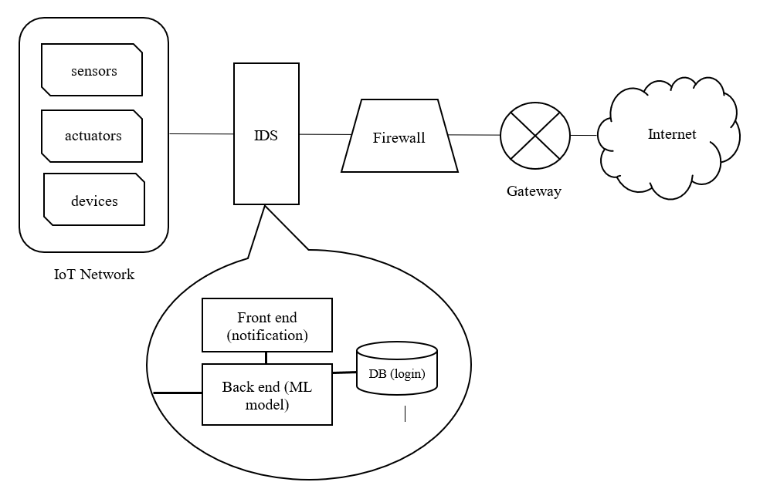
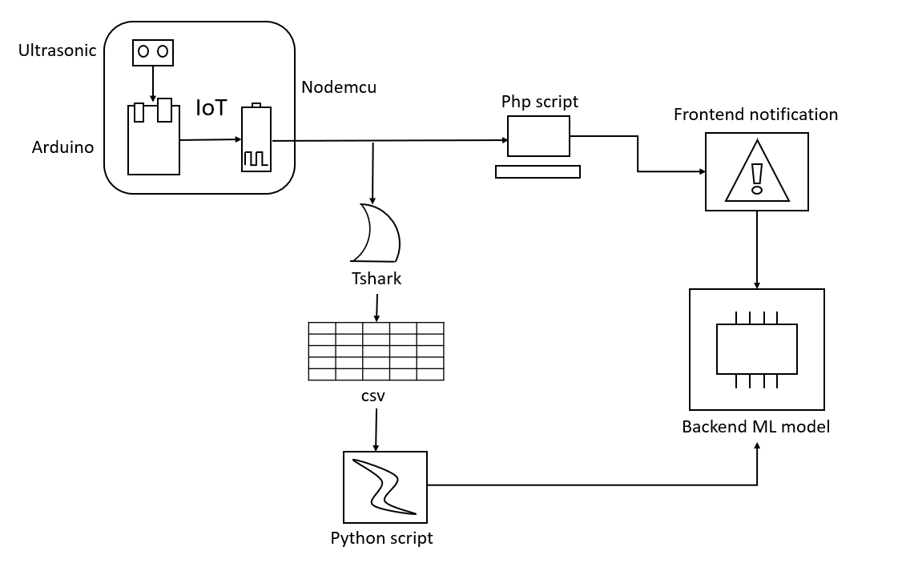
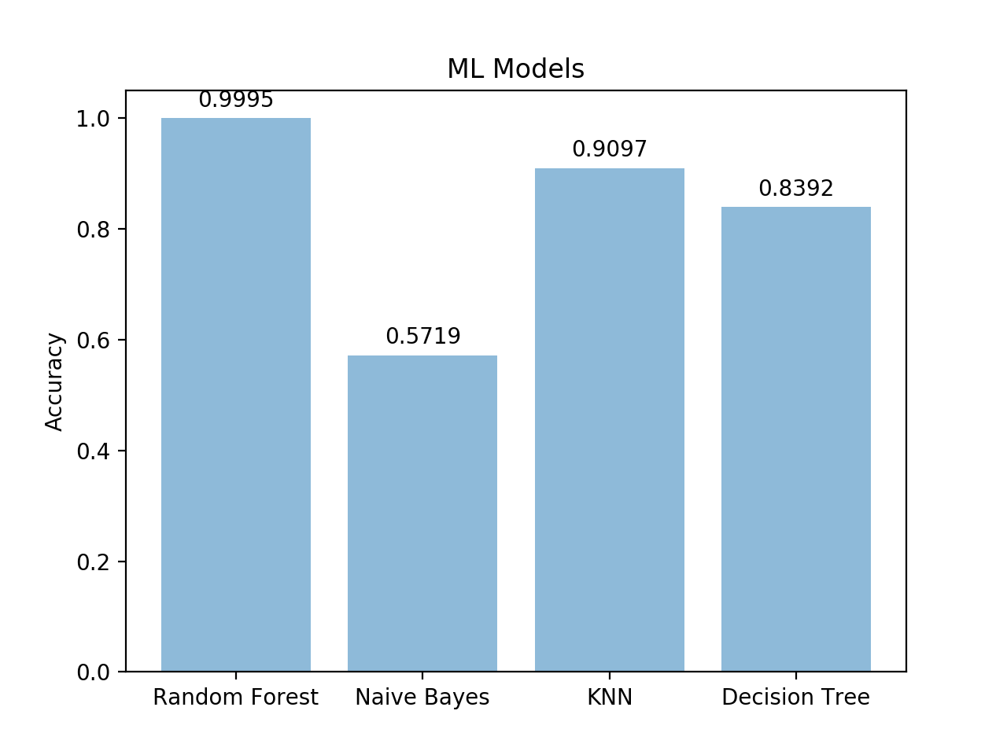
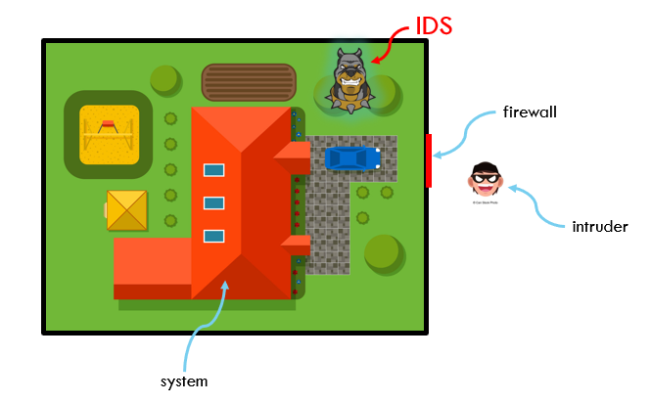
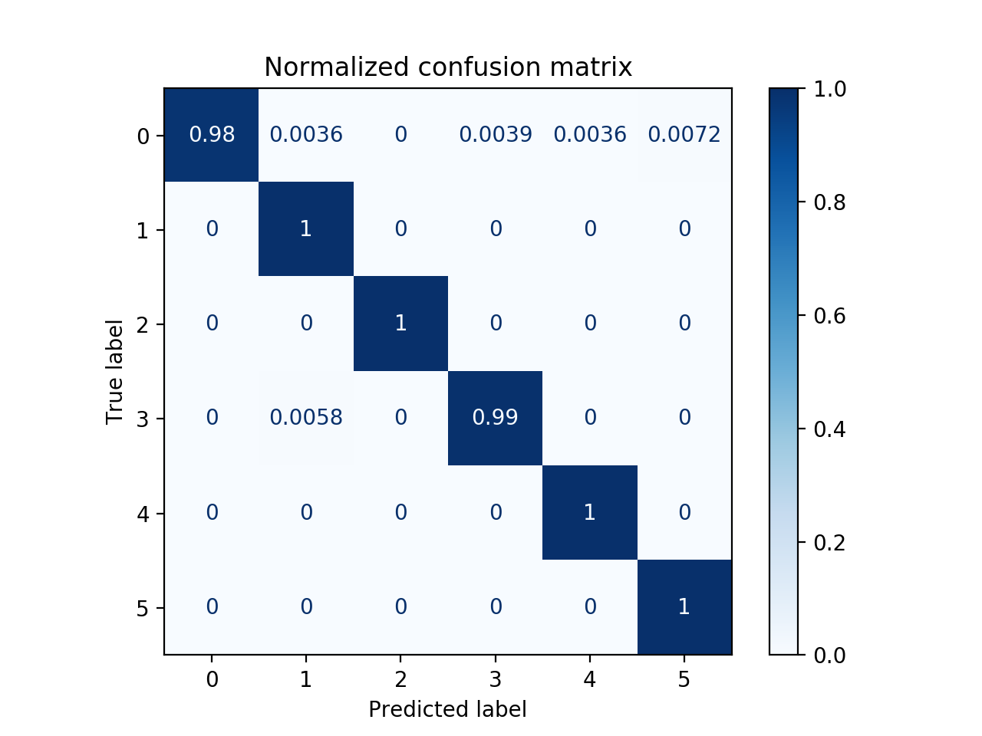
IEEE ESCI-2020
ANOMALY BASED INTRUSION DETECTION SYSTEMS IN IOT NETWORKS
^{#1}Rhishabh Hattarki, ^{#2}Shruti Houji, ^{#3}Sanika Patil, ^{#4}Sahil Dixit, ^{#5}Manisha Dhage
Computer Department, Sinhgad College of Engineering,Pune, Maharashtra, 411041, India
Abstract
Motivation
System Architecture/Circuit Diagram
Conclusion
IoT devices are becoming popular day-by-day. Several vulnerabilities in IoT present the need for IoT security. The number of attacks on these devices keep increasing and most of them are slight variations of the previously known attacks, which can bypass the conventional ﬁrewall systems.
The existing systems are not suitable for IOT devices as IOT devices have low computational power. Those that use signature-based intrusion detection work only on known patterns and attacks, hence they cannot recognize newer attacks with unknown pattern. Also, many systems use cloud computing, which has a downfall that it needs access to internet at all times and are most often paid.
The following survey discusses a few of the anomaly based intrusion detection systems built to tackle this situation. It shows the different methods used along with their drawbacks or future scope. Also, an anomaly-based detection system has been proposed. It comes into eﬀect when detecting newer attacks, that are not ﬁltered by the ﬁrewall. It is capable of handling newer/unknown attacks, which signature based cannot deal with. It would be set up on a local higher powered device rather than on cloud.
With myriads of devices generating, processing and exchanging a vast amount of data that consists of safety, security and privacy critical information, it is bound to attract the attention of cyber criminals. The security issues are often known to the device manufacturers. However, a large chunk of the development time and effort is dedicated into getting the product to the market prior to the deadline. Hence, the security in IoT devices is either neglected or left out. As a result IoT devices become an easier target for hackers. [2]. Using the vulnerabilities in IoT design, software and hardware, the adversaries can plant malicious code, install a virus, etc. and infiltrate the IoT network.
Intrusion detection systems act as a second line of defense after the firewall and are beneficial for the security of IoT networks. The paper provides a survey of few of the different types of intrusion detection systems, mostly anomaly based systems. A system has been proposed using the pointers from the survey to detect intrusions in IoT networks. This can be used in a real time IoT networks to improve its security.
References
1)Jesus P., Salim H., "IoT Security Framework for Smart Cyber Infrastructures", IEEE 1st International Workshops on Foundations and Applications of Self* Systems, 2016, pp. 242-247
2)Jacob W., Khoa H., Orlando A., Ahmad-Reza S. et. al., "Security analysis on consumer and industrial IoT devices", 21st Asia and South Pacific Design Automation Conference (ASP-DAC), 2016
3)Shadi A., Monther A., Muneer B. Y., ”Anomaly-based intrusion detection system through feature selection analysis and building hybrid eﬃcient model”, Journal of Computational Science, 25, 2018, 152-160.
4)Ebelechukwu N., Andre C., Gedare B., ”Anomaly-based Intrusion Detection of IoT Device Sensor Data using Provenance Graphs”, 1st International Workshop on Security and Privacy for the Internet-of-Things (IoTSec), 2018.
5) Sébastien J.J. G., Alvin K.H. L., Craig O. F., et. al., “MAIDENS: MIL-STD-1553 Anomaly-Based Intrusion Detection System Using Time-Based Histogram Comparison”, IEEE Transactions on Aerospace and Electronic Systems, 2019
6)Abebe A. Diro., Naveen C., ”Distributed attack detection scheme using deep learning approach for Internet of Things”, Future Generation Computer Systems, 82, 2017, 761-768.
7)Ashima C., Brian L., Sheila F., Paul J., ”Host based Intrusion Detection System with Combined CNN/RNN Model”, IWAISe 2018- ECML PKDD Conference, 2018.
Literature Survey
System Overview
There have been many novel methods of anomaly based intrusion detection systems such as the deep learning based IoT/fog network attack detection system [6] which reduces the performance overhead of a single IoT node, the cloud based system by Tagy Aldeen Mohamed [8] which uses a combination of random forest and neural network, hybrid efficient model proposed by Shadi A. et. al. [3] which uses an ensemble of J48, Meta Pagging, Random Forest, REPTree, AdaBoostM1, Decision Stump and Naïve Bayes and the system by Sébastien J.J. G., et al, [5] that uses time based histogram analysis for MIL-STD 1553 protocol, CNN-GRU language model by Ashima C. et. al. [7].
Most of the researches surveyed were anomaly based IDSs including some signature based along with some hybrids. The datasets used were NSL-KDD, ADFA-LD, DS2OS, etc. They each had merits as well as drawbacks like insufficient models tested, unsatisfactory accuracy, high training times, no practical implementation etc.
The aim would be to overcome all or at the least most of these drawbacks and design a system that includes all the positive traits.
Introduction
IoT consist of devices such as smart devices, vehicles, home appliances, industrial smart devices that contain electronics, software, sensors, actuators, and connectivity which allows these things to connect, interact and exchange data.
When an IoT network is compromised, the intrusion detection system works as a second line of defence after the firewall.[1] If an attacker breaks into a system or system server by forwarding malicious packets to the user system, which is used to steal, modify or corrupt any private important information, it is said to be an Intrusion. The intrusion detection system monitors the network traffic for suspicious activity using either misuse or anomaly detection systems. [3]
Analogy of IDS
An anomaly, also referred to an outlier, is data that deviates from the normal system behavior, which is learned by the detection system by the provided set of accepted network behavior data. Anomalies indicate that the system has a fault or that a malicious event has compromised the system. [4] Although it is prone to high false alarm rates, where a particular activity is considered as a threat even when it isn’t.
Detailed Architecture
Result & Analysis
Methodology/Implementation
This IDS is designed to run in the background of an IoT network, where distance data is processed and sent from the node (combination of ultrasonic sensor, Arduino, Nodemcu) to the apache server. The network traffic is monitored using Tshark and dumped into a csv file. The python script in the backend reads this csv file, preprocesses it and feeds it to the ML model. If an intrusion is detected, it is notified to the user on the front end.
The ML model Random Forest is used as its accuracy was proven to be better than any other model that was tested. The model was trained using the data collected from the IoT network traffic, which included attacks like dos, data type probing, network scan, etc. The dataset created had features ip address, ip length, value, info, frame length, etc.
Comparison of different ML models
Contact information
^{Address:}
Computer Department, Sinhgad College of Engineering,Pune, Maharashtra, 411041, India
^{Email:}
¹rhish9h@gmail.com,
²shrutihouji98@gmail.com,
³patilsanika02@gmail.com,
⁴sahildxgeneration10@gmail.com,
⁵mrdhage.scoe@sinhgad.edu
Normalised confusion matrix – normal vs anomalous

