Slide 2
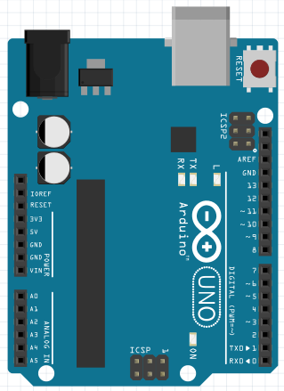
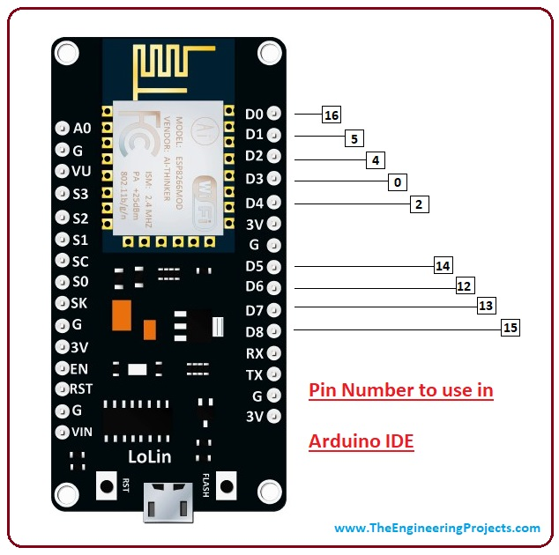
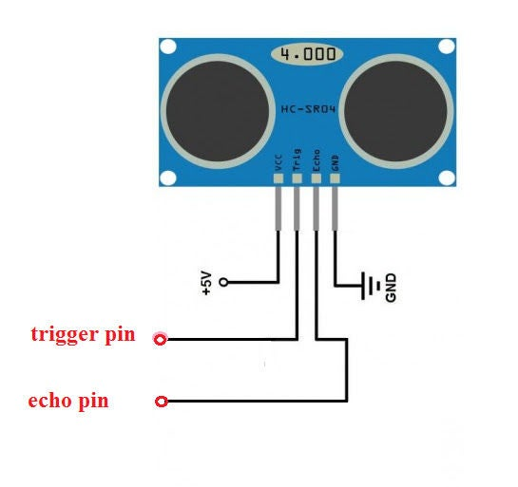
IoT node connections

Slide 4
Creation of Dataset
Some Attributes are listed below:
Attribute Name | Description
Duration | Time duration of the connection
Dst_host_count | Number of connections having the same Destination host IP address
Land | if source and destination IP addresses and port numbers are equal then,this variable takes value 1 else 0
Service | Destination network service used
Flag | Status of the connection – Normal or Error
Source_id | Source Address Code
Timestamp | A timestamp is the current time of an event that is recorded by a computer.
Destination_id | Destination Address Code

Slide 5
ML Model
ML Model
Preprocessing of Dataset
Training of the module
Testing the Module

