Slide 1

Anomaly Based Intrusion Detection System in IoT Networks using Random Forest REVIEW 3
Project By – Under guidance of-
Shruti Houji (71707035C) Prof. M. R. Dhage
Rhishabh Hattarki (71707027B)
Sahil Dixit (71706924K)
Sanika Patil (71707451L)

Slide 2
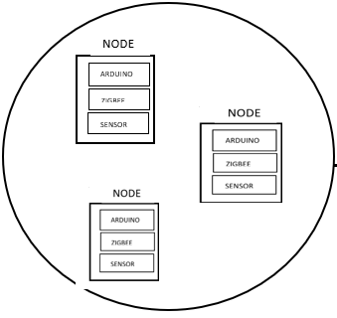


Architecture Diagram
Iot network
Apache server
Data for dashboard
React FE
Result –
normal/anomaly
packets
Packet analyser
Django BE – ml model

Slide 3
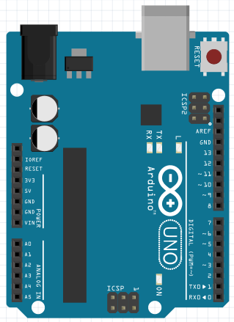
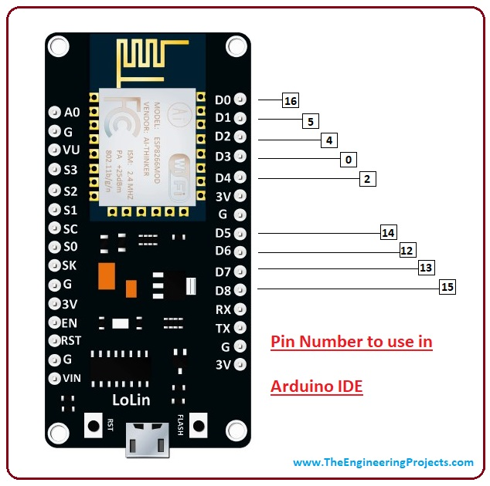
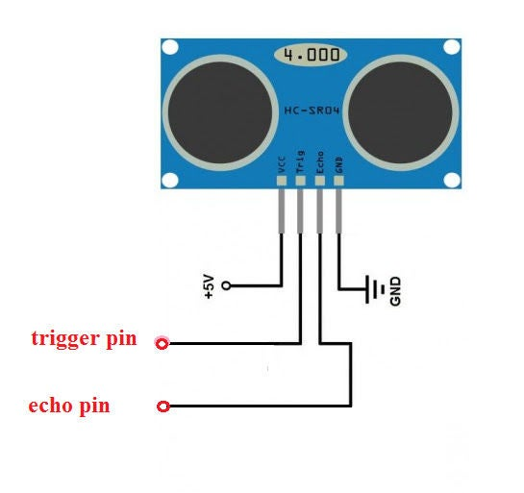
IoT node connections

Slide 4
Register Page
Username
Mobile Number
Email Id
Password
Server Login Page
Admin User ID text field
Admin Password text field
Admin Login Button
Change Password Button
Home Button
Change Password Page
Old username text field
Old password text field
New password text field
Change Button
Home Page
Header-NIDS
Navigation bar-
Dashboard
Log Viewer
Analysis
Notification Alert

Slide 6
Creation of Dataset
Some Attributes are listed below:
Attribute Name | Description
Duration | Time duration of the connection
Dst_host_count | Number of connections having the same Destination host IP address
Land | if source and destination IP addresses and port numbers are equal then,this variable takes value 1 else 0
Service | Destination network service used
Flag | Status of the connection – Normal or Error
Source_id | Source Address Code
Timestamp | A timestamp is the current time of an event that is recorded by a computer.
Destination_id | Destination Address Code

Slide 7
ML Model
ML Model
Preprocessing of Dataset
Training of the module
Testing the Module

