Slide 1
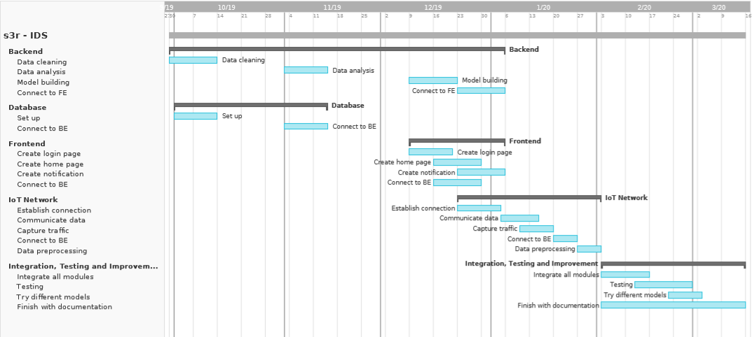
Project milestones and timeline

Slide 2
Project Risks
Schedule risks – starting too slow (not finishing in time), rushing too fast (sacrificing on quality which will further create more issues)
Budget risks – hardware failure, extra hardware required (adapters, cables, controllers)
Technical risks – bugs, bad code structure, connectivity issues, lack of commenting/documentation, lack of technical knowledge
Management risks – lack of coordination, improper task assignment
External risks – Exams, submissions, unavoidable events, health issues

Slide 3
Risk Prioritization and Backup plan
Plan 1 – Create software ready – model creation, testing with DS2OS
Plan 2 – Test with created model
Backup – Create own dataset
Plan 3 – Use 2 nodes with separate computer for processing
Backup – Use only 1 node
Plan 4 – Use Zigbee with adapter
Backup – Get raspberry pi with wifi module

