Slide 1

Anomaly Based Intrusion Detection System in IoT Networks using Random Forest
Project By – Under guidance of-
Shruti Houji (71707035C) Prof. M. R. Dhage
Rhishabh Hattarki (71707027B)
Sahil Dixit (71706924K)
Sanika Patil (71707451L)

Slide 2

Problem Statement
To design and implement an anomaly Based Intrusion Detection System in IoT Networks using Random Forest which will passively monitor the IoT network traffic and alert the user for any intrusion detected.

Slide 3
MOTIVATION
IOT devices are becoming pervasive.
Several vulnerabilities in IOT present the need for IOT security.
Build an intrusion detection system for an IOT network
Keeping in mind the low computational power of IOT devices.
Recognize zero-day attacks and distinguish between normal and anomalous behavior
Accurately identify and notify the user of an attack.

Slide 4
Objectives
To develop a model for Intrusion Detection using Random Forest algorithm.
To establish connection between IoT devices in the network and send this data to the base station.
To preprocess the IoT network data and use ML model for classification of normal vs anomalous.
To notify user at the front end if intrusion has been detected in the IoT network.

Slide 5
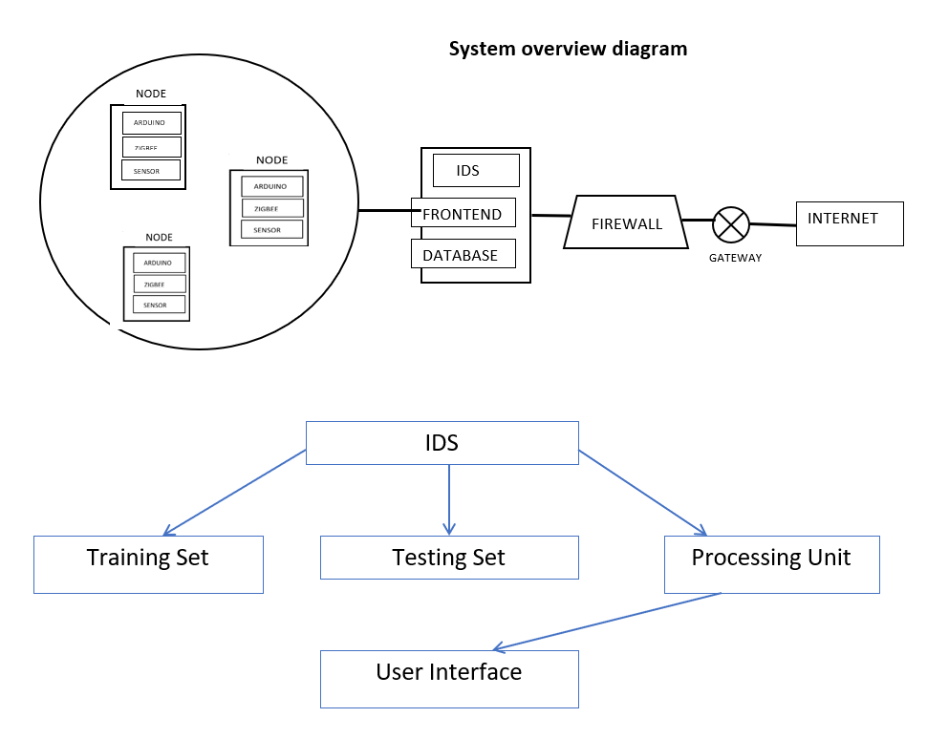
System overview diagram

Slide 6
Literature Survey
Title | Year | Publication | Dataset | HIDS/NIDS | Anomaly/Signature | Model used | Drawbacks
Anomaly based intrusion detection system through feature selection analysis and building hybrid efficient model | 2018 | Journal of computational science 25(2018) 152-160 | NSL-KDD | NIDS | Anomaly | hybrid | Not implemented for iot devices
Towards Machine Learning Based IoT Intrusion Detection Service | 2018 | Springer International Publishing AG, part of Springer Nature 2018 | UNSW-NB15 | NIDS, cloud | Anomaly | Neural network, random forest | uses cloud computing, which increases the resource requirements
Distributed attack detection scheme using deep learning approach for Internet of Things | 2017 | Future Generation Computer Systems (2017) | NSL-KDD | NIDS, fog | Signature | Deep learning | signature based, new attacks cannot be recognized
Host based intrusion detection system with combined CNN/RNN model | 2019 | Springer Nature Switzerland AG 2019 | ADFA-LD | HIDS | Anomaly | RNN with GRU | HIDS, and not NIDS Performance doesn’t match ensemble models
Anomaly-based intrusion detection of iot device sensor data using provenance graphs | 2018 | 1st International Workshop on Security and Privacy for the Internet-of-Things (IoTSec) | longitudinal data on the thermal conditions | HIDS | Anomaly | Provenance graphs | Works with offline data, doesn’t work with real time data

Slide 7



PROJECT’S END USER
Any location that has a network of IOT devices is susceptible to intrusive attacks. All such networks are the end users of this intrusion detection system. For example:
Factories and companies employing a network of IOT devices.
These IOT networks are usually larger and require high level of security.
Residential complexes/ habitants employing IOT network
With increasing usage of smart homes and residential complexes using IOT devices like CCTVs, fire alarm, smoke detectors etc. , it is crucial to have a good security system for these networks

Slide 8

Projected cost of producing the IDS
As per the basic COCOMO cost estimation formula projected cost for our product,
Development Effort = a₁ x (KLOC)ª₂PM
= 2.4 * (4)^{1.05} = 10 Person Months(approx)
Nominal development time = b₁ x (Effort)^{b}₂ Months
= 2.5 * (10)^{0.38} = 6 months(approx)
Cost required to develop the product = NDT x Average salary per month x members
=6 * 5000 * 4
=Rs 120,000/-
Where, KLOC is the estimated size of the software product expressed in Kilo Lines of Code
a₁, a₂, b₁, b₂ are constants for each category of software products

Slide 9
Is project achievable in specified (Time, Cost Budget)?
Properly planned schedule
implementation from oct’19 to March'20.
Resourses needed are provided by the college
IOT node
Zigbee adaptor, Arduino, ultrasonic sensor
Basic Plan –
build intrusion detection model first
classifying the data depends on this model
approximately 15 to 20 days for implementation of one module
Divide the project work equally among all the group members
complete it as early as possible within specified date
achieve it at a specific level of quality

Slide 10
Are the requirements within the scope of the project? – Functional requirements
Login Authentication-This requirement is within the scope as we can create a web application displaying username and password for a login page.
Network Connection-Here the data which is sensed is sent to the base station using Zigbee protocol.
Training data and intrusion detection-Random forest algorithm is used to detect the category of the attack which is within the scope of the project.
Notification-Display on the web page if the attack is malicious.

Slide 11
Non-functional requirements:
minimum real time functioning and processing data time of the system
regular maintenance of the Arduino and Zigbee adaptor
protection of the system from unauthorized data
systems configurable for detection and reaction
systems updating all will be taken care off to avoid unexpected bugs

Slide 12
Scope
Usage - The product can be used in any IOT network for the purpose of the security.
Network layer - The product will work on network layer of the IOT System.
IoT security - So it can be deployed anywhere where we need security measures in place to protect IOT device.
Detection - The product will only detect the intrusion but it will not take any measures to prevent the intrusion.
Prototype - The prototype will be limited to two nodes and a base station, which can be further scaled to more IoT nodes.

Slide 13

Problem statement defining scope
To design and implement an anomaly Based Intrusion Detection System in IoT Networks using Random Forest which will passively monitor the IoT network traffic and alert the user for any intrusion detected. The system will look for anomalous behavior in the IOT System and will only detect any intrusion in the network layer of IOT System.

Slide 14
Requirements fitting into hardware
IOT nodes are embedded with Arduino microcontroller which uses Zigbee protocol for communication
ZigBee Adaptor.
Ultrasonic sensor.

Slide 15
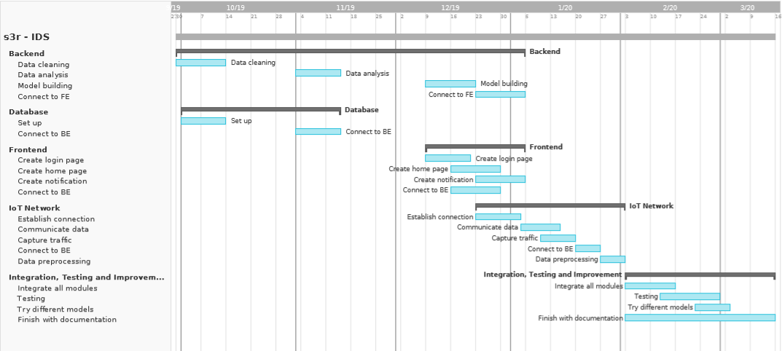
Project milestones and timeline
October
November
December
January
February
March

Slide 16
Project risks, Priority
Type of risk | Risk | Details | Priority | Backup/Solution
Schedule | Wrong time estimate Resources not tracked properly | Not able to start with IoT implementation in time Need of more hardware, learning Django, Vue (frameworks), learning IoT connectivity | Low Low/Medium | Timely schedule checks
Budget | Hardware issues | Zigbee adapter, cable needed Sensor failure | High Low | Borrow/buy Borrow/buy
Technical | Dataset issues Change in requirements | Not able to use DS2OS directly More devices needed, different sensors used, different algorithms used | High Low | Create own dataset Redesign and implement
Operational | Lack of communication Subject training | Not communicating well leading to delays, redundancy of work, wrong work Learning concepts, languages (Python, Javascript, Arduino), frameworks (Django, Vue) | Low High | Regular meetings Regular learning
External | Academic risks Health issues | Exams, submissions Members can get unwell | Low Low | Take the necessary break and work around it

Slide 17
Idea matrix ‘I’
IDEA | Deliverable | Parameter Affected
Increase | It increases Network security It increases network monitoring | Network security Network monitoring
Improve | It improves zero day attack detection Improves IoT security Improves awareness of user about network intrusions | Unknown attacks IoT security User awareness
Ignore | It ignores the normal behavior in the network | Normal behavior

Slide 18
IDEA | Deliverable | Parameter Affected
Deliver | It delivers efficient intrusion detection system for IoT devices | IoT security
Document | Documentation of the project for researchers to understand and improve on the project in the future. | Project documentation
Decrease | It decreases efforts taken to create signatures | Effort
Idea matrix
‘D’

Slide 19
IDEA | Deliverable | Parameter Affected
Educate | Educate project members with – security concepts, machine learning, MySQL, Wireshark Educate user | Project members User
Evaluate | Continuously monitor network traffic for intrusions Evaluate packets to determine if there is an intrusion | Network traffic Packets
Experiment | Experiment on different types of attacks Experiment on different types of ML models | Attacks ML models
Idea matrix
‘E’

Slide 20
IDEA | Deliverable | Parameter Affected
Accelerate | It increases the processing speed by using a separate device instead of the IoT device itself | Processing speed
Analysis | It analyses detected anomalies to determine what type of attack it is | Category of attack
Advertise | Advertise about IoT security and need of an IDS Create a GitHub page, which will include code, documentation and process | Security awareness GitHub
Idea matrix
‘A’

Slide 21
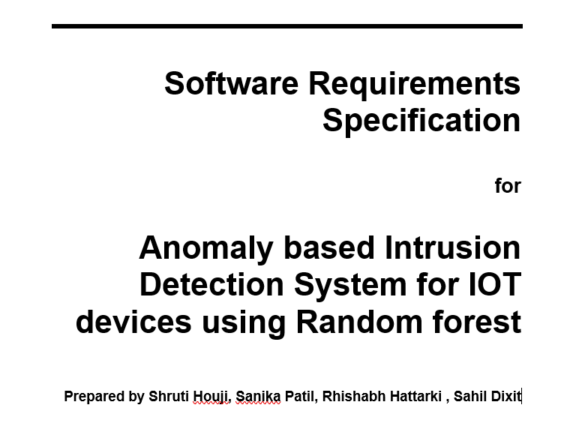
SRS

Slide 22

Mathematical Model

Slide 23
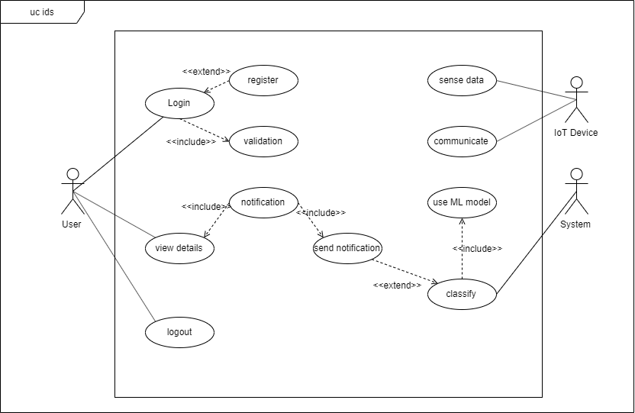
Use Case diagram

Slide 24
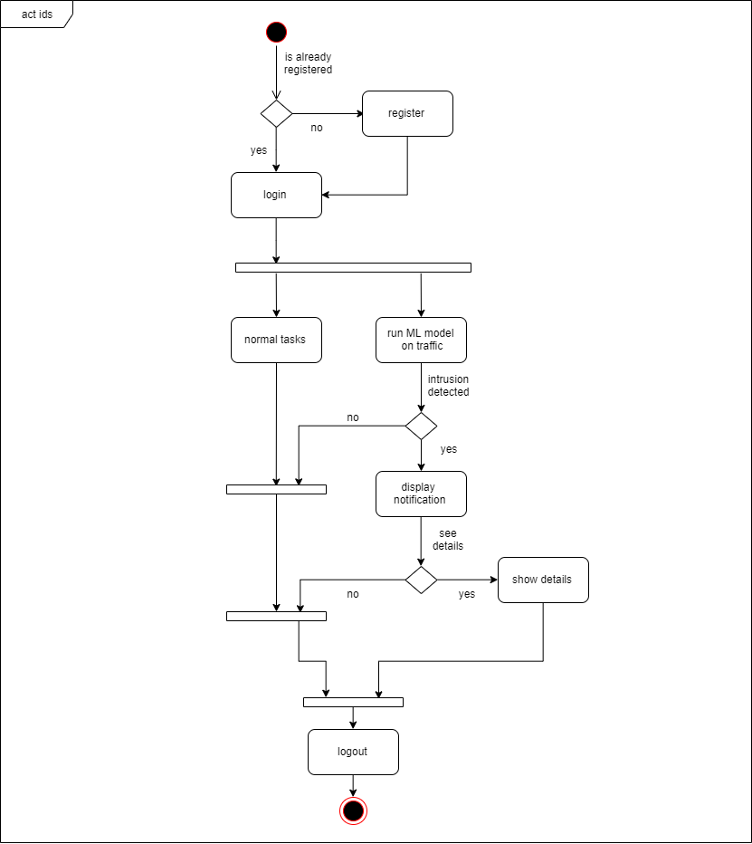
Activity diagram

Slide 25
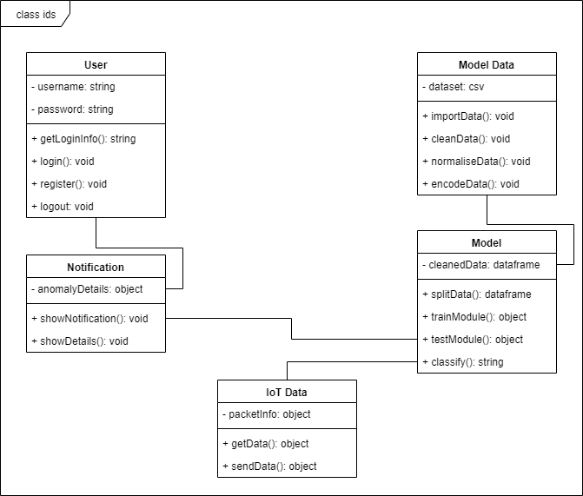
Class diagram

Slide 26
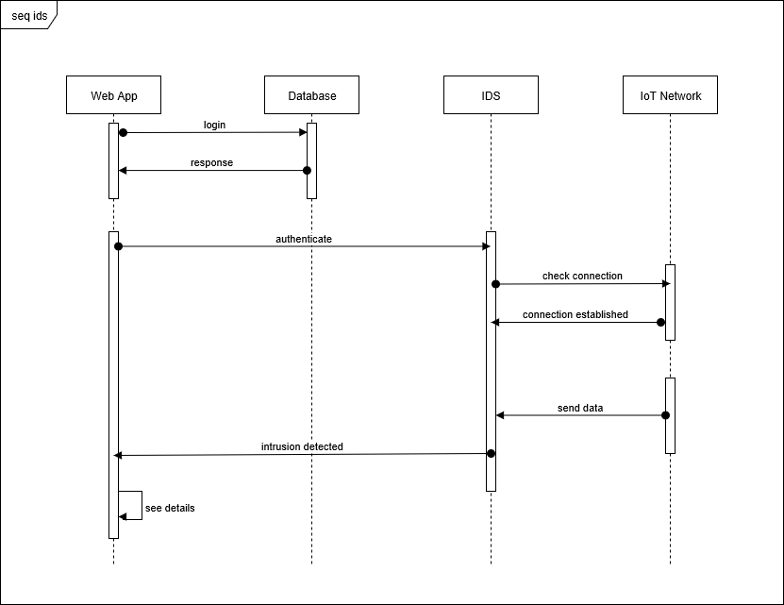
Sequence diagram

Slide 27
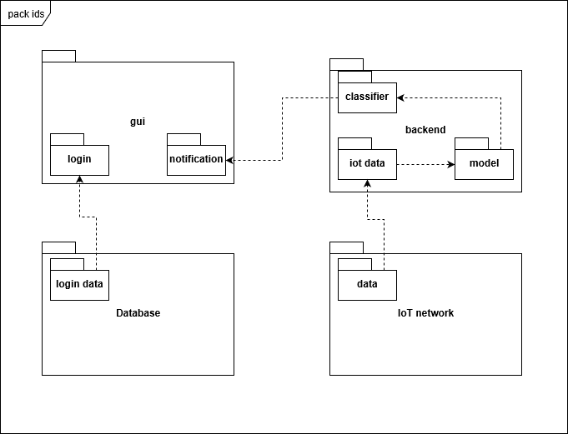
Package diagram

Slide 28
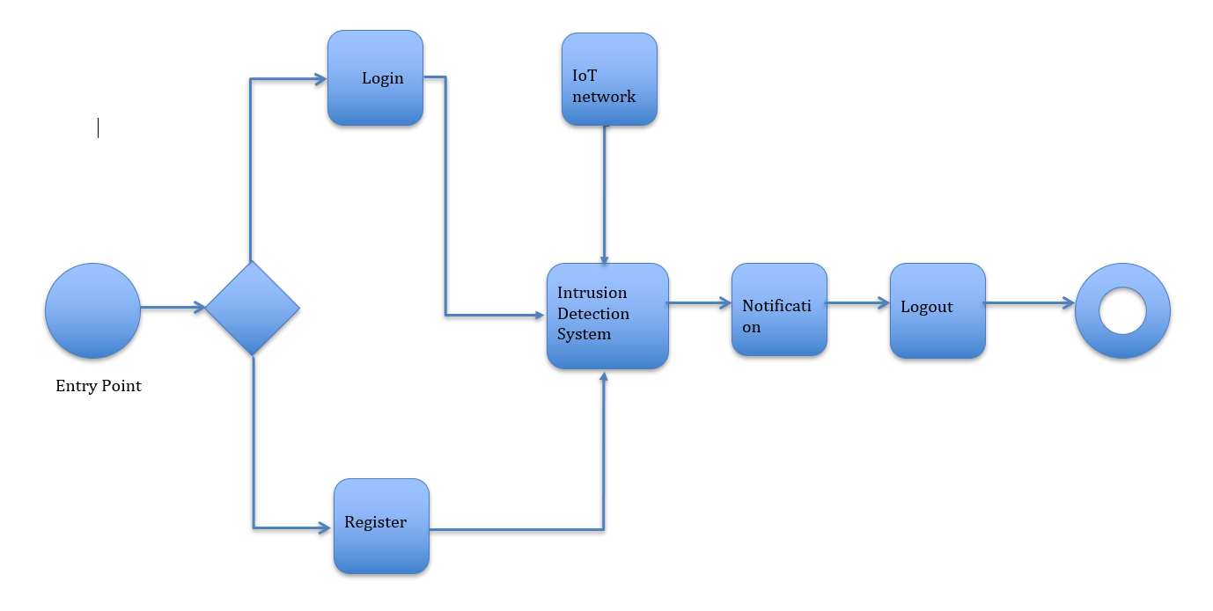
State machine diagram

Slide 29
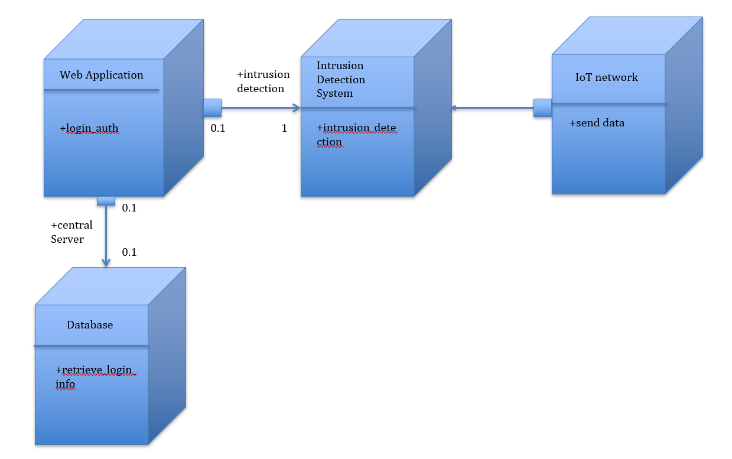
Deployment diagram

Slide 30

Feasibility Analysis
The problem is to detect an intrusion in a Iot network. The main objective of our project is to provide a real-time solution for any possible intrusions.
In the proposed system, we are planning to use anomaly-based detection system. The anomaly-based intrusion detection system comes into effect when detecting newer attacks, that are not filtered by the firewall. Random Forest is an ensemble model of decision trees.
Training Complexity: O((n^2)pntrees)
Prediction Complexity: O(pntrees)
Calling n the number of training sample, p the number of features, ntrees the number of trees (for methods based on various trees),
where,
n= 21000 (Approx)
p = 17
ntress= 4
Hence O(pntrees) runs in polynomial time complexity.
The algorithm falls in P. Hence, the given problem is NP.

Slide 31
Thank You.

