Slide 1
Going Pro with HTML/CSS
Day 2
The Coding Bootcamp

Slide 2
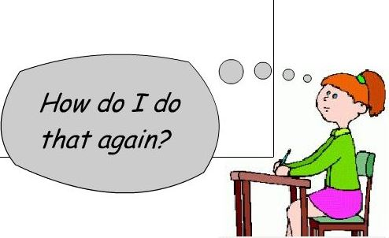
It’s Okay!

Slide 3
Admin Items

Slide 4
Where to Get Help
Practice, Practice, Practice: Work Individually or in Groups
Review In Class Material (Exercises and Slides): <<<<PROVIDE LINK HERE>>>>>
Re-Watch Class Videos: <<<<PROVIDE LINK HERE>>>>>
In Class Office Hours: 45 minutes before class, 30 minutes after
One-on-One Sessions: By Announcement through SSM
Contact Student Success: Anytime!

Slide 5
Homework #1 - Assignment
Also, at this point everyone should have access to the homework repository in GitHub. <<<<< LINK HERE>>>>
Homework Assignment #1 this week
Due: (<<<<DATE HERE>>>>)

Slide 6
Today’s Class!

Slide 7
Today’s Objectives
Students will make more HTML documents.
Students will learn to properly use basic HTML tags.
Students will implement basic CSS styling to HTML documents.

Slide 8
Know Thyself
If you are a complete beginner to HTML/CSS and Coding:
Continue getting comfortable with HTML.
Be able to completely write a basic HTML document (like in last class).
Understand what CSS is, what it’s for, and how it works with HTML.
Be able to use Git and GitHub to upload code.
If you’ve had past exposure and felt comfortable with the last lesson:
Aim to build up your skills. Clear up any questions or confusions about HTML.
Become knowledgeable about a wider range of HTML and CSS tags.
Be able to selectively apply CSS to specific HTML elements.
Be able to use Git and GitHub to upload code.

Slide 9
HTML Round 2

Slide 10
HTML Syntax (Basic)
Content
<h1>
This is Mah House
</h1>
Opening Tag
Closing Tag

Slide 11
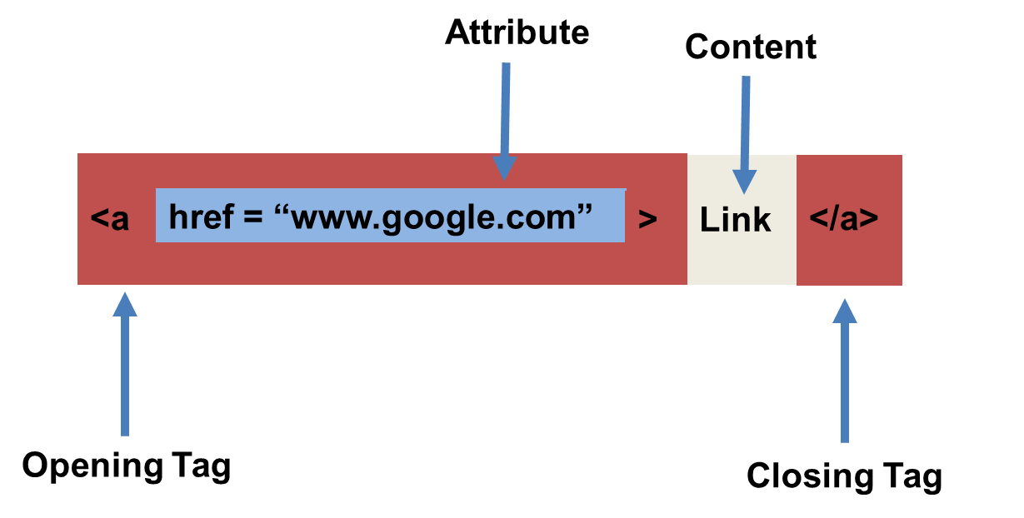
HTML Syntax (with Attribute)

Slide 12
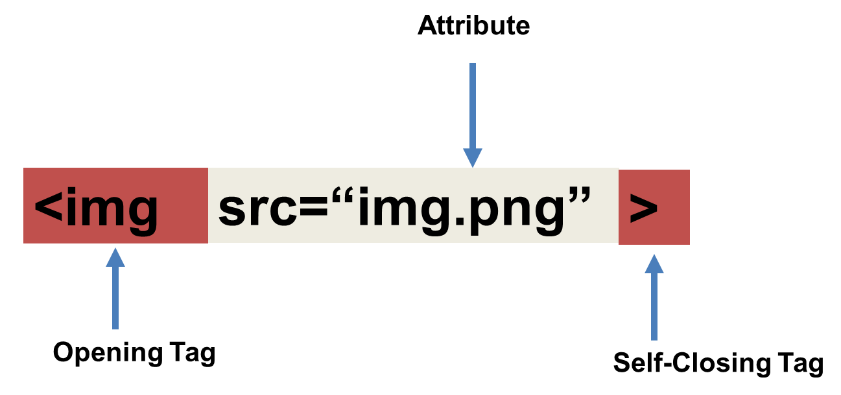
Tricky Tags (Self-Closing)

Slide 13
Important Common Tags
Headings:
<h1> </h1> - Heading 1 (Largest Heading)
<h2> </h2> - Heading 2 (Next Largest Heading)
<h3> </h3> - Heading 3
…
Containers:
<html> </html> - Wraps the entire page
<head> </head> - Wraps the header of the page
<body> </body> - Wraps the main content
<div> </div> - Logical Container ***
<p> </p> - Wraps individual Paragraphs
Others:
<strong> (bold), <em> (emphasis)
<img> (images), <a href> (links), <li> (list items) , <title> (title), <br> (line break), <table> (tables), <!-- --> (comments)

Slide 14
Less Common Tags
All HTML Tags are listed here: http://www.w3schools.com/tags/
Don’t try to memorize them! Simply refer back to documentation as needed.
Other tags:
<video> for Videos
<audio> for Audio files
<embed> for Embedded files
<code> for including computer code
<header> for headers
<nav> for navigation bars
<footer> for footers

Slide 15
HTML for Forms
Common UI (User Interface) Form Elements:
<form> - Creates a form section in HTML
<input> - Input boxes
<label> - Labels for boxes
<button> - Button
<textarea> - Large textbox

Slide 16
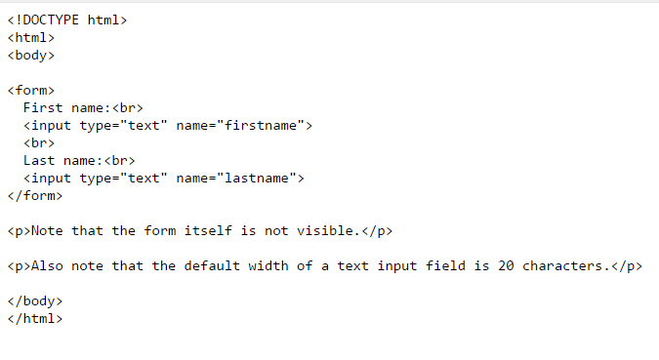
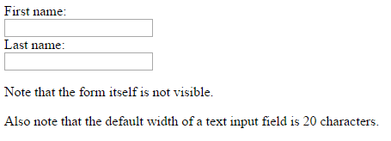
HTML for Forms

Slide 17
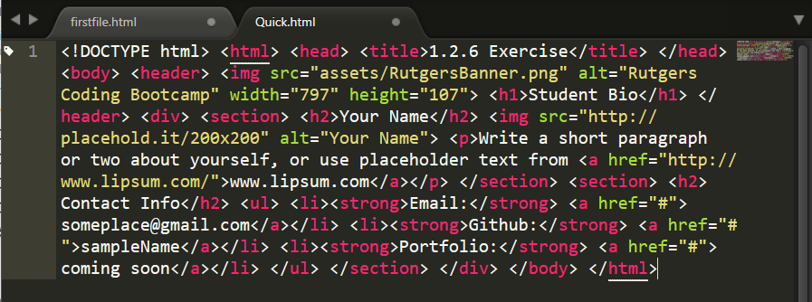
On Ugly HTML
Don’t do this… Use proper indentation and sectioning.
Readable code is easier to maintain.
Invest time to get better about this now. It will pay dividends!

Slide 18
> YOUR TURN!
Activity: 1-HTML_Git | Suggested Time: 20 min
Assignment
In this activity, you’ll create a student bio using HTML. You will then add, commit, and push your completed HTML to GitHub for the world to see.
Additional instructions, sent via Slack.

Slide 19
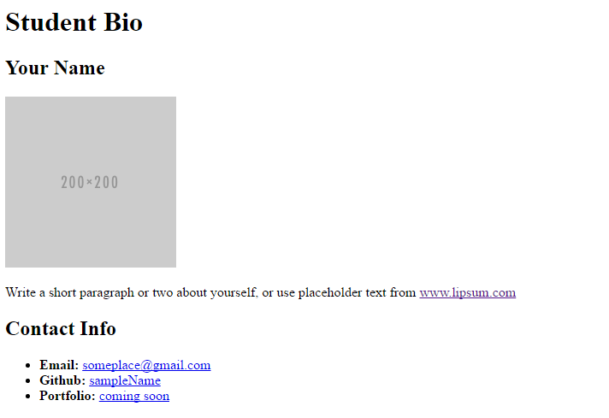
> YOUR TURN!

Slide 20
CSS Stylin’

Slide 21
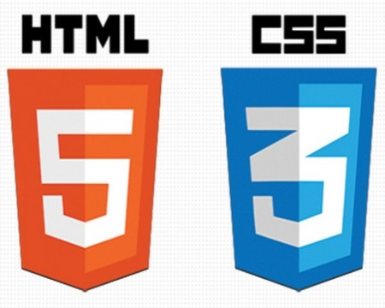

HTML / CSS Definitions (*yawn* unimportant)
HTML: Hypertext Markup Language – (Content)
CSS: Cascading Style Sheets – (Appearance)
HTML/CSS are the “languages of the web.” Together they define both the content and the aesthetics of a webpage – handling everything from the layouts, colors, fonts and content placement. (JavaScript is the third – handling logic, animation, etc.)

Slide 22


HTML / CSS Analogy
HTML Alone
Like writing papers in “Notepad.”
Can only write unformatted text.
HTML / CSS
Like writing papers in Microsoft Word.
Can format text, page settings, alignment, etc. based on “highlighting” and menu options.

Slide 23
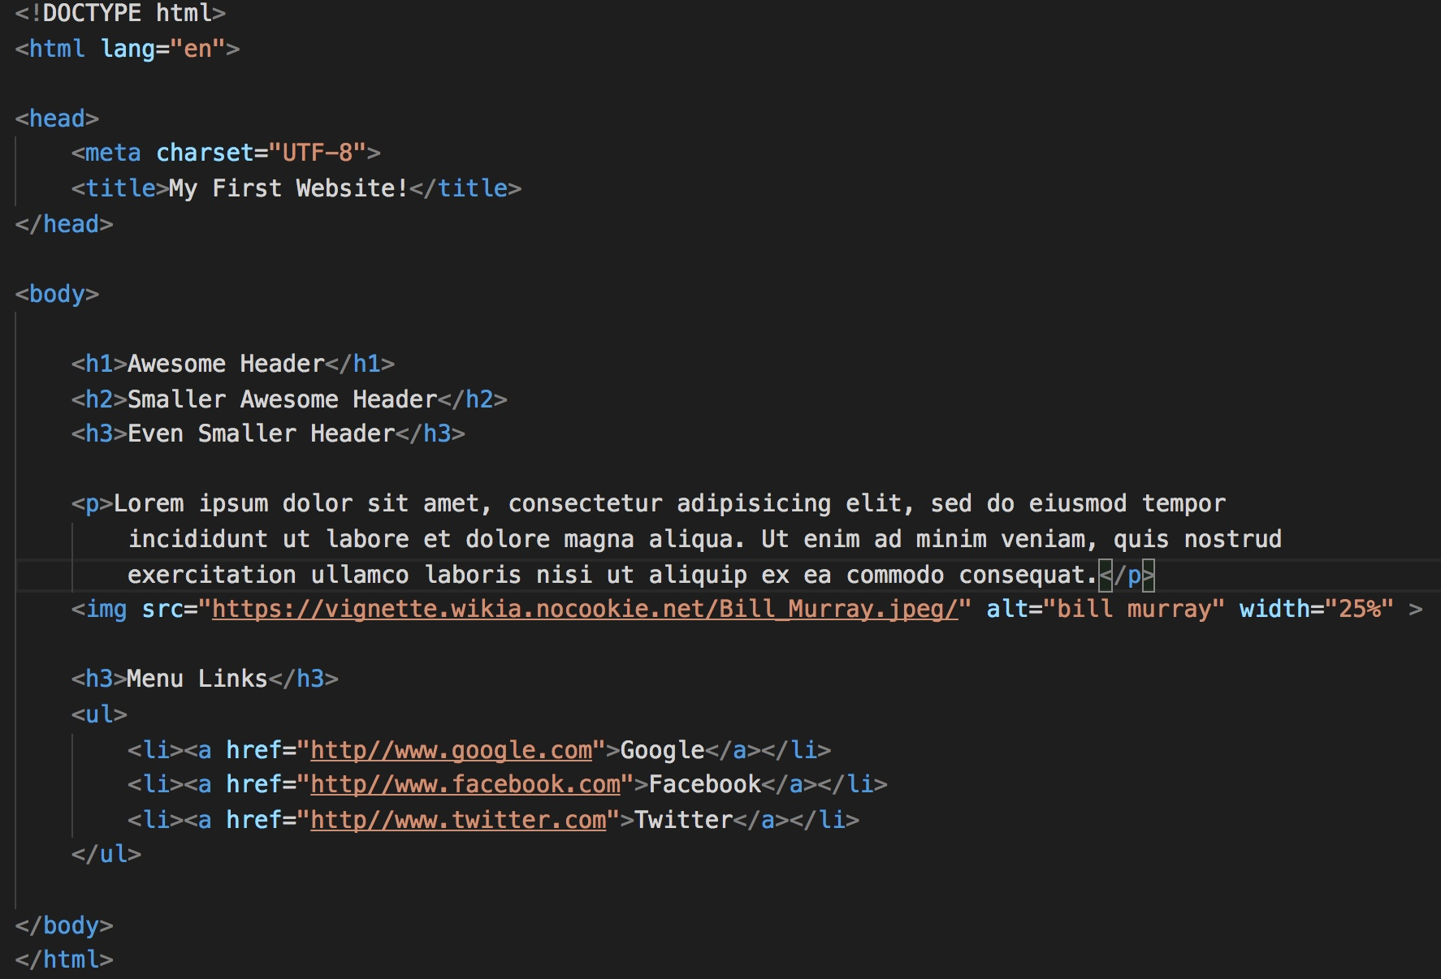
Basic HTML Page

Slide 24
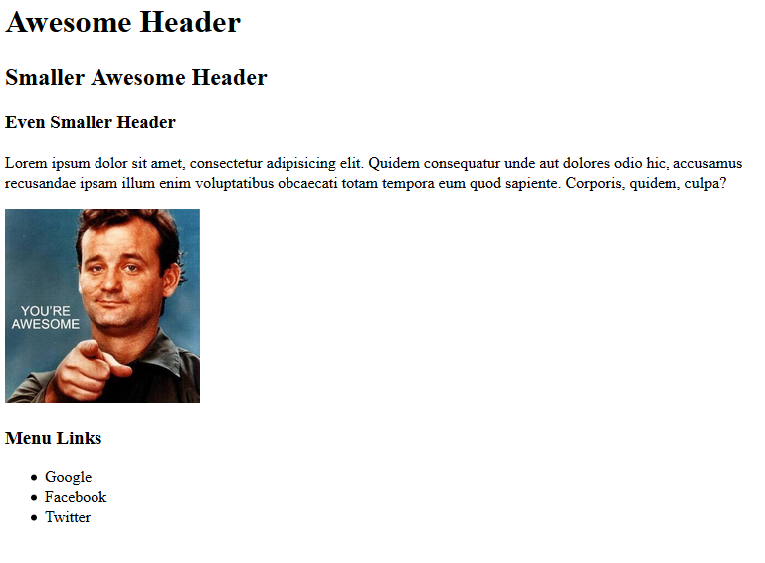
Basic HTML Page - Result

Slide 25
Basic HTML Page - Result
Hella Boring…

Slide 26
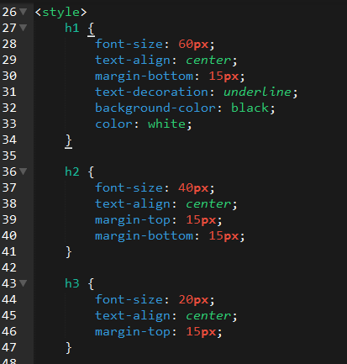
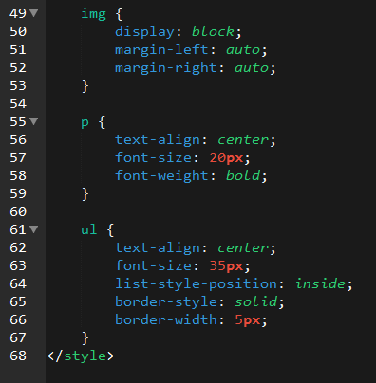
Enter CSS

Slide 27
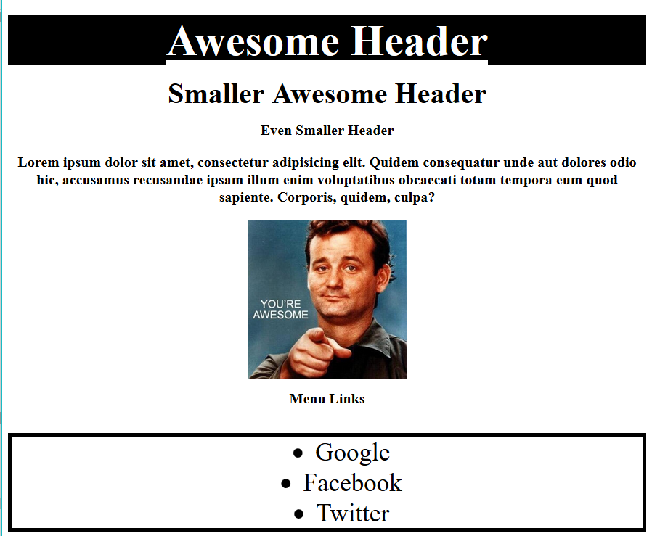
Enter CSS - Result

Slide 28
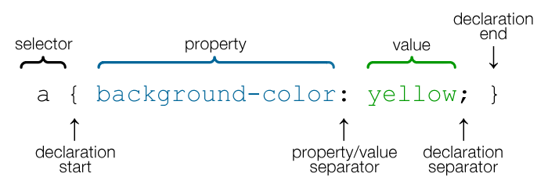
CSS Syntax
CSS works by hooking onto selectors added into HTML using classes and identifiers.
Once hooked, we apply styles to those HTML elements using CSS.

Slide 29
CSS Example
In the below example the “Header” would be turned blue and MUCH larger because of the CSS.
We can incorporate an element’s class or ID to apply a CSS style to a particular part of the document.
Just remember to include the necessary symbol before the CSS: “.” for class, “#” for ID.
Example (HTML):
<p class=“bigBlue”>Header</p>
Example (CSS):
.bigBlue
{
font-size: 100px;
color: blue;
}

Slide 30
Key CSS Attributes
Font / Color:
color: Sets color of text.
font-size: Sets size of the font.
font-style: Sets italics.
font-weight: Sets bold.
Alignment / Spacing:
padding (top/right/bottom/left): Adds space between element and its own border.
margin (top/right/bottom/left): Adds space between element and surrounding elements.
float: Forces elements to the sides, centers, or tops.
Background:
background-color: sets background color.
background-image: sets background image.

Slide 31
Powerful Duo
Believe it or not, HTML / CSS is all you need
to develop a vivid, full-blown website.

Slide 32
INSTRUCTOR DEMO
Instructor: Demo
(quick-example-internal-css.html | 05 -BasicCSS)

Slide 33
> YOUR TURN!
Activity: 3-HTML_CSS_Layout | Suggested Time: 20 min
Assignment
In this activity, you’ll upgrade your previous HTML bio-page using CSS style rules. Once you’re done, commit and push up your changes to GitHub.
We’ll send you additional instructions via Slack.

Slide 34
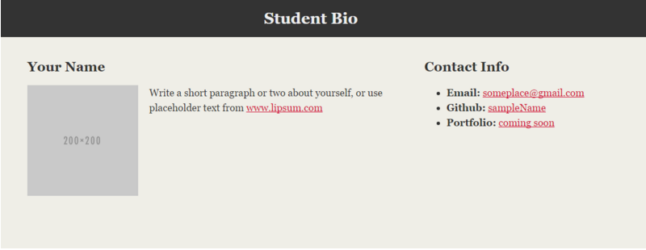
> YOUR TURN!

Slide 35
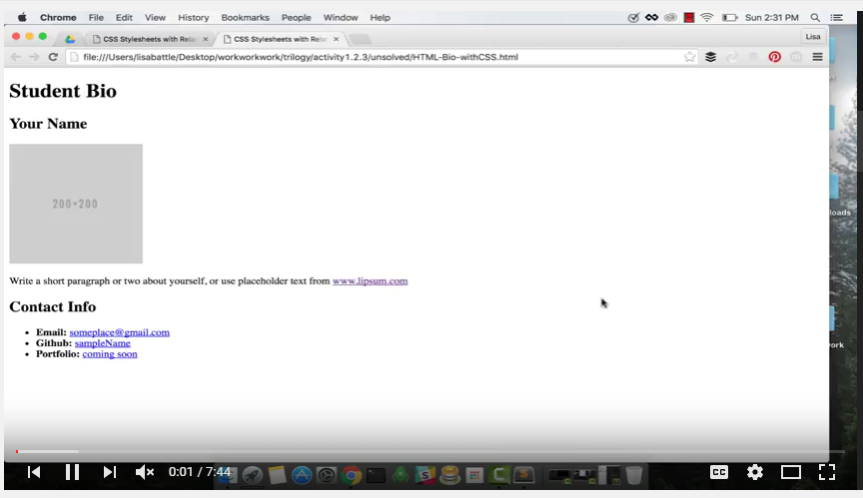
Video Walkthrough!!
https://www.youtube.com/watch?v=kMBinXTCrXI&list=PLgJ8UgkiorCnMLsUevoQRxH8t9bt7ne14&index=2

Slide 36
Relative File Paths

Slide 37
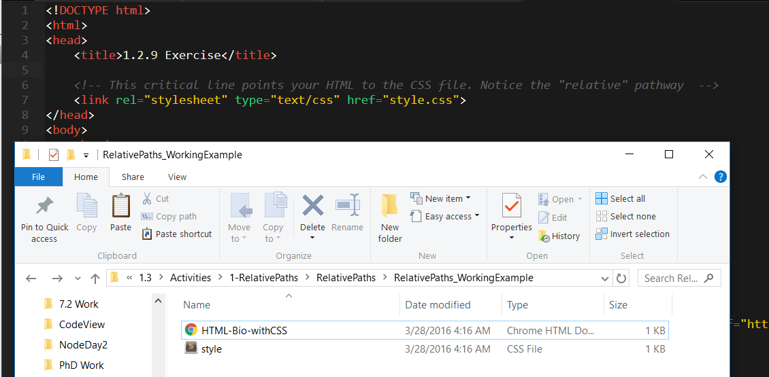
Relative File Paths
Relative file paths connect us with other files in our working directory. In this case, style.css is in the same folder as our html document.

Slide 38
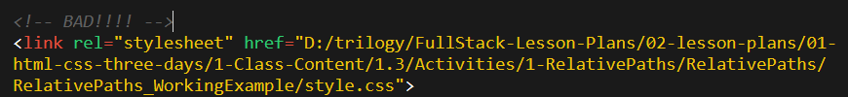

Absolutely No Absolute Paths
VERY VERY BAD
ALWAYS USE RELATIVE FILE PATHS.
If you deploy your sites without them, all of your links will fail.
The same will happen if you move your project from one folder to another.
Remember, there is no such thing as a “C:” drive on the internet.

Slide 39
Quick Demo
Instructor: Demo
(RelativePaths_DEMO | 1-RelativePaths)

Slide 40
> YOUR TURN!!
Activity: 1-RelativePaths| Suggested Time: 10 min
Assignment
1. Unzip the folder sent to you via Slack.
2. Edit the HTML files in all of the “RelativePaths” folders. You need to write relative paths that link the HTML documents with CSS stylesheets.
Tip: Check out the “RelativePaths_WorkingExample” folder.

Slide 41
LUNCH (30 mins)

Slide 42
Box Model

Slide 43
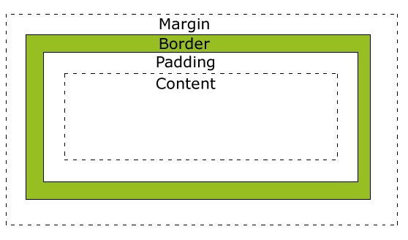
Boxes Upon Boxes
In CSS, every element rests within a series of boxes.
Each box has customizable space properties:
margin, border, and padding.
Typical spacing value: 20px 10px 10px 20px (top, right, bottom, left)

Slide 44
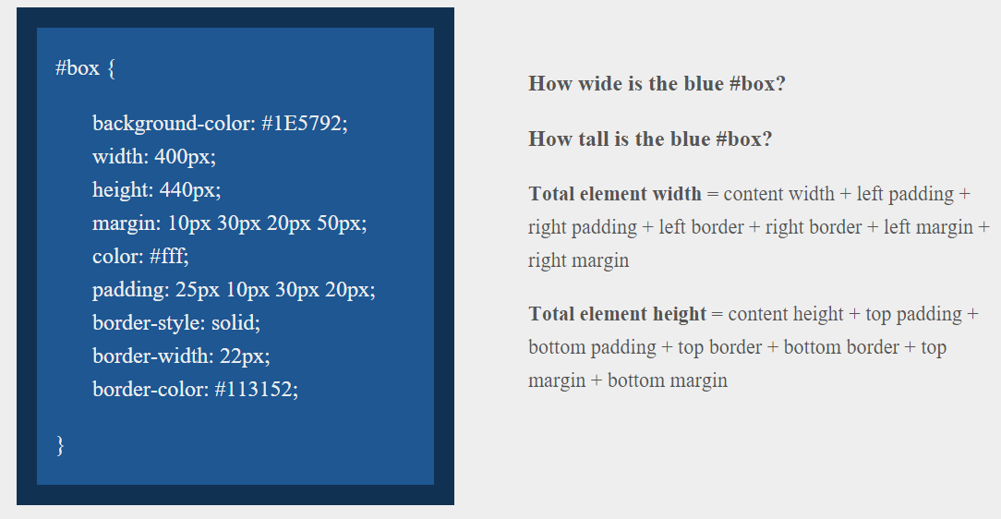
> YOUR TURN!!
Suggested Time: 10 min

Slide 45
> YOUR TURN!!
Answer
Width: 474 px (no margin), 554 px (with margin)
Height: 539 px (no margin), 569 px (with margin)

Slide 46
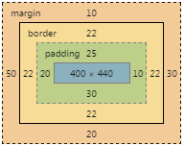
> YOUR TURN!!
Answer
Width: 474 px (no margin), 554 px (with margin)
Height: 539 px (no margin), 569 px (with margin)

Slide 47
We Be Floatin’

Slide 48
Take a Facebook Break…
Warning!
These next topics are fairly “tricky”… but VERY IMPORTANT.
Time to channel that inner genius.

Slide 49
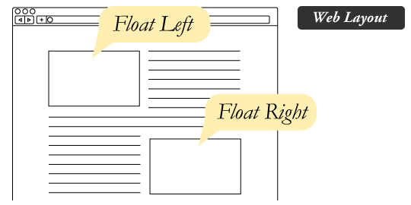
The Concept of “Flow”
By default, every HTML element displayed in the browser is governed by a concept called flow.
This means that HTML elements force their adjacent elements to flow around them.

Slide 50
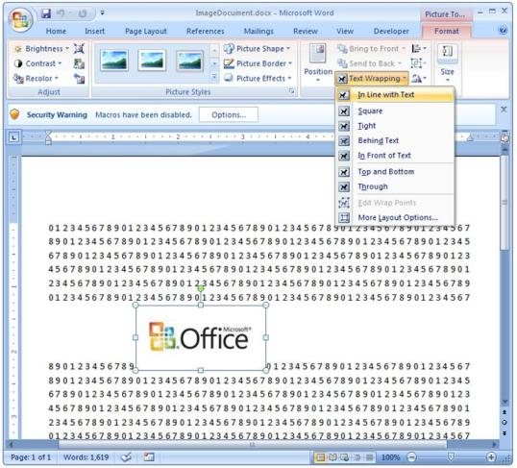
Flow Analogy to MS Word
This concept of “flow” is very similar to the wrap-text options you may be familiar with in Microsoft Word.
Just as in MS Word, you can have images in-line with text, on-top of text, etc.

Slide 51
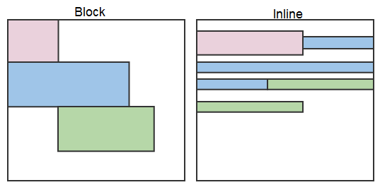
Block Elements
By default, web clients render many HTML elements as block elements. Paragraphs, headers, divs and more receive this treatment.
A block element will take up an entire line of space—unless you intervene with CSS properties.

Slide 52
Block Elements vs. Inline Elements
Now contrast the block elements with inline elements.
By using float CSS properties, we can command our website to display multiple HTML elements adjacently.

Slide 53
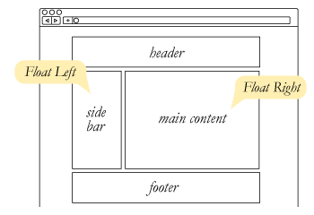
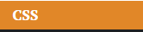
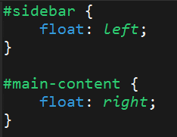
Floating
To transform these block elements into inline elements, we use a CSS property called float.
Floats are necessary for building web layouts.

Slide 54
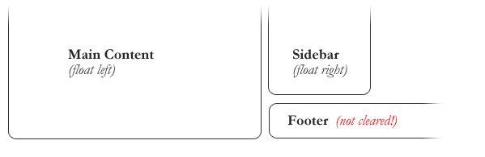
Clearing the Float
Floats often get in the way of our layouts.
Sometimes we don’t want to give each element the “inline” treatment.

Slide 55
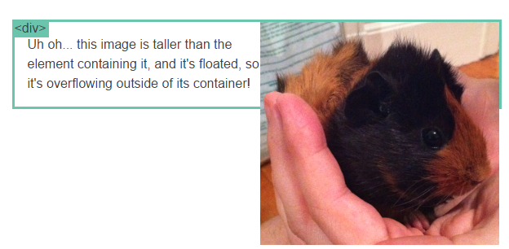
Clearfix Hack
Sometimes when elements don’t match up in size, we get situations like the above…

Slide 56
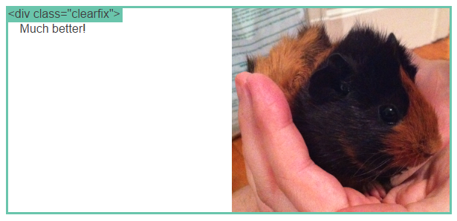
Clearfix Hack
We can get around this by using “the clearfix hack.”

Slide 57
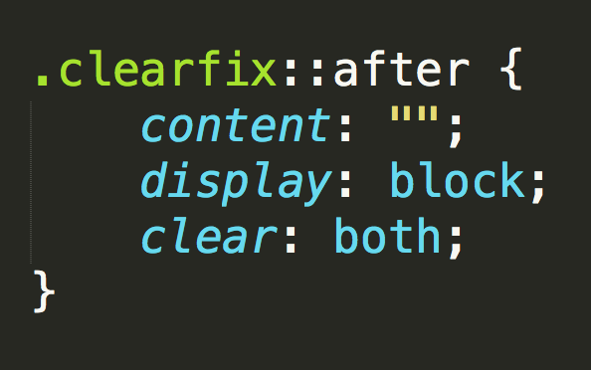
Clearfix Hack
::after is what we call a pseudo-element. We use it to style specific parts of an element.
This will add an HTML element, hidden from view, after the content of the “.clearfix” element. This clears the float.

Slide 58
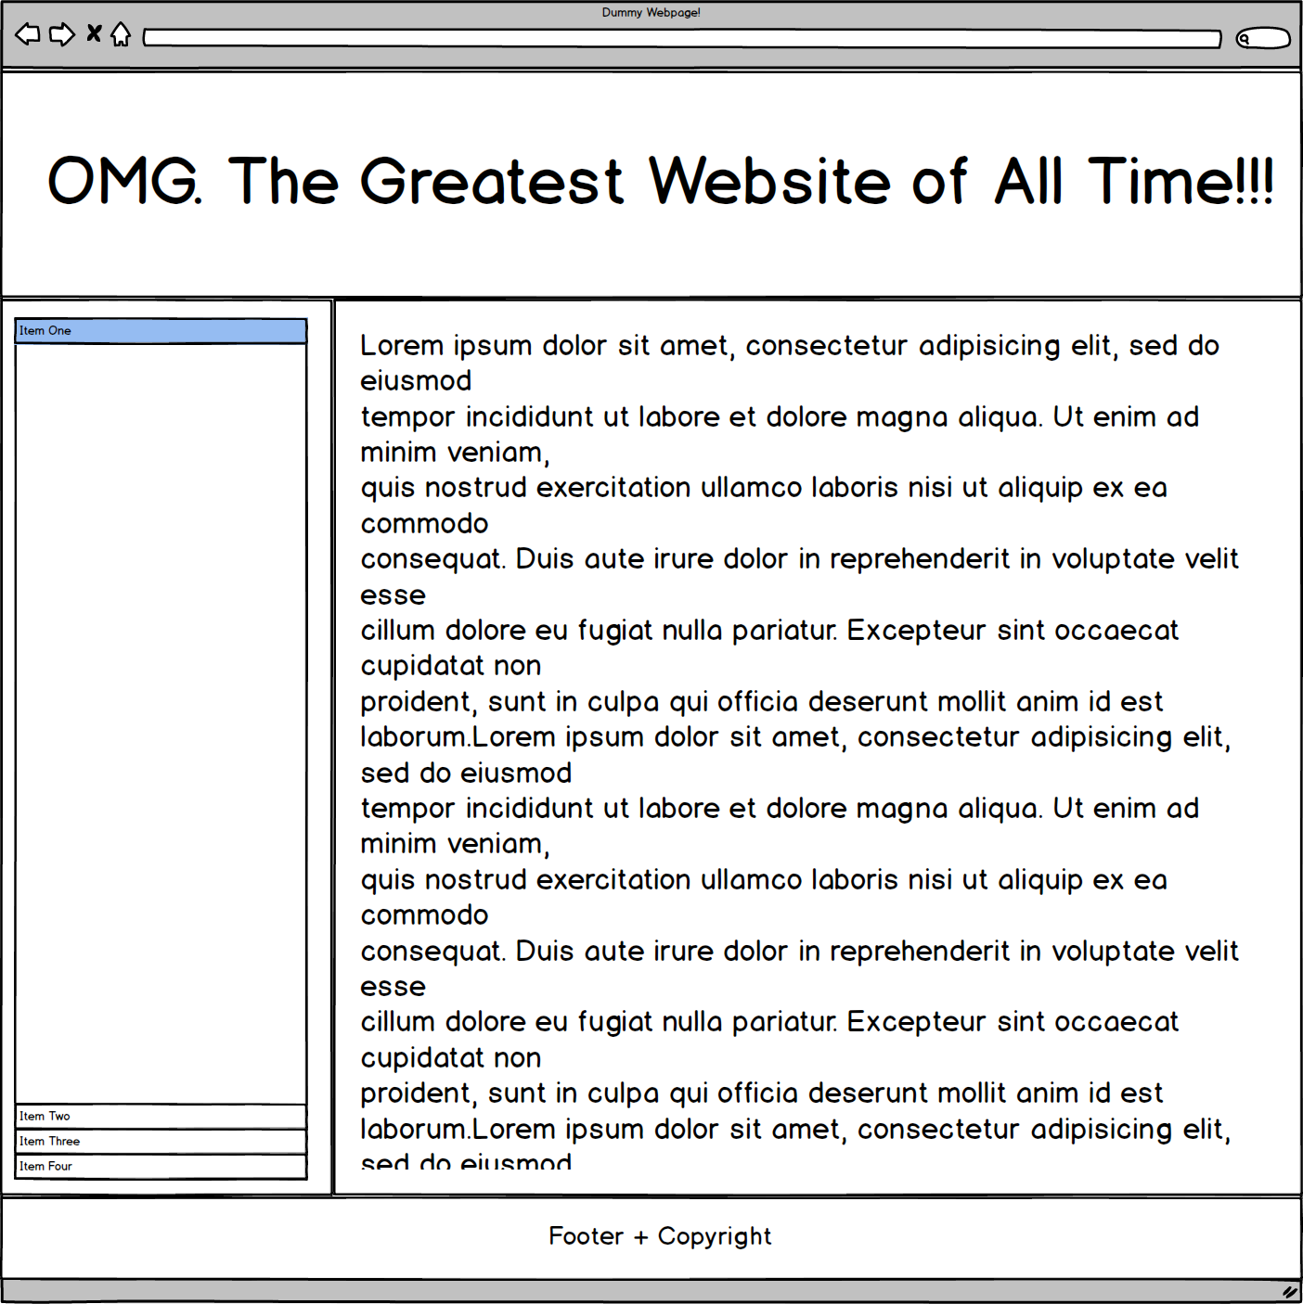
Quick Demo!

Slide 59
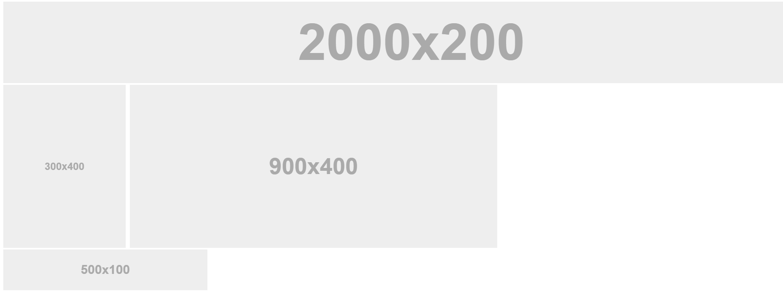
Quick Demo!

Slide 60
Quick Demo
Instructor: Demo
(2-FloatExamples)

Slide 61

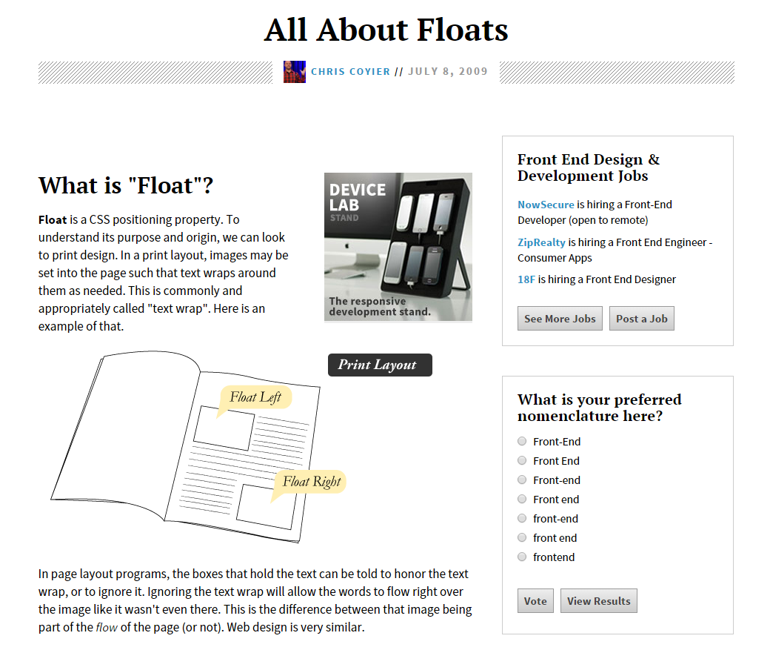
Fantastic Guide on Floats ****
To all serious front-end developers (this is a necessary read): https://css-tricks.com/all-about-floats/

Slide 62
> YOUR TURN!!
Activity: 3-FloatLayout-Activity | Suggested Time: 30 min
Assignment
In this activity, you’ll flex your newfound floating skills by creating a conceptual layout. Eyeball the design to your best ability.
Check your Slack for more instructions.

Slide 63
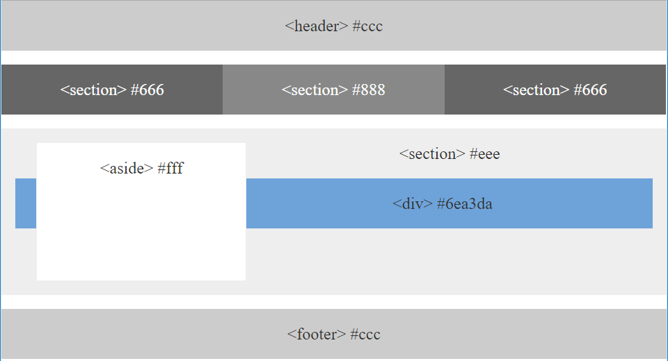
> YOUR TURN!!

Slide 64

Good work!
Your brain may rest now…

Slide 65
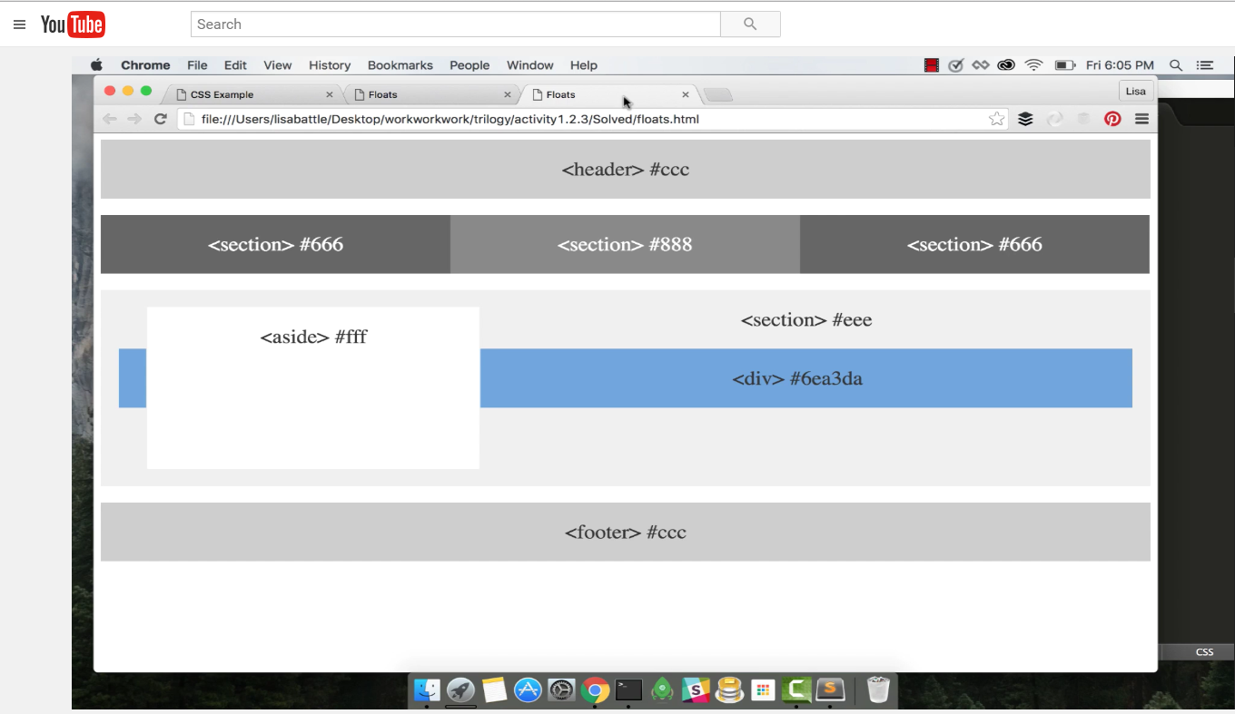
Video Walkthrough! (Highly, HIGHLY Recommend!!!)
Video Link: https://youtu.be/0lpxKw6E90Y

Slide 66
Recap + Questions

Slide 67

Still a Bit Confused?
Remember! We’ve got video guides for key activities like that last one.
If you feel like you are EVER falling behind, use those online walkthroughs to help catch back up. They are made to be easy to understand.
Still having trouble? Shoot your instructor or one of your TAs a message!
We are here to help you out in whatever way we can!

