Slide 1
Adventure Viking
(Filipe Rodrigues)

Slide 2
Revision History
Version | Date | Description | Author
1.0 | 2016.08.04 | First Release | Filipe Rodrigues

Slide 3
Contents
UI Structure
Usage Scenario
Key policy
How to change languages

Slide 4
UI Structure
Main
Levels
Choose the Level to play
Share Score on Social Media
Play
Return o Levels Page
Rerun same Level
Go to Levels Page
Go to Credits Page

Slide 5
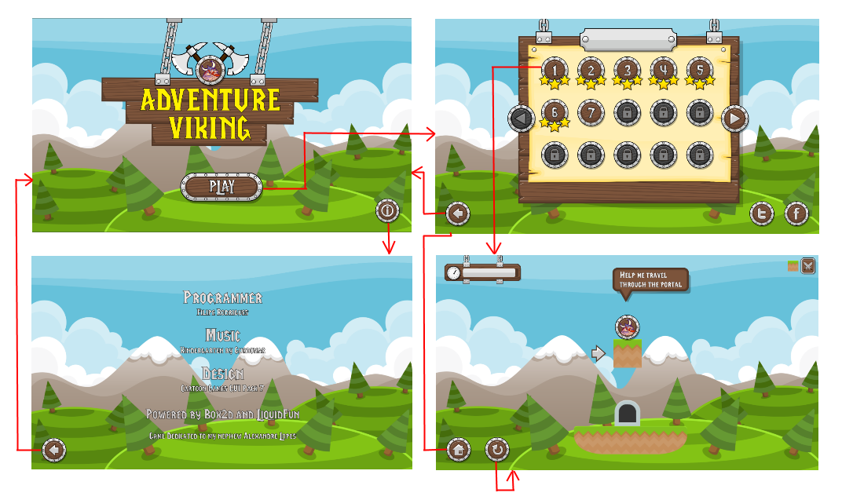
Usage Scenario

Slide 6
Key Policy
Button | Action | Remarks
RETURN | Move to previous page | Samsung Mandatory
EXIT | Close the app and show broadcasting channel | Samsung Mandatory
RETURN/EXIT | In case of Game App, if game is terminated, the exit popup should be displayed. | Samsung Mandatory

Slide 7
How to change languages
Items | Contents
How to change languages

