Slide 1



Feb 24, 2012

Slide 2
Hello, I'm
Subbu Allamaraju
@sallamar
http://www.subbu.org

Slide 3
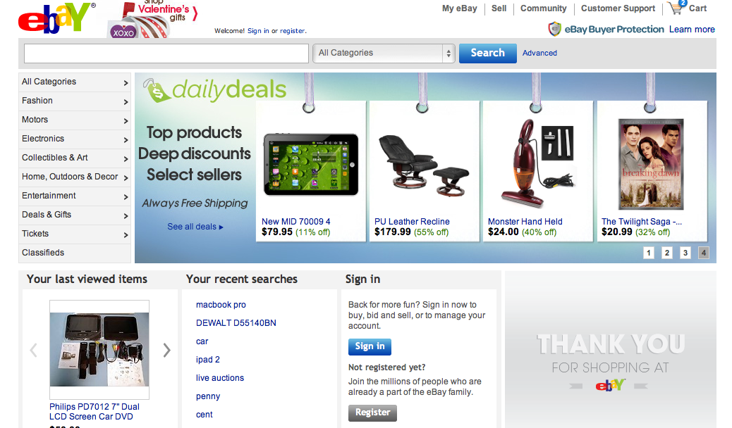

Slide 4

http://ql.io
https://github.com/ql-io/ql.io
Open source (Apache 2)

Slide 5
Consumers
APIs
XX,000,000,000
req/day
Producers

Slide 6
Consumers
Producers
Many APIs
XX,000,000,000

Slide 7
Consumers
Producers
Many Dialects
XX,000,000,000

Slide 8
Producers
Many Dialects
Q1: Make them RESTful and consistent?

Slide 9
Consumers
Producers
> 1 req per user action

Slide 10
Consumers
Q2: Optimize producers for every consumer?

Slide 11
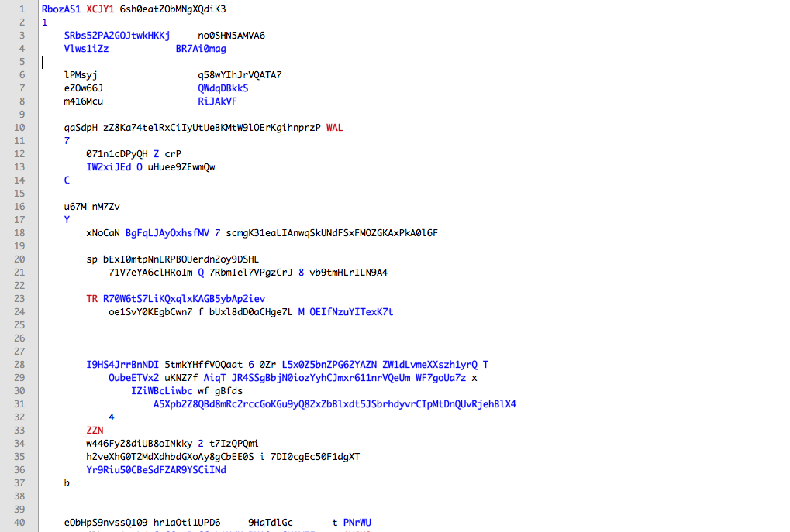
Real code (randomized)

Slide 12
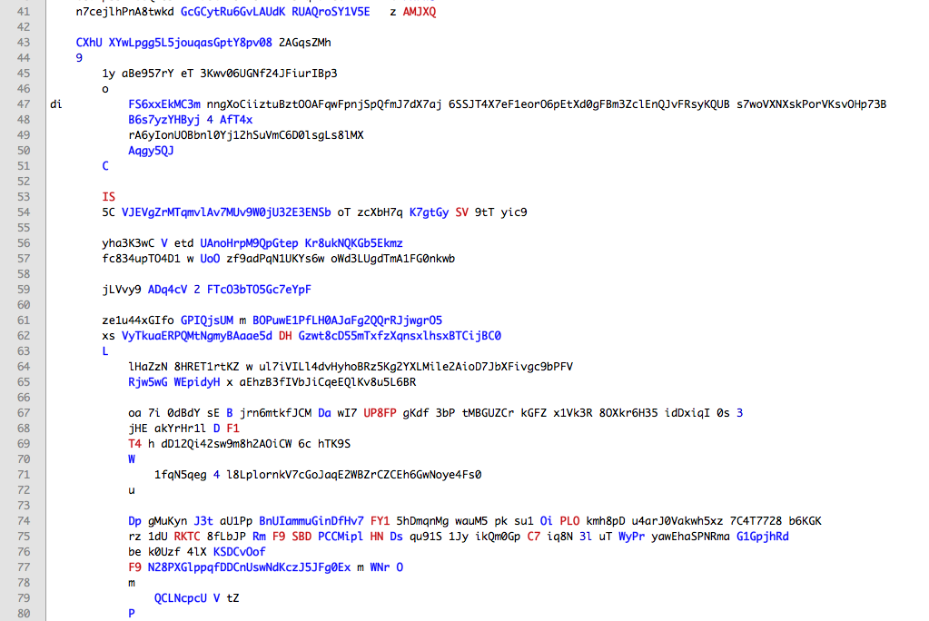

Slide 13
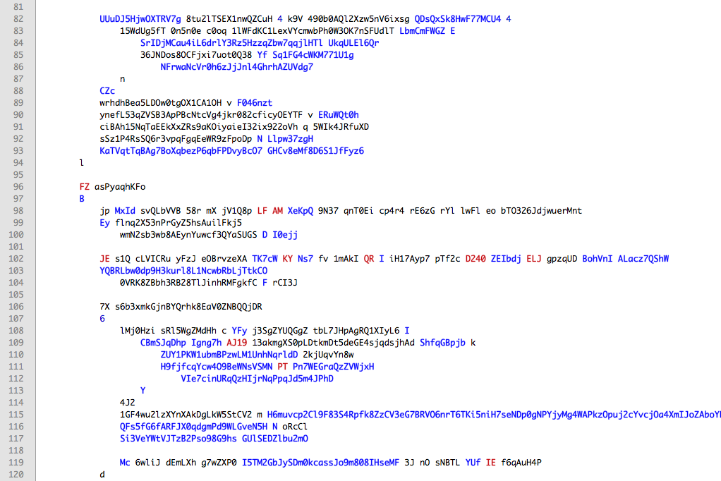

Slide 14
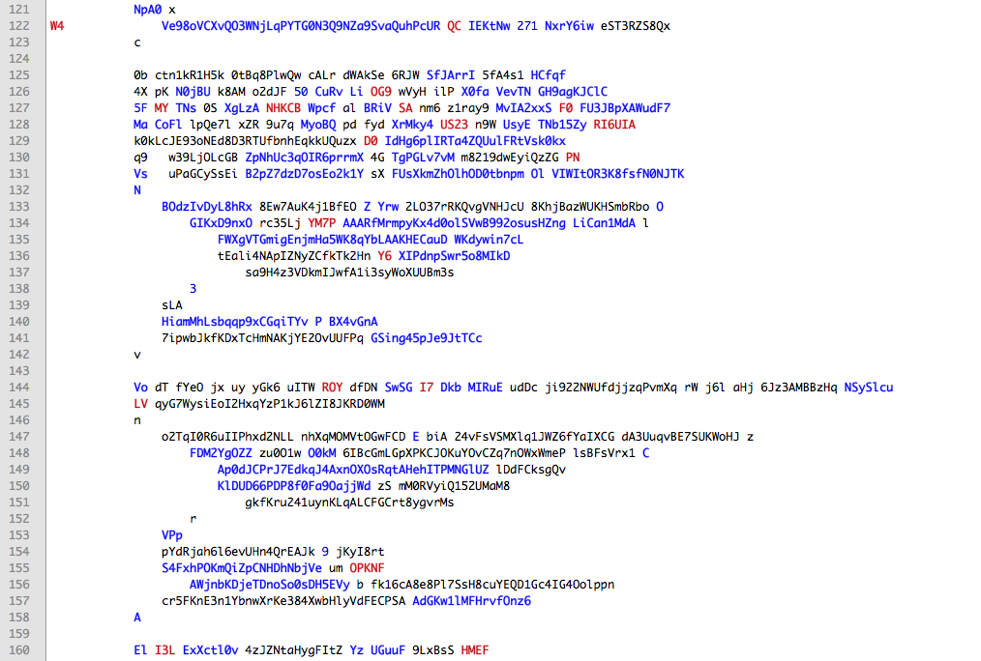

Slide 15
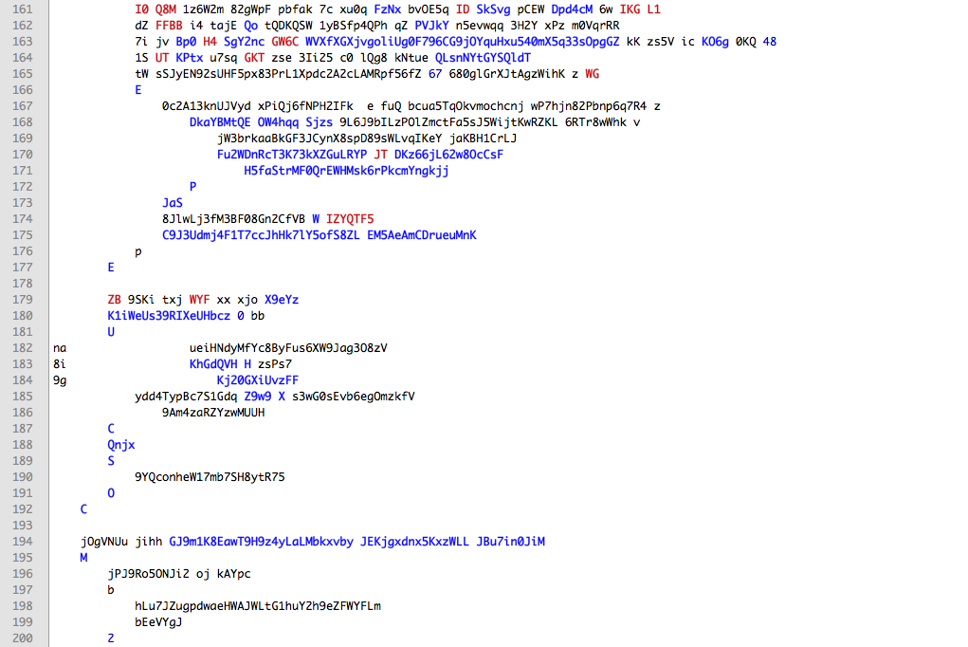

Slide 16
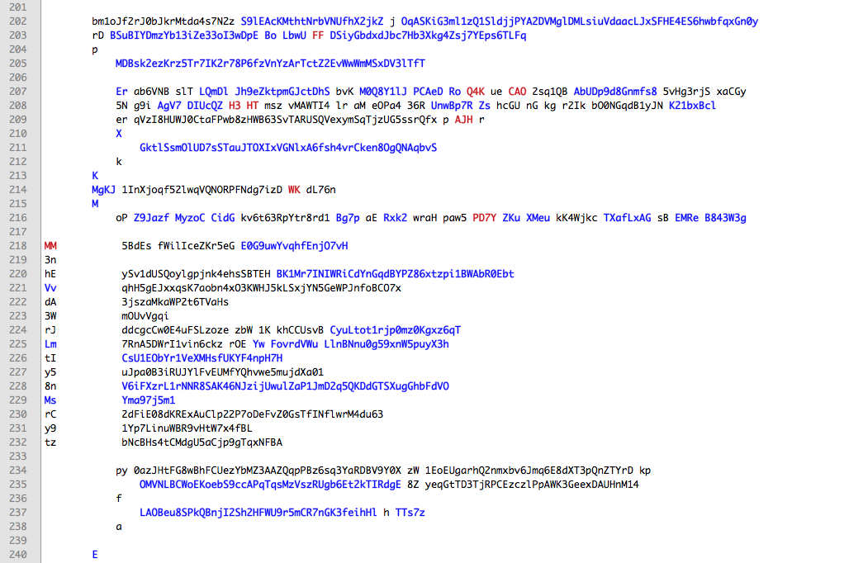

Slide 17
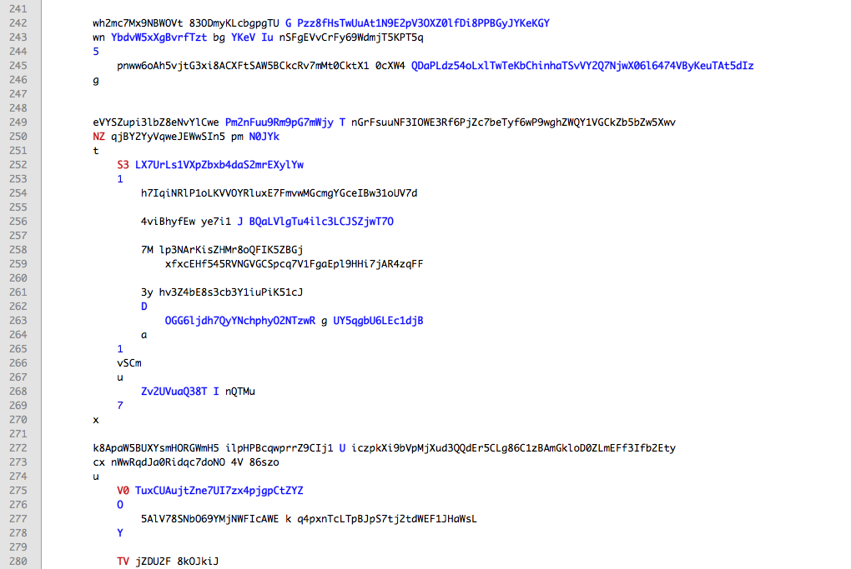

Slide 18
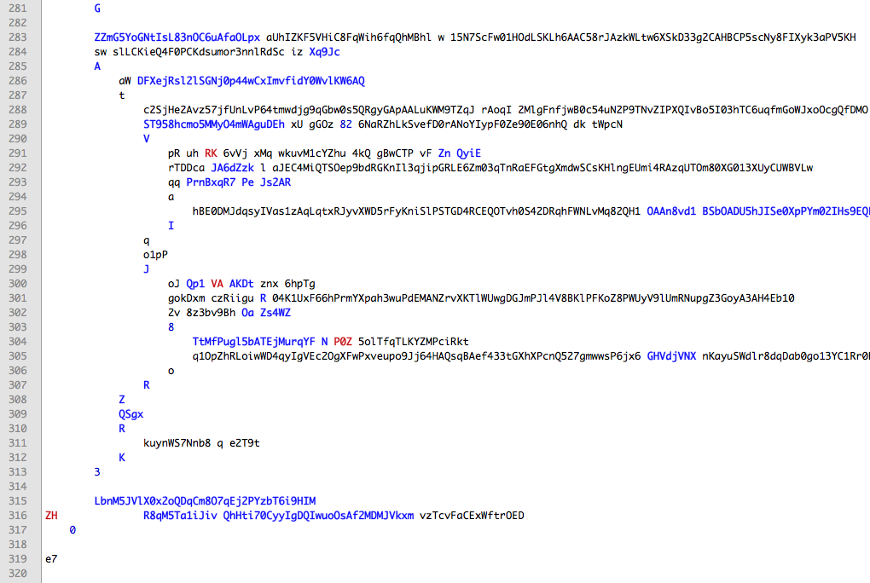

Slide 19
Sprint 1: Blocking IO code with sequential requests
Client
Server-1
Server-2
Server-3
t₁
t₂
(t₁+t₂+t₃)
t₃

Slide 20
Sprint 4: Parallelize independent requests
Client
Server-1
Server-2
Server-3
max(t₁,t₂,t₃)

Slide 21
Sprint "n": Fork/join dance
Client
Server-1
Server-2
Server-3
Server-4
max(max(t₁+
t₄),t_{2,}t₃)

Slide 22
Parallellizing Sequencing Joining Normalizing
I/O
Writing such code once or twice is fun – writing tens of times is not.

Slide 23
Bad for far-away clients
Native, mobile
Single page apps
Server-1
Server-2
Server-3
Server-4

Slide 25
Easy and fast HTTP consumption

Slide 26
The same in ql.io (randomized)
HFRwni G NIxGNs TSMeb7 A9On vtwZhQoJGnFQFqgkV9 3WFgC 93TbEBy6 Q ocpBxgpH3 Pu4ju fi
ZsKb W RkIs5b z UAsS QK3nyJ68IhTSB0aTufR98ymV evsX7
tUH 8i4fwR S Hut69mnCHAO
ufyx w CZLOtN 9 PvTU sPd2lMVDV42tRAfIoPM56H1hE tGz5s kmekNeyrai5SklC 5 TstTKDhFb
OLy 5KQ5oz A MiZzQJSCbEv
aLr068KLleE X q8cwPm 5 nZpH 3jpeWcIpkTTIjGsZovq7 fR4Hn dz3Lhl o MfdTDqpFVdh
aiPOsj2fO9 w fWD3mv p ORHX Bq4xIMvLGjMrgnC6JpBw1S5 HDwoI CwhI09 z 742rMEqx626
ZH0qwtN g boU4fU W QYKf F24BKGrFfg0sfhkc8U4aZfL4bn kUNmG vm6odt 6 YaC6b0Ff4gG
Ox4Jh0 6
aXtsEg G LUlJL3k2O
WeRAMe d 9GlF1XJM8
9oicQwaHnMp7n U Pjnojj5kdhD0sZzh
Pz3HHpnBy L OlVQMpHAILCH
RF3vwaFHarZR Q i2Ofa38U9ylvve
cE

Slide 27
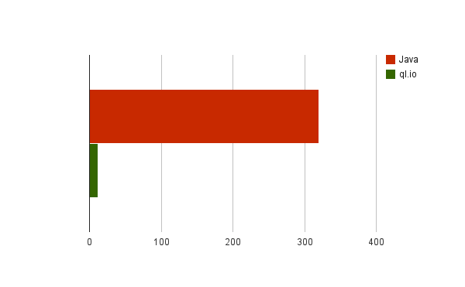
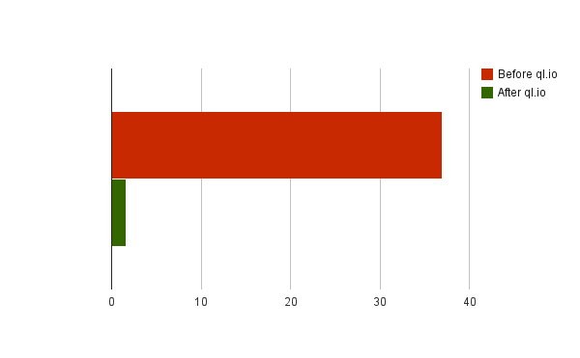
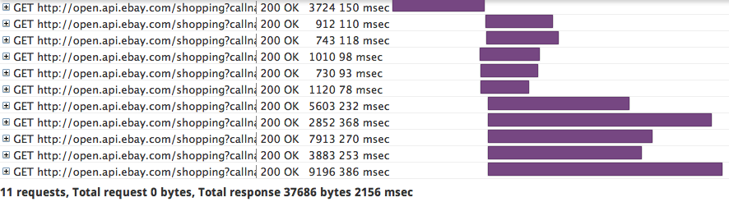
Lines of code for 5 API calls
Data size (k)
before
after

Slide 28
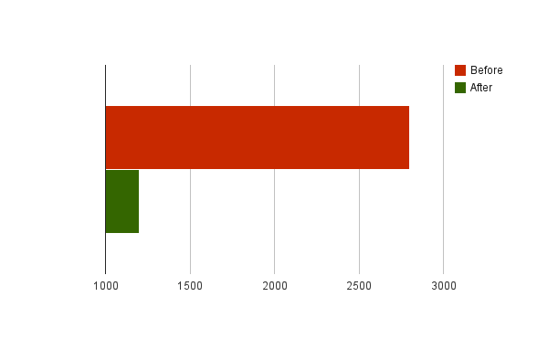
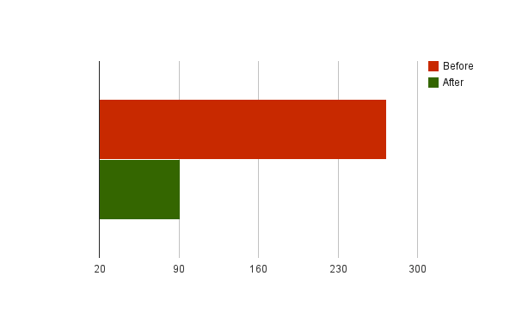
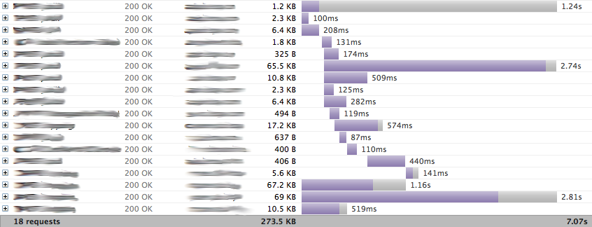
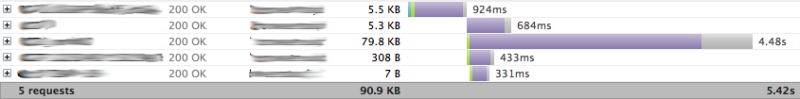
Lines of code for API calls
Data size (k)
before
after

Slide 29
What is ql.io

Slide 30
A DSL for HTTP An HTTP gateway Built on node.js

Slide 31
HTTP CRUD to SQLish CRUD
create table for each resource
select to read
insert into to add or create
update to update
delete to delete
# HTTP requests with one line of code
select long_url from bitly.shorten
where shortUrl = 'http://bit.ly/uZIvmY'
select Url from bing.soap.search
where q = "ql.io"

Slide 32
HTTP Resources as Tables
create table bitly.shorten
on insert get from 'http://api.bitly.com/v3/shorten?login={^login}&apiKey={^apikey}&longUrl={^longUrl}&format={format}'
using defaults apikey = "…", login = "…",
format = "json"
resultset 'data.url'
on select get from http://api.bitly.com/v3/expand?login={^login}&apiKey={^apikey}&shortUrl={^shortUrl}&format={format}
using defaults apikey = "…", login = "…",
format = "json"
resultset 'data.expand'

Slide 33
Any HTTP Method
// POST on a resource bound to SELECT
create table bing.soap.search
on select post to 'http://api.bing.net/soap.asmx'
using defaults appid = '…'
using bodyTemplate 'bing.soap.xml.mu'
type 'application/xml'
resultset 'soapenv:Envelope.soapenv:Body.SearchResponse.parameters.Web.Results.WebResult';

Slide 34
Body Templates
<soapenv:Envelope xmlns:soapenv="http://schemas.xmlsoap.org/soap/envelope/">
<soapenv:Header/>
<soapenv:Body>
<SearchRequest xmlns="http://schemas.microsoft.com/LiveSearch/2008/03/Search">
<parameters>
{{#params}}
<Query>{{q}}</Query>
<AppId>{{appid}}</AppId>
{{/params}}
<Sources>
<SourceType>Web</SourceType>
</Sources>
</parameters>
</SearchRequest>
</soapenv:Body>
</soapenv:Envelope>

Slide 35
No Async Mind-Bending
-- Sequential
minis = select * from finditems where
keywords = 'mini cooper' limit 10;
return select PictureURL from details where
itemId = "{minis.itemId}";
-- Or parallel
keyword = "ql.io";
web = select * from bing.search where q = "{keyword}";
tweets = select id as id, from_user_name as user_name,
text as text from twitter.search where q = "ql.io";
return {
"keyword": "{keyword}",
"web": "{web}",
"tweets": "{tweets}"
}

Slide 36
Implicit Fork-Join
prodid = select ProductID[0].Value from eBay.FindProducts
where QueryKeywords = 'macbook pro';
details = select * from eBay.ProductDetails where
ProductID in ('{prodid}') and
ProductType = 'Reference';
reviews = select * from eBay.ProductReviews where
ProductID in ('{prodid}') and
ProductType = 'Reference';
return select d.ProductID[0].Value as id,
d.Title as title, d.ReviewCount as reviewCount,
r.ReviewDetails.AverageRating as rating
from details as d, reviews as r
where d.ProductID[0].Value = r.ProductID.Value

Slide 37
How to Use

Slide 38
As a Gateway
ql.io as an HTTP
Gateway
Client apps
S-1
S-2
S-3
S-4
Optional streaming
through WebSockets

Slide 39
Routing
prodid = select ProductID[0].Value from eBay.FindProducts
where QueryKeywords = 'macbook pro';
details = select * from eBay.ProductDetails where
ProductID in ('{prodid}') and
ProductType = 'Reference';
reviews = select * from eBay.ProductReviews where
ProductID in ('{prodid}') and
ProductType = 'Reference';
return select d.ProductID[0].Value as id,
d.Title as title, d.ReviewCount as reviewCount,
r.ReviewDetails.AverageRating as rating
from details as d, reviews as r
where d.ProductID[0].Value = r.ProductID.Value
via route '/myapi' using method get;

Slide 40
-- Show daily deals - use siteId=0 for US
-- and siteId=3 for UK.
dailyDealsResponse = select * from dailydeals
where siteId="{siteId}";
dailyDeals = "{dailyDealsResponse.$..Item}";
itemDetails = select ItemID as itemId,
Title as title,
GalleryURL as pic,
Seller.UserID as sellerUserId,
Seller.FeedbackScore as feedback,
HitCount as pageViews
from details where itemId in (dailyDeals.ItemID);
return itemDetails
via route '/deals/{siteId}' using method get;

Slide 41
Node.js Module
/> npm install ql.io-engine
var Engine = require('ql.io-engine'), fs = require('fs');
var engine = new Engine({tables : __dirname + '/tables'});
var script = fs.readFileSync(__dirname + '/myapi.ql', 'UTF-8');
engine.execute(script, function(emitter) {
emitter.on('prodid', function(data) {
console.log('found ' + data.length + ' product IDs');
});
emitter.on('details', function(data) {
console.log('found ' + data.length + ' details');
});
emitter.on('reviews', function(data) {
console.log('found ' + data.length + ' reviews');
});
emitter.on('end', function(err, result) {
console.log(result.body);
});
});

Slide 42
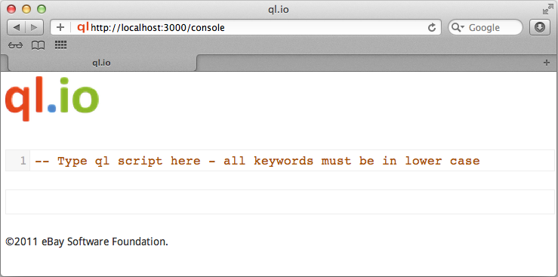
mkdir myapp
cd myapp
curl -L "http://tinyurl.com/7cgglby"| bash
bin/start.sh

Slide 43
We're Hiring
DM @sallamar

Slide 44
http://ql.io

