Slide 1


Consuming HTTP at Scale
Node Summit, Jan 24, 2012

Slide 2
Hello, I'm
Subbu Allamaraju
@sallamar
http://www.subbu.org

Slide 3

Brought to you by
eBay's platform engineering
https://github.com/ql-io/ql.io
Open source (Apache 2)

Slide 4
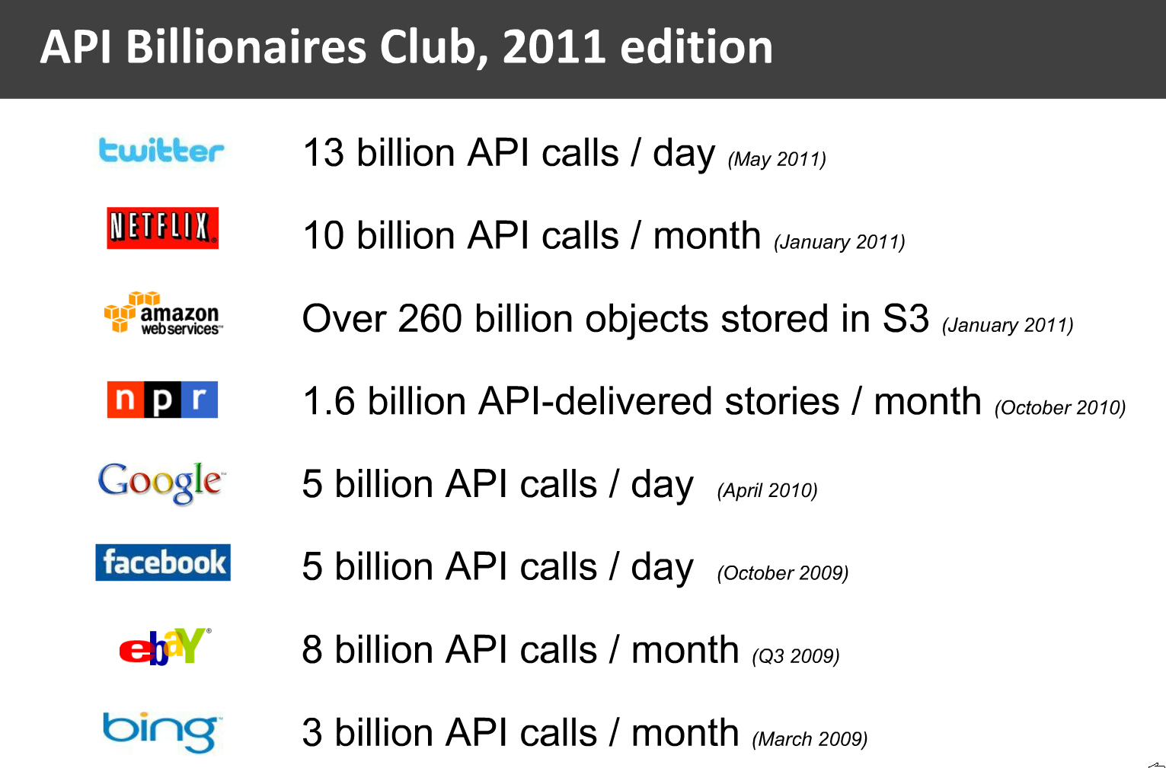
[http://blog.programmableweb.com/2011/05/25/api-business-models-then-and-now/]

Slide 5
A DSL for HTTP An HTTP gateway Built on node.js

Slide 6
Make HTTP APIs easy and fast to consume

Slide 7
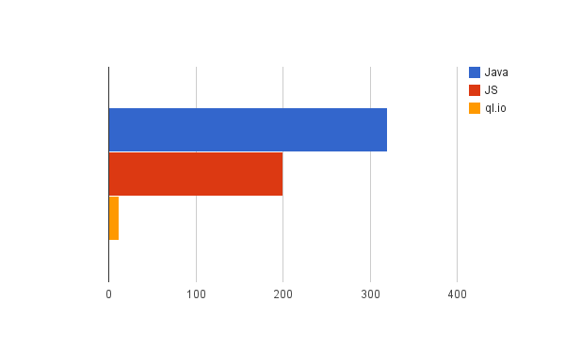
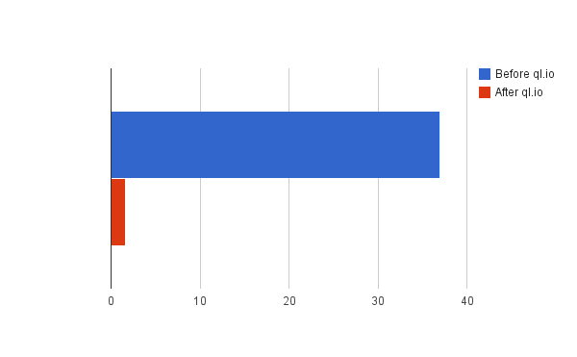
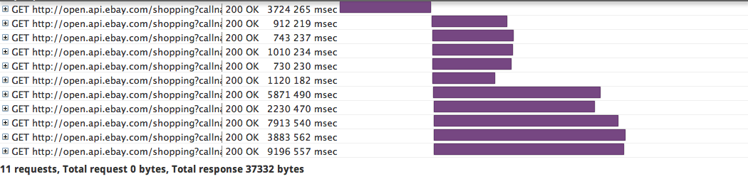
Lines of code for API calls
Data size (k)
before
after

Slide 8
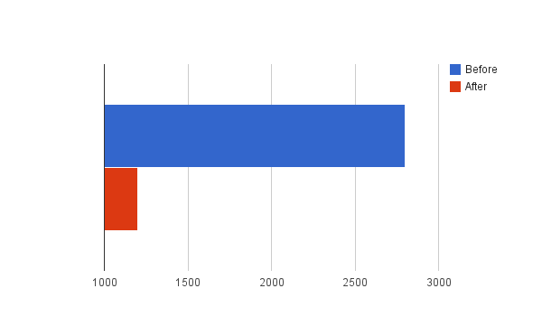
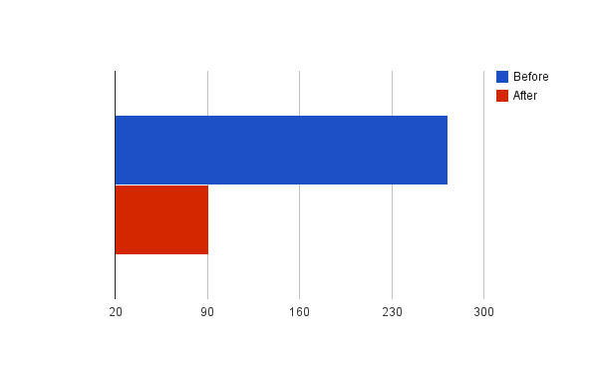
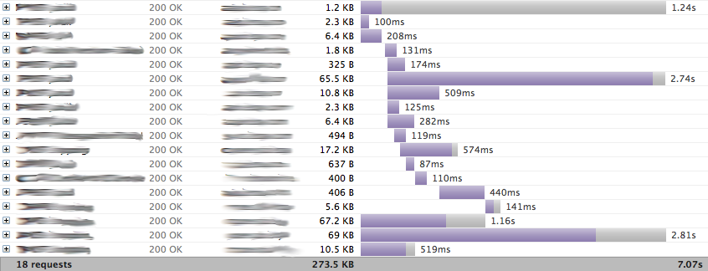
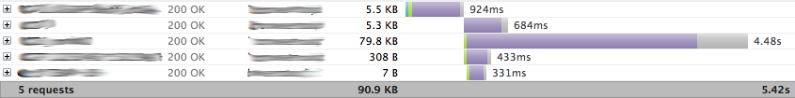
Lines of code for API calls
Data size (k)
before
after

Slide 9
How Come?

Slide 10
// HTTP and network coding is already easy
//
var http = require('http');
var client = http.request({
method : 'GET',
host : 'my host',
path : 'my path'}, function(res) {
res.on('data', function(chunk) { ... };
res.on('end', function() { ... });
});
client.end();

Slide 11
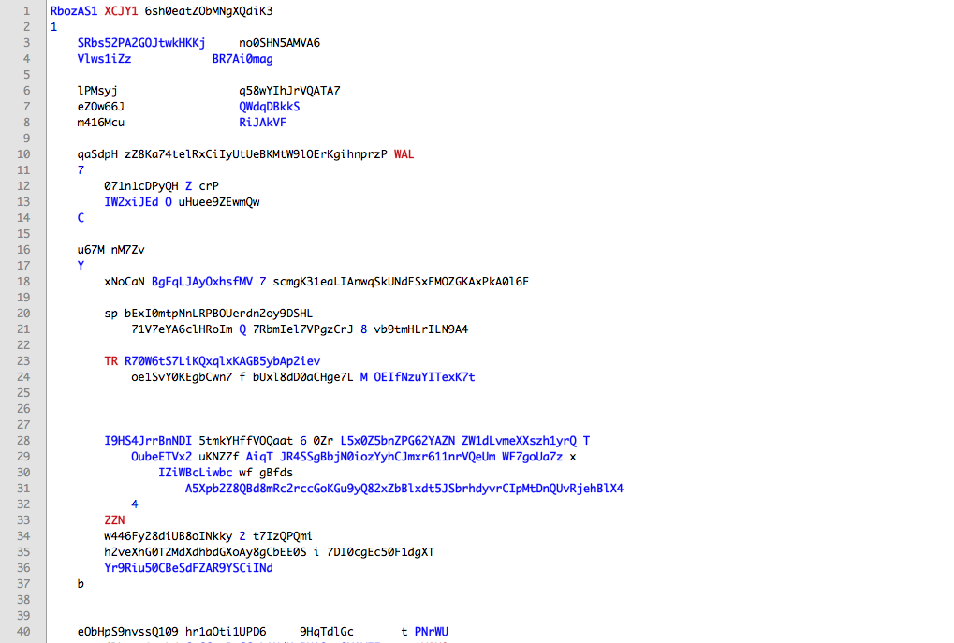
Real code (randomized)

Slide 12
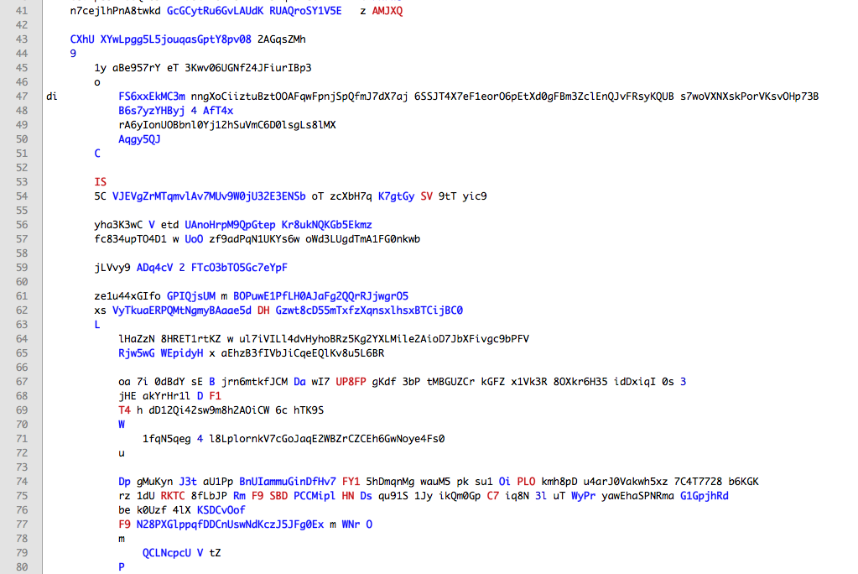

Slide 13
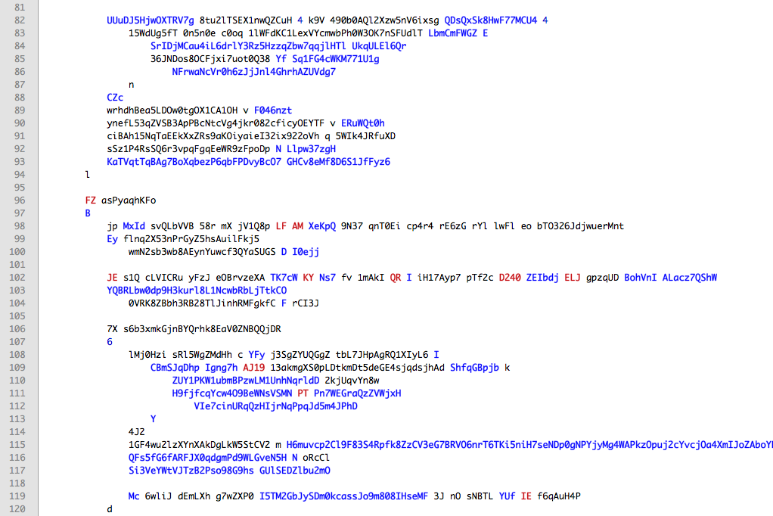

Slide 14
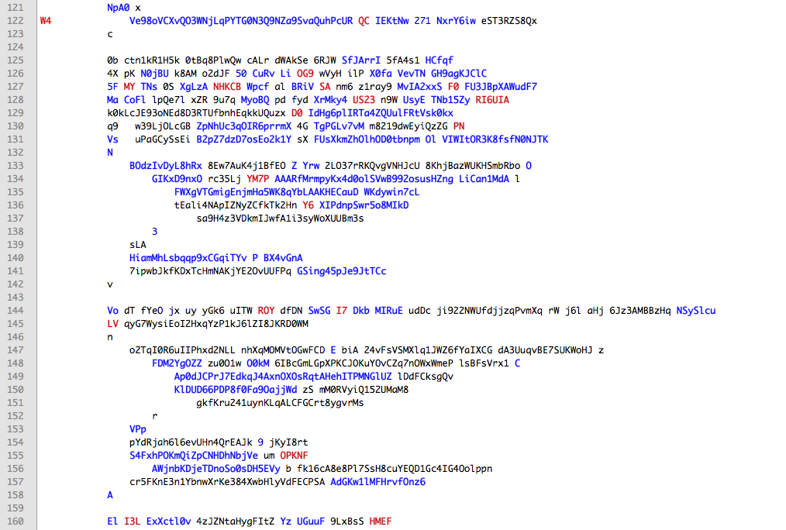

Slide 15
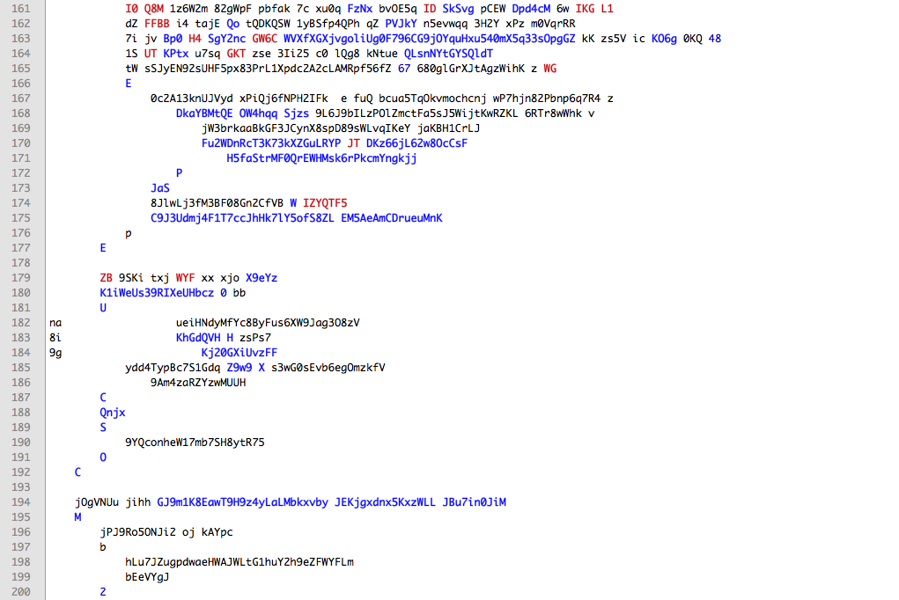

Slide 16
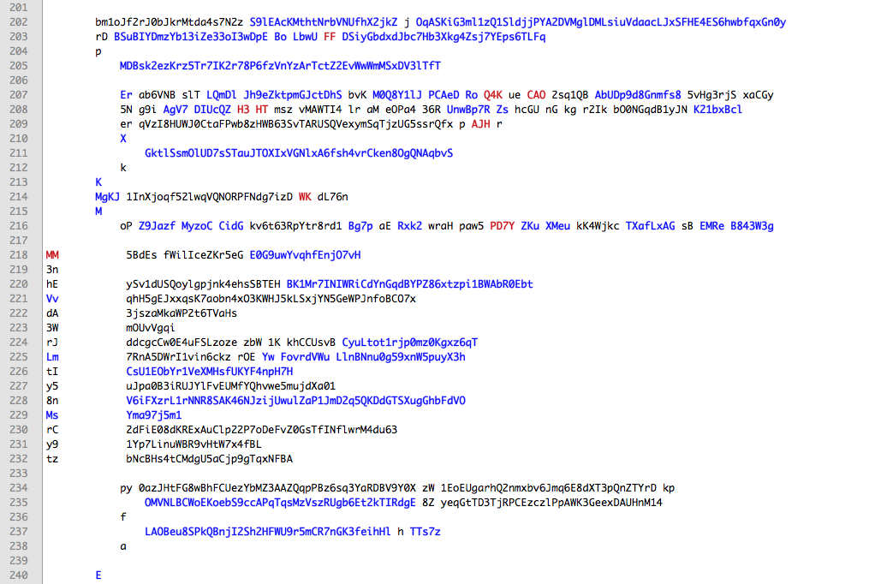

Slide 17
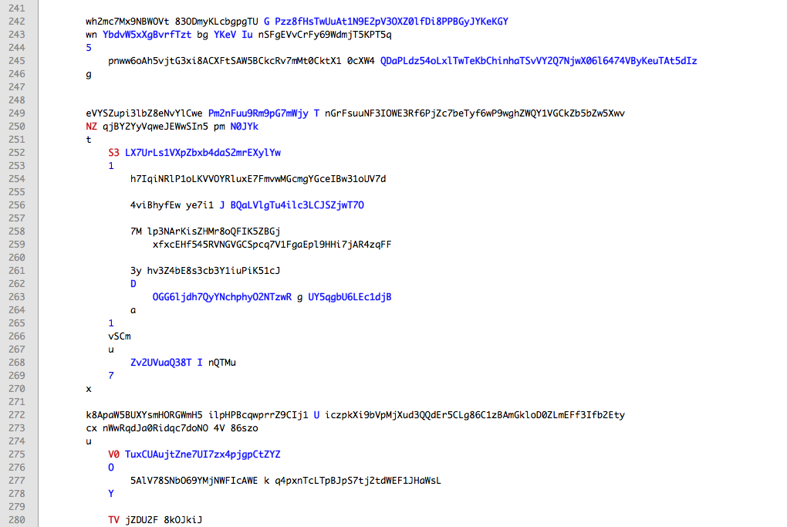

Slide 18
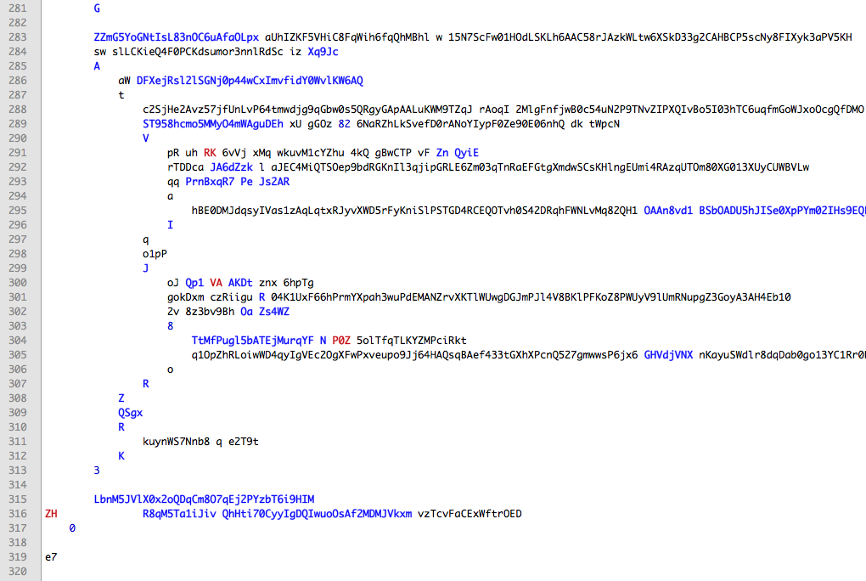

Slide 19
The same in ql.io (randomized)
HFRwni G NIxGNs TSMeb7 A9On vtwZhQoJGnFQFqgkV9 3WFgC 93TbEBy6 Q ocpBxgpH3 Pu4ju fi
ZsKb W RkIs5b z UAsS QK3nyJ68IhTSB0aTufR98ymV evsX7
tUH 8i4fwR S Hut69mnCHAO
ufyx w CZLOtN 9 PvTU sPd2lMVDV42tRAfIoPM56H1hE tGz5s kmekNeyrai5SklC 5 TstTKDhFb
OLy 5KQ5oz A MiZzQJSCbEv
aLr068KLleE X q8cwPm 5 nZpH 3jpeWcIpkTTIjGsZovq7 fR4Hn dz3Lhl o MfdTDqpFVdh
aiPOsj2fO9 w fWD3mv p ORHX Bq4xIMvLGjMrgnC6JpBw1S5 HDwoI CwhI09 z 742rMEqx626
ZH0qwtN g boU4fU W QYKf F24BKGrFfg0sfhkc8U4aZfL4bn kUNmG vm6odt 6 YaC6b0Ff4gG
Ox4Jh0 6
aXtsEg G LUlJL3k2O
WeRAMe d 9GlF1XJM8
9oicQwaHnMp7n U Pjnojj5kdhD0sZzh
Pz3HHpnBy L OlVQMpHAILCH
RF3vwaFHarZR Q i2Ofa38U9ylvve
cE

Slide 20
5+
Mobile and front-end
requests per UI paint
[Jan 2011 ad hoc testing on an iPhone] Bing – 4, Google - 13, Mint – 26, Netflix – 13, Amazon – 2, LinkedIn 5, Facebook - 9

Slide 21
Fork/join dance
Client
Server-1
Server-2
Server-3
Server-4
max(max(t₁+
t₄),t_{2,}t₃)

Slide 22
Parallellizing Sequencing Joining Normalizing
I/O
Writing such code once or twice is fun – writing tens of times is not.

Slide 23
Bad for far-away clients
Native, mobile
Single page apps
Server-1
Server-2
Server-3
Server-4

Slide 24
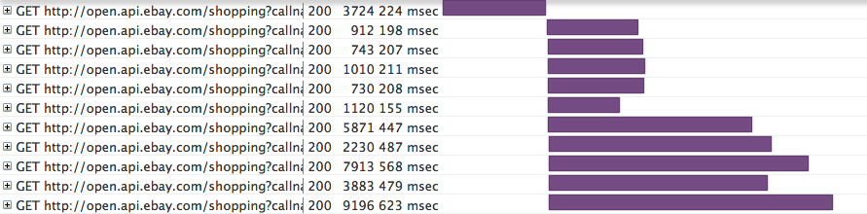
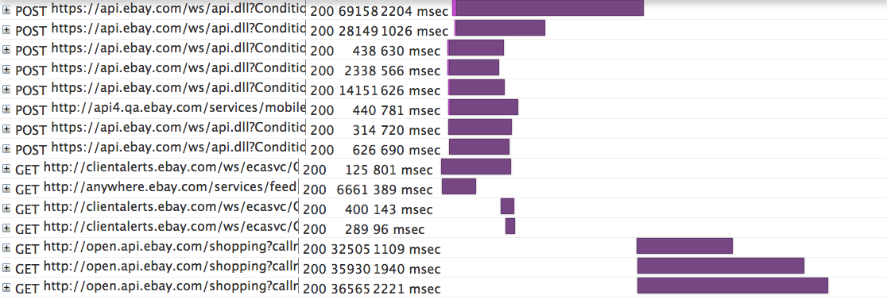
Many requests and connections, high bandwidth use, high latency, low reliability

Slide 25
Easy Button

Slide 26
HTTP CRUD to SQLish CRUD
create table for each resource
select to read
insert into to add or create
update to update
delete to delete
# HTTP requests with one line of code
select long_url from bitly.shorten
where shortUrl = 'http://bit.ly/uZIvmY'
select Url from bing.soap.search
where q = "ql.io"

Slide 27
Designed for the lazy
// GET on a resource bound to SELECT
create table bing.search
on select get from 'http://api.bing.net/xml.aspx?Appid={appid}&query={q}&sources=web'
using defaults appid = '{config.bing.appid}'
resultset 'SearchResponse.web:Web.web:Results.web:WebResult';
// POST on a resource bound to SELECT
create table bing.soap.search
on select post to 'http://api.bing.net/soap.asmx'
using defaults appid = '{config.bing.appid}'
using bodyTemplate 'bing.soap.xml.mu'
type 'application/xml'
resultset 'soapenv:Envelope.soapenv:Body.SearchResponse.parameters.Web.Results.WebResult';

Slide 28
No Async Mind-Bending
# Sequential
minis = select * from finditems where
keywords = 'mini cooper' limit 10;
return select PictureURL from details where
itemId = "{minis.itemId}";
# Or parallel
keyword = "ql.io";
web = select * from bing.search where q = "{keyword}";
tweets = select id as id, from_user_name as user_name,
text as text from twitter.search where q = "ql.io";
return {
"keyword": "{keyword}",
"web": "{web}",
"tweets": "{tweets}"
}

Slide 29
Implicit Fork-Join and Routing
prodid = select ProductID[0].Value from eBay.FindProducts
where QueryKeywords = 'macbook pro';
details = select * from eBay.ProductDetails where
ProductID in ('{prodid}') and
ProductType = 'Reference';
reviews = select * from eBay.ProductReviews where
ProductID in ('{prodid}') and
ProductType = 'Reference';
return select d.ProductID[0].Value as id,
d.Title as title, d.ReviewCount as reviewCount,
r.ReviewDetails.AverageRating as rating
from details as d, reviews as r
where d.ProductID[0].Value = r.ProductID.Value
via route '/myapi' using method get;

Slide 30
How to Use

Slide 31
As a Gateway
ql.io as an HTTP
Gateway
Client apps
S-1
S-2
S-3
S-4
Optional streaming
through WebSockets

Slide 32
Node.js Module
/> npm install ql.io-engine
var Engine = require('ql.io-engine'), fs = require('fs');
var engine = new Engine({tables : __dirname + '/../tables'});
var script = fs.readFileSync(__dirname + '/myapi.ql', 'UTF-8');
engine.execute(script, function(emitter) {
emitter.on('prodid', function(data) {
console.log('found ' + data.length + ' product IDs');
});
emitter.on('details', function(data) {
console.log('found ' + data.length + ' details');
});
emitter.on('reviews', function(data) {
console.log('found ' + data.length + ' reviews');
});
emitter.on('end', function(err, result) {
console.log('Got results');
});
});

Slide 33
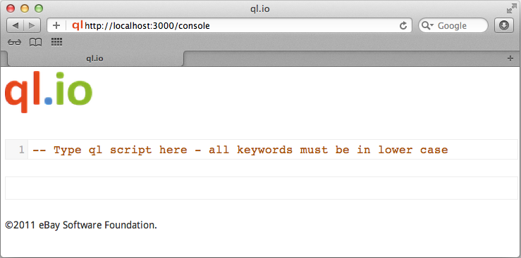
mkdir myapp
cd myapp
curl -L "http://tinyurl.com/7cgglby"| bash
bin/start.sh

Slide 34
http://ql.io

