Slide 1



@
Apr 05, 2012

Slide 2
Subbu Allamaraju
@sallamar
www.subbu.org
github.com/s3u

Slide 3
0. Data Web was broken

Slide 4
1. Fix the server

Slide 5
Get protocols right

Slide 6


Slide 7
2. Fix the client

Slide 8
?

Slide 9
1 … many

Slide 10
Consumers
Producers
> 1 req per user action

Slide 11
Interop

Slide 12
Many Dialects
Producers
Clients
How to make sense of multiple dialects at once

Slide 13
Data size

Slide 14
The best request is one that is never made.
The best payload size is one that can not be reduced further
Producers
Clients

Slide 15
Latency

Slide 16
Agility

Slide 17
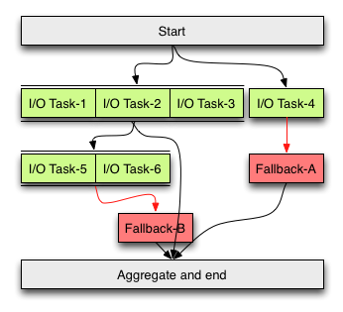
Parallelizing, sequencing, joining, normalizing
Consumers

Slide 18

REST
is not the answer

Slide 19
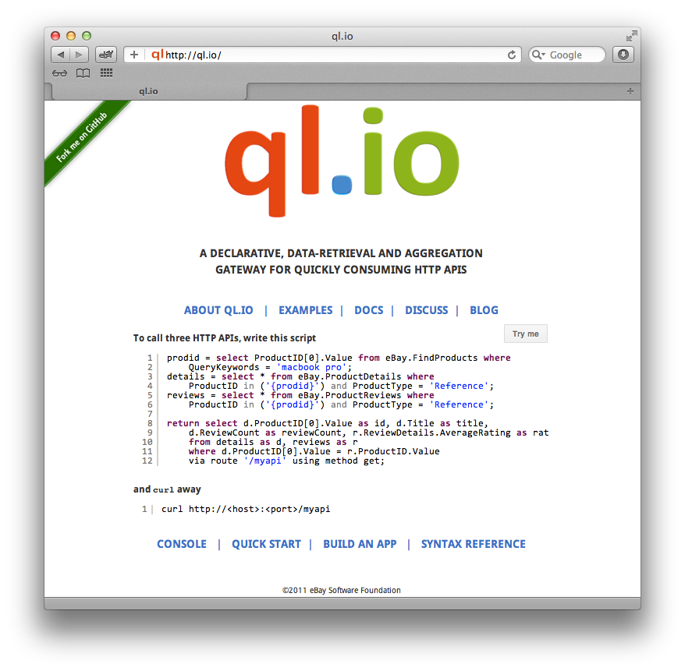

Slide 20
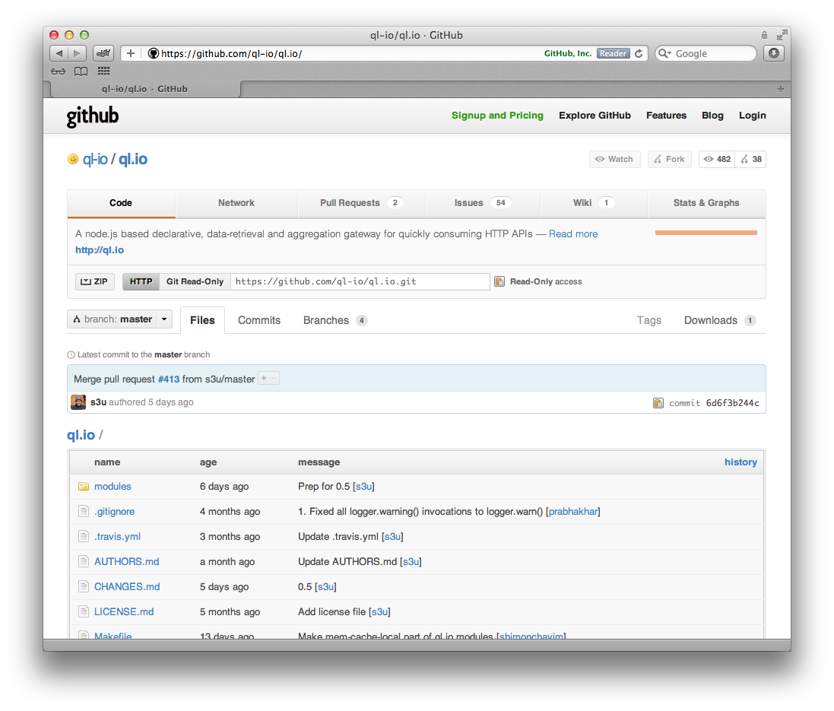


Slide 21
DSL for HTTP HTTP gateway Built on node.js

Slide 22
ql
CRUD
transformations
io
async IO
parallelization
automatic orchestration
HTTP, JSONP, WebSockets, …
Clients
Servers

Slide 23
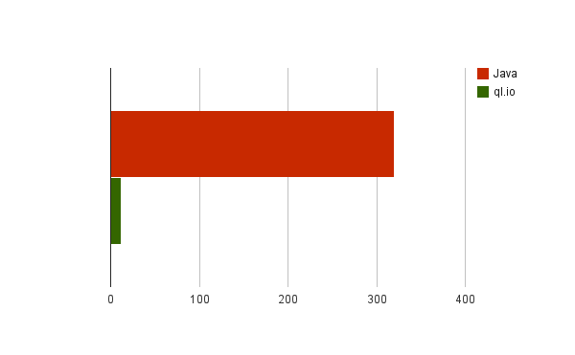
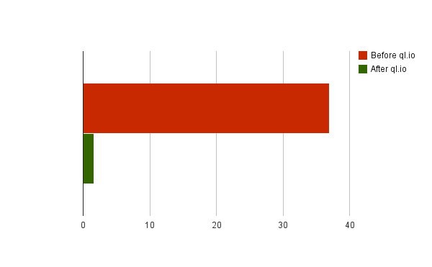
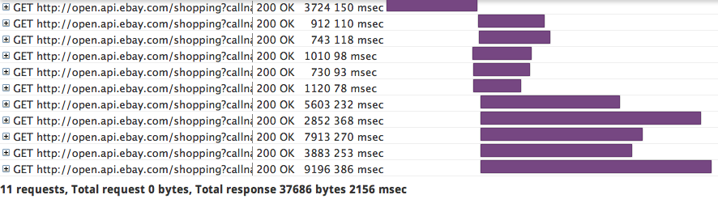
Lines of code for 5 API calls
Data size (k)
before
after

Slide 24
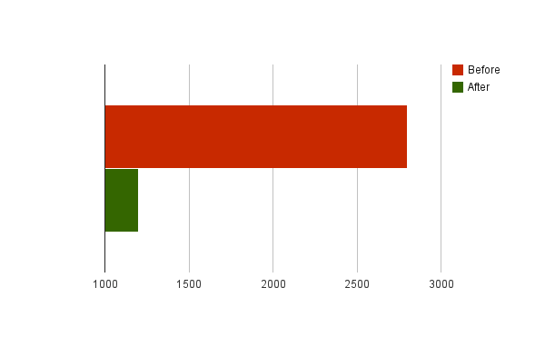
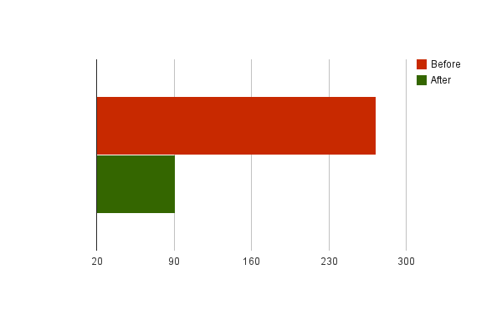
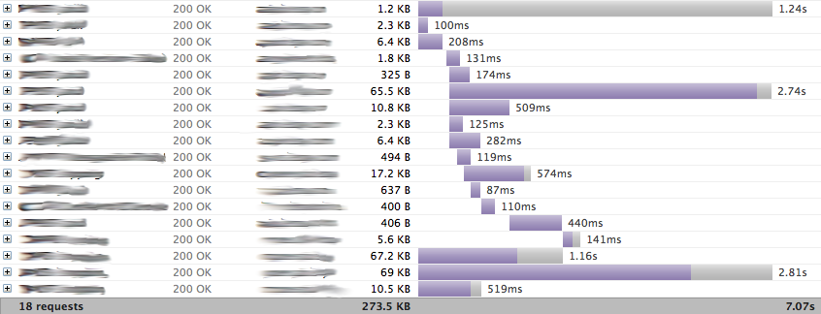
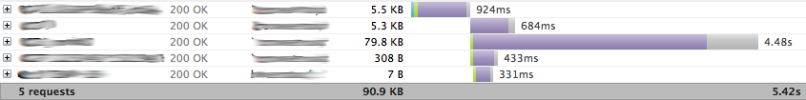
Lines of code for API calls
Data size (k)
before
after

Slide 25
1. How to make a request

Slide 26
create table {a name}
on {select|insert|update|delete}
{get from|post to|
put to|delete|patch}
{a URI template}
using headers {name}={value}*
using bodyTemplate={a file}
type={media type}

Slide 27

create table {a name}
on {select|insert|update|delete}
{get from|post to|
put to|delete | patch}
{URI template}
using headers {name}={value}*
using bodyTemplate={a file}
type={media type}
HTTP method
URI template
Headers
Body
Media type

Slide 28
2. What parts of response

Slide 29
create table {a name}
on {select|insert|update|delete}
{get from|post to|
put to|delete|patch}
{a URI template}
using headers {name}={value}*
using bodyTemplate {a file}
type={mediatype}
resultset {JSON path}

Slide 30
3. Write a script

Slide 31
SQL_{ish} and JSON statements
→

Slide 32
prodid = select ProductID[0].Value from eBay.FindProducts
where QueryKeywords = 'macbook pro';
details = select * from eBay.ProductDetails where
ProductID in ('{prodid}') and
ProductType = 'Reference';
reviews = select * from eBay.ProductReviews where
ProductID in ('{prodid}') and
ProductType = 'Reference';
return select d.ProductID[0].Value as id,
d.Title as title, d.ReviewCount as reviewCount,
r.ReviewDetails.AverageRating as rating
from details as d, reviews as r
where d.ProductID[0].Value = r.ProductID.Value'

Slide 33
4. npm install ql.io-engine

Slide 34
var Engine = require('ql.io-engine'), fs = require('fs');
var engine = new Engine({
tables : __dirname + '/tables',
config: __dirname + '/config/dev.json'
});
var script = fs.readFileSync(__dirname + '/myapi.ql', 'UTF-8');
engine.execute(script, function(emitter) {
emitter.on('prodid', function(data) {
console.log('found ' + data.length + ' product IDs');
});
emitter.on('details', function(data) {
console.log('found ' + data.length + ' details');
});
emitter.on('reviews', function(data) {
console.log('found ' + data.length + ' reviews');
});
emitter.on('end', function(err, result) {
console.log(result.body);
});
});

Slide 35
5. Routes

Slide 36
prodid = select ProductID[0].Value from eBay.FindProducts
where QueryKeywords = '{keyword}';
details = select * from eBay.ProductDetails where
ProductID in ('{prodid}') and
ProductType = 'Reference';
reviews = select * from eBay.ProductReviews where
ProductID in ('{prodid}') and
ProductType = 'Reference';
return select d.ProductID[0].Value as id,
d.Title as title, d.ReviewCount as reviewCount,
r.ReviewDetails.AverageRating as rating
from details as d, reviews as r
where d.ProductID[0].Value = r.ProductID.Value
via route '/myapi?q={keyword}' using method get;

Slide 37
mkdir myapp
cd myapp
curl -L "http://tinyurl.com/7cgglby"| bash
bin/start.sh
curl http://localhost:3000/myapi?q=iPad

Slide 38
Make peace

Slide 39
Coming Soon …

Slide 40
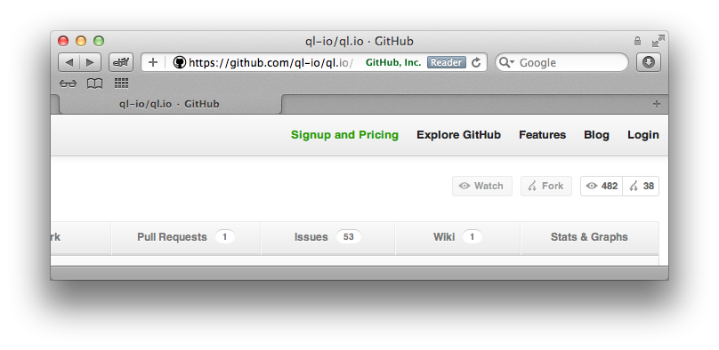
http://ql-io.github.com/

Slide 41
We're Hiring

