Slide 1
node.js and ql.io
Build Your Own HTTP APIs for Agility and Scale
OSCON July 20, 2012

Slide 2
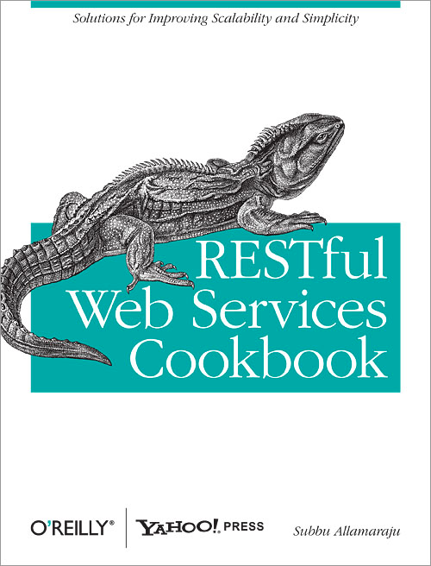

Subbu Allamaraju
@sallamar
github.com/s3u

Slide 3


Jon LeBlanc
@jcleblanc
github.com/jcleblanc

Slide 4
How to consume HTTP APIs cheaply and efficiently

Slide 5
curl -X <HTTP method> <URI>

Slide 6
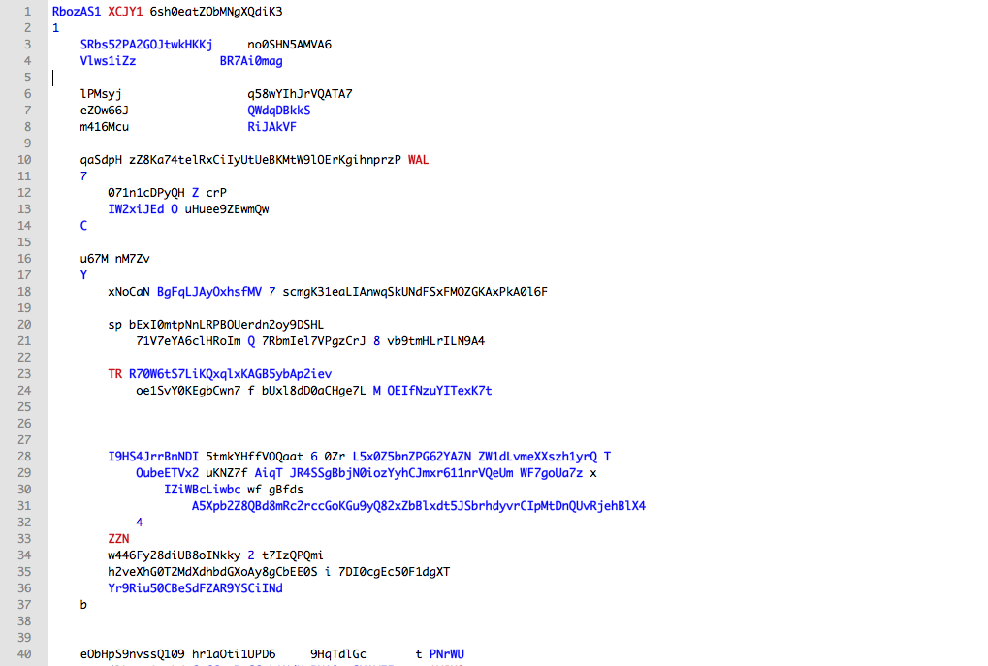
Real code (randomized)

Slide 7
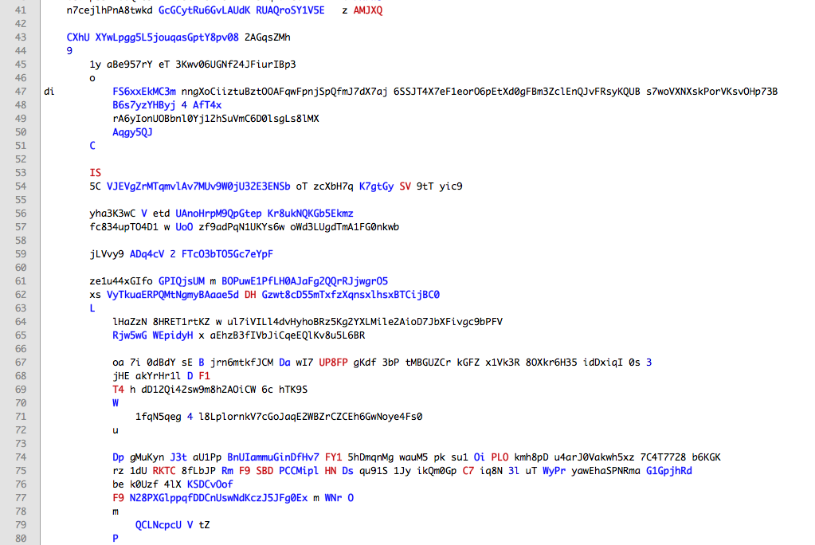

Slide 8
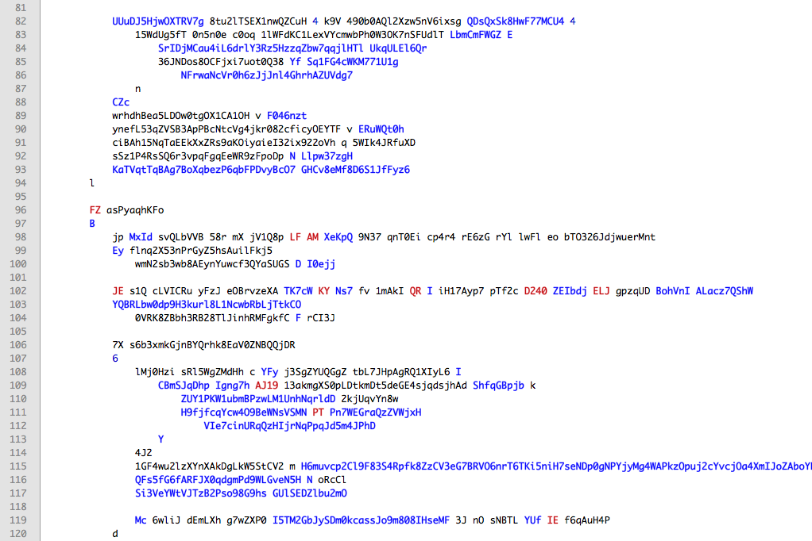

Slide 9
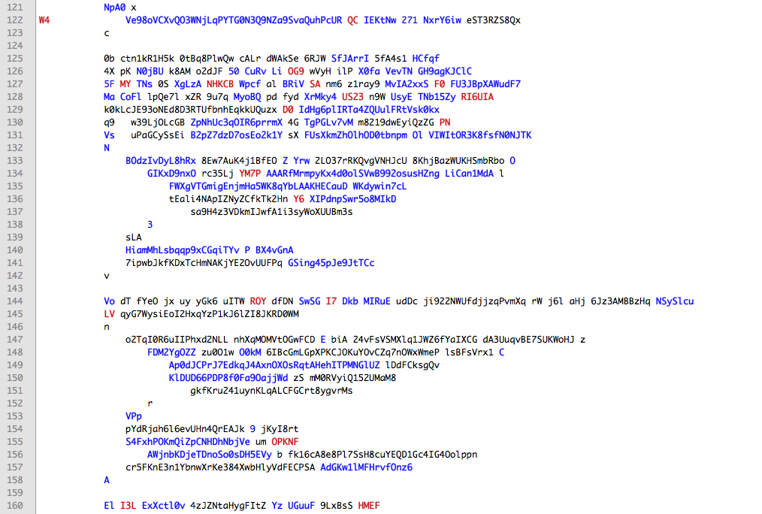

Slide 10
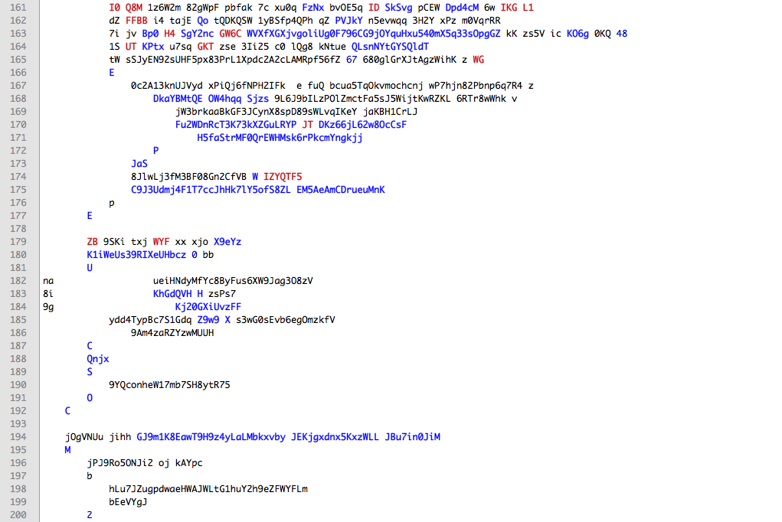

Slide 11
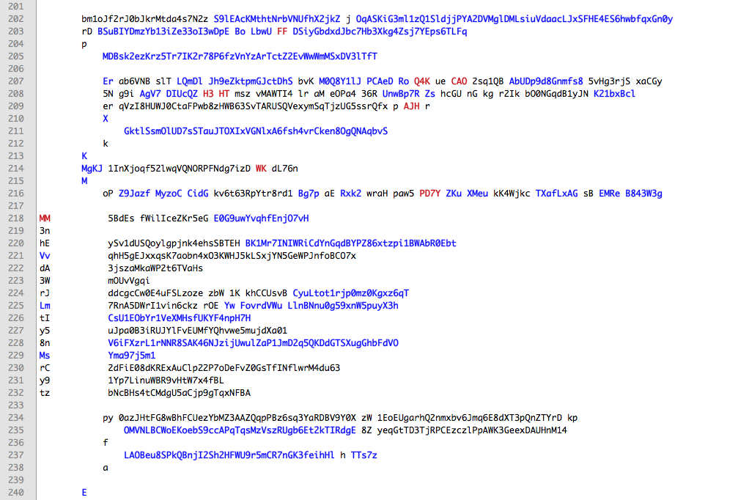

Slide 12
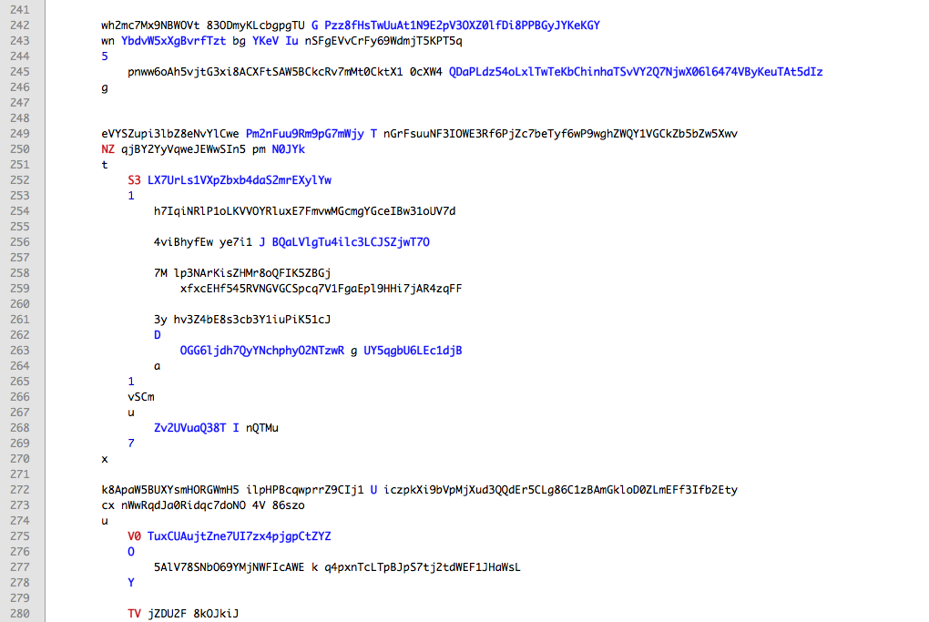

Slide 13
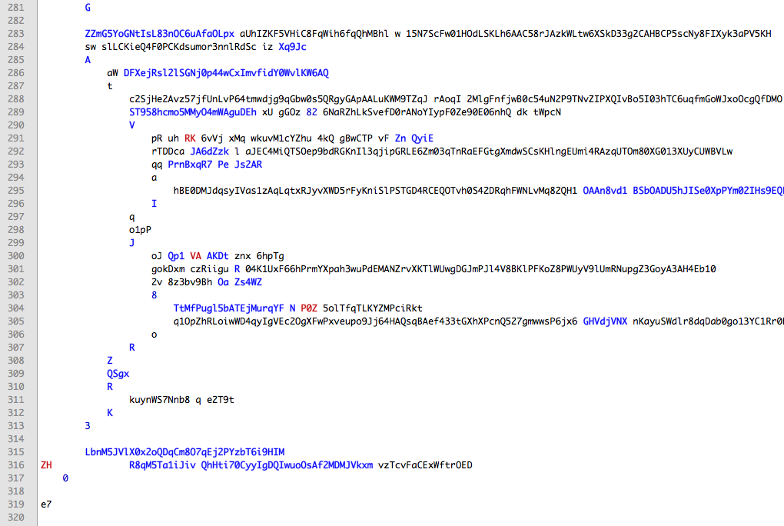

Slide 14
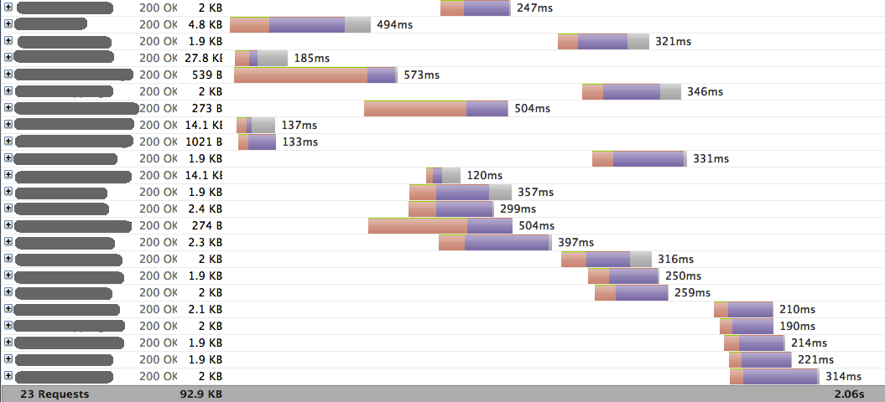

Slide 15
Use case:
Find things from A
For each thing, find details from B
For each thing, find more details from C
Merge results

Slide 16
Use case:
Find products
Find dominant categories of products
Look up category info
Merge categories with products

Slide 17
Use case:
Get stuff from A
If A is down, try from B
Annotate stuff with other stuff from C
Ignore some things from the stuff
Join all

Slide 18
[Really important client]
Why don't you give me an API optimized for my use cases?
Client
Producers
[Really important producer]
Thanks. Get a number and stand in the line!
Server

Slide 19
[Really important client]
Why don't you give me an API optimized for my use cases?
Client
Producers
Who gets to decide the right thing?
[Really important producer]
Thanks. Get a number and stand in the line!
Server

Slide 20
Build Your Own Optimized APIs

Slide 21

https://github.com/ql-io/ql.io
Platform Engineering

Slide 22
A domain specific language for HTTP client programming

Slide 23
cut down lines of code
reduce no of requests
save bandwidth

Slide 24
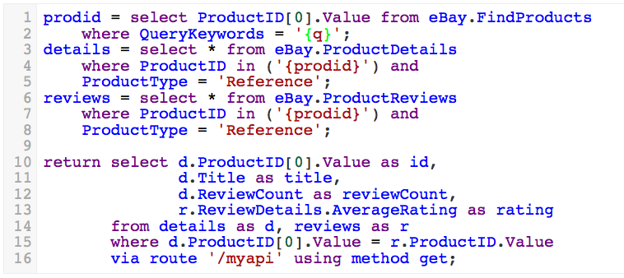

Slide 25
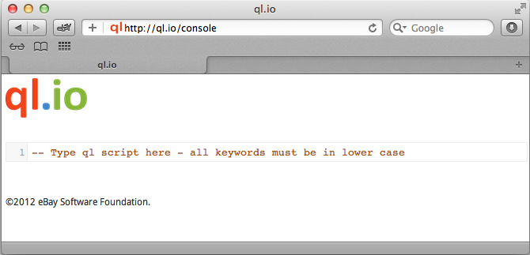
http://ql.io/console

Slide 26



ql.io Installation Modes
Web
Server
Node.js

Slide 27
curl http://<host>/q?s=query

Slide 28



As a Standalone Server
Data (internal)
ql.io
Node Host
Data (external)
Notes:
If you download the standalone server version of ql.io, it will sit on top of your existing node server (or within your node applications) and be able to query your internal data and/or external data sources

Slide 29
# As a node.js module
npm install ql.io-engine

Slide 30
// Use ql.io from node.js
var Engine = require('ql.io-engine');
var engine = new Engine({
//OPTIONS
});
var script = '…';
engine.execute(script, function(emitter){
emitter.on("end", function(err, res){
…
});
});

Slide 31


Language: Defining a Data Source
Include in Request
Include in .ql file
Notes:
A create table call (to define a data source) may be included in the HTTP request to the ql.io web source or defined in a .ql file, which is added into the /tables directory of your application.

Slide 32

Example: Mustache Templates
Notes:
First we need some mustache power

Slide 33

Example: jQuery for Cross Domain Reqs
Notes:
Route files are also stored with the .ql extension but are placed under the routes directory

Slide 34

Let’s Do It!
Notes:
create table slideshare on select get from "http://www.slideshare.net/rss/user/{user}" resultset "rss.channel";
create table github.users on select get from "http://github.com/api/v2/json/user/show/{user}";
user = "jcleblanc";
slides = select * from slideshare where user="{user}";
twitter = select * from github.users where user="{user}";
return {
"slides": "{slides}",
"twitter": "{twitter}"
}

Slide 35
Interop via HTTP
SQL inspired
Implicit orchestration
Failure modes
Consumer oriented

Slide 36
code
https://github.com/ql-io/ql.io
docs/demos
http://ql.io
https://github.com/jcleblanc/api-masher
blog
http://ql-io.github.com

