Slide 1
Birds of a Feather: High performance geometric multigrid (HPGMG) proposal for a new Top500 benchmark
Mark Adams (LBNL)
Jed Brown (ANL,CU)
John Shalf (LBNL)
Brian Van Straalen (LBNL)
Erich Strohmaier (LBNL)
Sam Williams (LBNL)
Notes:
Welcome to the birds of a feather for high performance geometric multigrid – HPGMG – a propose new metric for the Top500 list.
I am Mark Adams from Lawrence Berkeley National Laboratory.
Myself and the HPGMG team, Jed Brown from Argonne National Laboratory and CU Boulder, Sam Williams from LBNL, are here to present our work in the past year on proposed new metrics to complement the existing Top500 metrics HPL, and to soliciting feedback from the community.

Slide 2
HPGMG Birds of a Feather Outline
HPGMG design (MA)
HPGMG-FV, Sam Williams
HPGMG-FE, Jed Brown
Users
Mitsuhisa Sato, Tsukuba/RIKEN
Muthu M Baskaran, Reservoir Labs
Panel discussion
Short survey: hpgmg.org/survey
Notes:
I will begin by describing the HPGMG benchmark and its design principles, Sam and Jed will then talk about their work with HPGMG metrics, a finite volume and a finite element metric respectively, followed by two talks from users of HPGMG. We conclude with a panel discussion, where we open up the BoF to questions from the audience and welcome your input.
And please feel free at some point to fill out the short survey from our web site hpgmg.org/survey.

Slide 3
Motivation for New Top500 Metric
HPL not relevant for contemporary extreme scale applications
Extreme scale application today optimal, O(1) work/word, algos
HPL polynomial complexity – poor match to HPC application pool
True 20 years ago
Getting worse as machines scale up
HPL is a valuable benchmark – FPU – necessary but not sufficient
HPL has been effective Top5000 benchmark
served community well
Addition of new metric – HPCG – Top500 list, demonstrates
Recognition HPL deficient & willingness to address it
Publication of HPCG motivated two (diverse) groups to do better
Both came up with same design ... we merged a year ago

Slide 4
Proposed New Top500 Metric
High Performance Geometric MultiGrid – HPGMG
Full geometric multigrid - optimal, O(N), small constants
Fast Matrix free kernels, ~10-20% theoretical peak
Global algorithm with fast kernels: Stresses network
Want to address deficiencies of HPL & HPCG as detailed in recent paper:
“Performance modeling of the HPCG benchmark”
Vladimir Marjanović, José Gracia, and Colin W. Glass

Slide 5
HPGMG Benchmark definition
High Performance (Full) Geometric MultiGrid
Solve of discretized Laplacian logically regular grid
Non-iterative, asymptotically exact O(N) work complexity
Built-in verification – oblivious to floating point
Metric: Q = number of equations solved per second
Perhaps functional of Q for dynamic range (pressure network)
“We suggest … running a suite of short simulations with varying, predefined system sizes and reporting the (weighted) average performance.” – Marjanović, et al.
Map equations to flops (eg, HPL’s 2N³ flops/eq): flops/sec
Unlike HPL, HPGMG can fill whole machine and run in few sec
More convenient & economical to run
Notes:
(nearly) Optimal solver algorithm for the Laplacian on Cartesian grid
Need to legislate: like “no Strassen” rule: no high order interpolation
No FFT’s, etc. – great to open up but that is another benchmark
Weak/strong speedup, dynamic range, etc.

Slide 6
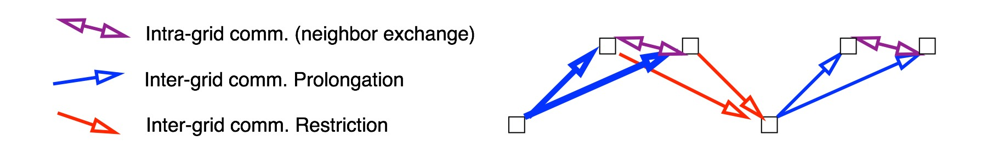
Parallel full multigrid – 2 processes
The classic multigrid V-cycle
Start at coarsest grid, accurate solve
usually “local” – little parallelism available
Refine grid, split, prolongate, MG V-cycle
Fully populate processes
exponentially increasing parallelism
Three types of communication:
Inter-grid Restriction & Prolongation
Standard intra-grid nearest neighbor halo exchange

Slide 7
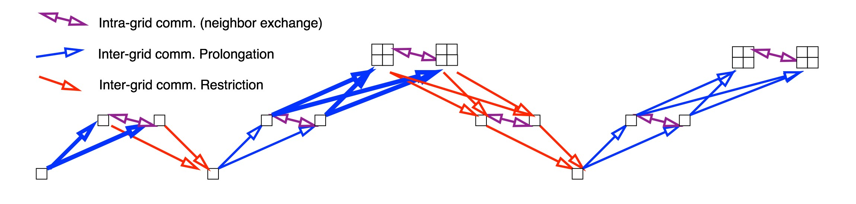
Parallel full multigrid – 2 processes
The classic multigrid V-cycle
Continue to fully populate – continue local refinement
Building a “fuzzy” tree
O(N) work/data algorithm – time & energy efficient
O(log²(N)) computational depth, PRAM complexity …

Slide 8
HPGMG design principles
Stick to HPL formula: Conceptually simple: solve A x = b
Scale free & architecture free specification
Easy to administer with small staff for 500+ applications
Minimal legislation – low order prolongation for example
Like HPL’s no Strassen, etc., rule
Easy build, few dependencies: C + MPI + language/libraries in kernel
Proxy application interest to HPC
Balanced stress of machine
Memory system, network, floating point …
(fuzzy) tree communication – common HPC paradigm
MG hierarchy representative data pattern of apps/algorithms
Notes:
Users optimize: compilers, one primary kernel, secondary kernels, … communication, …
as far down as new programming models (Muthu)

Slide 9
Our Top500 list design requirements
Durable metric: Remain relevant indefinitely
Optimal algorithm, architecture and scale free spec (pure math)
Increasingly effective proxy as more apps use efficient algorithms
Scale Free specification: Independent of scale & parallel strategy
Avoid adjudicating sub domain, process, and having cmplx spec.
Architecture Free specification:
No: cache, main/shared memory, processor, FPU, etc., in spec.
Stresses interconnect – global tree w/ non-trivial app code in nodes
Extensive metric (Strohmaier): not just sum of node performance
Notes:
Balanced exercise of machine:
Memory system, memory bandwidth, floating point, network, …
10-20% peak FP, more balanced: HPL @ ~90%; HPCG @ ~1%
Stresses network – extensive benchmark

Slide 10
HPGMG-FE & HPGMG-FV
HPGMG-FV & HPGMG-FV excellent parallel multigrid impls & w/ great kernels
Sam and Jed are awesome.
Both stress memory bandwidth, network, local caches, and vectorization
HPGMG-FV (Sam Williams):
Long vector length, lower arithmetic intensity
~9.6% peak flop rate on SuperMUC
~60% parallel efficiency on SuperMUC (filling ~2% of memory)
MPI+OpenMP optimized, runs well on x86, MIC, SPARC VIIIfx (K) & BGQ
Bottleneck: memory bandwidth & network
HPGMG-FE (Jed Brown):
Short vector length, higher arithmetic intensity
~15% peak flop rate on SuperMUC
~78% parallel efficiency on SuperMUC (filling ~2% of memory)
More flops, higher flop rates, better scaling: because more kernel time
Bottleneck: local caches & vectorization
Add dynamic scale to metric to stress network more effectively
Notes:
Agreed, though HPGMG-FE is not bottlenecked on memory bandwidth on any
architectures I know. It uses a sizable fraction of bandwidth, but
local caches and vectorization are the leading performance factor.

Slide 11
HPGMG-FV Performance
Sam Williams (LBNL)
SWWilliams@lbl.gov

Slide 12
HPGMG-FV
Finite Volume Method
variable coefficient stencils
homogeneous Dirichlet boundary condition via linear interpolation
moderate arithmetic intensity ~ 0.25-1.0 flops/byte depending on optimizations
Optimized MPI+OpenMP implementation of HPGMG-FV
delivers nearly equal performance per core compared to flat MPI
Faster coarse-grid solves on multi-/manycore processors
Mitigates some non-scalable MPI routines
User defined domain decomposition with multiple subdomains (boxes) per process
improves load balancing
improves scalability

Slide 13
HPGMG-FV
In this talk, we will examine weak scaling HPGMG-FV performance on various systems
Fix the problem size to 2M DOF/NUMA node* ( = 128³)
This provides apples-to-apples comparisons as at a given scale, all machines will solve the same problem in the same way
Allows us to quantify HPGMG performance as function of…
Processor performance
DRAM bandwidth
Network topology (Torus, Tree, Dragonfly, etc…)
etc…
We plot time-to-solution as a function of concurrency
Flat curve is perfect scaling (better networks)
Lower curves show better performance (faster nodes)
*Note, the cost and power per NUMA node will vary by perhaps a factor of 2x

Slide 14
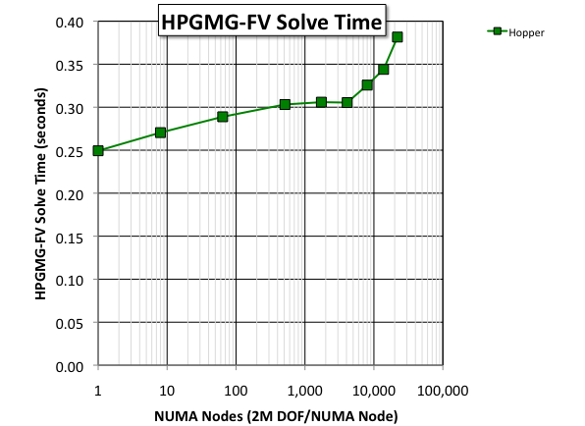
3D Torus (Gemini)
Consider Hopper (Cray XE6)
single process multigrid solve time is fast (250ms)
performance degrades at scale
larger problem sizes mitigate this lack of scalability
Scalability
of the Network
Performance
of the Processor

Slide 15
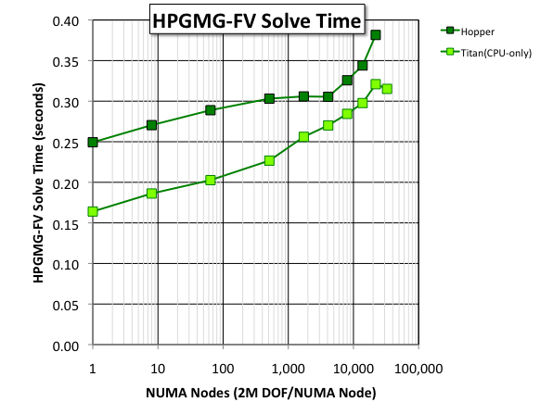
3D Torus (Gemini)
Consider Hopper (Cray XE6)
single process multigrid solve time is fast (250ms)
performance degrades at scale
larger problem sizes mitigate this lack of scalability
Titan (Cray XK7)
use only CPUs (same MPI+OpenMP)
delivered 50% better performance per socket and ~2x better overall performance
However, as Hopper and Titan both use Gemini, the network impeded performance at scale

Slide 16
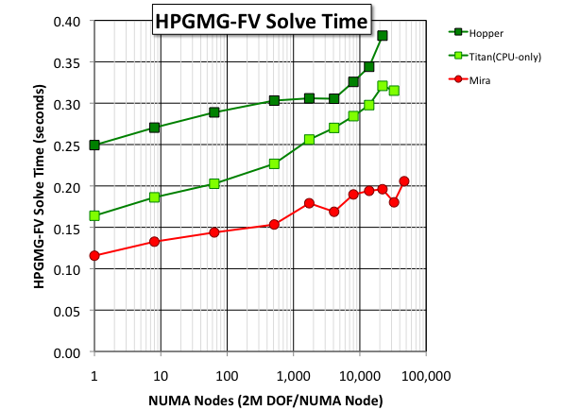
Blue Gene/Q
Mira (Blue Gene/Q)
custom processor enabled better performance per socket
custom network (5D torus) enabled better scalability

Slide 17
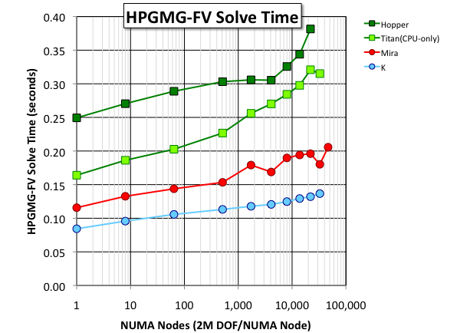
K (6D Torus/Mesh)
K (Sparc VIIIfx) at RIKEN
less flops per proc than BGQ
more bandwidth per proc than BGQ
= deliver better HPGMG-FV performance per node.
TOFU (6D) delivered similar (but smoother) scalability to BGQ

Slide 18
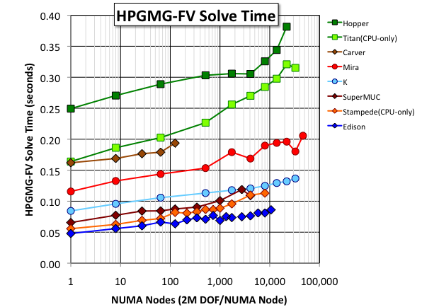
Fat Trees and Dragonfly
Xeon processors (IVB, SNB, NHM) are common on the Top500 today
Xeon performance defined by #cores, processor frequency, and memory frequency
Fat Trees saw degraded scaling beyond 1K sockets
XC30/Aries (Dragonfly), K (6D), and BGQ (5D) continued to scale well from 1K-48K sockets

Slide 19
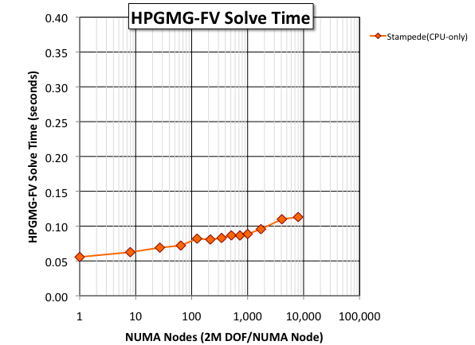
Accelerators?
Thus far, we have completely ignored accelerators like the Xeon Phi.
Consider Stampede…
Xeon (SNB)
Fat Tree
Scaled reasonably well for this mid-sized problem
Each Stampede node also has a MIC
How does HPGMG-FV on MIC (Xeon Phi) perform/scale?
using Stampede for CPU or MIC runs removes the network as a variable

Slide 20
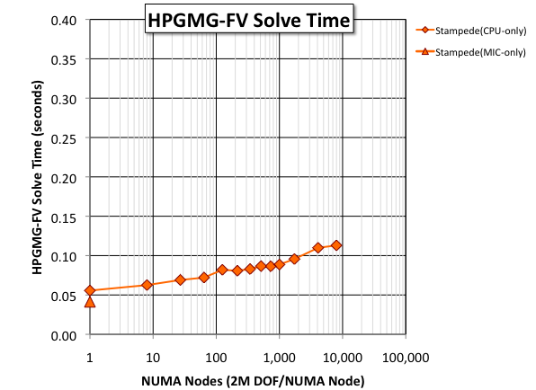
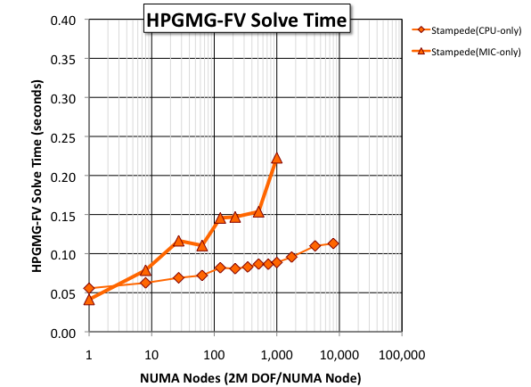
MIC Scaling
MIC can run HPGMG-FV without modification
we tuned BLOCKCOPY_TILE_*
MIC delivers the best single node performance of any architecture
However, with 2M DOF/proc, MIC did not weak scale well…
very surprising as MIC used the same network as the CPU runs
Messaging overheads
FMG sends O(log²(M*P)) messages
nominally overhead is small compared to data movement.
However, overheads for MPI messaging on MIC can be >10x the overhead on CPUs

Slide 21
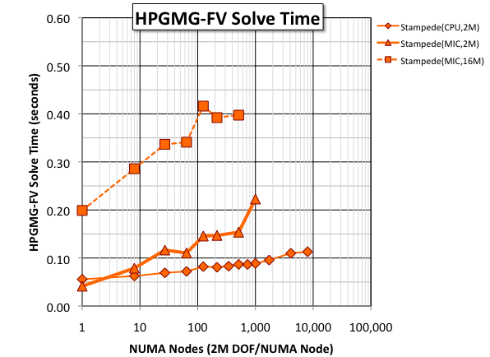
MIC Scaling
When running on 512 MIC’s, increasing the problem size by 8x increases performance by 3x
Thus, larger problem sizes helped, but didn’t rectify the issue
3x the
Performance
(DOF/s)

Slide 22
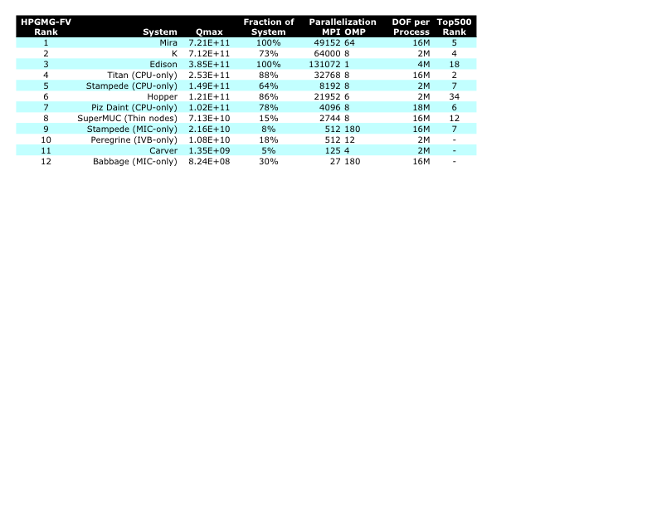
Maximum Performance
We can increase the problem size on all machines to obtain maximum performance…
NOTES…
We did not have the opportunity to run on >64K nodes or with >2M DOF on K.
FV jobs >2744 nodes failed to launch on SuperMUC.
Without a GPU implementation, GPU-accelerated machines were ranked lower.

Slide 23
What’s Missing?
MIC implementations / systems?
No data on TH2 (IVB-only and/or MIC-only)
No XC30’s w/KNC (are Cray’s overheads as high as Intel’s?)
HPGMG-FV should be able to run in Symmetric Mode on Stampede (2CPU+1MIC)
One could write an offload version of HPGMG-FV for MIC that would sidestep some of the current communication inefficiencies.
GPU implementations?
Will require a CUDA, OpenCL, or OpenACC port
Like MIC, HPGMG will challenge all aspects of GPU-accelerated systems.
However, there is the opportunity for truly heterogeneous implementations code is selectively run on either host or GPU
Clouds?
Amazon EC2, Microsoft Azure, etc…
HPGMG would stress Cloud performance far more than other benchmarks.

Slide 24
HPGMG-FV
In the last 6 months…
We wrote HPGMG-FV from scratch
Produced a high-performance, portable MPI+OpenMP implementation
Evaluated on a variety of systems (addressing a number of issues)
Demonstrated scalability to 64K nodes on K and 48K nodes on Mira
In this talk, we examined systems which varied…
DRAM bandwidth
Processor Performance
Network Bandwidth/Topology
MPI overheads
We demonstrated…
Improving any one aspect of the system showed limited performance benefits.
In order to significantly improve HPGMG-FV performance, one must improve multiple/all aspects of the system.

Slide 25
HPGMG-FE
Jed Brown (ANL)
jedbrown@mcs.anl.gov

Slide 26
Finite-element
Q2 elements – 3rd order accuracy
Mapped coordinates
More memory streams, longer critical path
Increased cache demands
3x3 tensor contraction, 3x3 inversion
Cache-vectorization tradeoff
7% BG/Q, >20% SNB/Haswell, vs. ~10% FV
Partition of data not an exact partition of work
Like FV with reconstruction & Riemann solves
Overlapping writes with naïve threading
Variable coefficients
Mix of reusable and non-reusable data
Can tune arithmetic intensity from ~3 F/B to >20 F/B
SC14 HPGMG BoF

Slide 27
Dynamic Range
HPC Relevance
Data assimilation, optimization, risk-aware decision
Need sequence of forward simulations
External requirements on time-to-solution
Policy: 5 SYPD for climate model to inform IPCC
Weather: 250x faster than real time
Supply chain dynamics, field studies, hazard
Transient simulation is not weak scaling (need more time steps)
What is machine versatility?
Performance across a range of turn-around times
Performance on benchmark sufficient for most apps
Features stressed by benchmark necessary for some app
SC14 HPGMG BoF

Slide 28
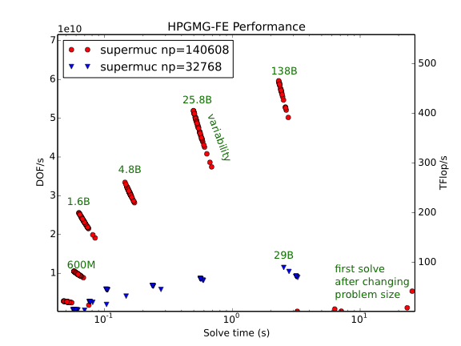
SuperMUC (FDR10, E5-2680)

Slide 29
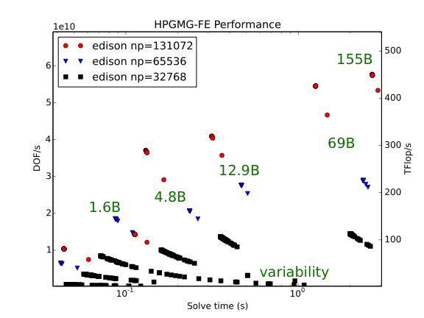
Edison (Aries, E5-2695v2)

Slide 30
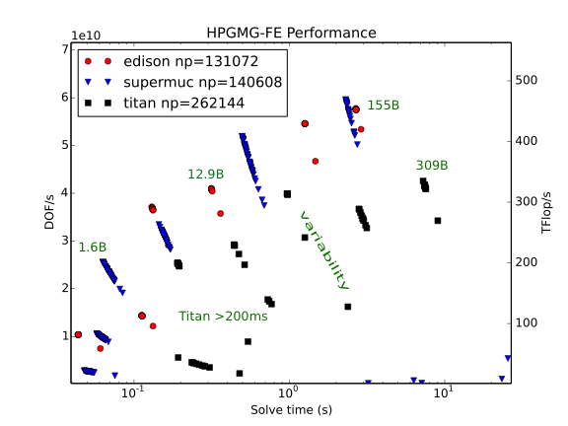
Edison, SuperMUC, Titan

Slide 31
HPGMG on the K computer
Takenori Shimosaka and Mitsuhisa Sato
RIKEN AICS, Japan

Slide 32
Overview
RIKEN AICS (Advanced Institute for Computational Science) is a research institute running the K computer.
We have measured the performance of HPMGM on the K computer
HPGMG-FV: Solve Constant and Variable Elliptic Problem geometric full multi grid method (f-cycle).
smoother: Jacobi, L1jacobi, Symmetric Gauss-Seidel ,Chebyshev polynomial
Benchmark for comparison with other machines using HPGMG
BG/Q in JSC, Germany (Thanks to JSC!)
Comparison with other benchmark: What benchmark is better?
HPMGM vs. HPCG

Slide 33
Execution Time of FMGSlove (old/new)
Old: 15. Apr 2014 version
New: 14. Oct 2014 version
Hybrid: 1 MPI proc/node+OpenMP
one 128³ box per node
flatMPI: 1 MPI proc/core,
one 64³ box per node
“new” is improved
from “old”
Parallel efficiency is about 60 to 70% on 32k nodes.
Solver performance is about 10% faster than old one.

Slide 34
Comparison: K computer and BG/Q
K computer: 128GF/node, mem BW 42.6GB/s, 5GB/s per link x bisectional x 10port = max 100GB/s
BG/Q: 204.8 GF/node, mem BW 64GB/s, 5x2x(2GB/s send + 2GB/s recv)=40GB/s

Slide 35
Comparison: K computer and BG/Q
K computer is 50% faster
than BG/Q !

Slide 36
Comparison with HPCG by perf. counter
K computer can collect many kind of perf. counters.
A few % of FP against peak
Can make use of SIMD efficiently.

Slide 37
Comments
HPGMG-FV using Chebyshev smoother has a good characteristic to reflect FLOPS and SIMD rate as well as memory bandwidth.
With using Gauss-Seidel smoother, it may be difficult to make use of SIMD efficiently. (HPCG has a similar characteristic. Too memory BW-oriented!)
SIMD is an important “accelerator” in recent manycore proc.
To the next version as a standard benchmark,
Fix the smoother (preferably, Chebyshev). The current version can select several kinds of smoothers.
And, use GF/s instead of DOF/s to make easy to understand results, and define submission rule, … etc.

Slide 38
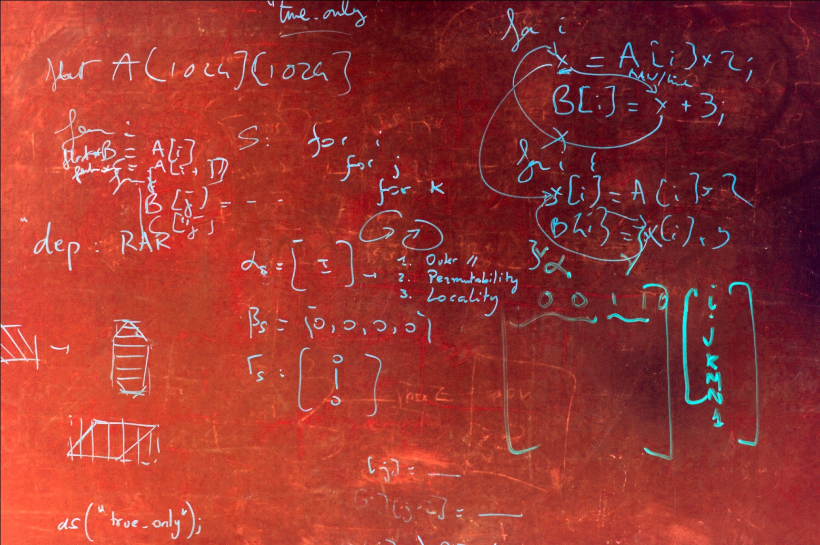
HPGMG on an Asynchronous Task-based Model
Muthu Baskaran @ Reservoir Labs
Reservoir Labs

Slide 39
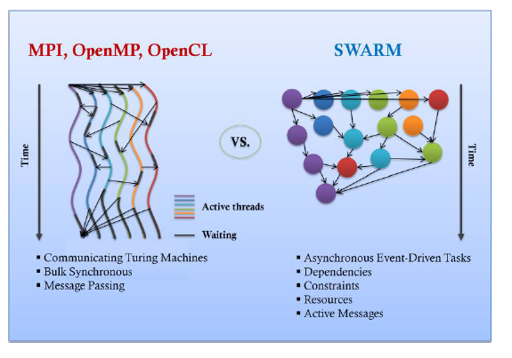
Task-based Programming Models
Over-provisioning (more tasks than processors)
Schedule (DAG of) tasks at runtime
Data-driven or control-driven
Asynchronous or pairwise synchronization
Task-based models that have many common features
OCR, SWARM, CnC, Charm++, PaRSEC, …
Courtesy: ETI SWARM

Slide 40
Multigrid Overview – “V” cycle
Start at finest grid
Smooth, calculate residual, restrict
Repeat until coarsest grid reached
Execute standard solver (e.g. BiCGStab)
Interpolate, smooth
Repeat until finest grid reached
Repeat V-cycles until truncation error is reached
smooth
smooth
restrict
prolongate
smooth
smooth
restrict
prolongate
bottom solve

Slide 41
Multigrid Overview – “F” cycle
Start at coarsest grid level
Interpolate (prolongate) to next finer grid level
V-cycle
Repeat until finest grid level
V-Cycle
smooth
smooth
V-Cycle
prolongate
restrict
prolongate
smooth
smooth
smooth
smooth
restrict
prolongate
restrict
prolongate
prolongate
bottom solve
bottom solve
bottom solve

Slide 42
HPGMG Bulk-synchronous Parallelism
Hierarchical
Domain is spatially decomposed into boxes
Boxes distributed to MPI ranks
Within a rank, parallelization depends on function
Parallelize across and/or within box
Smoother parallelizes across boxes when they are small, within boxes when they are large
Large proportion of time in HPGMG spent in smoother

Slide 43
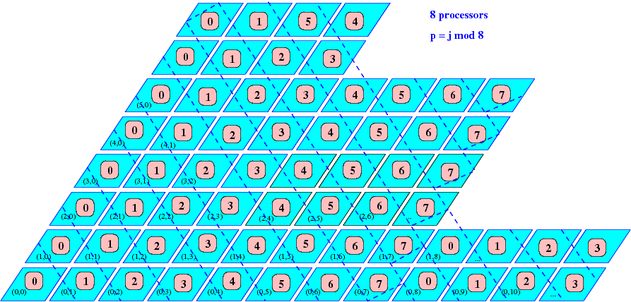
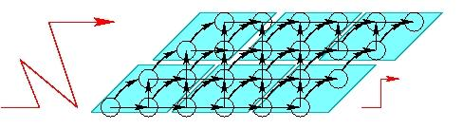
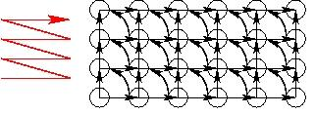
HPGMG Asynchronous Parallelism
Create tasks (tiles)
performing “fused” smooth, restrict operators with deeper ghost zones or performing operators separately
Capture task dependencies
Pipeline-parallel asynchronous execution of tasks (within and across levels)
Decouple communication of boundaries (pairwise communication) and computation
overlap them (with possible hardware support – e.g. DMA)
Asynchronous execution
Dependence analysis
Task formation

Slide 44
Optimizing HPGMG with R-Stream (WIP)
What is done so far
Used R-Stream to generate OCR code for GSRB and Chebyshev smoothers
Benchmarked OCR, OpenMP, MPI
Performed preliminary performance tuning
Clear path defined for further tuning and optimization
What is to be done
Further tile size tuning
Expand R-Stream mapped code region
Optimize across combinations of restrict, interpolate, error, and smooth functions

Slide 45
Acknowledgments

Slide 46
Acknowledgments
Mitsuhisa Sato, Takenori Shimosaka (RIKEN)
Muthu Baskaran (Reservoir Labs)
Bill Barth, Dan Stanzione (TACC)
Nick Wright, Katie Antypas, Helen He (NERSC)
Ray Grout (NREL)
Thomas Schulthess, Benjamin Cumming (CSCS)
All authors from Lawrence Berkeley National Laboratory were supported by the DOE Office of Advanced Scientific Computing Research under contract number DE-AC02-05CH11231.
This research used resources of the National Energy Research Scientific Computing Center, which is supported by the Office of Science of the U.S. Department of Energy under Contract No. DE-AC02-05CH11231.
This research used resources of the Argonne Leadership Computing Facility at Argonne National Laboratory, which is supported by the Office of Science of the U.S. Department of Energy under contract DE-AC02-06CH11357.
This research used resources of the Oak Ridge Leadership Facility at the Oak Ridge National Laboratory, which is supported by the Office of Science of the U.S. Department of Energy under Contract No. DE-AC05-00OR22725.

Slide 47
Thank You !
Please visit http://hpgmg.org
Remember to fill out Survey http://hpgmg.org/survey
Please download and evaluate HPGMG
Send us feedback
Sign up and post questions to the mailing list: HPGMG-Forum@hpgmg.org
Thanks to speakers
Panel discussion

Slide 48
Thank you
Visit us on the web: hpgmg.org
Download the code
Take the short survey: hpgmg.org/survey
Thanks to speakers
Mitsuhisa Sato
Muthu Baskaran
Thank you for your attention
the HPGMG team
Mark Adams (LBNL)
Jed Brown (ANL,CU)
John Shalf (LBNL)
Brian Van Straalen (LBNL)
Erich Strohmaier (LBNL)
Sam Williams (LBNL)
Notes:
The addition of a new metric, HPCG, to the Top500 list for the first time in its 20+ year history raises some questions: Should there be multiple rankings? Or some sort of a mixture like a weighted geometric mean? something else?

