Slide 1
HPGMG
Samuel Williams¹
Mark Adams¹, Jed Brown², Erich Strohmaier¹, Brian Van Straalen¹
¹Lawrence Berkeley National Laboratory
²Argonne National Laboratory
SWWilliams@lbl.gov

Slide 2
Benchmarks
Procurement Benchmarks
e.g. NERSC, Trinity, CORAL, etc…
highly tailored to meet the current computing needs of each center
often full applications (hard to rewrite/port)
time-consuming benchmarking process
difficult to use as drivers for CS and architecture research
rarely run on more than one system (impossible to compare)
General Benchmarks
e.g. STREAM, HPL, NPB, HPCC, …
much simpler (range from kernels to numerical methods)
easily ported from one system to another
long-lived (makes it possible to observe trends)
common drivers for CS and architecture research, but can become disconnected from applications

Slide 3
Top500
For more than 20 years, the Top500 has ranked supercomputers in the world based on their HPL (High-Performance LINPACK) performance
HPL solves a (dense) system of linear equations via LU factorization
Top500 does not restrict the size of the problem
HPL is poorly correlated with the numerical methods used in applications today…
requires O(N³) work per equation
O(N) arithmetic intensity (flop:byte)
compute-limited (flops are prized)
have run times that can exceed 24hrs
Today’s applications often use superior numerical methods which …
have O(N) computational complexity
have O(1) arithmetic intensity
often DRAM or network limited
have run times of O(10s)

Slide 4
Alternate Benchmarks
NAS Parallel Benchmarks / NPB (1991)
8 benchmarks including CG (stored matrix), MG (ccPoisson), FFT, …
specified problem sizes, strong scaled
HPCC (2005)
weak scaled
STREAM: simple DRAM bandwidth kernel
GUPS: Random access kernel; atypical of most HPC applications
HPL: LINPACK; peak flop/s; atypical of most HPC applications
FFT: common method for small-scale HPC and simple problems
(e.g. constant coefficient Poisson with periodic BC’s)
HPCG (2013)
solves a FEM problem on a structured grid using a stored matrix PCG algorithm
(heavily DRAM bandwidth limited)
weak scaled
after discussions with us, a (2-level) MG preconditioner was added.
Graph500
BFS on graphs
little/no FP (targets a different domain)
specified problem sizes
Notes:
Over the years, many alternates to HPL have been proposed…

Slide 5
Goals for a new Top500
HPC Applications are increasingly built on scalable/hierarchical/recursive algorithms…
FFT, Fast Multipole (FMM), Algebraic Multigrid (AMG), Geometric MG (GMG)
any relevant benchmark should embody similar characteristics
Create an algorithm that is understandable by CS grad students.
fosters focused CS research (optimization, runtimes, languages, programming models, architecture, etc…) on MG just as HPL focused research on DGEMM
Do not specify the problem size or require a fixed matrix.
use weak-scaled problem generators
include self-checking/verification
Specify the algorithm (math), but leave the implementation free.
submissions may change the implementation, programming model, language, etc…,
submissions may not change the algorithm or math (e.g. the smoother)
Reward systems that are tightly integrated
provide an additional challenge to weak-scaled environments
e.g. O(N) FP complexity with superliner communication complexity
can penalize systems with massive numbers of compute nodes

Slide 6
HPGMG

Slide 7
HPGMG
Geometric Multigrid
multigrid on a structured Cartesian grid
GMG is found at the heart of many DOE applications including AMR/MG frameworks like CHOMBO and BoxLib
HPGMG (High Performance Geometric Multigrid)
solves b∇β∇u=f on the [0,1]³ domain discretized on a regular grid with Dirichlet BC’s
uses Full Multigrid (FMG) which is a one-pass direct solver built from a hierarchy of MG V-Cycles.
Three variants of HPGMG are currently being evaluated…
HPGMG-FV ( Finite Volume, 2nd order, memory intensive)
HPGMG-FV ( Finite Volume, 4th order, memory/cache intensive)
HPGMG-FE ( Finite Element, 3rd order, cache/floating-point intensive)
Reference Implementations on https://bitbucket.org/hpgmg/hpgmg
HPGMG-FV is written in C and parallelized with MPI+OpenMP
HPGMG-FE is written in C and parallelized with MPI (and PETSc)

Slide 8
Multigrid
Linear Solvers (Lu=f) are ubiquitous in scientific computing
Multigrid solves elliptic PDEs (Lu=f) using a hierarchical (recursive) approach.
solution (correction) to hard problem is expressed in terms of solution to an easier problem
Provides O(N) computational complexity where N is number of unknowns
Notes:
recast solution to problem on the finest grid as a function of the solution to a problem on a coarser grid…

Slide 9
Geometric Multigrid
In geometric multigrid, the linear operator (L) when solving Lu=f is a stencil on a structured grid (i.e. matrix-free)
Inter-grid operations are recast in terms of stencils based on the underlying numerical method (e.g. cell-centered finite volume)
Extremely fast/efficient…
O(N) computational complexity (#flops)
O(N) DRAM data movement (#bytes)
O(N^{0.66}) MPI data movement + O(logN) MPI messages
“MG V-cycle”
restriction
interpolation

Slide 10
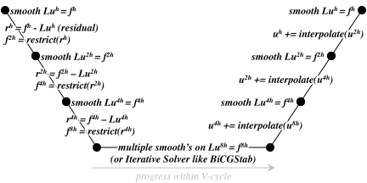
Geometric Multigrid
In reality, each level in the MG V-Cycle requires several key operations (almost all are stencils)…
smooth: series of stencils that damp high frequency error
residual: stencil that calculates f^{h}-Lu^{h}
restrict: stencil to that takes a N³ array and produces a (N/2)³ array
bottom solver: smooths or matrix-free BiCGStab
interpolate: stencil to that takes a (N/2)³ array and produces a N³ array
Each operation requires enforcing a boundary condition (stencil)

Slide 11
“V-Cycle” vs. “U-Cycle”
Ideally, one should be able to restrict the global problem down to a small coarse grid problem on a single node.
= true “V-Cycle”
In distributed memory, this approach requires a tree-like agglomeration in which subdomains are restricted and combined onto a subset of the nodes. HPGMG implements this approach.
32³
“V-Cycle”
16³
8³
4³
2³
1 cell
However, expediency often results in MG solvers terminating restriction early (e.g. only perform local restriction)
= “U-Cycle”
HPCG implements this approach
Unfortunately, the resultant distributed coarse grids solves are large and suffer greatly from superlinear computational complexity.
“U-Cycle”

Slide 12
Full Multigrid (FMG)
FMG uses an F-Cycle with a V-Cycle at each level.
No iterating. One global reduction (to calculate the final residual)
Essentially, an O(N) direct solver (discretization error in 1 pass)
Smooth
Residual
Restrict
Initial Restriction of RHS
Bottom Solve
Interpolate
Interpolate (High Order)
FMG has interesting properties for hierarchical memory architectures…
Fine grids (those in slow “capacity” memory) are accessed only twice
Coarser grids (those that have progressively smaller working sets) are accessed progressively more
Challenging as same routines are used many times with highly varied working sets
Coarsest grids are likely latency-limited (exploit heterogenity?)
FMG sends O(log²(P)) messages (needs low overhead communication)
Stresses many aspect of the system (memory hierarchy, network, compute, threading overheads, heterogeneity, …)

Slide 13
Multigrid Performance Challenges

Slide 14
Ideal Performance
Nominally, multigrid has three components that affect performance
DRAM data movement and flop’s to perform each stencil
MPI data movement for halo/ghost zone exchanges
latency/overhead for each operation
These are constrained by
DRAM and flop rates
MPI P2P Bandwidth
MPI overhead, OpenMP/CUDA overheads, etc…
The time spent in each of these varies with level in the V-Cycle
coarse grids have ⅛ the volume (number of cells), but ¼ the surface area (MPI message size)
Dominated by
On-Node Performance
Dominated by
MPI Performance
Overhead
Dominates
DRAM BW and Flop/s
Time in Component in Level
MPI P2P
Overhead / Latency
Level in the V-Cycle

Slide 15
Faster Machines?
If one just increases DRAM bandwidth by 10x, then the code becomes increasingly dominated by MPI P2P communication
If one improves just DRAM and MPI bandwidth, the code will eventually be dominated by CUDA, OpenMP, and MPI overheads.
Unfortunately, the overheads are hit O(logN) times.
Thus, if overhead dominates (flops and bytes are free), then MGSolve Time looks like O(logN)
Architecting for MG requires a balanced scaling of flop/s, GB/s, memory capacities, and overheads.
Time in Component in Level
MPI P2P
DRAM BW and Flop/s
Overhead / Latency
Level in the V-Cycle

Slide 16
HPGMG-FV Implementation

Slide 17
Cell Centered / Averaged
HPGMG-FV uses a cell centered or cell-averaged representation.
Values can represent…
cell averages (cell-centered)
face averages (face-centered)
i face
centered
value
cell-centered
value
j face centered
Restriction/Prolongation can be either cell- or face-centered.
Coarse grid elements are the average value of the region covered by fine grid elements
cell-centered
restriction
face-centered
restriction

Slide 18
Boundary Conditions
Solutions variables are cell centered, but boundary values exist on faces (face-centered)
enforcing a homogeneous Dirichlet boundary condition is not simply forcing the ghost cells to zero.
Rather one has to select a value for each ghost cell that allows one to interpolate to zero on the face.
At higher order, this BC requires a stencil
boundary
value
?
implied
ghost zone
cell-centered
value
Laplacian (∇β∇u) is built by applying divergence theorem…
sum of β-weighted 2pt stencils for 2nd order
7pt stencil in 3D
Has more flops, more data movement, and larger cache working sets than constant coefficient, finite difference stencils
similar, but more complex (and compute intensive) approach is needed for 4th order

Slide 19
Problem and Decomposition
HPGMG solves b∇β∇u=f on the [0,1]³ domain with a grid spacing of h.
a total problem size of 64³ cells implies h=1/64
The reference implementation decomposes the domain on each MG level (h) into cubical boxes (e.g. 16³ cells)
Boxes are distributed among MPI processes…
by default, HPGMG-FV uses a Z-Mort space filling curve
other options include various recursive and lexicographical approaches
decomposition can change between levels
64³ domain
decomposed into a
4x4x4 grid of boxes of
16³ cells each
If using 9 MPI processes, process 0 might own 7 boxes
In this example, each box is comprised of 16³ cells

Slide 20
OpenMP Threading
OpenMP performance and level of support varies substantially from compiler to compiler and even from architecture to architecture
Intel CC vs GNU vs. XL/C
Xeon vs. Xeon Phi
In order to affect performance (and performance portability) a process’s list of boxes is flattened into a list of roughly uniformly sized tiles.
all operators (stencils, vector-vector, norms, etc…)
ghost zone exchanges (buffer packing/unpacking)
boundary conditions
restriction (including MPI buffer packing/unpacking)
interpolation (including MPI buffer packing/unpacking)
#pragma omp parallel for is used to iterate over the list of tiles (portable)
The tile size is tuning parameter…
default tile size of 8x8 works well on Xeon architectures.
2x2 works well on Xeon Phi’s
32x32 works well on K
32x1 works well on BGQ
When NUMA is properly exploited, the MPI+OpenMP implementation is comparable to flat MPI
OpenMPI on K and MPICH on BGQ have O(P²) MPI_Comm_split scaling problems (P=3M processes)
High performance networks need multiple processes to saturate the network.

Slide 21
HPGMG-FV Performance

Slide 22
Weak Scaling Experiments
Examine weak scaling HPGMG-FV performance on various systems
Fix the problem size to 2M DOF/NUMA node (128³ / NUMA node)
provides apples-to-apples comparison
(at a given scale, all machines will solve the same problem in the same way)
Allows us to quantify HPGMG performance as function of…
Processor performance
DRAM bandwidth
Network topology (Torus, Tree, Dragonfly, etc…)
etc…
We plot time-to-solution as a function of concurrency
Flat curve is perfect scaling (better networks)
Lower curves show better performance (faster nodes)

Slide 23
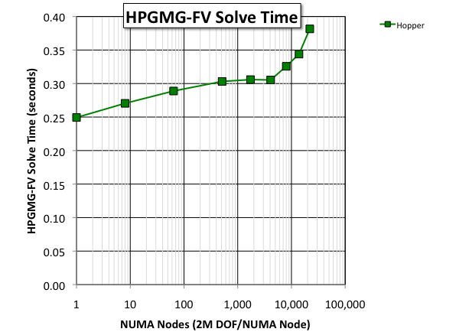
3D Torus (Gemini)
Consider Hopper (Cray XE6)
single process multigrid solve time is fast (250ms)
performance degrades at scale
larger problem sizes mitigate this lack of scalability
Scalability
of the Network
Performance
of the Processor

Slide 24
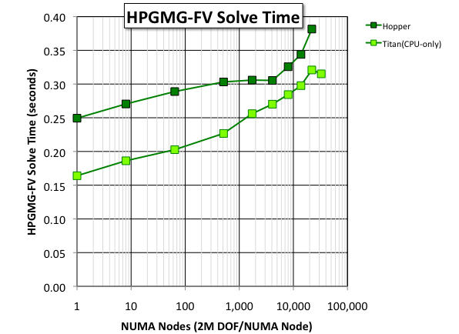
3D Torus (Gemini)
Consider Hopper (Cray XE6)
single process multigrid solve time is fast (250ms)
performance degrades at scale
larger problem sizes mitigate this lack of scalability
Titan (Cray XK7)
use only CPUs (same MPI+OpenMP)
delivered 50% better performance per socket and ~2x better overall performance
However, as Hopper and Titan both use Gemini, the network impeded performance at scale

Slide 25
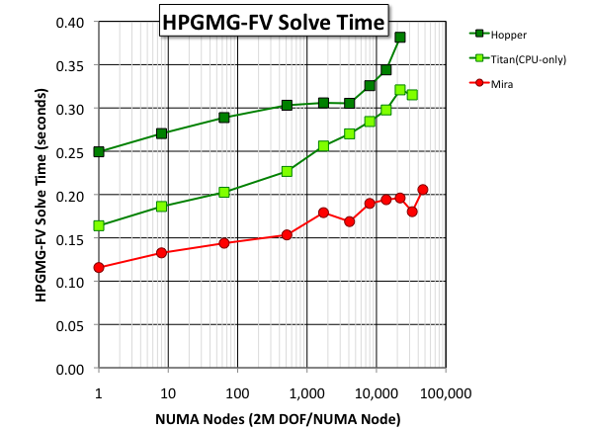
Blue Gene/Q
Mira (Blue Gene/Q)
custom processor enabled better performance per socket
custom network (5D torus) enabled better scalability

Slide 26
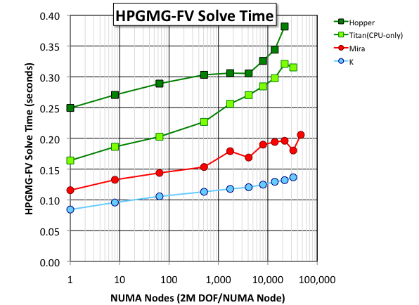
K (6D Torus/Mesh)
K (Sparc VIIIfx) at RIKEN
less flops per proc than BGQ
more bandwidth per proc than BGQ
= deliver better HPGMG-FV performance per node.
TOFU (6D) delivered similar (but smoother) scalability to BGQ

Slide 27
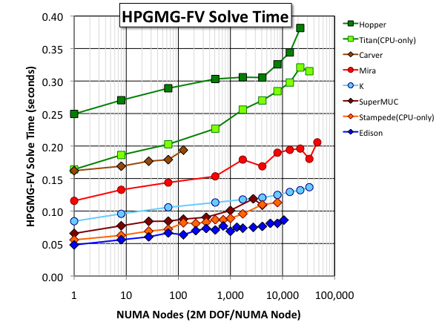
Fat Trees and Dragonfly
Xeon processors (IVB, SNB, NHM) are common on the Top500 today
Xeon performance defined by #cores, processor frequency, and memory frequency
Fat Trees saw degraded scaling beyond 1K sockets
XC30/Aries (Dragonfly), K (6D), and BGQ (5D) continued to scale well from 1K-48K sockets

Slide 28
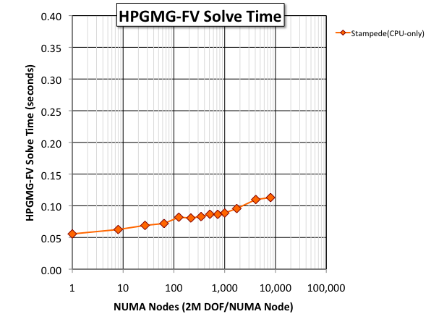
Accelerators? Baseline Network Performance
How do accelerators like the Xeon Phi perform on HPGMG?
Consider Stampede…
Xeon (SNB)
Fat Tree
Scaled reasonably well for this mid-sized problem
Each Stampede node also has a MIC
How does HPGMG-FV on MIC (Xeon Phi) perform/scale?
using Stampede for CPU-only and MIC-only removes the network as a variable

Slide 29
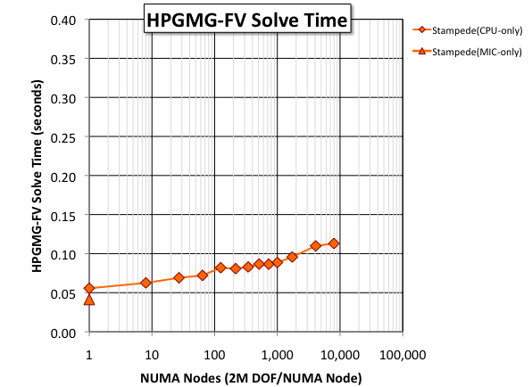
Accelerators? MIC Scaling
MIC can run HPGMG-FV without modification
we tuned BLOCKCOPY_TILE_*
MIC delivered the best single node performance of any architecture

Slide 30
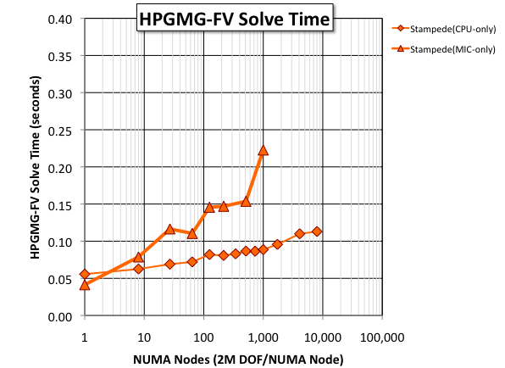
Accelerators? MIC Scaling
MIC can run HPGMG-FV without modification
we tuned BLOCKCOPY_TILE_*
MIC delivered the best single node performance of any architecture
However, with 2M DOF/proc, MIC did not weak scale well…
very surprising as MIC used the same network as the CPU runs
Messaging overheads
FMG sends O(log²(M*P)) messages
nominally overhead is small compared to data movement.
However, overheads for MPI messaging on MIC can be >10x the overhead on CPUs

Slide 31
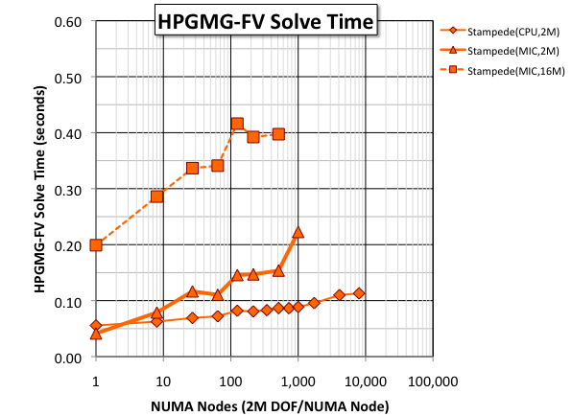
Accelerators? MIC Scaling
512 MIC’s increasing the problem size by 8x increased performance by 3x
Thus, larger problem sizes helped, but didn’t rectify the issue
3x the
Performance
(DOF/s)

Slide 32
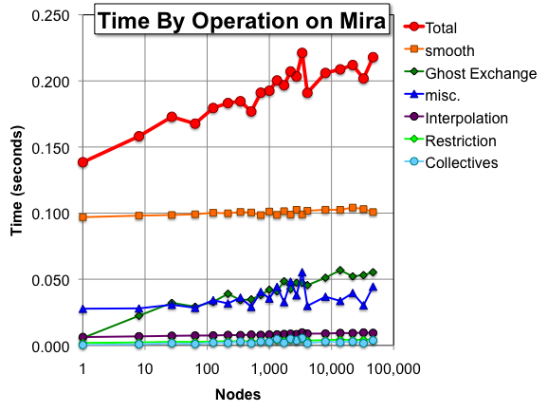
Weak Scaling Breakdown of Time
Breakdown of time on Mira…:
smooth time is roughly constant.
misc…
Residual and BLAS1 operations
relatively constant (residual is large %)
but sees some variation for odd coarse grid problem sizes (15³) due to variable # of BLAS1 in BiCGStab iterations
Ghost zone exchange time steadily increases with scale…
topology not exploited in job scheduler or MPI as mapping processes in AMR codes is difficult
Collectives…
Just 1 global collective for the residual
many local collectives on the coarse grid solve
Collectives on on BGQ are fast
Restriction/Interpolation…
despite requiring inter-level communication are still very fast
Interpolation sends 8x more data

Slide 33
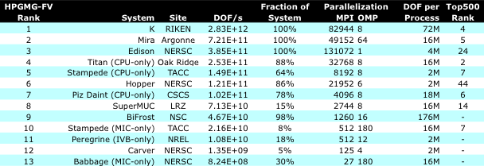
Unlimited Problem Size
Allow submissions to use any amount of memory
Enables submitters to trade increased memory cost to reduced network cost (i.e. more memory hides network scalability issues)
With sufficient memory usage (problem size), most CPU architectures asymptotically approach their STREAM bandwidths
GDDR memory technology trades increased bandwidth for reduced capacity (hence limits the ability to hide the network and hit stream bandwidth)
The lack of a GPU implementation of HPGMG depressed Titan and Piz Daint performance relative to their Top500 ranking.

Slide 34
Summary

Slide 35
Observations
HPGMG-FV performance is particularly sensitive to the network and MPI library performance…
Dragonfly, 5D Torus, and 6D torus scaled well
3D Torus and Fat Trees were challenged
FMG’s O(log²P) message rates coupled with poor native mode MIC MPI overheads further impaired MIC scalability
Machines were further differentiated by memory technology…
Key characteristic is ratio of memory capacity to memory bandwidth
ratio for DDR is ~1s (easy to hide network issues in 1s)
ratio for GDDR is ~50ms (can’t fill enough memory to hide the network)
If you can hide the network, HPGMG-FV is STREAM-limited
The 2nd order HPGMG-FV is probably not sufficiently challenging
To that end, we’ve developed a 4th order HPGMG-FV

Slide 36
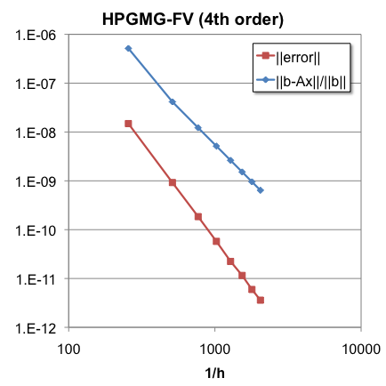
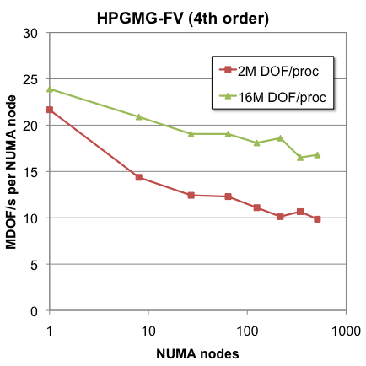
4th order HPGMG-FV
4th order HPGMG-FV is both
mathematically superior
flop, cache, memory, and network challenging
In order to attain equal time-to-solution, one needs a machine with…
4x the GFLOP/s
3x the MPI message rate (messages/second)
2x the MPI bandwidth (MPI GB/s)
1x the DRAM bandwidth
We are just starting to evaluate the 4th order version
mathematical performance is very good (low residual and low error)
Performance on Edison and K is good, but performance on MIC and BGQ is very poor.
Nevertheless, out-of-the box performance on Edison is suboptimal… less than 20% of Flop/s, 65% of STREAM.

Slide 37
HPGMG
Visit the website for updates: www.hpgmg.org
links to the LBL-hosted finite-volume documentation…
http://crd.lbl.gov/departments/computer-science/performance-and-algorithms-research/research/hpgmg
Download the source via git: bitbucket.org/hpgmg/hpgmg/
both finite volume (FV) implementations are in the finite-volume sub directory
the finite element (FE) version is in the finite-element sub directory
Subscribe/post to the mailing list for questions: hpgmg.org/lists/listinfo/hpgmg-forum
We are planning a second BoF at SC’15

Slide 38
Acknowledgements
All authors from Lawrence Berkeley National Laboratory were supported by the DOE Office of Advanced Scientific Computing Research under contract number DE-AC02-05CH11231.
This research used resources of the National Energy Research Scientific Computing Center, which is supported by the Office of Science of the U.S. Department of Energy under Contract No. DE-AC02-05CH11231.
This research used resources of the Argonne Leadership Computing Facility at Argonne National Laboratory, which is supported by the Office of Science of the U.S. Department of Energy under contract DE-AC02-06CH11357.
This research used resources of the Oak Ridge Leadership Facility at the Oak Ridge National Laboratory, which is supported by the Office of Science of the U.S. Department of Energy under Contract No. DE-AC05-00OR22725.

Slide 39
Questions?
SWWilliams@lbl.gov

Slide 40
BACKUP SLIDES

Slide 41
Points
Algorithmically Relevant
replace Flop/s with DOF/s (24hr LINPACK -> 24s HPGMG)
don’t confuse a metric (flops) with performance (time-to-solution)
In HPGMG, requisite messaging rate increases with scale
rewards high-performance networks
capacity:bandwidth ratio of various memory technology (DDR, GDDR, stacked) vs. performance
Currently evaluating 3 variants (FV2, FE3, FV4) which vary FP, cache, memory, and network requirements
Performance metric for ranking

Slide 42
HPGMG-FV
portable MPI + OpenMP (no SIMD intrinsics)
Based on true distributed V-Cycles that allow restriction of a trillion cells distributed across 100K processes down to one cell (total).
Once a process runs out of cells (falls beneath a threshold), the next restriction will shuffle data onto a subset of the processes in a tunable tree-like agglomeration structure
Unfortunately, restriction/prolongation are now distributed operations in which locally restricted/interpolated grids may need to be sent en masse to another process (inter-level communication)
Data decomposition is on a level-by-level basis (rather than static)
proxies the irregular decompositions which may emerge on an AMR level
allows for easy extension with any user-defined domain decomposition
(recursive bisection ~= Z-Mort, specialized recursive variant, and lexicographical)
allows for a truly heterogeneous implementation (not yet implemented) in which fine grids are run on accelerators and coarse grids on host processor
Configurable for U-Cycles, V-Cycles, or F-Cycles (FMG)
In addition to GSRB, there are Chebyshev, SymGS, weighted-Jacobi, and L1-Jacobi smoothers
Implements both homogenous Dirichlet and periodic BC’s
Configurable bottom solver including BiCGStab, CG, and s-step variants.

Slide 43
HPGMG-FV detailed timing….
Time within a MG level by function
Total Time by function
0 1 2 3 4 5 6 7 8 9
box dimension 128^3 64^3 32^3 16^3 8^3 8^3 8^3 4^3 2^3 9^3 total
------------------ ------------ ------------ ------------ ------------ ------------ ------------ ------------ ------------ ------------ ------------ ------------
smooth 0.083160 0.009769 0.002024 0.000753 0.000592 0.000711 0.000833 0.001602 0.001382 0.000000 0.100826
residual 0.018734 0.000940 0.000204 0.000088 0.000073 0.000087 0.000102 0.000181 0.000158 0.000155 0.020721
applyOp 0.000000 0.000000 0.000000 0.000000 0.000000 0.000000 0.000000 0.000000 0.000000 0.001907 0.001907
BLAS1 0.004449 0.000115 0.000057 0.000053 0.000064 0.000069 0.000082 0.000206 0.000197 0.014692 0.019984
BLAS3 0.000000 0.000000 0.000000 0.000000 0.000000 0.000000 0.000000 0.000000 0.000000 0.000000 0.000000
Boundary Conditions 0.000000 0.000308 0.000080 0.000017 0.000005 0.000005 0.000005 0.000013 0.000014 0.000011 0.000458
Restriction 0.000922 0.000350 0.000297 0.000141 0.000435 0.000363 0.000445 0.000603 0.000790 0.000000 0.004346
local restriction 0.000915 0.000342 0.000288 0.000130 0.000032 0.000037 0.000042 0.000129 0.000146 0.000000 0.002062
pack MPI buffers 0.000001 0.000001 0.000000 0.000001 0.000001 0.000001 0.000001 0.000001 0.000001 0.000000 0.000007
unpack MPI buffers 0.000001 0.000001 0.000001 0.000001 0.000095 0.000106 0.000124 0.000140 0.000224 0.000000 0.000694
MPI_Isend 0.000001 0.000000 0.000001 0.000001 0.000001 0.000001 0.000001 0.000001 0.000001 0.000000 0.000007
MPI_Irecv 0.000001 0.000001 0.000001 0.000001 0.000035 0.000045 0.000061 0.000056 0.000063 0.000000 0.000263
MPI_Waitall 0.000000 0.000001 0.000001 0.000001 0.000263 0.000164 0.000205 0.000263 0.000340 0.000000 0.001239
Interpolation 0.002921 0.001742 0.001107 0.000369 0.000499 0.000579 0.000741 0.000631 0.000740 0.000000 0.009329
local interpolation 0.002916 0.001735 0.001098 0.000358 0.000068 0.000077 0.000085 0.000137 0.000147 0.000000 0.006621
pack MPI buffers 0.000000 0.000000 0.000001 0.000001 0.000157 0.000179 0.000202 0.000147 0.000238 0.000000 0.000926
unpack MPI buffers 0.000000 0.000000 0.000001 0.000001 0.000001 0.000001 0.000001 0.000001 0.000002 0.000000 0.000009
MPI_Isend 0.000000 0.000000 0.000001 0.000001 0.000131 0.000154 0.000196 0.000154 0.000185 0.000000 0.000822
MPI_Irecv 0.000000 0.000000 0.000001 0.000001 0.000001 0.000001 0.000001 0.000001 0.000001 0.000000 0.000007
MPI_Waitall 0.000001 0.000001 0.000001 0.000001 0.000132 0.000155 0.000241 0.000176 0.000150 0.000000 0.000856
Ghost Zone Exchange 0.010486 0.005997 0.003671 0.003480 0.003963 0.004767 0.005602 0.007449 0.007796 0.002098 0.055309
local exchange 0.000003 0.000003 0.000004 0.000005 0.000006 0.000007 0.000008 0.001059 0.001659 0.001838 0.004589
pack MPI buffers 0.001327 0.000467 0.000442 0.000518 0.000624 0.000743 0.000863 0.000991 0.001208 0.000026 0.007210
unpack MPI buffers 0.000473 0.000455 0.000485 0.000593 0.000738 0.000878 0.001019 0.001130 0.001331 0.000025 0.007125
MPI_Isend 0.000302 0.000339 0.000450 0.000781 0.000937 0.001143 0.001334 0.001515 0.001190 0.000018 0.008009
MPI_Irecv 0.000093 0.000096 0.000140 0.000165 0.000210 0.000250 0.000299 0.000313 0.000257 0.000012 0.001835
MPI_Waitall 0.008260 0.004603 0.002103 0.001355 0.001370 0.001656 0.001970 0.002306 0.002008 0.000011 0.025641
MPI_collectives 0.001312 0.000000 0.000000 0.000000 0.000000 0.000000 0.000000 0.000000 0.000000 0.002378 0.003691
------------------ ------------ ------------ ------------ ------------ ------------ ------------ ------------ ------------ ------------ ------------ ------------
Total by level 0.122319 0.018799 0.007384 0.004927 0.005706 0.006680 0.008064 0.010724 0.010967 0.021933 0.217503
Total time in MGBuild 225.675795 seconds
Total time in MGSolve 0.217941 seconds
number of v-cycles 1
Bottom solver iterations 70
Performance 4.489e+11 DOF/s
calculating error...
h = 2.170138888888889e-04 ||error|| = 4.595122248560908e-11
smooth on finest level is only 38% of solve time
Time in an operation by level
demonstrates performance of MPICH’s MPI_Comm_split/dup is broken at scale !
Used to verify implementation…error should be 2nd order

Slide 44
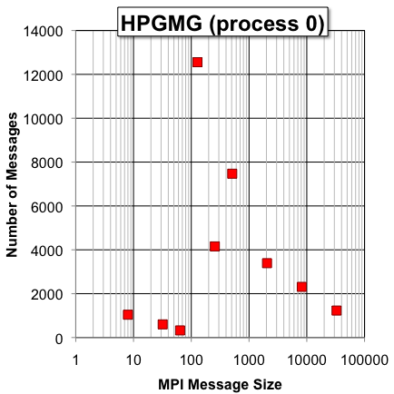
HPGMG-FV (message sizes)
In FMG,
large messages only occur in only the last V-Cycle
smaller messages are more frequent as FMG performs progressively more small V-Cycles
agglomeration causes a spike in message counts when you reach the agglomeration threshold
eventually all cells are on one node and the number of messages is small.
Performance on small messages (overhead/latency) can be critical
Agglomeration Sends whole Boxes
FMG Effect
(ghost zones)
data collected on BGQ w/HPM

Slide 45
Coordinates
Coordinates can either be discrete of continuous
Continuous coordinates
labeled x,y,z by convention
represent coordinates in space
are used to evaluate continuous functions
are independent of multigrid/AMR level
Discrete coordinates
labeled i,j,k by convention
access array elements
define array sizes
are a function of the current MG/AMR level and grid spacing h…
(x,y,z) = (i*h,j*h,k*h) for some grid spacing h

Slide 46
Boxes (The Quanta for Domain Decomposition)
box is a cubical region of space at a particular grid spacing h
has a i,j,k discrete coordinate of its lower coordinate
discrete i,j,k maps to continuous coordinates x,y,z = ih,jh,kh
boxes have a dimension ‘dim’, but have additional ‘ghosts’-deep ghost zones (halo) which replicates data from neighboring boxes.
boxes can have some array padding to facilitate SIMDization/alignment
jStride, kStride, and volume are defined to facilitate indexing in the presence of deep ghost zones with complex padding for alignment
Boxes have ‘numVectors’ vectors (e.g. solution, RHS, D^{-1}, etc…) each comprising double-precision values over the region of space
box->vectors[id] returns a pointer to a 3D double precision array
this data can represent either cell-centered –or– face-centered data.
box->vectors[id][0] is the first ghost zone element !!
many routines perform some pointer arithmetic to create a pointer to the first non-ghost zone element.

Slide 47
Boxes (Cell- vs. Face-Centered Data Layout)
Nominally, face-centered data can get by with smaller array dimensions
(no need for face-centered ghost data)
However, for simplicity and to facilitate indexing, HPGMG always uses the same number of elements for both cell- or face-centered (=array padding)
Thus we have different 3D arrays (#’s are offsets from the base pointer)
Although data is always stored in separate arrays…
30
31
32
33
34
35
30
31
32
33
34
35
30
31
32
33
34
35
24
25
26
27
28
29
24
25
26
27
28
29
24
25
26
27
28
29
18
19
20
21
22
23
18
19
20
21
22
23
18
19
20
21
22
23
12
13
14
15
16
17
12
13
14
15
16
17
12
13
14
15
16
17
6
7
8
9
10
11
6
7
8
9
10
11
6
7
8
9
10
11
j
0
1
2
3
4
5
0
1
2
3
4
5
i
0
1
2
3
4
5
Cell-centered data
( e.g. x[ ] )
Face-centered data
( e.g. beta_i[ ] )
Face-centered data
( e.g. beta_j[ ] )

Slide 48
Boxes (Cell- vs. Face-Centered Data Layout)
However, conceptually, it represents different quantities in the same region of space…
30
30
31
31
32
32
33
33
34
34
35
35
30
31
32
33
34
35
24
24
25
25
26
26
27
27
28
28
29
29
24
25
26
27
28
29
18
18
19
19
20
20
21
21
22
22
23
23
18
19
20
21
22
23
12
12
13
13
14
14
15
15
16
16
17
17
12
13
14
15
16
17
6
6
7
7
8
8
9
9
10
10
11
11
6
7
8
9
10
11
0
0
1
1
2
2
3
3
4
4
5
5
0
1
2
3
4
5

Slide 49
Boxes (Cell- vs. Face-Centered Data Layout)
With a little pointer arithmetic, the first non-ghost zone cell or lower faces of that cell have coordinates (0,0,0)
e.g.
const double * __restrict__ rhs = level->my_boxes[box].vectors[rhs_id] + ghosts*(1+jStride+kStride);
23
23
24
24
25
25
26
26
27
27
28
28
23
24
25
26
27
28
17
17
18
18
19
19
20
20
21
21
22
22
17
18
19
20
21
22
11
11
12
12
13
13
14
14
15
15
16
16
11
12
13
14
15
16
5
5
6
6
7
7
8
8
9
9
10
10
5
6
7
8
9
10
-1
-1
0
0
1
1
2
2
3
3
4
4
-1
0
1
2
3
4
-7
-7
-6
-6
-5
-5
-4
-4
-3
-3
-2
-2
-7
-6
-5
-4
-3
-2

Slide 50
Boxes (Cell- vs. Face-Centered Data Layout)
A variable-coefficient 7-point stencil has asymmetric coefficient indexing
observe that a stencil at x[ijk=0] uses…
beta_i[0] and beta_i[1]
beta_j[0] and beta_j[6]
x[-1], x[1], x[-6], x[6], and x[0]
23
23
24
24
25
25
26
26
27
27
28
28
23
24
25
26
27
28
17
17
18
18
19
19
20
20
21
21
22
22
17
18
19
20
21
22
11
11
12
12
13
13
14
14
15
15
16
16
11
12
13
14
15
16
5
5
6
6
7
7
8
8
9
9
10
10
5
6
7
8
9
10
-1
-1
0
0
1
1
2
2
3
3
4
4
-1
0
1
2
3
4
-7
-7
-6
-6
-5
-5
-4
-4
-3
-3
-2
-2
-7
-6
-5
-4
-3
-2

Slide 51
Choice of Smoother
In the manycore era, the choice of smoother:
must balance mathematical (convergence) and architectural constraints (TLP/SIMD/BW).
may see up to a 100x performance hit without threading on a Xeon Phi (MIC)
Using HPGMG-FV we observed differences in performance among smoothers…
GSRB and w-Jacobi were the easiest to use
SYMGS required fewer total smooths, but its performance per smooth was very poor.
Based on Rob/Ulrike’s paper, L1 Jacobi was made as fast as w-Jacobi
Chebyshev was fastest in the net (smooth was little slower, but required fewer smooths)
Unfortunately, Chebyshev is a bit twitchy as it needs eigenvalue estimates.
SYMGS
(blocked)
Gauss-Seidel
Red-Black
Chebyshev
Polynomial
weighted
Jacobi
L1
Jacobi
Convergence
very good
(2 SYMGS)
good
(2-3 GSRB)
very good
Degree 2 or 4
slow
(8+ smooths)
slow
(8+ smooths)
Requirements
(in addition to D⁻¹)
N/A to high-order operators
spectral properties of the operator
not necessarily stable
L1 norm
Threading?
extremely
difficult
yes
yes
yes
yes
SIMD?
extremely
difficult
inefficient
(stride-2)
yes
yes
yes

Slide 52
GMG vs. AMG
GMG
uses a structured grid
operator (A) is a stencil
variable coefficient finite volume stencil requires 32 bytes per stencil
same is true for 27pt or higher order
R and P are defined geometrically based on properties of the underlying numerical method.
constructs the coarse grid operator directly as if it were a fine grid
decomposition, communication, and optimization are straightforward.
works very well for many problems of interest.
when it fails, try alternate bottom solve or use AMG.
AMG
uses a arbitrary graph
operator (A) is a sparse matrix
assembled matrix requires ~12 bytes and a FMA per point in the stencil
low compute intensity regardless of discretization
R and P are constructed based on the graph and the operator.
constructs the coarse grid operator using the A^{2h} = R^{h}A^{h}P^{h} triple product (expensive)
good decomposition becomes a graph partitioning problem
more general approach, but performance optimization is challenging

