Slide 1
High Performance Geometric Multigrid: a New Computer Architecture Benchmark
Mark Adams (LBNL), Jed Brown (ANL,CU) John Shalf (LBNL), Erich Strohmaier (LBNL) Brian Van Straalen (LBNL), Sam Williams (LBNL)

Slide 2
Benchmarking
Drive system designers, provide tool/target for designers
Ranking – Top500
Define machine capability for procurement to allocate resources
How do you measure benefit of an exa-machine? Exa-science?
HPC facility production capability hard to measure
HPGMG: a small & (conceptually) simple benchmark
Not a replacement for extensive procurement suites (eg, CORAL)
Sensitive many metrics: MPI BW & rates; DRAM BW; FPU, cache …
Balanced exercise of machines emphasis on scalability – tightly integrated
Community needs build tools aid in allocating resources cost effectively
Develop benchmark codes (eg, HPGMG, CORAL benchmark suite, …)
Correlate benchmarks & applications – data on efficacy of benchmarks

Slide 3
Motivation: HPL is a distorting force in HPC
We all dislike HPL’s influence, depends perspective, we don’t do chemistry
HPL good benchmark but abused – good HPL machine not good for most apps now
HPL got a lot right:
Solve a global problem - algebraic equation solve - fully coupled
Best practices solver algorithm, well defined & understood – Gauss LU
Good implementations - block all levels memory, etc.
Applications changed: now exploit structure get O(1) work / word
Architectures changed: trend in relative memory bandwidth decay
My experience: stored matrix, 3D elasticity, algebraic multigrid, PETSc (IBMs)
1994 (92) IBM RS6K (my first AMG): 25% R_{peak}
2004 (00) IBM SP3 Gordon Bell (special category): 5% R_{peak}
2014 (12) IBM BG/Q (PETSc ex56): 1% R_{peak}
Applications now use algorithms that exploit structure (e.g., multigrid)
HPL sensitive FPU; FPU over provisioned for most apps (cheap & HPL influence)
HPL and HPCG each stress one component (FPU & DRAM bandwidth resp.)
HPGMG is sensitive to: MPI BW & message rates, DRAM BW, FPU, OMP runtime…

Slide 4
Alternate Benchmarks
NAS Parallel Benchmarks / NPB (1991)
8 benchmarks including CG (stored matrix), MG (ccPoisson), FFT, …
specified problem sizes, strong scaled
HPCC (2005)
weak scaled
STREAM: simple DRAM bandwidth kernel
GUPS: Random access kernel; atypical of most HPC applications
HPL: LINPACK; peak flop/s; atypical of most HPC applications
FFT: common method for small-scale HPC and simple problems
HPCG (2013)
solves a FEM problem on a structured grid using a stored matrix PCG algorithm
weak scaled
after discussions with us, a (2-level) MG preconditioner was added.
Graph500
BFS on graphs
little/no FP (targets a different domain)
specified problem sizes
Notes:
Over the years, many alternates to HPL have been proposed…

Slide 5
HPGMG design & philosophy
Design: Full geometric multigrid (FMG) Laplacian solve Cartesian grids
Non-iterative, asymptotically exact solver with O(N) work complexity
Built-in correctness verification – oblivious to floating point errors
Metric: equations solved / sec
Scale Free specification: Solution independent parallelization strategy
Do not mathematically punish/reward fine/coarse grain parallelism
No problem size specified
Stresses interconnect – global tree w/ non-trivial software kernels
Reward systems that are tightly integrated
Hard problem implicitly demands good end-to-end engineering (HPL)
Benchmark remain relevant indefinitely
Increasingly effective proxy over time more apps use efficient algorithms
HPGMG is good direct proxy for matrix free stencil & FE apps, & multigrid, but intended to mirror sensitivities of apps with no superficial similarities:
Correlate apps and HPGMG with metrics – efficacy demonstrated w/ data
Metrics that apps are sensitive to: MPI BW & message rate, DRAM BW, …

Slide 6
Multigrid Tree++ & Nearest Neighbor Communication Patterns
FMG starts with accurate solve on coarsest grid

Slide 7
Multigrid Tree++ & Nearest Neighbor Communication Patterns
Nearest neighbor intra grid comm.
Inter grid tree++ comm.
Refine grid split processes, building tree

Slide 8
Multigrid Tree++ & Nearest Neighbor Communication Patterns
FMG goes back to coarse grid after each new level

Slide 9
Multigrid Tree++ & Nearest Neighbor Communication Patterns
Nearest neighbor intra grid comm.
Inter grid tree++ comm.
Back down

Slide 10
Multigrid Tree++ & Nearest Neighbor Communication Patterns
Nearest neighbor intra grid comm.
Inter grid tree++ comm.
refine & populate procs

Slide 11
Multigrid Tree++ & Nearest Neighbor Communication Patterns
Nearest neighbor intra grid comm.
Inter grid tree++ comm.
Populate & refine
Fully populated – continue refinement

Slide 12
Multigrid Tree++ & Nearest Neighbor Communication Patterns
Nearest neighbor intra grid comm.
Inter grid tree+ comm.
Populate & refine

Slide 13
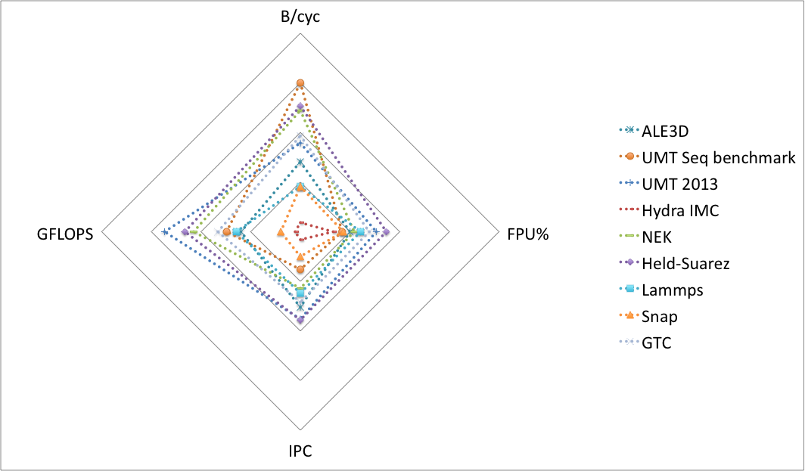
Metrics: Applications & Benchmarks HPM on IBM BG/Q data
Courtesy Bert Still and Ian Karlin, LLNL
Notes:
dotted: an application, a mini-app or a package from an application (Hydra IMC).HPM BG/Q

Slide 14
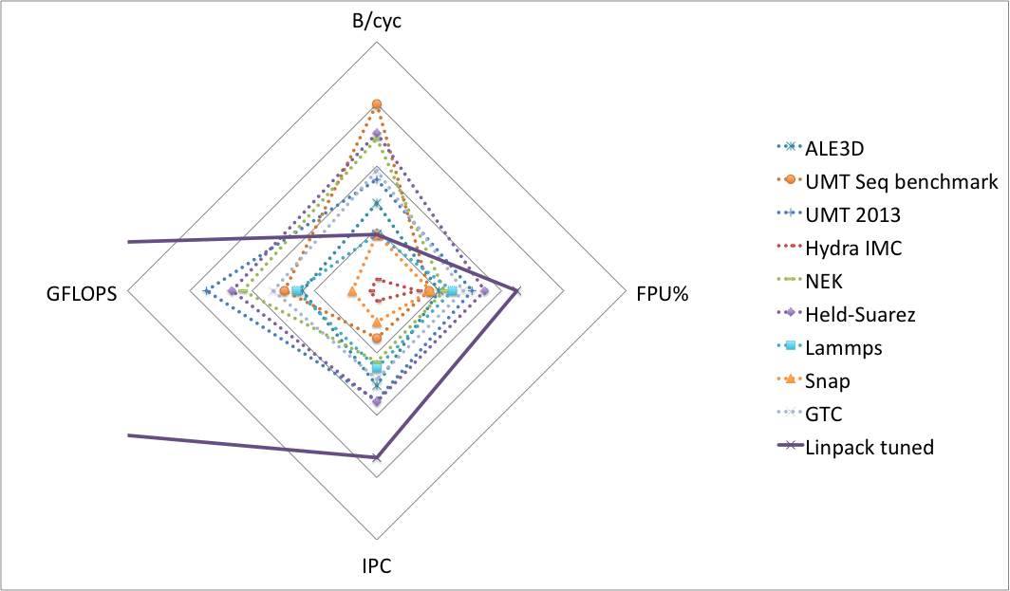
Metrics: Applications & Benchmarks HPM on IBM BG/Q data
Courtesy Bert Still and Ian Karlin, LLNL
Qbox & HACC removed (by LLNL)
Notes:
dotted: an application, a mini-app or a package from an application (Hydra IMC).HPM BG/Q

Slide 15
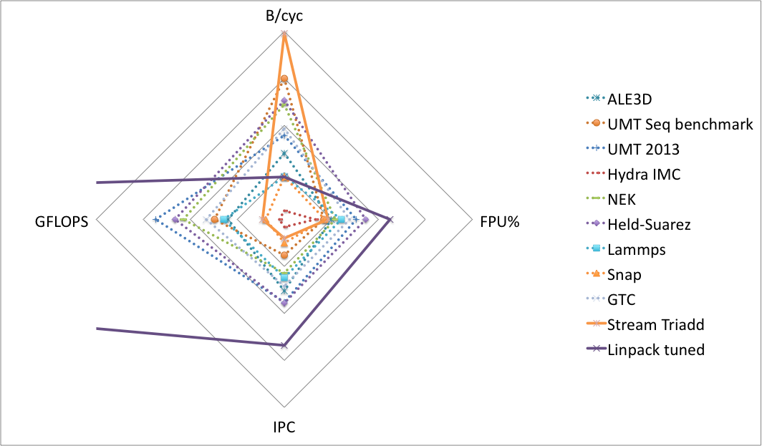
Metrics: Applications & Benchmarks HPM on IBM BG/Q data
Courtesy Bert Still and Ian Karlin, LLNL
Notes:
dotted: an application, a mini-app or a package from an application (Hydra IMC).HPM BG/Q

Slide 16
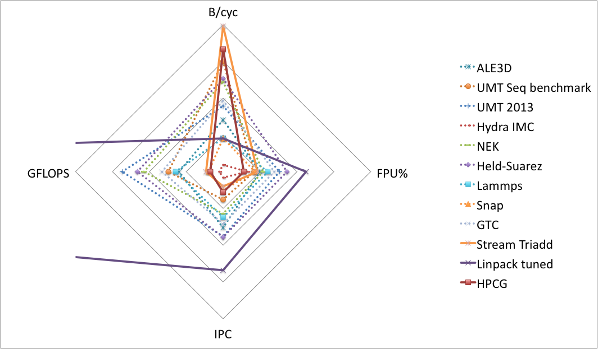
Metrics: Applications & Benchmarks HPM on IBM BG/Q data
Courtesy Bert Still and Ian Karlin, LLNL
Notes:
dotted: an application, a mini-app or a package from an application (Hydra IMC).HPM BG/Q
UMT 2013 - transport

Slide 17
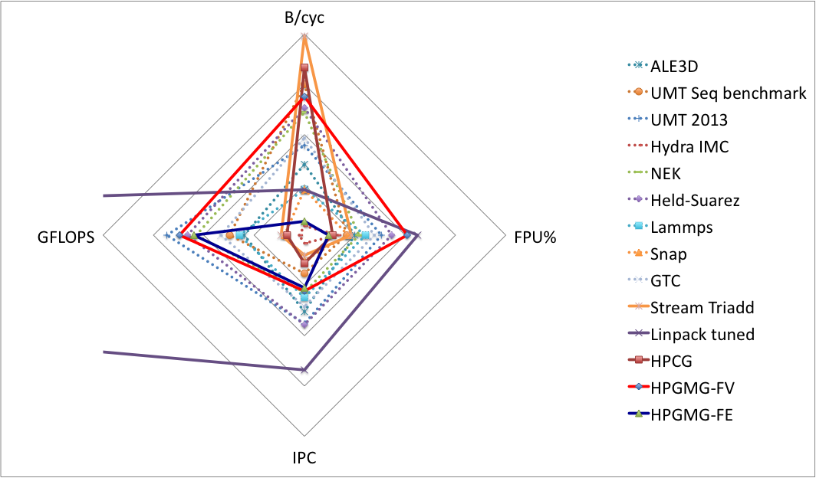
Metrics: Applications & Benchmarks HPM on IBM BG/Q data
(2nd order)
Broken
compiler
Courtesy Bert Still and Ian Karlin, LLNL
Notes:
dotted: an application, a mini-app or a package from an application (Hydra IMC).HPM BG/Q

Slide 18
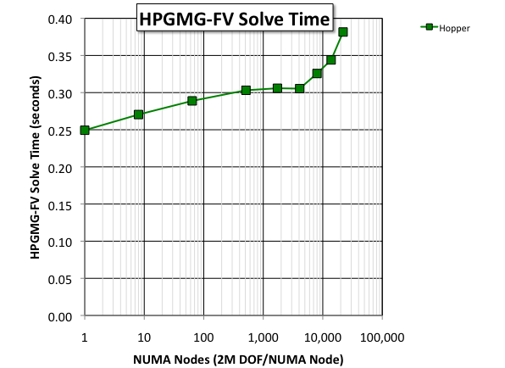
HPGMG-FV
3D Torus (Gemini)
Hopper (Cray XE6)
single process multigrid solve time is fast (250ms)
performance degrades at scale
larger problem sizes mitigate this lack of scalability
Scalability
of the Network
Performance
of the Processor

Slide 19
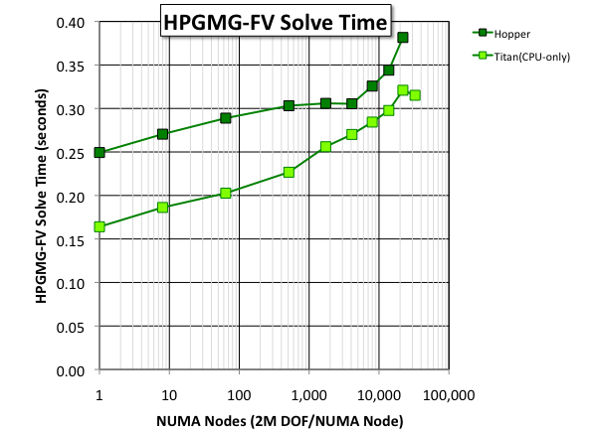
HPGMG-FV
3D Torus (Gemini)
Hopper (Cray XE6)
single process multigrid solve time is fast (250ms)
performance degrades at scale
larger problem sizes mitigate this lack of scalability
Titan (Cray XK7)
use only CPUs (same MPI+OpenMP)
delivered 50% better performance per socket and ~2x better overall performance
However, as Hopper and Titan both use Gemini, the network impeded performance at scale

Slide 20
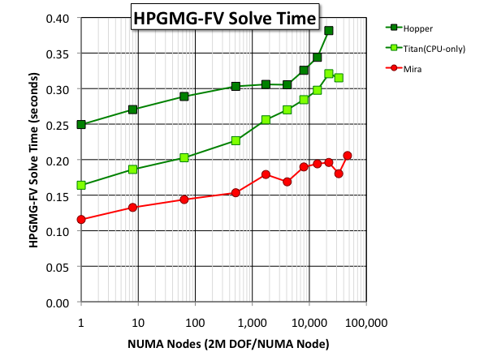
HPGMG-FV
Blue Gene/Q
Mira (Blue Gene/Q)
custom processor enabled better performance per socket
custom network (5D torus) enabled better scalability

Slide 21
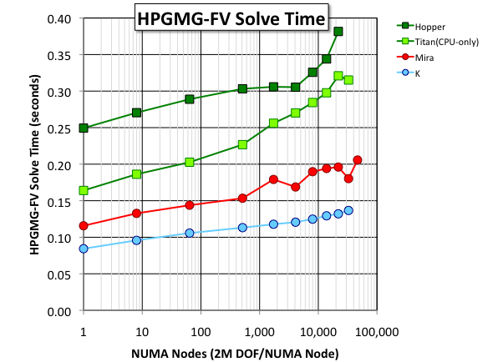
K (6D Torus/Mesh)
K (Sparc VIIIfx) at RIKEN
less flops per proc than BGQ
more bandwidth per proc than BGQ
= deliver better HPGMG-FV performance per node.
TOFU (6D) delivered similar (but smoother) scalability to BGQ

Slide 22
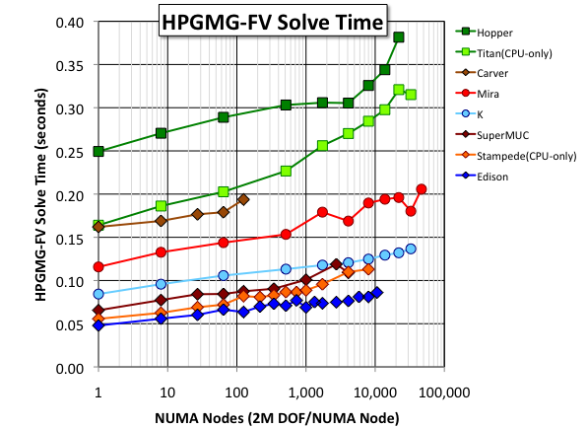
Fat Trees and Dragonfly
Xeon processors (IVB, SNB, NHM) are common on the Top500 today
Xeon performance defined by #cores, processor frequency, and memory frequency
Fat Trees saw degraded scaling beyond 1K sockets
XC30/Aries (Dragonfly), K (6D), and BGQ (5D) continued to scale well from 1K-48K sockets

Slide 23
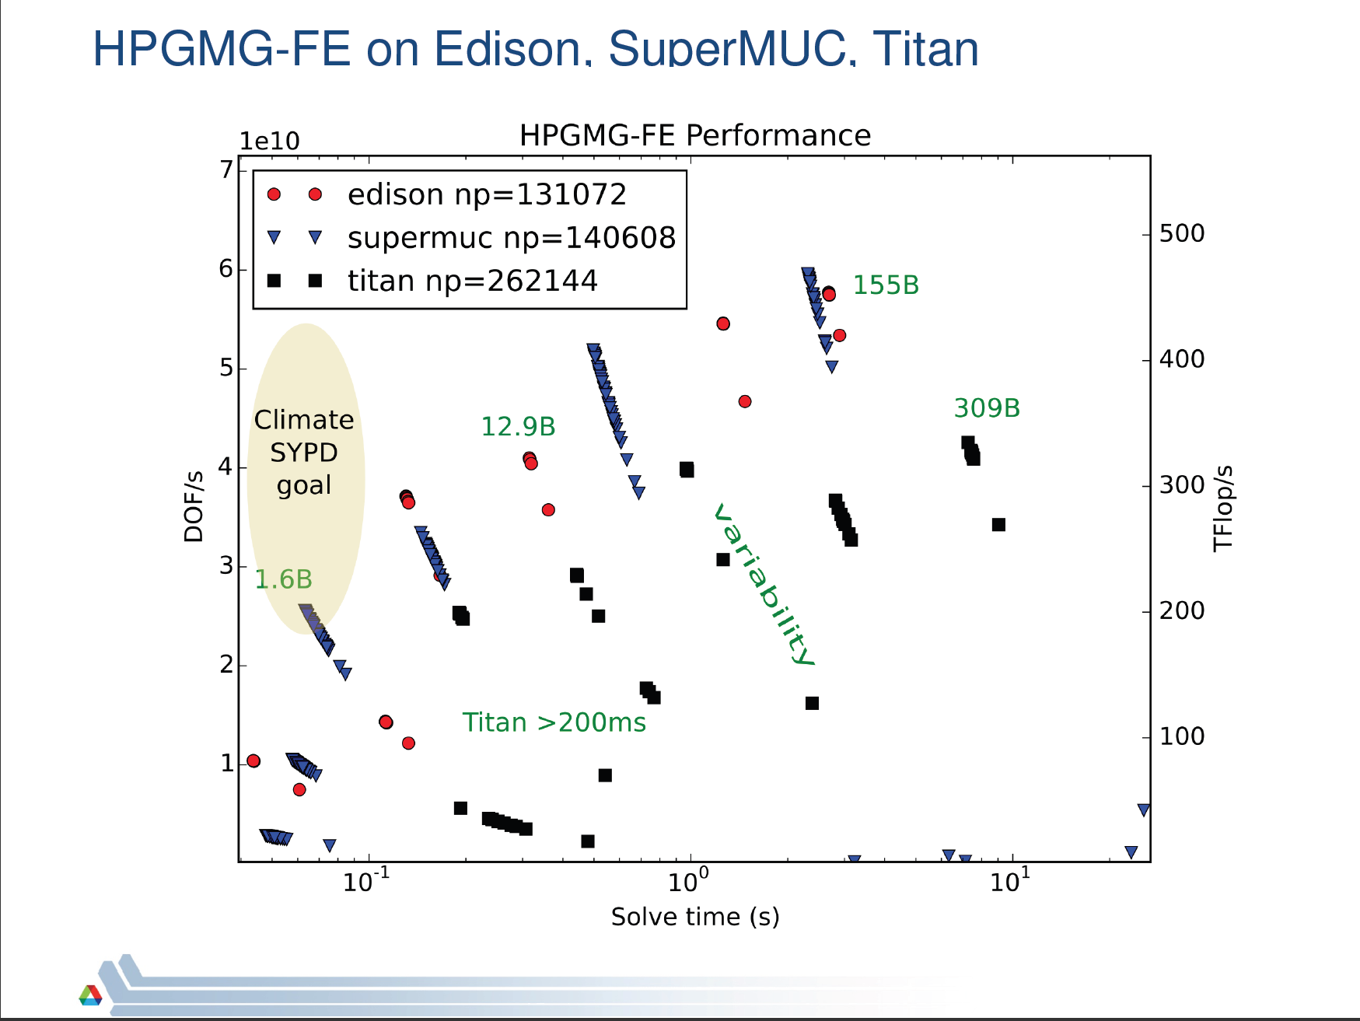
Machine spectra
The metric

Slide 24
Machine spectra
Perfect
The metric
Strong Scaling

Slide 25
Machine spectra
The metric
Strong Scaling

Slide 26
Machine spectra
The metric
Strong Scaling

Slide 27
Machine spectra
The metric
Strong Scaling

Slide 28
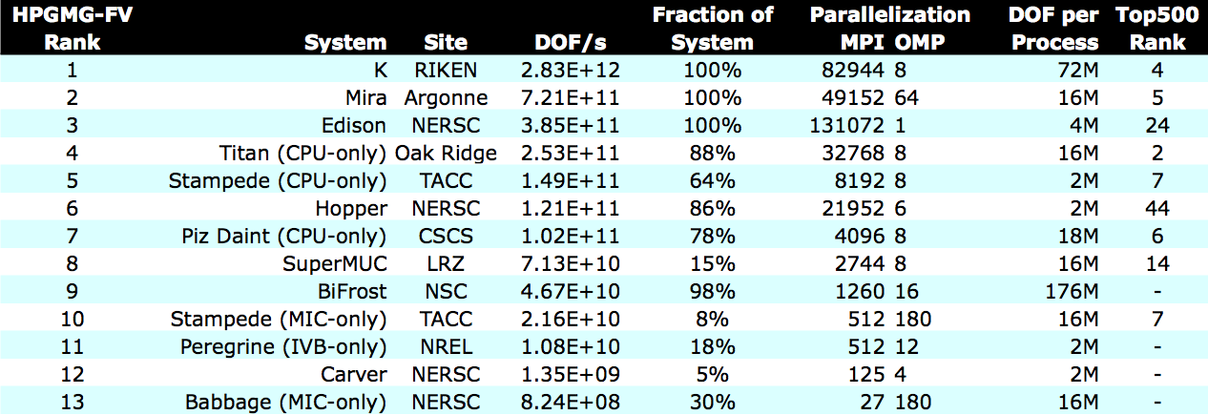
GMG500: getting ready first release

Slide 29
hpgmg.org
Three variants of HPGMG available (% peak FPU)
HPGMG-FV: Finite Volume, 2nd order, memory intensive (5)
HPGMG-FV: Finite Volume, (new) 4th order, memory/cache intensive (20)
HPGMG-FE: Finite Element, 3rd order, cache/floating-point intensive (25)
Reference Implementations (C + MPI) on https://bitbucket.org/hpgmg/hpgmg
We welcome community input and involvement:
hpgmg-forum@hpgmg.org
Welcome collaboration on metric design, metric acquisition tools, application pool (eg, CORAL), an analysis of correlation with application pool to rationally design a Top500 like metric

