Slide 1
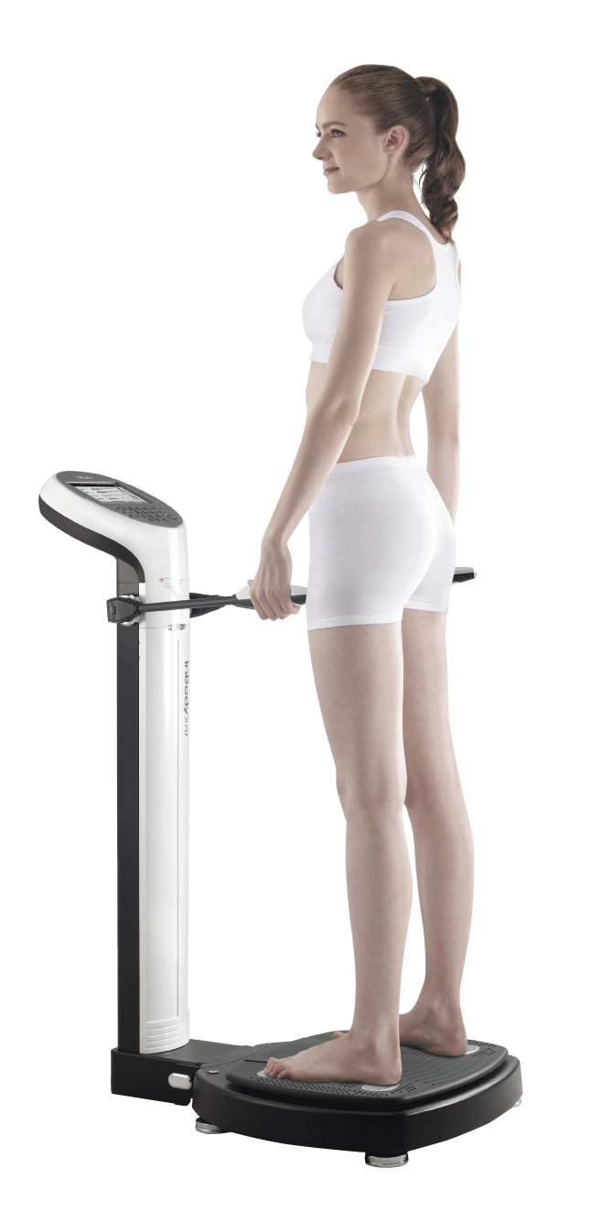
Applications of InBody in Bariatric Surgery
Ms. Sakshi Mhatre
Clinical Dietitian
InBody India

Slide 2
What is Bariatric Surgery?

Slide 3


INTRODUCTION
Bariatric = Baros: heaviness/Large/ Pressure/
It is the field of medicine encompassing the study of Obesity, Its causes, Prevention & treatment
Bariatric Surgery:
A therapeutic Intervention to understand and treated the causes and sequel of morbid obesity
Bariatric surgery involves reducing the size or capacity of the stomach by a series of surgical procedure for weight loss purposes.

Slide 4
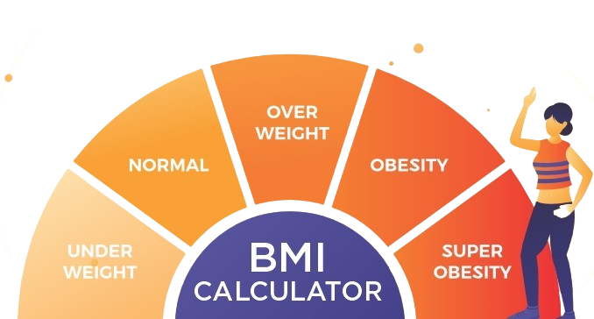
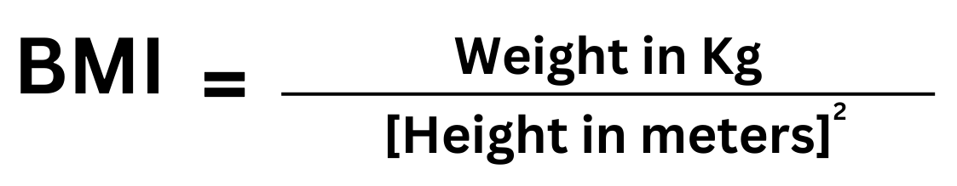
Body Mass Index
(BMI)
is a simple index of weight-for-height that is commonly used to
classify overweight and obesity in adults.
Defined as a person’s weight in kilograms divided by the square of his height in meters (kg/m2).

Slide 5
Bariatric surgery can help such cases of extreme obesity, when immediate weight loss is required
What is Bariatric Surgery?
Who is eligible for
Bariatric Surgery?
Bariatric surgery involves reducing the size or capacity of the stomach by a series of surgical procedure for weight loss purposes.
Morbidly obese people are the ones who opt for bariatric surgery. People with obesity and high diabetes also often opt for bariatric surgery. Bariatric surgery can help them shed some weight so that they can at least get moving and start exercising again.
Notes:
I’m sure that everyone already has heard so much about diabetes.
Diabetes has been on the rise, and currently 422 million adults have diabetes. This means 1 out of 11 person has diabetes.
As we can see on the chart, compared to 1980, number of diabetes patients has significantly rise.
However, the real reason we have to take good care of diabetes is because it has a lot of complications.

Slide 6
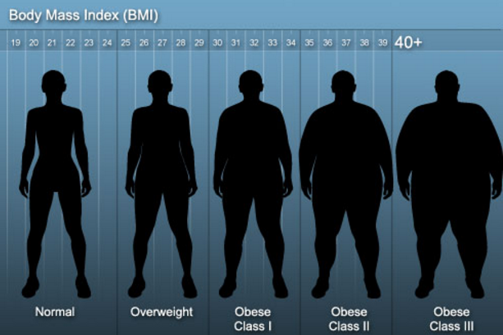
Bariatric Surgery in Latin America
Patients eligible for Bariatric Surgery
BMI ≥ 40, or more than 100 pounds overweight
BMI ≥ 35 and at least one or more obesity-related co-morbidities such as T2DM, Hypertension and so on
Inability to achieve a healthy weight loss sustained for a period of time with prior weight loss efforts.
From ASMBS (American society for Metabolic and Bariatric surgery)
※ Since the effort for weight loss should be accompanied after surgery, the patients of Bariatric surgery should have understanding of surgery process and willingness to lose his/her weight.

Slide 7
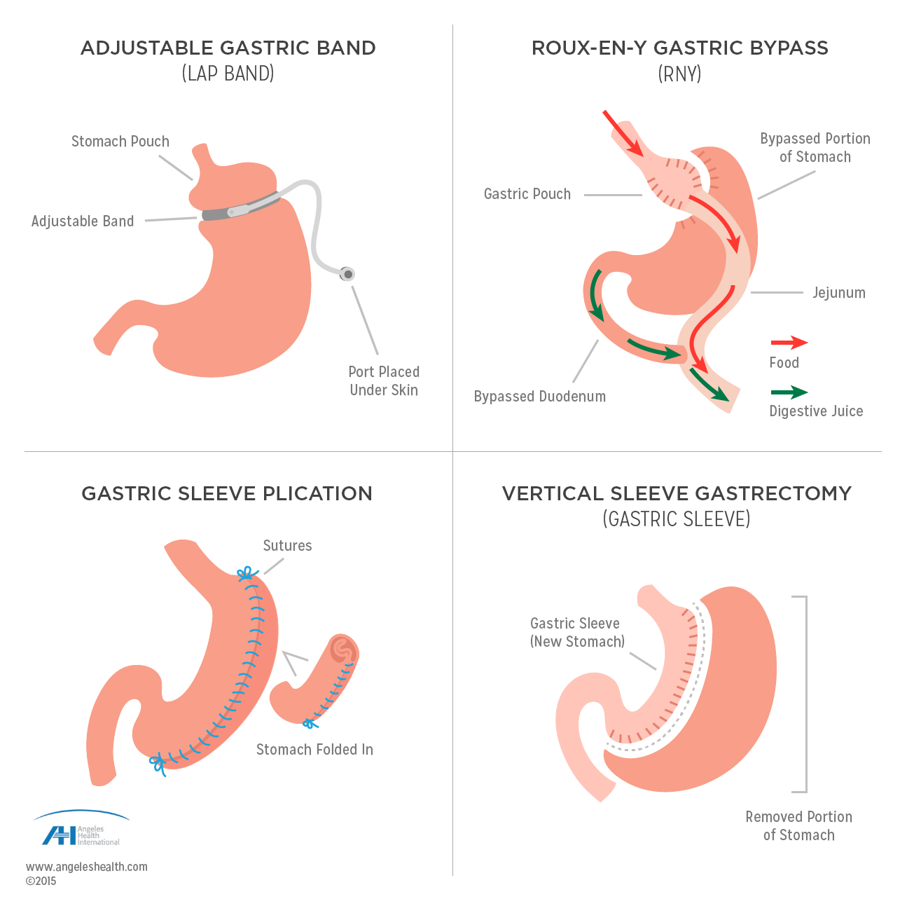
Types of Bariatric Surgery
4 Most Common Bariatric Surgeries
Adjustable Gastric Band (LAP BAND)
Gastric Sleeve Plication
Roux-En-Y Gastric Bypass
Vertical Sleeve Gastrectomy
(Gastric Sleeve)

Slide 8
Process of Bariatric Surgery
Before Surgery
Surgery
After Surgery
High protein liquid diet
Physical Exercise
Mental consultant
Taking a daily multivitamin & mineral
Adjustable gastric banding
Sleeve gastrectomy
Roux-en-Y gastric bypass
Following dietary program
Monitoring Balance of Protein, mineral, Carbs
Physical Exercise

Slide 9
& Bariatric Surgery

Slide 10
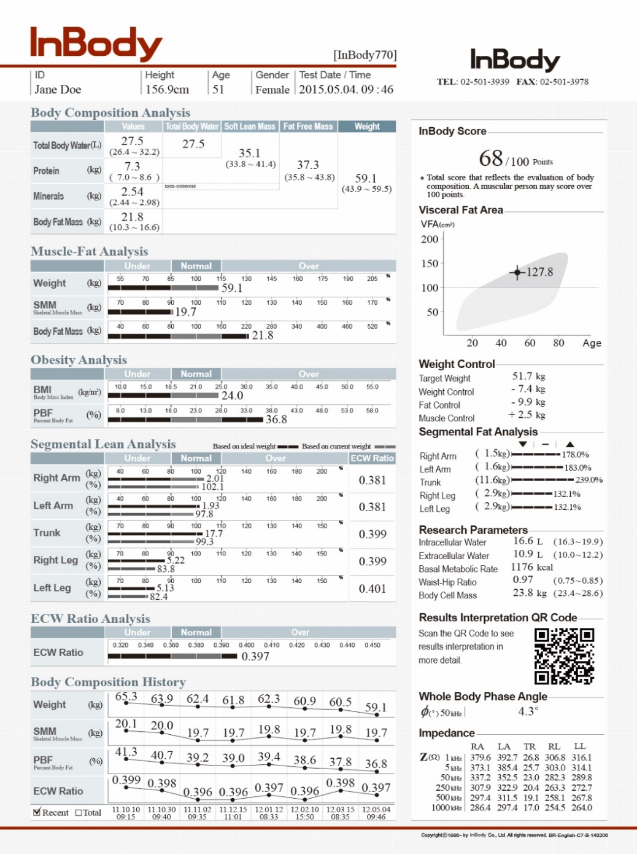
InBody in Bariatric Surgery
Pre-Surgery: Prediction of Surgery outcome
Body Composition: Obesity analysis
Phase Angle: Prediction of surgical outcomes

Slide 11

InBody in Bariatric Surgery
Pre-Surgery: Prediction of Surgery outcome
Body Composition: Obesity analysis
Phase Angle: Prediction of surgical outcomes
Post-Surgery: Post surgery management
ECW Ratio(ECW/TBW): Malnutrition monitoring
BMR: Monitoring weight recycling

Slide 12
InBody in Bariatric Surgery
Pre-Surgery: Prediction of Surgery outcome
Body Composition: Obesity analysis
Phase Angle: Prediction of surgical outcomes
Post-Surgery: Post-surgery Management
ECW Ratio(ECW/TBW): Malnutrition monitoring
ECW Ratio(ECW/TBW): Monitoring recovery
Patient Monitoring: Keeping the patients fit
BMR: Monitoring weight recycling
SMI: Monitoring Muscle Loss

Slide 13
Pre-Surgery

Slide 14
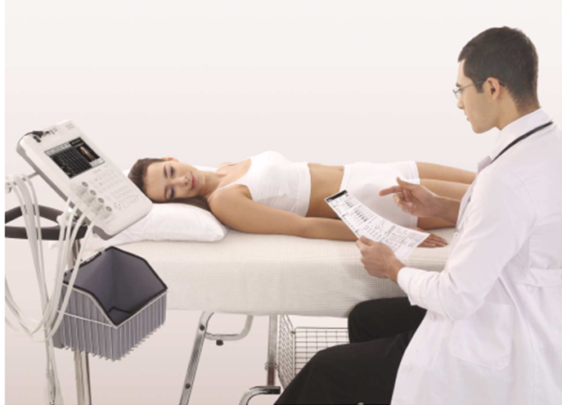
InBody in Bariatric Surgery
① Pre-surgery: Prediction of surgery outcome
Most appropriate treatment can be selected by analyzing obesity types before surgery.
InBody Test
Obesity type analysis
Minimize Risk of Surgery
Predict Success rate
Pre-Surgery
▷ Different types of obesity patients can have appropriate surgery based on their condition.
Body composition analysis
▷ Success rate of the surgery can be predicted by Phase angle parameter.
▷ Accurate analysis of patient will minimize the risk of surgery which can occur.

Slide 15
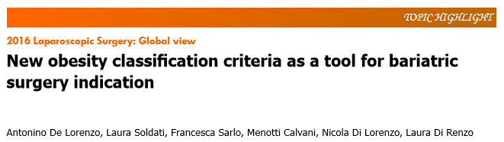
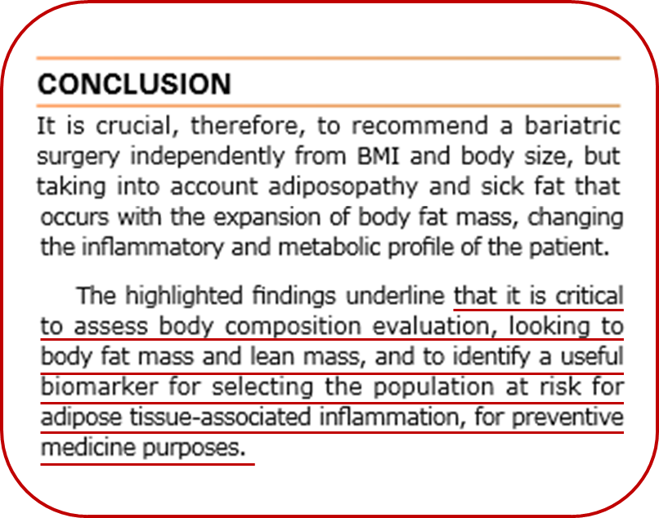
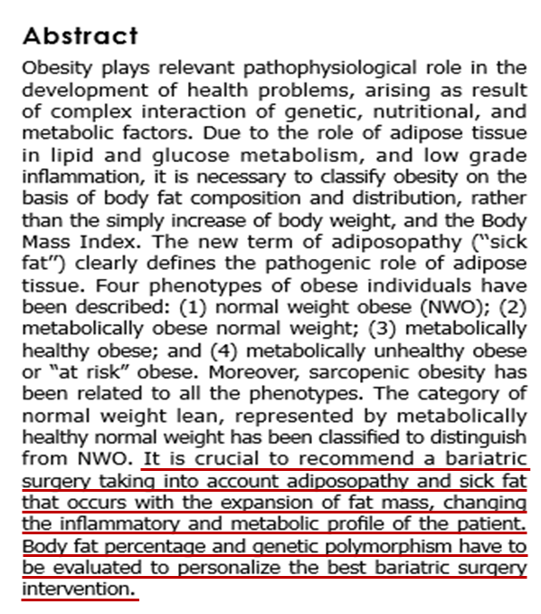
InBody in Bariatric Surgery
① Pre-surgery: Prediction of surgery outcome
Most appropriate treatment can be selected by analyzing obesity types before surgery.
Body composition analysis will give you a
guideline for selecting treatment.

Slide 16
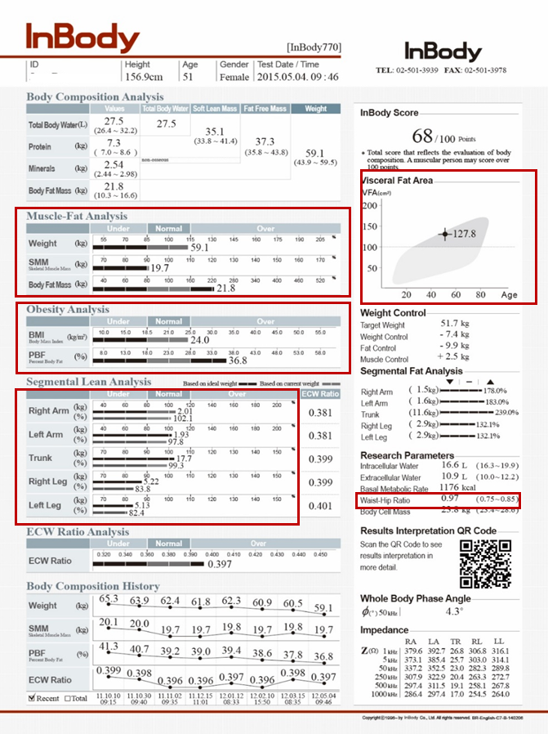

InBody in Bariatric Surgery
① Pre-surgery: Prediction of surgery outcome
BMI
Over normal
SMM>
Normal
SMM≤
Normal
ECW ratio>
Normal
ECW ratio ≤
Normal
VFA >
100cm²
VFA ≤
100cm²
Visceral Fat Obese
Subcutaneous fat Obese
Edematous
Obese
Muscular

Slide 17

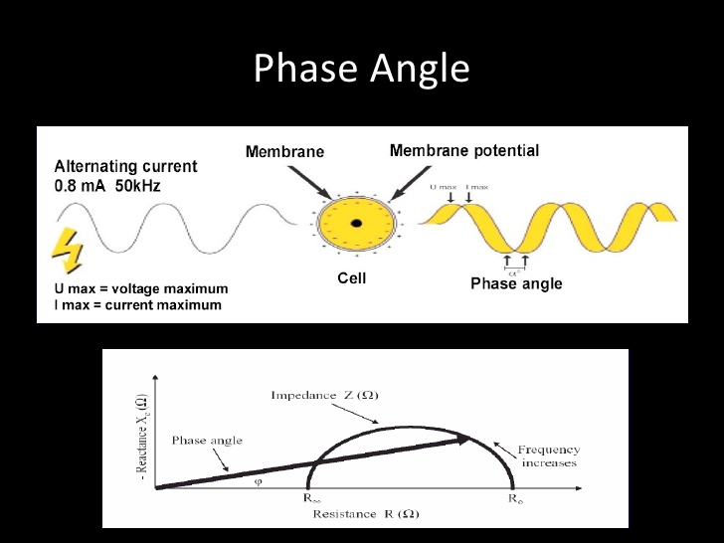
InBody in Bariatric Surgery
① Pre-surgery: Prediction of surgery outcome
Phase Angle can be a predictor for post-surgical outcomes.
phase angle is a parameter reflecting cell membrane integrity and physiological function which can be used as a weight loss predictor.
Phase angle
Success!
Success?

Slide 18
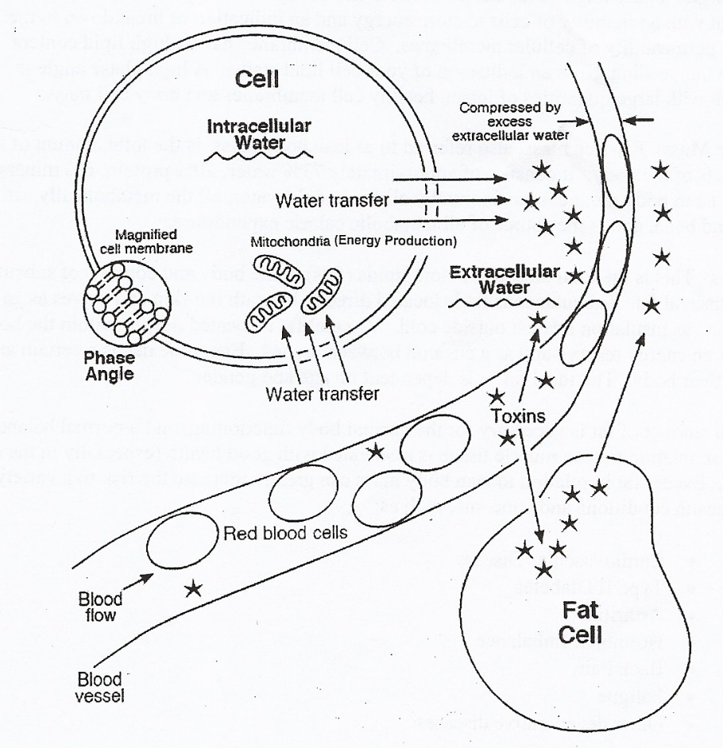
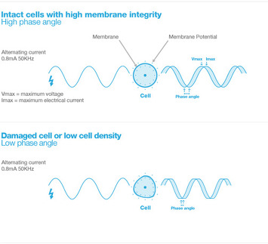
InBody in Bariatric Surgery
① Pre-surgery: Prediction of surgery outcome
Phase Angle can be a predictor for post-surgical outcomes.
Phase angle shows the nutrition level of cell mass and can be used for evaluating survival rate and nutrition level of cell mass.

Slide 19
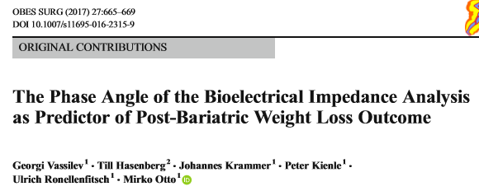
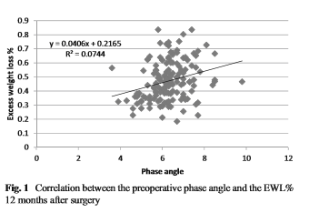
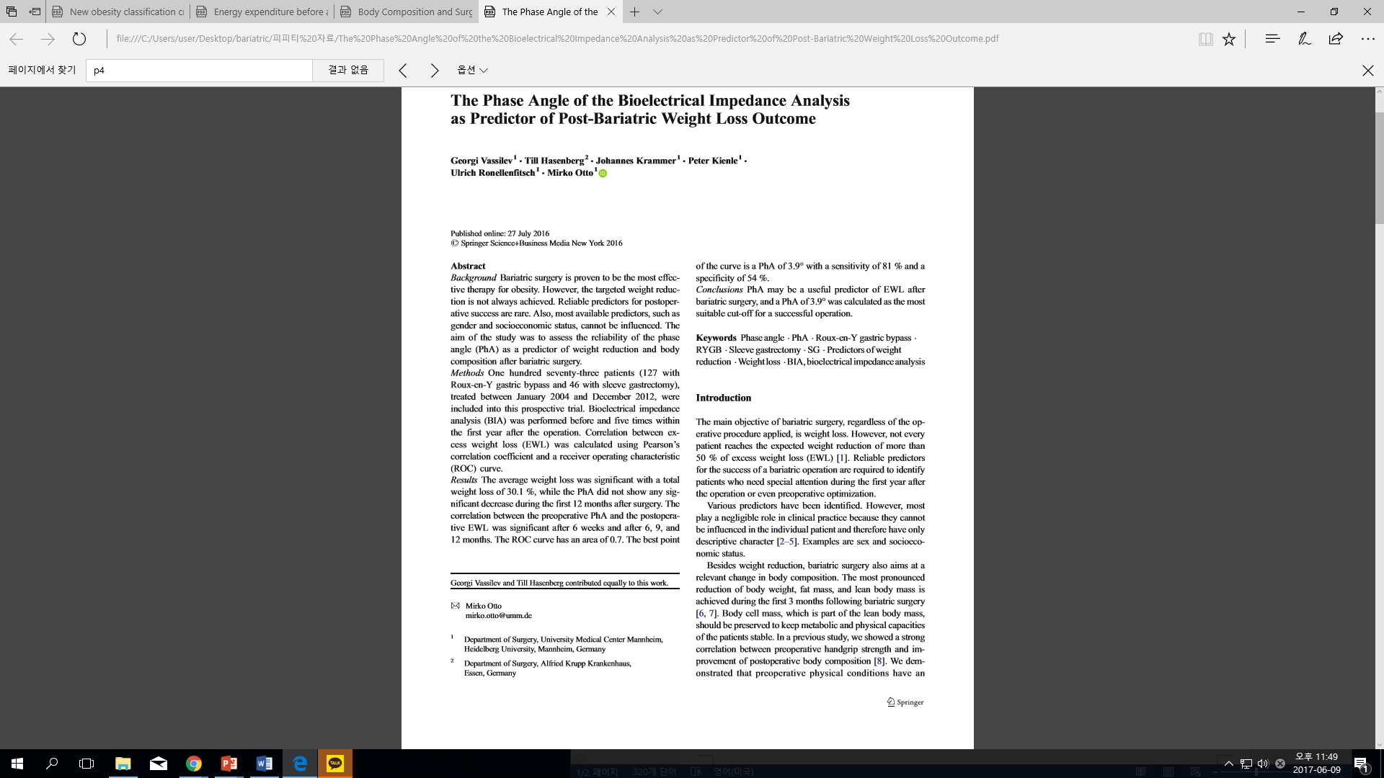
InBody in Bariatric Surgery
① Pre-surgery: Prediction of surgery outcome
Phase angle showed a close correlation with the EWL%(Exceww Weight Loss) after 6 weeks. 6 months, 9 months, 12 months surgery.
PhA can be used as predictor of weight loss success rate before bariatric surgery.

Slide 20
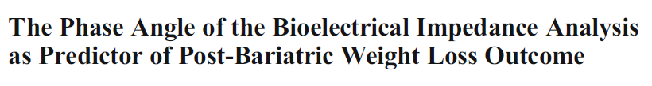
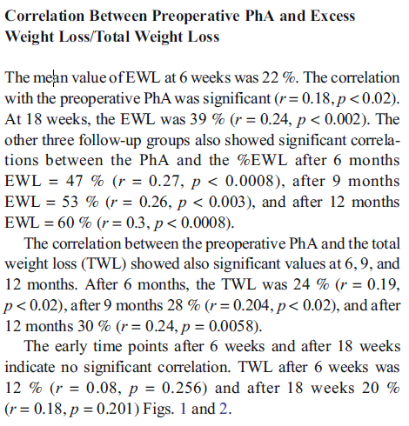

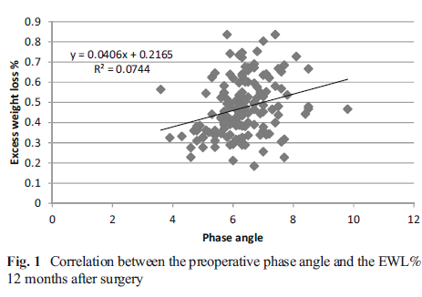
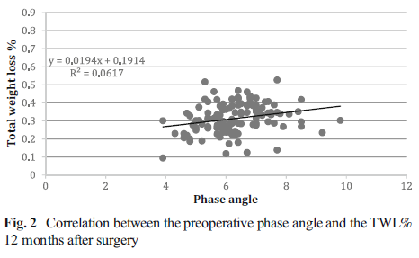

InBody in Bariatric Surgery
El ángulo de fase puede ser un predictor útil de pérdida de peso excesiva después de la cirugía

Slide 21
Post-Surgery

Slide 22
InBody in Bariatric Surgery
② Post-surgery: Post-surgery Management
Monitoring Individual to help in successful recovery
InBody Test
Malnutrition Prevention
Successful
Recovery
Recovery Monitoring
Post-Surgery
▷ Malnutrition is one of the post-surgical issues in bariatric surgery.
-> ECW ratio from InBody can monitor malnutrition in post-surgical patients
▷ Monitoring post-surgical edema for tracking recovery.
-> InBody measures water volume that can track edema in whole body and in each segments.

Slide 23
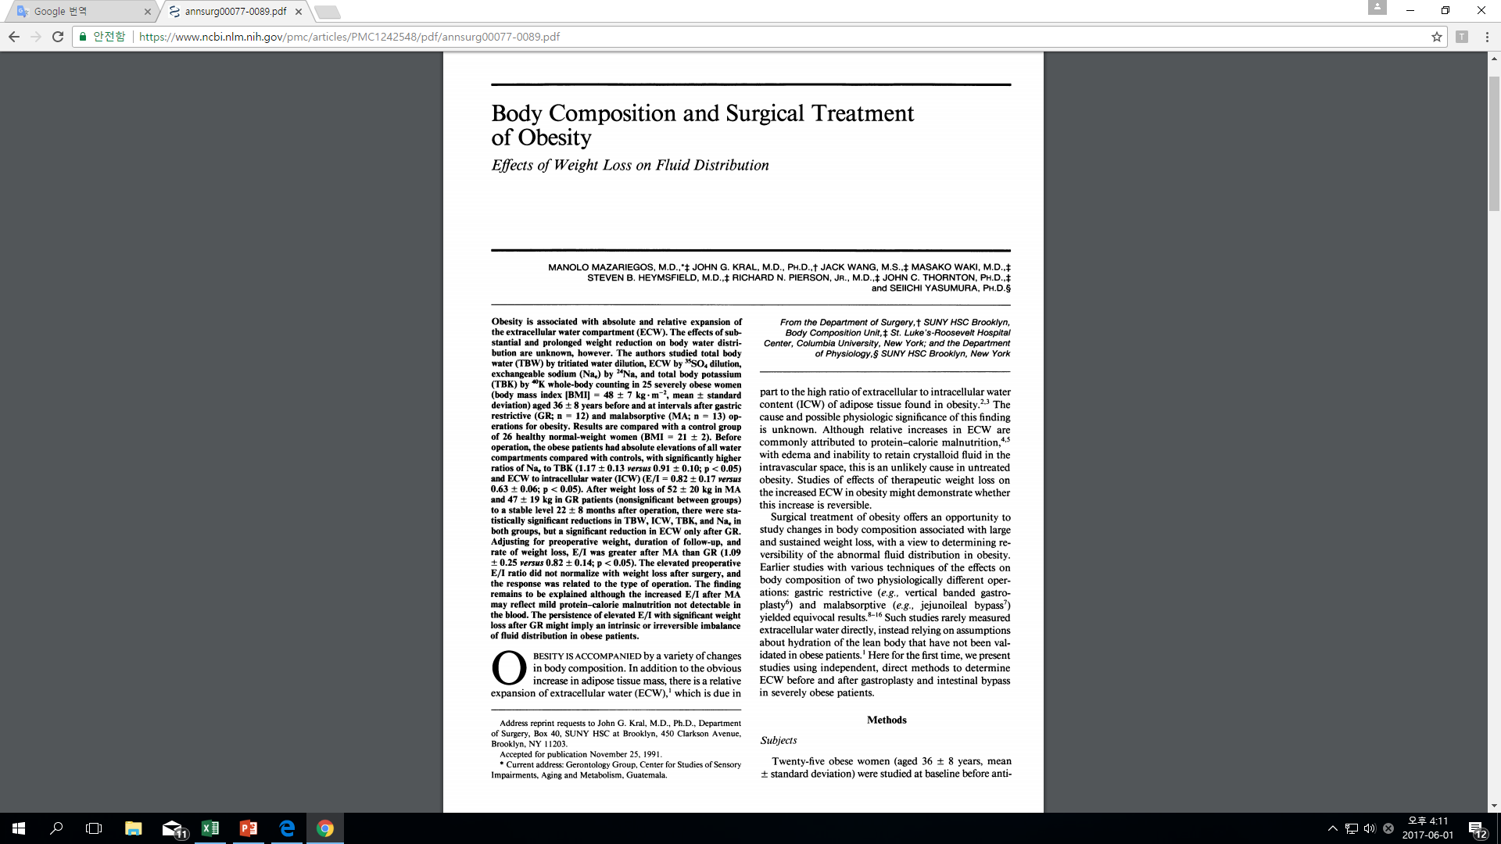
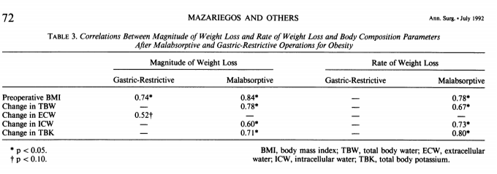
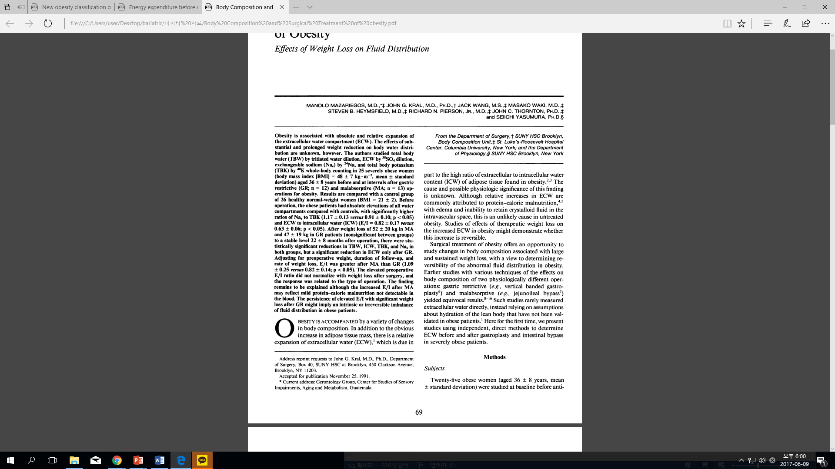
InBody in Bariatric Surgery
② Post-surgery: Post-surgery Management
Monitoring Individual to help in successful recovery
ECW/ICW was increased after duodenoileal bypass surgery which is a absorption limiting procedure.
ECW/ICW can be used as tool for evaluation of nutrition status after bariatric surgery.

Slide 24
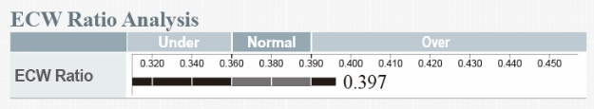
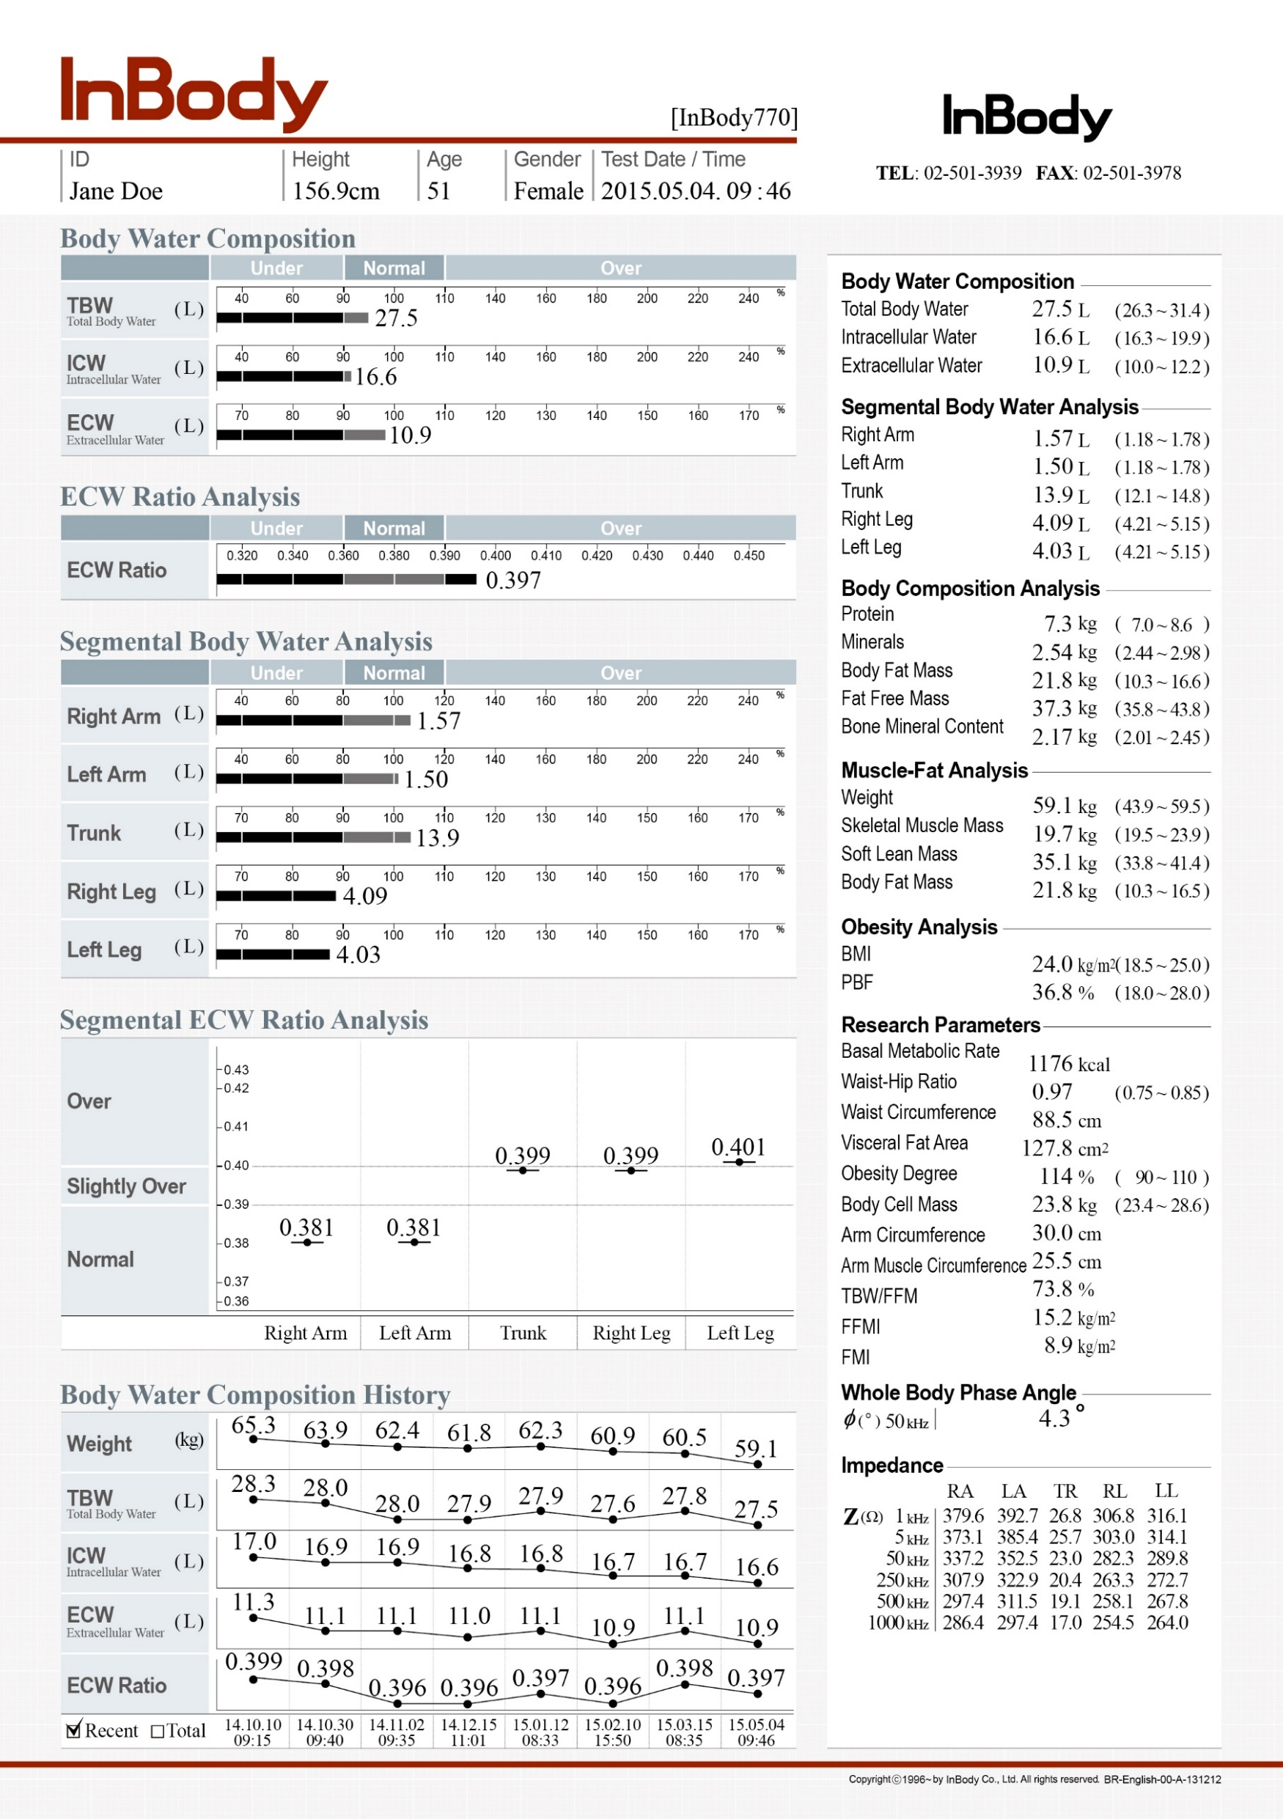
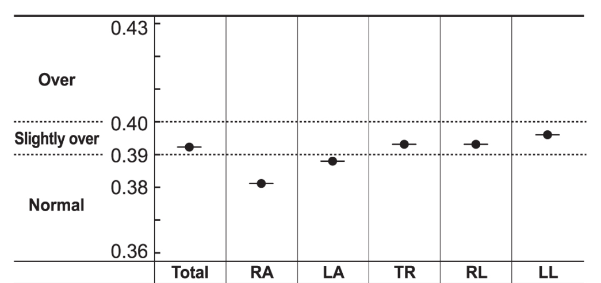
InBody in Bariatric Surgery
② Post-surgery: Post-surgery Management
Monitoring Individual to help in successful recovery
After surgery by using the ECW Ratio, we can see how well the patient is recovering from surgery.
If the ECW ratio comes down to the normal, which means the patient has recovered well and does not have edema any more, We can track the actual fat, muscle decrease from the surgery and keep on monitoring the body composition change of the patient.

Slide 25
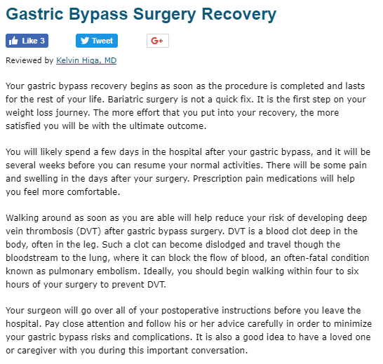
InBody in Bariatric Surgery
② Post-surgery: Post-surgery Management
Monitoring Individual to help in successful recovery

Slide 26
InBody in Bariatric Surgery
③ Patient Monitoring
Monitoring Individual to help in successful weight loss
InBody Test
Prevent Weight Recycling
Successful
Weight Reduction
Prevent Muscle Loss
Post-Surgery
▷ Majority of the patients tend to re-gain weight after surgery.
-> Preventing patients from weight recycling in very important
▷ Patients tend to lose muscle after surgery.
->Keeping certain amount of muscle helps maintain the weight loss

Slide 27
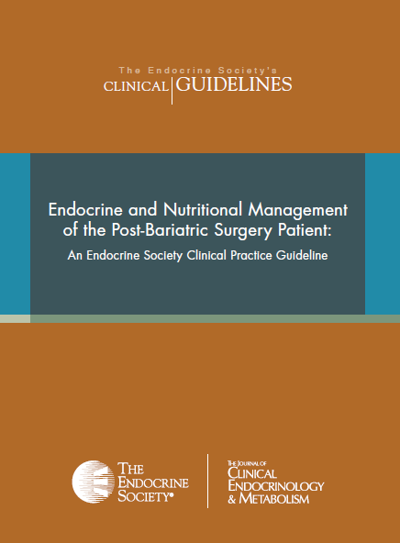

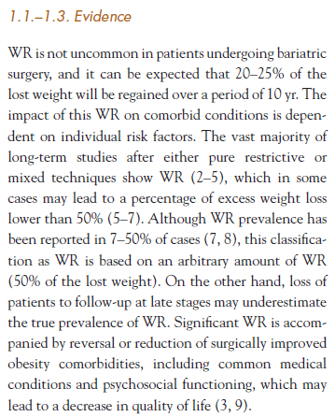
InBody in Bariatric Surgery
③ Patient Monitoring
Continuous Follow-up Management affects Sustaining Weight Loss
One of the most common side effects after bariatric surgery is regaining of weight. Against patients’ wishes, weight can be increased despite of bariatric surgery and this may be related with various complications
Weight regain is not uncommon in patients undergoing bariatric surgery and it can be expected that 20%-25% of the lost weight will be regained over a period of 10yr.
Endocrine and Nutritional Management of the Post-Bariatric Surgery Patient (P.7)

Slide 28
InBody in Bariatric Surgery
③ Patient Monitoring
Continuous Follow-up Management affects Sustaining Weight Loss
In order to prevent weight re-gain, continuous and intensive management is necessary. Continuous visit and follow-up management can affect positively on weight loss maintenance.
Impact of Follow-Up on Weight Loss For LAGB and RYGB
Mean % EWL at 1 Year
67.6
66.1
50.4
41.9
(N=130)
(N=56)
(N=53)
(N=62)
LAGB
RYGB
Procedure: Number of F/U Visits
Shen R, et al, Obes surg 2004; 14: 514-9

Slide 29
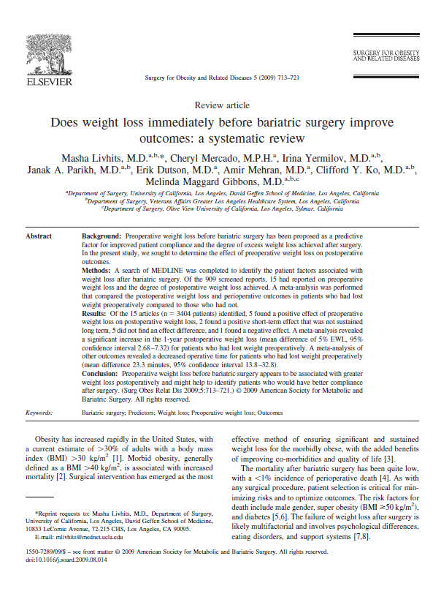
InBody in Bariatric Surgery
③ Patient Monitoring
Continuous Follow-up Management affects Sustaining Weight Loss
“ Preoperative weight loss before bariatric surgery appears to be associated with greater weight loss postoperatively and might help to identify patients who would have better compliance after surgery. ”

Slide 30
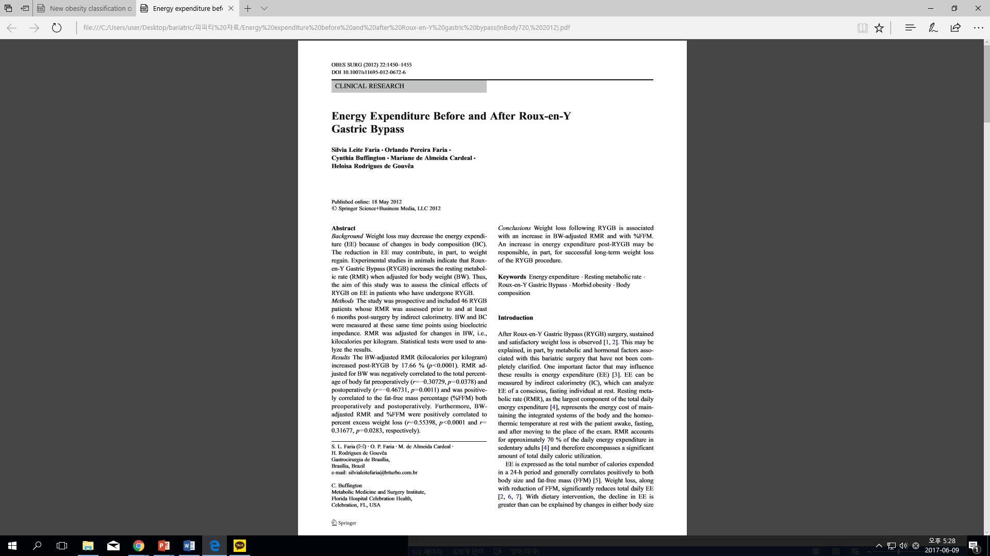
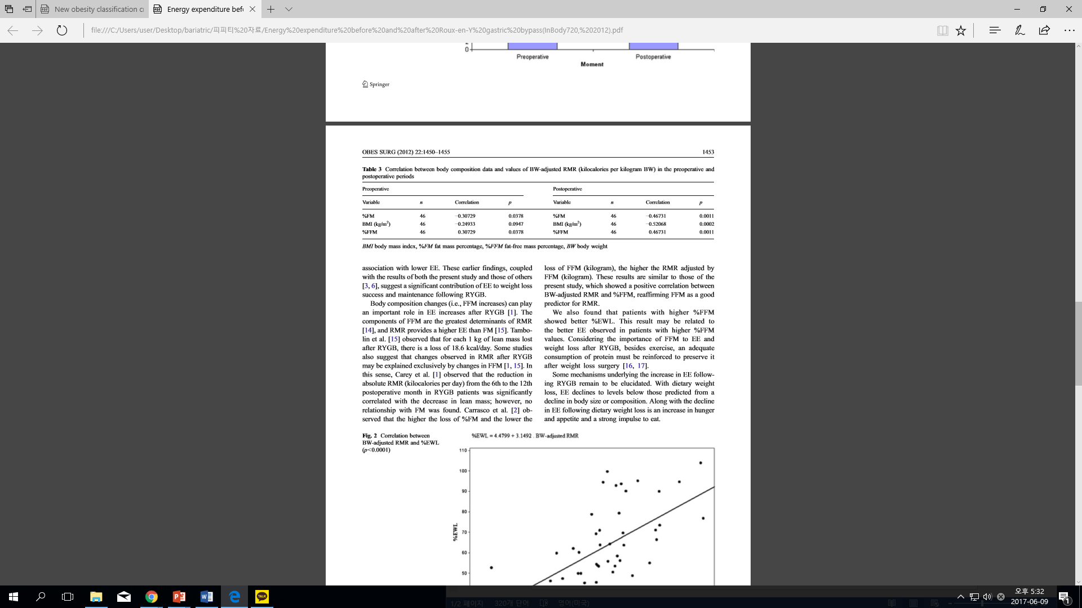
InBody in Bariatric Surgery
③ Patient Monitoring
Monitoring Individual to help in successful weight loss
This study is conducted on 46 patients to see the relationship between RMR and body composition before surgery.
Results show that increase in energy-expenditure may be a predictor for successful long-term weight loss of RYGB.
Maintaining FFM & RMR by monitoring from InBody parameter, it can prevent the patient from weight re-gain after bariatric surgery.

Slide 31
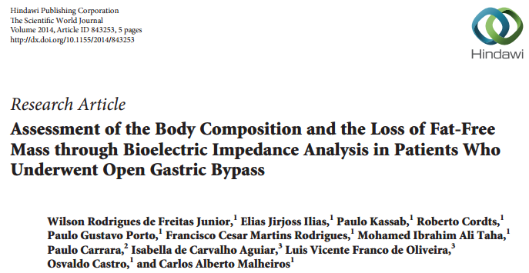
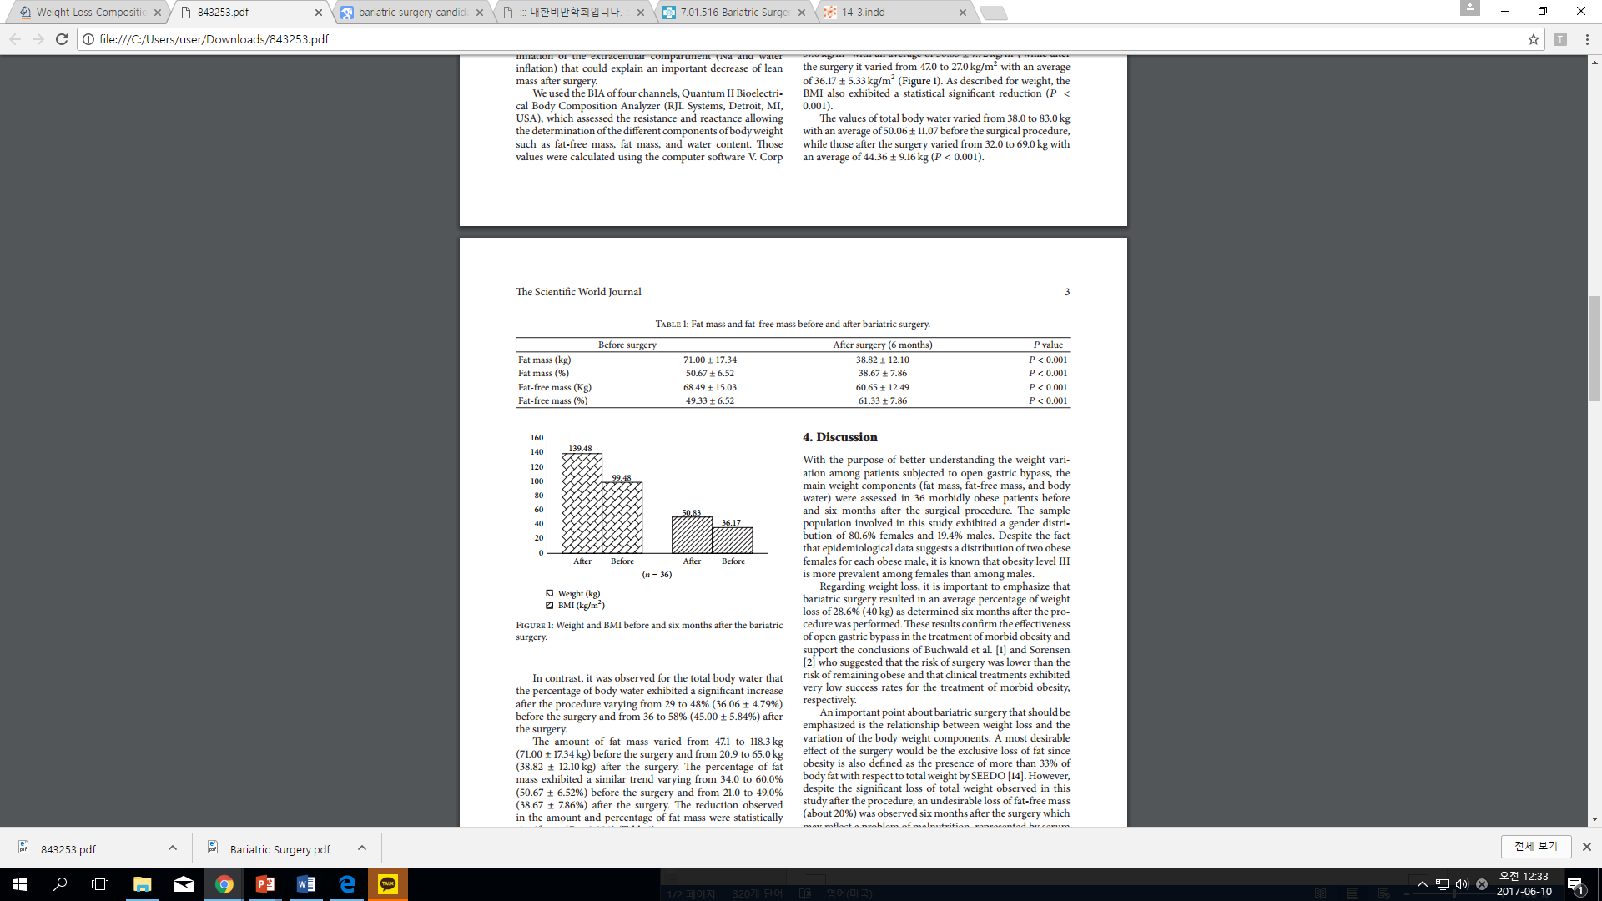
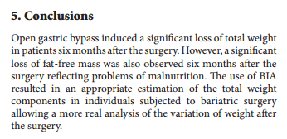
InBody in Bariatric Surgery
③ Patient Monitoring
Monitoring Individual to help in successful weight loss
After open gastric bypass, there was significant weight loss. However, a significant loss of fat-free mas was also observed six months after the surgery.
The use of BIA resulted in an appropriate estimation of total weight components in individuals subjected to bariatric surgery allowing a more real analysis of the variation of weight after the surgery.
Body composition analysis by BIA technology will give customized guide line/management for patients.

Slide 32
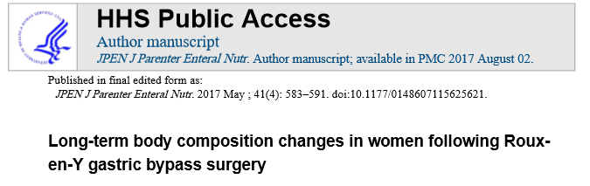
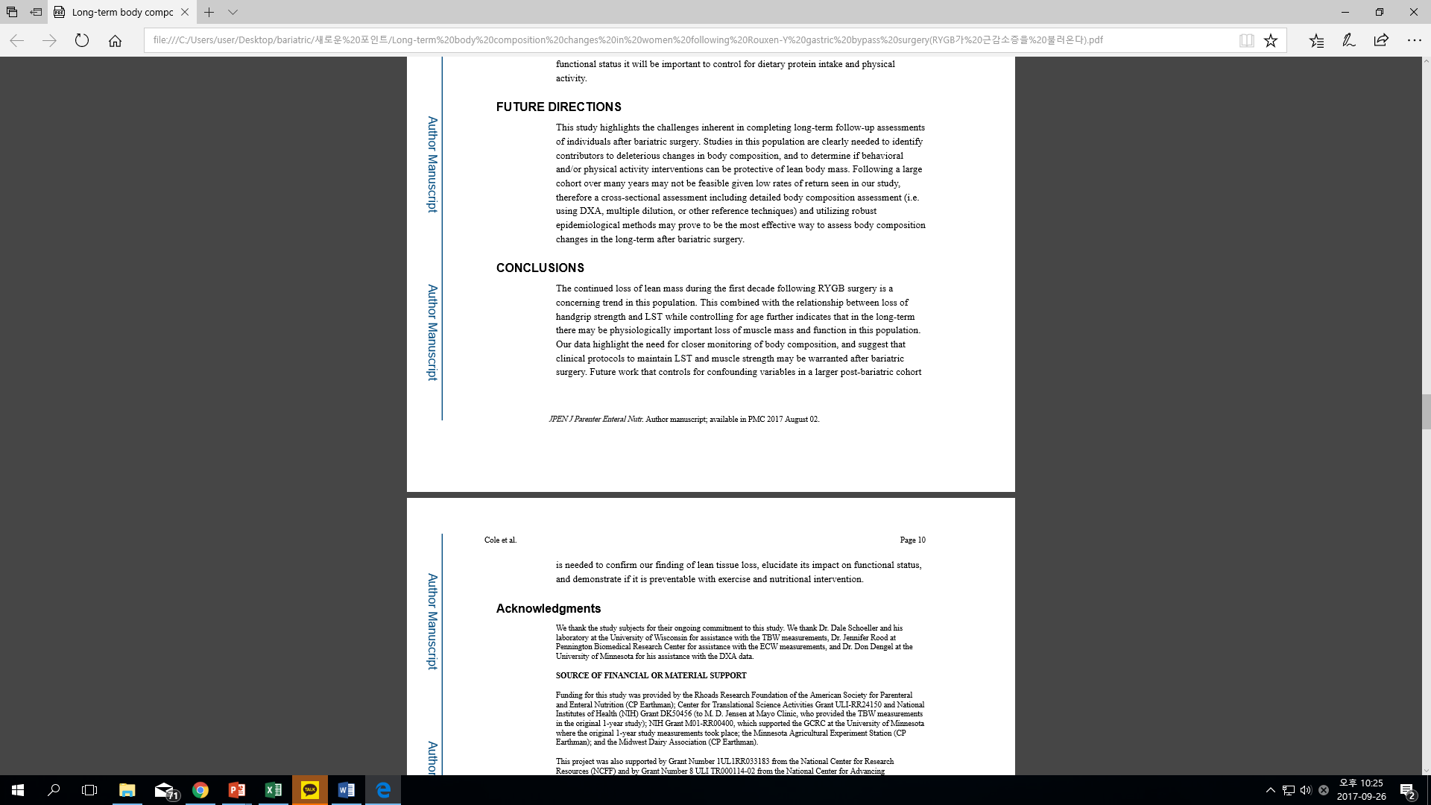
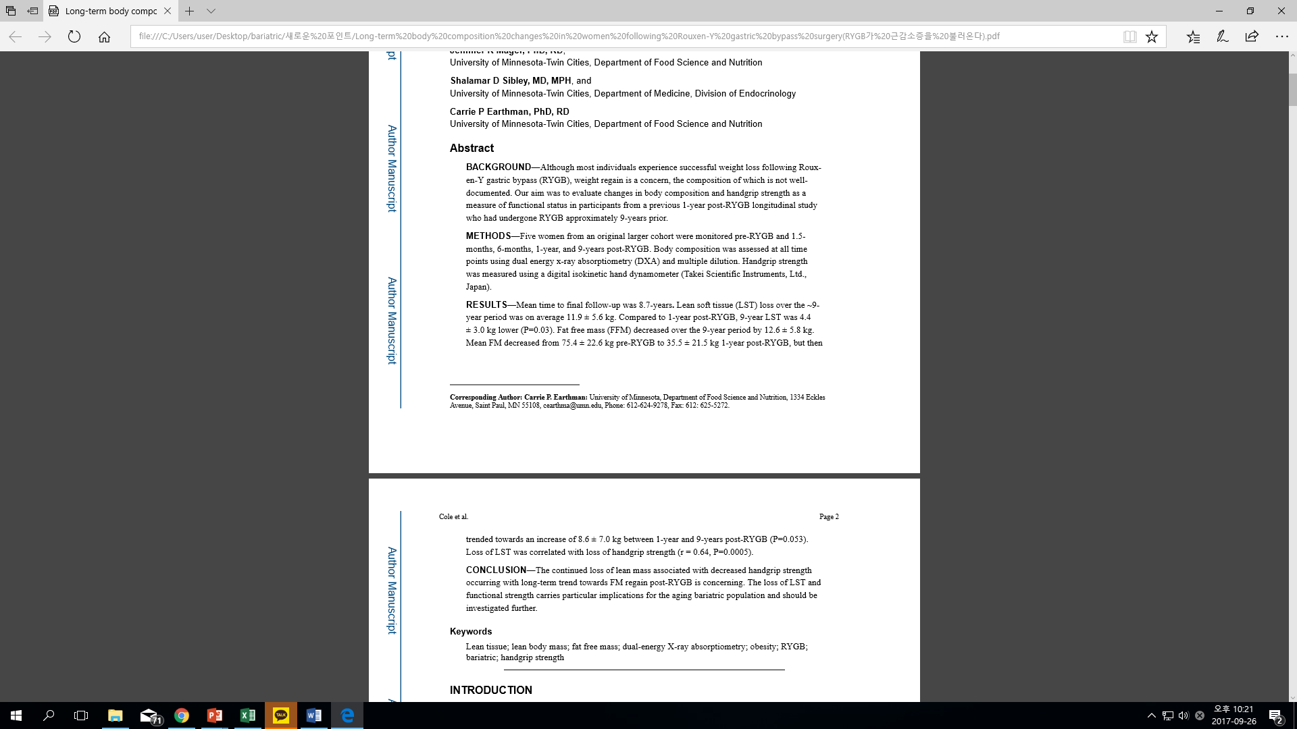
InBody in Bariatric Surgery
③ Patient Monitoring
Monitoring Individual to help in successful weight loss
FFM tends to decrease continuously after Roux-en-Y gastric bypass surgery.
Monitoring is necessary in order to maintain FFM and muscle strength.
Skelectal Muscle mass Index (SMI) can be used for preventing sarcopenia after surgery.

Slide 33
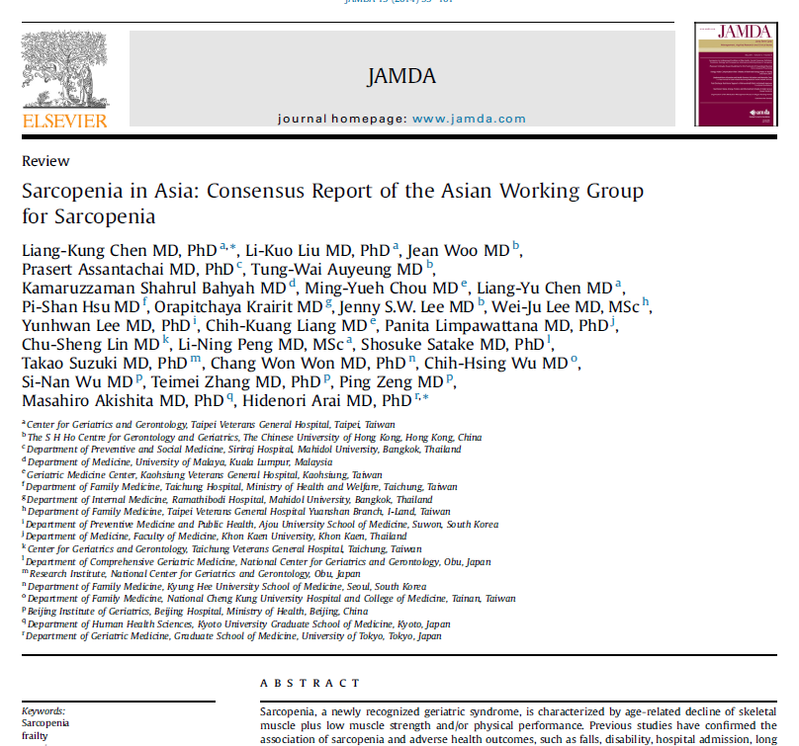
InBody in Bariatric Surgery
③ Patient Monitoring
Cut-off for Sarcopenia (Asian)
Skeletal Muscle mass Index
Appendicular Skeletal Muscle Mass/height2
MALE : 7.0kg/m² FEMALE : 5.7kg/m²

Slide 34
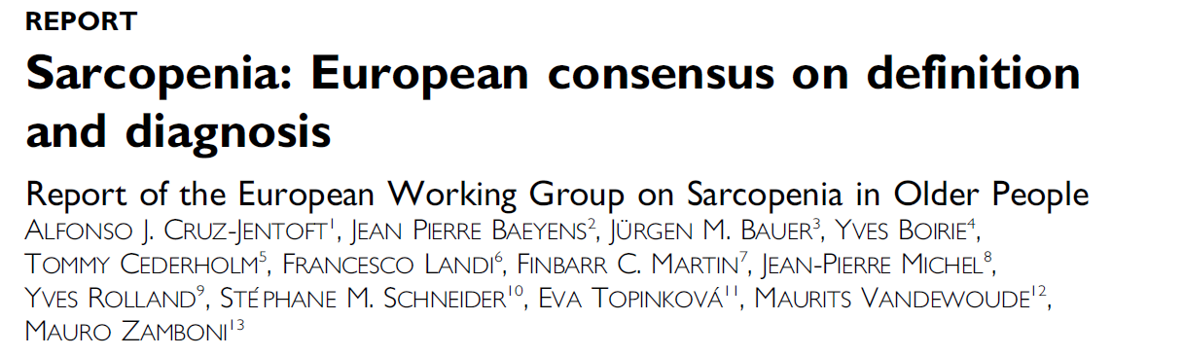
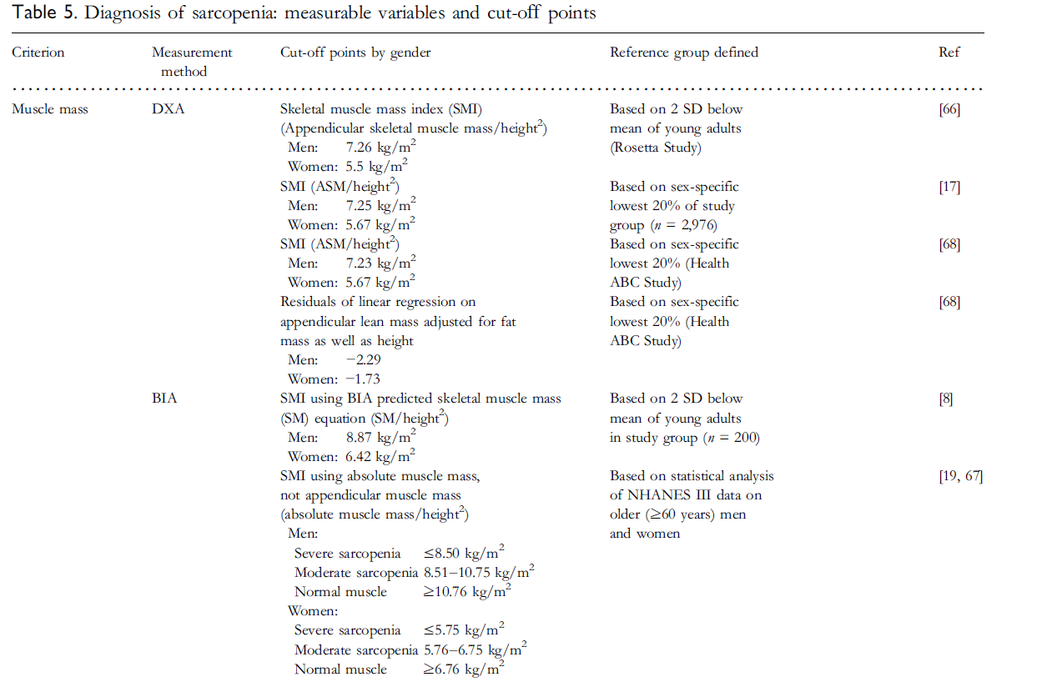
InBody in Bariatric Surgery
③ Patient Monitoring
Cut-off for Sarcopenia (European)
(Age Ageing. 2010 Jul;39(4):412-23)

Slide 35
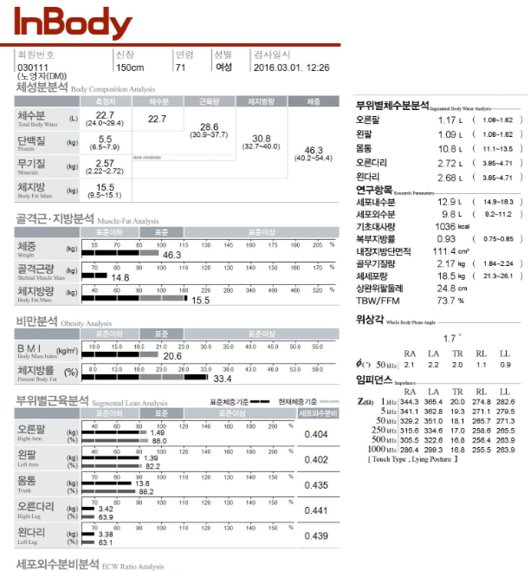
InBody in Bariatric Surgery
③ Patient Monitoring
Sarcopenia evaluation through BIA
`
`
Skeletal Muscle mass Index
(Appendicular SMM ÷ Height^2) is less than the standard → Sarcopenia
Journal of the American Medical Directors Association 15(2):95-101, 2014
Appendicular SMM ÷ Height Square
9.68 ÷ 2.25 = 4.30
※ Female / 150㎝ / 46.3kg

Slide 36
Case Studies

Slide 37

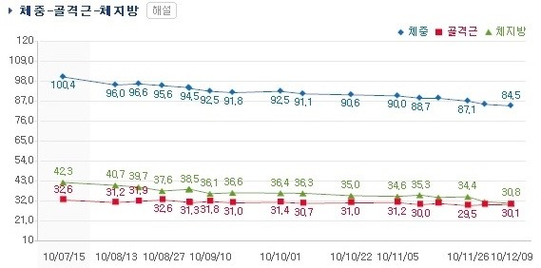
Laparoscopic adjustable gastric banding (LAGB)
Case Study 1
Weight
Percent Body Fat
Weight & SMM
Skeletal Muscle
Weight: 100.4 kg
%BF: 42.3 %
SMM: 32.6 kg
Weight: 84.5 kg
%BF: 30.8 %
SMM: 30.1 kg
(After 4 months)

Slide 38
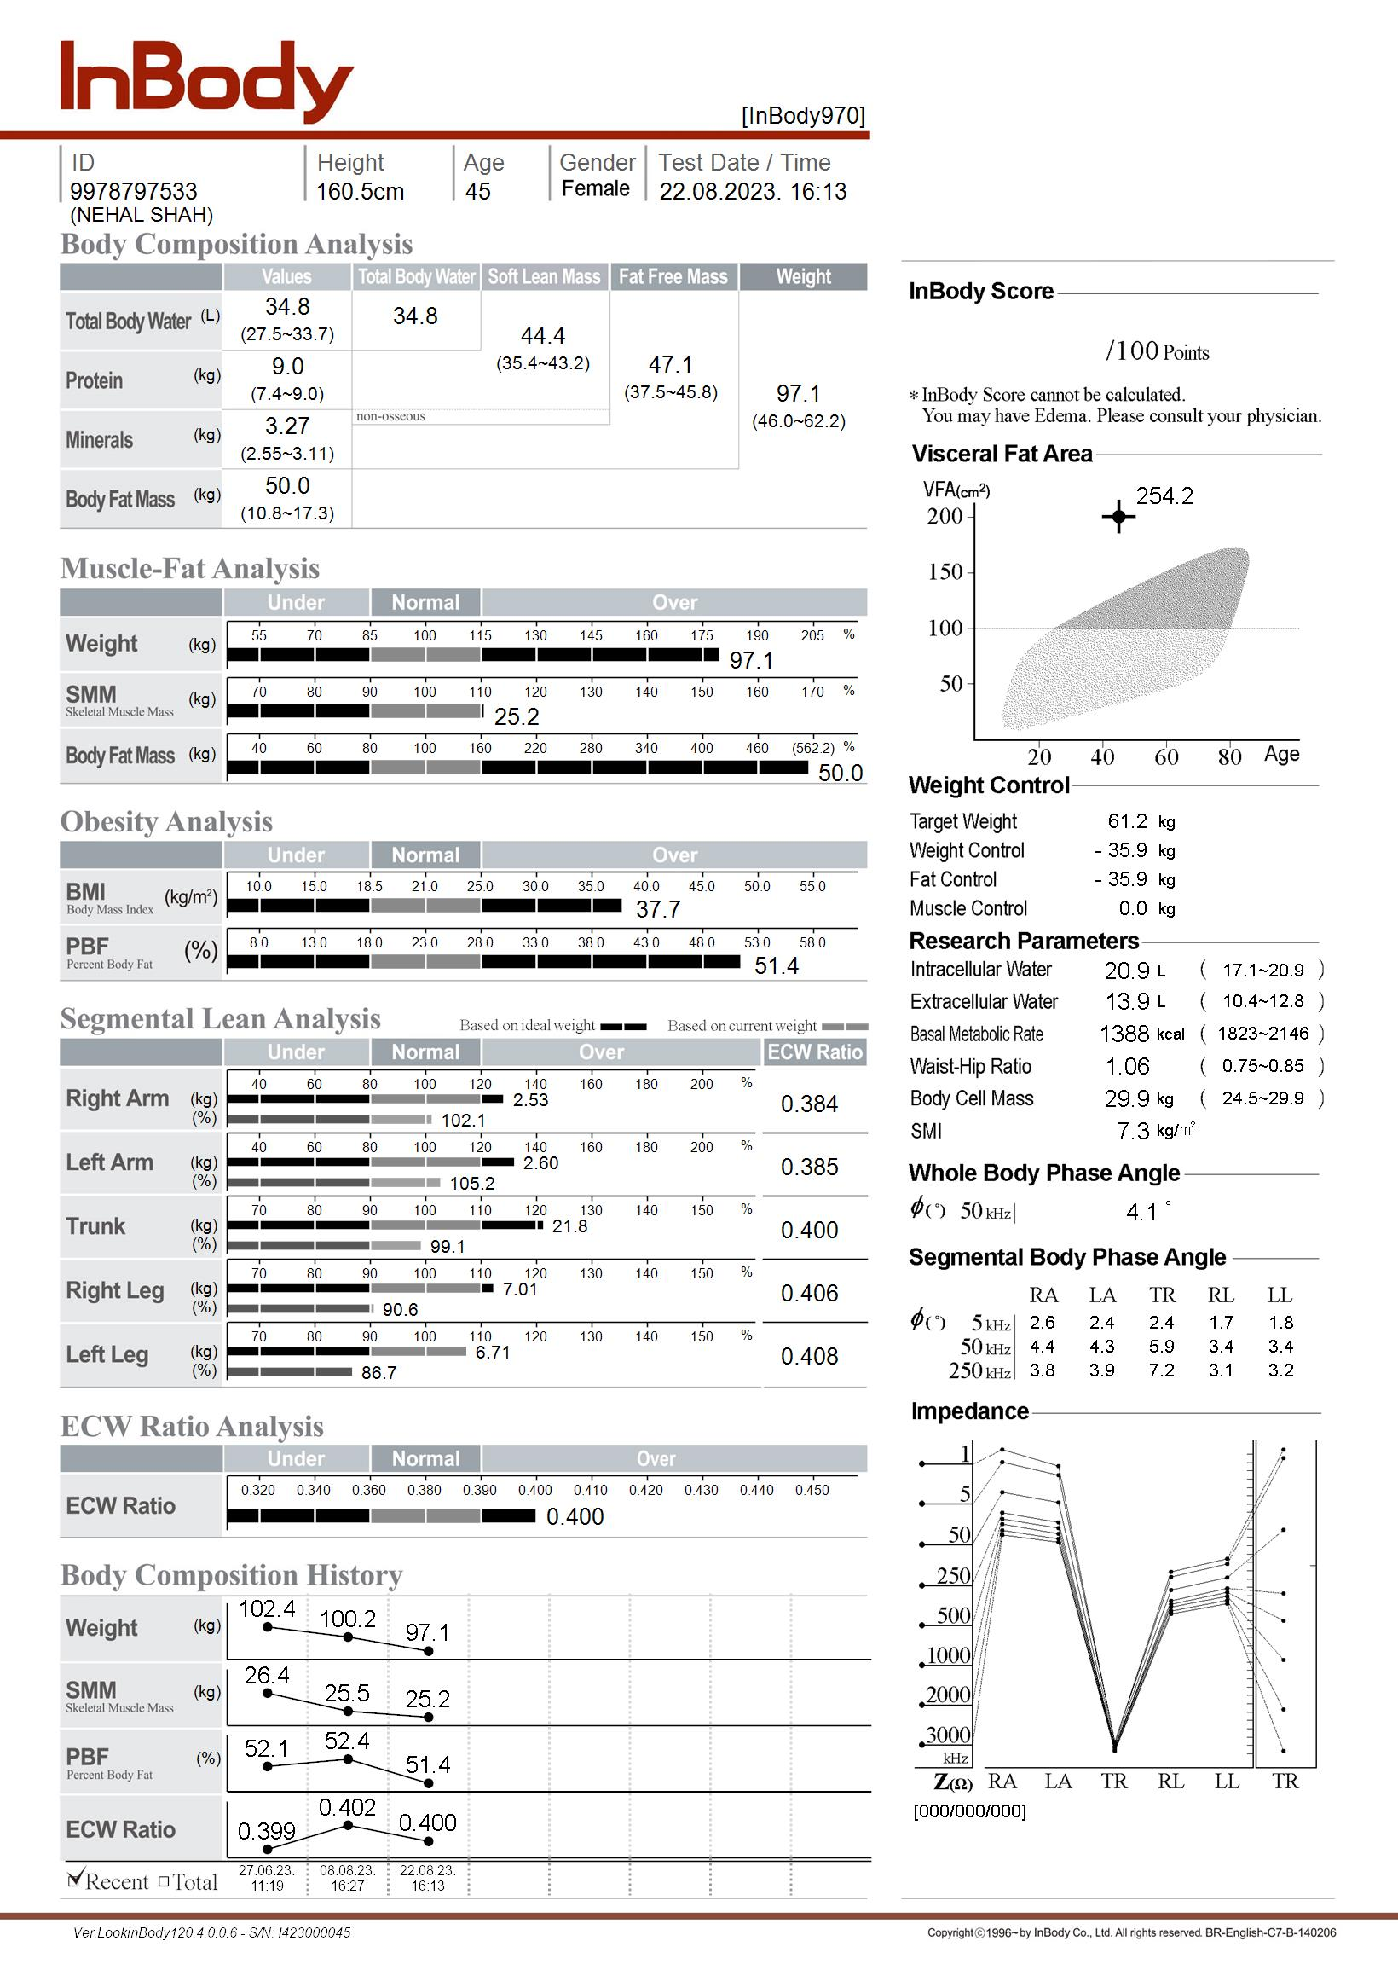
Case Study 2 : (Over weight individual)
45 Year old Female Bariatric patient weight 97.1 kg , Body Fat Mass (Kg) is 50Kg.
Her PBF is 51.4 % .
There is presence of lower body edema as the ECW Ratio is higher in trunk and legs.
The phase angle 4.1 suggests the patient can undergo a bariatric surgery

Slide 39
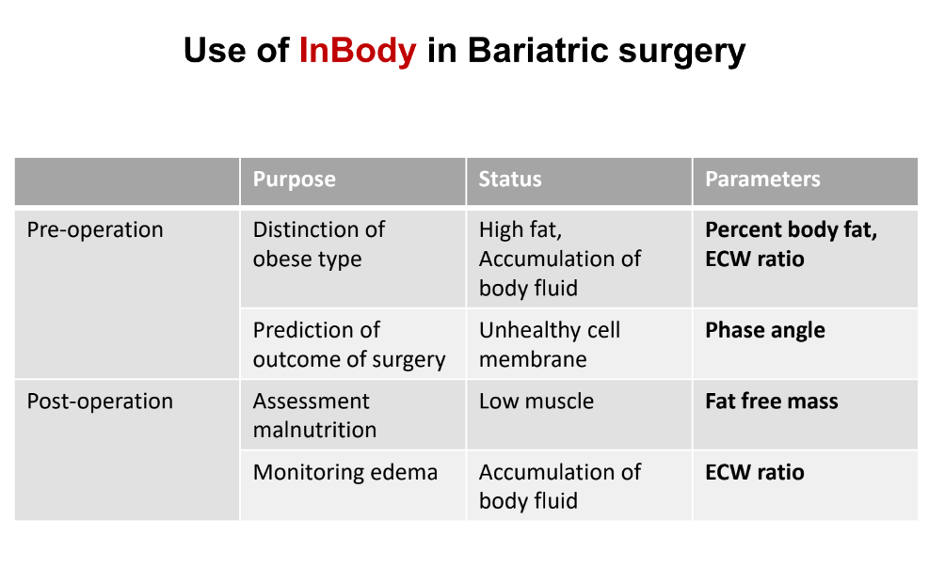

Slide 40
Thank You
www.inbody.in

