Slide 1

CLINICAL WORKSHOP · SALES TEAM
Sales Training
From clinical knowledge to customer conversation
InBody India · 2026

Slide 2

Workshop Agenda
FULL-DAY WORKSHOP
9:30 AM – 4:55 PM
Time | Session | Slide
9:30 – 9:45 AM | Welcome & Workshop Overview
9:45 – 10:30 AM | 1. Basics of Body Composition Analysis Technology | 03
10:30 – 11:15 AM | 2. InBody Result Sheet Interpretation – Part 1 | 13
11:15 – 11:25 AM | Short Break
11:25 AM – 12:10 PM | 3. Result Sheet Interpretation – Part 2: Clinical Interpretation | 25
12:10 – 12:50 PM | 4. Diabetes & Body Composition | 53
12:50 – 1:30 PM | 5. GLP-1 Therapy & Body Composition | 67
1:30 – 2:15 PM | Lunch Break
2:15 – 2:55 PM | 6. Bariatric & Obesity Management | 77
2:55 – 3:30 PM | 7. Dietetics & BCA-Guided Nutrition Practice | 100
3:30 – 3:40 PM | Short Break
3:40 – 4:05 PM | 8. Aesthetic & Wellness Market | 108
4:05 – 4:25 PM | 9. Ayurveda & Integrative Wellness | 117
4:25 – 4:55 PM | 10. Mock Call – From Clinical Knowledge to Customer Conversation | 125
InBody India · Sales Training
02

Slide 3
01
SESSION 1 · 9:45 – 10:30 AM
Basics of Body Composition Analysis Technology
InBody India · Sales Training
03

Slide 4

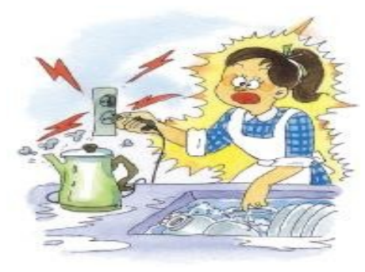

What is BIA?
SESSION 1
Basics of Body Composition Analysis Technology
Key Concept
InBody is a Bioimpedance Analyzing device that measures Body Water, Skeletal Muscle Mass, Body Fat, Segmental Muscle Mass and more.
Grabbing an electrical device with a wet hand is dangerous, since electricity flows through water well.
Based on this theory, InBody uses Bio-Impedance Analysis: a small electrical current flows through the body, and the resistance (impedance) is measured to calculate body composition.
KEY TAKEAWAY
A small electrical current + the measured resistance (impedance) = body composition.
InBody India · Sales Training
04

Slide 5
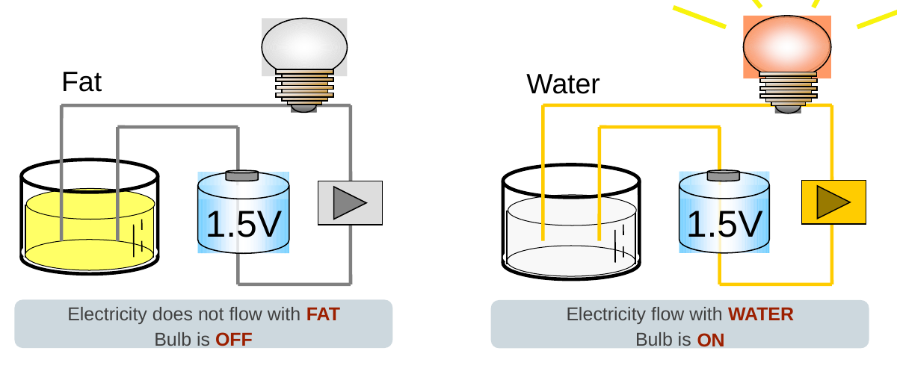
What is BIA?
SESSION 1
Basics of Body Composition Analysis Technology
Key Concept
Relationship between Body Water and Impedance
Electricity does not flow through FAT: the bulb stays OFF.
Electricity flows through WATER: the bulb turns ON.
KEY TAKEAWAY
Resistance to electrical flow = Impedance.
InBody India · Sales Training
05

Slide 6
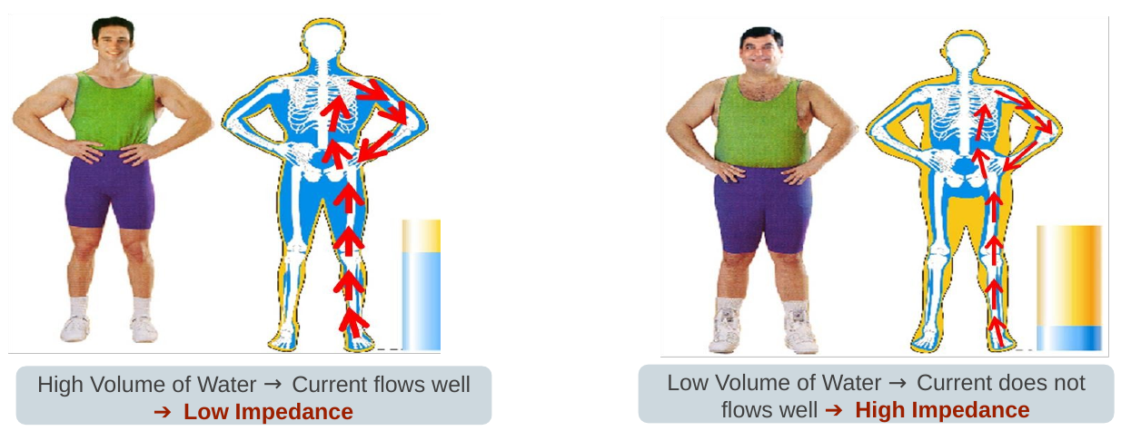
What is BIA?
SESSION 1
Basics of Body Composition Analysis Technology
Key Concept
Relationship between Body Water and Impedance
High volume of water → current flows well → Low Impedance.
Low volume of water → current does not flow well → High Impedance.
KEY TAKEAWAY
Impedance and body water are inversely proportional. BIA devices use impedance to measure body water.
InBody India · Sales Training
06

Slide 7
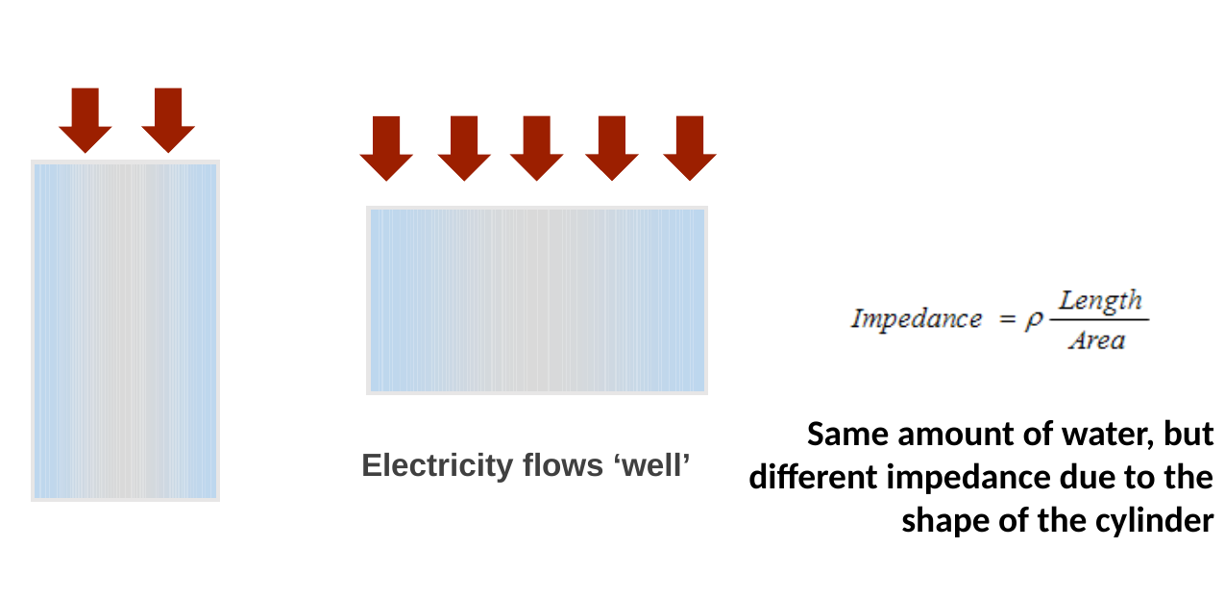
What is BIA?
SESSION 1
Basics of Body Composition Analysis Technology
Key Concept
The shape of the cylinder changes impedance
Narrow and long cylinder = electricity does not flow well = High Impedance.
Wide and short cylinder = electricity flows well = Low Impedance.
KEY TAKEAWAY
Same amount of water, but different impedance due to the shape of the cylinder.
InBody India · Sales Training
07

Slide 8
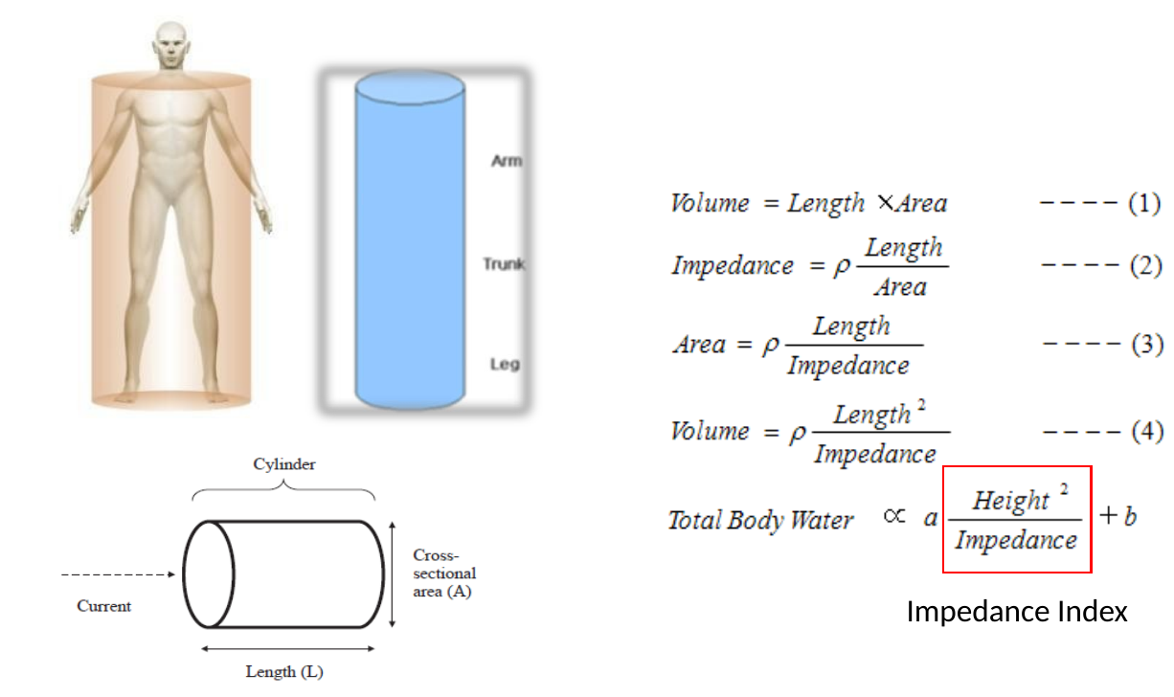
What is BIA?
SESSION 1
Basics of Body Composition Analysis Technology
Key Concept
How do we measure Body Water?
The body is modelled as cylinders: arm, trunk and leg.
Volume = Length × Area, and Impedance = ρ × Length / Area.
Combining the two: Volume = ρ × Length² / Impedance.
Using height as length, Total Body Water is proportional to Height² / Impedance, the Impedance Index.
KEY TAKEAWAY
InBody converts measured impedance into Total Body Water using the Impedance Index (Height² / Impedance).
InBody India · Sales Training
08

Slide 9
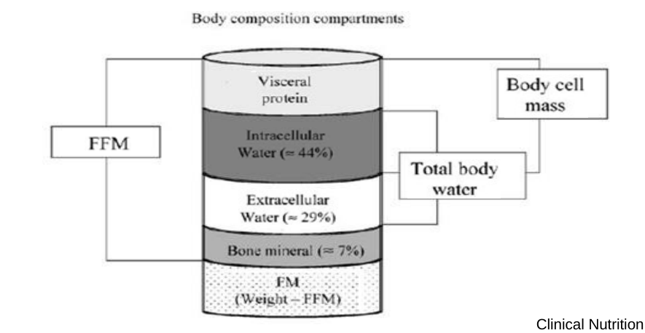
What is BIA?
SESSION 1
Basics of Body Composition Analysis Technology
Key Concept
How do we measure other body composition?
Total Body Water (TBW) is calculated from the Impedance Index (Height² / Z).
Fat Free Mass is consistently hydrated at about 73%, so FFM = TBW ÷ 0.73.
Whatever is not fat-free is fat: Fat Mass = Weight − FFM.
Source: Clinical Nutrition 23:1226–1243, 2004
KEY TAKEAWAY
Every InBody result starts from water: Impedance → TBW → Fat Free Mass → Fat Mass.
InBody India · Sales Training
09

Slide 10
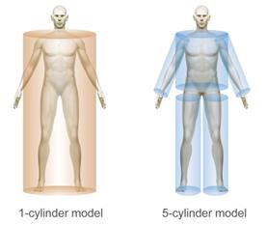
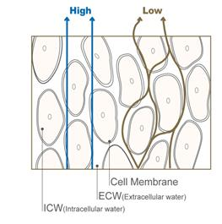

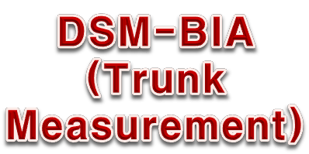
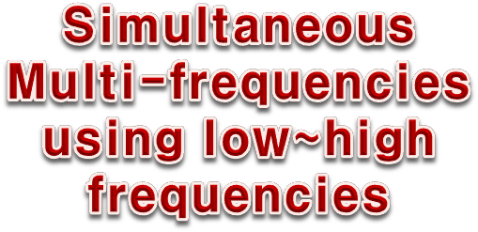
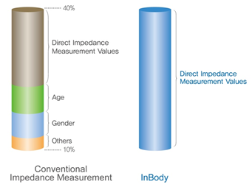
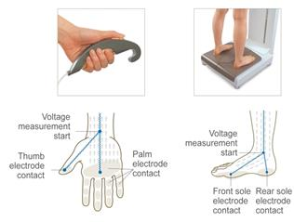


InBody Technologies
SESSION 1
Basics of Body Composition Analysis Technology
InBody India · Sales Training
10

Slide 11
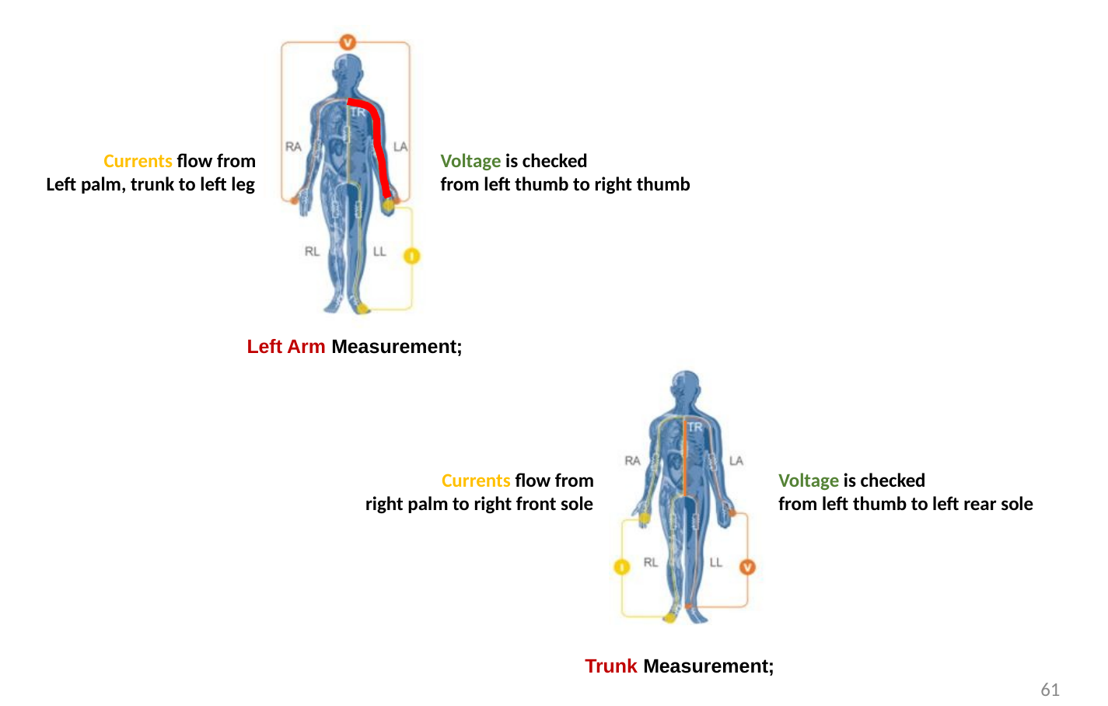
InBody Technologies
SESSION 1
Basics of Body Composition Analysis Technology
Key Concept
Left arm measurement
Current flows from the left palm through the trunk to the left leg. Voltage is checked from the left thumb to the right thumb.
Trunk measurement
Current flows from the right palm to the right front sole. Voltage is checked from the left thumb to the left rear sole.
KEY TAKEAWAY
Tactile 8-point electrodes let InBody measure each body segment separately.
InBody India · Sales Training
11

Slide 12
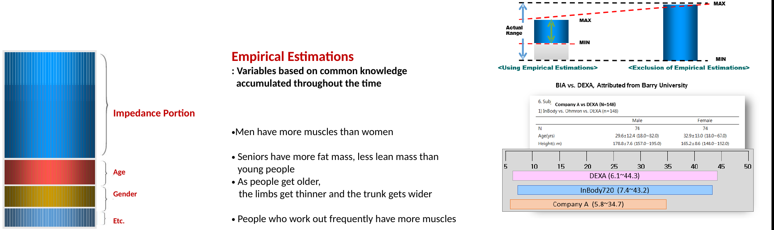
InBody Technologies
SESSION 1
Basics of Body Composition Analysis Technology
Key Concept
Empirical estimations
Variables based on common knowledge accumulated over time, for example:
Men have more muscle than women.
Seniors have more fat mass and less lean mass than young people.
As people get older, the limbs get thinner and the trunk gets wider.
People who work out frequently have more muscle.
KEY TAKEAWAY
InBody excludes these assumptions: results come from each person's measured impedance, not from age or gender.
InBody India · Sales Training
12

Slide 13
02
SESSION 2 · 10:30 – 11:15 AM
InBody Result Sheet Interpretation – Part 1
InBody India · Sales Training
13

Slide 14
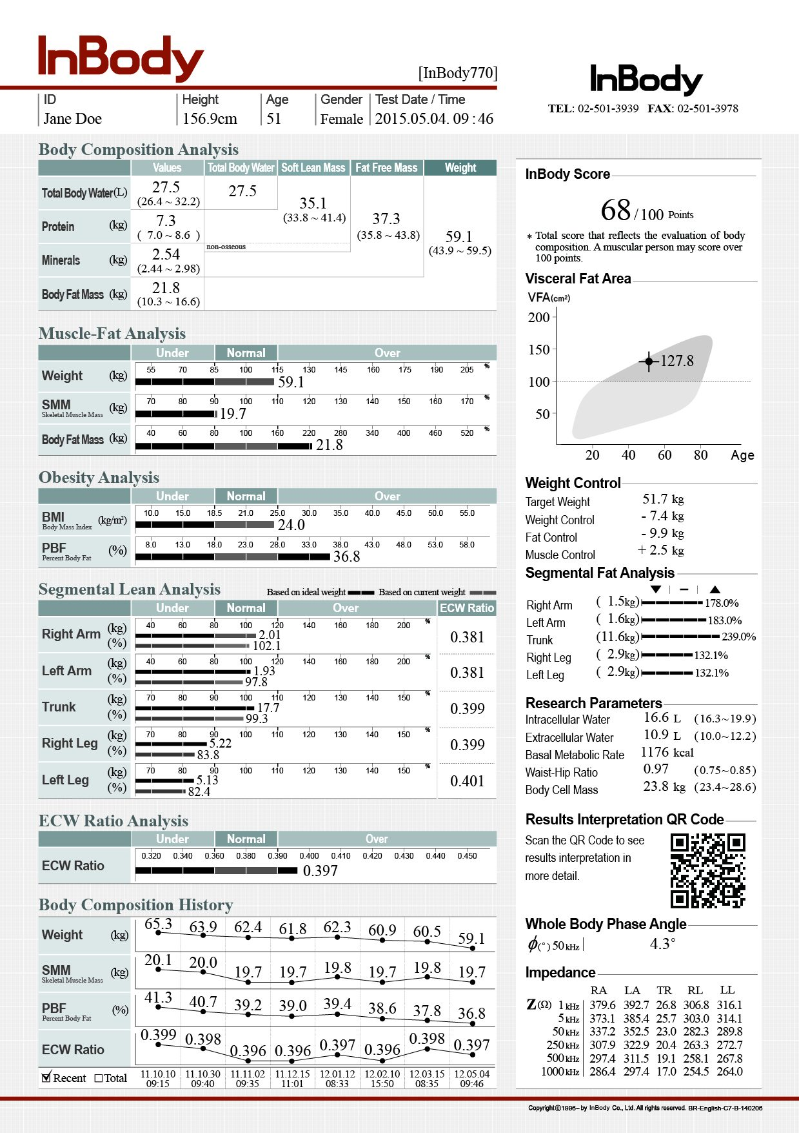
The Result Sheet in 6 Chapters
SESSION 2
InBody Result Sheet Interpretation – Part 1
Chapter 1. Body Composition Analysis
Chapter 2. Muscle-Fat Analysis
Chapter 3. Obesity Analysis
Chapter 4. Segmental Analysis
Chapter 5. ECW Ratio & Phase angle
Chapter 6. Additional Parameters
InBody India · Sales Training
14
Notes:
The result is majorly divided into 6 parts:
Chapter 1. Body Composition Analysis
Chapter 2. Muscle-Fat Analysis
Chapter 3. Obesity Analysis
Chapter 4. Segmental Lean Balance
Chapter 5. Additional Data
Chapter 6. Phase angle and impedance

Slide 15
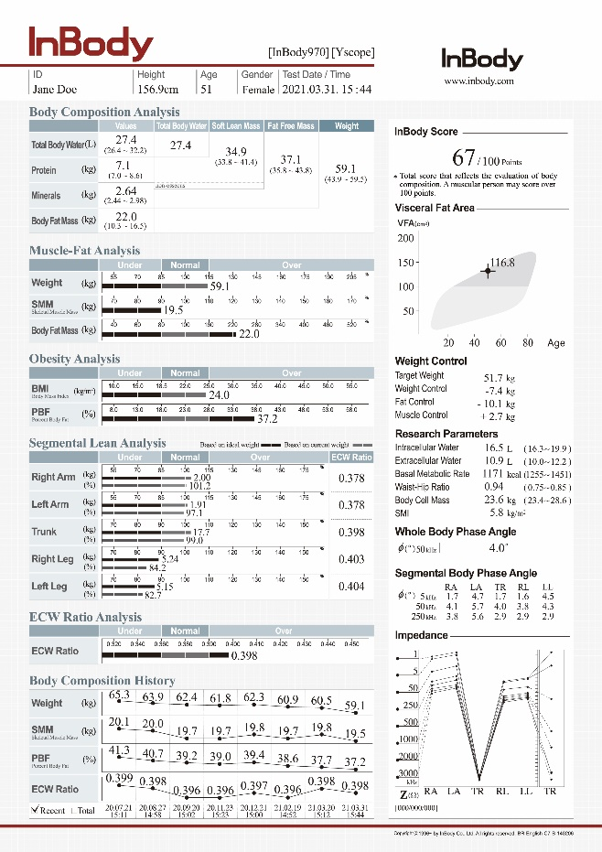
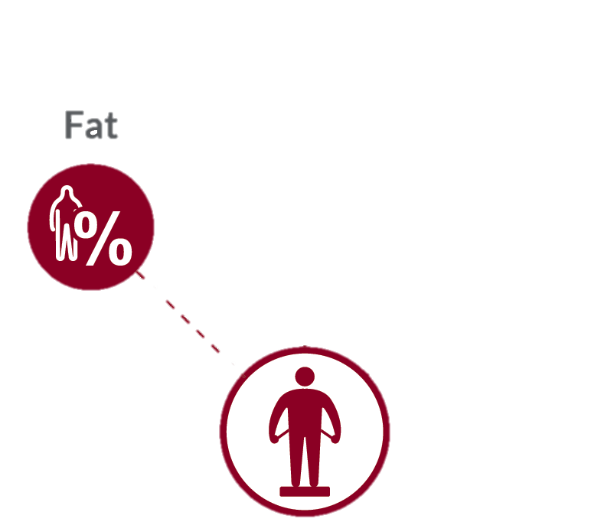
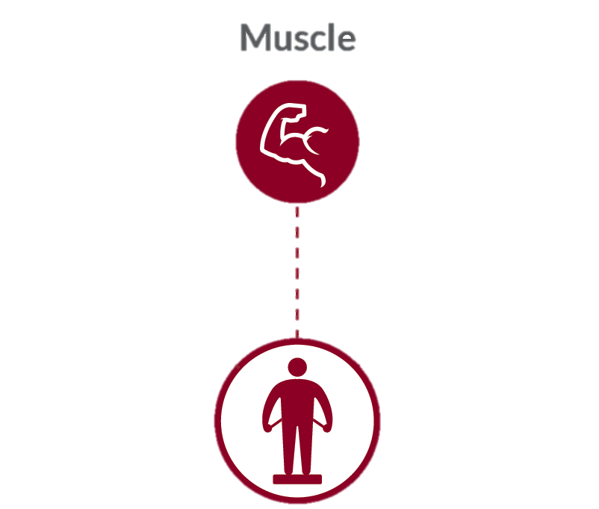
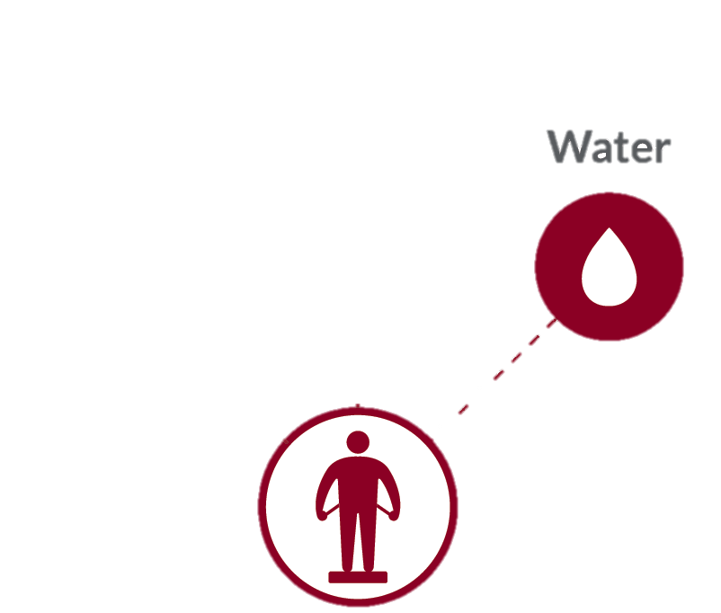
Body Composition Result Sheet
SESSION 2
InBody Result Sheet Interpretation – Part 1
InBody India · Sales Training
15
Notes:
InBody result sheet
Having more than 100 parameters
Seems difficult where to start but
2. But it’s all about 3 things : Fat, Muscle, Water

Slide 16
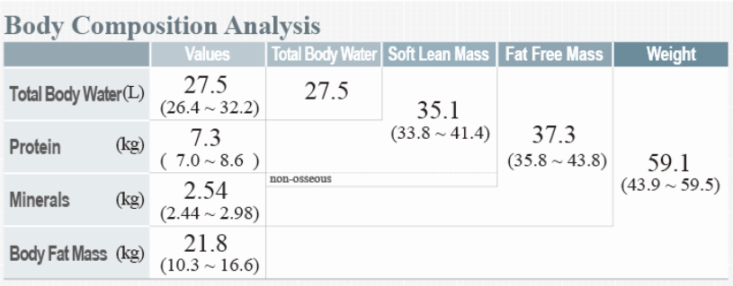
Body Composition Analysis
SESSION 2
InBody Result Sheet Interpretation – Part 1
External Factor | Influence of BCA
Calories | Influence weight/fat gain/loss
Macronutrients | Protein builds muscle, fat stored when excess
Micronutrients | Vitamin D, Magnesium affect muscle health
Hydration | Affects body water balance (ECW & ICW)
Meal Timing | Impacts fat oxidation, muscle recovery
InBody India · Sales Training
16

Slide 17
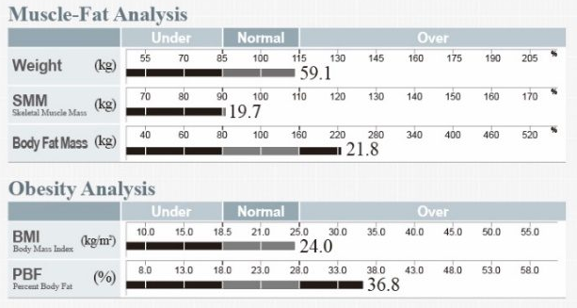
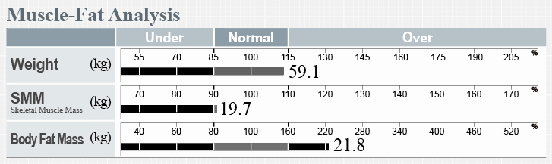
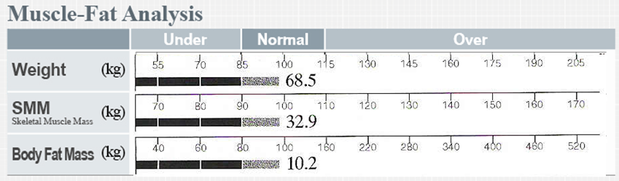
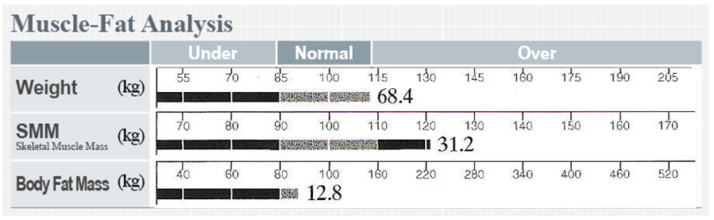
Check Body Type – Muscle-Fat Analysis
SESSION 2
InBody Result Sheet Interpretation – Part 1
Check body balance with C D I
Muscle should be at least 90%, Fat should be within the normal range
Muscle ↑ = Target weight ↑, InBody Score ↑
Cautious
Ideal
Developed
C
I
D
Muscle < Fat
Sarcopenia, Skinny obese body
Balanced Muscle & Fat
Normal and Healthy
Muscle > Fat
Muscular, athletic people
InBody India · Sales Training
17

Slide 18
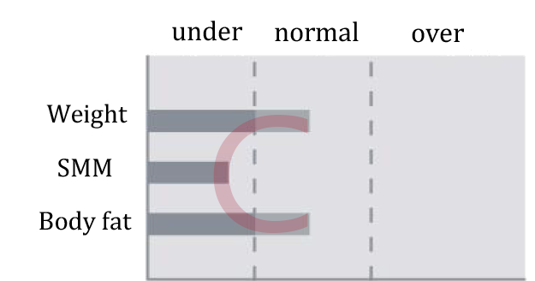
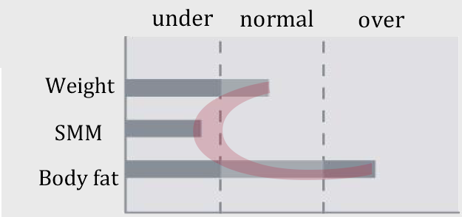
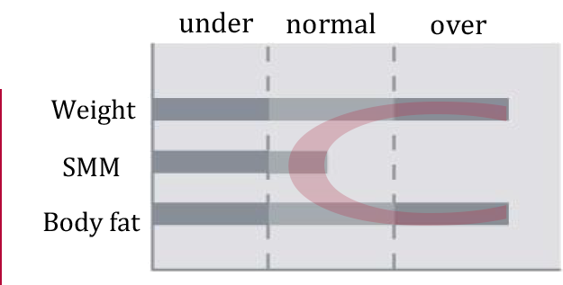
C-Shape Body Type
SESSION 2
InBody Result Sheet Interpretation – Part 1
1
Standard weight and weak
Lack of exercise or protein intake, injury or illness can lead to edema, loss of muscle tissue, changes to the nervous system, secondary infections or growth inhibition.
Should follow a proper exercise and diet regime. Mostly seen in the female population; nutrition plays a major role.
2
Standard weight and obese
Body fat mass is greater than skeletal muscle mass, with abdominal obesity at both standard and higher weights. Risk of adult diseases; proper management and treatment are required.
The most common type in India: normal weight, but obese because of excess body fat mass.
3
Overweight and weak
Skeletal muscle is low compared with the excess body fat, which raises health risks. Reducing body fat is essential.
Usually linked to a sedentary lifestyle. Weight management is a constant challenge, so a proper diet is required.
InBody India · Sales Training
18
Notes:
The graphs vary for different sports. For E. g. Marathon runners will have less body fat and weight. While Crickets will have proper weight and body fat levels. Body Builders may have both in
higher ratios or can be overweight due to muscles and having less body fat.

Slide 19
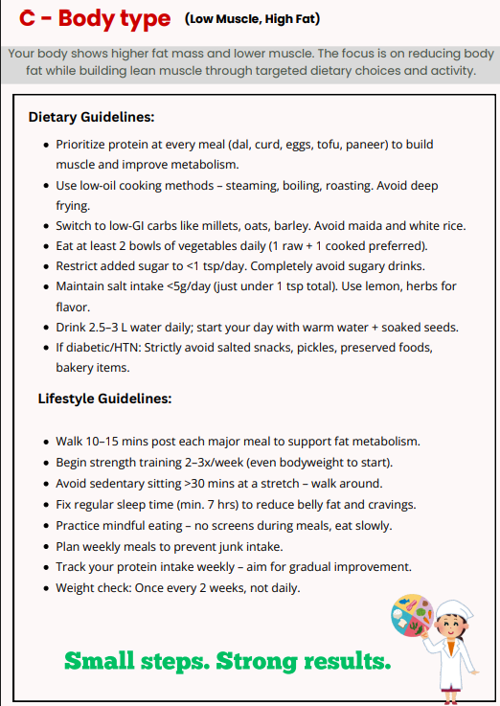
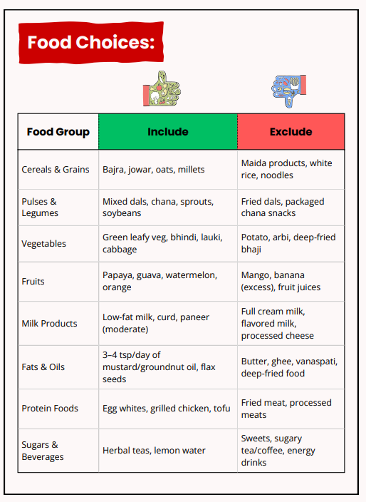
C-Type: Diet & Lifestyle Guide
SESSION 2
InBody Result Sheet Interpretation – Part 1
InBody India · Sales Training
19

Slide 20
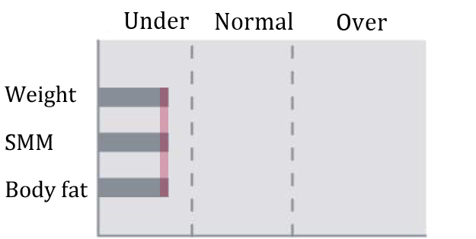
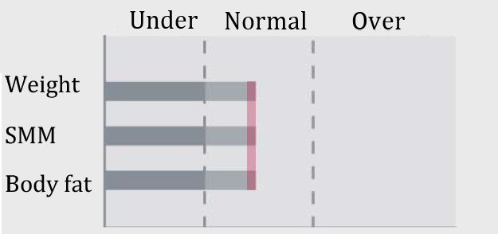
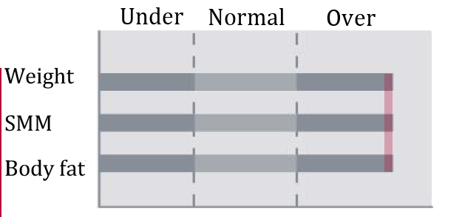
I-Shape Body Type
SESSION 2
InBody Result Sheet Interpretation – Part 1
1
Underweight and weak
Serious underweight can cause edema and hair loss, and long-term malnutrition or poor nutrient absorption. Often due to appetite loss from illness, metabolic disorders or drug use.
Should follow a proper exercise and diet regime. Mostly seen in lower socioeconomic groups.
2
Standard weight and healthy
The best body composition type. Keep it with consistent care, and monitor regularly, as abdominal fat can increase over time.
Exercise to control fat mass. A combination of diet and exercise works best.
3
Overweight and obese
Severely obese. Treatment to reduce body weight and body fat is required, which helps treat and prevent obesity-related illnesses.
Needs proper exercise and diet to reduce fat mass and prevent lifestyle disorders.
InBody India · Sales Training
20

Slide 21
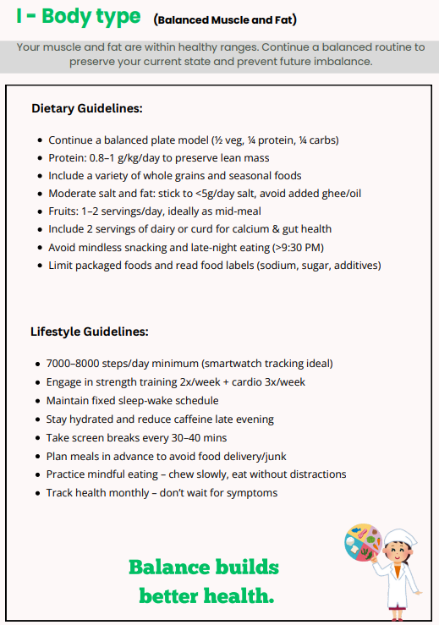
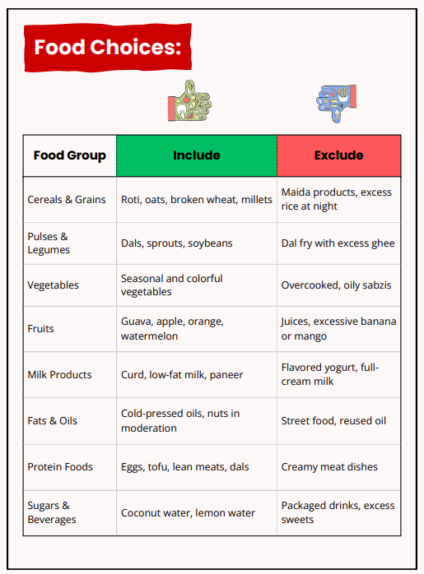
I-Type: Diet & Lifestyle Guide
SESSION 2
InBody Result Sheet Interpretation – Part 1
InBody India · Sales Training
21

Slide 22
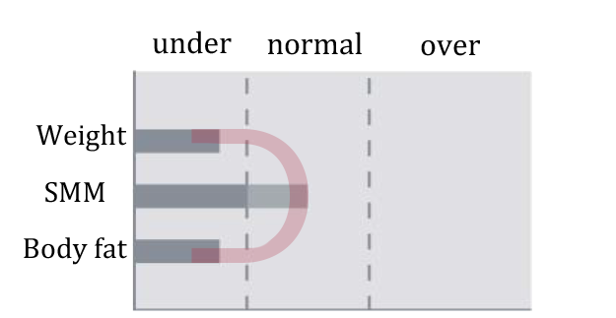
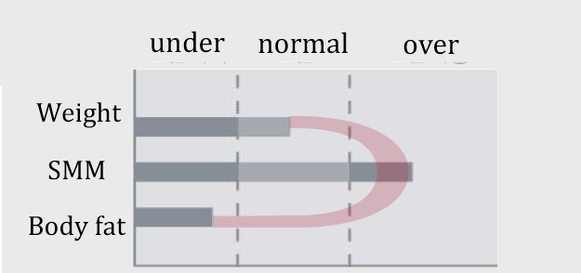
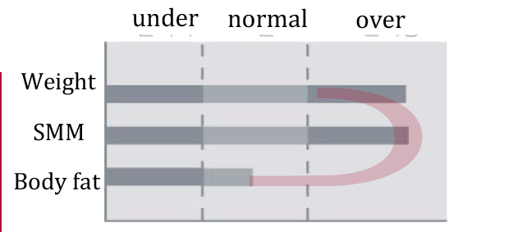
D-Shape Body Type
SESSION 2
InBody Result Sheet Interpretation – Part 1
1
Underweight and strong
Low risk of adult diseases. While maintaining skeletal muscle, keep enough body fat for its essential functions, such as absorbing fat-soluble vitamins and building cell membranes.
Muscular because of their activity levels. They need proper nutrition guidance to maintain their condition.
2
Standard weight and strong
Well-developed muscles and a strong body type, seen in many healthy people. Care is needed not to let body fat fall too far below the recommended level.
Muscular because of their activity levels. They need proper nutrition guidance to maintain their condition.
3
Overweight and strong
Often seen in athletes. BMI shows them as overweight, but the extra weight is skeletal muscle, so no weight management is required.
Muscular because of their activity levels. They need proper nutrition guidance to maintain their condition.
InBody India · Sales Training
22

Slide 23
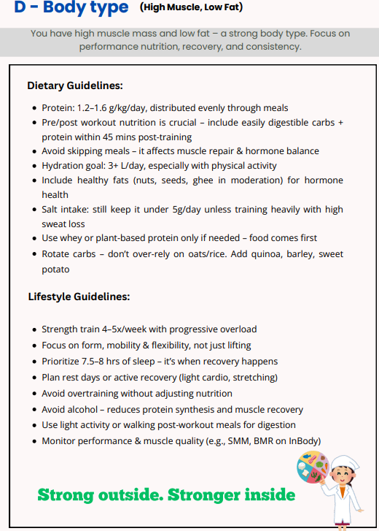
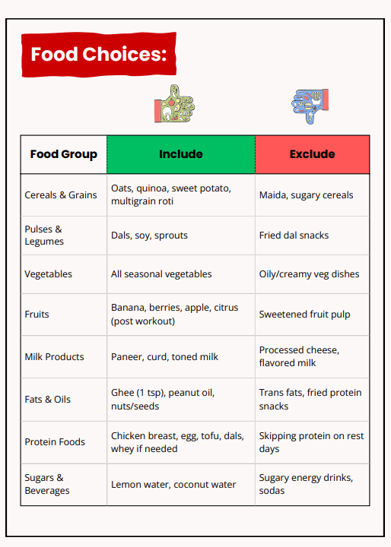
D-Type: Diet & Lifestyle Guide
SESSION 2
InBody Result Sheet Interpretation – Part 1
InBody India · Sales Training
23

Slide 24
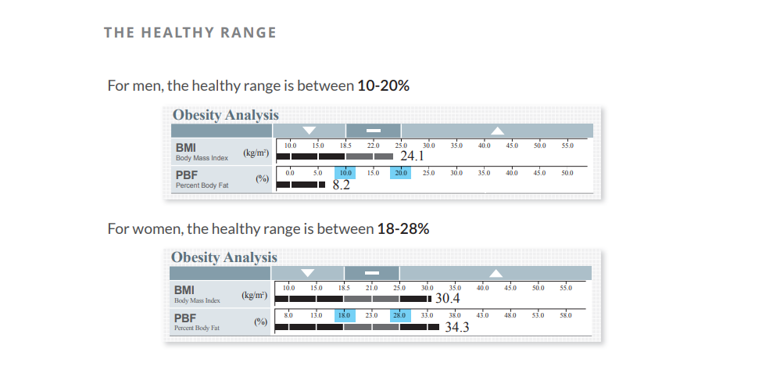
The Healthy Body Fat Range
SESSION 2
InBody Result Sheet Interpretation – Part 1
InBody India · Sales Training
24
Notes:
BMI should not be considered as a parameter to assess health since there are cases where BMI maybe normal but there is high presence of PBF.
In Menopause or in PCOS/PCOD there is a observation that the PBF levels rise up to 40% and above.

Slide 25
03
SESSION 3 · 11:25 AM – 12:10 PM
Result Sheet Interpretation – Part 2: Clinical Interpretation
InBody India · Sales Training
25

Slide 26
SESSION 3 · RESULT SHEET INTERPRETATION – PART 2: CLINICAL INTERPRETATION
Segmental Analysis
InBody India · Sales Training
26

Slide 27
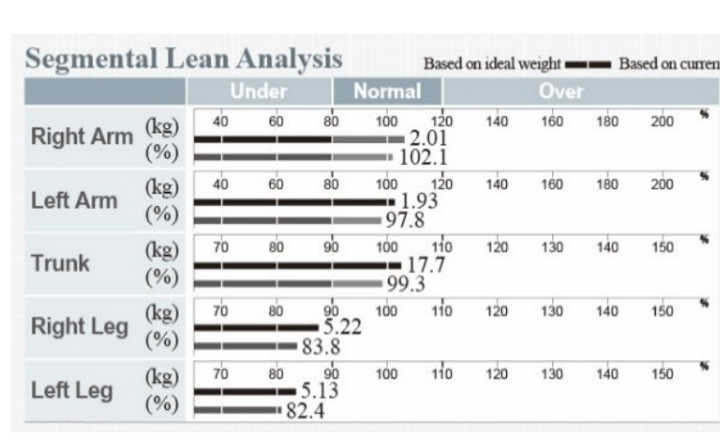
How to Read Segmental Lean Analysis
SESSION 3
Result Sheet Interpretation – Part 2: Clinical Interpretation
Key Concept
Through InBody's advanced BIA technology, it is easy to see the exact amount of lean muscle and fat in each segment of the body.
Example
This person has 2.01 kg of muscle in the right arm, which is just over 100% of the required muscle.
KEY TAKEAWAY
Segmental analysis shows exactly how much muscle and fat sits in each arm, each leg and the trunk.
InBody India · Sales Training
27

Slide 28
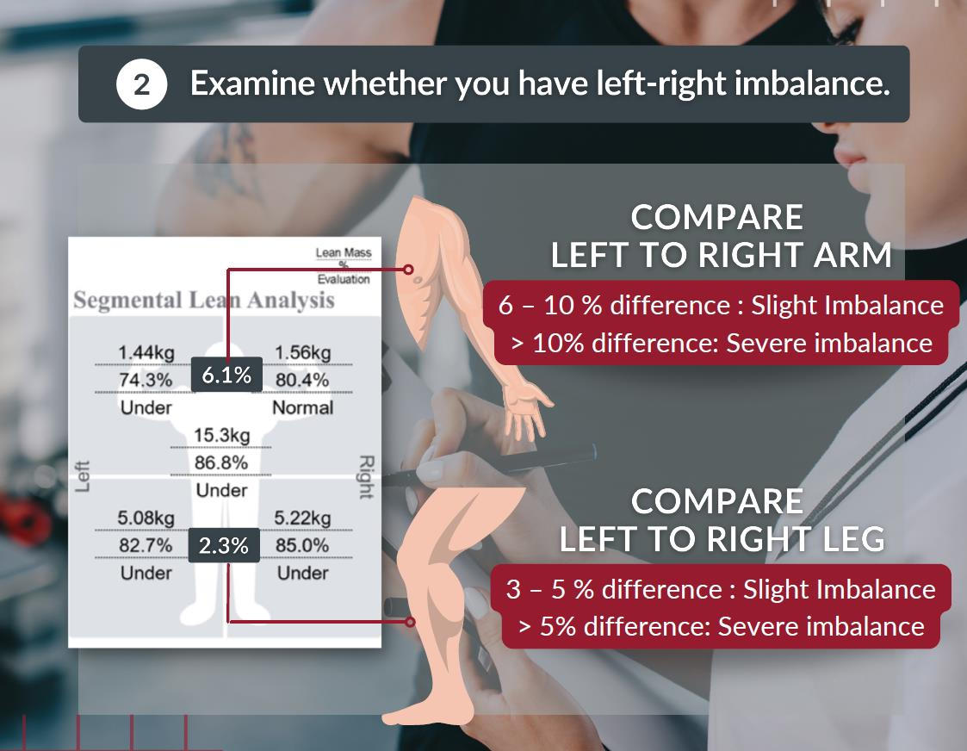
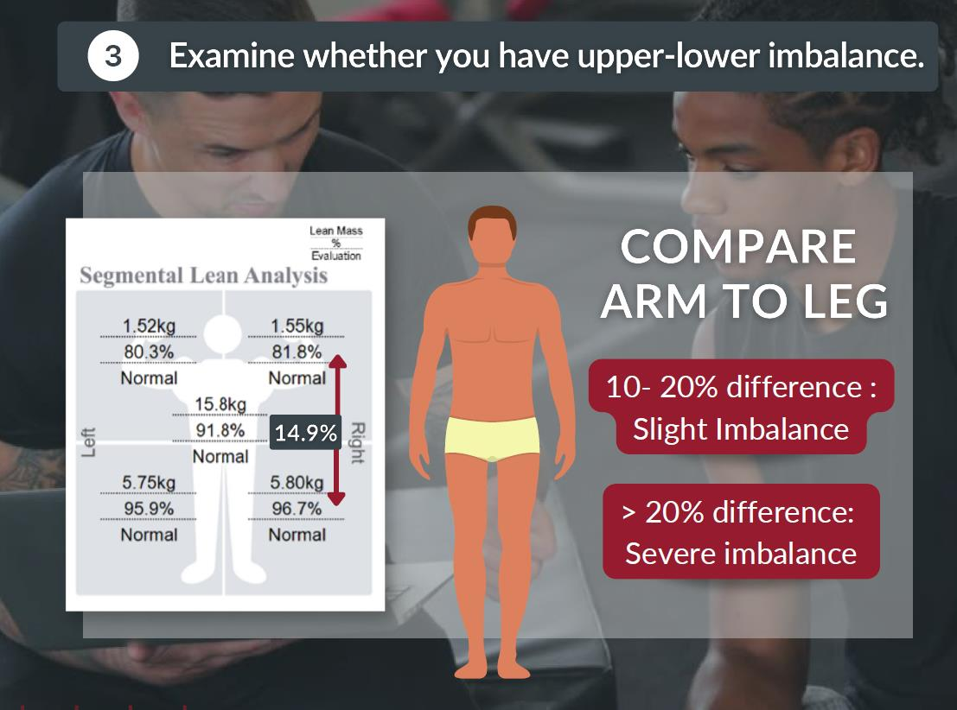
Muscle Imbalance Assessment
SESSION 3
Result Sheet Interpretation – Part 2: Clinical Interpretation
InBody India · Sales Training
28

Slide 29
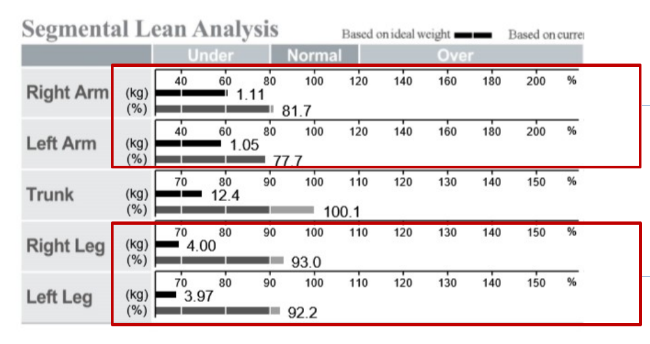
Sarcopenia Assessment (SMI)
SESSION 3
Result Sheet Interpretation – Part 2: Clinical Interpretation
Key Concept
Cut-off (Muscle Mass, SMI)
Men: below 7.0 kg/m²
Women: below 5.7 kg/m²
Formula
ASM (appendicular skeletal muscle) = RA + LA + RL + LL
SMI = ASM ÷ height (m)²
Example
ASM = 1.11 + 1.05 + 4.00 + 3.97 = 10.13 kg
SMI = 10.13 ÷ 1.523² = 4.37 kg/m²
KEY TAKEAWAY
Muscle wasting in diabetic and sarcopenic patients can be assessed through the SMI.
InBody India · Sales Training
29

Slide 30
SESSION 3 · RESULT SHEET INTERPRETATION – PART 2: CLINICAL INTERPRETATION
ECW Ratio Analysis & Phase Angle
InBody India · Sales Training
30

Slide 31
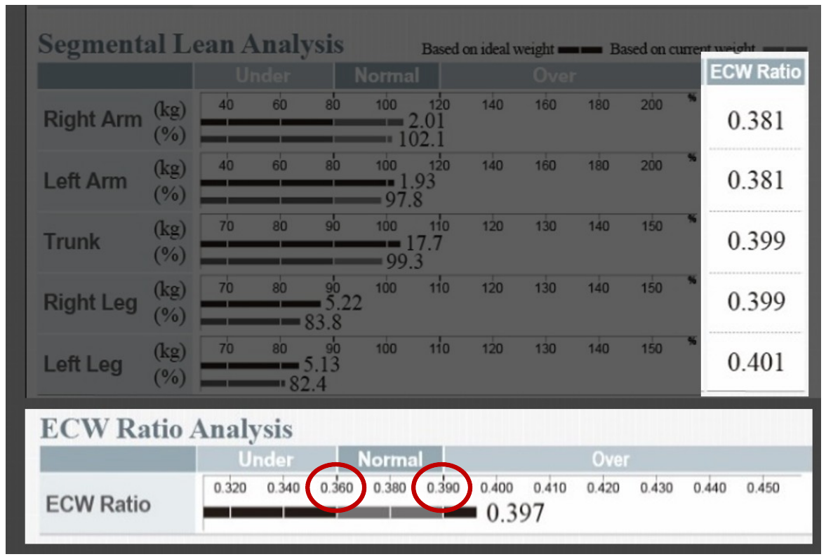
ECW Ratio Analysis
SESSION 3
Result Sheet Interpretation – Part 2: Clinical Interpretation
Key Concept
The normal range for ECW ratio is 0.360 to 0.390. Higher values indicate inflammation or water retention in the body.
The body composition analyzer shows exactly where the water retention is: arms, trunk or legs.
KEY TAKEAWAY
ECW ratio above 0.390 signals inflammation or water retention, and InBody shows which segment.
InBody India · Sales Training
31

Slide 32
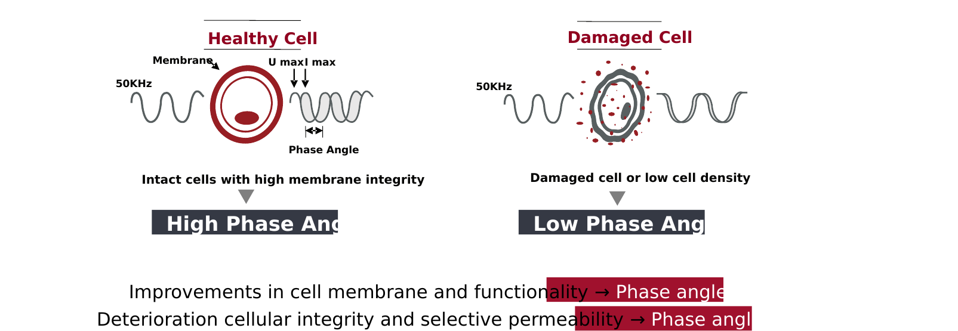
Phase Angle
SESSION 3
Result Sheet Interpretation – Part 2: Clinical Interpretation
Key Concept
Phase angle represents the structural integrity and physiological function of the cells, and is used for nutritional assessment.
Healthy cells with high membrane integrity → High phase angle.
Damaged cells or low cell density → Low phase angle.
Improvements in cell membrane and function → phase angle increases.
Deterioration of cell integrity and selective permeability → phase angle decreases.
KEY TAKEAWAY
Higher phase angle = healthier, more intact cells.
InBody India · Sales Training
32

Slide 33
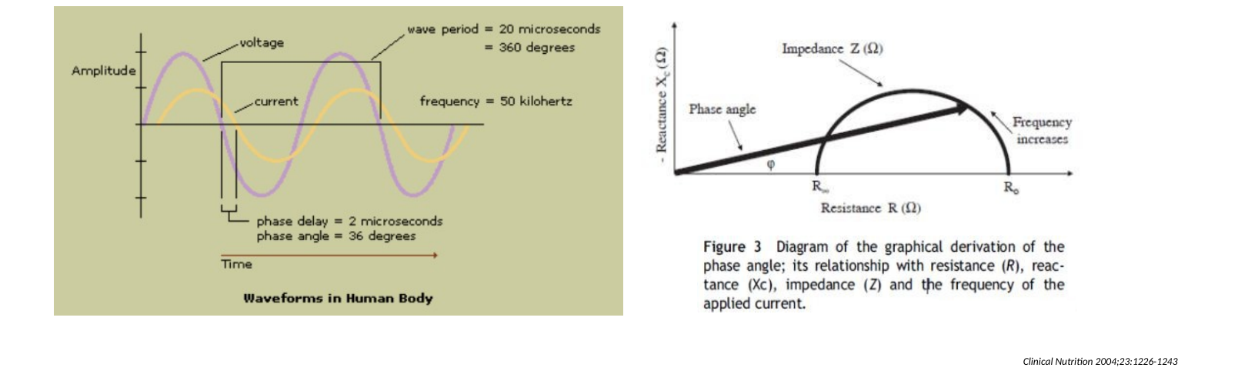
Phase Angle: Resistance & Reactance
SESSION 3
Result Sheet Interpretation – Part 2: Clinical Interpretation
Key Concept
Sending alternating current through the body gives impedance (Z) values, which can be separated into resistance (R) and reactance (Xc).
Phase angle represents Xc relative to R: it increases as Xc increases and decreases as Xc decreases.
Source: Clinical Nutrition 2004;23:1226–1243
KEY TAKEAWAY
Phase angle rises with reactance (Xc), a measure of healthy cell membranes.
InBody India · Sales Training
33

Slide 34
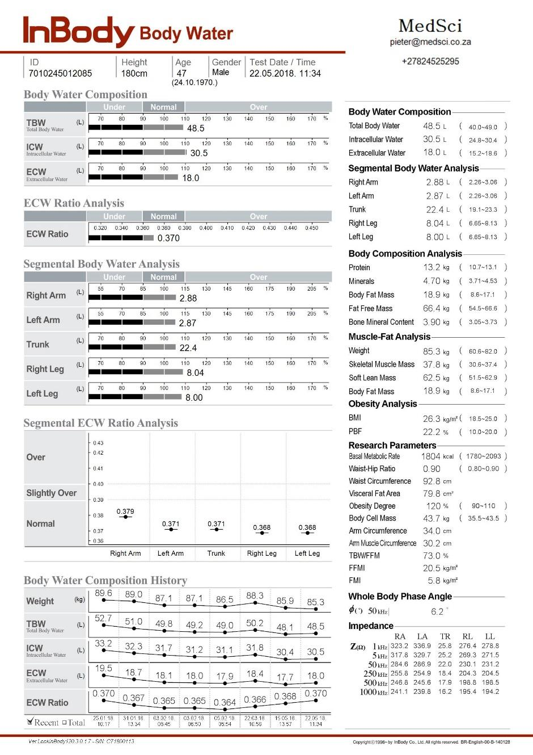


Injury Management
SESSION 3
Result Sheet Interpretation – Part 2: Clinical Interpretation
[Injury Stage]
[Injury Recovery]
[Normal Stage]
InBody India · Sales Training
34

Slide 35
SESSION 3 · RESULT SHEET INTERPRETATION – PART 2: CLINICAL INTERPRETATION
Additional Parameters
InBody India · Sales Training
35

Slide 36
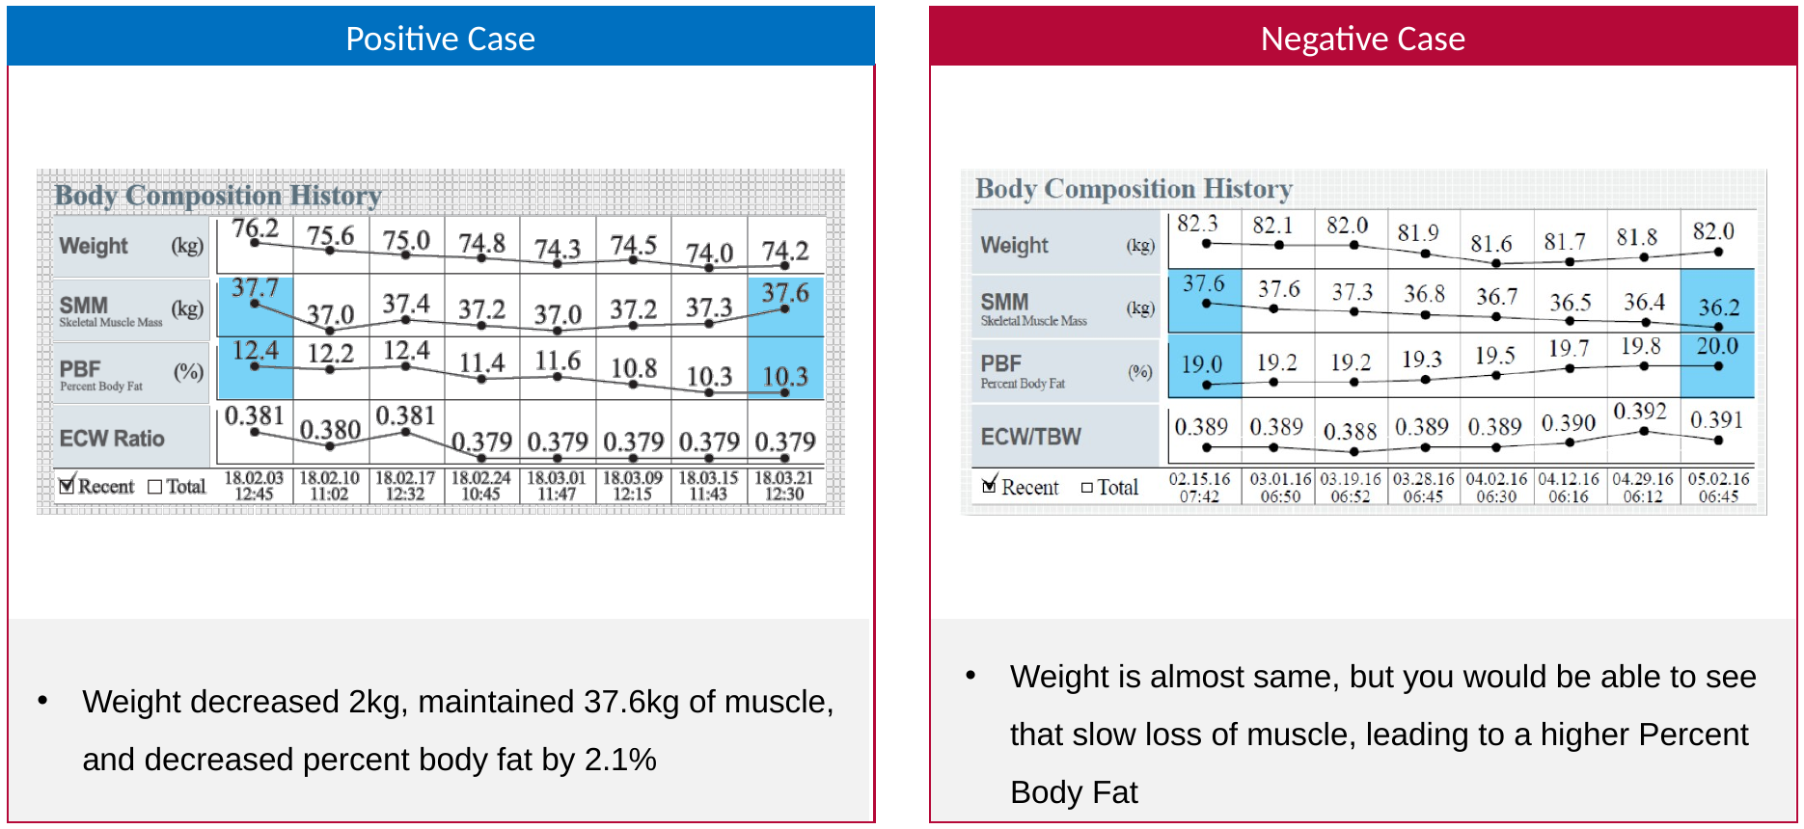
Muscle Quality Assessment (ECW Ratio)
SESSION 3
Result Sheet Interpretation – Part 2: Clinical Interpretation
Key Concept
Positive case
Weight decreased 2 kg, muscle held at 37.6 kg, and percent body fat fell by 2.1%.
Negative case
Weight stayed almost the same, but slow muscle loss led to a higher percent body fat.
KEY TAKEAWAY
The scale can hide muscle loss: the body composition history shows the real trend.
InBody India · Sales Training
36
Notes:
This is to evaluate how the trainer is performing through the client’s history tracking.

Slide 37
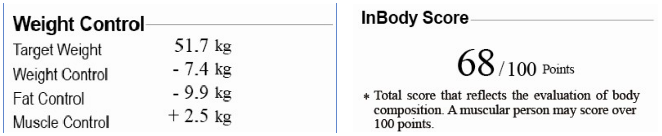
Weight Control & InBody Score
SESSION 3
Result Sheet Interpretation – Part 2: Clinical Interpretation
Key Concept
The full body composition report shows the person's target weight, how much fat to lose and how much muscle to gain.
InBody Score
A score of 80 points indicates ideal body composition. A very muscular person can score over 100.
KEY TAKEAWAY
Target weight, fat control and muscle control turn the result sheet into a clear plan.
InBody India · Sales Training
37

Slide 38

Research Parameters
SESSION 3
Result Sheet Interpretation – Part 2: Clinical Interpretation
Key Concept
Visceral Fat Area (VFA): cut-off 100 cm². Above it can indicate future cardiovascular issues.
ICW and ECW should always be in the normal ranges.
BMR can be tracked to see if metabolism is improving.
Waist-Hip Ratio: normal 0.75–0.85 (women), 0.80–0.90 (men).
Body Cell Mass = ICW + protein, which also shows health status.
KEY TAKEAWAY
VFA above 100 cm² flags future cardiovascular risk.
InBody India · Sales Training
38

Slide 39

Nutritional Parameters – BMR, BCM
SESSION 3
Result Sheet Interpretation – Part 2: Clinical Interpretation
Key Concept
Basal Metabolic Rate (BMR)
Calories you burn to maintain basic essential functions.
Body Cell Mass (BCM)
Protein + ICW; useful for patients with edema.
Mifflin-St Jeor (common formula)
Men: (10 × kg) + (6.25 × cm) − (5 × age) + 5
Women: (10 × kg) + (6.25 × cm) − (5 × age) − 161
KEY TAKEAWAY
InBody itself calculates BMR from lean body mass: BMR = 370 + 21.6 × LBM (kg).
InBody India · Sales Training
39

Slide 40

Q&A: Muscle Terms
SESSION 3
Result Sheet Interpretation – Part 2: Clinical Interpretation
Key Concept
Q. There are many terms for muscle. What is the difference?
Fat Free Mass (FFM) = Total body mass − Body fat mass
Soft Lean Mass = Total body mass − Body fat mass − Bone mineral
Skeletal Muscle Mass (SMM) = Sum of limb muscle mass ÷ 0.75
Segmental Lean = Fat Free Mass in one segment
KEY TAKEAWAY
Each muscle term measures something different. Use the right one when explaining the sheet.
InBody India · Sales Training
40

Slide 41
Q&A: Ideal & Target Weight
SESSION 3
Result Sheet Interpretation – Part 2: Clinical Interpretation
Key Concept
Ideal weight
Ideal BMI × height (m)² (men: 22 × height², women: 21 × height²)
Based on weight and height only; it does not factor in body composition.
Target weight
Fat control = (15% men / 23% women × ideal weight) − current body fat mass
Muscle control = (85% men / 77% women × ideal weight) − current fat-free mass
Q
CUSTOMER QUESTION
How can we calculate ideal weight and target weight?
KEY TAKEAWAY
Target weight = current weight + fat control + muscle control.
InBody India · Sales Training
41

Slide 42

Current, Ideal & Target Weight
SESSION 3
Result Sheet Interpretation – Part 2: Clinical Interpretation
Key Concept
Ideal weight
Men: 22 × height² · Women: 21 × height²
Jane Doe: 21 × 1.569 × 1.569 = 51.70 kg
Target weight = current weight + weight control
Fat control = (23% × ideal weight) − current fat mass = −9.9 kg
Muscle control = (77% × ideal weight) − current fat-free mass = +2.5 kg
Jane Doe: 59.1 − 9.9 + 2.5 = 51.7 kg
KEY TAKEAWAY
Show customers their target weight: exactly how much fat to lose and muscle to gain.
InBody India · Sales Training
42

Slide 43

Segmental Lean: Interpretation Example
SESSION 3
Result Sheet Interpretation – Part 2: Clinical Interpretation
Key Concept
Interpretation example
Right arm: 2.01 kg of lean mass = 102.1%, enough to support the current weight.
Left arm: 1.93 kg = 97.8%, not quite enough for the current weight.
The top bar is based on ideal weight (51.70 kg). Against ideal weight, the left arm has enough muscle.
KEY TAKEAWAY
The % compares muscle to current weight; the bar length compares it to ideal weight.
InBody India · Sales Training
43

Slide 44
Result Parameters Q&A
SESSION 3
Result Sheet Interpretation – Part 2: Clinical Interpretation
Key Concept
Q. How is SMM calculated?
Physiology says the arms and legs contain 75% of whole-body skeletal muscle.
SMM = (RA + LA + RL + LL lean mass) ÷ 0.75
InBody also factors in the ECW ratio and upper/lower body balance.
KEY TAKEAWAY
SMM is calculated from limb muscle, adjusted for water balance and body balance.
InBody India · Sales Training
44

Slide 45

Result Parameters Q&A
SESSION 3
Result Sheet Interpretation – Part 2: Clinical Interpretation
Key Concept
Q. How does InBody measure visceral fat?
BIA cannot directly separate visceral fat from subcutaneous fat.
InBody built regression equations against CT-measured VFA.
The estimate is based on research linking a person's segmental lean and fat distribution to fat-storage trends.
KEY TAKEAWAY
VFA is estimated from CT-validated equations using segmental fat and lean distribution.
InBody India · Sales Training
45

Slide 46

Result Parameters Q&A
SESSION 3
Result Sheet Interpretation – Part 2: Clinical Interpretation
Key Concept
Q. What is the difference between VFA and VFL?
VFA estimates the area of visceral fat in cm².
VFL is a simplified 1–20 scale; each level equals 10 cm² of VFA.
A VFA of 11.3 cm² is roughly a VFL of 1. The maximum is Level 20.
KEY TAKEAWAY
VFA gives the exact area in cm²; VFL is the same measure on a simple 1–20 scale.
InBody India · Sales Training
46

Slide 47
Interpretation Q&A
SESSION 3
Result Sheet Interpretation – Part 2: Clinical Interpretation
Key Concept
Safe: an implant is not electronic like a pacemaker, whatever its size or position.
Metal conducts current better than water, so readings near the implant show low impedance, making body water and muscle look higher.
The effect varies by material, shape, size and site, so there is no fixed reference.
Small bolts have very little effect; changes stay within the error range.
Q
CUSTOMER QUESTION
Can we measure patients with metal implants?
KEY TAKEAWAY
Patients with implants can be measured: use InBody to monitor their change over time.
InBody India · Sales Training
47

Slide 48
Interpretation Q&A
SESSION 3
Result Sheet Interpretation – Part 2: Clinical Interpretation
Key Concept
Safe: a stent is not electronic like a pacemaker, whatever its size or position.
A stent is metal, but very small, so its effect on impedance is within the error range.
Results can be used with the same level of confidence.
Q
CUSTOMER QUESTION
Can a patient with a cardiovascular stent be measured? Does it affect the results?
KEY TAKEAWAY
Stent patients can be measured normally, with full confidence in the results.
InBody India · Sales Training
48

Slide 49
Interpretation Q&A
SESSION 3
Result Sheet Interpretation – Part 2: Clinical Interpretation
Key Concept
Breast implants are measured as FAT.
In female bodybuilders, fat mass is sometimes measured higher than expected.
Subjects with breast or other cosmetic implants can show results like this.
Q
CUSTOMER QUESTION
What are breast implants measured as?
KEY TAKEAWAY
Cosmetic implants read as fat, so fat mass may look higher than expected.
InBody India · Sales Training
49

Slide 50
Interpretation Q&A
SESSION 3
Result Sheet Interpretation – Part 2: Clinical Interpretation
Key Concept
A missing limb length means less resistance to the current in that segment.
InBody assumes all limbs are normal length, so it reads that segment as having a lot of body water.
InBody shows the impedance values as they are, so it can still track the amputated limb's condition over time.
Q
CUSTOMER QUESTION
How much can we trust results for amputated patients? Is there a minimum limb length?
KEY TAKEAWAY
For amputees, use InBody to monitor change over time, not for absolute values.
InBody India · Sales Training
50

Slide 51

All About Bioelectrical Impedance
SESSION 3
Result Sheet Interpretation – Part 2: Clinical Interpretation
Key Concept
What to check after measuring
Impedance should decrease as the frequency increases.
Each impedance should not be too low or too high.
The left–right impedance difference should be below 30 ohms.
KEY TAKEAWAY
Check the impedance first: it tells you whether the test was done correctly.
InBody India · Sales Training
51

Slide 52
All About Bioelectrical Impedance
SESSION 3
Result Sheet Interpretation – Part 2: Clinical Interpretation
Key Concept
Impedance is the individual value behind every body composition result.
For accurate measurements, check the impedance first to confirm the test was done correctly.
Q
CUSTOMER QUESTION
How do we know the measurement was done correctly? Check the impedance.
KEY TAKEAWAY
Make sure the measurement is correct using the impedance values.
InBody India · Sales Training
52

Slide 53
04
SESSION 4 · 12:10 – 12:50 PM
Diabetes & Body Composition
InBody India · Sales Training
53

Slide 54

Diabetes Monitoring
SESSION 4
Diabetes & Body Composition
BUT, is it enough?
HbA1c Test
(6.5 above)
Weight
Fasting Plasma Glucose
Waist circumference
(126 or above)
Oral Glucose Tolerance Test
(200 or above)
Blood Pressure
InBody India · Sales Training
54

Slide 55
Points of Focus
SESSION 4
Diabetes & Body Composition
Muscle Mass
Visceral Fat
ECW Ratio
InBody India · Sales Training
55

Slide 56

About Diabetes & Muscle
SESSION 4
Diabetes & Body Composition
Everyꢀ10%ꢀincreaseꢀinꢀ
muscleꢀmassꢀresultsꢀinꢀaꢀ
decreaseꢀinꢀinsulinꢀ
J Clin Endocrinol Metab, 2011
resistanceꢀbyꢀ11%.ꢀ
Healthy
people
Low
Muscle
Insulin
Resistance↑
Diabetes
Healthy
people
High
Muscle
Insulin
Resistance↓
Prevent
Diabetes
InBody India · Sales Training
56

Slide 57

Muscle Mass and Diabetes
SESSION 4
Diabetes & Body Composition
Key Concept
Why thigh muscle matters
Muscle stores blood glucose. Thigh muscle is a large share of total skeletal muscle, so more thigh muscle can store more glucose.
The cycle
Low leg muscle → muscle weakness → less physical activity → more muscle loss → higher insulin resistance.
KEY TAKEAWAY
Leg muscle helps clear blood glucose: track it closely in diabetic patients.
InBody India · Sales Training
57
Notes:
전신 근육량과 골격근량을 모니터링하는 것도 중요하지만 그 중 다리 근육량을 집중적으로 모니터링 하는 것도 필요하다
왜? 전체 근육의 2/3를 차지하고, 많은 양을 차지하는 많은 Glucose clearance에 더 많이 관여
실제 연구들에 따르면 많은 당뇨 환자들에게서 low leg muscle을 보이고 실제
허벅지 근육이 중요한데, 근육이 혈당을 저장하는 역할을 해주는 곳인데
허벅지의 경우에는 총 근육량의 2/3를 차지하고 있다.
허벅지 근육이 많으면 면적도 넓다보니 혈당이 높아졌을 때 저장을 더 많이 할 수 있다.
허벅지 근육이 줄어들면 반대의 효과

Slide 58



Muscle Mass and Diabetes
SESSION 4
Diabetes & Body Composition
Body Composition |  | Symptoms | Parameter provided by InBody | Application
Screening | Risk of Diabetes | Low Muscle | SMM (Skeletal Muscle Mass) | Insulin resistance(sensitivity) related to low muscle mass
Monitoring | Muscle Wasting Disease | Muscle Decrease | SMI (Skeletal Muscle Index) | Sarcopenia Evaluation
Measurement
SMI = Appendicular Lean(RA + LA + RL + LL) / Height²
InBody India · Sales Training
58
Notes:
그렇기 떄문에 우리는 근육량을 통해 당뇨의 위험을 Screening하고,
당뇨인 환자들의 근육량이 줄어들지 않도록, 저근육증이 오지 않도록 인바디를 통해 관리해야한다고 말할 수 있는 것이다.

Slide 59

Muscle Mass and Diabetes
SESSION 4
Diabetes & Body Composition
Key Concept
Cut-off for sarcopenia (Asians)
SMI (Skeletal Muscle Index) = appendicular skeletal muscle mass ÷ height²
Men: 7.0 kg/m²
Women: 5.7 kg/m²
Source: J Am Med Dir Assoc. 2014;15(2):95–101 (Asian Working Group for Sarcopenia)
KEY TAKEAWAY
Below these SMI cut-offs, BIA indicates sarcopenia in Asian patients.
InBody India · Sales Training
59
Notes:
Journal of American Medical Directors Association

Slide 60




Diagnostic Criteria and Staging
SESSION 4
Diabetes & Body Composition
InBody Test
Handgrip Test
Sit & Up Test
+
+
Men
Women
Men
Women
Men
Women
Sarcopenia
Severe Sarcopenia
Low SMI + Low Strength
OR
Low Physical Performance
+Low SMI
Low SMI +
Low Strength +
Low Physical Performance
InBody India · Sales Training
60

Slide 61


Muscle Mass and Diabetes
SESSION 4
Diabetes & Body Composition
InBody India · Sales Training
61

Slide 62
SESSION 4 · DIABETES & BODY COMPOSITION
Visceral Fat and Diabetes
InBody India · Sales Training
62

Slide 63

Visceral Fat and Diabetes
SESSION 4
Diabetes & Body Composition
Key Concept
In this study, participants who developed type 2 diabetes had significantly higher visceral fat area at baseline.
Higher baseline VFA was significantly associated with a rising incidence of type 2 diabetes. Risk began to increase at VFA ≥ 80 cm² in men and ≥ 60 cm² in women.
KEY TAKEAWAY
High visceral fat area is linked to a higher risk of developing type 2 diabetes.
InBody India · Sales Training
63

Slide 64
SESSION 4 · DIABETES & BODY COMPOSITION
ECW Ratio
InBody India · Sales Training
64

Slide 65

Water Retention
SESSION 4
Diabetes & Body Composition
Key Concept
InBody screens water accumulation in the whole body and in each segment: arms, legs and trunk.
Diabetes damages blood vessels and makes them leaky, so fluid leaks out, causing fluid retention or edema.
Body water is 50–70% of the body: ICW (inside muscle) and ECW (blood and interstitial fluid). Healthy ICW:ECW is 62:38.
Chronic swelling and poor blood flow can lead to ulcers or infections of the legs, feet or ankles.
KEY TAKEAWAY
Monitor the ECW ratio of the legs in diabetic patients.
InBody India · Sales Training
65

Slide 66
Diabetes: How InBody Helps
SESSION 4
Diabetes & Body Composition
Body Composition |  | Subjects | Symptoms | Parameter provided by InBody | Application
Screening | Risk of Diabetes | Pre-diabetes | Low Muscle | SMM (Skeletal Muscle Mass) | Insulin resistance(sensitivity) related to low muscle mass
 |  |  | High Body Fat | PBF(Percent Body Fat), VFA(Visceral Fat Area) | Obesity Evaluation
Monitoring | Muscle Wasting Disease | DM patients | Muscle Decrease | SMI (Skeletal Muscle Index) | Sarcopenia Evaluation
 | Risk of Complications |  | Lower limb Edema | Segmental ECW ratio | Prevention of progress to dialysis due to diabetes complications
Motivating | Motivation for patients to | DM patients | To motivate patients / people from understanding their risks for diabetes and complications that can occur with diabetes.
InBody India · Sales Training
66

Slide 67
05
SESSION 5 · 12:50 – 1:30 PM
GLP-1 Therapy & Body Composition
InBody India · Sales Training
67

Slide 68


GLP-1 Treatment
SESSION 5
GLP-1 Therapy & Body Composition
InBody India · Sales Training
68

Slide 69

Monitoring GLP-1 RA Treatment
SESSION 5
GLP-1 Therapy & Body Composition
Key Concept
Ideal obesity treatment strategy
Reduce adiposity
Reduce obesity-related complications
Preserve muscle mass, with nutrition therapy and physical activity
The review compares body-composition methods (DXA, CT, MRI, BIA and others) by availability, accuracy and cost.
Mechanick JI et al., Obesity Reviews, 2024
KEY TAKEAWAY
GLP-1 treatment should cut fat while preserving muscle, so body composition must be monitored.
InBody India · Sales Training
69

Slide 70

Effect of Semaglutide on Body Composition
SESSION 5
GLP-1 Therapy · Muscle & Fat Mass
Key Concept
Key findings
Weight loss of about 9.5% over 24 weeks
Fat reduction, including visceral fat
Phase angle stayed stable
Improved metabolic parameters
Similar results for oral and injected semaglutide
KEY TAKEAWAY
Semaglutide reduced fat and improved metabolic parameters while preserving lean body mass.
InBody India · Sales Training
70
Notes:
이 연구는 제2형 당뇨병(T2DM)과 비만 성인을 대상으로 세마글루타이드가 체성분과 대사 지표에 미치는 영향을 평가했습니다. 세마글루타이드는 글루카곤 유사 펩타이드-1 수용체 작용제(GLP-1ra)로, 24주 동안 경구 또는 피하 투여 방식으로 사용되었습니다. 연구는 지방량(FM), 제지방량(FFM), 골격근량, 총 체수분량, 위상각(PhA)에 미치는 영향을 중점적으로 분석했습니다.
This study assesses the impact of semaglutide on body composition and metabolic parameters in adults with type 2 diabetes mellitus (T2DM) and obesity. Semaglutide, a glucagon-like peptide-1 receptor agonist (GLP-1ra), was administered either orally or subcutaneously over 24 weeks. The focus was on its effects on fat mass (FM), fat-free mass (FFM), skeletal muscle mass, total body water, and phase angle (PhA).
경구 및 피하 투여 모두 유의미한 체중 감소(~9.5%)를 달성했으며, 주로 지방량 감소로 인해 발생했으며 제지방량은 유지되었습니다.
Both oral and subcutaneous administration achieved significant weight loss (~9.5%), primarily due to FM reduction while preserving lean mass.
내장지방 영역과 전체 지방량에서 상당한 감소가 관찰되었습니다.
Substantial reductions in visceral fat area and overall FM were observed.
치료 중 PhA는 안정적으로 유지되어 세포 무결성이 유지됨을 나타냈습니다.
PhA remained stable, indicating maintained cellular integrity during the treatment.
HbA1c, 공복 혈당, 지질 프로파일이 유의미하게 개선되었습니다.
HbA1c, fasting glucose, and lipid profiles improved significantly.
경구와 피하 투여 방식 간에 유사한 결과가 관찰되었습니다.
Comparable outcomes were observed between oral and subcutaneous administration routes.

Slide 71

Efficient Fat Reduction with Muscle Preservation
SESSION 5
GLP-1 Therapy · Muscle & Fat Mass
Key Concept
Semaglutide effectively reduced body fat while preserving skeletal muscle mass and strength in a real-world setting.
Device used: InBody S10
Skeletal Muscle Index (SMI) was an important index to evaluate muscle content.
KEY TAKEAWAY
Efficient fat reduction with muscle preservation, measured with InBody.
InBody India · Sales Training
71
Notes:
세마글루타이드는 체지방을 효과적으로 감소시키면서 골격근량과 근력을 유지하여 비만 치료에 유망한 치료 옵션을 제공합니다.
Semaglutide effectively reduces body fat while preserving skeletal muscle mass and strength, offering a promising treatment for obesity in a real-world setting.

Slide 72

Valuable Biomarker with Obesity
SESSION 5
GLP-1 Therapy · Phase Angle
Key Concept
Phase angle and metabolic health
Lower PhA is linked to insulin resistance, impaired glucose metabolism and dyslipidemia.
Higher inflammatory markers (CRP, IL-6, TNF-α) go with lower PhA.
PhA drops more in people with metabolic diseases.
PhA may help monitor nutrition and muscle preservation during diet, exercise, medication or bariatric surgery.
KEY TAKEAWAY
Phase angle could be a valuable biomarker for assessing health in people with obesity.
InBody India · Sales Training
72
Notes:
결론: 위상각(PhA)은 비만 환자의 건강 상태를 평가하는 데 유용한 바이오마커가 될 수 있습니다.
→ 체중 감량 중재 중 영양 상태와 근육 보존을 모니터링하는 데 유용할 수 있습니다.
→ 비만 치료(식이 요법, 운동, 약물 치료, 비만 수술)에서 PhA 변화를 모니터링하는 것이 도움이 될 수 있습니다.

Slide 73
Wegovy Patient Data
SESSION 5
GLP-1 Therapy · Direct Feedback
Common Trends | Effects | Side Effects
Fat-focused weight loss Lower muscle mass reduction Higher body fat loss percentage [Summary] Most diet medication cause both muscle and fat loss, but Wegovy stands out for preserving muscle while primarily reduction fat | Muscle Protection: Weight loss mainly from fat. Slow and Steady Loss: 1–2 kg per month, maintaining stability. Fewer side effects compared to other diet medication. | Reported issues: Nausea, reduced focus, fatigue. Positive Feedback: Many patients appreciate reduced appetite and smaller meal portions. Other: After Wegovy was launched in Korea in October 2024, one patient at this hospital discontinued its use due to skin rash.
InBody India · Sales Training
73
Notes:
The data from the field
Gradual weight & fat loss, resembling a steady slope.
Food intake 가 줄었음.

Slide 74
Opinion from Practicing Physicians
SESSION 5
GLP-1 Therapy · Direct Feedback
Doctor’s Perspective
Other Notes
Patients with low BMI frequently struggle with muscle deficiency, and Wegovy could be a solution.
Muscle loss during dieting can lead to additional issues, such as mental health challenges.
Patients with diabetes-related edema experienced swelling reduction with GLP-1 treatment.
→ Some Saxenda users are reluctant to switch to Wegovy.
→ Patients with low phase angle and skin rash discontinued Wegovy. Further research and continuous monitoring of the correlation between Wegovy and phase angle are needed.
InBody India · Sales Training
74
Notes:
The data from the field

Slide 75
Doctor’s Feedback
SESSION 5
GLP-1 Therapy · Summary
▲Advantages | Effective even for patients who have failed with other weight loss medications. Preserves muscle mass while steadily reducing fat compared to other medication. Minimal impact on patients' quality of life. Consistent weight loss without plateaus.
▽Disadvantages | Patients may feel dissatisfied due to smaller weight loss relative to the cost. Potential for side effects, though no major cases have been reported yet.
InBody India · Sales Training
75
Notes:
Thailand Marketing 570 4 Utilizing InBody for GLP-1 marketing purposes
Brazil
Costa Rica
Mexico
Colombia
Czech Republic
Hungary
Russia
South Africa
Saudi Arabia

Slide 76




What are the Benefits of using InBody?
SESSION 5
GLP-1 Therapy · Benefits of InBody
1st
2nd
3rd
Ensures patient retention with reliable data for long-term GLP-1 monitoring.
Supports physicians with consultation tools and data-driven prescription decisions.
Enables personalized care through phase angle monitoring.
Supports Patients
in Maintaining treatment
Provides Comprehensive Consultation
Data for Physicians
Assesses Patient Condition
through Cellular Health
InBody India · Sales Training
76

Slide 77
06
SESSION 6 · 2:15 – 2:55 PM
Bariatric & Obesity Management
InBody India · Sales Training
77

Slide 78
SESSION 6 · BARIATRIC & OBESITY MANAGEMENT
What is Bariatric Surgery?
InBody India · Sales Training
78

Slide 79

Introduction to Bariatrics
SESSION 6
Bariatric & Obesity Management
Bariatric = Baros: heaviness/Large/ Pressure/
It is the field of medicine encompassing the study of Obesity, Its causes, Prevention & treatment
Bariatric Surgery:
A therapeutic Intervention to understand and treated the causes and sequel of morbid obesity
Bariatric surgery involves reducing the size or capacity of the stomach by a series of surgical procedure for weight loss purposes.
InBody India · Sales Training
79

Slide 80


Body Mass Index (BMI)
SESSION 6
Bariatric & Obesity Management
Body Mass Index
(BMI)
is a simple index of weight-for-height that is commonly used to
classify overweight and obesity in adults.
Defined as a person’s weight in kilograms divided by the square of his height in meters (kg/m2).
InBody India · Sales Training
80

Slide 81
What is Bariatric Surgery?
SESSION 6
Bariatric & Obesity Management
Bariatric surgery can help such cases of extreme obesity, when immediate weight loss is required
What is Bariatric Surgery?
Who is eligible for
Bariatric Surgery?
Bariatric surgery involves reducing the size or capacity of the stomach by a series of surgical procedure for weight loss purposes.
Morbidly obese people are the ones who opt for bariatric surgery. People with obesity and high diabetes also often opt for bariatric surgery. Bariatric surgery can help them shed some weight so that they can at least get moving and start exercising again.
InBody India · Sales Training
81
Notes:
I’m sure that everyone already has heard so much about diabetes.
Diabetes has been on the rise, and currently 422 million adults have diabetes. This means 1 out of 11 person has diabetes.
As we can see on the chart, compared to 1980, number of diabetes patients has significantly rise.
However, the real reason we have to take good care of diabetes is because it has a lot of complications.

Slide 82

Who is Eligible for Bariatric Surgery?
SESSION 6
Bariatric & Obesity Management
Key Concept
Patients eligible (ASMBS)
BMI ≥ 40, or more than 100 pounds overweight
BMI ≥ 35 with at least one obesity-related co-morbidity, such as T2DM or hypertension
Unable to sustain healthy weight loss with prior efforts
KEY TAKEAWAY
Weight-loss effort must continue after surgery, so patients need to understand the process and be willing.
InBody India · Sales Training
82

Slide 83

Types of Bariatric Surgery
SESSION 6
Bariatric & Obesity Management
Key Concept
4 most common bariatric surgeries
Adjustable Gastric Band (LAP-BAND)
Gastric Sleeve Plication
Roux-en-Y Gastric Bypass
Vertical Sleeve Gastrectomy (Gastric Sleeve)
KEY TAKEAWAY
Each surgery reduces the size or capacity of the stomach in a different way.
InBody India · Sales Training
83

Slide 84
Process of Bariatric Surgery
SESSION 6
Bariatric & Obesity Management
Before Surgery
Surgery
After Surgery
High protein liquid diet
Physical Exercise
Mental consultant
Taking a daily multivitamin & mineral
Adjustable gastric banding
Sleeve gastrectomy
Roux-en-Y gastric bypass
Following dietary program
Monitoring Balance of Protein, mineral, Carbs
Physical Exercise
InBody India · Sales Training
84

Slide 85

InBody in Bariatric Surgery
SESSION 6
Bariatric & Obesity Management
Pre-Surgery: Prediction of Surgery outcome
Body Composition: Obesity analysis
Phase Angle: Prediction of surgical outcomes
InBody India · Sales Training
85

Slide 86

InBody in Bariatric Surgery
SESSION 6
Bariatric & Obesity Management
Pre-Surgery: Prediction of Surgery outcome
Body Composition: Obesity analysis
Phase Angle: Prediction of surgical outcomes
Post-Surgery: Post surgery management
ECW Ratio(ECW/TBW): Malnutrition monitoring
BMR: Monitoring weight recycling
InBody India · Sales Training
86

Slide 87
InBody in Bariatric Surgery
SESSION 6
Bariatric & Obesity Management
Pre-Surgery: Prediction of Surgery outcome
Body Composition: Obesity analysis
Phase Angle: Prediction of surgical outcomes
Post-Surgery: Post-surgery Management
ECW Ratio(ECW/TBW): Malnutrition monitoring
ECW Ratio(ECW/TBW): Monitoring recovery
Patient Monitoring: Keeping the patients fit
BMR: Monitoring weight recycling
SMI: Monitoring Muscle Loss
InBody India · Sales Training
87

Slide 88
SESSION 6 · BARIATRIC & OBESITY MANAGEMENT
Pre-Surgery
InBody India · Sales Training
88

Slide 89

InBody in Bariatric Surgery
SESSION 6
Bariatric & Obesity Management
① Pre-surgery: Prediction of surgery outcome
Most appropriate treatment can be selected by analyzing obesity types before surgery.
InBody Test
Obesity type analysis
Minimize Risk of Surgery
Predict Success rate
Pre-Surgery
▷ Different types of obesity patients can have appropriate surgery based on their condition.
Body composition analysis
▷ Success rate of the surgery can be predicted by Phase angle parameter.
▷ Accurate analysis of patient will minimize the risk of surgery which can occur.
InBody India · Sales Training
89

Slide 90

InBody in Bariatric Surgery
SESSION 6
Bariatric & Obesity Management
① Pre-surgery: Prediction of surgery outcome
BMI
Over normal
SMM>
Normal
SMM≤
Normal
ECW ratio>
Normal
ECW ratio ≤
Normal
VFA >
100cm²
VFA ≤
100cm²
Visceral Fat Obese
Subcutaneous fat Obese
Edematous
Obese
Muscular
InBody India · Sales Training
90

Slide 91

InBody in Bariatric Surgery
SESSION 6
Bariatric & Obesity Management
Key Concept
Pre-surgery: prediction of surgery outcome
Phase angle reflects cell membrane integrity and physiological function.
It can be used as a predictor of weight loss after surgery.
KEY TAKEAWAY
Phase angle can predict post-surgical outcomes before bariatric surgery.
InBody India · Sales Training
91

Slide 92

InBody in Bariatric Surgery
SESSION 6
Bariatric & Obesity Management
Key Concept
Pre-surgery: prediction of surgery outcome
Phase angle showed a close correlation with excess weight loss (EWL%) at 6 weeks, 6 months, 9 months and 12 months after surgery.
KEY TAKEAWAY
PhA can predict the weight-loss success rate before bariatric surgery.
InBody India · Sales Training
92

Slide 93






InBody in Bariatric Surgery
SESSION 6
Bariatric & Obesity Management
Phase angle can be a useful predictor of excess weight loss after surgery
InBody India · Sales Training
93

Slide 94
SESSION 6 · BARIATRIC & OBESITY MANAGEMENT
Post-Surgery
InBody India · Sales Training
94

Slide 95
InBody in Bariatric Surgery
SESSION 6
Bariatric & Obesity Management
② Post-surgery: Post-surgery Management
Monitoring Individual to help in successful recovery
InBody Test
Malnutrition Prevention
Successful
Recovery
Recovery Monitoring
Post-Surgery
▷ Malnutrition is one of the post-surgical issues in bariatric surgery.
-> ECW ratio from InBody can monitor malnutrition in post-surgical patients
▷ Monitoring post-surgical edema for tracking recovery.
-> InBody measures water volume that can track edema in whole body and in each segments.
InBody India · Sales Training
95

Slide 96



InBody in Bariatric Surgery
SESSION 6
Bariatric & Obesity Management
② Post-surgery: Post-surgery Management
Monitoring Individual to help in successful recovery
After surgery by using the ECW Ratio, we can see how well the patient is recovering from surgery.
If the ECW ratio comes down to the normal, which means the patient has recovered well and does not have edema any more, We can track the actual fat, muscle decrease from the surgery and keep on monitoring the body composition change of the patient.
InBody India · Sales Training
96

Slide 97
InBody in Bariatric Surgery
SESSION 6
Bariatric & Obesity Management
③ Patient Monitoring
Monitoring Individual to help in successful weight loss
InBody Test
Prevent Weight Recycling
Successful
Weight Reduction
Prevent Muscle Loss
Post-Surgery
▷ Majority of the patients tend to re-gain weight after surgery.
-> Preventing patients from weight recycling in very important
▷ Patients tend to lose muscle after surgery.
->Keeping certain amount of muscle helps maintain the weight loss
InBody India · Sales Training
97

Slide 98



InBody in Bariatric Surgery
SESSION 6
Bariatric & Obesity Management
③ Patient Monitoring
Continuous Follow-up Management affects Sustaining Weight Loss
One of the most common side effects after bariatric surgery is regaining of weight. Against patients’ wishes, weight can be increased despite of bariatric surgery and this may be related with various complications
Weight regain is not uncommon in patients undergoing bariatric surgery and it can be expected that 20%-25% of the lost weight will be regained over a period of 10yr.
Endocrine and Nutritional Management of the Post-Bariatric Surgery Patient (P.7)
InBody India · Sales Training
98

Slide 99

Case Study: Gastric Banding (LAGB)
SESSION 6
Bariatric & Obesity Management
Key Concept
Case study: gastric banding (LAGB)
Before: 100.4 kg · PBF 42.3% · SMM 32.6 kg
After 4 months: 84.5 kg · PBF 30.8% · SMM 30.1 kg
KEY TAKEAWAY
−15.9 kg in 4 months, mostly fat, but SMM also fell 2.5 kg, so track muscle after surgery.
InBody India · Sales Training
99

Slide 100
07
SESSION 7 · 2:55 – 3:30 PM
Dietetics & BCA-Guided Nutrition Practice
InBody India · Sales Training
100

Slide 101
Check Body Type – Muscle-Fat Analysis
SESSION 7
Dietetics & BCA-Guided Nutrition Practice
Check body balance with C D I
Muscle should be at least 90%, Fat should be within the normal range
Muscle ↑ = Target weight ↑, InBody Score ↑
Cautious
Ideal
Developed
C
I
D
Muscle < Fat
Sarcopenia, Skinny obese body
Balanced Muscle & Fat
Normal and Healthy
Muscle > Fat
Muscular, athletic people
InBody India · Sales Training
101

Slide 102
C-Shape Body Type
SESSION 7
Dietetics & BCA-Guided Nutrition Practice
1
Standard weight and weak
Lack of exercise or protein intake, injury or illness can lead to edema, loss of muscle tissue, changes to the nervous system, secondary infections or growth inhibition.
Should follow a proper exercise and diet regime. Mostly seen in the female population; nutrition plays a major role.
2
Standard weight and obese
Body fat mass is greater than skeletal muscle mass, with abdominal obesity at both standard and higher weights. Risk of adult diseases; proper management and treatment are required.
The most common type in India: normal weight, but obese because of excess body fat mass.
3
Overweight and weak
Skeletal muscle is low compared with the excess body fat, which raises health risks. Reducing body fat is essential.
Usually linked to a sedentary lifestyle. Weight management is a constant challenge, so a proper diet is required.
InBody India · Sales Training
102
Notes:
The graphs vary for different sports. For E. g. Marathon runners will have less body fat and weight. While Crickets will have proper weight and body fat levels. Body Builders may have both in
higher ratios or can be overweight due to muscles and having less body fat.

Slide 103
C-Type: Diet & Lifestyle Guide
SESSION 7
Dietetics & BCA-Guided Nutrition Practice
InBody India · Sales Training
103

Slide 104
I-Shape Body Type
SESSION 7
Dietetics & BCA-Guided Nutrition Practice
1
Underweight and weak
Serious underweight can cause edema and hair loss, and long-term malnutrition or poor nutrient absorption. Often due to appetite loss from illness, metabolic disorders or drug use.
Should follow a proper exercise and diet regime. Mostly seen in lower socioeconomic groups.
2
Standard weight and healthy
The best body composition type. Keep it with consistent care, and monitor regularly, as abdominal fat can increase over time.
Exercise to control fat mass. A combination of diet and exercise works best.
3
Overweight and obese
Severely obese. Treatment to reduce body weight and body fat is required, which helps treat and prevent obesity-related illnesses.
Needs proper exercise and diet to reduce fat mass and prevent lifestyle disorders.
InBody India · Sales Training
104

Slide 105
I-Type: Diet & Lifestyle Guide
SESSION 7
Dietetics & BCA-Guided Nutrition Practice
InBody India · Sales Training
105

Slide 106
D-Shape Body Type
SESSION 7
Dietetics & BCA-Guided Nutrition Practice
1
Underweight and strong
Low risk of adult diseases. While maintaining skeletal muscle, keep enough body fat for its essential functions, such as absorbing fat-soluble vitamins and building cell membranes.
Muscular because of their activity levels. They need proper nutrition guidance to maintain their condition.
2
Standard weight and strong
Well-developed muscles and a strong body type, seen in many healthy people. Care is needed not to let body fat fall too far below the recommended level.
Muscular because of their activity levels. They need proper nutrition guidance to maintain their condition.
3
Overweight and strong
Often seen in athletes. BMI shows them as overweight, but the extra weight is skeletal muscle, so no weight management is required.
Muscular because of their activity levels. They need proper nutrition guidance to maintain their condition.
InBody India · Sales Training
106

Slide 107
D-Type: Diet & Lifestyle Guide
SESSION 7
Dietetics & BCA-Guided Nutrition Practice
InBody India · Sales Training
107

Slide 108
08
SESSION 8 · 3:40 – 4:05 PM
Aesthetic & Wellness Market
InBody India · Sales Training
108

Slide 109

Aesthetic Medicine
SESSION 8
Aesthetic & Wellness Market
Key Concept
Aesthetic medicine focuses on improving appearance while promoting overall health and wellness.
Key goals
Enhancing body shape and contour
Improving skin tone and firmness
Supporting a natural, healthy appearance
KEY TAKEAWAY
Visible results depend on muscle, fat and hydration underneath, not just weight.
InBody India · Sales Training
109

Slide 110

Core Applications in Aesthetic & Wellness
SESSION 8
Aesthetic & Wellness Market
InBody India · Sales Training
110

Slide 111
Applications in Aesthetic Medicine
SESSION 8
Aesthetic & Wellness Market
Muscle Mass
Fat Mass
Fluid Balance
Cellular Health
InBody India · Sales Training
111

Slide 112

Muscle Mass
SESSION 8
Aesthetic & Wellness Market
Key Concept
Skeletal muscle mass reflects the total muscle in the arms, legs and trunk.
Adequate muscle is crucial for a toned, firm look and good posture.
Low muscle can cause sagging or less defined contours, even at normal weight.
Segmental muscle shows which areas need focused work.
KEY TAKEAWAY
Assessing SMM helps design muscle-toning programs and predict results after fat reduction.
InBody India · Sales Training
112

Slide 113

Fat Mass
SESSION 8
Aesthetic & Wellness Market
Key Concept
Total and segmental fat mass strongly shape body contour.
High abdominal and flank fat creates a bloated or "apple-shaped" look.
Extra fat in the thighs or arms affects proportion and silhouette.
Segmental analysis measures change in the areas that matter most.
KEY TAKEAWAY
Tracking fat before and after treatment helps choose procedures and prove progress.
InBody India · Sales Training
113

Slide 114

Visceral Fat Mass
SESSION 8
Aesthetic & Wellness Market
Key Concept
Patients with high visceral fat may look bloated even if their BMI is normal.
VFA levels help clinicians recommend lifestyle changes, exercise and abdominal-contouring treatments.
KEY TAKEAWAY
Regular visceral fat monitoring shows how well procedures and treatment plans are working.
InBody India · Sales Training
114

Slide 115

Body Water (ICW/ECW Ratio & TBW)
SESSION 8
Aesthetic & Wellness Market
Key Concept
Body water distribution (ICW and ECW) is a critical factor in skin appearance and recovery.
High ECW may mean fluid retention or puffiness.
Low ICW can reduce skin elasticity and firmness.
Total body water (TBW) gives the overall hydration status.
KEY TAKEAWAY
Balanced body water supports better skin and post-treatment recovery.
InBody India · Sales Training
115

Slide 116

The Result Sheet for Aesthetics
SESSION 8
Aesthetic & Wellness Market
Total muscle mass -
High muscle mass → better body tone, posture, and firmness
Low muscle mass → sagging or flabby appearance even with normal weight
Visceral Fat Area
Fat around internal organs (not visible externally).
High VFAT → bloated abdomen, poor waist definition.
Influences overall silhouette, even if BMI is normal.
Fat Mass / Percent Body Fat (PBF)
Higher fat in abdomen/flanks may reduce contour definition. Track fat reduction over treatments.
Phase Angle
Higher phase angle indicates better skin firmness and cellular integrity; lower value suggests need for skin/muscle support.
Segmental Muscle analysis
Segmental analysis helps identify asymmetry. Targeted fat reduction or muscle toning recommended where values are low/high.
ECW Ratio
High ECW → puffiness; low ICW → poor skin elasticity
InBody India · Sales Training
116

Slide 117
09
SESSION 9 · 4:05 – 4:25 PM
Ayurveda & Integrative Wellness
“Ayurveda tells the story, BCA gives the statistics.”
InBody India · Sales Training
117

Slide 118

Why Ayurveda and BCA Together?
SESSION 9
Ayurveda & Integrative Wellness
Key Concept
Ayurveda
A holistic framework: Prakriti (constitution), Vikruti (current imbalance), Doshas (Vata, Pitta, Kapha), Dhatus (tissues), Agni (digestion) and Ojas (vitality).
BCA
Measurable insights: skeletal muscle, fat distribution, water balance, visceral fat, BMR and phase angle.
KEY TAKEAWAY
Ayurveda tells the why and the tendency; BCA tells how much and where.
InBody India · Sales Training
118

Slide 119

Dosha Profiles on BCA
SESSION 9
Ayurveda & Integrative Wellness
Key Concept
Vata-dominant
On BCA: lower muscle (SMM, SMI), lower fat, sometimes lower phase angle.
Pitta-dominant
On BCA: balanced muscle-to-fat, normal/high BMR, stable water balance.
Kapha-dominant
On BCA: higher fat %, higher visceral fat, possibly higher ECW/TBW.
KEY TAKEAWAY
Each dosha type shows a typical, measurable pattern on the result sheet.
InBody India · Sales Training
119

Slide 120

Vikruti (Imbalance) via BCA
SESSION 9
Ayurveda & Integrative Wellness
Ayurveda says health issues come when Doshas go out of balance.
BCA makes this visible:
InBody India · Sales Training
120

Slide 121

Dhatus (Tissues) and BCA Parameters
SESSION 9
Ayurveda & Integrative Wellness
Key Concept
Ayurveda describes 7 dhatus. BCA overlaps directly with several:
Mamsa (muscle) → SMM, SMI
Meda (fat) → body fat %, visceral fat, segmental fat
Asthi (bone) → indirectly, via lean mass and frame
Rasa (fluids) → TBW, ICW/ECW
Ojas (vitality) → phase angle
KEY TAKEAWAY
BCA lets practitioners observe dhatu balance in a measurable way.
InBody India · Sales Training
121

Slide 122

Agni (Digestive Fire) and BMR
SESSION 9
Ayurveda & Integrative Wellness
Key Concept
Ayurveda says strong Agni = good health, weak Agni = disease risk. BMR is a direct window into metabolic activity.
Low BMR → sluggish Agni (Kapha tendency)
High BMR → strong/irritated Agni (Pitta tendency)
Fluctuating BMR → irregular Agni (Vata tendency)
KEY TAKEAWAY
BMR turns Agni into a number practitioners can track.
InBody India · Sales Training
122

Slide 123

Ojas and Phase Angle
SESSION 9
Ayurveda & Integrative Wellness
Key Concept
Ojas is the essence of immunity, vitality and resilience. Phase angle reflects cell membrane integrity and vitality.
Higher phase angle → better Ojas (robust health, resilience)
Lower phase angle → depleted Ojas (fatigue, illness risk)
KEY TAKEAWAY
Phase angle gives Ojas, an Ayurvedic concept, a measurable scientific marker.
InBody India · Sales Training
123

Slide 124

Summary: BCA and Ayurveda
SESSION 9
Ayurveda & Integrative Wellness
1
Muscle - Fat Analysis
“Ayurveda tells the why & tendency, BCA tells the how much & where”
Mamsa Dhatu (Muscle)
Weak → Low SMM (Vata imbalance)
Meda Dhatu (Fat)
Excess → High PBF/Body fat (Kapha imbalance, sluggish Agni)
Balance → Shows healthy Agni & stable Doshas
1
Basal Metabolic Rate (BMR)
4
2
Obesity Analysis
2
Agni (Digestive Fire) and BMR
Low → Sluggish (Kapha)
High → Sharp/irritated (Pitta)
Fluctuating → Irregular (Vata)
Meda Dhatu imbalance
Kapha imbalance - High fat % → Obesity (Sthaulya)
Pitta imbalance - Normal BMI + high fat % → Hidden metabolic stress
Vata imbalance - Low BMI + low fat % → Under-nourished state
4
5
3
Phase angle
5
3
ECW Ratio
Strong Ojas → High Phase Angle (healthy, resilient cells)
Weak Ojas → Low Phase Angle (fatigue, low immunity
Balanced Rasa → Normal ECW ratio.
Imbalance Rasa → High ECW (fluid retention)
InBody India · Sales Training
124

Slide 125
10
SESSION 10 · 4:25 – 4:55 PM
Mock Call – From Clinical Knowledge to Customer Conversation
InBody India · Sales Training
125

