Slide 1
FOLIO
"A daily newspaper for culture — one curated edition a day, no algorithm, archived forever after."
WEEK 9 STAND-UP · TEAM 11 · DECO3500

Slide 2
One decisive pivot
Not a scramble — a single evidence-driven move, backed by 13 interviews and course feedback.
MOTIF (Assignment 2 proposal) → Cultiva (prototype working name) → FOLIO — decided, final
Three names, one project getting sharper each time — Cultiva was our build-phase working title; Folio is what we're shipping and presenting from here on.
BEFORE — MOTIF → CULTIVA
AFTER — FOLIO
A wiki for world culture — music, fashion, art, food. Wide in scope, undefined in what made it different from Wikipedia, Spotify, or Instagram doing the same things separately.
One curated daily Thread — any domain, any combination. No algorithm. Locks permanently at midnight into a dated archive. Human-curated, evidence-backed, structurally impossible to doomscroll.
SLIDE 2 — THE PIVOT
FOLIO · TEAM 11 · WEEK 9 STAND-UP

Slide 3
Our domain
Social and mobile computing for shared everyday expression.
WHY THIS HOLDS UP
Social — people react to and coordinate around a shared moment together, not alone.
Mobile — tied to where you are and what's happening right now, not what you'd find at a desktop.
Backed by evidence, not assumption — every core decision traces to a real interview or direct course feedback.
Why culture, specifically — culture is where social coordination and mobile, in-the-moment context are most visible and highest-stakes: people already discover, perform and coordinate identity together, live, around real places. That makes it the sharpest possible test case for the SMC concepts we have to demonstrate.
SLIDE 3 — DOMAIN
FOLIO · TEAM 11 · WEEK 9 STAND-UP

Slide 4
Research findings
13 interviews — 6 Round 1 (concept), 7 Round 2 (behaviour) — including cross-checked findings from three separate interviewers.
STRONGEST FINDING — 5 OF 5
Every Round 2 participant asked, independently, drew the same line: genuine "inspiration" leaves you with something; "killing time" is automatic and unremembered. Repeated across two rounds, two interviewers, zero prompting.
Algorithm fatigue
Curator credibility = retention
Real precedent for coordination
3+ participants named the exact same trap — "you forget why you came" — unprompted, across both rounds.
Every positive concept reaction was conditioned on trusting the curator. This is now our #1 open risk.
Friends already coordinate outfits/music for real occasions — we're formalising existing behaviour, not inventing it.
SLIDE 4 — RESEARCH FINDINGS
FOLIO · TEAM 11 · WEEK 9 STAND-UP

Slide 5
From insight to response
Every core decision traces back to a specific piece of evidence — nothing here was assumed.
EVIDENCE (WHAT WE HEARD)
REQUIREMENT
DESIGN RESPONSE
Every Round 2 participant drew the same line: inspiration leaves you with something, killing time is automatic and unremembered.
Discovery must feel deliberate, not another feed to scroll.
One curated Thread a day. No infinite scroll, no algorithmic feed.
3+ participants named the same trap — "you forget why you came" — unprompted, across both rounds.
The product must be structurally impossible to doomscroll.
Hard midnight lock. Today's Thread archives permanently; nothing to keep chasing.
Every positive concept reaction was conditioned on trusting the curator.
Curator credibility has to be earned and visible, not assumed.
Open curator application, visible rotation queue, editorial (not popularity-based) selection.
Friends already coordinate outfits/music for real occasions, unprompted.
Support coordination that already happens — don't invent new behaviour.
"Friends & More": ambient view of group vibe, no following or messaging required.
SLIDE 5 — FROM INSIGHT TO RESPONSE
FOLIO · TEAM 11 · WEEK 9 STAND-UP

Slide 6
What we're building
Three tabs. A universal post action. Nothing else.
Today
Archive
Me
One curated Thread — any domain, any number of elements. Curator, credibility note, live presence, lock countdown. "Plan tonight": group vibe, loose itinerary, link out to Spotify.
Threads (locked, read-only), Posts (general reflection), Saved (private bookmarks). Category browsing retired entirely.
Diary-style profile, your circles (viewable community peers), drafts, status progression (not verified → verified → curator) via Settings.
SLIDE 6 — REQUIREMENTS & STRUCTURE
FOLIO · TEAM 11 · WEEK 9 STAND-UP

Slide 7
Communities & curators
How we answer "who decides what's featured" — without an algorithm.
12 COMMUNITIES → GROUPED INTO 5 AT ONBOARDING → YOU PICK 1
Music
Art
Fashion
Film
Food
Architecture & Design
Poetry/Literature
Photography
Dance
Craft/Textile
Ritual/Spirituality
Tattoo/Body Art
Music & Sound
Visual Arts & Design
Fashion & Craft
Film & Literature
Food & Ritual
Every reader picks 1 of these 5 groups at onboarding — it shapes their default view, not a hard wall; the 12 underlying communities still tag every post.
CURATOR MODEL
Open application — any verified user may apply, gated by community membership
Theme basis (priority order): calendar significance → local relevance → curator's community → emerging post activity
Curator personally selects the top 20 featured posts — human editorial judgement, not popularity or engagement ranking
SLIDE 7 — COMMUNITIES & CURATOR MODEL
FOLIO · TEAM 11 · WEEK 9 STAND-UP

Slide 8
Working prototype
Fully clickable — not mockups. [Live demo / screen recording here]
Real relevance/safety check on every post
Real countdown to midnight lock
Real photo attachment on posts
Live-fluctuating presence indicator
Draft vs. Save vs. Post flow, fully working
Settings-gated status progression
SLIDE 8 — PROTOTYPE
FOLIO · TEAM 11 · WEEK 9 STAND-UP

Slide 9
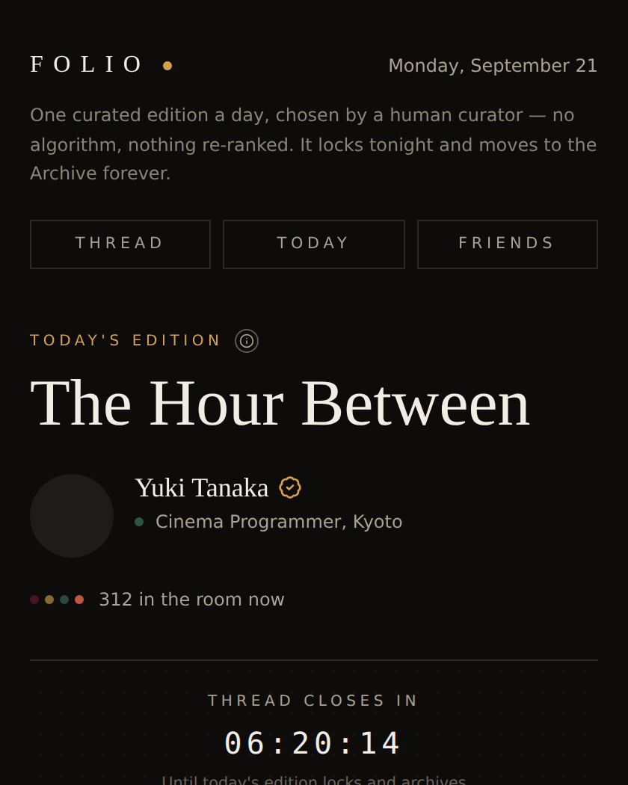
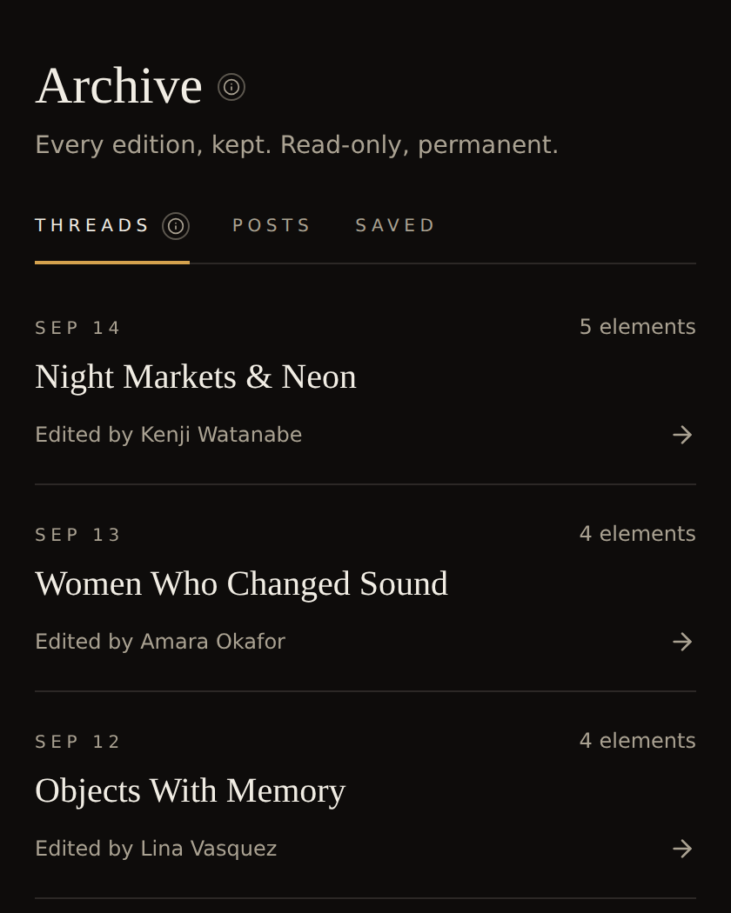
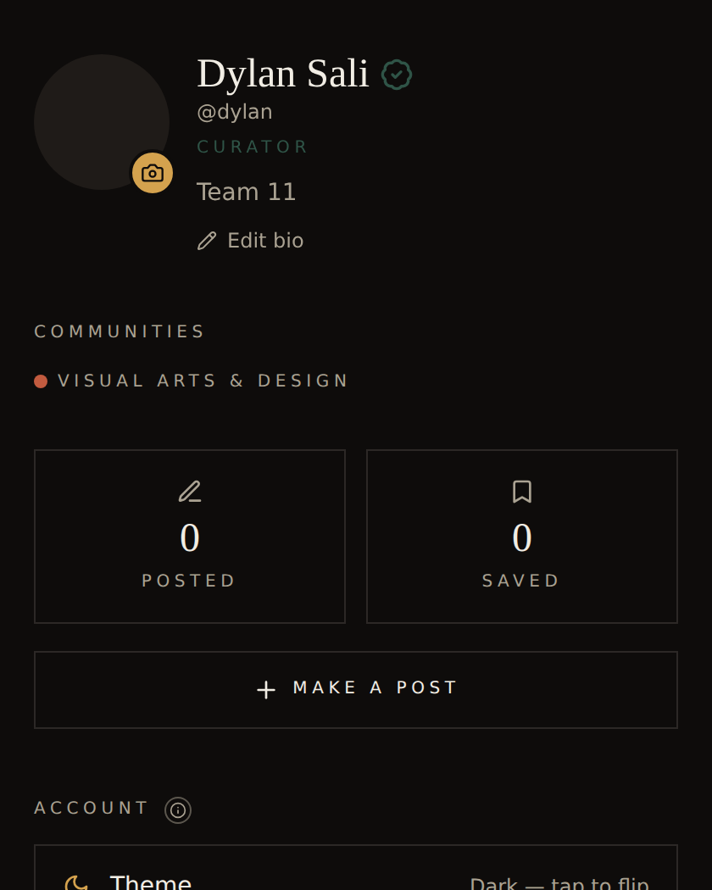
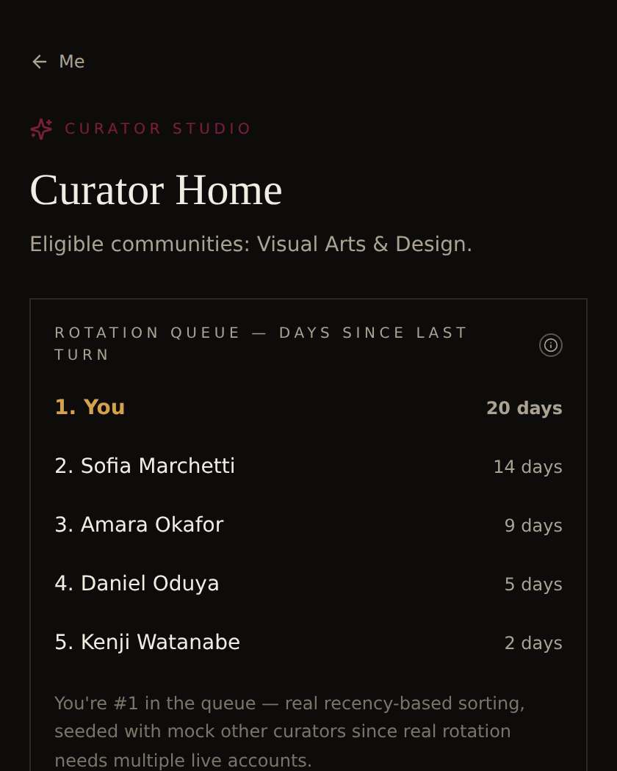
The real screens
Not mockups — every one of these is the actual build, running live.
Today — the daily Thread
Archive — locked, permanent, read-only
Me — verification → curator progression
Curator Studio — rotation queue
SLIDE 9 — REAL SCREENS
FOLIO · TEAM 11 · WEEK 9 STAND-UP

Slide 10
Evaluation findings
USABILITY TESTING — IN PROGRESS
Concept validation is strong (13 interviews). What's still needed: real people clicking through this exact build. Sessions run this week — [insert findings once complete].
WHAT WE'RE SPECIFICALLY TESTING
Can someone find and use "Make a post" without help?
Does the Archive Threads / Posts / Saved split make sense on first look?
Does the curator credibility block actually build trust, or does it get skipped over?
SLIDE 10 — EVALUATION FINDINGS
FOLIO · TEAM 11 · WEEK 9 STAND-UP

Slide 11
Open risks & what's next
STILL GENUINELY OPEN
TOWARD WEEK 12
Curator cold-start — who curates before rotation has real momentum
Real usability data on this build, not just concept validation
Ethics Wiki page — cultural representation, community-authored content
Real usability round + fixes from findings
A2 poster + 2-3 min pitch, all members ready
GitHub repo fully populated, Wiki pages live
EVERY MEMBER SPEAKS
Dylan — research synthesis & structure. Pranav — audience research & testing. Mohammad — technical build & prototype.
SLIDE 11 — OPEN RISKS & NEXT STEPS
FOLIO · TEAM 11 · WEEK 9 STAND-UP

