Slide 1


Smart Weather App
Solving weather together
Real-time weather updates via Crowdsourcing
TEAM [E]
Notes:
This template can be used as a starter file for presenting training materials in a group setting.
Sections
Sections can help to organize your slides or facilitate collaboration between multiple authors. On the Home tab under Slides, click Section, and then click Add Section.
Notes
Use the Notes pane for delivery notes or to provide additional details for the audience. You can see these notes in Presenter View during your presentation.
Keep in mind the font size (important for accessibility, visibility, videotaping, and online production)
Coordinated colors
Pay particular attention to the graphs, charts, and text boxes.
Consider that attendees will print in black and white or grayscale. Run a test print to make sure your colors work when printed in pure black and white and grayscale.
Graphics, tables, and graphs
Keep it simple: If possible, use consistent, non-distracting styles and colors.
Label all graphs and tables.

Slide 2
Presentation Overview
1. Background
2. Service Overview
3. Design Challenge
4. Prototype
5. Story Board
6. Lesson Learnt
Q & A
Notes:
This template can be used as a starter file for presenting training materials in a group setting.
Sections
Sections can help to organize your slides or facilitate collaboration between multiple authors. On the Home tab under Slides, click Section, and then click Add Section.
Notes
Use the Notes pane for delivery notes or to provide additional details for the audience. You can see these notes in Presenter View during your presentation.
Keep in mind the font size (important for accessibility, visibility, videotaping, and online production)
Coordinated colors
Pay particular attention to the graphs, charts, and text boxes.
Consider that attendees will print in black and white or grayscale. Run a test print to make sure your colors work when printed in pure black and white and grayscale.
Graphics, tables, and graphs
Keep it simple: If possible, use consistent, non-distracting styles and colors.
Label all graphs and tables.

Slide 3

Background
Current mindset
  Trivial
  Not controllable
Problem
  Lack of reliable real-time weather updates for precise location
Propose
  it’s a simple but yet powerful solution
Notes:
Give a brief overview of the presentation. Describe the major focus of the presentation and why it is important.
Introduce each of the major topics.
To provide a road map for the audience, you can repeat this Overview slide throughout the presentation, highlighting the particular topic you will discuss next.

Slide 4
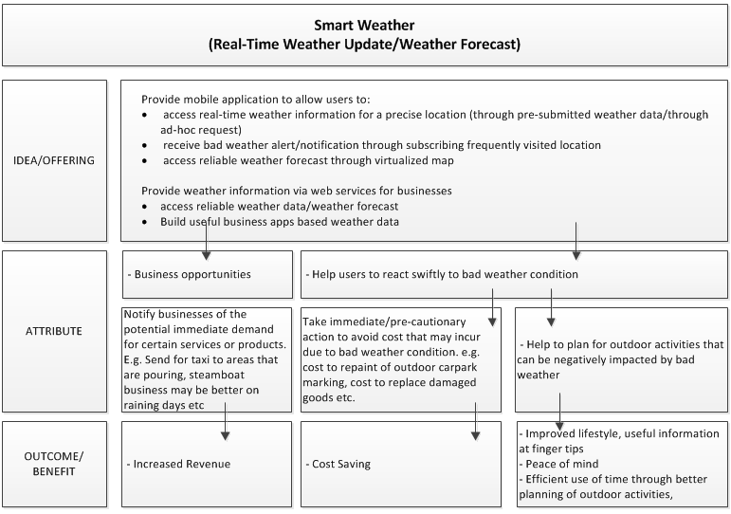
Service Overview
Notes:
Give a brief overview of the presentation. Describe the major focus of the presentation and why it is important.
Introduce each of the major topics.
To provide a road map for the audience, you can repeat this Overview slide throughout the presentation, highlighting the particular topic you will discuss next.

Slide 5
Design Challenge
How can we encourage our users to actively send weather reports back to the proposed weather system so the information will be readily available as and when there is a request from other users.
Notes:
Give a brief overview of the presentation. Describe the major focus of the presentation and why it is important.
Introduce each of the major topics.
To provide a road map for the audience, you can repeat this Overview slide throughout the presentation, highlighting the particular topic you will discuss next.

Slide 6
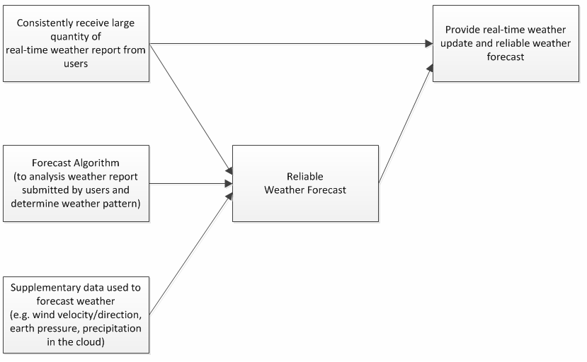
Concept Map - 1
Notes:
Give a brief overview of the presentation. Describe the major focus of the presentation and why it is important.
Introduce each of the major topics.
To provide a road map for the audience, you can repeat this Overview slide throughout the presentation, highlighting the particular topic you will discuss next.

Slide 7
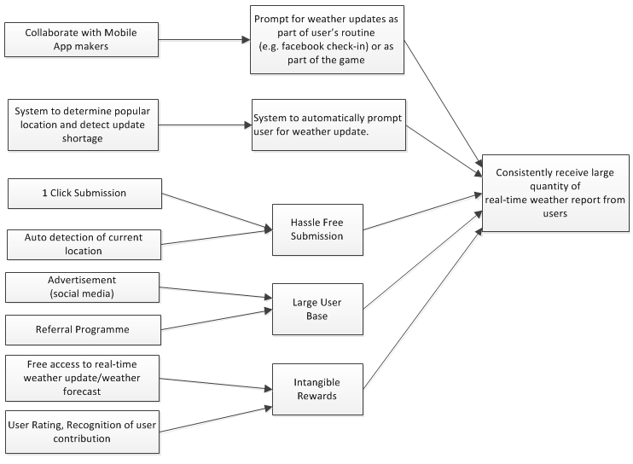
Concept Map - 2
Notes:
Give a brief overview of the presentation. Describe the major focus of the presentation and why it is important.
Introduce each of the major topics.
To provide a road map for the audience, you can repeat this Overview slide throughout the presentation, highlighting the particular topic you will discuss next.

Slide 8
Prototype
Questions
What are the relevant daily activities that can be integrated with this weather service?
How much are you willing to pay for an app that provides accurate weather information?
Imagine you have this app on your smart phone, how many times at least do you think you will utilize it on a normal day?

Slide 9
Prototype
Key Findings
Other factors that can change the rain condition apart from the wind direction
Users prefer interactive activities like comments on the weather posts
Weather status request to be transmitted based on the active users in the area

Slide 10
Prototype
Decisions
Better to focus on the rain condition as the first version of the app
Rain forecast using the wind direction shall be improved further as data grow bigger
Display forecasts by NEA on the app for user convenience

Slide 11
PROTOTYPE
DEMO
https://www.fluidui.com/editor/live/preview/p_lbQAt8P6DP7JZs1qNESLdgddOpNXVNs0.1349602586057

Slide 12
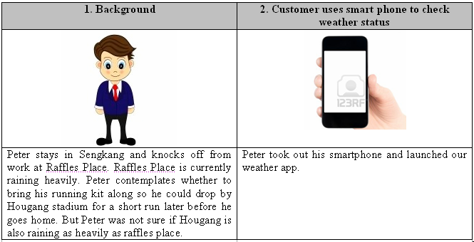
Story Board

Slide 13
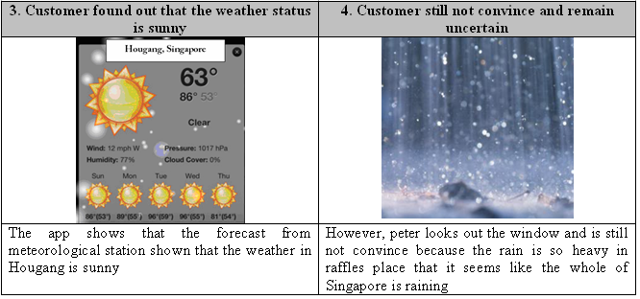
Story Board

Slide 14
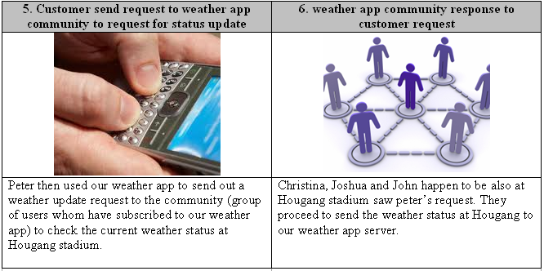
Story Board

Slide 15
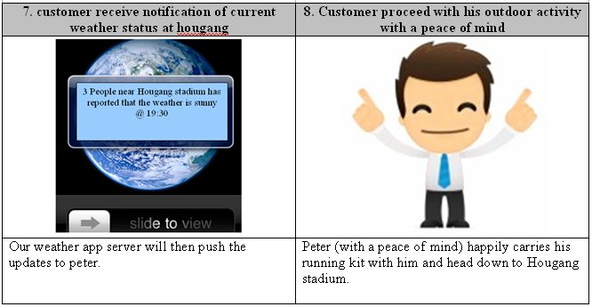
Story Board

Slide 16
Lesson Learnt
How can we take the SDL approach in providing innovative services
It is important to conduct sufficient user research to understand the topic’s pros and cons
Customer journey and service blue prints are effective approaches to model the service and can be used as a tool to improve or create new service opportunities

Slide 17
Lesson Learnt
Users play a core role in Innovation, value co-creation will naturally be part of the outcome

Slide 18

Thank you

