Slide 1


e-Government
SG Government’s Adoption in Social Media
TEAM 6

Slide 2

Discussion Topic
Prepare a case study of a social media initiative undertaken by a Singapore government agency with primary data collection. How does the government organizes itself to deal with this media? In what ways is this considered a success or failure?

Slide 3
Presentation Overview
# | Topic | Presenter | Duration
1 | Fact sheets on current status of government’s adoption to social media | Rollei | 05 mins
2 | How the government organized itself to deal with social media. Policies, Training, Technologies, new ways the government engage the public. Risks | Dayong, Rein | 10 mins
3 | Assessment Survey Analysis/Observation (public & agencies) Social Media Maturity Level in organization | Joseph, Thuzar | 10 mins
4 | Q & A | Team 5 | 05 Mins
* Total Slides : xxx
* Time Keeper: Rollei, Dayong
Total Duration : 30 Mins

Slide 4
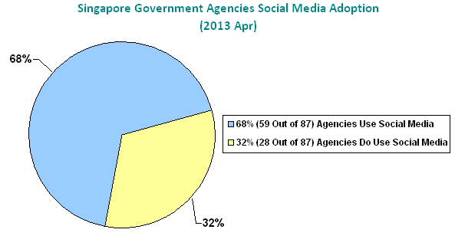
Fact sheets - 1/5

Slide 5
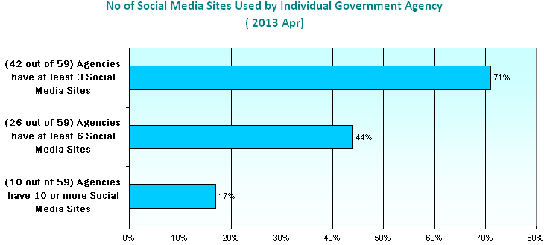
Fact sheets - 2/5

Slide 6
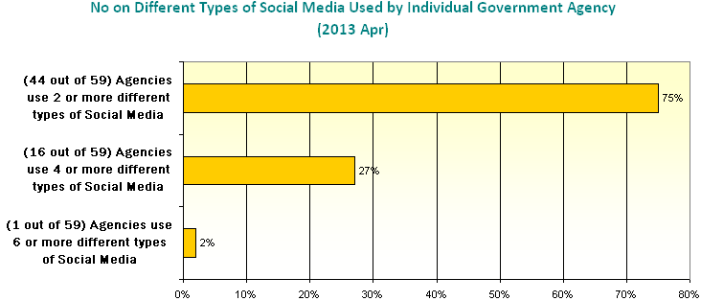
Fact sheets - 3/5

Slide 7
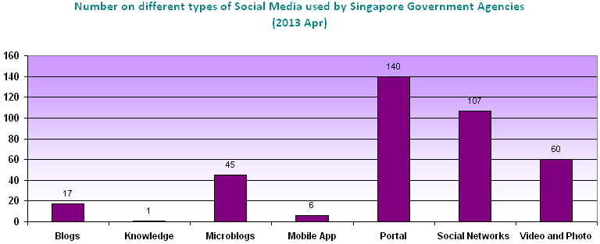
Fact sheets - 4/5

Slide 8
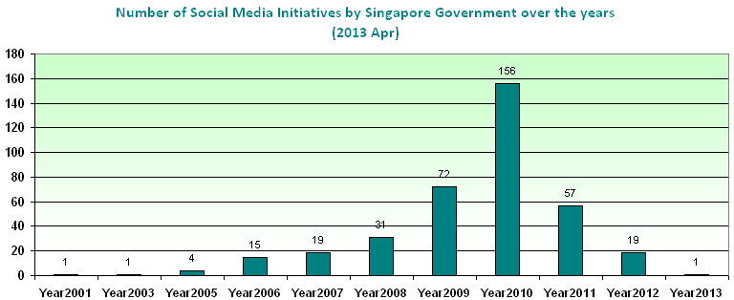

Fact sheets - 5/5

Slide 9
Summary on Social Media Adoption by the SG GOV
Started as early as 2001, NS Portal by Mindef.
  http://www.ns.sg
  A forum for NS community to interact, share and exchange their experiences centred around various NS-centric themes.
First Facebook & Twitter were created on Feb 2006 by MCCY to engage the youth
  http://www.twitter.com/youthsg
  http://www.facebook.com/youthsg
  A youth portal for youth engagement and provide youth resources.
First Youtube was created on Dec 2006 by People Association
  http://www.youtube.com/user/youthdotsg
  Central Singapore Community Development Council (CSCDC) Youtube Page provides videos about its key functions and activities.

Slide 10
Summary on Social Media Adoption by the SG GOV
Portal remain as the main type of social media site used by many agencies

Slide 11
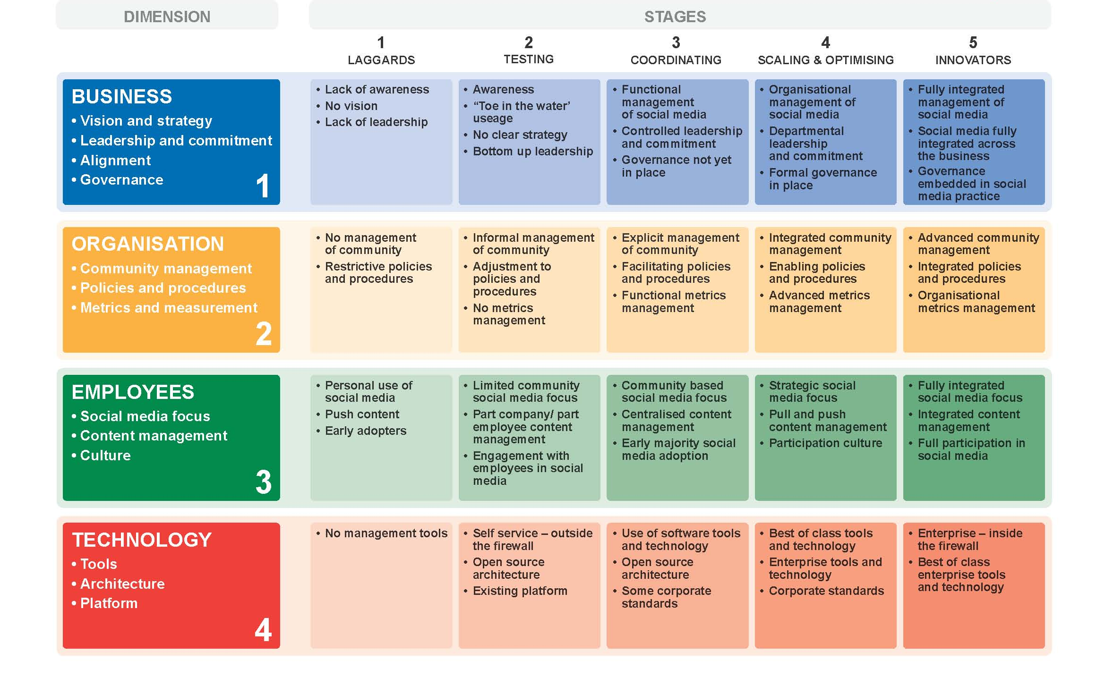
Social Media Maturity Model

Slide 12
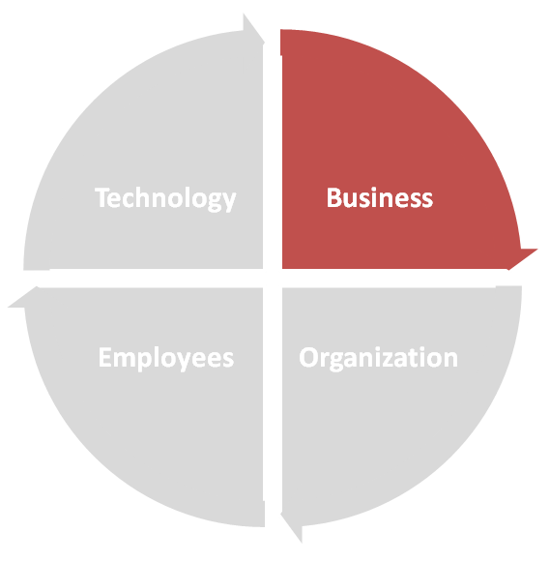
Maturity Evaluation - Business
Vision and strategy
Leadership and commitment
Alignment
Governance

Slide 13
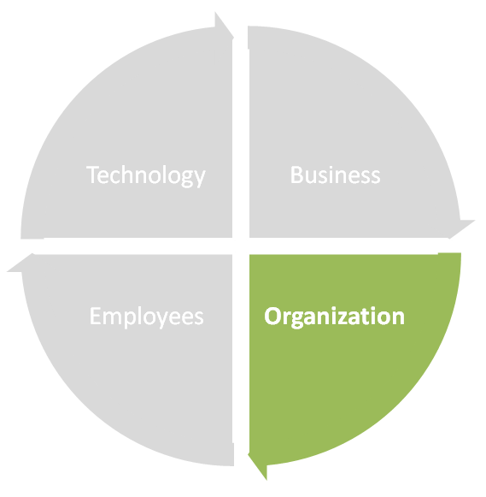
Maturity Evaluation - Organization
Community management
Policies and procedures
Metrics and measurement

Slide 14
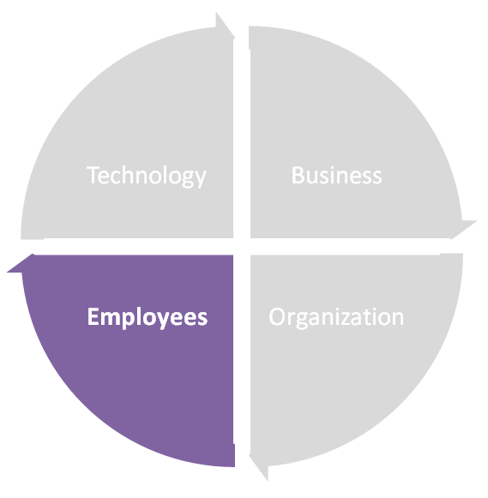
Maturity Evaluation - Employees
Social media focus
Content management
Culture

Slide 15
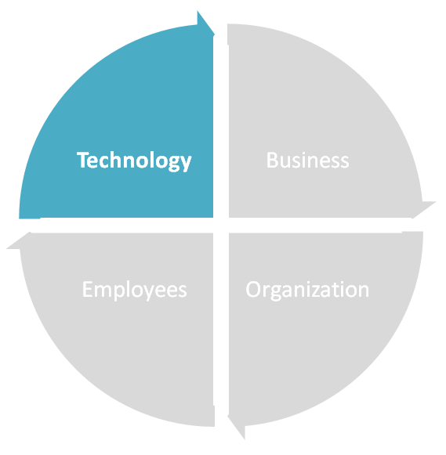
Maturity Evaluation - Technology
Tools
Architecture
Platform

Slide 16
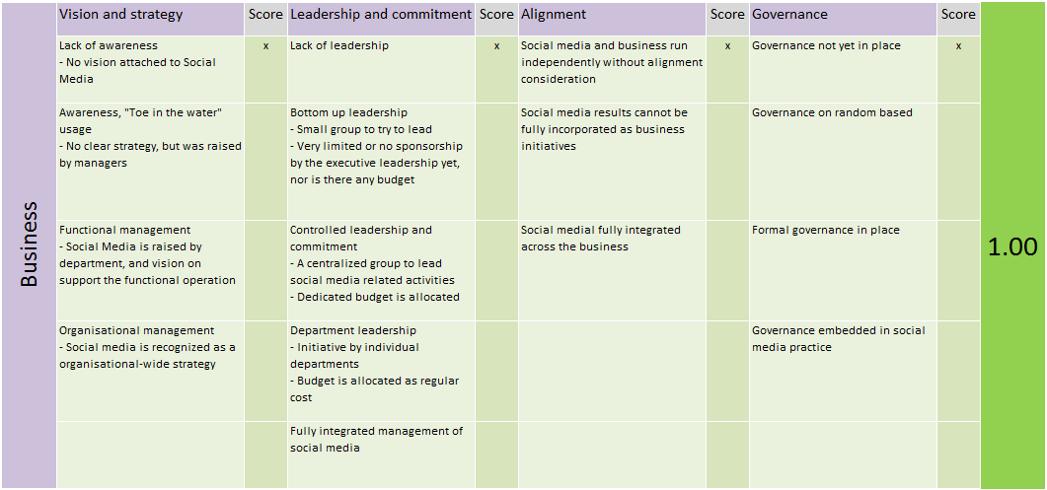
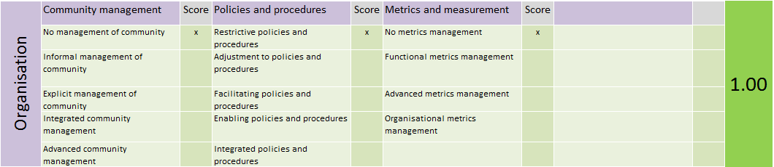
Measurement – Point System

Slide 17
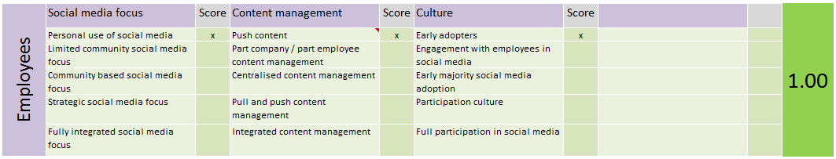
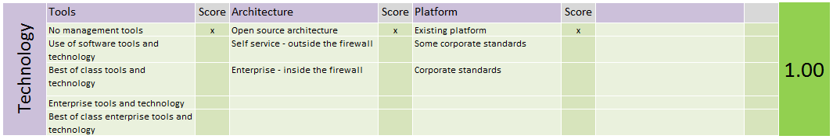
Measurement – Point System

Slide 18
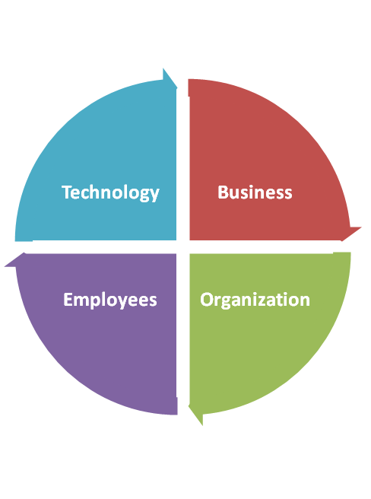

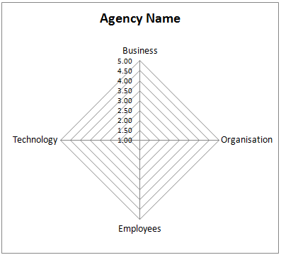
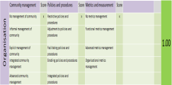
Measurement: from Conceptual to Measurable

Slide 19
Agencies’ Survey Results

Slide 20
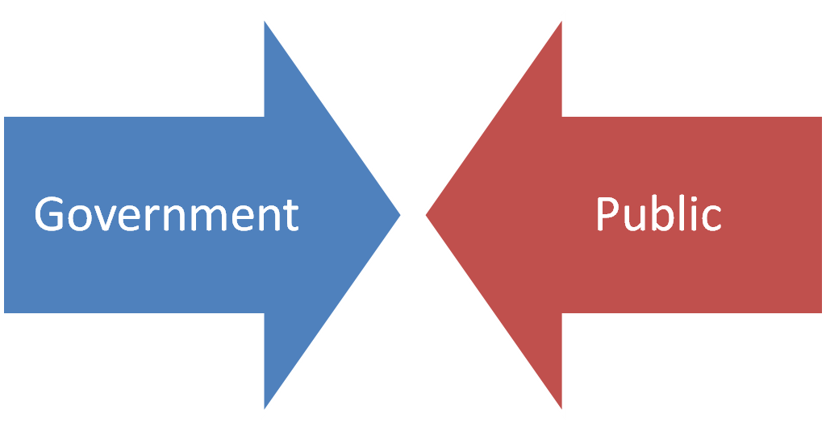
On the other side?

Slide 21
Public Survey Results

Slide 22
Survey Results

Slide 23


Slide 24


Slide 25
NOT SURE IF SLIDES AFTER THIS IS STILL APPLICABLE. Nevertheless, I leave it as it is till further disucssion

Slide 26
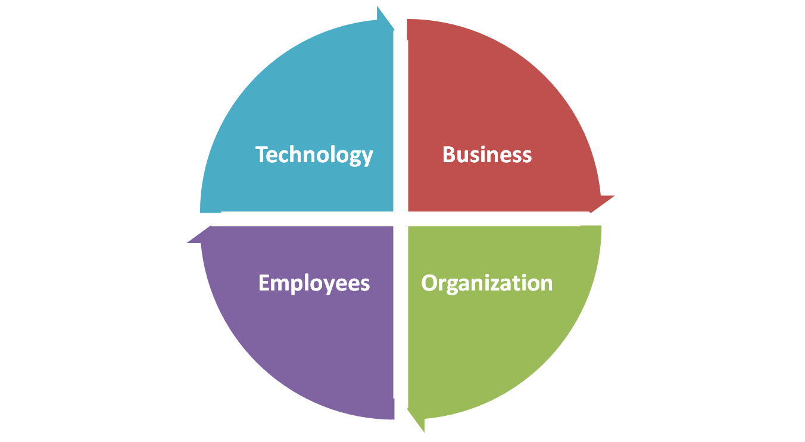

Slide 27
Social Media Roadmap

Slide 28
Conduct Literature study
Conduct Expert interviews
Conduct Group session
Create assessment tool
Evaluate the maturity model
Communicate results

Slide 29
Maturity Model
Collaboration
  Co-creation with customers, partners, internally
  Division between internal / external fades
  Innovate process in place to promote ideas
  Products and services adapted based on external / internal conversations
  Organization remodeled for social media conversation and deployment
  Social media strategy now dovetails with business strategic planning
Community
  Empower internal and external brand advocates
  User generated content
  Develop location based marketing
  Social tools help define the marketing
  Division between internal units fades
  Cooperation with external partners in marketing campaigns
  External stakeholders are not helping to evaluate, plan and execute services
Engagement
  Allow customers to talk via forums, blogs, Twitter conversations
  Join and start conversations
  Still just an ad tool. Not a tool for empowerment
  Not all departments are coordinated in social media efforts
  Create organizational social media policy, empower internal and external stakeholders
Broadcast
  Coherent presence established (Facebook, Twitter, Youtube)
  Social media policy established (although probably on for a department)
  Traditional broadcast approach
  Lack of resources. Lack of understanding of how social media is two way
  Push for establishment of two-way communication
Ad Hoc
  Individual experimentation with social media
  Monitoring of social media
  No Social Media policy
  Fear of the unknown of consequences
http://www.ofwim.org/docs/2011/Presentations/Tuesday/10-18%201335%20-%20Social%20Media%20Overview%20-%20Keller.pdf

Slide 30
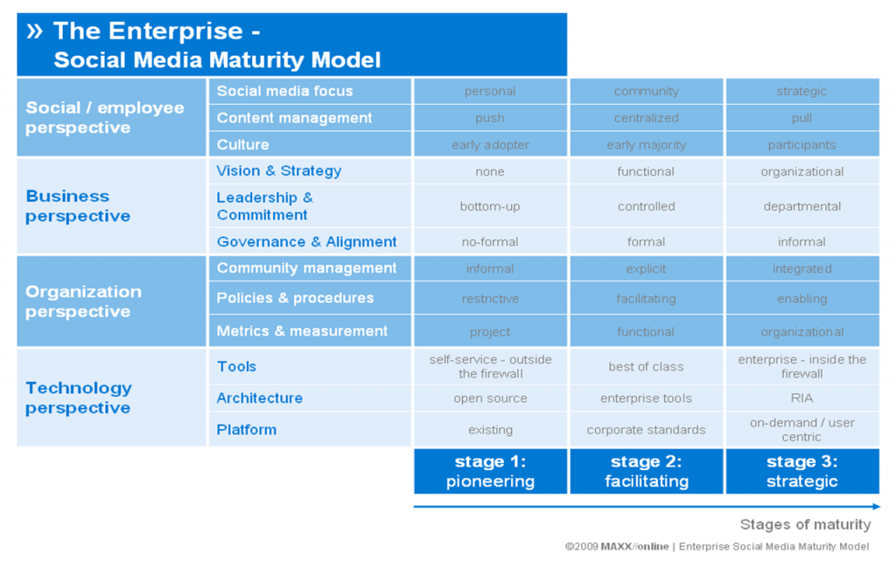

Slide 31
Risk Mitigation Process
Employee Enablement
Social Training / Social Learning
Response Guidelines
Technical Design

Slide 32
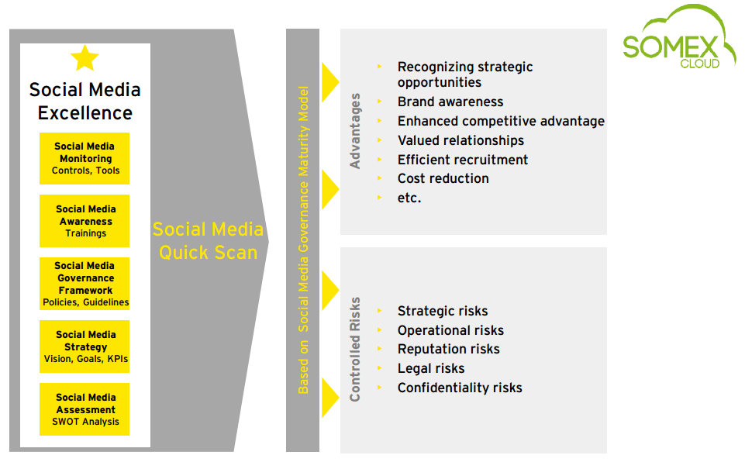
http://socialmediaswitzerland.files.wordpress.com/2012/04/2012_05_16_-making-the-case-for-some-in-your-organization_final1.pdf

Slide 33
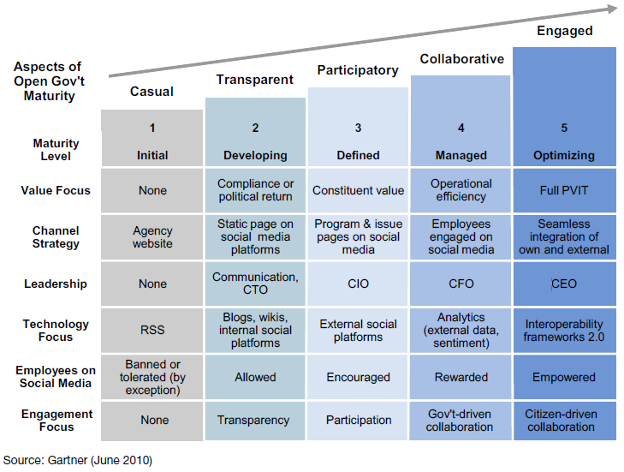
Maturity Model
Notes:
According to Gartner, the maturity model varies in countries and domains. Different government domains and countries will have different needs and priorities, influenced by mandates, regulations, political priorities and budgetary pressures. Also, organizations may exhibit elements and characteristics that are at different levels of maturity. In this case, the maturity model is a useful tool for government agencies to reflect about which aspects of their open government initiatives are missing or need to be strengthened. In particular, the balance between “inside-out” (government provides information for citizens and other stakeholders to use it) and outside-in (government looks for information that is collected and socialized by citizens) may be very different. While the maturity model assigns the latter a higher level, both are required to actually achieve higher maturity.

Slide 34
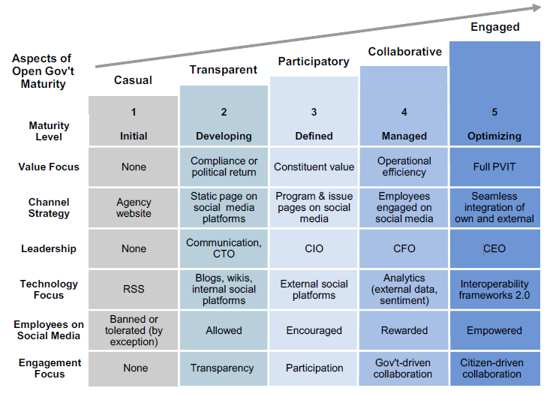
Level 1: Initial
  Open government is not a concern. Nobody fully understands what it is and its benefits, although there is some superficial interest of senior leadership because of initiatives elsewhere and media as well as stimuli by some of those employees who praise the importance of social software.
  There are sporadic attemps at adding some Web2.0 functionalities on existing websites, such as Really Simple Syndication (RSS) feeds, but there are no specific policies or strategies in place. In many cases, employees are not allowed to use any consumer social-media site from the corporate network, and there is no understanding by senior leadership about the potential value of such tools. There is also substantial confusion between e-government and its evolution and open government.
  A social-media policy does not exist yet, but is being defined. However its focus is primarily on the communication aspects.

Slide 35
Level 2: Developing
  Open government becomes a concern, mostly due to initiatives triggered by senior leadership in response to political pressures or the need to match what is being done in other jurisdictions. There is no understanding of and focus on value creation, but the priority is complying with all-of-government directives or mandates as well as using new media for external communication purposes.
  An initial open government vision and plan is being developed, but there is very limited to no sponsorship by the executive leadership yet, nor is there any budget.
  A social-media policy is being deployed that covers some but not all the issues that need to be addressed, and may soon need to be revised to better cope with records management and retention issues.
  While the lack of a consistent social media policy does not provide any common reference framework for different parts of the organization to effectively progress toward adoption and engagement, there is the desire to apply an enterprisewide approach.
  Employees’ social-media activity is tolerated at best.

Slide 36
Level 3: Defined
  Various groups in the organization recognize the need and the potential benefits of open government and engage in isolated initiatives. There is not yet a high-level executive sponsorship or significant investment, and there is a combination of top-down and bottom-up initiatives, with relatively little coordination.
  The open government or Government 2.0 plan is being revised, with greater engagement of business executive, but only a very marginal budget is explicitly earmarked for related initiatives.
  An initial measurement framework is in place, but its focus is mostly limited to articulating or demonstrating the impact on constituents. The ability to measure benefits, costs and risks is still very limited.
  Social-media policies are well developed and address both the institutional and the personal presence, although there is not yet a full-fledged framework to drive value creation from participation in external networks.
  Employees' activity on social media is selectively encouraged, although the focus remains on communities that are built and controlled by government.

Slide 37
Level 4: Collaborative
  The relevance and value of open government is recognized across the whole organization, at the head of agencies and deputy levels. CIOs and communication officers do not need to champion any longer. Open government initiatives and their progress are regularly on the executive meeting agenda, and specific resources are committed to advance the open government plans, with required budget.
  The open government plan is mature, with clear leadership roles assigned to business executives.
  A measurement framework is being used, which is based almost exclusively on quantitative elements and focuses on operational efficiency.
  Social-media policies are mature and well-tested, and frameworks are in place to manage the personal engagement of employees with relevant communities and to identify how individual initiatives can be more systematically leveraged from an enterprise perspective.
  Employees' activity on social media is rewarded.

Slide 38
Level 5: Optimizing
  The organization has made open government planning and initiatives part of the normal course of business, achieving a seamless integration with other business processes, and has focused on how to improve operational efficiency besides providing value to constituents and helping to fulfill the agency mission. Budgets can be more directly related to achievements.
  A full-fledged measurement framework is being used and improved over time, which is based almost exclusively on quantitative elements, with the main focus on operational efficiency while also considering other dimensions of public value.
  Social-media policies and frameworks have evolved to systematically account for input from outside the organization. Social-network analysis and social-media monitoring are regularly used across the organization, and drive both strategy development and service operations.
  Employees' activity on social media is actively encouraged.
  The focus on the relevance of external information leads to a critical review of interoperability frameworks and a revision of the information architecture. Activities based on the Semantic Web aimed at better integration across agencies are reassessed in view of how external, nongovernment communities model information.

Slide 39
Assessment Overview
 | Level 1 Initial | Level 2 Developing | Level 3 Defined | Level 4 Managed | Level 5 Optimizing
Vision | Casual | Transparent | Participatory | Collaborative | Engaged
Strategy | None | Citizen-centric | Employee-centric | Citizen-driven | Smarter government
Metrics | Compliance with mandate (e.g., meeting deadlines) | Political return (e.g., alignment with agency strategic objectives) | Constituent impact (e.g., number of people reached, satisfaction index) | Operational efficiency (e.g., head count/cost reduction, higher throughput, shorter case resolution) | Public value of IT (e.g., balanced combination of constituent impact, operational efficiency and mission relevance)
Governance | None | Communication, PIO, CTO | CIO chairing committee | CFO chairing committee | CEO, director general
Government to Citizen Processes | Opportunistic, unfocused, no prioritization process in place | Opportunistic, unfocused, no prioritization process in place | Still prevalent, attempt at targeting, cleansing and prioritizing | Total cost of ownership (TCO) model and subset of risks | Total cost of ownership (TCO) and full risk model, efficiency oriented
Citizen to Government Processes | Social-media policy being defined | Social-media policy is being deployed that covers some but not all of the issues | Social-media policy mature, allowed personal use for professional purposes | Formal framework for personal engagement in place | Systematic external engagement becomes prevalent
Technology | Some internal use: blogs, wiki | Internal deployment of collaboration suites. Agency pages on consumer social media | Topic-based pages on consumer social media | Engagement on external, nongovernment consumer social media (plus monitoring and social network analysis) | Information interoperability and integration

Slide 40
