Slide 1
This is a story about
HAO MIN & NINI

Slide 2



Slide 3


Slide 4
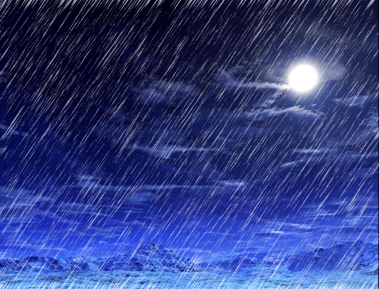

Slide 5
Rewind

Slide 6
Weather Alert:
Heavy Rain Expected
In East Coast Park @ 7pm

