Slide 1

The Chat-Bot Feels You – A Counseling Service
Using Emotional Response Generation

Slide 2
Group- 9
Salman Mostafiz Chowdhury 17101149
S. M. Bayazid Hossain 16101072
Md. Nazmur Sakib 17301124
Md. Shamiul Islam 17301108
Md. Sadiqul Islam Sakif 17301137
Ali Ahammed Rohid 17101361

Slide 3
Introduction
What is a chatbot
How can we use it in Counseling

Slide 4
Literature Review

Slide 5
Ideas & Plans
Adapting with depression
Descriptive Statistics
BIT

Slide 6
Ideas & Plans
Natural Language Processing
Natural Language Understanding
CNN
RNN Attention Network
General Language Generation
Soft Mechanism
Word Vector
Decoder and language model
Response generation Model
Print Network Model

Slide 7
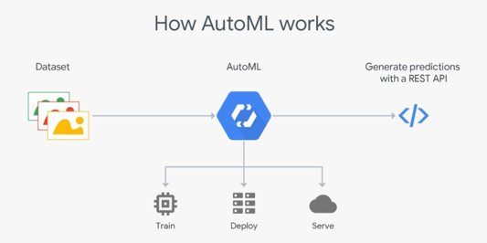
Types of NLP Engine
Cloud NLP Engines:
i. data security compromise
ii. Cost efficient
In house NLP Engines:
i. strictly maintain data security
ii.Costly

Slide 8
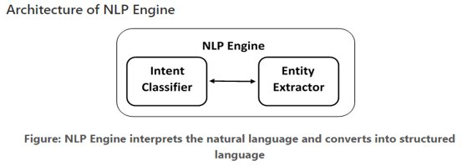
Architecture of NLP Engine
Intent Classifier
Different feature:
i. Pattern Matching
ii. Machine Learning Algorithms
iii. Neural Networks
II. Entity Extractor
Extract key information from user.
Example: Age, Gender, Type of issue.

Slide 9
Challenges
Enough data collection
Intimate data protection
Suitable respond in critical circumstance
Conduct neural network

Slide 10
Conclusion
By using the chatbot people can find their solution
It will continue developing its knowledge from the new user in future

Slide 11
Thank You

