Slide 1



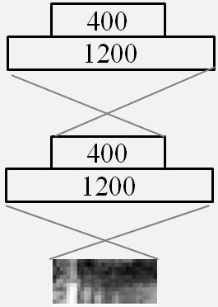
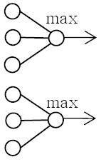
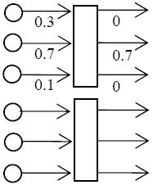
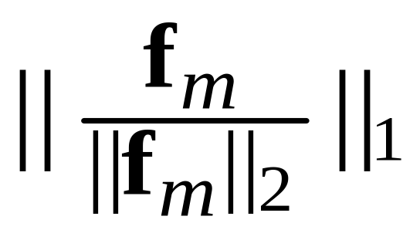
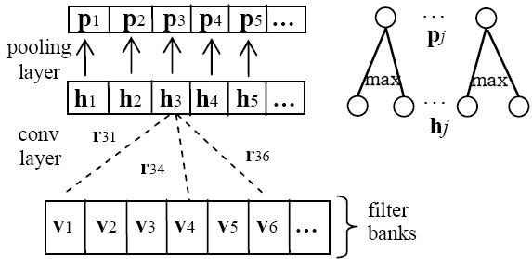
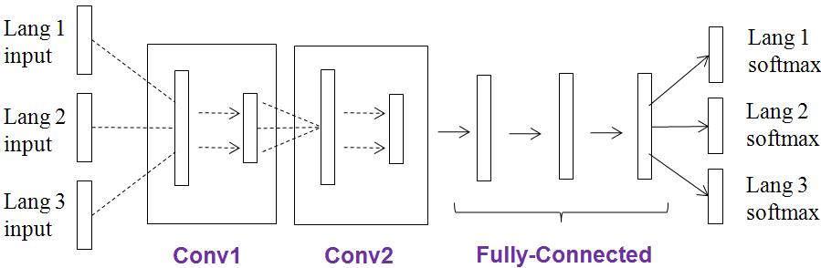
Improving Language-Universal Feature Extraction with Deep Maxout and Convolutional Neural Networks
Yajie Miao Florian Metze
Language Technologies Institute, School of Computer Science, Carnegie Mellon University
ymiao, fmetze@cs.cmu.edu
1. Introduction
3. Sparse Feature Extraction
5. Experiment Results and Observations
DNNs become the state of the art for speech recognition. DNNs provide an
architecture particularly suitable for multi-lingual and cross-lingual ASR.
DNN-based language universal feature extraction (LUFE) was proposed in [1]. A
multilingual DNN can be learned with hidden layers shared across languages.
Each language has its own input features and softmax output layer.
On the new language, the shared hidden layers act as a deep feature extractor.
Hybrid DNN models are built over feature representations from this extractor. This
realizes cross-language knowledge transfer.
Goal: improve LUFE via maxout and convolutional networks; generate sparse
and invariant feature representations
1. Maxout Networks for Sparse Feature Extraction
On the target language Tagalog, the identical DNN topology is used for hybrid
systems over different feature extractors.
We report WERs(%) on a 2-hour testing set of Tagalog.
pSparsity is computed as an average over the entire Tagalog training set
Maxout networks [3] partition the hidden units into groups. Each group outputs
the max value within it as the activation.
After the maxout network is trained, sparse representations can be generated
from any of the maxout layers via a non-maximum masking operation.
Non-maximum masking only happens during the feature extraction stage. The
training stage always applies max-pooling.
Models | WER% | pSparsity
Monolingual DNN | 70.8 | -----
Monolingual CNN | 68.2 | -----
Monolingual Baseline
DNN-LUFE | 69.6 | 21.3
CNN-LUFE | 67.1 | 20.4
LUFE with CNNs
Lang 1
softmax
Lang 2
softmax
Lang 3
softmax
Rectifier-LUFE | 68.2 | 10.7
Maxout-LUFE | 67.5 | 17.7
LUFE with Maxout
…
Hybrid
DNN
maxout network
maxout layer
non-max masking
Source
…
Feature Extractor
Maxout-CNN-LUFE | 65.9 | 16.6
CNN+Maxout
Target
2. More Comparison
Application of LUFE improves the monolingual DNN consistently
The CNN extractor outperforms the DNN extractor by 2.5% absolute WER
Maxout networks generate sparse features and better WERs. Rectifier networks
output even sparser features but worse WERs. Over-sparsification may hurt
speech recognition performance!!
Combining maxout and CNN results in the best feature extractor
…
Rectifier networks [4] also generate zero-sparsity features
Quantitatively measure sparsity via the popularity sparsity metric [5]. Given one
speech frame, we assume fm is the feature representation:
Lang 1
input
Lang 2
input
Lang 3
input
Target Lang
pSparsity =
2. LUFE with Convolutional Networks
3. Combination of CNN and Maxout Networks
CNN inputs: 11 frames of 30-dim fbank
Convolution only on the frequency axis
Network structure:
11x30 → 100x11x5 → 200x100x4 →
1024:1024:1024
Pooling size of 2
Keep the convolutional layers unchanged. The fully connected layers are replaced
by maxout layers
This generates both invariant and also sparse feature representation
6. References
[1] J. Huang, J. Li, D. Yu, L. Deng, and Y. Gong, “Cross-language knowledge transfer using multilingual deep neural network with shared hidden layers,” in Proc. ICASSP, 2013.
[2] T. N. Sainath, A. Mohamed, B. Kingsbury, and B. Ramabhadran, “Deep convolutional neural networks for LVCSR,” in Proc. ICASSP, pp. 8614-8618, 2013.
[3] Y. Miao, F. Metze, and S. Rawat, “Deep maxout networks for low-resource speech recognition,” in Proc. ASRU, 2013.
[4] X. Glorot, A. Bordes, and Y. Bengio, “Deep sparse rectifier neural networks,” in Proc. AISTATS, 2011.
[5] J. Ngiam, P. Koh, Z. Chen, S. Bhaskar, and A. Y. Ng, “Sparse filtering,” in Proc. NIPS, 2013
4. Experimental Setup
BABEL corpus: Base Period languages
Tagalog (IARPA-babel106-v0.2f) Cantonese (IARPA-babel101-v0.4c)
Turkish (IARPA-babel105b-v0.4) Pashto (IARPA-babel104b-v0.4aY)
Features
Statistics | Target | Source
 | Tagalog | Cantonese | Turkish | Pashto
# training speakers | 132 | 120 | 121 | 121
training (hours) | 10.7 | 17.8 | 9.8 | 9.8
dict size | 8k | 7k | 12k | 8k
Acknowledgements
This work was supported by the Intelligence Advanced Research Projects Activity (IARPA) via Department of Defense U.S. Army Research Laboratory (DoD / ARL) contract number W911NF-12-C-0015. The U.S. Government is authorized to reproduce and distribute reprints for Governmental purposes notwithstanding any copyright annotation thereon. Disclaimer: The views and conclusions contained herein are those of the authors and should not be interpreted as necessarily representing the official policies or endorsements, either expressed or implied, of IARPA, DoD/ARL, or the U.S. Government.
# tied states | 1920 | 1867 | 1854 | 1985

