Slide 1
ECE 599/692 – Deep Learning
Lecture 3 – Convolutional Neural Network (CNN)
Hairong Qi, Gonzalez Family Professor
Electrical Engineering and Computer Science
University of Tennessee, Knoxville
http://www.eecs.utk.edu/faculty/qi
Email: hqi@utk.edu
Notes:
AICIP stands for Advanced Imaging and Collaborative Information Processing

Slide 2
Outline
Lecture 3: Core ideas of CNN
  Receptive field
  Pooling
  Shared weight
  Derivation of BP in CNN
Lecture 4: Practical issues
  Normalized input and initialization of hyperparameters
  Cross validation
  Momentum
  Learning rate
  Activation functions
  Pooling strategies
  Regularization
Lecture 5: Variants of CNN
  From LeNet to AlexNet to GoogleNet to VGG to ResNet
Lecture 6: Implementation
Lecture 7: Applications of CNN – Binary hashing
Lecture 8: Applications of CNN – Person re-identification

Slide 3
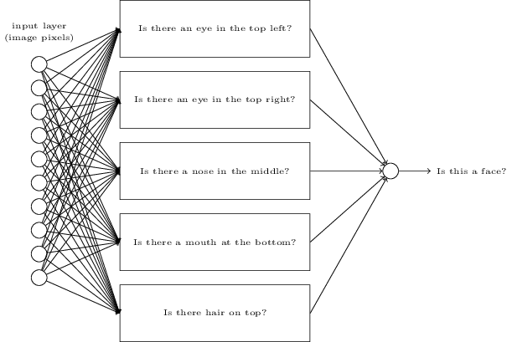
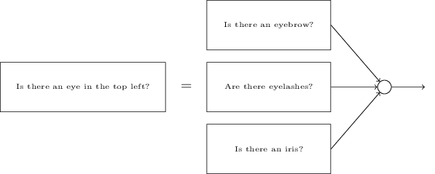
From NN to deep NN

Slide 4
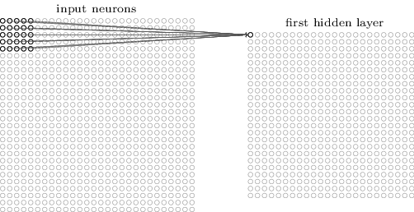
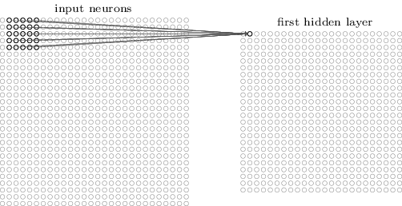
Receptive field (RF) and shared weight

Slide 5
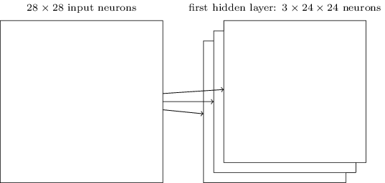
Feature maps

Slide 6
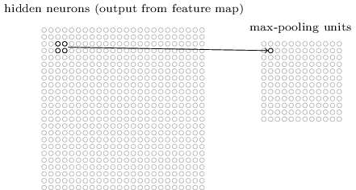
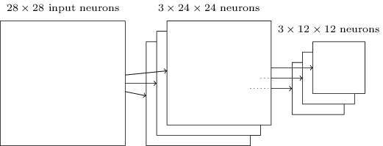
Max pooling

Slide 7
Output of max pooling invariant to shifts in the inputs
Not very clear (from Le)
Translational invariant systems
Major source of distortions in natural data is typically translation

Slide 8
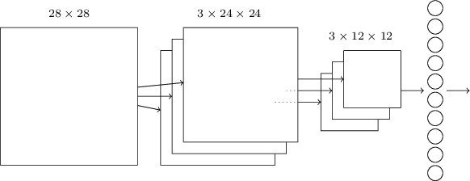
A simple CNN framework

Slide 9
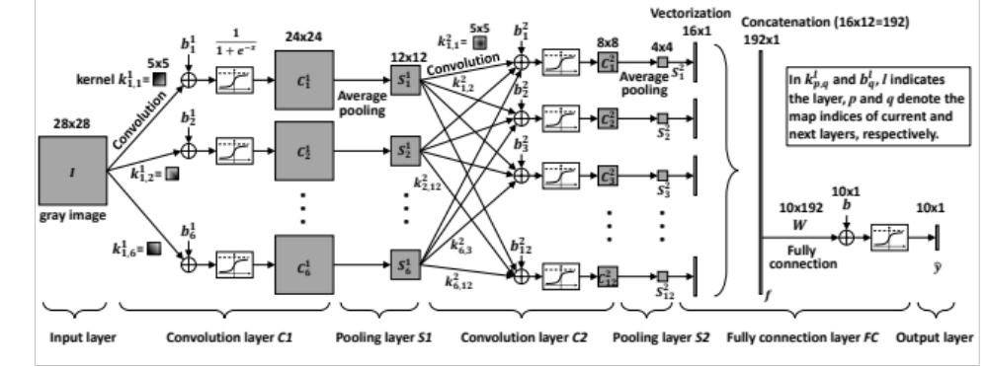
A more practical framework

Slide 10
Acknowledgement
All figures except the last one are from [Nielsen]

