Slide 1


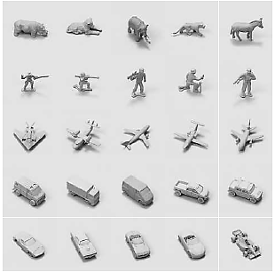
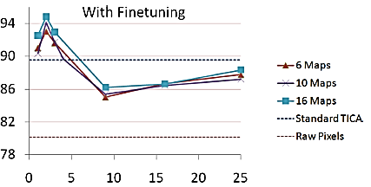
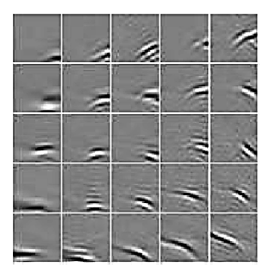











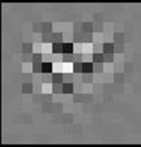
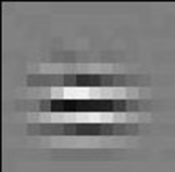
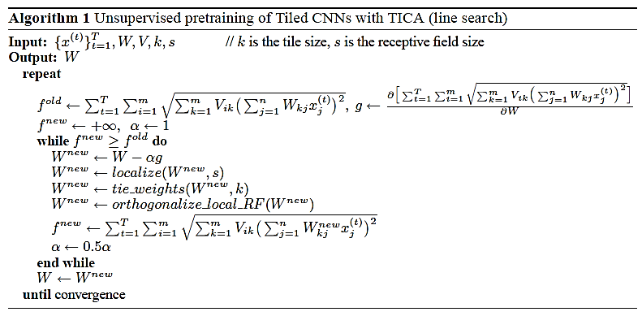
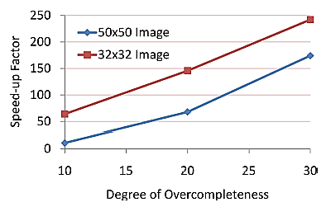
Tiled Convolutional Neural Networks
S
T
A
N
F
O
R
D
Quoc V. Le, Jiquan Ngiam, Zhenghao Chen, Daniel Chia, Pang Wei Koh, and Andrew Y. Ng
Abstract
Tiled Convolutional Neural Networks
Results on the NORB dataset
1
3
7
Convolutional neural networks (CNNs) have been successfully applied to many tasks such as digit and object recognition. Using convolutional (tied) weights significantly reduces the number of parameters that have to be learned, and also allows translational invariance to be hard-coded into the architecture. In this paper, we consider the problem of learning invariances, rather than relying on hard-coding. We propose tiled convolutional neural networks (Tiled CNNs), which use a regular “tiled” pattern of tied weights that does not require that adjacent hidden units share identical weights, but instead requires only that hidden units k steps away from each other to have tied weights. By pooling over neighboring units, this architecture is able to learn complex invariances (such as scale and rotational invariance) beyond translational invariance. Further, it also enjoys much of CNNs’ advantage of having a relatively small number of learned parameters (such as ease of learning and greater scalability). We provide an efficient learning algorithm for Tiled CNNs based on Topographic ICA, and show that learning complex invariant features allows us to achieve highly competitive results for both the NORB and CIFAR-10 datasets.
Pooling Units
Tied
Weights
Weight
untying
Tied
Weights
Multiple
maps
Algorithms | Accuracy
Deep Tiled CNNs [this work] | 96.1%
CNNs [LeCun et al] | 94.1%
3D Deep Belief Networks [Nair & Hinton] | 93.5%
Deep Boltzmann Machines [Salakhutdinov et al] | 92.8%
TICA | 89.6%
SVMs | 88.4%
Tile Size (k) = 2
Pooling Size = 3
Simple Units
Number
of Maps = 3
Input
CNN
Tiled CNN
Tiled CNN with multiple feature maps
(Our model)
Tiled CNNs are more flexible and usually better than fully convolutional neural networks.
Pretraining with TICA finds invariant and discriminative features and works well with finetuning.
State-of-the-art results on NORB
Pretraining with Topographic ICA
4
Local
Orthorgonalization
Test Set Accuracy
p1
p2
p3
….
Untied
Weights
Sqrt
V
Tile size (k)
Square
Local orthorgonalization
Results on the CIFAR-10 dataset
W
8
Motivation
2
TICA first layer filters
(2D topography, 25 rows of W).
Convolutional neural networks [1] work well for many recognition tasks:
  Local receptive fields for computational reasons
  Weight sharing gives translational invariance
However, weight sharing can be restrictive because it prevents us from learning other kinds of invariances.
TICA network architecture
Evaluating benefits of convolutional training
Training on 8x8 samples and using these weights in a Tiled CNN obtains only 51.54% on the test set compared to 58.66% using our proposed method.
Visualization:
Networks learn concepts like edge detectors, corner detectors
Invariant to translation, rotation and scaling
Algorithms | Accuracy
LCC++ [Yu et al] | 74.5%
Deep Tiled CNNs [this work] | 73.1%
LCC [Yu et al] | 72.3%
mcRBMs [Ranzato & Hinton] | 71.0%
Best of all RBMs [Krizhevsky et al] | 64.8%
TICA | 56.1%
Raw pixels | 41.1%
Algorithms for pretraining convolutional neural networks [2,3] do not use untied weights to learn invariances.
TICA can be used to pretrain Tiled CNNs because it can learn invariances even when trained only on unlabeled data [4, 5].
Overcompleteness (multiple maps) can be achieved by local orthogonalization. We localize neurons that have identical receptive fields
Convolutional Neural Networks
5
6
Pooling Units
Algorithm
TICA Speedup
Tied
Weights
Speedup over non-local (fully-connected) TICA
References
  [1] Y. LeCun, L. Bottou, Y. Bengio, and P. Haffner. Gradient based learning applied to document recognition. Proceeding of the IEEE, 1998.
  [2] H. Lee, R. Grosse, R. Ranganath, and A.Y. Ng. Convolutional deep belief networks for scalable unsupervised learning of hierarchical representations. In ICML, 2009.
  [3] M.A. Ranzato, K. Jarrett, K. Kavukcuoglu and Y. LeCun. What is the best multi-stage architecture for object recognition? In ICCV, 2009.
  [4] A. Hyvarinen and P. Hoyer. Topographic independent component analysis as a model of V1 organization and receptive fields. Neural Computation, 2001.
  [5] A. Hyvarinen, J. Hurri, and P. Hoyer. Natural Image Statistics. Springer, 2009.
  [6] K. Kavukcuoglu, M. Ranzato, R. Fergus, Y. LeCun. Learning invariant features through topographic filter maps . In CVPR, 2009.
  [7] K. Gregor, Y. LeCun. Emergence of Complex-Like Cells in a Temporal Product Network with Local Receptive Fields. ARXIV, 2010.
http://ai.stanford.edu/~quocle/
9
Simple Units
Optimization for
Sparsity at Pooling units
Input
Local Receptive Fields
Projection step
Locality, Tie weight and
Orthogonality contraints

