Slide 1
Convolutional
neural networks
Abin - Roozgard

Slide 2
Presentation layout
Introduction
Drawbacks of previous neural networks
Convolutional neural networks
LeNet 5
Comparison
Disadvantage
Application

Slide 3
introduction

Slide 4
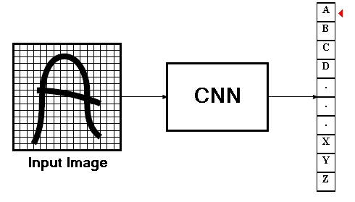
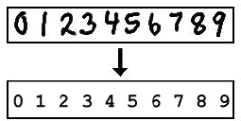
Introduction
Convolutional neural networks
  Signal processing, Image processing
improvement over the multilayer perceptron
  performance, accuracy and some degree of invariance to distortions in the input images

Slide 5
Drawbacks

Slide 6
Behavior of multilayer neural networks
Types of
Decision Regions
Exclusive-OR
Problem
Classes with
Meshed regions
Most General
Region Shapes
Structure
Single-Layer
Half Plane
Bounded By
Hyper plane
A
B
B
A
B
A
Two-Layer
Convex Open
Or
Closed Regions
A
B
B
A
B
A
Three-Layer
Arbitrary
(Complexity
Limited by No.
of Nodes)
A
B
B
A
B
A

Slide 7
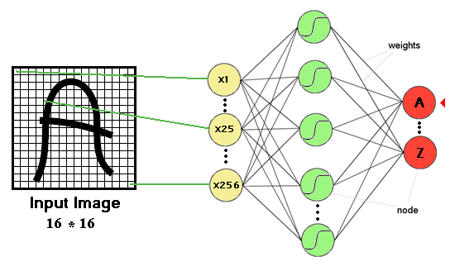
Multi-layer perceptron and image processing
One or more hidden layers
Sigmoid activations functions

Slide 8
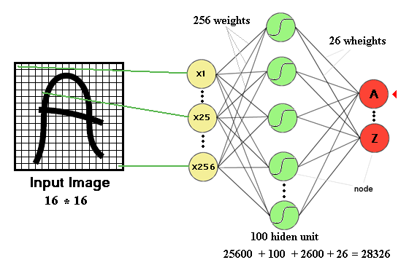
Drawbacks of previous neural networks
the number of trainable parameters becomes extremely large

Slide 9
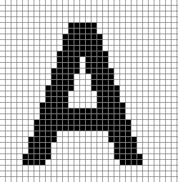
Drawbacks of previous neural networks
Little or no invariance to shifting, scaling, and other forms of distortion

Slide 10
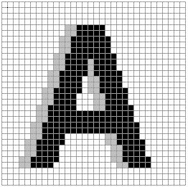
Drawbacks of previous neural networks
Little or no invariance to shifting, scaling, and other forms of distortion
Shift left

Slide 11
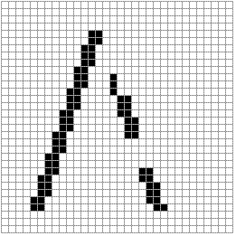
Drawbacks of previous neural networks
154 input change from 2 shift left
77 : black to white
77 : white to black

Slide 12
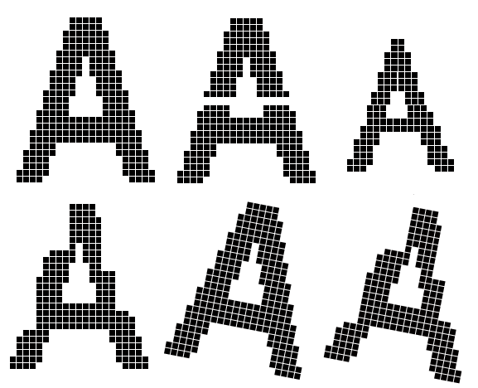
Drawbacks of previous neural networks
scaling, and other forms of distortion

Slide 13

Drawbacks of previous neural networks
the topology of the input data is completely ignored
work with raw data.
Feature 1
Feature 2

Slide 14


Drawbacks of previous neural networks
Black and white patterns:
Gray scale patterns :
32 * 32 input image

Slide 15
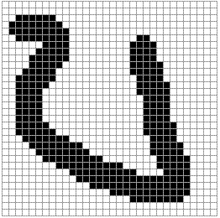
Drawbacks of previous neural networks
A
A

Slide 16
Improvement
Fully connected network of sufficient size can produce outputs that are invariant with respect to such variations.
  Training time
  Network size
  Free parameters

Slide 17
Convolutional neural network
(CNN)

Slide 18

History
In 1995, Yann LeCun and Yoshua Bengio introduced the concept of convolutional neural networks.
Yann LeCun, Professor of Computer Science
The Courant Institute of Mathematical Sciences
New York University
Room 1220, 715 Broadway, New York, NY 10003, USA.
(212)998-3283 yann@cs.nyu.edu

Slide 19
About CNN’s
CNN’s Were neurobiologically motivated by the findings of locally sensitive and orientation-selective nerve cells in the visual cortex.
They designed a network structure that implicitly extracts relevant features.
Convolutional Neural Networks are a special kind of multi-layer neural networks.

Slide 20
About CNN’s
CNN is a feed-forward network that can extract topological properties from an image.
Like almost every other neural networks they are trained with a version of the back-propagation algorithm.
Convolutional Neural Networks are designed to recognize visual patterns directly from pixel images with minimal preprocessing.
They can recognize patterns with extreme variability (such as handwritten characters).

Slide 21
Classification
Classification
Convolutional neural network
f1
f 2
Pre-processing for feature extraction
f1 … fn
Input
Classification
output
Input
Feature extraction
Shift and distortion invariance
classification
output

Slide 22
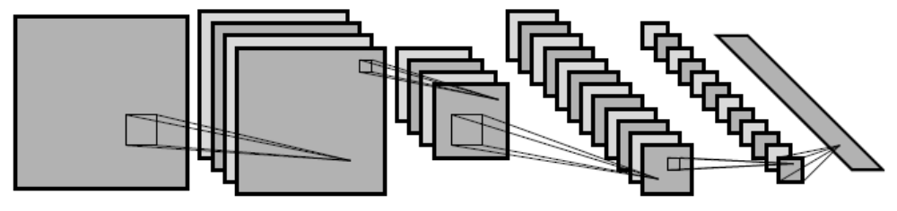
CNN’s Topology
Feature maps
C
Feature extraction layer
Convolution layer
Shift and distortion invariance or
Subsampling layer
S

Slide 23

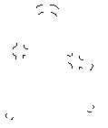
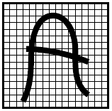

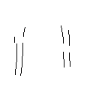

Feature extraction layer or Convolution layer
detect the same feature at different positions in the
input image.
features

Slide 24

Feature extraction
-1
0
1
Convolve with
Threshold
-1
0
1
-1
0
1
w11
w12
w13
w11
w12
w13
w21
w22
w23
w21
w22
w23
w31
w32
w33
w31
w32
w33

Slide 25
Feature extraction
Shared weights: all neurons in a feature share the
same weights (but not the biases).
In this way all neurons detect the same feature at
different positions in the input image.
Reduce the number of free parameters.
Inputs
C
S

Slide 26


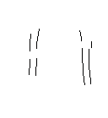
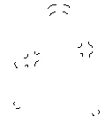

Feature extraction
If a neuron in the feature map fires, this corresponds to a match with the template.

Slide 27


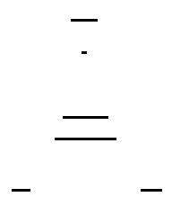
Subsampling layer
the subsampling layers reduce the spatial resolution of each feature map
By reducing the spatial resolution of the feature map, a certain degree of shift and distortion invariance is
achieved.

Slide 28

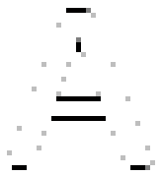




Subsampling layer
the subsampling layers reduce the spatial resolution of each feature map

Slide 29







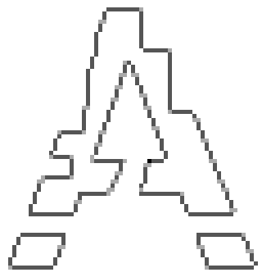


Subsampling layer

Slide 30





Subsampling layer
The weight sharing is also applied in subsampling
layers.

Slide 31
Subsampling layer
the weight sharing is also applied in subsampling layers
reduce the effect of noises and shift or distortion
Feature map

Slide 32
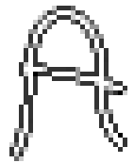
Up to now …

Slide 33
LeNet 5

Slide 34
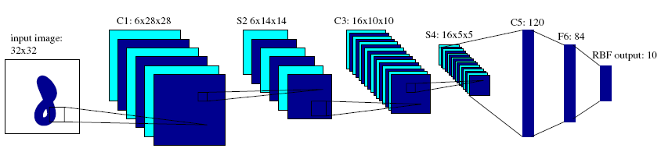
LeNet5
Introduced by LeCun.
raw image of 32 × 32 pixels as input.

Slide 35
LeNet5
C1,C3,C5 : Convolutional layer.
5 × 5 Convolution matrix.
S2 , S4 : Subsampling layer.
Subsampling by factor 2.
F6 : Fully connected layer.

Slide 36
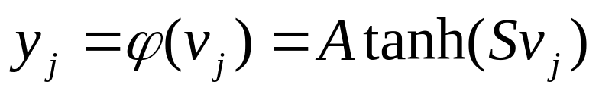
LeNet5
All the units of the layers up to F6 have a sigmoidal activation function of the type:

Slide 37
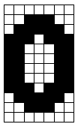
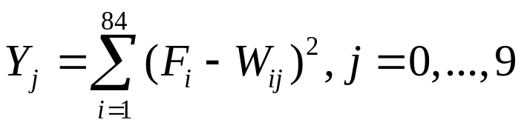
LeNet5
+1
+1
F1
W1
F2
W2
0
Y0
+1
W84
F84

Slide 38
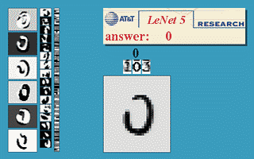

LeNet5
About 187,000 connection.
About 14,000 trainable weight.

Slide 39
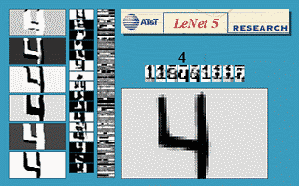
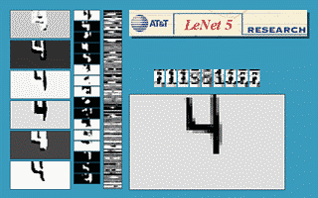
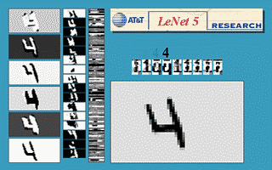
LeNet5

Slide 40
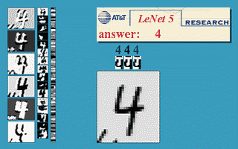
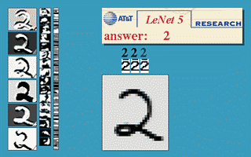
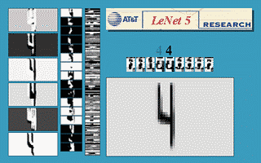
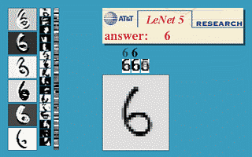
LeNet5

Slide 41
Comparison

Slide 42
Comparison
Database : MNIST (60,000 handwritten digits )
Affine distortion : translation, rotation.
elastic deformations : corresponding to uncontrolled oscillations of the hand muscles.
MLP (this paper) : has 800 hidden unit.

Slide 43
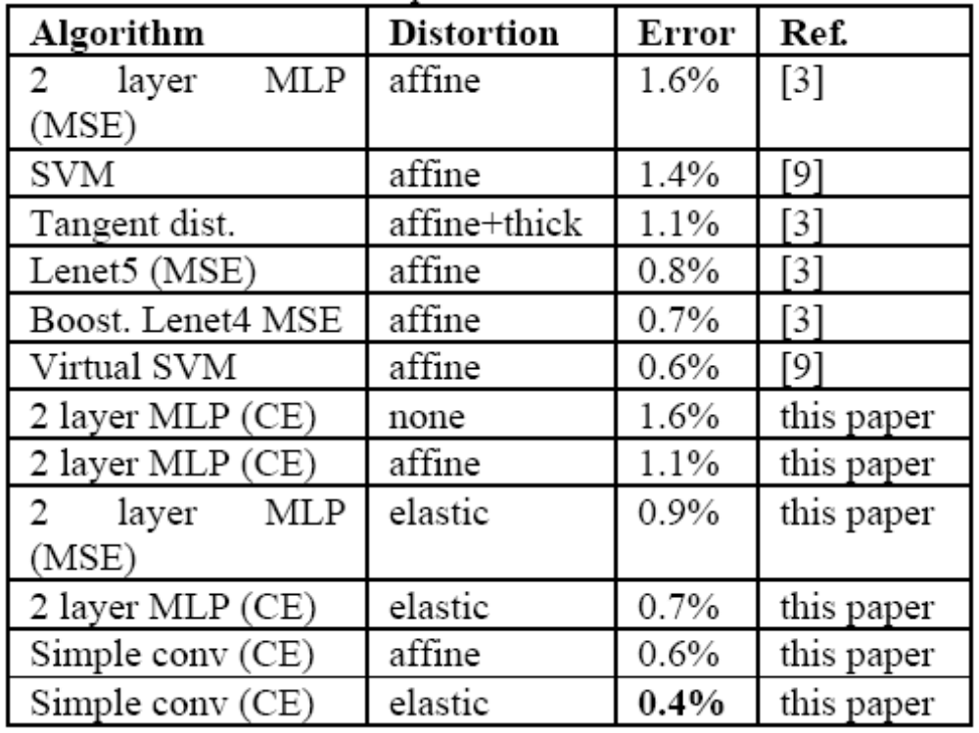
Comparison
“This paper” refer to reference[ 3] on references slide.

Slide 44
Disadvantages

Slide 45
Disadvantages
From a memory and capacity standpoint the CNN is
not much bigger than a regular two layer network.
At runtime the convolution operations are
computationally expensive and take up about
67% of the time.
CNN’s are about 3X slower than their fully connected equivalents (size-wise).

Slide 46
Disadvantages
Convolution operation
  4 nested loops ( 2 loops on input image & 2 loops on kernel)
Small kernel size
  make the inner loops very inefficient as they frequently JMP.
Cash unfriendly memory access
  Back-propagation require both row-wise and column-wise
  access to the input and kernel image.
  2-D Images represented in a row-wise-serialized order.
  Column-wise access to data can result in a high rate of cash
  misses in memory subsystem.

Slide 47
Application

Slide 48

Application
A Convolutional neural network achieves 99.26%
accuracy on a modified NIST database of
hand-written digits.
MNIST database : Consist of 60,000 hand written digits uniformly distributed over 0-9.
Mike O'Neill

Slide 49
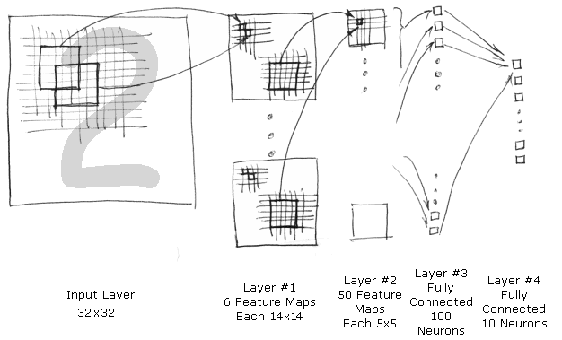
Application

Slide 50
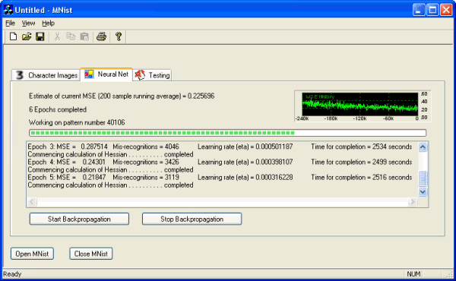
Application

Slide 51
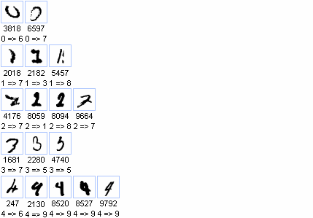
Application

Slide 52
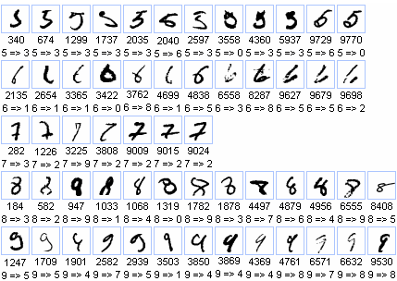
Application

Slide 53
References
[1].Y. LeCun and Y. Bengio.“Convolutional networks for images, speech, and time-series.” In M. A. Arbib, editor, The Handbook of Brain Theory and Neural Networks. MIT Press, 1995.
[2].Fabien Lauer, ChingY. Suen, Gérard Bloch,”A trainable
feature extractor for handwritten digit recognition“,Elsevier,
october 2006.
[3].Patrice Y. Simard, Dave Steinkraus, John Platt, "Best
Practices for Convolutional Neural Networks Applied to
Visual Document Analysis," International Conference on
Document Analysis and Recognition (ICDAR), IEEE
Computer Society, Los Alamitos, pp. 958-962, 2003.

Slide 54

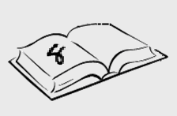
Questions
8
4
6

