Slide 1
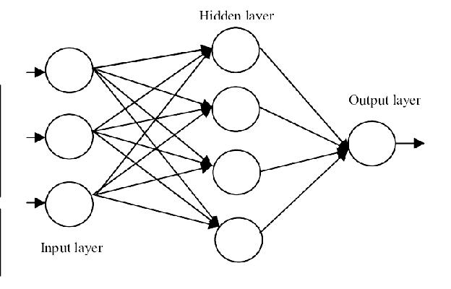
BiSkFPN
Class Prediction FCN Net : Classification
High-level features in marine object recognition include the specific shape or configuration of the fishes, crabs etc., such as whether the fish is moving or whether the crab is sitting idle. Other high-level features include body morphology, behavioral characteristics and taxonomy.
CONV1
CONV1
CONV1
CONV1
CONV1
Box Prediction FCN Net : Regression
(Also handles Regularization Loss)
Low-level features include Position, orientation, and size of the species, as well as features extracted from individual aquatic animal, such as their curvature or length of fins. Other low-level features might include the color, texture, or motion of the animals or fish. Overall, at this step, model can extract color, shape, fins, scales, eyes, mouth, and body-size.
Input resized to 416*416
:
:
Conv Block
Down sample
C3
:
Edge, corner, blob,
scale, orientation,
color feature maps
:
Up sample
C4
:
:
Feature Fusion Maps
Skip Connection
:
Deconvolutional feature maps
C5
:
Attention Feature Map further improved in [16]
SPP
:
Low Level features
Identity Connection

