Slide 1
Presentation-1 on Chosen Advanced ML Technique –EfficientDet Advanced Machine Learning ITI41820

Slide 2
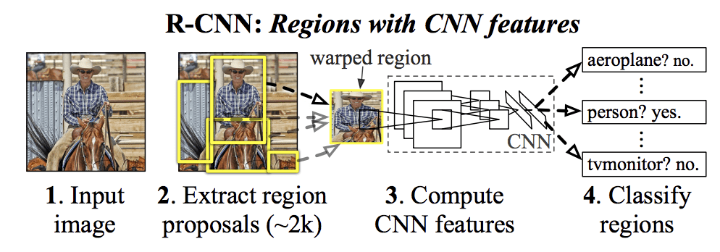
What is Object Detection? Simply put – Classification and Localisation!
For any object detection task
Object Proposals
Classification
Localisation

Slide 3
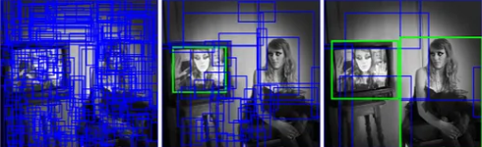
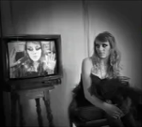
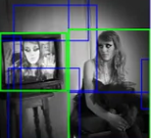
1. What is this technique / algorithm?
Chosen Technique / Algorithm : One-Stage Object Detection using EfficientDet algorithm.
TSOD
TSOD | OSOD
RCNN | YOLO
Fast RCNN | SSD
Faster RCNN | EfficientDet
OSOD

Slide 4
2. Why EfficientDet special?
Cost effective (Less parameters than other YOLO)
YOLO 61M
Faster RCNN 57M
SSD 25M
EfficientDet 5.3M
Balances the speed vs accuracy tradeoff
Adaptive Transfer Learning

Slide 5
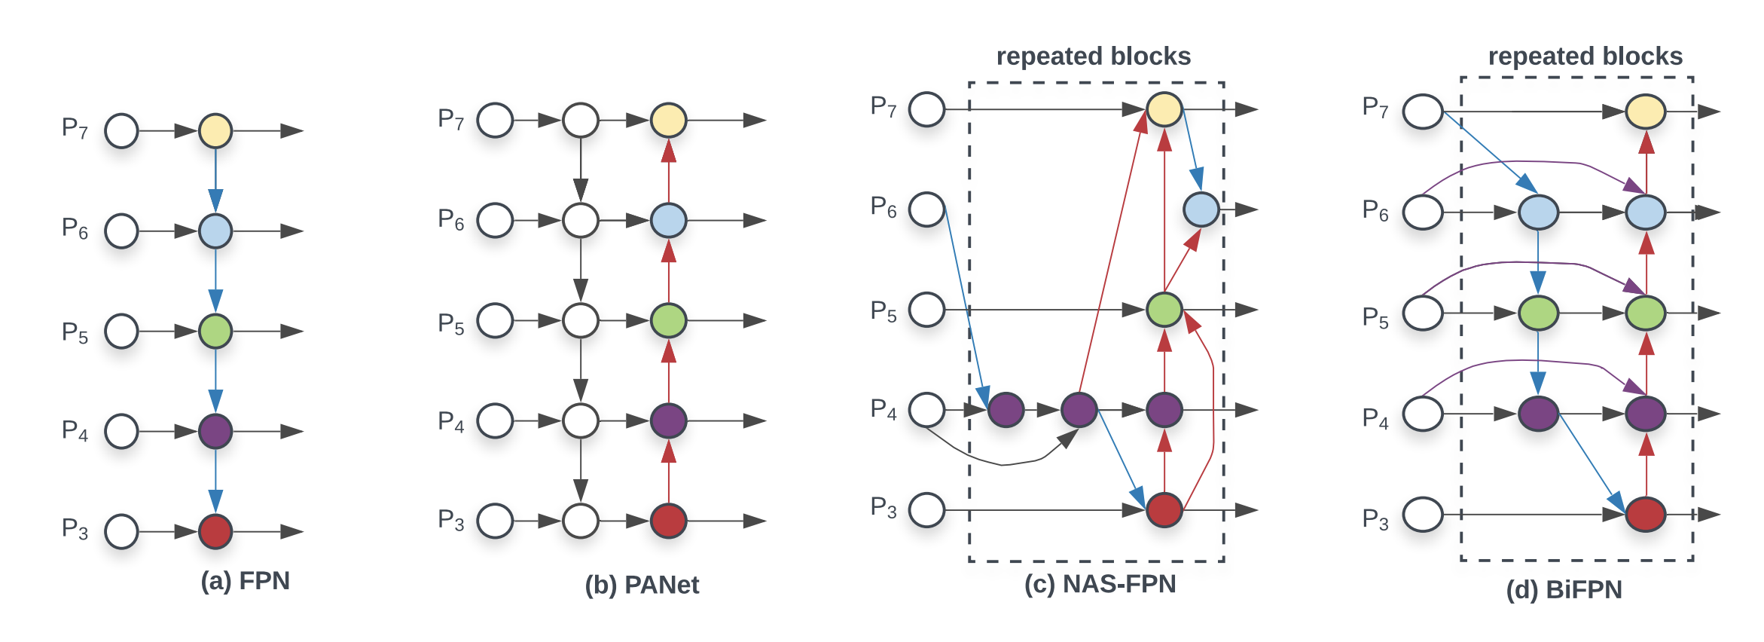
3.1 How is it different from other similar techniques
BiFPN - Bilateral Fusion Pyramid Network
Used in EfficientDet
Used in YOLOv5
(top down+bottom up)
(top down+
bottom up+
skip Connections)
Used in SSD (top down)

Slide 6
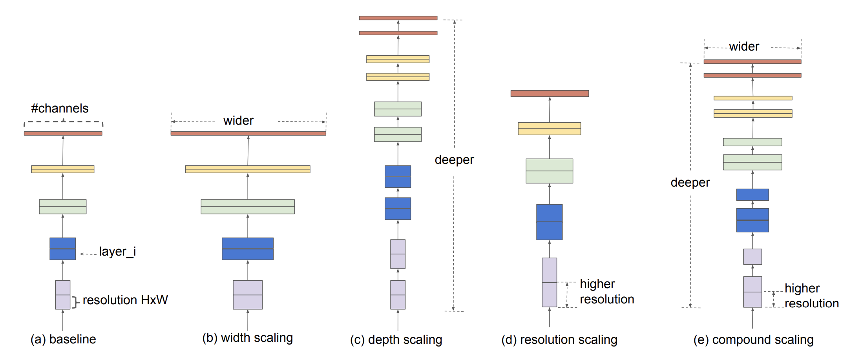
3.2 How is it different from other similar techniques
Compound Scaling method for Uniform Scaling
Tan, M., & Le, Q. (2019, May). Efficientnet: Rethinking model scaling for convolutional neural networks. In International conference on machine learning (pp. 6105-6114). PMLR.
+
=

Slide 7
3.3 Practical Example
Widely used in real time edge computing with high time constraints
EfficientDet for fabric defect detection based on edge computing (2021, S. Song et al)
EfficientDet for Crop Circle Detection in Desert (M.L.Mekhalfi et al 2022)

Slide 8
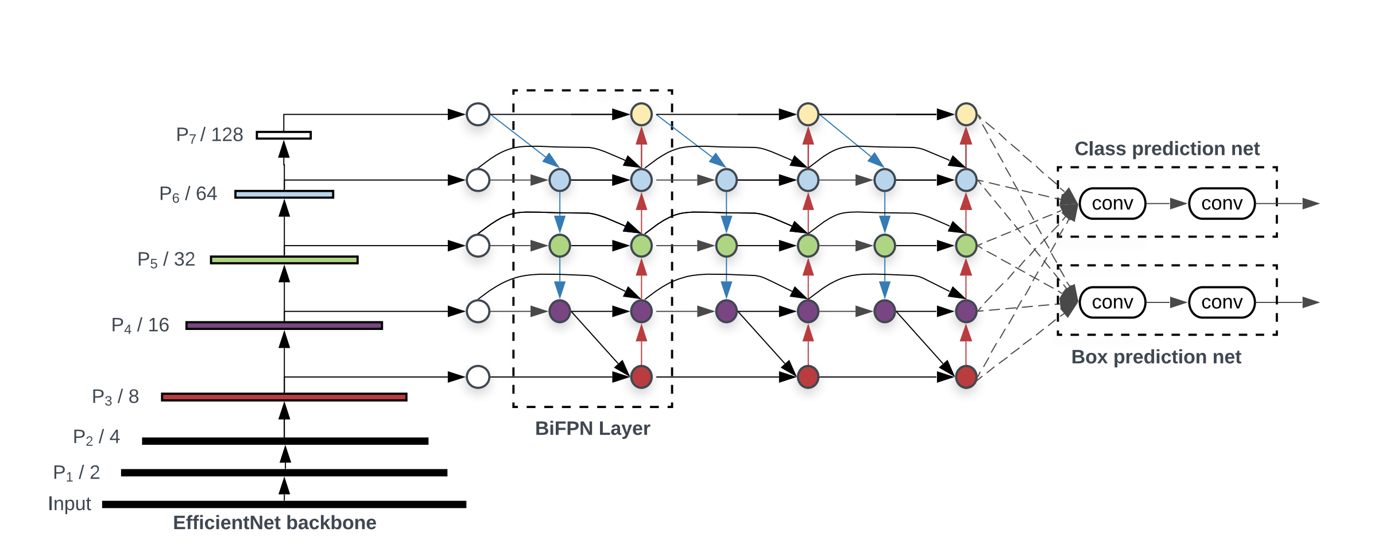
4.1 Working Principle
EfficientDet Architecture
Tan, M., Pang, R., & Le, Q. V. (2020). Efficientdet: Scalable and efficient object detection. In Proceedings of the IEEE/CVF conference on computer vision and pattern recognition (pp. 10781-10790).
Backbone
Head
Neck

Slide 9
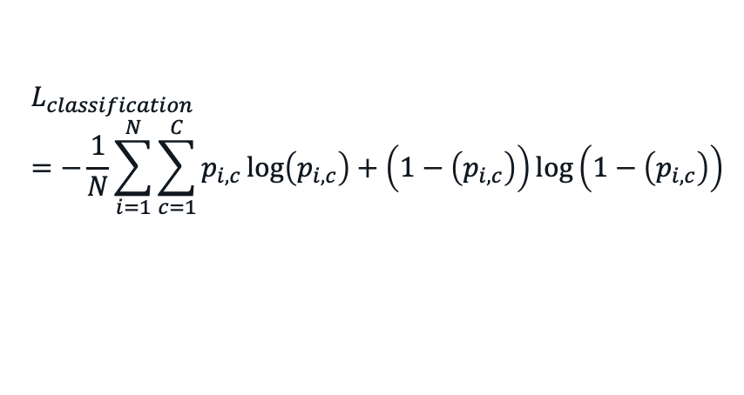
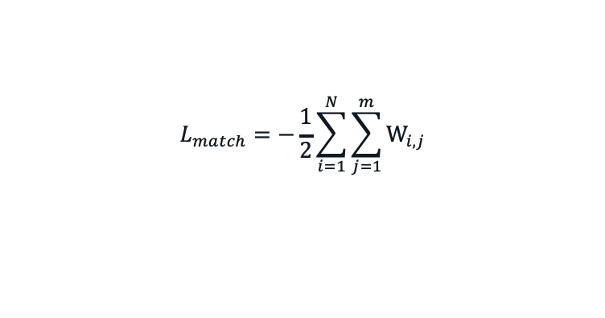
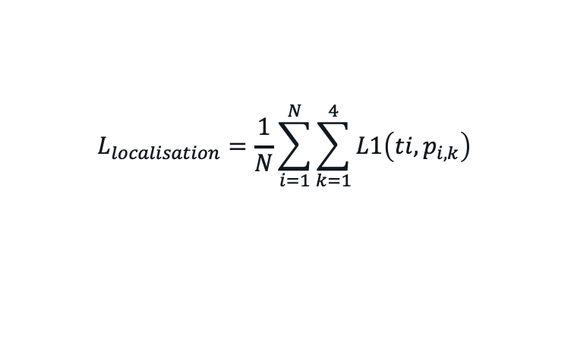
4.2 Working Principle
Loss Functions
Classification Loss
Localisation Loss
Anchor Matching Loss / Regularisation
$$L_{classification}=−\frac{1}{N}\sum_{i=1}^{N}{\sum_{c=1}^{C}{p_{i,c}\log\left(p_{i,c}\right)+\left(1−\left(p_{i,c}\right)\right)log\left(1−\left(p_{i,c}\right)\right)⁡}}$$
$$L_{localisation}=\frac{1}{N}\sum_{i=1}^{N}{\sum_{k=1}^{4}{L1\left(ti,p_{i,k}\right)}}$$
$$L_{match}=−\frac{1}{2}\sum_{i=1}^{N}{\sum_{j=1}^{m}{W_{i,j}}}$$

Slide 10
5. Advantages and Disadvantages
Advantages
Super efficient and Accurate among other OSOD
Less number of parameters compared to other OSOD
Simple Architecture
Disadvantages
Large memory requirement
Train time
Lack of Interpretability

Slide 11
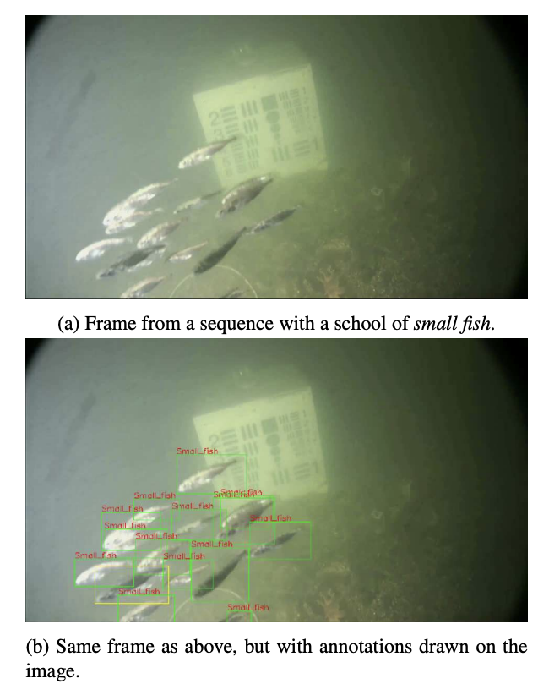
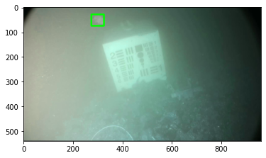
6.1 Probable Practical Application
Detection of underwater martime objects (Brackish Dataset AALBORG University) – Cross Domain Modalities
Source of Dataset: Pedersen, M., Bruslund Haurum, J., Gade, R., & Moeslund, T. B. (2019). Detection of marine animals in a new underwater dataset with varying visibility. In Proceedings of the IEEE/CVF Conference on Computer Vision and Pattern Recognition Workshops (pp. 18-26).

Slide 12
6.2 Why EfficientDet for this application than other OSOD like YOLO, SSD, RetinaNet
EfficientDet has reportedly proven to work best on
Complex task domains where objects are relatively difficult to identify because of the nature of task.
For example – Crop Detection, Adulteration detection in grains, Defect detection in fabric factory, Efficient site detection for solar power etc.
Most of the researchers has considered YOLO framework because of its fast-to-implement, however, for such complex tasks, EfficientDet is expected to give SOTA accuracy on such tasks. One of such tasks, that I plan to chose is “Detection of underwater martime objects”

Slide 13
Planned Novel Contributions
Replacing backbone for specific task
EfficientDet has less interpretability.
To make it more Interpretable.
Make it robust for adversarial attacks, by adversarial training.

Slide 14

Thank You! Questions? References:
[1] Girshick, R., Donahue, J., Darrell, T., & Malik, J. (2014). Rich feature hierarchies for accurate object detection and semantic segmentation. In Proceedings of the IEEE conference on computer vision and pattern recognition (pp. 580-587).
[2] Tan, M., Pang, R., & Le, Q. V. (2020). Efficientdet: Scalable and efficient object detection. In Proceedings of the IEEE/CVF conference on computer vision and pattern recognition (pp. 10781-10790).

Slide 15
Probable Question
But Why I would use EfficientDet? I have been able to solve my tasks with YOLO very well so far. Is it worth to re-establish my whole ML infrastructure and replace YOLO with EfficientDet? Will it be really rewarding?

Slide 16
Presentation-2 Detection and Classification of Maritime objects using EfficientDet Advanced Machine Learning ITI41820

Slide 17
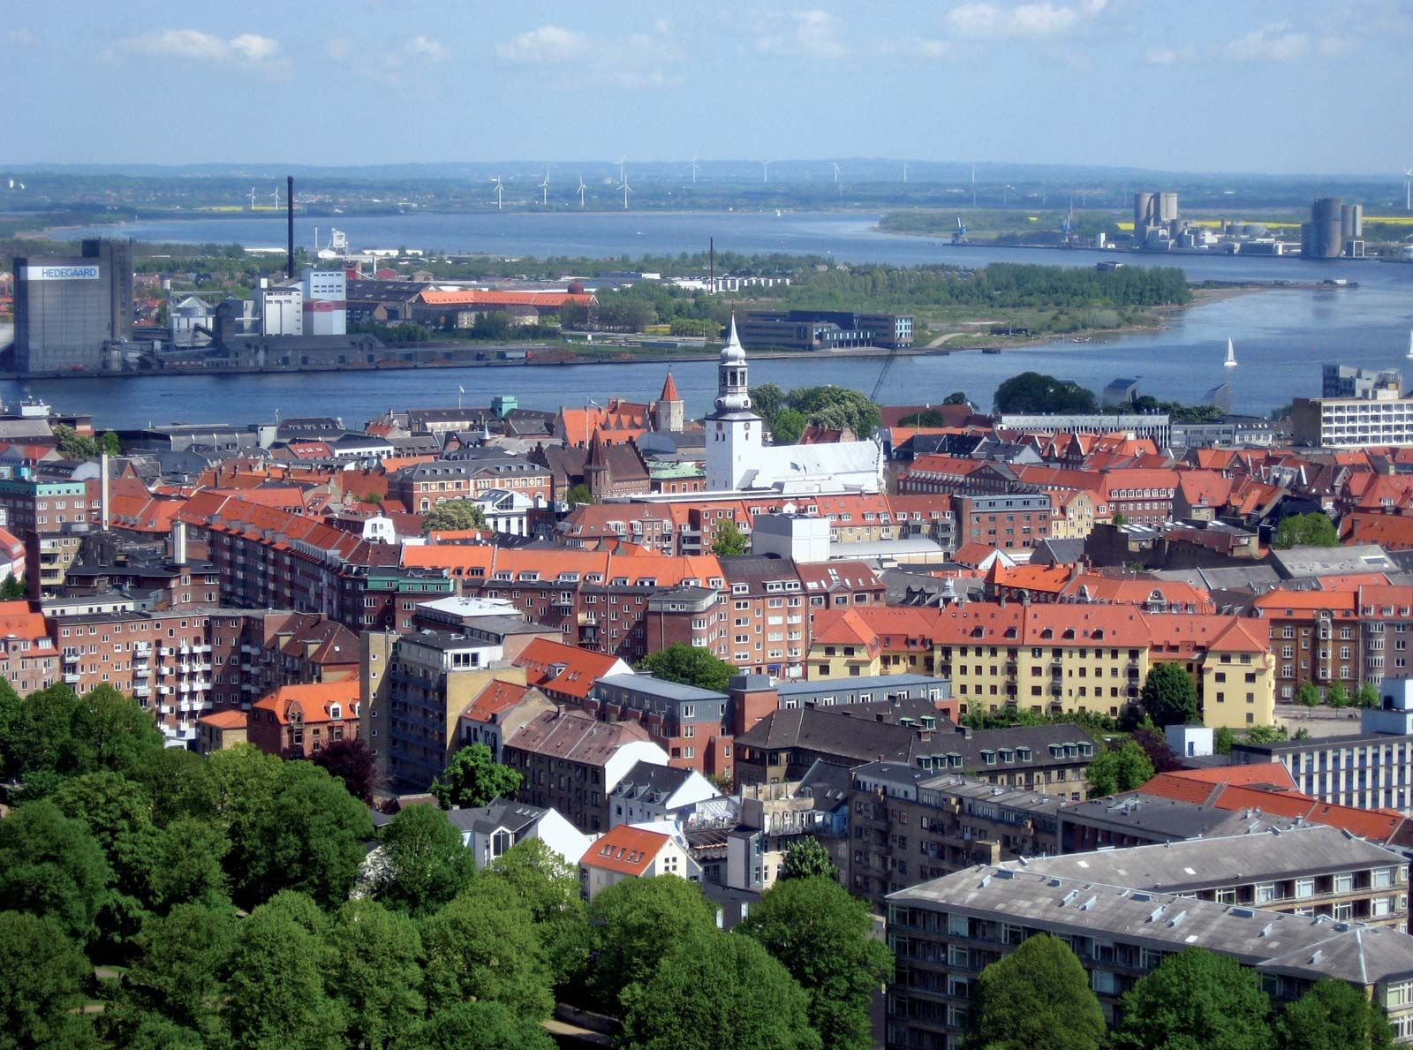

Part A.1: What is the selected application?
Limfjorden
Marine Species Detection and Localization
To an extend, when trained models are deployed into the wild, application becomes: “Automated Marine Monitoring and Underwater Wildlife Research”
Dataset - First publicly available European underwater image dataset
Recorded in Limfjorden, which is a brackish strait that runs through Aalborg in the northern part of Denmark
Fish,Small_fish,Crab,Shrimp,Jellyfish,Starfish (Total 6 classes)
https://vap.aau.dk/the-brackish-dataset/

Slide 18
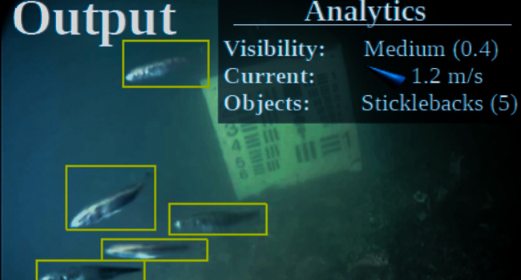
Part A.2: What are the challenges related to the application?
Marine Vision expeditions and discovery is expensive.
Sustainable fisheries, healthy oceans.
Variations in illumination
Angle of the captured image
Complexity of the marine environment
Quality and Quantity of available Datasets
Noise
(The particles found in water images, ranging from dissolved matter to floating leaves and seaweed, are considered )

Slide 19
Part A.3.1: Why Object Detection suitable to handle the application
Automating Marine Vision
Automating the process of identifying and localizing marine animals in underwater images
Model can easily be trained to recognize, specific features of marine animals, such as their shape, color, and texture, and locate them within an image. Moreover, a specie too.
Save time and cost in analyzing and research aquatic life.
Marine life ecology, behavior and diversity where humans cannot reach.

Slide 20
Part A.3.2: Why EfficientDet Object Detection suitable to handle the application
Cheap computation (Efficient)
Less number of parameters to deploy on edge (4 Megabytes)
State of the art (High Accuracy)
We will see results and analysis in Part C of the presentation
Well suited to domains like:
EfficientDet can handle challenging conditions such as variations in illumination and the presence of noise from particles in the water
This is because of the architecture (we saw in Presentation 1)

Slide 21
Part A.4: What other alternative techniques / algorithm can be applied to handle this application?
Newly applied techniques (in this project):
EfficientDet d0
YOLOv8
YOLOv5
Previously applied techniques:
CNN (fine tuned)
YOLOv3
YOLOv4
We analyze comparative analysis in detail in part C

Slide 22
Part A.5: Why do you think your selected technique / algorithm is better than alternatives?
BiFPN - Bilateral Fusion Pyramid Network
EfficientNet backbone
Robustness (changing environment and domains)
Multi Task Learning – Object Detection + Classification (3 losses – localization loss, classification loss and regularization loss)
The localization loss measures the difference between the predicted bounding boxes and the ground-truth bounding boxes. The classification loss measures the difference between the predicted class labels and the ground-truth class labels. The regularization loss is used to prevent overfitting.

Slide 23
Part B.1: What are your selected articles?
[1]. Xu, S., Zhang, H., He, X., Cao, X., & Hu, J. (2022). Oil tank detection with improved EfficientDet model. IEEE Geoscience and Remote Sensing Letters, 19, 1-5.
Oil Tank Detection With Improved EfficientDet Model Su Xu; Haowei Zhang; Xiping He; Xiaoli Cao; Jian Hu IEEE Geoscience and Remote Sensing Letters Year: 2022 | Volume: 19 | Journal Article | Publisher: IEEE
[2]. Mekhalfi, M. L., Nicolò, C., Bazi, Y., Al Rahhal, M. M., Alsharif, N. A., & Al Maghayreh, E. (2021). Contrasting YOLOv5, transformer, and EfficientDet detectors for crop circle detection in desert. IEEE Geoscience and Remote Sensing Letters, 19, 1-5.
Contrasting YOLOv5, Transformer, and EfficientDet Detectors for Crop Circle Detection in Desert Mohamed Lamine Mekhalfi; Carlo Nicolò; Yakoub Bazi; Mohamad Mahmoud Al Rahhal; Norah A. Alsharif; Eslam Al Maghayreh IEEE Geoscience and Remote Sensing Letters Year: 2022 | Volume: 19 | Journal Article | Publisher: IEEE
[3]. Medak, D., Posilović, L., Subašić, M., Budimir, M., & Lončarić, S. (2021). Automated defect detection from ultrasonic images using deep learning. IEEE Transactions on Ultrasonics, Ferroelectrics, and Frequency Control, 68(10), 3126-3134.
Automated Defect Detection From Ultrasonic Images Using Deep Learning Duje Medak; Luka Posilović; Marko Subašić; Marko Budimir; Sven Lončarić IEEE Transactions on Ultrasonics, Ferroelectrics, and Frequency Control Year: 2021 | Volume: 68, Issue: 10 | Journal Article | Publisher: IEEE
[4]. Qin, P., Cai, Y., Liu, J., Fan, P., & Sun, M. (2021). Multilayer feature extraction network for military ship detection from high-resolution optical remote sensing images. IEEE Journal of Selected Topics in Applied Earth Observations and Remote Sensing, 14, 11058-11069.
Multilayer Feature Extraction Network for Military Ship Detection From High-Resolution Optical Remote Sensing Images Peng Qin; Yulin Cai; Jia Liu; Puran Fan; Menghao Sun IEEE Journal of Selected Topics in Applied Earth Observations and Remote Sensing Year: 2021 | Volume: 14 | Journal Article | Publisher: IEEE
[5]. Kim, H. J., Lee, D. H., Niaz, A., Kim, C. Y., Memon, A. A., & Choi, K. N. (2021). Multiple-clothing detection and fashion landmark estimation using a single-stage detector. IEEE Access, 9, 11694-11704.
Multiple-Clothing Detection and Fashion Landmark Estimation Using a Single-Stage Detector Hyo Jin Kim; Doo Hee Lee; Asim Niaz; Chan Yong Kim; Asif Aziz Memon; Kwang Nam Choi IEEE Access Year: 2021 | Volume: 9 | Journal Article | Publisher: IEEE

Slide 24
Part B.2: Why do you think your selected articles are related to your work?
[1] uses an improved version of the EfficientDet model for detecting oil tanks, which could potentially be adapted for detecting other types of objects in marine environments.
[2] compares different object detection models for detecting crop circles in desert regions, but the techniques and algorithms used in these models could also be applied to detecting other types of objects or features in marine environments.

Slide 25
Part B.2: Why do you think your selected articles are related to your work?
[3] uses OD for defect detection in ultrasonic images, which could potentially be applied to detecting defects, abnormalities or noise in underwater images of marine life or structures.
[4] While the focus of this article is on detecting military ships, the same techniques and methods used in this study could potentially be applied to detecting other types of marine vessels or even marine life in remote sensing images. Additionally, the authors' use of high-resolution optical remote sensing images highlights the potential for using advanced imaging technologies to improve marine species detection and localization.
[5] uses a effdet detector for detecting multiple items of clothing, which could potentially be adapted for detecting and tracking multiple marine organisms in underwater images.

Slide 26
Part B.3.1: [1] Why I need to use baseline algorithm?
NEED TO WORK HERE!
Goal: The goal of this article is to develop an improved version of the EfficientDet model for detecting oil tanks in remote sensing images.
Methodology: The authors use a modified version of the EfficientDet model with additional feature extraction layers and a larger input size. The model is trained on a dataset of labeled oil tank images.
Results: The improved model achieves higher accuracy and faster inference times compared to the original EfficientDet model.
Advantages: The improved model is more accurate and faster than the original EfficientDet model, making it more suitable for real-world applications.
Disadvantages: The modified algorithm is only useful in remote sensing images, or geographic dataset. Not marine vision dataset.

Slide 27
Part B.3.2: [2] Motivation for using EfficientDet than YOLO.
NEED TO WORK HERE!
Goal: The goal of this article is to compare the performance of different object detection models for detecting crop circles in desert regions.
Methodology: The authors compare the YOLOv5, Transformer, and EfficientDet models on a dataset of labeled crop circle images. They evaluate the models based on accuracy and computational efficiency.
Results: The EfficientDet model achieves the highest accuracy and fastest inference times compared to the other models.
Advantages: The study provides a useful comparison of different object detection models for detecting specific features in remote sensing images.
Disadvantages: The study does not focus on marine environments, and the results may not be directly applicable to marine species detection and localization.

Slide 28
Part B.3.3: [3] Motivation why EffDet is good in noisy
NEED TO WORK HERE!
Goal: The goal of this article is to develop a deep learning model for automated defect detection in ultrasonic images.
Methodology: The authors use a convolutional neural network (CNN) to extract features from ultrasonic images, followed by a detection head that predicts the locations and types of defects in the image. The model is trained on a dataset of labeled ultrasonic images.
Results: The proposed model achieves high accuracy and outperforms other state-of-the-art methods for defect detection in ultrasonic images.
Advantages: The study demonstrates the potential for using deep learning to automate defect detection in ultrasonic imaging.

Slide 29
Part B.3.4: [4]
NEED TO WORK HERE!
Goal: The goal of this article is to develop a multilayer feature extraction network for detecting military ships in high-resolution optical remote sensing images.
Methodology: The authors propose a network consisting of several convolutional layers and pooling layers that extract features at different scales, followed by a detection head that predicts the locations and categories of ships in the image. The model is trained on a dataset of labeled remote sensing images.
Results: The proposed model achieves high accuracy for ship detection in remote sensing images.
Advantages: The study demonstrates the potential for using advanced imaging technologies and deep learning for marine vessel detection and monitoring.
Disadvantages: The study focuses only on ship detection and does not explore the potential for detecting other types of marine objects or features.

Slide 30
Part B.3.5: [5]
NEED TO WORK HERE!
Goal: The goal of this article is to develop a single-stage object detector for detecting multiple clothing items and fashion landmarks in images.
Methodology: The authors use a single-stage object detector that predicts the locations and categories of clothing items and fashion landmarks in an image. The model is trained on a dataset of labeled fashion images.
Results: The proposed model achieves high accuracy for multiple clothing detection and fashion landmark estimation in images.
Advantages: The study demonstrates the potential for using object detection techniques for detecting and tracking multiple marine organisms in underwater images, which could have applications in automated marine monitoring and underwater wildlife research.
Disadvantages: The study focuses only on fashion images and does not explore the potential for detecting other types of objects or features in marine environments. Additionally, the model's performance may be affected by factors such as lighting conditions, image quality, and variability in the appearance of different marine organisms.

Slide 31
Part C.1: The idea, platform, and system of your own implementation
NEED TO WORK HERE!
Idea: involves a step-wise procedure to preprocess, train and analyze the pipeline.
Platform: Used Google Colab runtime to train YOLOv5, YOLOv8 and EfficientDet Algorithm.
System: A single click runnable

Slide 32
Part C.2: Results
NEED TO WORK HERE!
Describe the implementation, results with comparison/analysis to "Advanced" level.
﻿﻿It is not enough to only compare the achieved results.
﻿﻿You should justify why your results are better or worse than the comparing results. If your achieved results are worse than the comparing results, you need to include your thoughts about improving it.

Slide 33
Part C.3: Analysis
Compare from implementation point of view agianst the selected articles.

Slide 34
Miscellaneous
Google Colab Demo
Roboflow annotation tool
Dataset space / mostly localized object map (from roboflow)
Small example of MLOps using Colab (performing live testing)
Some initial results from Explainability.

Slide 35
Thank You! Questions? References:
[1] Girshick, R., Donahue, J., Darrell, T., & Malik, J. (2014). Rich feature hierarchies for accurate object detection and semantic segmentation. In Proceedings of the IEEE conference on computer vision and pattern recognition (pp. 580-587).
[2] Tan, M., Pang, R., & Le, Q. V. (2020). Efficientdet: Scalable and efficient object detection. In Proceedings of the IEEE/CVF conference on computer vision and pattern recognition (pp. 10781-10790).
[3] Pedersen, M., Bruslund Haurum, J., Gade, R., & Moeslund, T. B. (2019). Detection of marine animals in a new underwater dataset with varying visibility. In Proceedings of the IEEE/CVF Conference on Computer Vision and Pattern Recognition Workshops (pp. 18-26).

