Slide 1
Presentation-1 on Chosen Advanced ML Technique –EfficientDet Advanced Machine Learning ITI41820

Slide 2
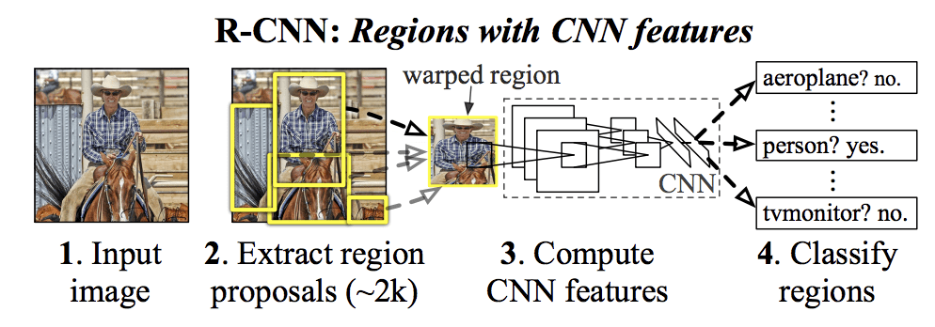
What is Object Detection? Simply put – Classification and Localisation!
For any object detection task
Object Proposals
Classification
Localisation

Slide 3
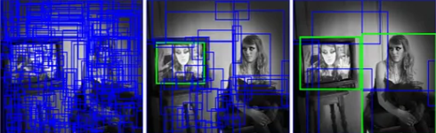

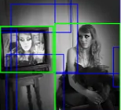
1. What is this technique / algorithm?
Chosen Technique / Algorithm : One-Stage Object Detection using EfficientDet algorithm.
TSOD
TSOD | OSOD
RCNN | YOLO
Fast RCNN | SSD
Faster RCNN | EfficientDet
OSOD

Slide 4
2. Why EfficientDet special?
Cost effective (Less parameters than other YOLO)
YOLO 61M
Faster RCNN 57M
SSD 25M
EfficientDet 5.3M
Balances the speed vs accuracy tradeoff
Adaptive Transfer Learning

Slide 5
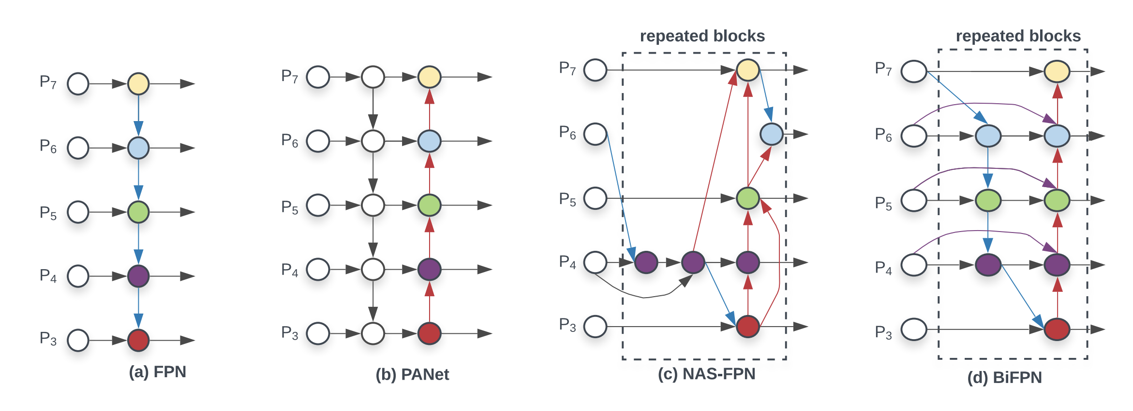
3.1 How is it different from other similar techniques
BiFPN - Bilateral Fusion Pyramid Network
Used in EfficientDet
Used in YOLOv5
(top down+bottom up)
(top down+
bottom up+
skip Connections)
Used in SSD (top down)

Slide 6
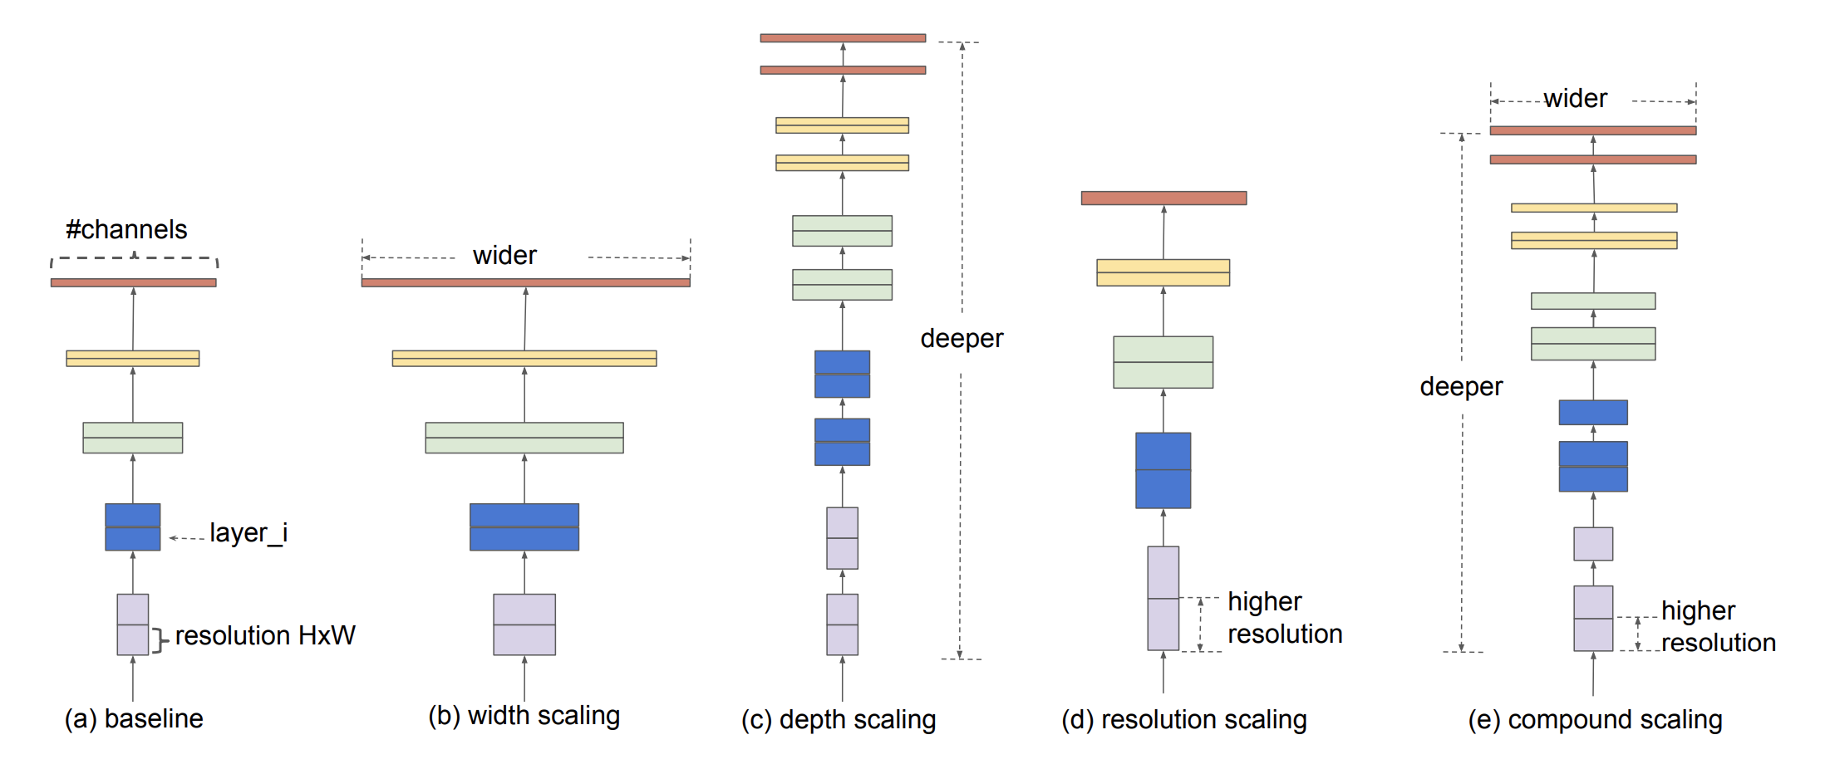
3.2 How is it different from other similar techniques
Compound Scaling method for Uniform Scaling
Tan, M., & Le, Q. (2019, May). Efficientnet: Rethinking model scaling for convolutional neural networks. In International conference on machine learning (pp. 6105-6114). PMLR.
+
=

Slide 7
3.3 Practical Example
Widely used in real time edge computing with high time constraints
EfficientDet for fabric defect detection based on edge computing (2021, S. Song et al)
EfficientDet for Crop Circle Detection in Desert (M.L.Mekhalfi et al 2022)

Slide 8
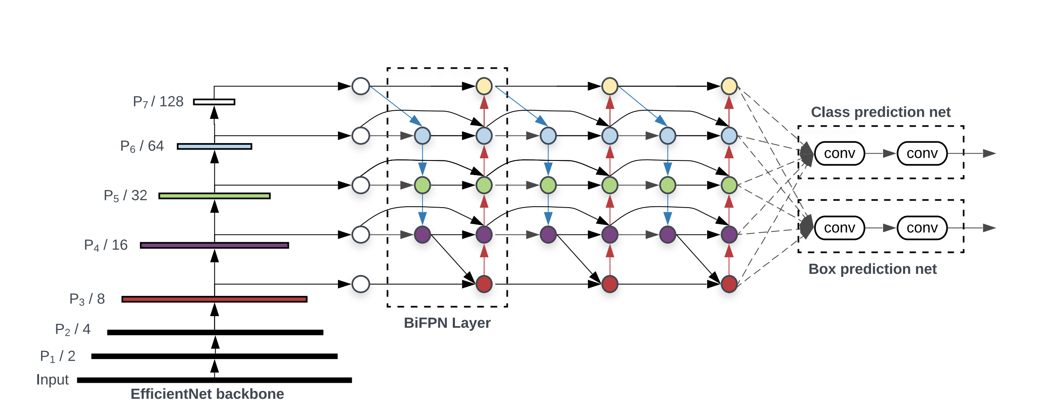
4.1 Working Principle
EfficientDet Architecture
Tan, M., Pang, R., & Le, Q. V. (2020). Efficientdet: Scalable and efficient object detection. In Proceedings of the IEEE/CVF conference on computer vision and pattern recognition (pp. 10781-10790).
Backbone
Head
Neck

Slide 9
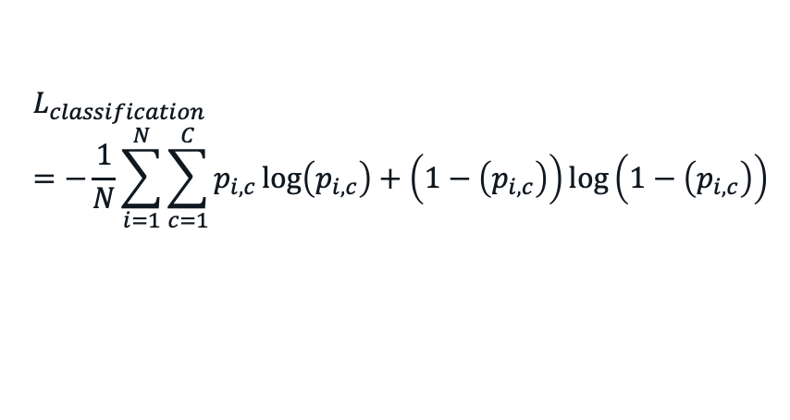
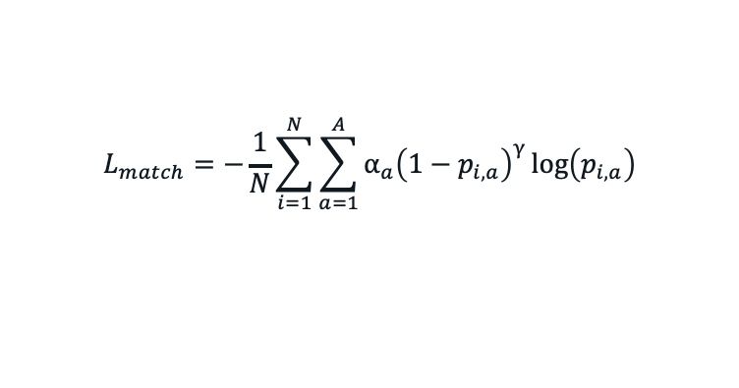
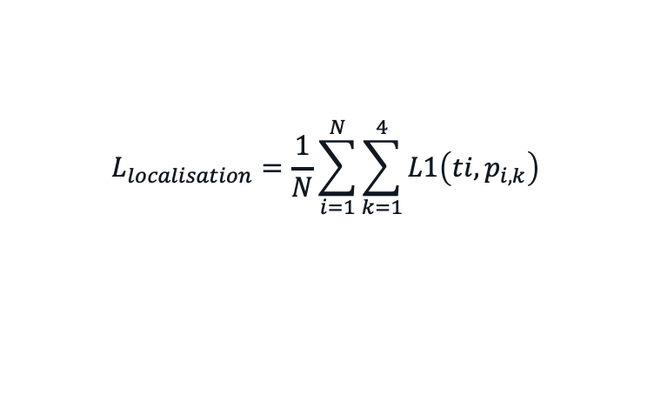
4.2 Working Principle
Loss Functions
Classification Loss
Localisation Loss
Anchor Matching Loss
$$L_{classification}=−\frac{1}{N}\sum_{i=1}^{N}{\sum_{c=1}^{C}{p_{i,c}\log\left(p_{i,c}\right)+\left(1−\left(p_{i,c}\right)\right)log\left(1−\left(p_{i,c}\right)\right)⁡}}$$
$$L_{localisation}=\frac{1}{N}\sum_{i=1}^{N}{\sum_{k=1}^{4}{L1\left(ti,p_{i,k}\right)}}$$
$$L_{match}=−\frac{1}{N}\sum_{i=1}^{N}{\sum_{a=1}^{A}{α_{a}{\left(1−p_{i,a}\right)}^{γ}}\log\left(p_{i,a}\right)}$$

Slide 10
5. Advantages and Disadvantages
Advantages
Super efficient and Accurate among other OSOD
Less number of parameters compared to other OSOD
Simple Architecture
Disadvantages
Large memory requirement
Train time
Lack of Interpretability

Slide 11
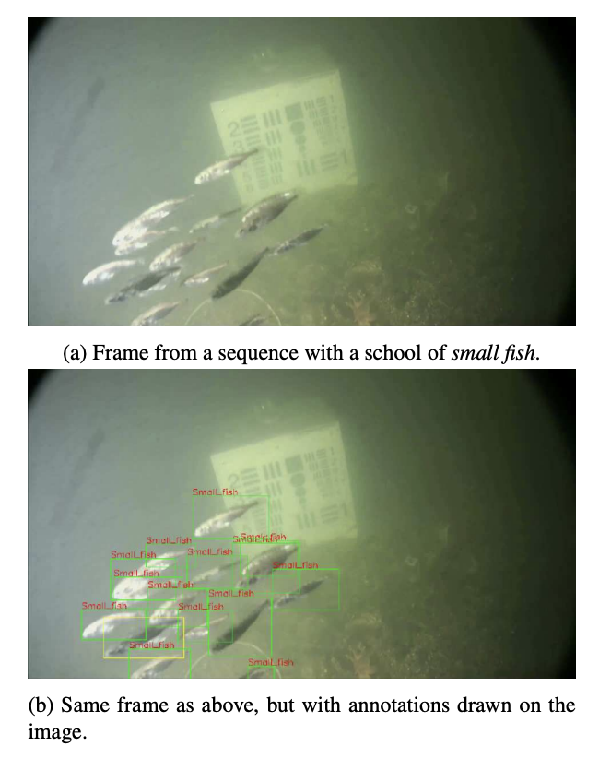
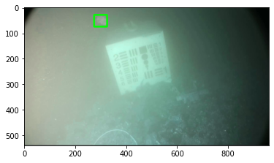
6.1 Probable Practical Application
Detection of underwater martime objects (Brackish Dataset AALBORG University) – Cross Domain Modalities
Source of Dataset: Pedersen, M., Bruslund Haurum, J., Gade, R., & Moeslund, T. B. (2019). Detection of marine animals in a new underwater dataset with varying visibility. In Proceedings of the IEEE/CVF Conference on Computer Vision and Pattern Recognition Workshops (pp. 18-26).

Slide 12
6.2 Why EfficientDet for this application than other OSOD like YOLO, SSD, RetinaNet
EfficientDet has reportedly proven to work best on
Complex task domains where objects are relatively difficult to identify because of the nature of task.
For example – Crop Detection, Adulteration detection in grains, Defect detection in fabric factory, Efficient site detection for solar power etc.
Most of the researchers has considered YOLO framework because of its fast-to-implement, however, for such complex tasks, EfficientDet is expected to give SOTA accuracy on such tasks. One of such tasks, that I plan to chose is “Detection of underwater martime objects”

Slide 13
Planned Novel Contributions
Replacing backbone for specific task
EfficientDet has less interpretability.
To make it more Interpretable.
Make it robust for adversarial attacks, by adversarial training.

Slide 14

Thank You! Questions? References:
[1] Girshick, R., Donahue, J., Darrell, T., & Malik, J. (2014). Rich feature hierarchies for accurate object detection and semantic segmentation. In Proceedings of the IEEE conference on computer vision and pattern recognition (pp. 580-587).
[2] Tan, M., Pang, R., & Le, Q. V. (2020). Efficientdet: Scalable and efficient object detection. In Proceedings of the IEEE/CVF conference on computer vision and pattern recognition (pp. 10781-10790).

Slide 15
Probable Question
But Why I would use EfficientDet? I have been able to solve my tasks with YOLO very well so far. Is it worth to re-establish my whole ML infrastructure and replace YOLO with EfficientDet? Will it be really rewarding?

