Slide 1
The Capital Asset Pricing Model (Chapter 8)
Premise of the CAPM
Assumptions of the CAPM
Utility Functions
The CAPM With Unlimited Borrowing and Lending at a Risk-Free Rate of Return
Capital Market Line Versus Security Market Line
Relationship Between the SML and the Characteristic Line
The CAPM With No Risk-Free Asset
The CAPM With Lending at the Risk-Free Rate, but No Borrowing
The CAPM With Lending at the Risk-Free Rate, and Borrowing at a Higher Rate
Market Efficiency

Slide 2
Premise of the CAPM
The Capital Asset Pricing Model (CAPM) is a model to explain why capital assets are priced the way they are.
The CAPM was based on the supposition that all investors employ Markowitz Portfolio Theory to find the portfolios in the efficient set. Then, based on individual risk aversion, each of them invests in one of the portfolios in the efficient set.
Note, that if this supposition is correct, the Market Portfolio would be efficient because it is the aggregate of all portfolios. Recall Property I - If we combine two or more portfolios on the minimum variance set, we get another portfolio on the minimum variance set.

Slide 3
One Major Assumption of the CAPM
Investors can choose between portfolios on the basis of expected return and variance. This assumption is valid if either:
  1. The probability distributions for portfolio returns are all normally distributed, or
  2. Investors’ utility functions are all in quadratic form.
If data is normally distributed, only two parameters are relevant: expected return and variance. There is nothing else to look at even if you wanted to.
If utility functions are quadratic, you only want to look at expected return and variance, even if other parameters exist.

Slide 4
Evidence Concerning Normal Distributions
Returns on individual stocks may be “fairly” normally distributed using monthly returns. For yearly returns, however, distributions of returns tend to be skewed to the right. (-100% is the largest possible loss; upside gains are theoretically unlimited, however.
Returns on portfolios may be normally distributed even if returns on individual stocks are skewed.

Slide 5
Utility Functions
Utility is a measure of well-being.
A utility function shows the relationship between utility and return (or wealth) when the returns are risk-free.
Risk-Neutral Utility Functions: Investors are indifferent to risk. They only analyze return when making investment decisions.
Risk-Loving Utility Functions: For any given rate of return, investors prefer more risk.
Risk-Averse Utility Functions: For any given rate of return, investors prefer less risk.

Slide 6
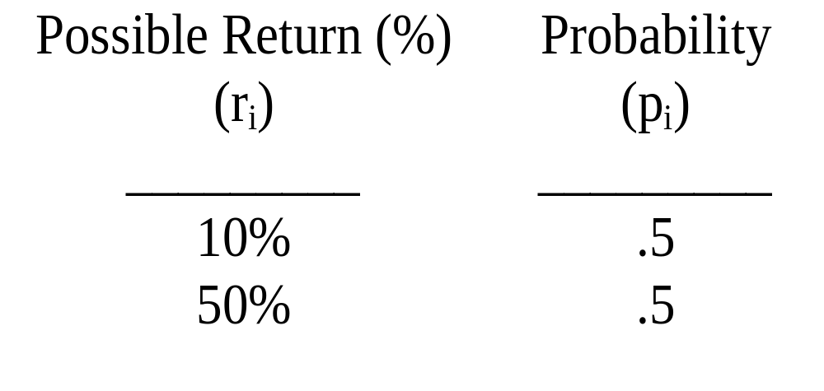
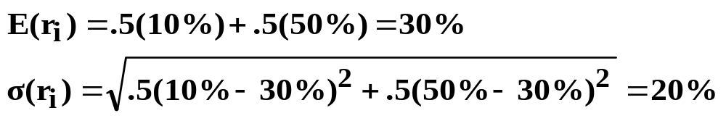
Utility Functions (Continued)
To illustrate the different types of utility functions, we will analyze the following risky investment for three different investors:

Slide 7
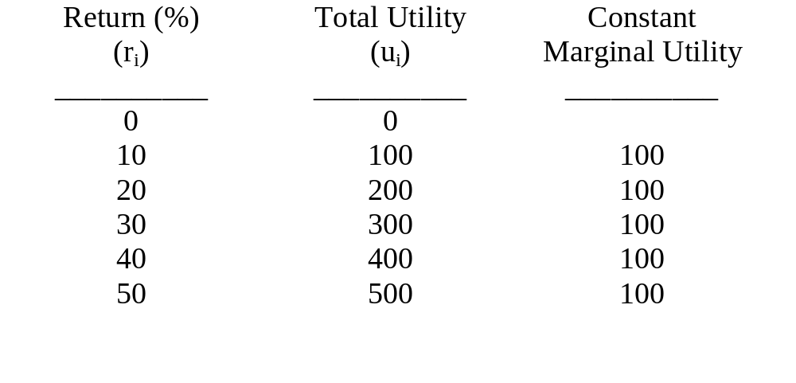
Risk-Neutral Investor
Assume the following linear utility function:
u_{i} = 10r_{i}

Slide 8
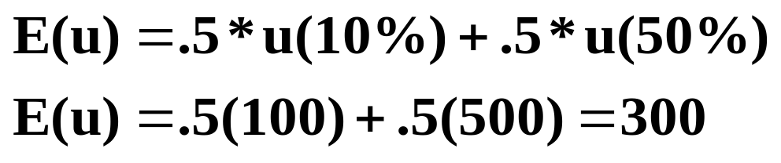
Risk-Neutral Investor (Continued)
Expected Utility of the Risky Investment:
Note: The expected utility of the risky investment with an expected return of 30% (300) is equal to the utility associated with receiving 30% risk-free (300).

Slide 9
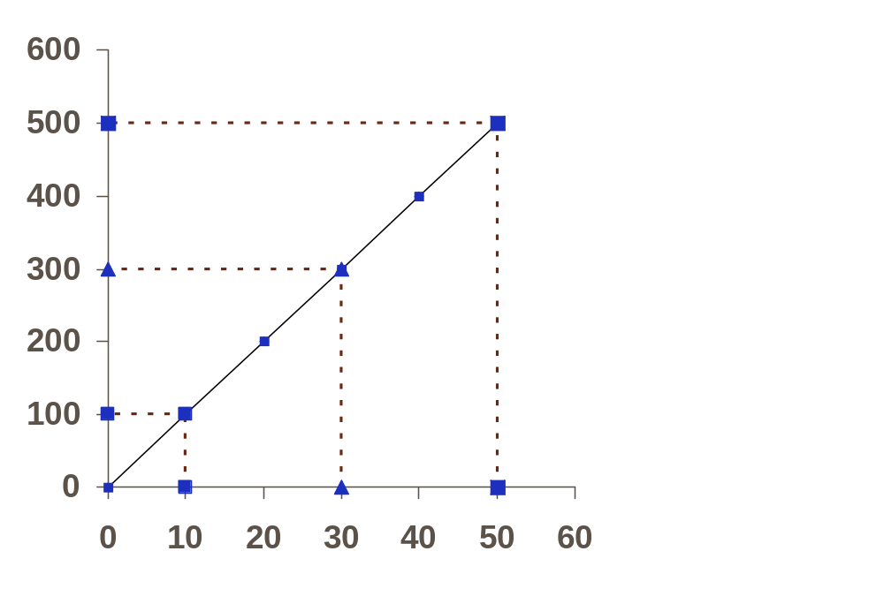
Risk-Neutral Utility Function u_{i} = 10r_{i}
Total Utility
Percent Return

Slide 10
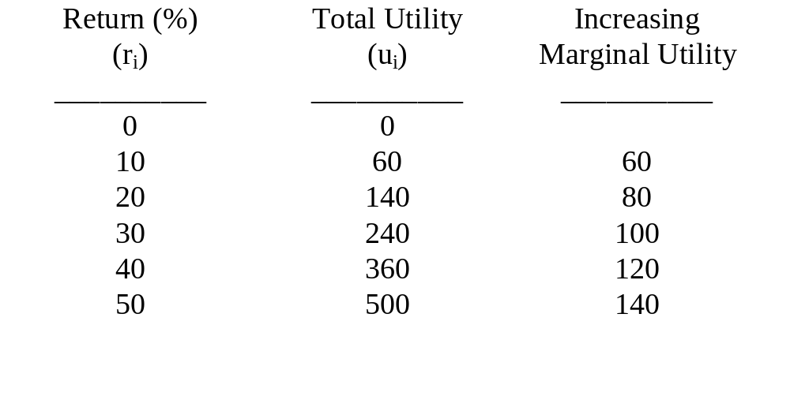
Risk-Loving Investor
Assume the following quadratic utility function:
u_{i} = 0 + 5r_{i} + .1r_{i}²

Slide 11
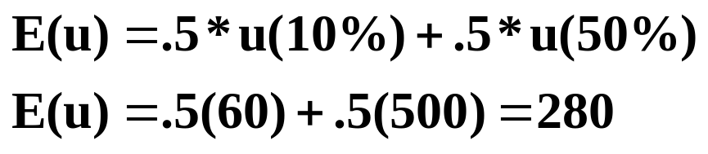
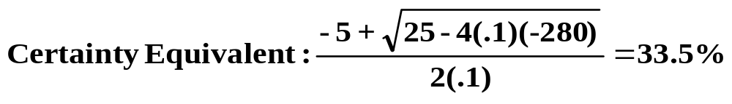
Risk-Loving Investor (Continued)
Expected Utility of the Risky Investment:
Note: The expected utility of the risky investment with an expected return of 30% (280) is greater than the utility associated with receiving 30% risk-free (240).
That is, the investor would be indifferent between receiving 33.5% risk-free and investing in a risky asset that has E(r) = 30% and σ(r) = 20%

Slide 12
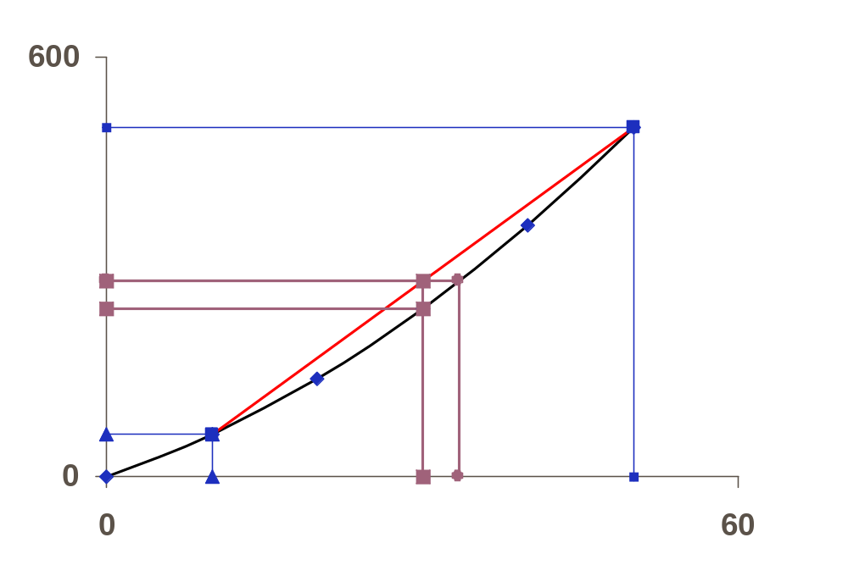
Risk-Loving Utility Function u_{i} = 0 + 5r_{i} + .1r_{i}²
Total Utility
500
280
240
60
10
30 33.5
50
Percent Return

Slide 13
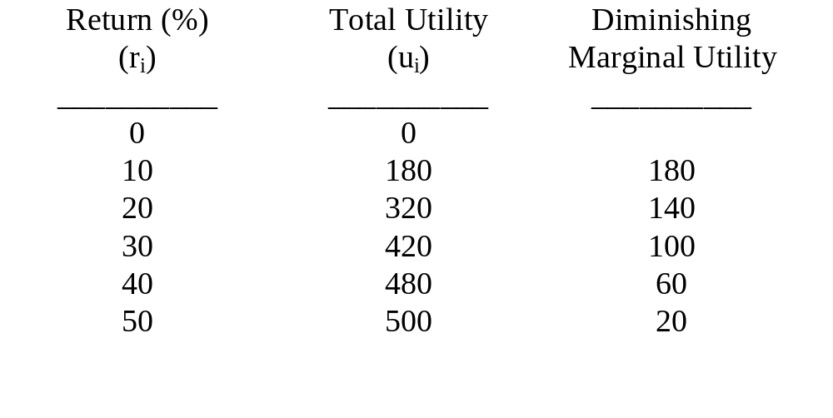
Risk-Averse Investor
Assume the following quadratic utility function:
u_{i} = 0 + 20r_{i} - .2r_{i}²

Slide 14
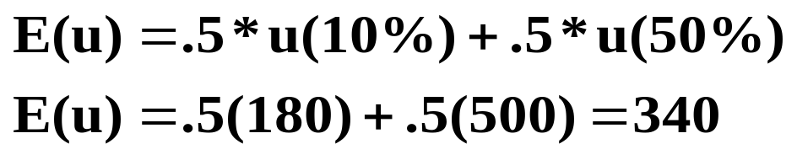
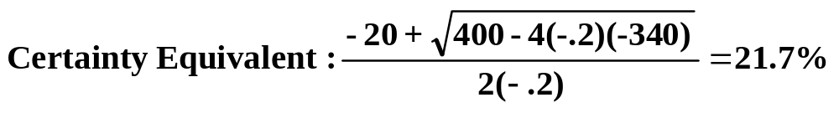
Risk-Averse Investor (Continued)
Expected Utility of the Risky Investment:
Note: The expected utility of the risky investment with an expected return of 30% (340) is less than the utility associated with receiving 30% risk-free (420).
That is, the investor would be indifferent between receiving 21.7% risk-free and investing in a risky asset that has E(r) = 30% and σ(r) = 20%.

Slide 15
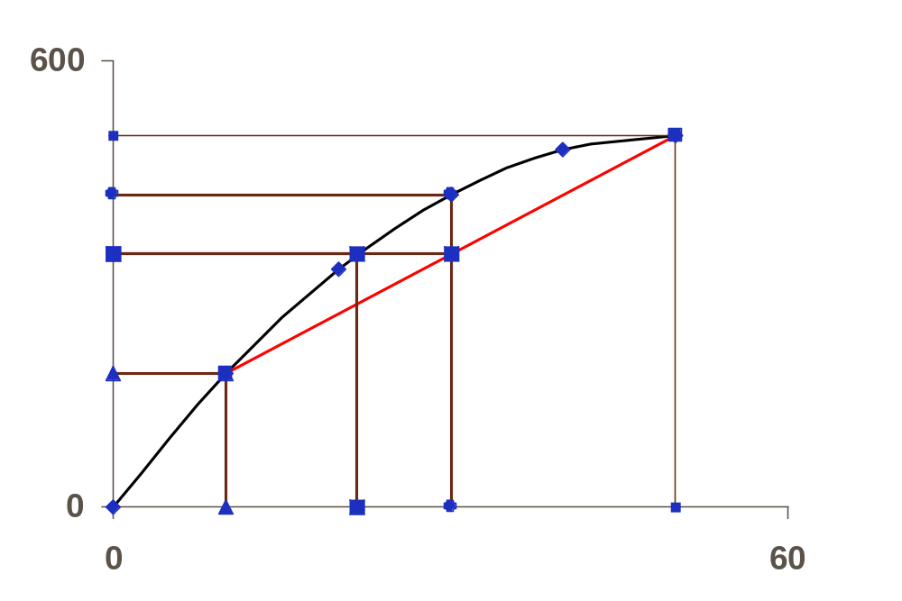
Risk-Averse Utility Function u_{i} = 0 + 20r_{i} - .2r_{i}²
Total Utility
500
420
340
180
10 21.7 30 50
Percent Return

Slide 16
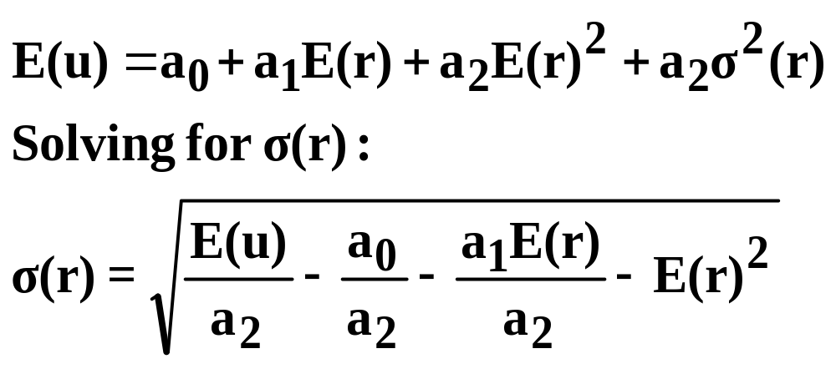
Indifference Curve
Given the total utility function, an indifference curve can be generated for any given level of utility. First, for quadratic utility functions, the following equation for expected utility is derived in the text:

Slide 17
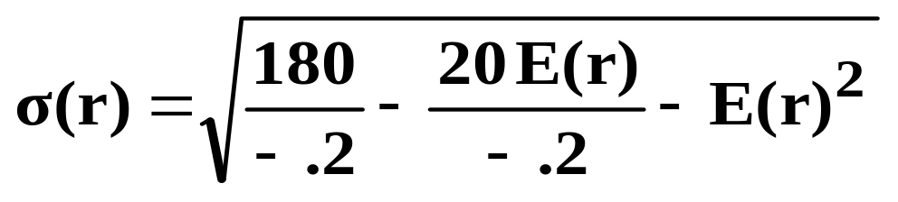
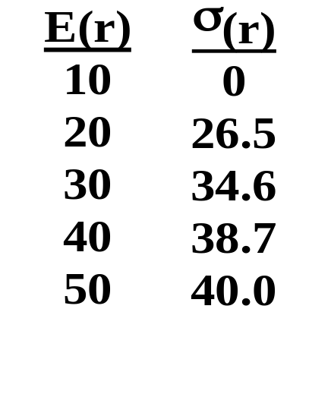
Indifference Curve (Continued)
Using the previous utility function for the risk-averse investor, (u_{i} = 0 + 20r_{i} - .2r_{i}²), and a given level of utility of 180:
Therefore, the indifference curve would be:

Slide 18
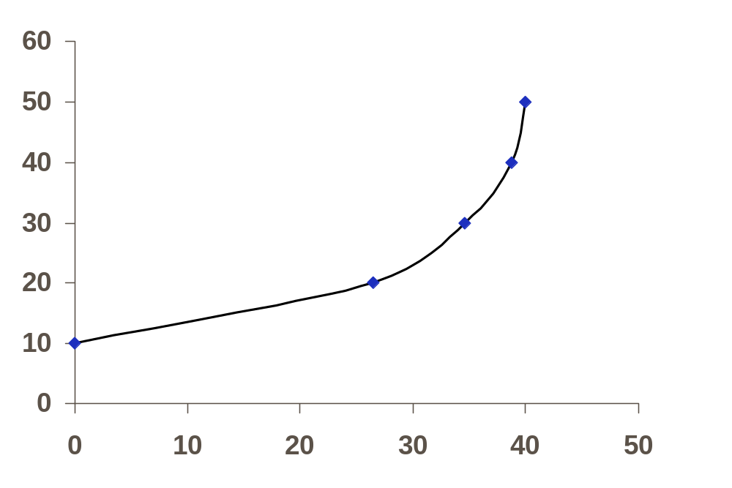
Risk-Averse Indifference Curve
When E(u) = 180, and u_{i} = 0 + 20r_{i} - .2r_{i}²
Expected Return
Standard Deviation of Returns

Slide 19
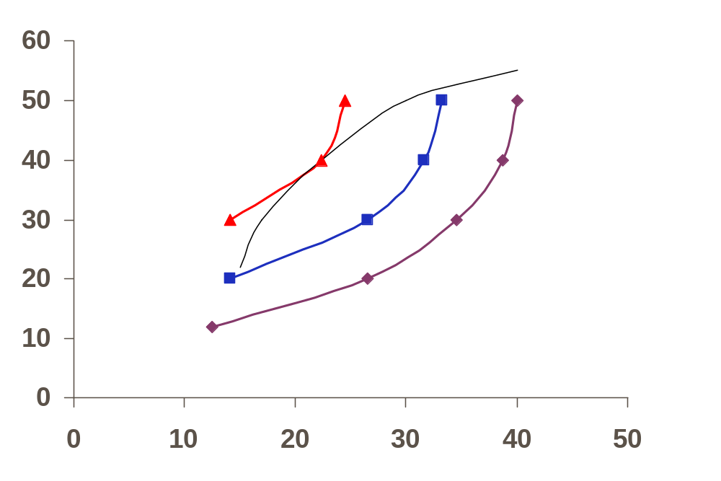
Maximizing Utility
Given the efficient set of investment possibilities and a “mass” of indifference curves, an investor would maximize his/her utility by finding the point of tangency between an indifference curve and the efficient set.
Expected Return
E(u) = 380
E(u) = 280
Portfolio That
Maximizes
Utility
E(u) = 180
Standard Deviation of Returns

Slide 20
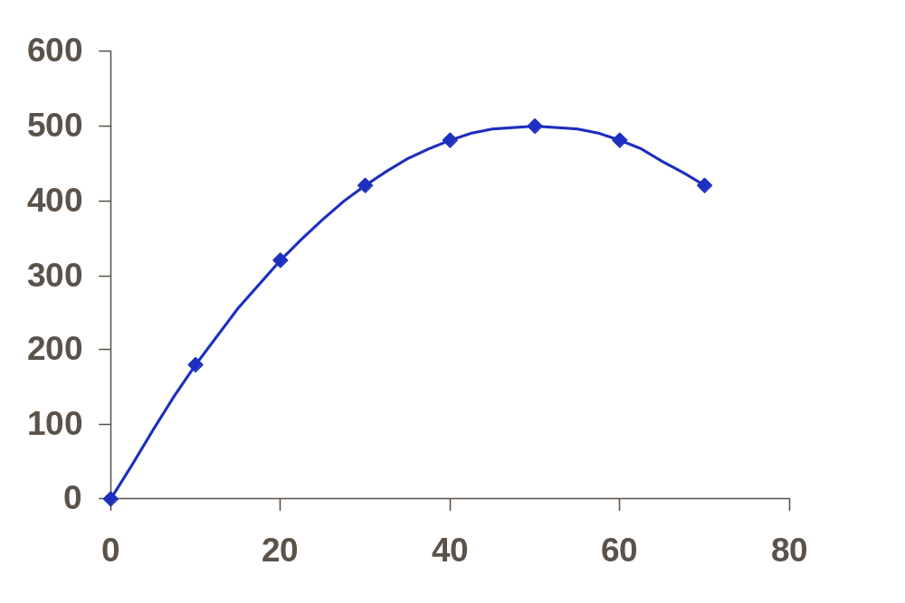
Problems With Quadratic Utility Functions
Quadratic utility functions turn down after they reach a certain level of return (or wealth). This aspect is obviously unrealistic:
Total Utility
Unrealistic
Percent Return

Slide 21
Problems With Quadratic Utility Functions (Continued)
As discussed in the Appendix on utility functions, with a quadratic utility function, as your wealth level increases, your willingness to take on risk decreases (i.e., both absolute risk aversion [dollars you are willing to commit to risky investments] and relative risk aversion [% of wealth you are willing to commit to risky investments] increase with wealth levels). In general, however, rich people are more willing to take on risk than poor people. Therefore, other mathematical functions (e.g., logarithmic) may be more appropriate.

Slide 22
Two Additional Assumptions of the CAPM
Assumption II - All investors are in agreement regarding the planning horizon (i.e., all have the same holding period), and the distributions of security returns (i.e., perfect knowledge exists).
Assumption III - There are no frictions in the capital market (i.e., no taxes, no transaction costs, no restrictions on short-selling).
Note: Many of the assumptions are obviously unrealistic. Later, we will evaluate the consequences of relaxing some of these assumptions. The assumptions are made in order to generate a model that examines the relationship between risk and expected return holding many other factors constant.

Slide 23
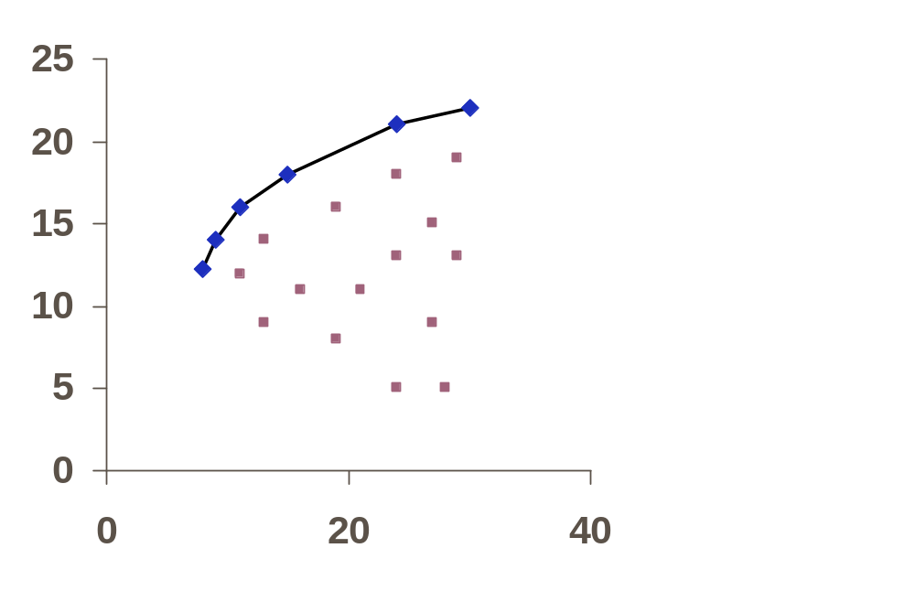
The CAPM With Unlimited Borrowing & Lending at a Risk-Free Rate of Return
First, using the Markowitz full covariance model we need to generate an efficient set based on all risky assets in the universe:
Expected Return
Standard Deviation of Returns

Slide 24
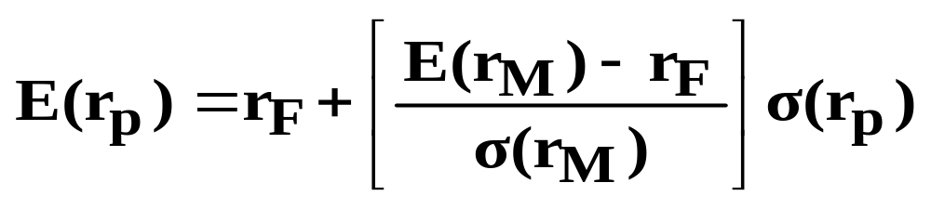
Capital Market Line (CML)
Next, the risk-free asset is introduced. The Capital Market Line (CML) is then determined by plotting a line that goes through the risk-free rate of return, and is tangent to the Markowitz efficient set. This point of tangency identifies the Market Portfolio (M). The CML equation is:

Slide 25
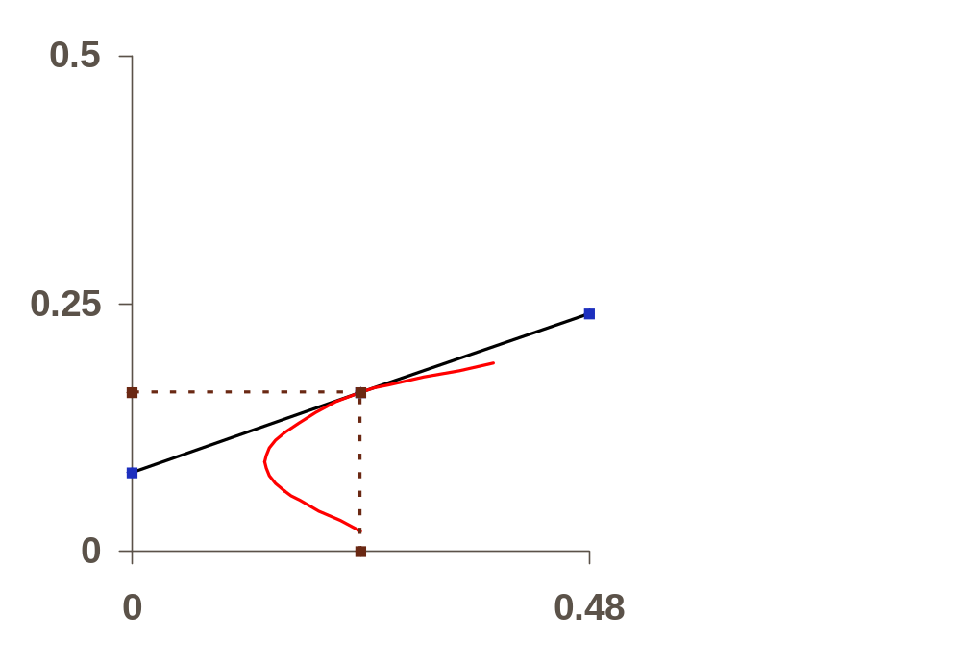
Capital Market Line (CML) - Continued
Expected Return
Borrowing
CML
Lending
M
E(r_{M})
r_{F}
σ(r_{M})
Standard Deviation of Returns

Slide 26
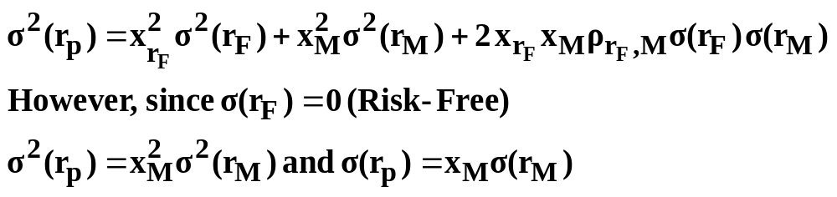
Portfolio Risk and the CML
Note that all points on the CML except the Market Portfolio dominate all points on the Markowitz efficient set (i.e., provide a higher expected return for any given level of risk). Therefore, all investors should invest in the same risky portfolio (M), and then lend or borrow at the risk-free rate depending on their risk preferences.
That is, all portfolios on the CML are some combination of two assets: (1) the risk-free asset, and (2) the Market Portfolio. Therefore, for portfolios on the CML:

Slide 27
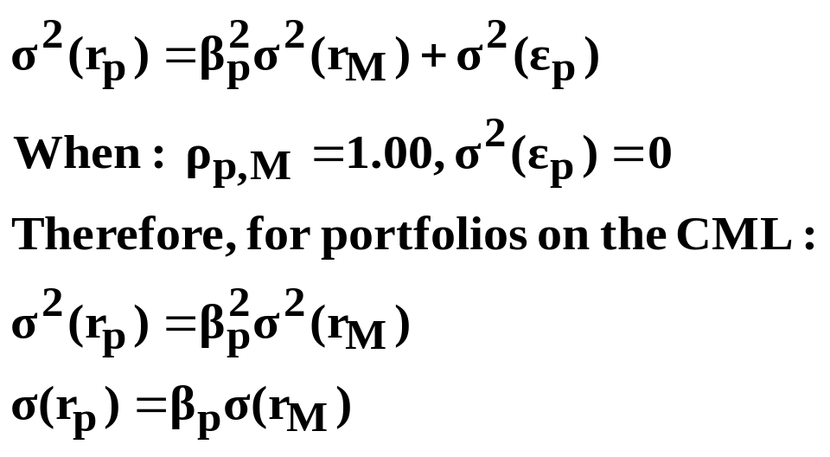
Portfolio Risk and the CML (Continued)
By definition, since σ(r_{p}) = x_{M}σ(r_{M}), all portfolios that lie on the CML are perfectly positively correlated with the Market Portfolio (i.e., 100% of the variance in the portfolio’s returns is explained by the variance in the market’s returns, when the portfolio lies on the CML).
Recall the Single-Factor Model’s Measure of Variance
Note, since σ(r_{M}) is the
same for all portfolios,
all of the risk of a
portfolio on the CML is
reflected in its beta.

Slide 28
Capital Market Line (CML
Versus
Security Market Line (SML)
Recall Property II:
Given a population of securities, there will be a simple linear relationship between the beta factors of different securities and their expected (or average) returns if and only if the betas are computed using a minimum variance market index portfolio.
Therefore:
Given the CML, we can determine the SML (relationship between beta & expected return)

Slide 29
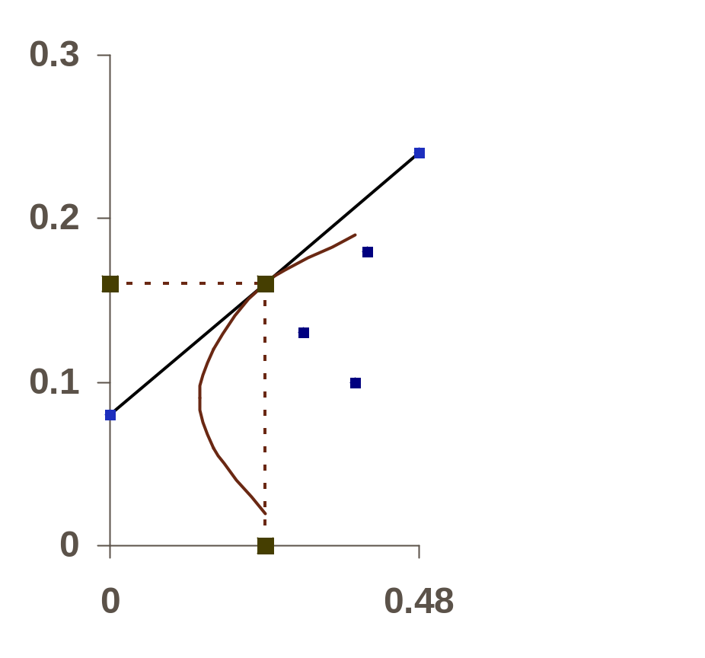
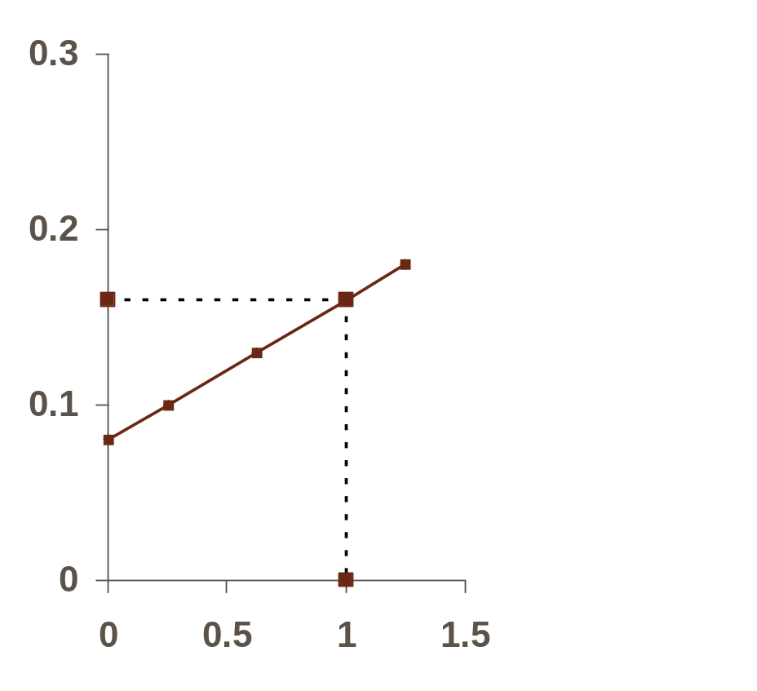
CML Versus SML
E(r)
E(r)
CML
C
SML
M
C
M
E(r_{M})
E(r_{M})
B
B
A
r_{F}
A
r_{F}
σ(r)
β
σ(r_{M})

Slide 30

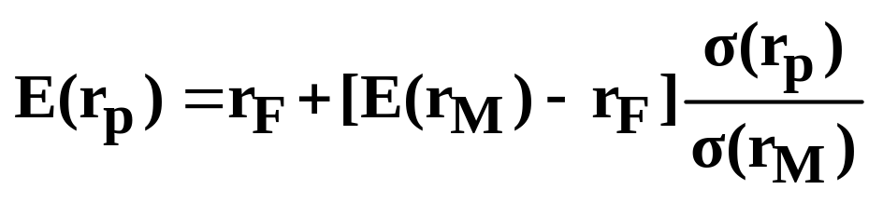
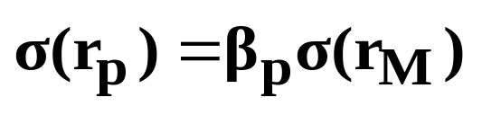
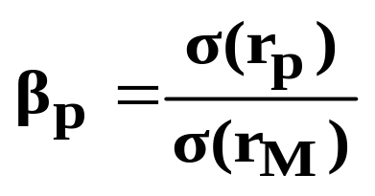
Portfolios That Lie on the CML
Will Also Lie on the SML
CML Equation:
Can be restated as:
And, since for portfolios on the CML:
We can state that for portfolios on the CML:

Slide 31
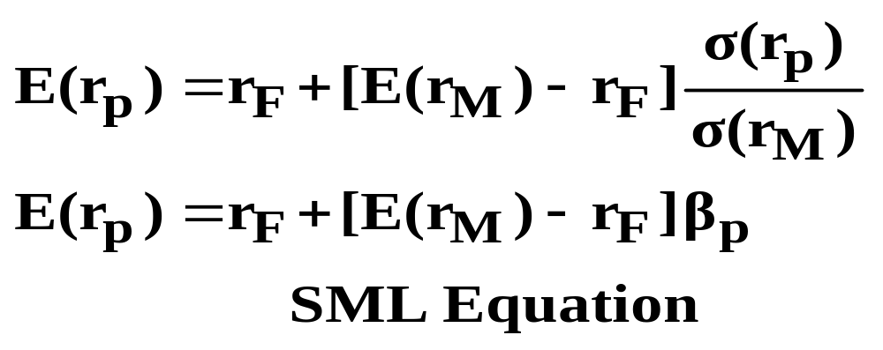
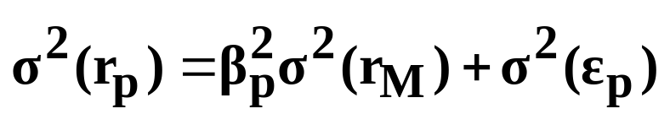
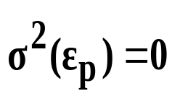
Therefore, for portfolios on the CML:
Individual Securities Will Lie on the SML,
But Off the CML
Recall:
However:
in well diversified portfolios (i.e., can be done
away with)

Slide 32
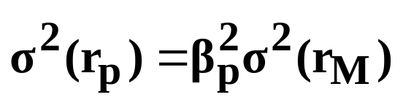
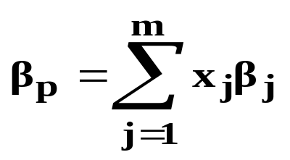
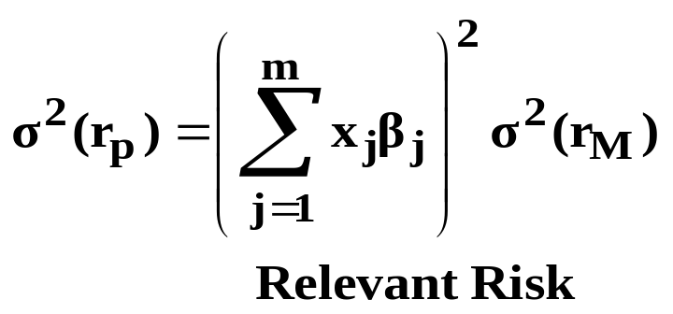
Therefore, Relevant Risk may be defined as:
And since:
We can state that:
That is, a security’s contribution to the risk of a portfolio can be measured by its beta. Since an individual security’s residual variance can be diversified away in a portfolio, the market place will not reward this “unnecessary” risk. Since only beta is relevant, individual securities will be priced to lie on the SML.

Slide 33
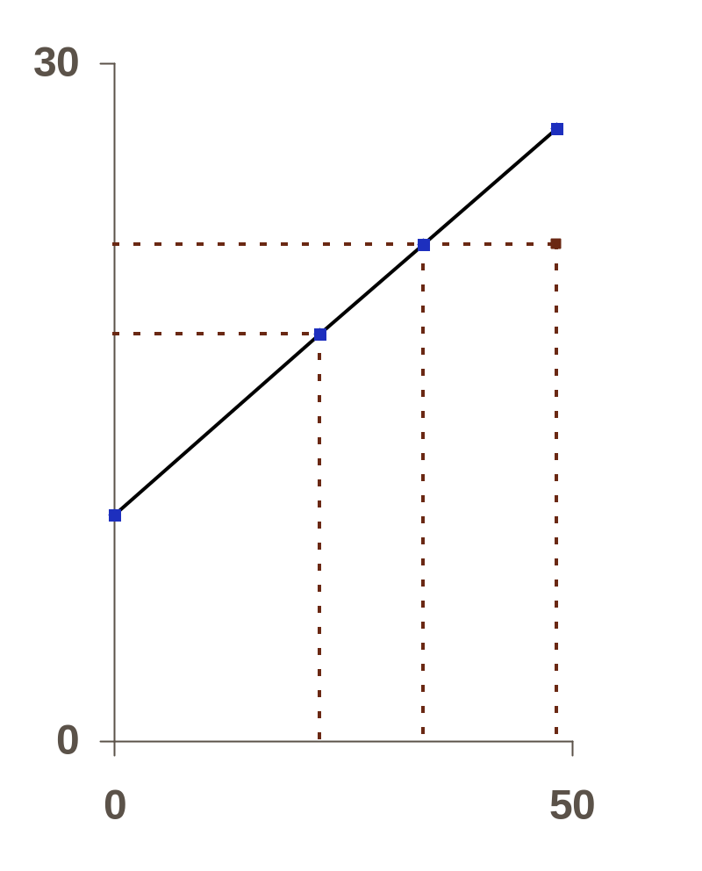
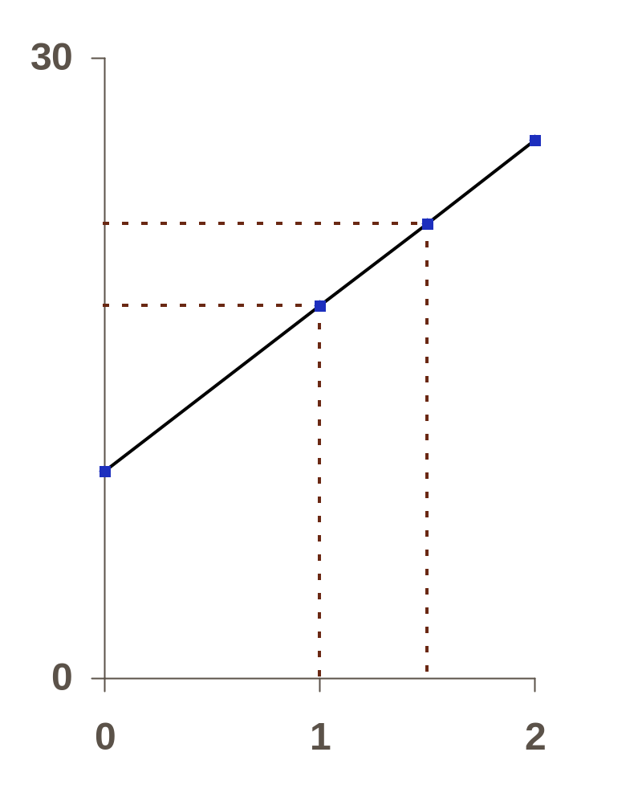
Individual Security on the SML and Off the CML (Continued)
E(r)
E(r)
CML
SML
22
22
M
M
18
18
Off the CML
On the SML
10
10
σ(r)
β
22.5
33.75
1.5

Slide 34
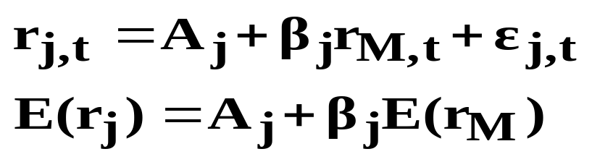
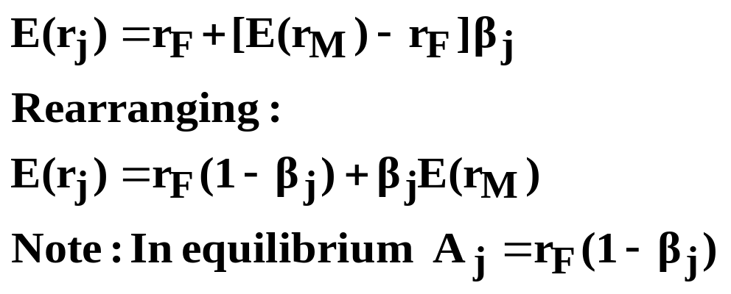
Relationship Between the SML and the Characteristic Line (In Equilibrium)
Characteristic Line:
Security Market Line (SML):
As a result, in equilibrium, all characteristic lines “pass through” the risk-free rate.

Slide 35
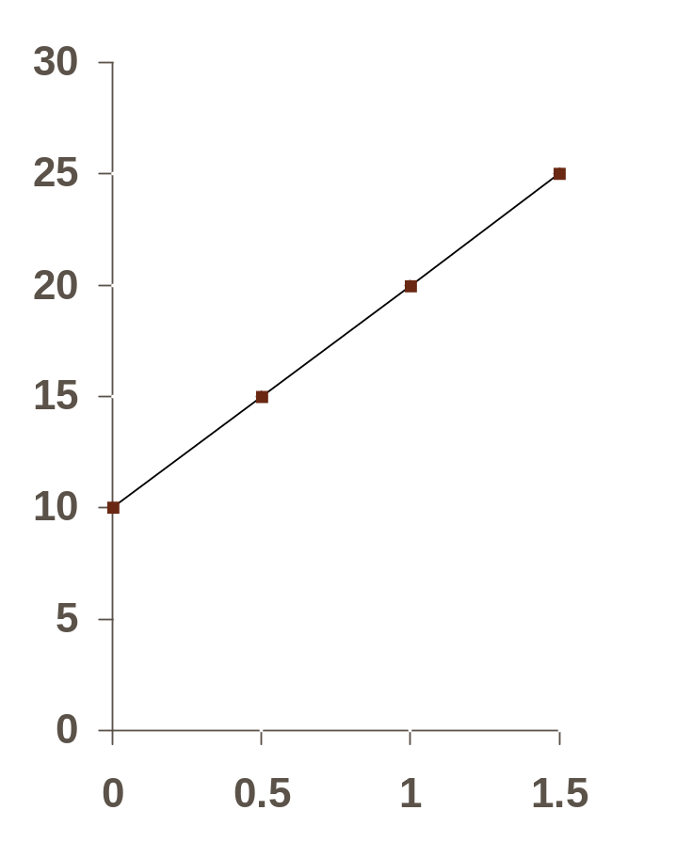
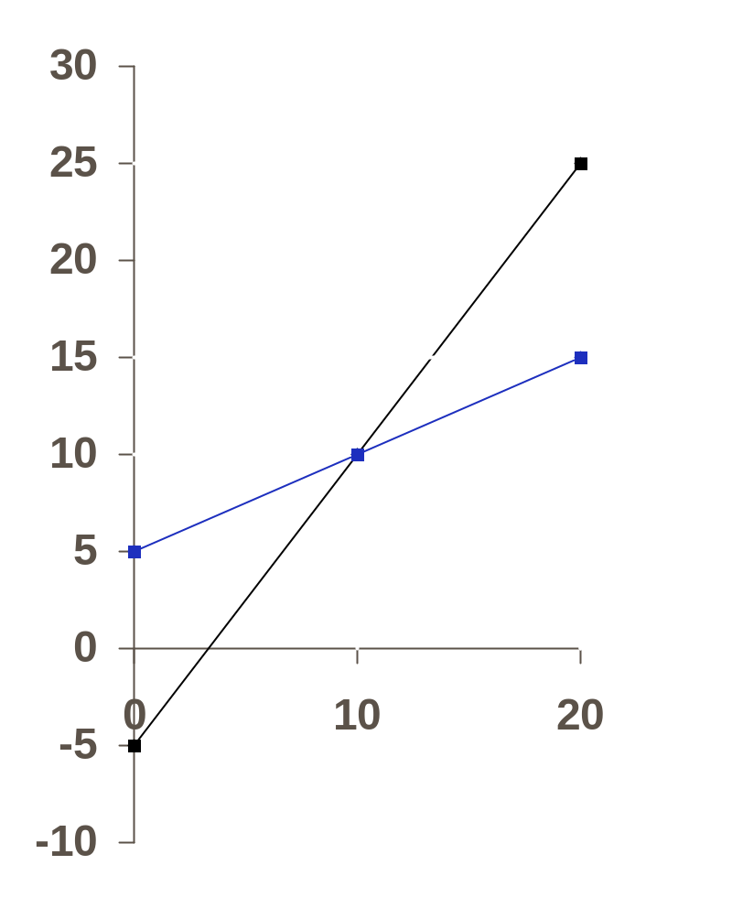
Characteristic Line Versus SML
(In Equilibrium)
r_{j}
E(r)
A₁ = 10(1 - .5) = 5
A₂ = 10(1 - 1.5) = -5
E(r₂)
E(r₂)
E(r_{M})
E(r_{M})
β₂ = 1.5
E(r₁)
E(r₁)
r_{F}
r_{F}
β₁ =.5
A₁
r_{M}
β
E(r_{M}) =
A₂
Characteristic Line
Security Market Line

Slide 36
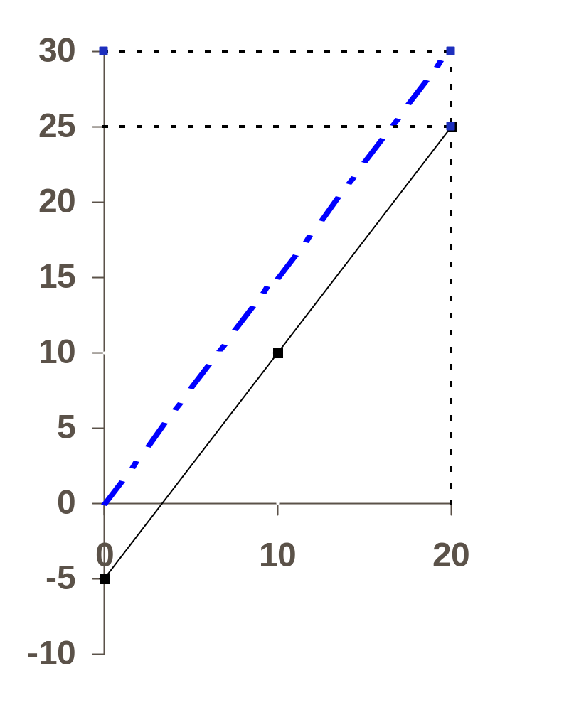
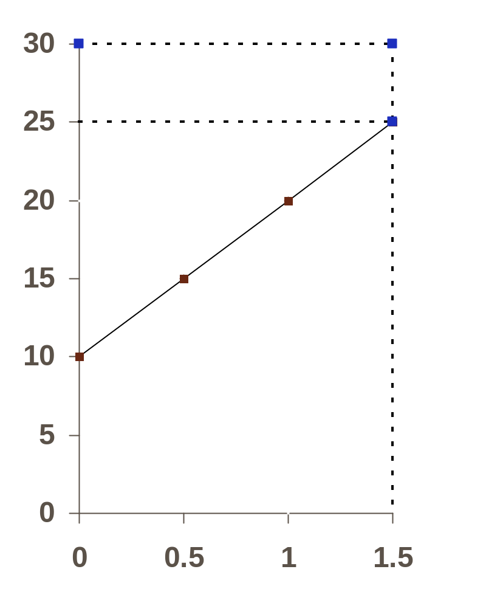
Characteristic Line Versus SML
(In Disequilibrium: Undervalued Security)
r_{j}
E(r)
E(r₂)
E(r₂)
E(r_{E})
E(r_{E})
β₂ = 1.5
E(r_{M})
E(r_{M})
r_{F}
r_{F}
r_{M}
E(r_{M}) =
A_{E}
β
Characteristic Line
Security Market Line

Slide 37
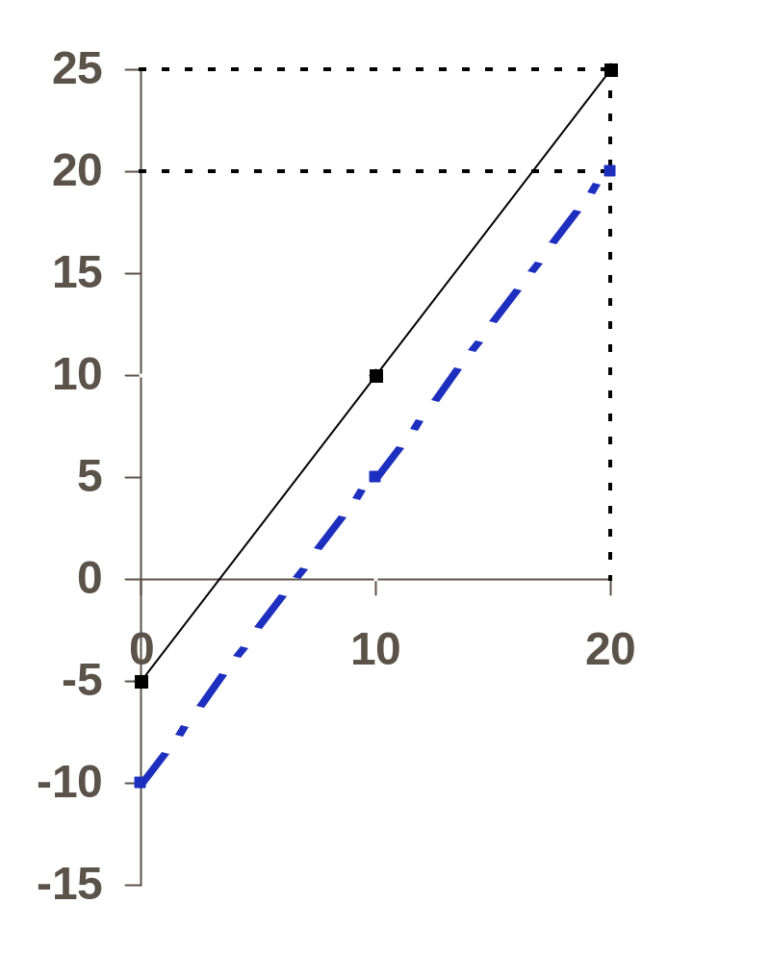
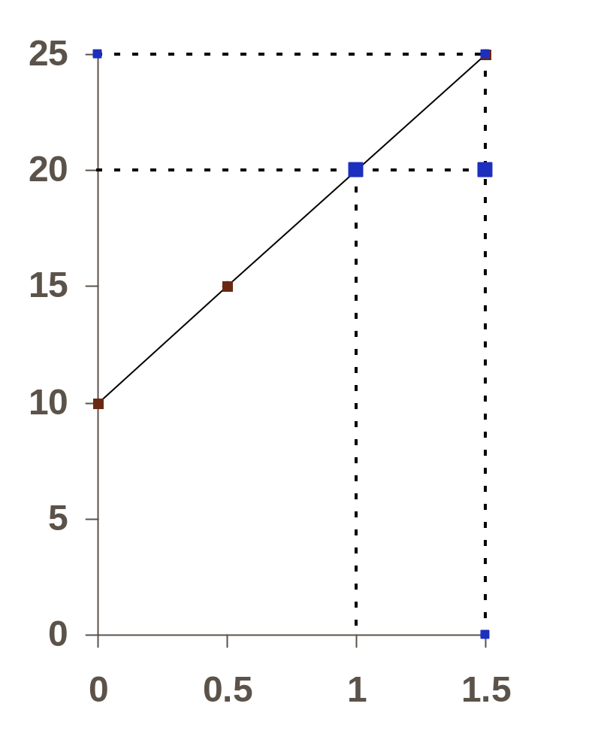
Characteristic Line Versus SML
(In Disequilibrium: Overvalued Security)
r_{j}
E(r)
E(r_{E})
E(r_{E})
E(r₂)
E(r_{M})
β₂ = 1.5
E(r₂)
r_{F}
r_{F}
r_{M}
E(r_{M}) =
A_{E}
Characteristic Line
β
Security Market Line

Slide 38
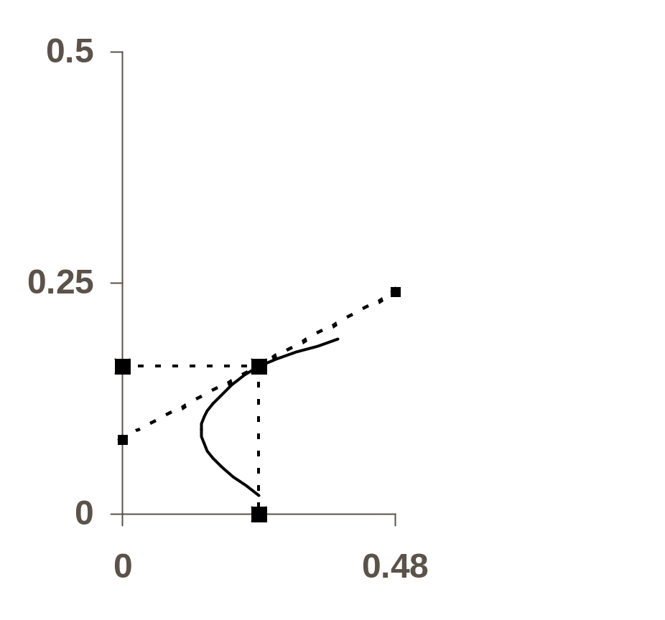
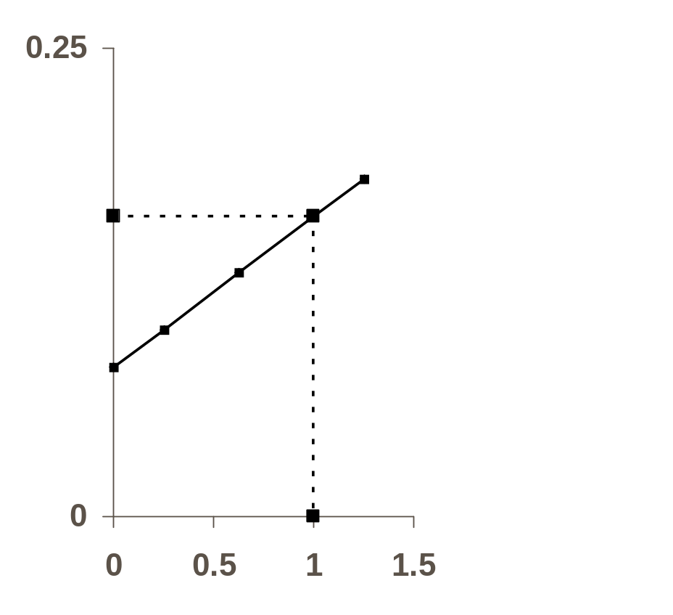
CAPM With No Risk-Free Asset
E(r)
E(r)
SML
E(r_{M})
X
E(r_{M})
M
E(r_{Z})
E(r_{Z})
MVP
σ(r)
β

Slide 39
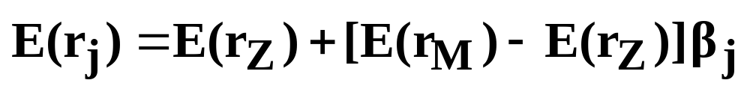
CAPM With No Risk-Free Asset
(Continued)
Assumption: All investors take positions on the efficient set (Between MVP and X)
In this case, the Markowitz efficient set (MVP to X) is the Capital Market Line (CML).
  M is the efficient Market Portfolio (the aggregate of all portfolios held by investors)
  E(r_{Z}) is the intercept of a line drawn tangent to (M)
From Property II, since (M) is efficient, a linear relationship exists between expected return and beta. All assets (efficient and inefficient) will be priced to lie on the SML.

Slide 40
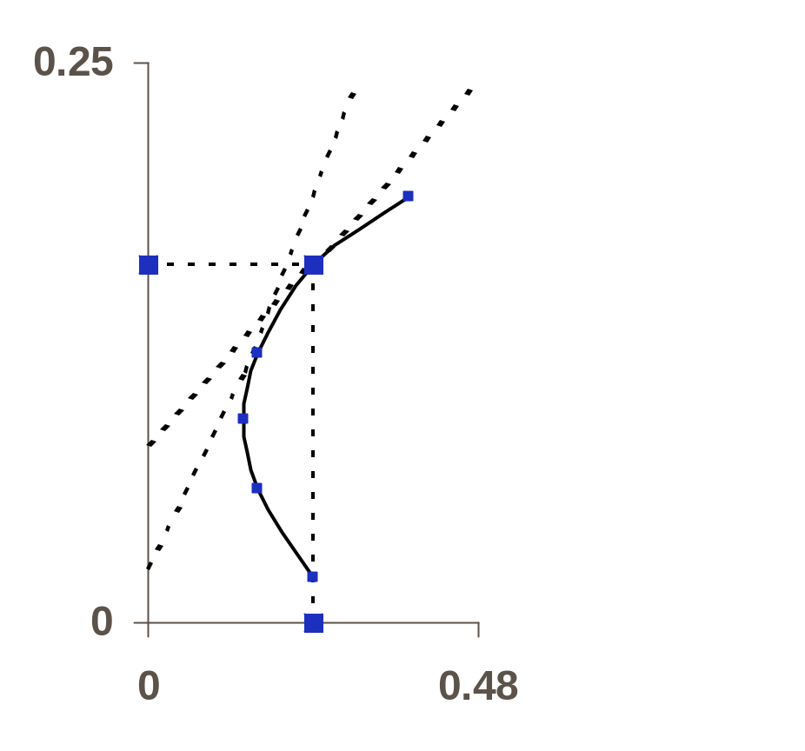
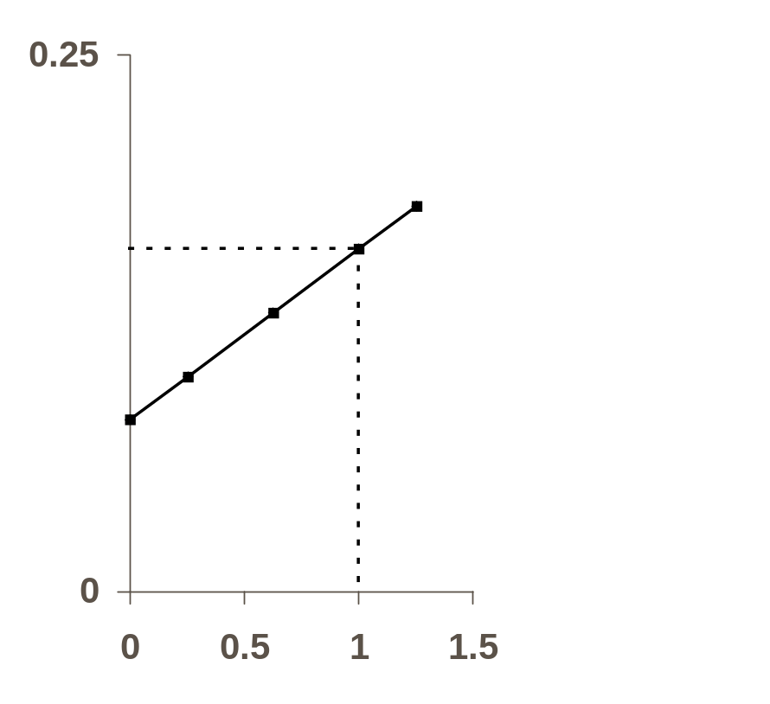
Can Lend, but Cannot Borrow at the Risk-Free Rate
E(r)
E(r)
SML
X
E(r_{M})
E(r_{M})
M
L
E(r_{Z})
E(r_{Z})
r_{F}
σ(r)
β
σ(r_{M})

Slide 41

Can Lend, but Cannot Borrow at the Risk-Free Rate (Continued)
Capital Market Line (CML):
  (r_{F} - L - M - X)
Between r_{F} and L:
  Combinations of the risk-free asset and the risky (efficient) portfolio L.
Between L and X:
  Risky portfolios of assets.
Security Market Line (SML):
  All assets (efficient and inefficient) will be priced to lie on the SML.

Slide 42


Can Lend at the Risk-Free Rate:
Borrowing is at a Higher Rate
E(r)
E(r)
X
SML
B
E(r_{M})
E(r_{M})
M
r_{B}
L
E(r_{Z})
E(r_{Z})
r_{F}
σ(r)
β
σ(r_{M})

Slide 43

Can Lend at the Risk-Free Rate, and Borrow at a Higher Rate (Continued)
Capital Market Line (CML):
  (r_{F} - L - M - B - X)
Between r_{F} and L:
  Combinations of the risk-free asset and the risky (efficient) portfolio L.
Between L and B:
  Risky portfolios of assets.
Between B and X:
  Combinations of the risky (efficient) portfolio B and a loan with an interest rate of r_{B}
Security Market Line (SML):
  All assets (efficient and inefficient) will be priced to lie on the SML

Slide 44
Conditions Required for Market Efficiency
In order for the Market Portfolio to lie on the efficient set, the following assumptions must hold:
  All investors must agree about the risk and expected return for all securities.
  All investors can short-sell all securities without restriction.
  No investor’s return is exposed to federal or state income tax liability now in effect.
  The investment opportunity set of securities is the same for all investors.

Slide 45
When the Market Portfolio is Inefficient
Investors Disagree About Risk and Expected Return
  In this case there will be no unique perceived efficient set for the Market Portfolio to lie on (i.e., different investors would have different perceived efficient sets).
Some Investors Cannot Sell Short
  In this case, Property I no longer holds. If a “constrained” efficient set were constructed with no short-selling, and each investor selected a portfolio lying on the “constrained” efficient set, the combination of these portfolios would not lie on the “constrained” efficient set.

Slide 46
When the Market Portfolio is Inefficient (Continued)
Taxes Differ Among Investors
  When tax exposure differs among investors (e.g., state, local, foreign, corporate versus personal), the after-tax efficient set for one investor will be different from that of others. There would be no unique efficient set for the Market Portfolio to lie on.
Alternative Investments Differ Among Investors
  Efficient sets will differ among investors when the populations of securities used to construct the efficient sets differ (e.g., some may exclude polluters, others may include foreign assets, etc.).

Slide 47
Summary of Market Portfolio Efficiency
In reality, assumptions underlying the efficiency of the Market Portfolio are frequently violated. Therefore, the Market Portfolio may well lie inside the efficient set even if the efficient set is constructed using the population of securities making up the market. In other words, perhaps the market can be beaten. That is, there may be portfolios that offer higher risk-adjusted returns than the overall Market Portfolio.

