Slide 1



Building African Voices
Perez Ogayo, Graham Neubig and Alan Black
Notes:
Please take a look at my slide creation tips:
https://docs.google.com/document/d/1H7YnQtyvhu2OY7vHSwzhvhfcgdJXpwM6phL1nJA4YY4/edit
Overall, you have a lot of text on your slides. Where you can, it's good to
(1) add illustrative graphics to make the slides more visually appealing. When creating slides in Google Slides I use this plugin to get some good icons: https://workspace.google.com/marketplace/app/insert_icons_for_slides_%F0%9F%91%8C/96201000411
(2) when you do need to use text, make sure that you avoid long, complete sentences and use bold on the most important words to make them stand out

Slide 2
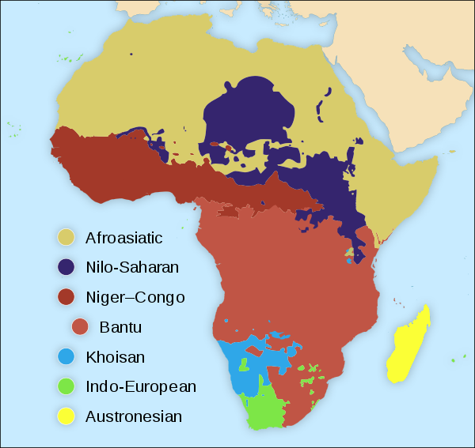
African Languages
Very little work for the > 2000 languages
A lot of work done on 11 South African languages
Why those languages?
Data exists:
They are official languages
Joint efforts from government agencies
Image source

Slide 3


To build a high quality speech synthesis corpora for African languages
Enable others to build speech systems for African languages with minimum technological resources and subject-matter expertise
Goals
Currently, more work on ASR than TTS

Slide 4
Demo https://www.africanvoices.tech/

Slide 5
Why is it hard?
Little data that is readily available
Most languages have no existing speech corpora
Available speech corpora are of low quality
Most languages have no text corpora on the internet
Access to recording equipment
Funds
Availability of the recording resources
Literacy levels
Finding fluent speakers for endangered languages
Multilingualism

Slide 6
Guiding Principles
We adopt a participatory approach guide by:
Accessibility: use Festvox and CMU Flite
Quality: curate high quality data
Breadth: To cover many languages, we use found sources and invite contributions
Notes:
“One philosophy of African Voices is that it is participatory, enabling interested parties to easily create voices for the languages that they speak or are interested in.”
Festvox and CMU Flite to build voices which are directly deployable on all Android phones through the open Google TTS API.

Slide 7


Two categories of sources of data
Found
We segment long-form audio into smaller utterances
Created:
We curate a text corpus, then record it.

Slide 8
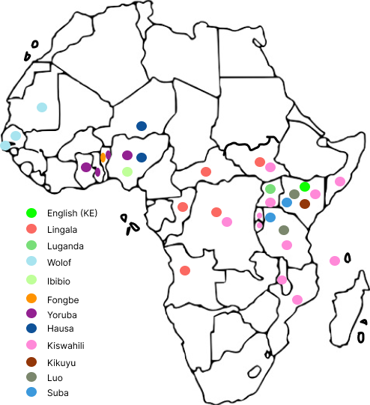
Focus Languages
Created
Luo : 4.2M speakers
Suba (Endangered): < 10k speakers
English (Kenyan)
Found
Lingala : 40-45M speakers
Kikuyu : 7M speakers
Yoruba : 25M speakers
Kiswahili
Wolof
Hausa
Ibibio
Fon
Luganda

Slide 9
Created data
Select a speaker
Adjust the transcript
01
02
03
04
Develop a prompt set
Record speech

Slide 10
Found data
Align utterances
01
02
03
Normalize text
Select utterances
Notes:
Text normalization
Created African Voices numbers dictionary
Added/modified missing segments
Added new lines to help mark sections
Utterance alignment
Used CMU wilderness
Took 2-5 days on a 16-CPU machine
Selecting a prompt-set
Using MCD score, selected the best 2000 utterances

Slide 11
Research Questions
RQ1
RQ2
RQ3
Are the dataset sufficient to build a high quality synthesizer in the target languages.
How much curated data is necessary?
How does curated data compare with found data?

Slide 12
Experimental Setup
Divided the created and found dataset by duration; 25, 50 and 101 min
Created models on those data segments
Used the created models to synthesize unseen text
Transcription test
Evaluators were asked to transcribe what they heard from the audio
A/B test
Evaluators were asked to select the one they preferred

Slide 13
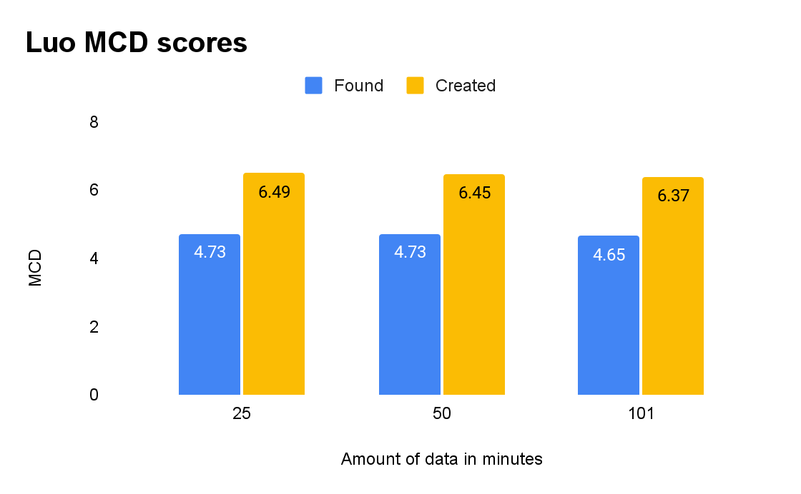
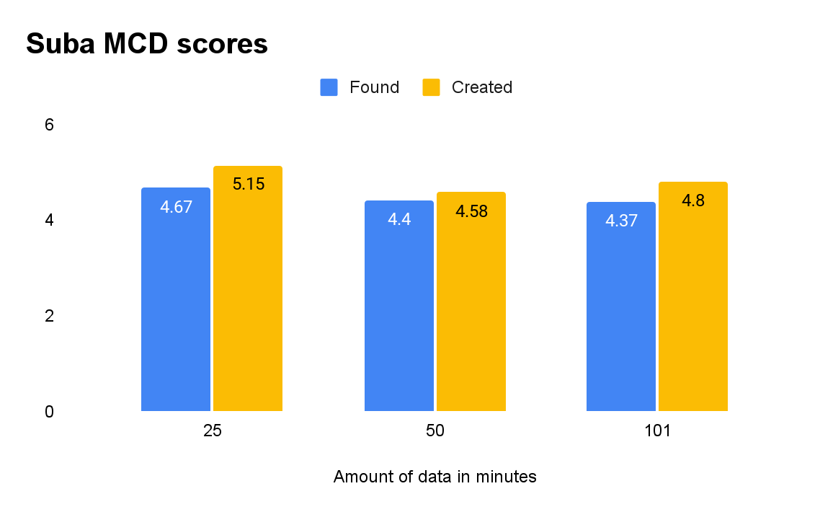
Objective Scores

Slide 14
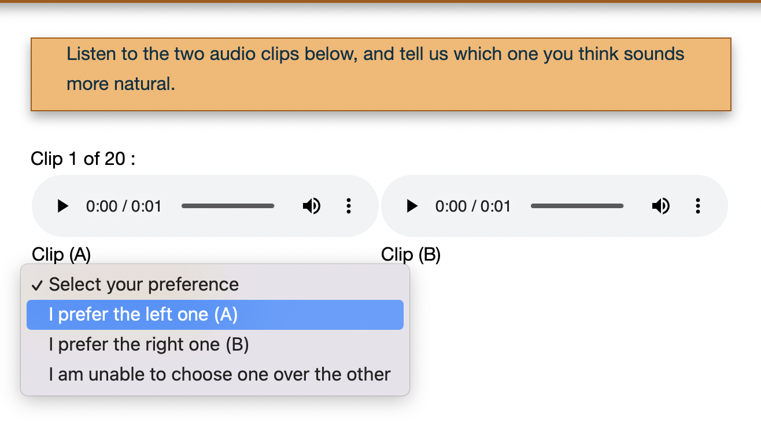
Human Evaluation
Advertised on social media
Had 2 evaluators for each language
Used TestVox for running subjective listening tests.
Testvox interface, AB setting

Slide 15
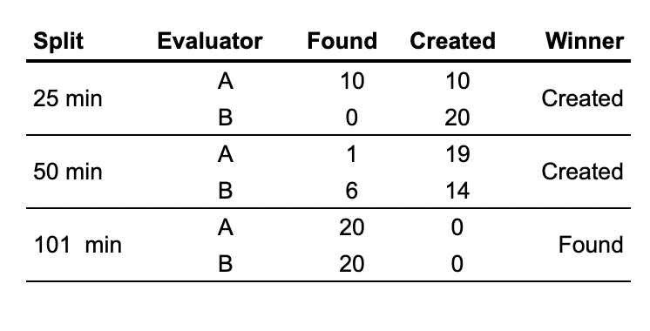
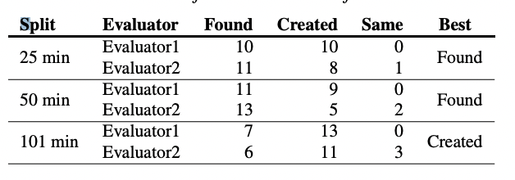
Results
A/B results for Suba
A/B results for Luo
Luo and Suba had an average CER of (5.85 found & 5.80 created) and (10.80 found & 13.78 created)

Slide 16
Analysis
RQ1
RQ2
RQ3
Are the dataset sufficient to build a high quality synthesizer in the target languages.
Yes
How much curated data is necessary?
> 25 min
How does curated data compare with found data?
Curated data is better than found data when it is small.

Slide 17
Conclusion
We:
curate and develop high quality TTS datasets for 12 African languages
train and evaluate TTS models
release the datasets and TTS models
show that curated data is comparable with found data

Slide 18
Interact with us!
Contribute:
https://github.com/neulab/AfricanVoices
Report bugs and request features:
https://github.com/Pogayo/african-voices-web
Read Paper:
https://arxiv.org/abs/2207.00688

Slide 19

Thank you!
Q&A

Slide 20
Impact

Slide 21
References
A. W. Black, “CMU wilderness multilingual speech dataset,” in ICASSP 2019 IEEE, 2019, pp. 5971–5975.

