Slide 1
Towards an Automatic Speech Recognizer for the Choctaw language
Jacqueline Brixey
David Traum
USC Institute for Creative Technologies

Slide 2
Motivation
Build first speech recognizer for Choctaw language
Tool for language learners to improve pronunciation and/or conversational skills
Support documentation efforts
Language technology for all

Slide 3
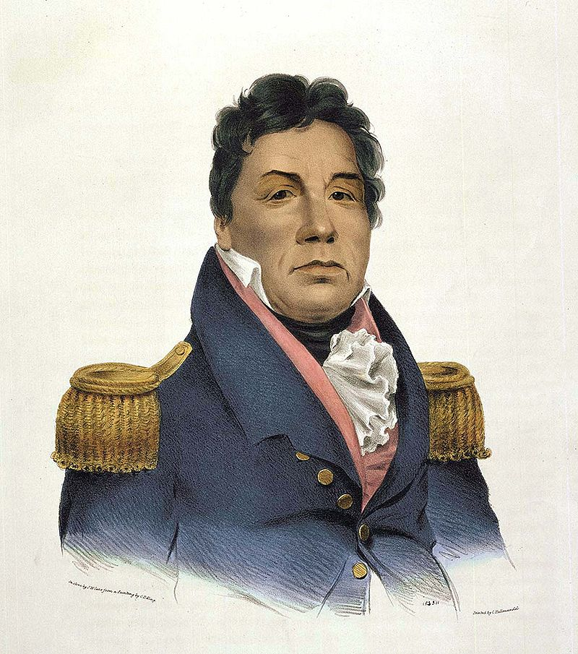
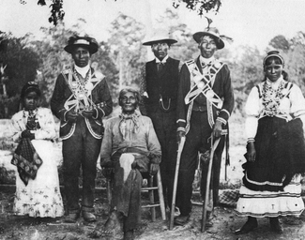
Choctaw people
An American indigenous tribe and language
~200,000 individuals (3rd largest tribal group in the US by population)

Slide 4
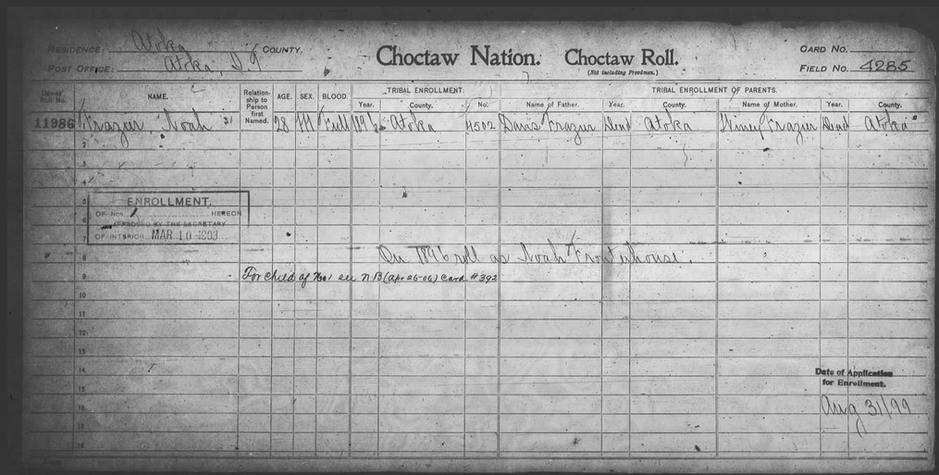
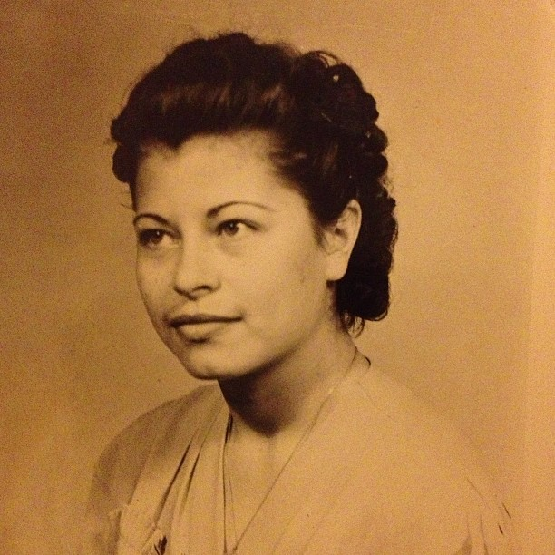
Choctaw people
Ella Louise Frazier Smith
Notes:
I am Choctaw, this is my grandmother

Slide 5
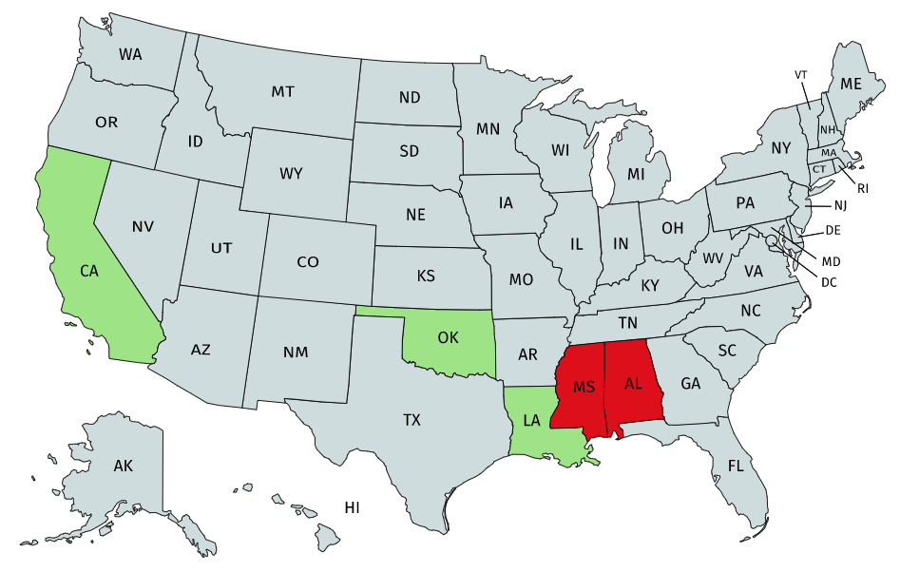



Choctaw language
~ 10,000 fluent speakers
Less since COVID
Endangered language status
In the Muskogean language family
Other members: Chickasaw, Alabama, Muscogee

Slide 6
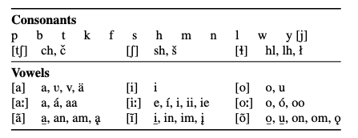
Choctaw language
First documented in the 1800s by a missionary, Cyrus Byington
Grammar
Dictionary
Other grammars by Nicklas (1972), Ulrich (1986), Broadwell (2006)
Dictionaries by Byington (1915), Wright (1880), Choctaw Nation of Oklahoma (2016)

Slide 7
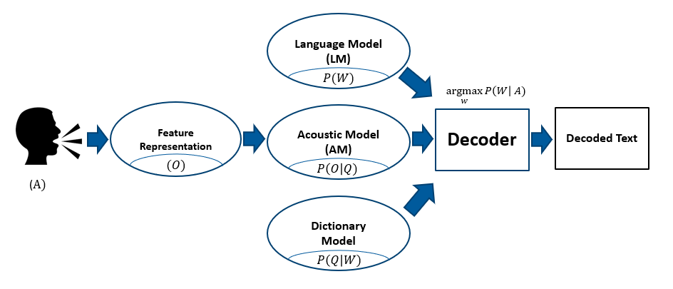
System development
Developed using Kaldi
Recipe: WSJ
Builds monophone and triphone acoustic models

Slide 8
Data set : Language model (previous work)
ChoCo (Brixey & Artstein, 2021)
Text to build language model with:
Type of text | Genre | Number of tokens
Dictionary |  | 46,704
Bilingual text (OK) | Correspondence Poetry Phrases Short stories | 159 203 16,465 6,234
Bilingual text (MS) | Phrases Short stories | 331 1,693
Monolingual text (OK) | Phrases Religious | 1,344 80,818
Monolingual text (MS) | Religions Phrases | 30,010 41
Audio with transcript | Sam Noble Chahta Anumpa Aikhvna Language Awareness Program School of Language CNO | 35,346 254 4,864
 |  | Total = 224,466

Slide 9
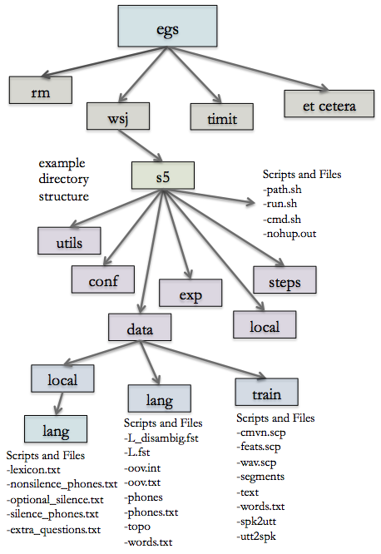
Dictionary model
Lexicon
2727 entries
Pronunciation attested to in 2016 dictionary
Image from: https://www.eleanorchodroff.com/tutorial/kaldi/familiarization.html

Slide 10
Data set : Acoustic model (previous work)
ChoCo (Brixey & Artstein, 2021)
Audio = 13 hours 45 minutes
Video = 2 hours 32 minutes

Slide 11
Data set : Acoustic model new data collection
Cho rep collection
48 Oklahoma Choctaw speakers recruited
Varying levels of fluency

Slide 12
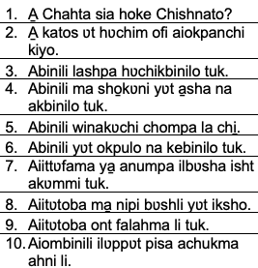

Data set : Acoustic model new data collection
Speakers repeated aloud 200 prepared phrases
Phrases selected to cover a range of sounds

Slide 13
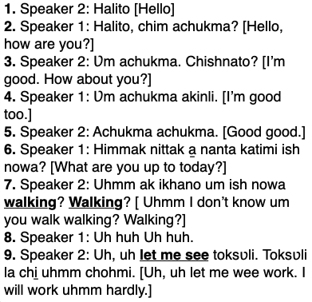
Data set : Acoustic model Dialogue collection
Eight 15-minute-long conversations between two speakers of differing levels of fluency
15 unique participants
Spoke on any topic of their choosing

Slide 14
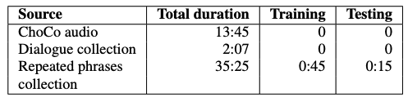
System development – training and testing
Data subset
Currently training a fluent speaker only model (12 of the 48 recordings)

Slide 15
Preliminary results
The fluent-only model is currently trained on a subset of the fluent recordings (6 of the 12 fluent)
Monophone model best WER = 49.35%
Triphone model best WER = 61.64%
 | Gold | Monophone model | Triphone model
1 | Keyu sʋ nushkobo hʋt hottupa kiyo | Kiyo sʋ nushkoboka hottupa kiyo | Keyu sʋ nushkobo ʋt hottupa kiyo
2 | Aka̱k nipi ilʋppʋt kalampi moma | Oka nipi ilʋppʋt kalampi moma | Aka̱k nipi ilʋppʋt kalampi moma
3 | Chim ʋlla yʋt chim ofi aiokpanchi | Chim ʋlla yʋt chim ofi aiokpanchi | Chibbak ʋlla yʋt kiyo ofi aiokpanchi
4 | Pi attoba chi̱ | Ittonla chi̱ | Kil
5 | Ʋllo̱si mʋt hochʋffo hʋt yaiya | Anusi mʋt hohchʋffo hʋpia yʋt | Anusi ilap hohchʋffo a yaiya
6 | Holisso apisa cha ish antta hʋt shohbi tuk o̱ | Holisso katos kucha ish ʋpʋt nukshobli tuk | Holisso apesʋchi la chahta shohbi tuk o̱

Slide 16
Discussion
Preliminary work
Promising for small data set
Promising for dictionary lookup type use

Slide 17
Future work
Finish implementing fluent only
Include dialogue data
Recordings include learning speakers, could implement a version to recognize learning speakers

Slide 18
Thanks! For more information: brixey@usc.edu traum@ict.usc.edu

