Slide 1
MATH2020: Discrete Math
Mini project
Turbo Turists
Hiep Pham
Cuong Nguyen
Khoi Dau
Nhan Nguyen
Notes:
1

Slide 2
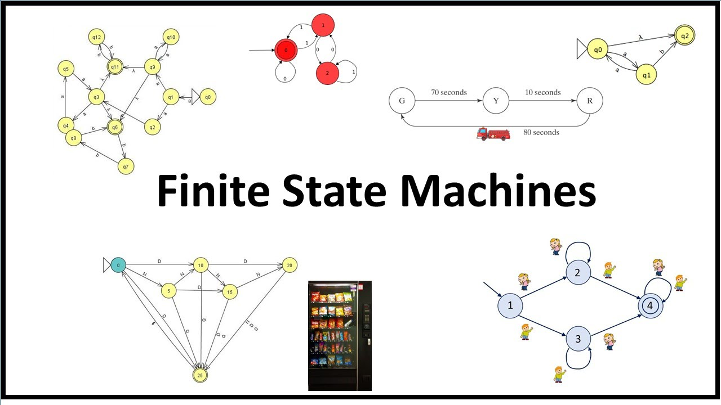
Finite State Machines
Represents a computational model used to simulate sequential logic.
The ideal starting place for designing any computational hardware system.
Existing solutions are either limited in supporting features or lacking in interactivity

Slide 3
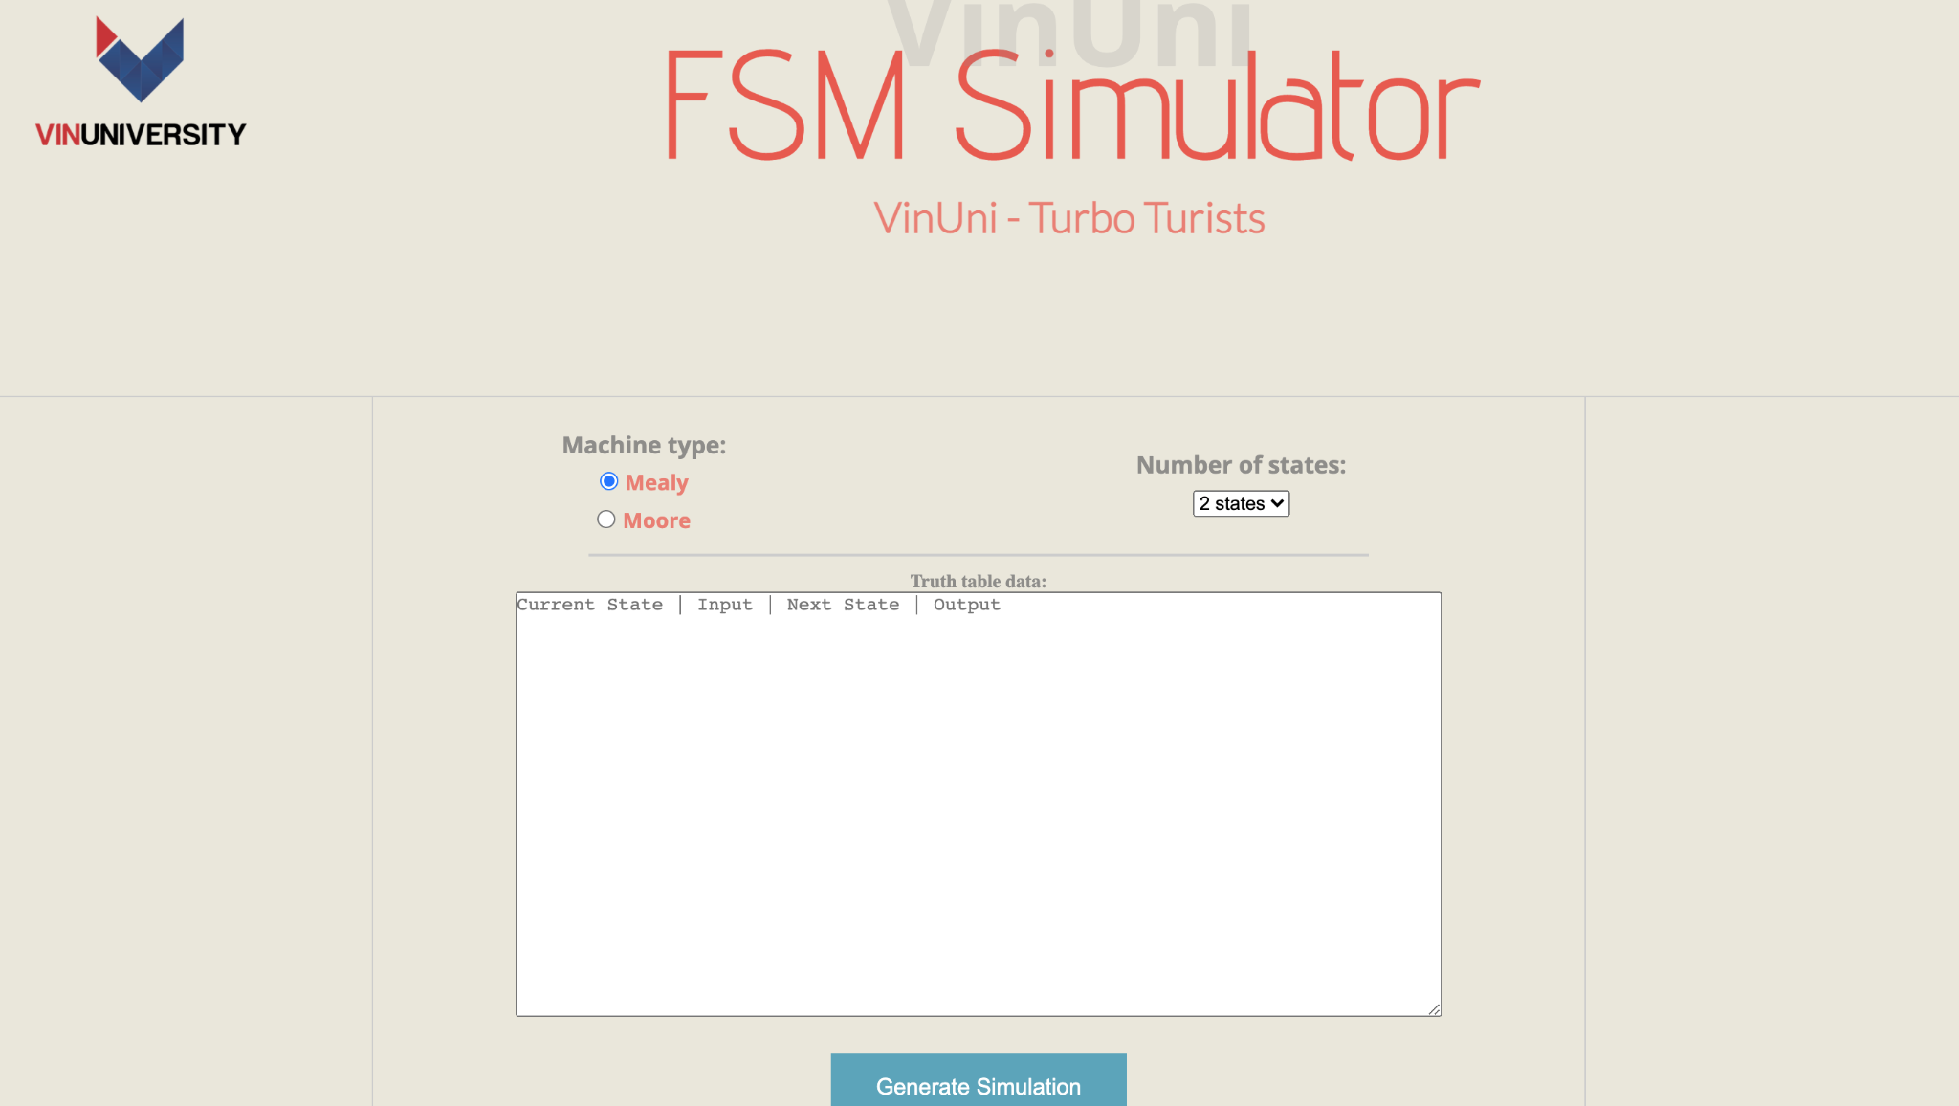
Our Product
OUR FSM:
Hosted on a website
Different interactive elements.
A user-friendly drag-n-drop control.
Customizable fonts and colors.
Smart notation systems.

Slide 4
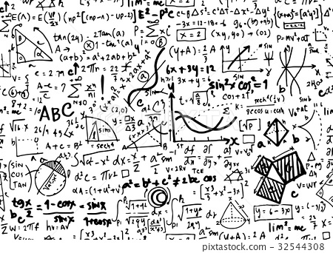
MATHEMATICAL BACKGROUND
OUR FSM:
Shift from one state to another.
Minimize the number of execution pathways.
Simplify the criteria examined at each branching point
Make transitions between modes of execution simpler.
Re-implementing Deterministic Finite State Machines and Non-deterministic Finite State Machines.

Slide 5
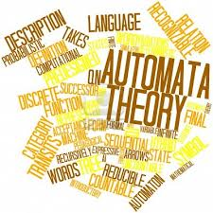
MATHEMATICAL BACKGROUND: AUTOMATA THEORY
"Automata" comes from the Greek word "automata”, meaning "self-acting." An automaton (plural: automata) is an abstract self-propelled computing system that automatically follows a predetermined series of operations.
An automaton having a finite number of states is called a Finite Automaton (FA) or Finite State Machine (FSM).

Slide 6
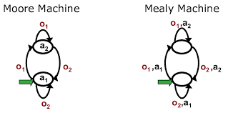
Automata Theory
The outputs of the finite automata might be linked to each transition.
2 different types of output-generating FSM:
Mealy Machine
Moore Machine

Slide 7
Types of output-generating FSM
Mealy Machine
A FSM whose output is determined by both the current state and the current input.
The output is expressed by separating each input symbol for each state with a /
The output length of the mealy machine is similar to the input length.
2. Moore Machine
A FSM with outputs that are solely dependent on the current state.
The output is displayed with each input state separated by /
The output length is greater than input by 1.

Slide 8
Usage
Firstly, selecting a machine type and the number of states
Afterwards, fill the necessary inputs, in the format of
“Current_state | input | Next_state | Output”

Slide 9
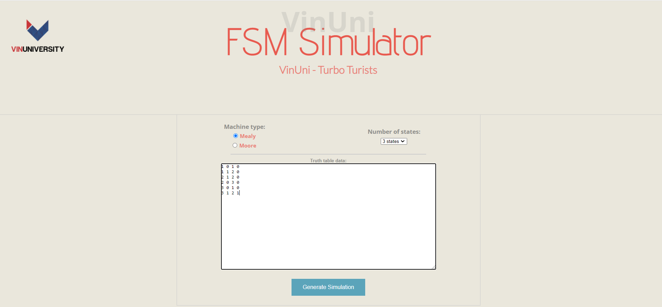
Example 1
Machine type: Mealy
Number of states: 3

Slide 10
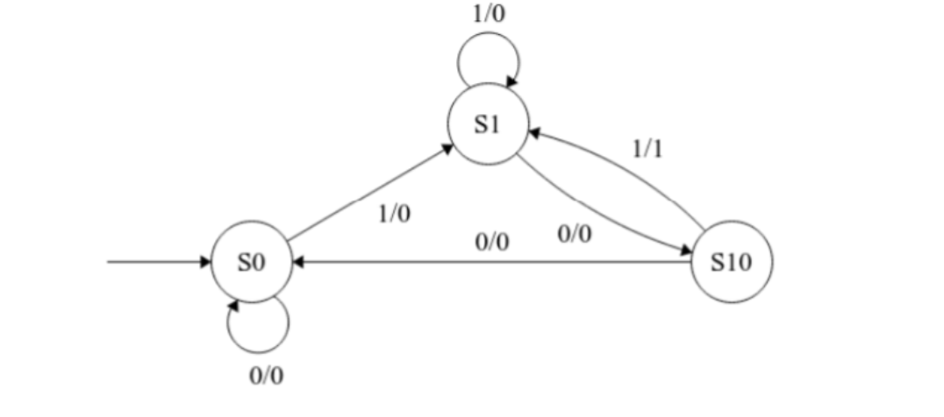
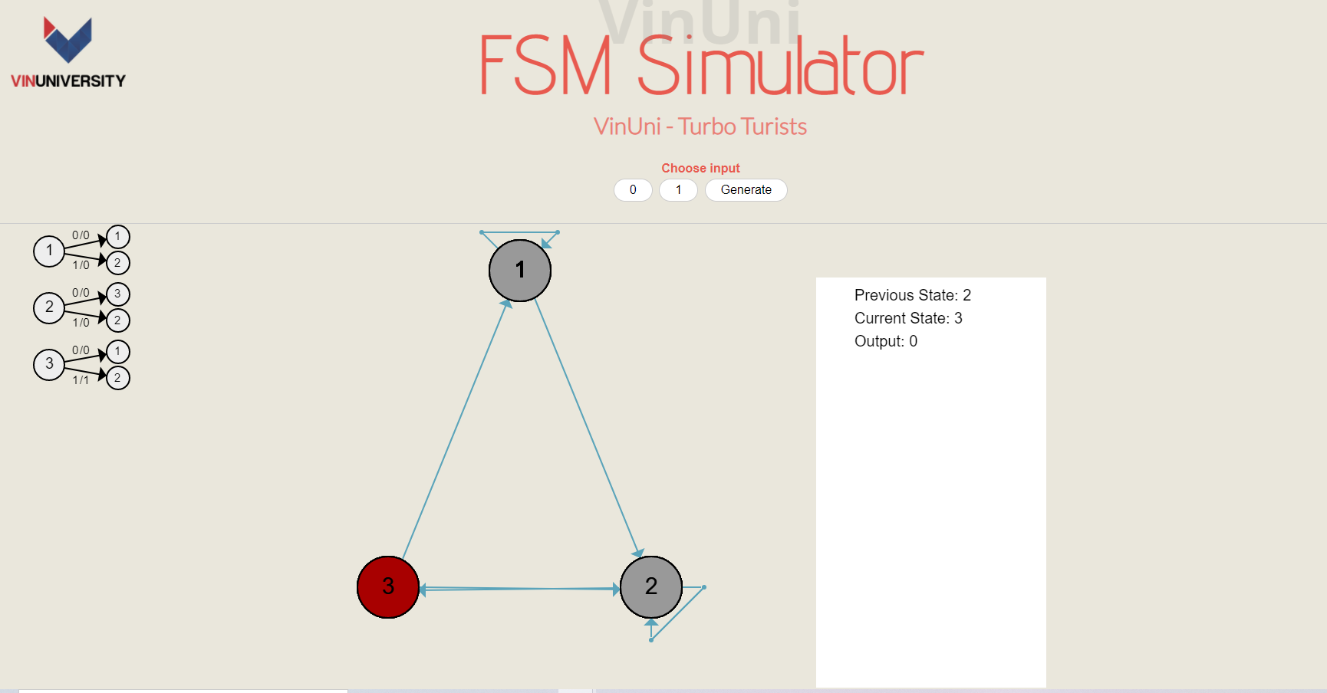
Example - Mealy Machine
Mealy Solution
Implementation using our website

Slide 11
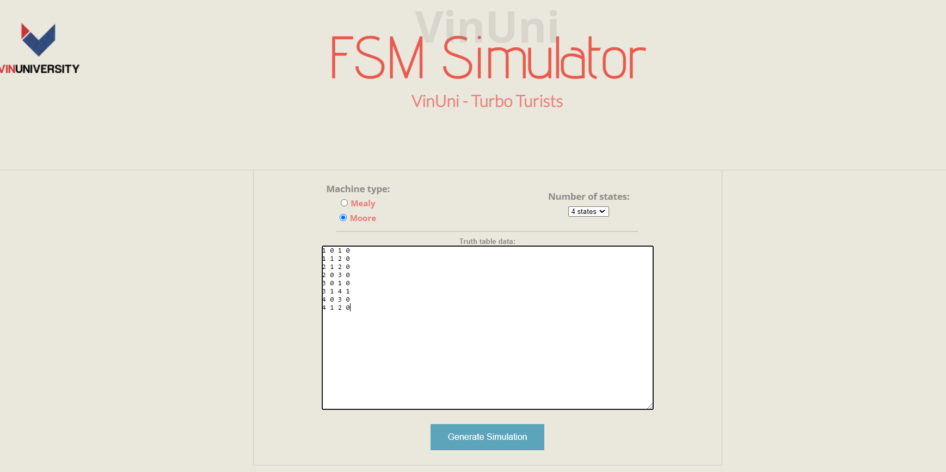
Example 2
Machine type: Moore
Number of states: 4

Slide 12
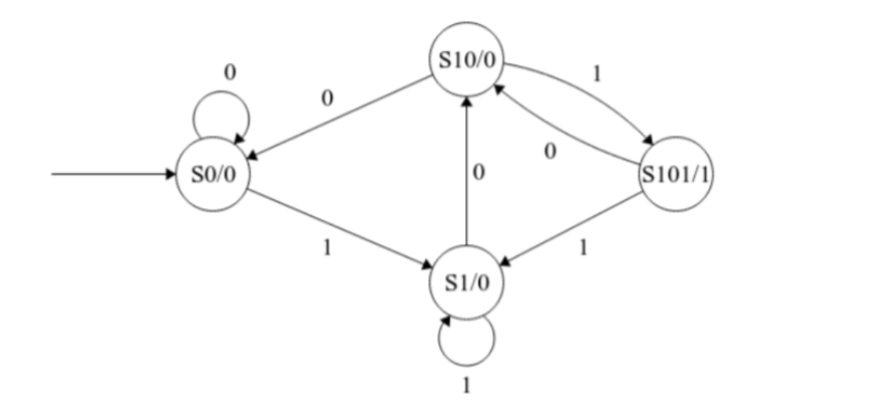
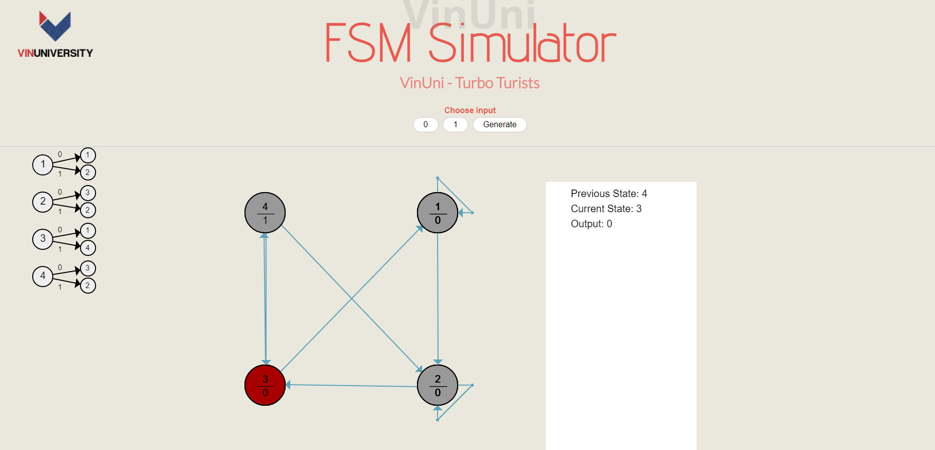
Example - Mealy Machine
Moore Solution
Implementation using our website

Slide 13

Tech Stack
Our Project is built using:
HTML: to structure the page that receives data from the machine described by the user
CSS: to design the page that reads the data
Java Script(together with the jQuery library): to process the data, construct the state machine, and perform the click events

Slide 14
Tech Stack & Implementation
HTML implementation: receive the user's input
JavaScript implementation: select and save the data entered by users as variables.
The critical part of the code: generate the circles and arrows.
There are the events of the input buttons:
Traverse an array
Contain the table with future state and output from the current state and input clicked
Decide which state to transition to.

Slide 15
CIRCLES AND ARROWS GENERATION
CIRCLES:
The position of the centers of circles have been planned out, for each of the 8 cases.
Each case will have its own predefined layouts of the circles.
some simple if-else statement and extracting information from the user's inputs, in order to come up with the corresponding circles formation.

Slide 16
CIRCLES AND ARROWS GENERATION
ARROWS:
Each circles’ center will be the starting and ending points of arrows corresponding to it.
Drawing the arrows is achieved also through simple conditional statements from the user’s inputs.

Slide 17

LIMITATIONS
The number of states is capped at 8, and coding an additional state (9, 10, ...) becomes linearly more difficult.
The web achieves little scalability when it comes to mobile / tablet usage

Slide 18
References
[1] Ankit, “Answer for ‘What is automata theory?” - Quora,” Quora, 05-Oct-2017. [Online]. Available:
https://www.quora.com/What-is-automata-theory. [Accessed: 09-Dec-2021].
[2] “Moore and Mealy Machines,” tutorialspoint, 2020. [Online]. Available:
https://www.tutorialspoint.com/automatatheory/mooreandmealy machines.htm. [Accessed: 09-Dec-2021].
[3] S. Tuteja, “Mealy and Moore Machines in TOC,” GeeksforGeeks, 20-Nov-2019. [Online]. Available:
https://www.geeksforgeeks.org/mealy-and-moore-machines-in-toc/. [Accessed: 09-Dec-2021].

Slide 19
Thank you!

