Slide 1
User interface, Usability requirements, testing tools and issue management
Sai vihari venigandla
Sindhuja Pannala
Harish kola
Priyanka kommula

Slide 2
Overview
User interface
Usability requirements
Testing tools (Selenium)
Issue management

Slide 3
User Interface
Sai vihari venigandla

Slide 4
User Interface
There are very few known techniques that can accurately and consistently shape a good UI
Sai vihari venigandla

Slide 5
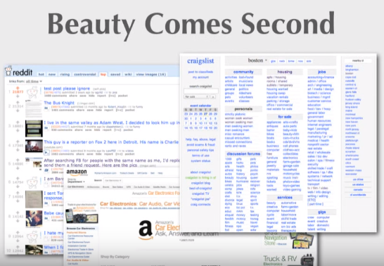
User interface
Sai vihari venigandla
Notes:
Tons of things you could say like keep it simple, relate to other things that are people are used to.
I am going to go through some trends that we have seen with websites.

Slide 6
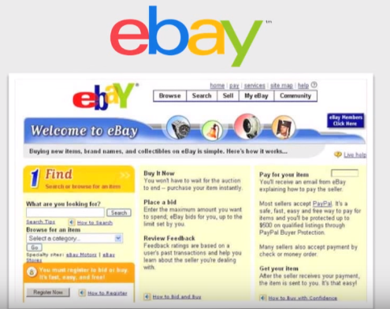
User interface
Users resist change…
Sai vihari venigandla

Slide 7
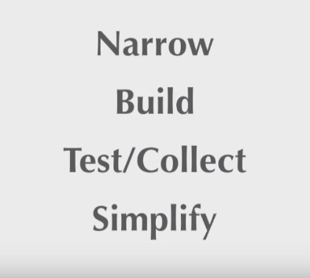
User interface
There are 4 steps to design an amazing user interface
Sai vihari venigandla

Slide 8

Narrow your scope
Identify a narrow band of target users(specifically your first-adopters)
Speeds up development time
Sai vihari venigandla

Slide 9



Build
…
Sai vihari venigandla

Slide 10

Test/Collect
Sai vihari venigandla

Slide 11
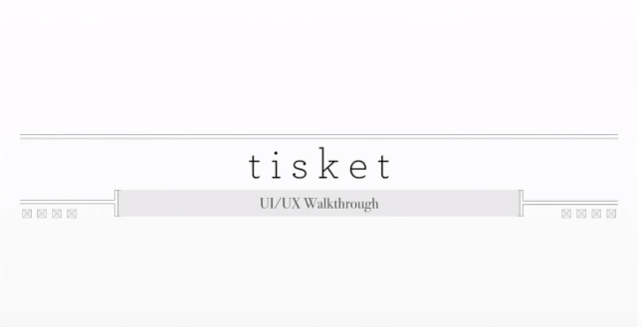
User interface
Sai vihari venigandla

Slide 12

User interface
Sai vihari venigandla

Slide 13
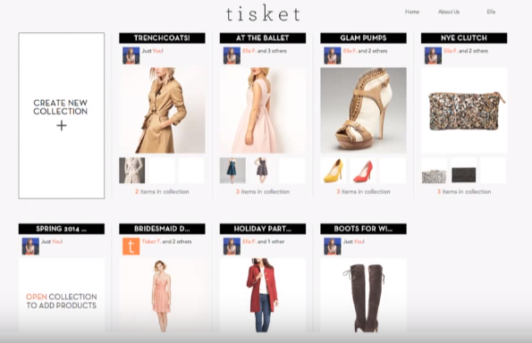
User interface
Sai vihari venigandla
Notes:
social commerce website that allows grp of frnds discuss collection of clothing purchases
target customers are women b/w ages 18 to 30

Slide 14
Simplify
Any intelligent fool can make things bigger, more complex and more violent. it takes a touch of genius and a lot of courage to move in the opposite direction-- Albert Einstein.
Sai vihari venigandla
Notes:
often times simplify takes in wrong time.

Slide 15
Usability Requirements
Sindhuja Pannala

Slide 16
Usability Requirements
To increase the ease of use of the product
Listed at the starting stage of the product design
Main aim of establishing usability requirements:
Efficiency
Effectiveness
Understandability
Sindhuja Pannala
Notes:
Easy to remember the process of tasks, learnable, understandable
Eg: ATM and web forms, often used by many people.

Slide 17
Usability Requirements
Usability requirements should support (and should be user centric):
Efficiency of use
Tasks to be performed with less or no errors
Intuitiveness
easy to navigate, use of buttons, help/ error messages etc.
Low perceived workload
interface should be easy, not demanding and frustrating
Sindhuja Pannala
Notes:
More errors-> frustrating the user, no one will use
Intuition-> eg: using login as a link instead of a button
Providing login at the top left or at the bottom of the page instead of right corner,
Workload-> no memory stress on the user to remember the words etc.
Whenever a new and inexperience user try to make some network security changes in the computer, he faces many issues ( don’t know which security setting resting)-> this is a complicated task but it this type of problem should not persist with simple tasks (making transaction in online banking)

Slide 18
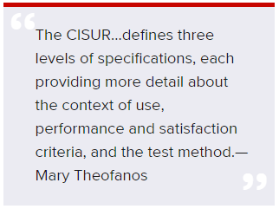
Usability Requirements
Usability requirements vary depending on the product and the users
Eg: online payment, health domain, hp
Website
Here are a few quotes which helps us define the usability requirements depending on the product and its users
Sindhuja Pannala
Notes:
Question: how do u test the product and say that this is recommended website, any mobile application or not( whether performance, easy interface, effectiveness else something)
Whenever you consider a payment process in an online application, the users and vendors consider the validation accuracy of the card, and how effectively it is performed, here time is not the main agenda,
In health domain, there can occur some situations where triage procedure should be completed in 15 min else the patient may die. In this scenario, time, accuracy and effectiveness, all are to be considered

Slide 19
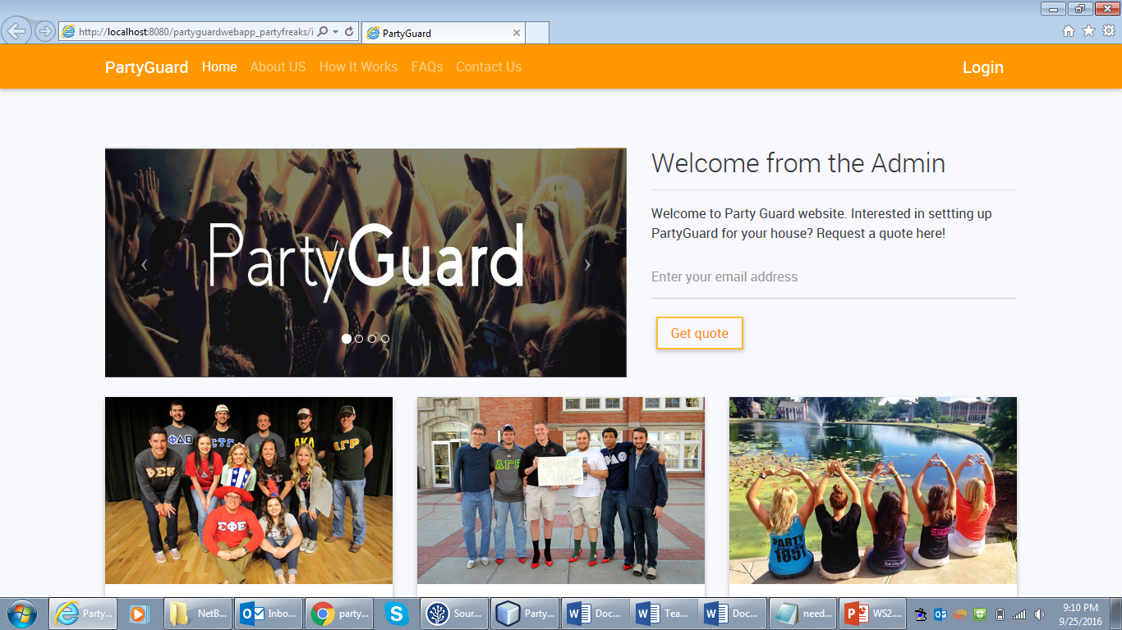
Usability requirements
Sindhuja Pannala

Slide 20
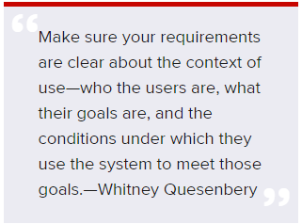
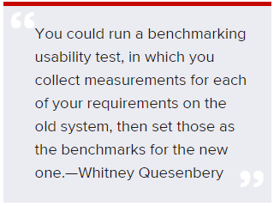
Usability Requirements
Sindhuja Pannala

Slide 21
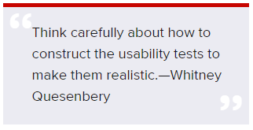
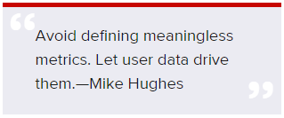
Usability Requirements
Sindhuja Pannala

Slide 22
Testing Tool
Harish Kola

Slide 23
Harish Kola

Slide 24
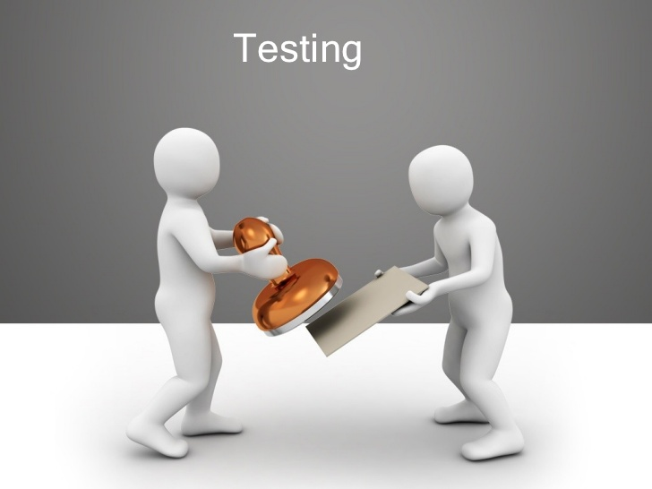
Testing
Evaluating a system with intend to find whether it satisfies the specified requirements or not.
Process rather than a single activity.
Harish Kola

Slide 25
When to start testing?
Requirement gathering phase - the analysis and verification of requirements
Design phase - intent to improve the design
Completion - testing at the end of development of code
Harish Kola

Slide 26
When to stop testing?
Testing deadlines
Completion of test case execution
Completion of functional and code coverage to a certain point
Bug rate falls below a certain level and no high-priority bugs are identified
Management decision
Harish Kola

Slide 27
Who does testing?
Software Testers
Software developers
Project Lead/Managers
End User
Harish Kola

Slide 28
Tips you should know before testing
Analyze your test results thoroughly
Maximize test coverage
Break your application into smaller functional modules
Write test cases for intended functionalities first . Then write for invalid conditions.
Think positive.
Write test cases in requirement analysis and design phases.
Make your test cases available to developers prior to coding.
Harish Kola

Slide 29
Tips you should know before testing(contd…)
Programmers do not test their own code
Keep developers away from test environment
Involve testers right from software requirement and design phase
Share best testing team practices
Increase your conversation with developers
Write clear, descriptive and unambiguous bug report.
Harish Kola

Slide 30

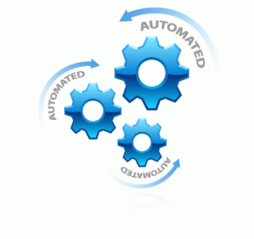
Types of Testing
Manual Testing
Testing a software manually without using any automated tool.
Automation Testing
Tester writes the scripts and uses another software to test.
Harish Kola
Notes:
Testers uses test plans, test cases or test scenarios to test a software to ensure the completeness of testing.
Stages in testing --- unit testing, integration testing, system testing and user acceptance testing.
Automation Testing is used to re-run the test scenarios that were performed manually, quickly, and repeatedly.
It increases the test coverage, improves accuracy, and saves time and money in comparison to manual testing.

Slide 31
How to Automate?
Identifying areas within a software for automation
Selection of appropriate tool for test automation
Writing test scripts
Development of test suits
Execution of scripts
Create result reports
Identify any potential bug or performance issues
Harish Kola

Slide 32
Software testing tools
HP Quick Test Professional
Selenium
IBM Rational Functional Tester
SilkTest
TestComplete
Testing Anywhere
WinRunner
LoadRunner
Visual Studio Test Professional
WATIR
Harish Kola

Slide 33
QTP | IBM RFT | Selenium
Licensed | Licensed | Open Source
Training Cost - Costly | Training Cost - Costly | Compared to license tool is less
Dedicated HP Support along with support forums | Dedicated IBM Support along with support forums | Open Source community
Hardware resource consumption during script execution - High | Hardware resource consumption during script execution - High | Hardware resource consumption during script execution - Low
Coding Experience of Engineer – Not Much | Coding Experience of Engineer – Required | Should be very good along with technical capabilities of integrating the framework
Environment support - only Windows | Environment support - only Windows | Windows, Linux, Solaris OS X
Language Support – VB Script | Language Support – Java and C# | Java, C#, Ruby, Python, Perl, PHP and JavaScript
Harish Kola

Slide 34
Selenium
Automated software testing tool for testing web applications.
Tools available in Selenium
Selenium IDE
Selenium RC
Selenium WebDriver
Selenium Grid
Harish Kola

Slide 35
Issue Tracking
Priyanka kommula

Slide 36
Introduction
What is an issue?
An issue is any query or occurrence that might have an impact on a project.
could be a software bug
could be a request for a change to something
could be something that just needs done
an action from a meeting
How does issues arises?
Could be bugs, enhancements or residual issues.
Priyanka Kommula

Slide 37
Issue Tracking system
Why do we need it?
Things change, stuff happens
capturing these things, this stuff, in a ordered way will save lots of later pain
How can we achieve it?
There are many tools for issue tracking. In further slides we will discuss each in detail.
Priyanka Kommula

Slide 38
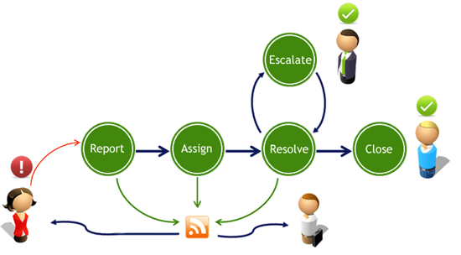
Issue life cycle
Priyanka Kommula

Slide 39






Issue tracking tools:
Priyanka Kommula

Slide 40


Issue tracker in Bitbucket
Place to track projects bugs, feature request and task etc.
Simple and flexible
Priyanka Kommula

Slide 41
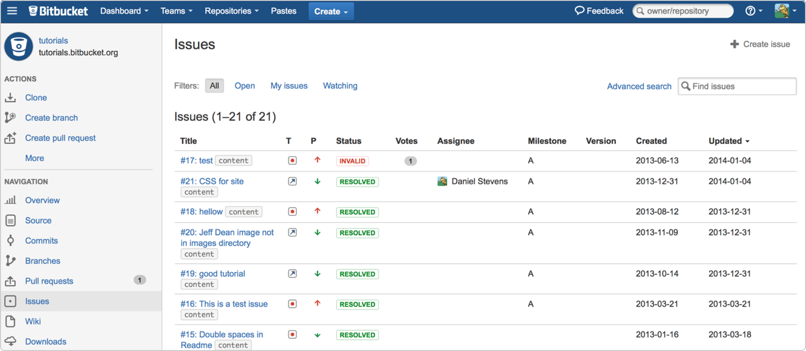
Issue tracker in Bitbucket(contd…)
Priyanka Kommula

Slide 42
Flow of issue in bit bucket
Enabling issue tracker
Creating an issue
Selecting issue category and priority
Configuring defaults for issue fields
Handling issue
Resolving issue
Priyanka Kommula

Slide 43
Issue tracking demo
Priyanka Kommula

Slide 44
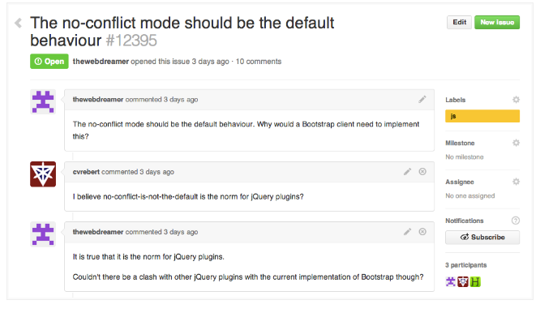
Issue Tracking
It focus on collaboration, references, and excellent text formatting
Priyanka Kommula

Slide 45
Features
A title and description describe what the issue is all about
Color-coded labels help you categorize and filter your issues
milestone acts like a container for issues
Comments allow anyone with access to the repository to provide feedback
Assignee is responsible for taking issue forward
@mentions and references help to notify other GitHub users & teams, and cross-connect
issues to each other.
Priyanka Kommula

Slide 46
Issue tracking demo
Priyanka Kommula

Slide 47
Pros of issue tracking tools
Effective in dealing with issues
Facilitates in monitoring, managing and closing the issue
Its availability for wide range of teams like technical, non-technical, customer facing issues and production related issues
Allows traceability or analysis on defect trends.
Helps in troubleshooting
Priyanka Kommula

Slide 48
Cons of issue tracking tools
Tools often difficult to integrate with other processing tools
Financial burden for smaller projects
For some reported issues it is hard to follow the issue life cycle than closing the issue itself
Needs training of tool
Hinders face to face communication
Priyanka Kommula

Slide 49
Conclusion
List usability requirements before design of the product, determining meaningful metrics for usability testing makes the testing process a little easier and helps in the success of the product.
Sindhuja Pannala

Slide 50
Thank you

