Slide 1
User Acceptance
Team WS 04
Bhavana Pilli
Nihitha Reddy Bhimireddy
Sairam Jalla
Abhinaya Mogalipuvvu

Slide 2
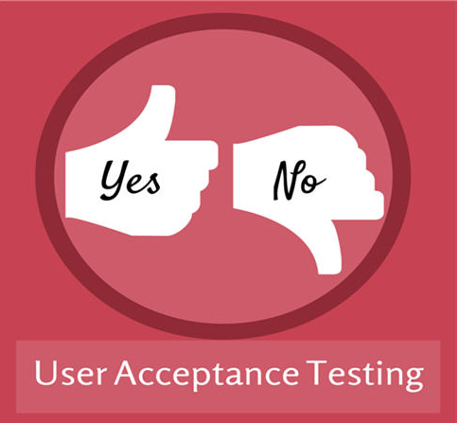
User Acceptance
User acceptance is a type of testing performed by the Client to certify the system with respect to the requirements that was agreed upon
BHAVANA PILLI

Slide 3
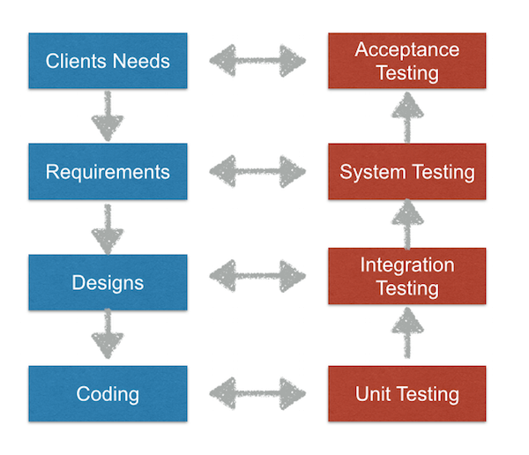
When is User Acceptance Testing(UAT) performed?
BHAVANA PILLI

Slide 4
Who Performs Use Acceptance Testing?
Product managers (mandatory)
Client
End Users
SME's from client care, compliance, professional services, beta customers depending on interest level and availability
BHAVANA PILLI

Slide 5
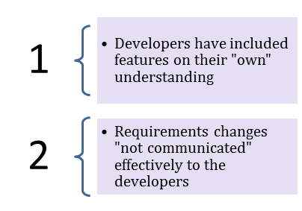
Need of User Acceptance Testing
BHAVANA PILLI
Notes:
Developers code software based on requirements document which is their "own" understanding of the requirements and may not actually be what the client needs from the software.
Requirements changes during the course of the project may not be communicated effectively to the developers.

Slide 6
How is User Acceptance Testing (UAT) different from functional testing?
User Acceptance Tests consist of a set of test steps, which verify if specific requirements are working for the user.
Functional testing, on the other hand, tests specific requirements and specifications of the software.
BHAVANA PILLI
Notes:
User Acceptance Tests consist of a set of test steps, which verify if specific requirements are working for the user. If the customer and the supplier agree on the product, the software development is done. Legally. And practically.
Functional testing, on the other hand, tests specific requirements and specifications of the software. It lacks the user component. A functional test could conclude that the software meets its specifications. However, it doesn’t verify if it actually works for the user. The functional dimension is only one of many.
Let me give you an example: A certain feature – let’s say, your in-app search feature – has some performance issues, and the loading time of the results page is pretty bad. Technically, it works. Every tester can use it – but because of the bad performance no one will want to. Functional tests would go well, usability tests would go fine as well, but the performance problems would probably lead to a failed acceptance test.

Slide 7
Types of User Acceptance Testing
Alpha & Beta Testing
Contract Acceptance Testing
Regulation Acceptance Testing
Operational Acceptance Testing
Black Box Testing
BHAVANA PILLI
Notes:
Alpha & Beta Testing
Alpha Testing normally takes place in the development environment and is usually done by internal staff – long before the product is even released to external testers or customers. Alpha Testing can also be done by potential user groups, but the important thing here is that it takes place in the development environment. The feedback – collected from the alpha testers – is then used to fix certain issues or bugs and improve the usability of the product.
Beta Testing, also known as “field testing”, takes place in the customer’s environment and involves some extensive testing by a group of customers who use the system in their environment. These beta testers then provide feedback, which in turn leads to improvements of the product.
Alpha and Beta Testing are done before the software is released to all customers.
Contract Acceptance Testing
Contract Acceptance Testing means that a developed software is tested against certain criteria and specifications which are predefined and agreed upon in a contract. The relevant criteria and specifications for acceptance must be defined when the contract itself is defined and agreed upon.
Regulation Acceptance Testing
Regulation Acceptance Testing, also known as Compliance Acceptance Testing, examines whether the software complies with the regulations. This includes governmental and legal regulations.
Operational acceptance testing
Also known as Operational Readiness Testing or Production Acceptance Testing, these test cases ensure there are workflows in place to allow the software or system to be used. This should include workflows for backup plans, user training, and various maintenance processes and security checks.
Black Box Testing
Black Box Testing is often categorised as functional testing, but can, to some extent, be seen as a type of User Acceptance Testing. It’s, basically, a method of software testing which analyzes certain functionalities without letting the tester see the internal code structure of the software. Therefore, Black Box Testing can also be applied to User Acceptance Testing, because Black Box Tests do share the same principles as User Acceptance Tests. During Black Box Tests the user isn’t aware of any code base, but only about the requirements which the software should meet.

Slide 8
Four steps in UAT
Define criteria by which the software is considered to be working
Create a set of UAT test cases.
Run UAT tests.
Record and evaluate.
BHAVANA PILLI

Slide 9
How is UAT Performed
Prerequisites of User Acceptance Testing:
Business Requirements must be available.
Application Code should be fully developed
Unit Testing, Integration Testing & System Testing should be completed
No Showstoppers, High, Medium defects in System Integration Test Phase
Only Cosmetic error are acceptable before UAT
NIHITHA REDDY BHIMIREDDY
Notes:
Fully sign off requirements should be provided.
The entire code should be functional.
User Acceptance Testing is performed after the unit, integration and system testing is performed.
No defects are considered in this phase
Errors like spelling mistakes or CamelCase are allowed.

Slide 10
Prerequisites of User Acceptance Testing(Contd..)
Regression Testing should be completed with no major defects
All the reported defects should be fixed and tested before UAT
Traceability matrix for all testing should be completed
UAT Environment must be ready
Sign off mail or communication from System Testing Team that the system is ready for UAT execution
NIHITHA REDDY BHIMIREDDY
Notes:
Regression comes between System testing and User Acceptance testing.
Defects that are identified in the previously stated testing should be fixed.
Test cases and the result of those test cases should be completed.
Different environments with servers should be setup before the UAT.
UAT is performed after System testing, so there should be a communication from the system testing team.

Slide 11
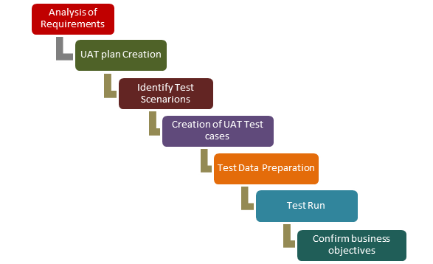
User Acceptance Testing Process
NIHITHA REDDY BHIMIREDDY
Notes:
UAT is done by the intended users of the system or software. This testing usually happens at the client location which is known as Beta Testing.
Analysis of Business Requirements
One of the most important activities in the UAT is to identify and develop test scenarios.
Creation of UAT Plan:
The UAT test plan outlines the strategy that will be used to verify and ensure an application meets its business requirements. It documents entry and exit criteria for UAT, Test scenarios and test cases approach and timelines of testing.
Identify Test Scenarios and Test Cases:
Identify the test scenarios with respect to high level business process and create test cases with clear test steps. Test Cases should sufficiently cover most of the UAT scenarios. Business Use cases are input for creating the test cases.
Preparation of Test Data:
It is best advisable to use live data for UAT. Data should be scrambled for privacy and security reasons. Tester should be familiar with the data base flow.
Run and record the results:
Execute test cases and report bugs if any. Re-test bugs once fixed. Test Management tools can used for execution.
Confirm Business Objectives met:
Business Analysts or UAT Testers needs to send a sign off mail after the UAT testing. After sign-off the product is good to go for production. Deliverables for UAT testing are Test Plan, UAT Scenarios and Test Cases, Test Results and Defect Log
Exit criteria for UAT:
Before moving into production, following needs to be considered:
No critical defects open
Business process works satisfactorily
UAT Sign off meeting with all stakeholders

Slide 12
Best practices for managing the client
Prepare UAT plan early in the project life cycle.
Prepare Checklist before the UAT starts.
Conduct Pre-UAT session during System Testing phase itself.
Set the expectation and define the scope of UAT clearly.
Test End to End business flow and avoid system tests.
NIHITHA REDDY BHIMIREDDY

Slide 13
Best practices(Contd..)
Test the system or application with real world scenarios and data.
Think as an Unknown user to the system.
Perform Usability Testing.
Conduct Feedback session and meeting before moving to production.
NIHITHA REDDY BHIMIREDDY

Slide 14
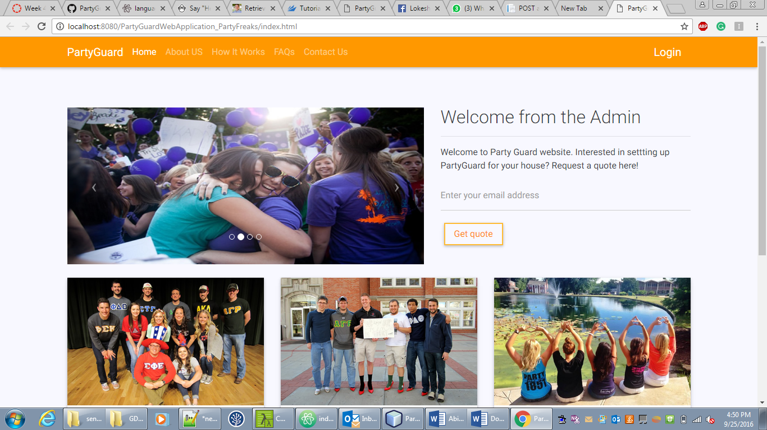
Before User Acceptance
NIHITHA REDDY BHIMIREDDY

Slide 15
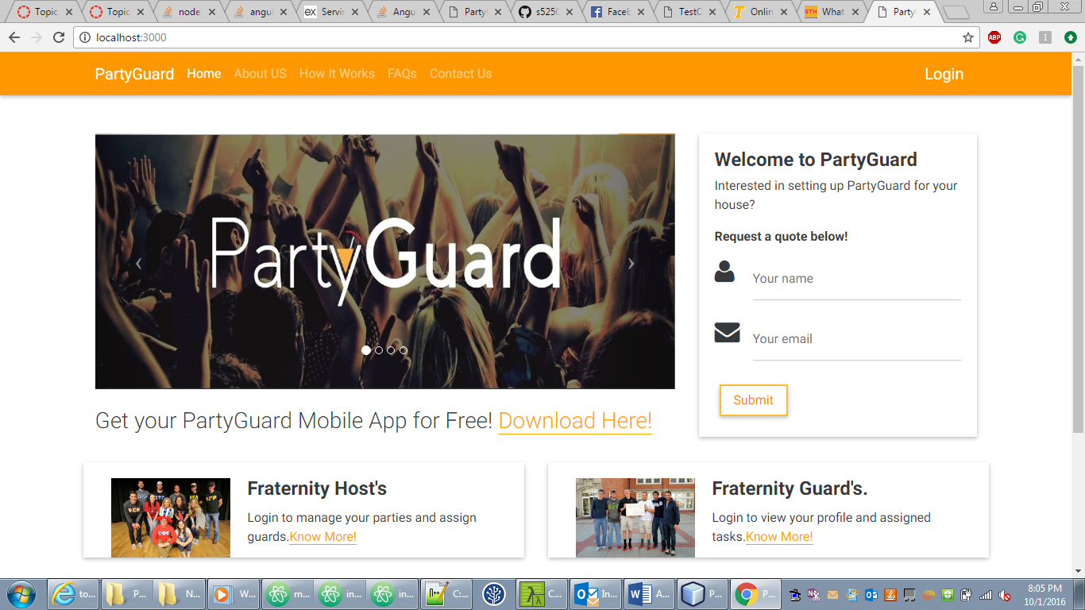
After User Acceptance
NIHITHA REDDY BHIMIREDDY

