Slide 1
PartyGuard Web Application

Slide 2
Party Freaks
Team Members
Prem Abishai Parise
Nihitha Reddy Bhimireddy
Sindhuja Pannala
Srichaitanya Peddinti
Spandana Velaga
Lokesh Reddy Pothapu
Gopinadh Cherupally

Slide 3
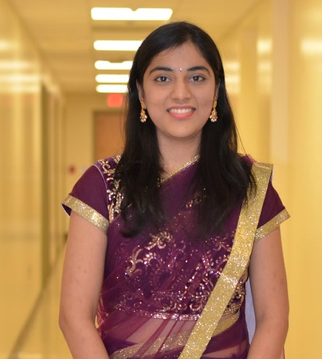
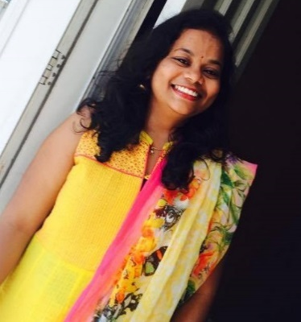
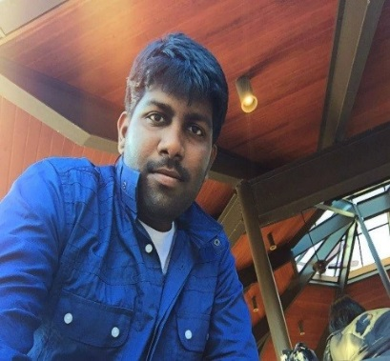
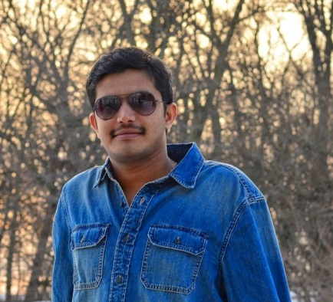
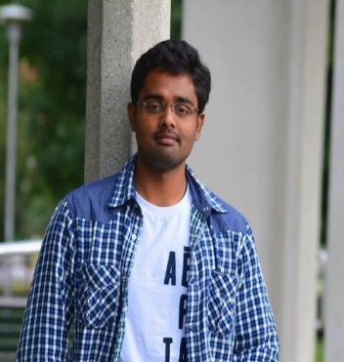
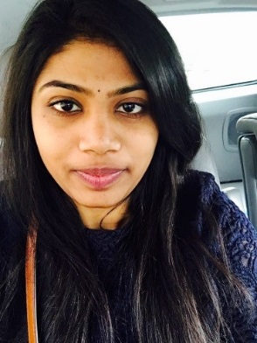
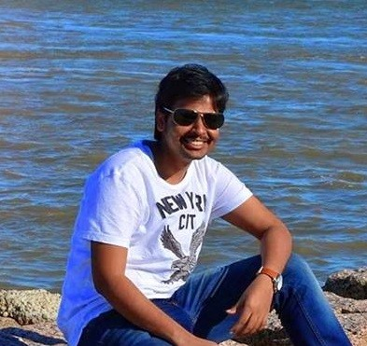
Team Members
Abishai
Sindhuja
Nihitha
Srichaitanya
Spandana
Lokesh
Gopinadh

Slide 4
Team Member Responsibilities
Role | Team Member
Primary Contact | Prem Abishai Parise
Client Management | Nihitha Reddy Bhimireddy
Requirements Management | Lokesh Reddy Pothapu
Data Management | Srichaitanya Peddinti
Issues Management | Sindhuja Pannala
Quality and Testing Management | Spandana Velaga
Communications and Documentation Management | Gopinadh Cherupally

Slide 5
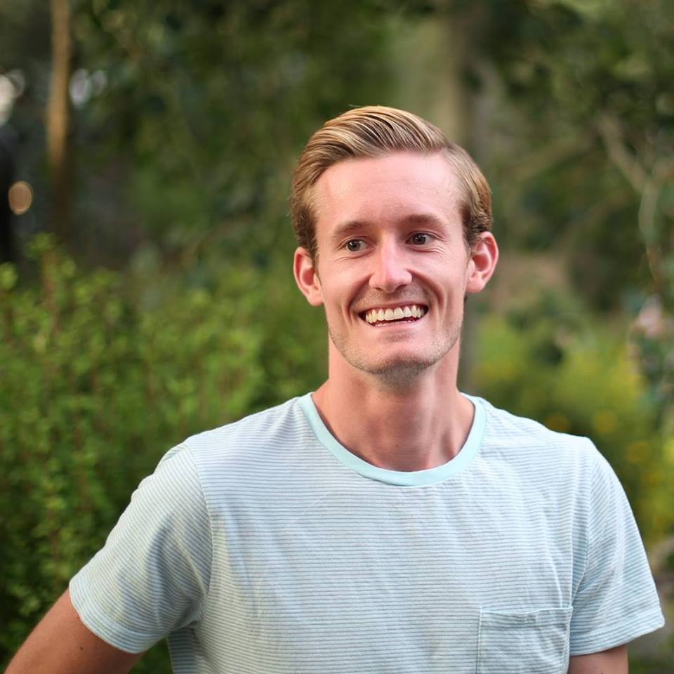
Client Information
Client mission:
To develop a web application for users which will help them to prevent sexual assaults and accidents happening within
Greek life specifically fraternity houses.
Jacob C Stansbury
S516098@mail.nwmissouri.edu

Slide 6
PartyGuard-Web
It is a web application which will be accessible to three kinds of users (i,e Master user, Host user and Basic user)
This application will offer service to subscribed fraternity houses only
Then the subscribed fraternity can use PartyGuard in their social gatherings to create a safe environment
This PartyGuard web application works in coordination with Android application and iOS application

Slide 7




Technology stack

Slide 8

IDE

Slide 9

Build Tool

Slide 10

Version Control

Slide 11

Hosting Service

Slide 12
Teams will be working with
We will be coordinating with the mobile application team
“Invincible Techies” to make sure that our web application
works properly.

Slide 13
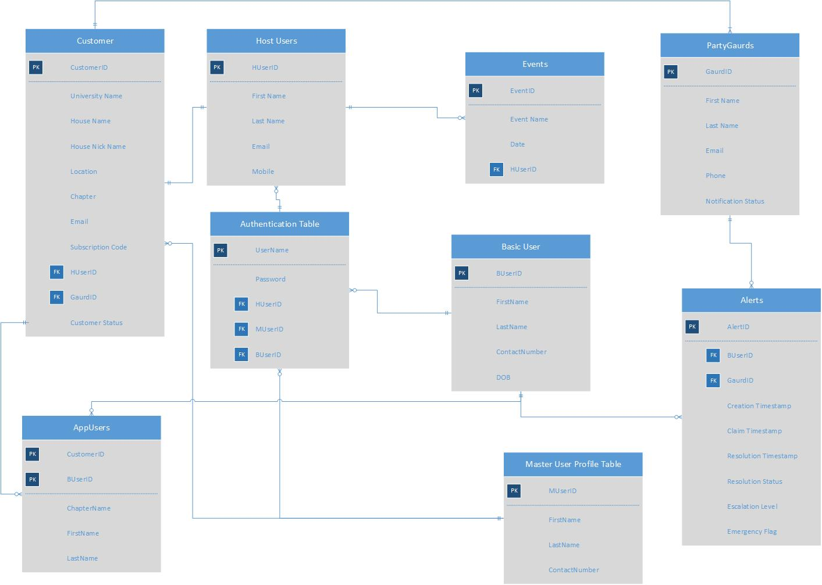
ER Diagram

Slide 14
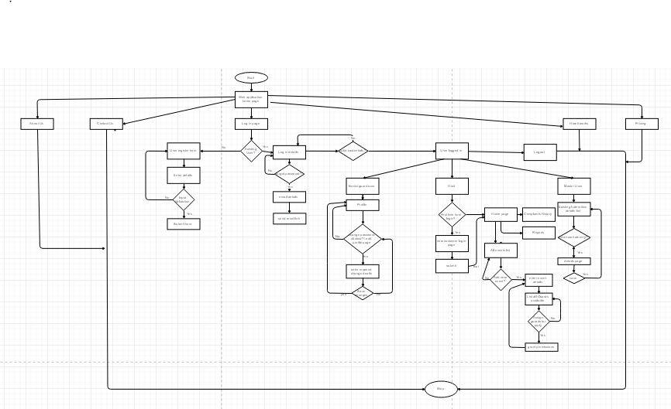
Flow Chart

Slide 15
Use case

Slide 16
Demo

Slide 17
Artifacts
User stories / use cases
Requirements document
Initial UI Web pages

Slide 18
Conclusion
Till now we have worked on
User Interface
Initial database design
Requirements
In future we will work on programming part and the database to provide access to different users and testing the various scenarios to maintain a better website

Slide 19
ThankYou

