Slide 1
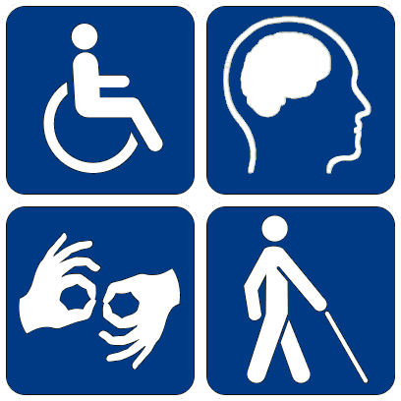
Hack-e-abled (Empowering deaf and dumb people)

Slide 2
Contents
Problem Statement
Objective
How to achieve?
What are gestures
Types of gestures
What is gesture recognition
Types of gesture recognition
Algorithms
Architecture diagram
How it works
Areas where we can use
Future scope

Slide 3
Problem Statement
In our society where we have number of differently abled (impaired hearing and vocally impaired) people who have faced lots of problems in their day to day lives either it’s as common as opening a bank account or to get a railway ticket. It’s very difficult for those people to express their feelings, thoughts and ideas.
As per 2011 Census, there are approx. 15 lacs differently abled people in India.
As we have large scale of these type of people in our community we should take steps to be able to communicate with them to share knowledge ,thoughts ,ideas and even feelings.
Deaf and mute generally communicate using sign language but not all of us understand all signs(gesture). Hence it makes difficult for them to communicate.

Slide 4
Objective
To create an innovative solution to help differently abled (deaf and mute) people of India.
Develop automated system to understand the sign language and convert it into text hence enable them to communicate effectively and independently.

Slide 5
How to achieve?
To achieve our objective we need to create a system that can read, understand and interpret different hand gestures into readable text (Could be text to speech in future as well).
To get the desired results (convert gestures into text or speech), it’s very important to understand what the gestures are and how to gesture recognition technology works.

Slide 6
What are gestures?
Gestures are an important aspect of human interaction, both interpersonally and in the context of machine interface.
Gesture is a form of non-verbal communication in which visible bodily actions communicate particular messages, either in place of speech or text.
Gestures include movement of hands, face or other parts of body.

Slide 7
Types of Gestures
Gesticulation
Spontaneous movements of hands and arms that accompany speech.
Language like gesture
Gesticulation that is integrated into spoken utterance, replacing a particular spoken word or phrase.
Sign languages
Linguistic system, such as American sign language, which is well defined.
Emblems
Familiar gesture like V for victory and thumbs up etc.

Slide 8
What is gesture recognition
Human computer interaction
Gesture provides a way for computers to understand human body language
Deals with the goal of interpreting human gestures via mathematical algorithms
Enables humans to interface with the machine and interact naturally without any mechanical devices.

Slide 9
Types of gesture recognition
Sign language recognition
Facial gesture recognition

Slide 10
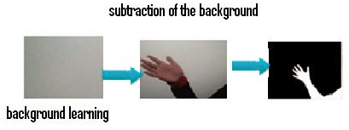
Background Subtraction Algorithm
It works on the principal of take an image as background and take the frames obtained at the time t, denoted by I(t) to compare with the background image denoted by B.
Using simple arithmetic calculations, we can segment out the objects simply by using image subtraction technique of computer vision meaning for each pixels in I(t), take the pixel value denoted by P[I(t)] and subtract it with the corresponding pixels at the same position on the background image denoted as P[B].
In mathematical equation, it is written as: P[F(t)]=P[I(t)]-P[B]}

Slide 11
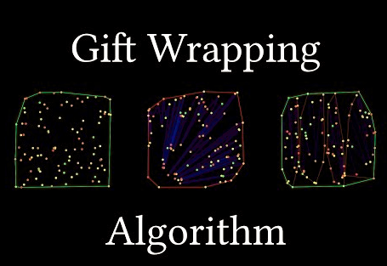
Gift Wrapping Algorithm
This algorithm helps to find the convexhull of the hand
The gift wrapping algorithm begins with i=0 and a point p0 known to be on the convex hull, e.g., the leftmost point, and selects the point pi+1 such that all points are to the left of the line pi pi+1.

Slide 12
High Level System Architecture

Slide 13
Technical Architecture and Algorithms
Hack-e-Abled
Algorithms Used:
Background Subtraction Algorithm
Gift Wrapping Algorithm

Slide 14
What is Hack-e-abled?
An innovative solution to understand impaired hearing and vocally impaired people.
The Objective of Hack-e-abled is to enable deaf and mute to communicate effectively and independently.
This system reads hand gesture using video input and Generates text as output.
*Note: This is just protocol and we identified limited number of gestures as POC.

Slide 15
How it works
Capture the image through camera and converts RGB source image to Grayscale image.
Set ROI (region of interest) using cvSetImageROI function.
Smooth the grayscale image using cvSmooth function.
Threshold the smoothed image by using cvThreshold function.
At last we find contours using contour detection, convex hull of palm region, convexity defects.

Slide 16
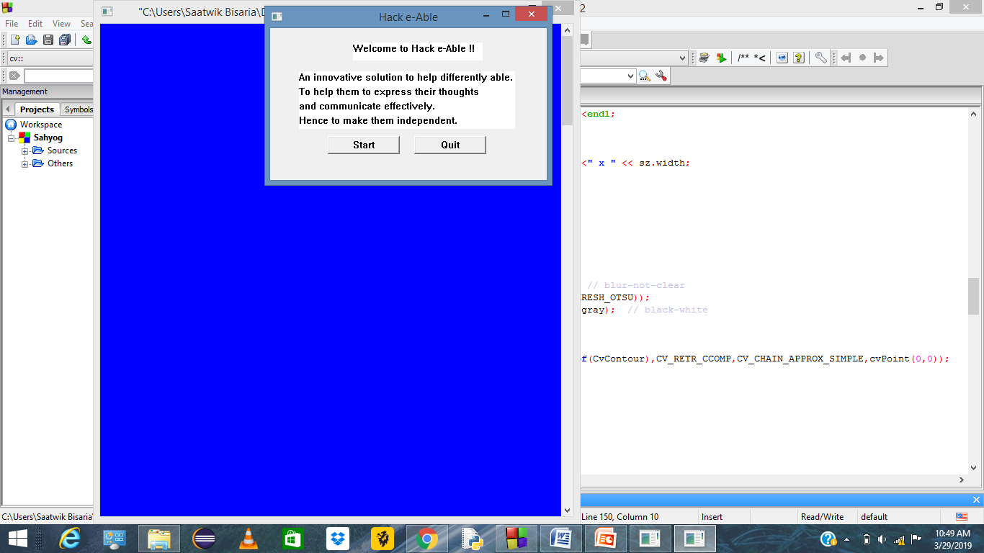
Hack-e-Abled System Screenshots

Slide 17
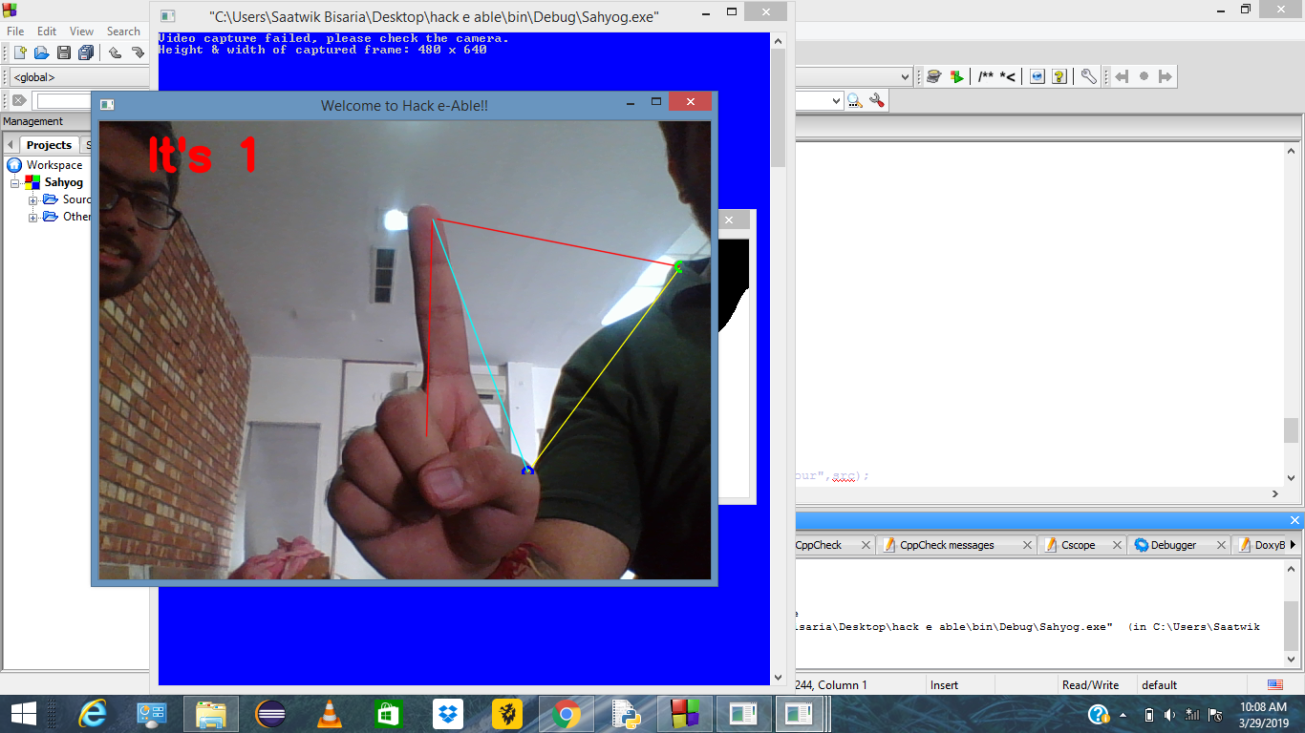
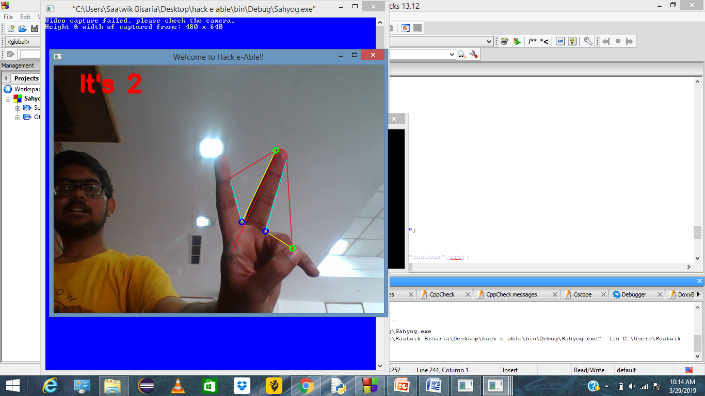
Detect Gestures!!

Slide 18
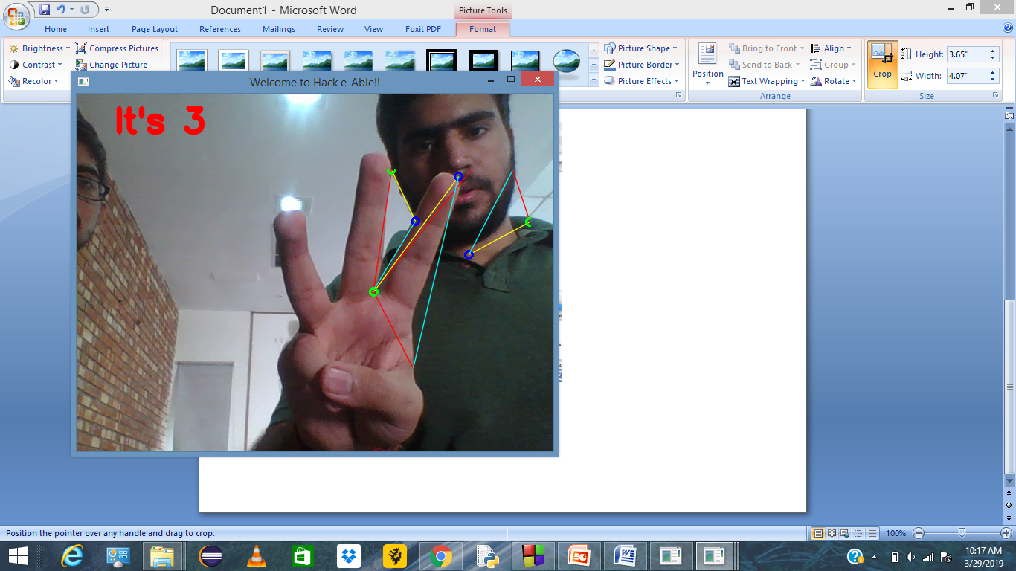
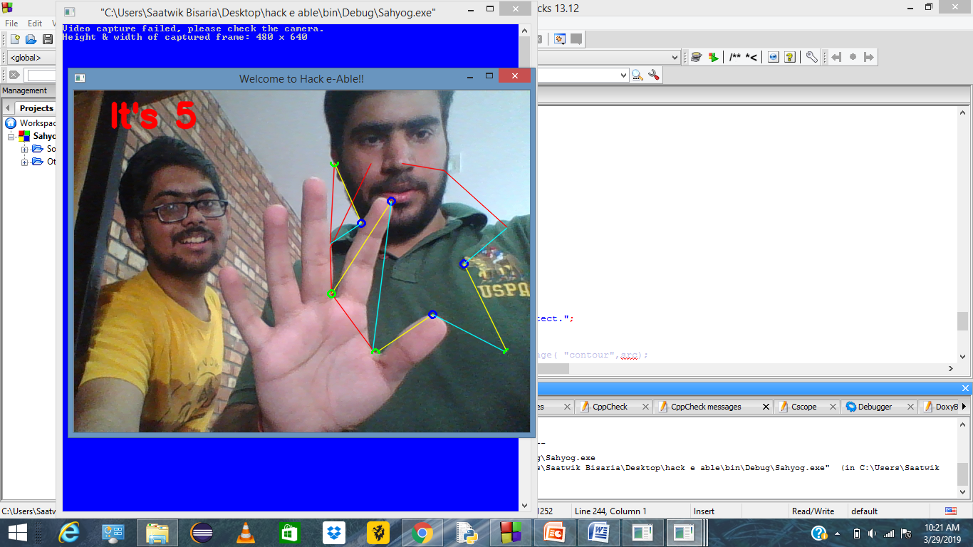

Slide 19
Areas where we can use
Banks
Railways
Airports
Other Public and Private sectors

Slide 20
Future Scope
Add face recognition capability to the program.
Enhance the recognition capability of various conditions.
Achieving more accuracy.
Identifying multiple number of gestures.
Applying gesture recognition for accessing internet applications.
Add ‘text to speech’ conversion to save time of reading the converted text.
Add supervised machine learning in order to recognize domain specific gesture using training database.
Create app so that needy can download on phones and use it anywhere anytime.

Slide 21
Thank you!

