Slide 1

A Holistic Evaluation of 2D Mobile Pose Estimation Models
for Home-Based Rehabilitation
Bachelor Thesis Defense — Eren Demir
First examiner: Prof. Dr. Jürgen Gall · Second examiner: Dr. Björn Krüger · Advisor: Lars Doorenbos
University of Bonn — Institute of Computer Science, Computer Vision Group
July 2026
1
Notes:
Good morning, and thank you for being here. My name is Eren Demir. Today I am
defending my bachelor thesis: a holistic evaluation of 2D mobile pose estimation
models for home-based rehabilitation.
Physiotherapy works when exercises are done correctly and regularly — but most of
it happens at home, unsupervised, and adherence is poor. A smartphone camera with a
pose estimation model could close that gap. So my thesis asks: which of today's
mobile models can you actually trust in a living room? And the answer turned out to
be more interesting than a simple ranking.

Slide 2
Home rehabilitation fails without feedback
Adherence to home exercise programs is poor (Jack et al. 2010)
Non-adherence prolongs recovery and raises costs
A single RGB camera + pose estimation = markerless exercise monitoring — no markers, no suits, no lab
Open question: which mobile model can carry such a system?
Patient exercises at home
Smartphone camera + pose estimation model
Exercise feedback & progress monitoring
2
Notes:
Why does this matter? Studies show that many patients skip their home exercises. And
when they skip them, recovery takes longer and costs go up.
Pose estimation offers a practical solution. A single RGB camera — the one in every
smartphone — can estimate where the body joints are. No markers, no suits, no lab
needed. [aufs Diagramm zeigen] The patient exercises at home. The camera and the
model watch. The system gives feedback and tracks progress.
The open question is the model itself: which mobile pose estimator can actually
carry such a system? That is the question of this thesis.

Slide 3
Four deployment constraints that standard benchmarks do not cover
Camera positioning
Patients rarely face the camera frontally — oblique and lateral views, self-occlusion
Multi-person interference
Family members or a therapist enter the frame — the target subject must be retained
Temporal stability
Real-time video feedback needs stable predictions — jitter ruins usability
Resource constraints
No GPU at home — usable throughput on CPU is required
COCO and MPII do not combine these conditions → the comparison has to be made on rehabilitation-style data
3
Notes:
There are already benchmarks for pose estimation. COCO and MPII rank models every
year. However, those benchmarks answer a different question. Home rehabilitation has
four conditions they do not cover.
[Boxen nacheinander] One: camera position. Patients rarely position themselves
frontally — you get oblique and side views, and self-occlusion. Two: other
people. A family member or a therapist walks into the frame — and the system must
keep tracking the right person. Three: stability over time. Feedback runs on
video. If the skeleton jitters from frame to frame, the feedback feels broken.
Four: hardware. There is no GPU in a living room. The model must run on a normal
CPU.
These four constraints define the evaluation — each one becomes a measured
dimension. Together with accuracy and completeness, that gives six dimensions, and I
will go through them one by one.

Slide 4
Five research questions
RQ1
How accurate and complete are the models on rehabilitation data with MoCap ground truth?
RQ2
How temporally stable are their predictions?
RQ3
How robust are they under suboptimal conditions — body orientation and multi-person interference?
RQ4
How far do rankings transfer to a standard benchmark (COCO)?
RQ5
What practical trade-offs and recommendations follow for deployment?
4
Notes:
Formally, this gives five research questions. You can read them simply as: how
good, how stable, how robust, does it transfer — and what should we deploy. I will
answer all five by the end.

Slide 5
The scope of this evaluation
9 model configurations
three families, three variants each — one shared protocol
1.1 million CPU inference runs
122,400 sampled frames × 9 configurations, plus COCO
6 quality dimensions, 2 benchmarks
accuracy · stability · viewpoint · multi-person · completeness · speed — plus COCO transfer
3 landmark systems unified
33, 17, and 26 joints mapped onto one shared 12-joint skeleton
Not a new model — a decision basis that did not exist before
5
Notes:
Before the setup, one slide on the scope. Nine model configurations — three
families, three variants each — all under one shared protocol. That meant over
1.1 million inference runs, all on CPU. Six quality dimensions, plus a
cross-dataset check on COCO. And to make the models comparable at all, three
different landmark systems — 33, 17, and 26 joints — had to be unified into one
shared 12-joint skeleton.
In short: not a new model — a decision basis that did not exist before.

Slide 6
Three models, three architectural paradigms
Top-down
Bottom-up
One-stage
MediaPipe Pose (BlazePose)
detect person → crop → estimate pose
Most precise per person (full-res crop)
Cost grows with person count
Depends on the upstream detector
33 native landmarks
MoveNet (MultiPose)
one full-image pass → keypoints grouped via person centers
Cost independent of person count
Grouping is the weak spot
17 COCO keypoints + boxes
YOLOv8-Pose
object detector with a pose head
Box + 17 keypoints in one shot
Best speed integration
No high-resolution per-person zoom
Selection criteria: CPU real-time capability · mature deployment ecosystem · paradigm coverage (+ 6 family variants)
6
Notes:
These are the three candidates. Each one represents one of the three main ways to
build a pose estimator.
[links] MediaPipe is top-down. Two stages: first a detector finds the person.
Then the image is cropped, and a second network estimates the pose on that crop.
Because it sees the person in full resolution, it is very precise per person. The
price: the cost grows with every person in the image. And everything depends on the
detector — no detection means no pose. It also gives 33 landmarks, more than the
others.
[Mitte] MoveNet is bottom-up. One single pass over the whole image. It predicts
person centers as a heatmap, and gets the keypoints from those centers. No cropping,
no second network. The cost stays the same no matter how many people are in the
image. The weak spot: grouping — deciding which keypoints belong to which person.
Internally, MoveNet refines each keypoint with full-image heatmaps, weighted towards
the person center — a detail that becomes relevant in the multi-person analysis
later.
[rechts] YOLOv8-Pose is one-stage. It is an object detector with an extra pose
head. Every detection comes out with its box and all 17 keypoints — in one shot. Fast
and simple. But it has no high-resolution zoom on the person, like top-down has.
I selected by three criteria: real-time on CPU, a mature ecosystem, and this paradigm
coverage — because it lets me connect behavior to architecture later. Six family
variants join the comparison as well.

Slide 7
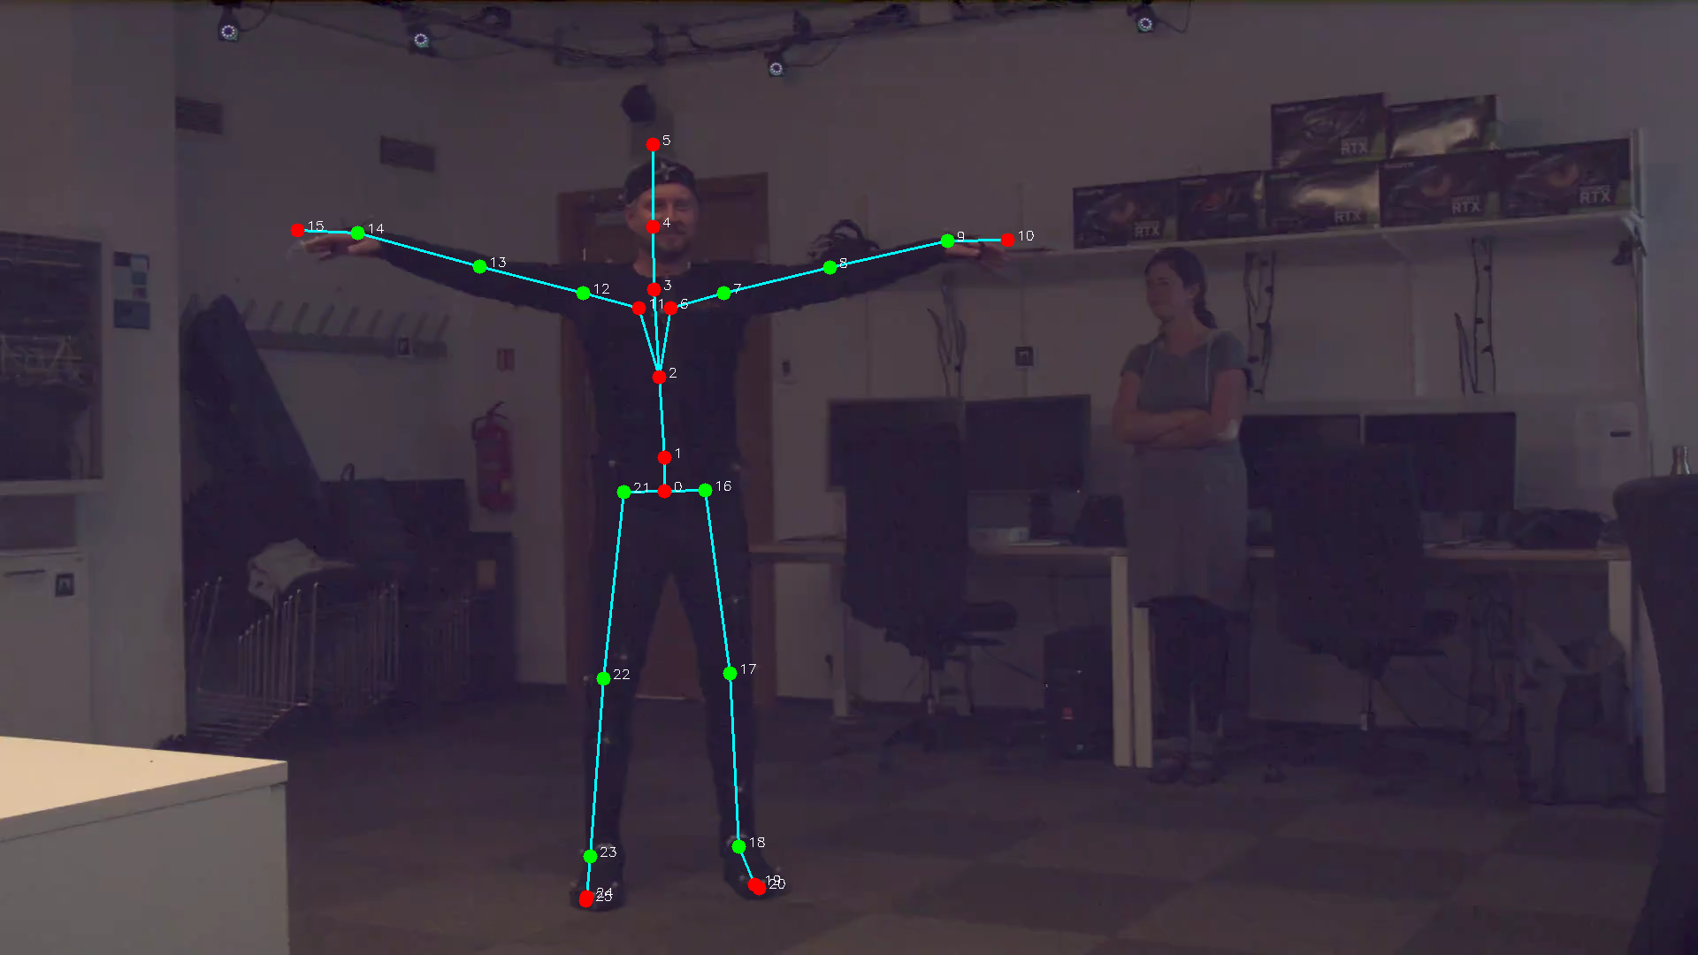
REHAB24-6: a rehabilitation-oriented proxy benchmark
10 healthy adults (6 m / 4 f, age 25–50)
6 physiotherapist-guided exercises, 1,072 repetitions
2 synchronized RGB views (c17 frontal, c18 lateral)
Ground truth: 41-marker MoCap → 26-joint skeleton → projected to 2D
63 recordings → 126 camera-view sequences
Green = 12 evaluated joints (shared skeleton)
A proxy testbed for rehabilitation-style movement analysis — not clinical validation
7
Notes:
The testbed is REHAB24-6 — a public benchmark of real physiotherapy exercises. Ten
healthy adults. Six exercises, guided by a physiotherapist. There are two
synchronized cameras — one roughly frontal, one roughly lateral.
The key feature is the ground truth. [aufs Bild] The subjects wore motion-capture
suits with 41 markers. From those, the system derives a skeleton and projects it into
the camera image. So for every frame, I know where every joint really was. The
green dots are the 12 joints all models share — shoulders, elbows, wrists, hips,
knees, ankles. Those 12 are what I evaluate.
Of course, this ground truth has its own error sources — marker placement, the
skeleton model, the projection into the image. That is exactly why I use it as a fair
comparison basis: all models are measured against the same reference.
[auf die Person im Hintergrund zeigen] And note the second person in the background —
this becomes relevant later.
One important qualification: this is a proxy benchmark with healthy volunteers,
not a clinical cohort. So it is a rehabilitation-oriented testbed — not clinical
validation. I will come back to that at the end.

Slide 8
A fixed evaluation protocol isolates the models
Video
(every 3rd frame, 10 Hz)
Frame-independent inference
(no tracking, no smoothing)
Person selection
(largest instance)
12-joint mapping
(33 / 17 / 26 → 12)
Joint filter
(confidence ≥ 0.5)
NMPJPE + displacement
NMPJPE = mean joint error / ground-truth torso length (×100%)
scale-free — comparable across subjects, camera distances, resolutions
Why frame-independent? We evaluate models, not pipelines.
8
Notes:
To compare fairly, every model runs through one fixed protocol. [Pipeline entlang]
We take every third frame — 10 frames per second. Every model sees every frame
independently. No tracking, no smoothing, no memory. If a model detects more than
one person, the pipeline selects the largest one — the most prominent person, like a
real app would. All predictions are mapped to the same 12 joints. Joints with
confidence below 0.5 are dropped — so unreliable guesses do not distort the accuracy
numbers. Then we compute the metrics.
The main metric is NMPJPE — normalized mean per joint position error. In plain
terms: the average distance between predicted and true joint positions, divided by
the person's torso length. So it is an error in percent of body size — comparable
across people, distances, and resolutions.
The evaluation is frame-independent because I evaluate models, not pipelines.
Smoothing and tracking — such as a Kalman filter — can be added on top of any model,
but they would mix engineering into the model comparison.

Slide 9
Frames lie about sample size — honest statistics
367,000 frames — but frames of one person are not independent
aggregate to 10 subject clusters
Only ten data points per model
exact permutation test: all 1024 sign flips, no distribution assumptions
Three pairwise comparisons
Holm correction controls false alarms
Significant ≠ large
bootstrap confidence intervals for effect size
+ auxiliary COCO val2017 comparison — different protocol, kept descriptive
9
Notes:
One slide on the statistics — each choice here solves a specific problem. [Zeilen
entlang] We have 367,000 frame observations — but frames of the same person are not
independent. So the analysis aggregates to ten subject clusters: the median error
per sequence, averaged per person.
On these cluster differences I run paired permutation tests. For me, that is the
natural choice: with only ten data points, I cannot rely on distribution assumptions
— and a permutation test needs none. Even better: at this sample size, the test is
exact — all 1024 combinations can simply be checked.
Because I compare three model pairs, Holm correction keeps the false-alarm rate
under control. And bootstrap confidence intervals add the second half of the
answer: not just whether a difference is real, but how large it is. As a sensitivity
check, I repeated the analysis on the video level — the ranking stays the same.
That completes the setup: six dimensions, nine model configurations, one fixed
protocol. Now to the results.

Slide 10
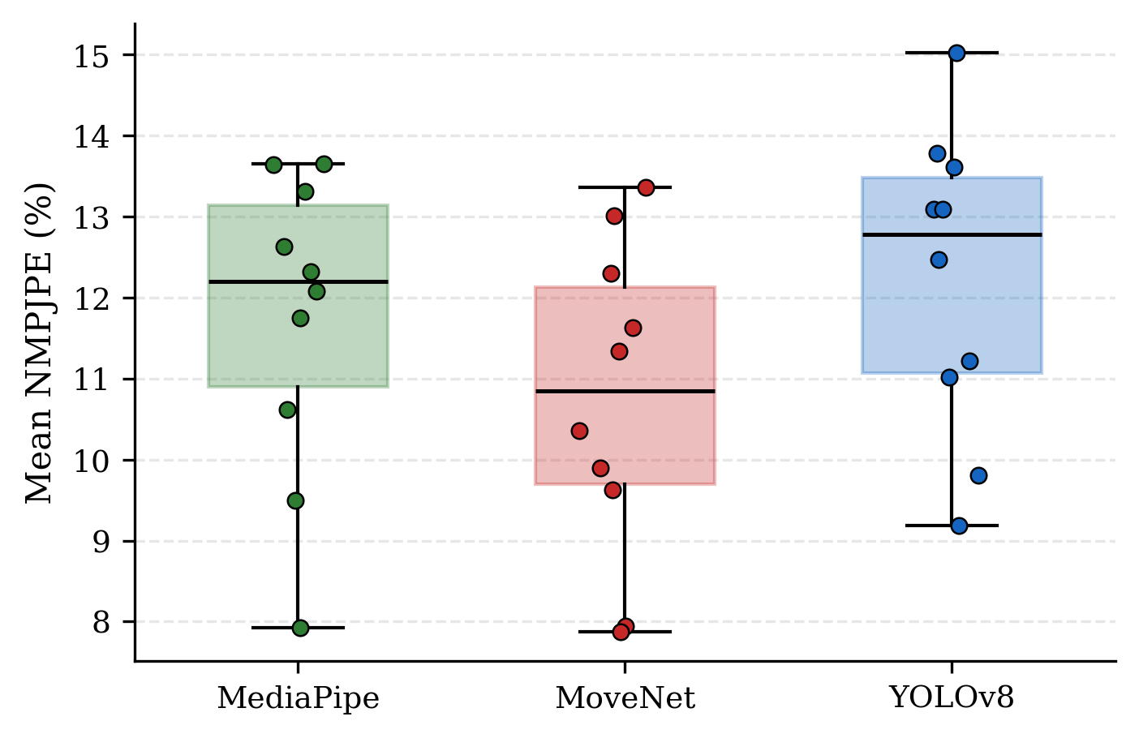
DIMENSION 1 OF 6 — BODY-JOINT ACCURACY
MoveNet is the most accurate — significant in all 10 subject clusters
Mean NMPJPE (valid subset):
MoveNet 10.52%
MediaPipe 12.53%
YOLOv8 12.77%
All pairwise differences survive Holm correction
MoveNet wins in all 10 clusters — p = 2/1024, the exact-test minimum
First on all 6 exercises
10
Notes:
Dimension one: accuracy. [Boxplot] Every dot here is one person — their average error
over all their videos. MoveNet: 10.5 percent. MediaPipe: 12.5. YOLOv8: 12.8.
And this is consistent across subjects: MoveNet's whole distribution sits below the
other two. In fact, MoveNet wins in every single cluster, against both
competitors — the strongest outcome the exact test can produce. All differences
survive Holm correction, and MoveNet is first on all six exercises.
So on accuracy: a clear winner.

Slide 11
DIMENSION 1 OF 6 — ACCURACY BY BODY REGION
The errors are not uniform — MediaPipe's hips stand out
Region
MediaPipe
MoveNet
YOLOv8
MediaPipe wins only the shoulders
MoveNet leads everywhere else
Hips: 16.7% vs. 11.3% — a concentrated problem, not general weakness
Excluding hips shrinks the MediaPipe–MoveNet gap by ~40% (2.0 → 1.2 pp)
Consistent with a landmark-definition mismatch — indirect evidence
Shoulders
8.8%
10.3%
10.2%
Elbows
11.2%
10.0%
13.1%
Wrists
12.0%
11.8%
16.3%
Hips
16.7%
11.3%
14.6%
Knees
9.9%
7.8%
9.9%
Ankles
14.6%
11.4%
12.6%
11
Notes:
One level deeper: where do these errors actually sit? [Tabelle] Not uniformly.
MediaPipe is actually the best model on the shoulders. MoveNet leads everywhere
else. But look at the hips: MediaPipe is at seventeen percent — against eleven for
MoveNet. That is a concentrated problem, not general weakness.
And there is a plausible reason: every model family defines the hip slightly
differently. MoveNet and YOLO are trained on COCO annotations. MediaPipe on Google's
own landmark scheme. And my ground truth is the motion-capture joint center — a third
convention. If I remove the hips, MediaPipe's gap to MoveNet shrinks by about forty
percent. So part of this is likely a definition mismatch, not a perception
failure — the evidence is indirect, and the thesis marks it that way.

Slide 12
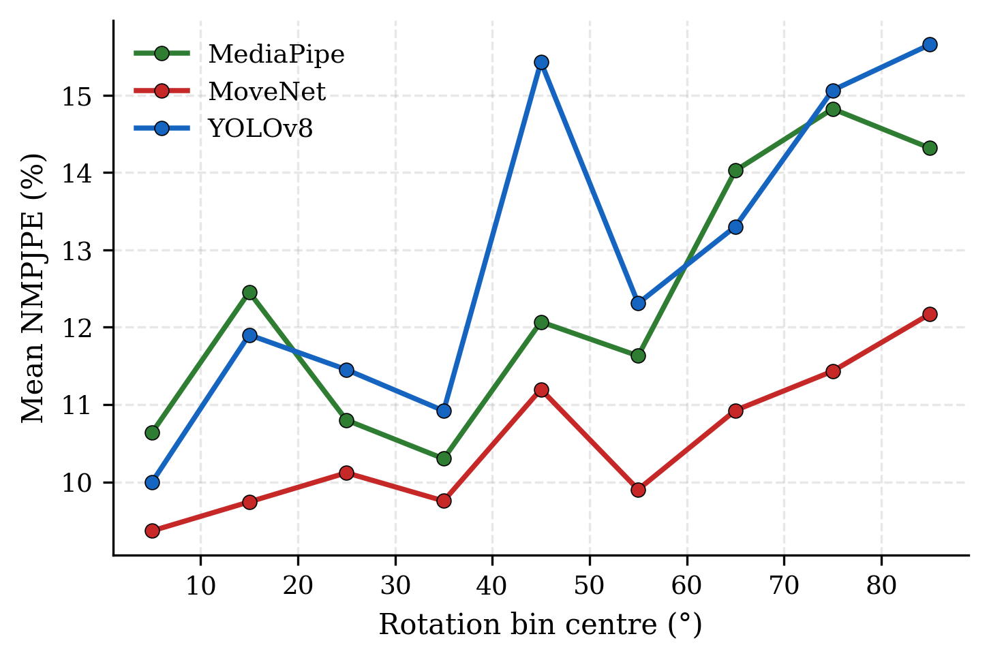
DIMENSION 2 OF 6 — VIEWPOINT SENSITIVITY
All models degrade on lateral views — MoveNet the least
Frontal (0–20°) → lateral (60–90°):
MoveNet 9.75% → 11.49% (+17.8%)
MediaPipe 11.28% → 14.38% (+27.5%)
YOLOv8 11.14% → 14.66% (+31.7%)
Orientation from 3D MoCap shoulders — no circularity
Fixed camera geometry, bimodal viewpoints — a viewpoint comparison, not a dense rotation study
12
Notes:
Dimension two: what happens when the patient turns sideways? All models get worse —
side views mean self-occlusion. But not equally: MoveNet degrades by 18 percent,
MediaPipe by 28, YOLOv8 by 32. One note on the method: the body angles come from the
3D motion capture, calibrated to each camera — not from the predictions, so model
errors cannot distort this analysis. Again: MoveNet.

Slide 13
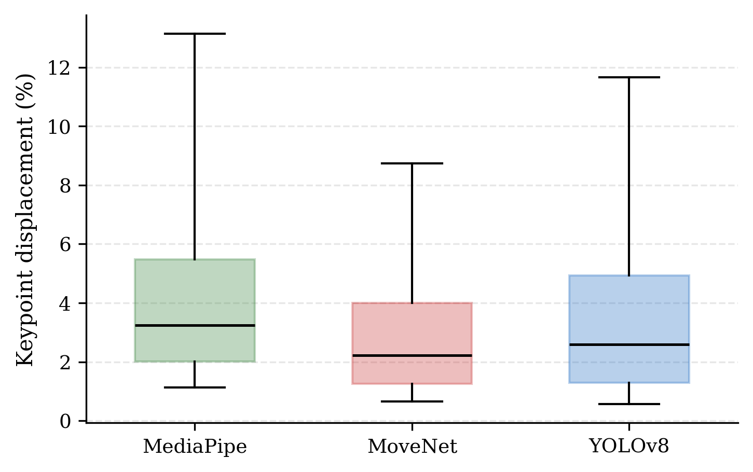
DIMENSION 3 OF 6 — TEMPORAL STABILITY
MoveNet is also the most stable — the whole family leads
Frame-to-frame displacement (% torso):
MoveNet 3.81%
YOLOv8 5.22%
MediaPipe 6.03%
Across all nine variants, the MoveNet family takes the top three (3.31 / 3.61 / 3.81)
Raw, unsmoothed outputs — true motion is identical across models, so differences isolate prediction noise
13
Notes:
Dimension three: temporal stability. Here I measure how much the predictions move
between two consecutive frames — the normalized frame-to-frame displacement, in
percent of torso length. This runs on raw outputs, without any smoothing. And since
the true motion is the same for every model on the same frames, whatever differs
between the models is prediction noise.
The result: MoveNet 3.8 percent. YOLOv8 5.2. MediaPipe 6.0. Across all nine variants,
the whole MoveNet family takes the top three — so this stability comes from the
architecture itself, not from any filter.

Slide 14
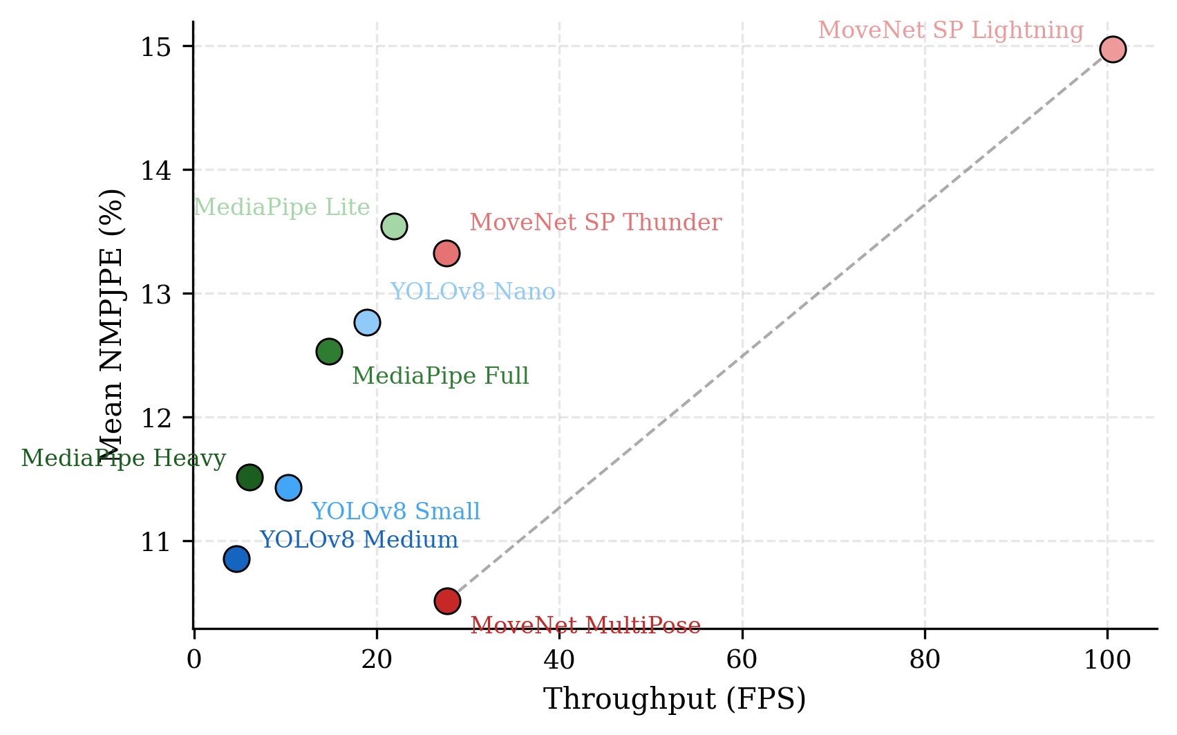
DIMENSION 4 OF 6 — CPU INFERENCE SPEED
MoveNet leads on speed — family accuracy gains cost real latency
CPU throughput (main configs):
MoveNet MultiPose 27.7 FPS
YOLOv8 Nano 18.9 FPS
MediaPipe Full 14.7 FPS
Fastest: MoveNet SP Lightning — 100.6 FPS
Accuracy leaders pay: MediaPipe Heavy 6.0 · YOLOv8 Medium 4.6 FPS
14
Notes:
Dimension four: CPU speed. [Scatter] This is the accuracy-speed landscape of all nine
variants. Down and right is better. Among the main models, MoveNet leads with about
28 frames per second. YOLOv8: 19. MediaPipe: 15. If you only need speed, MoveNet
SinglePose Lightning reaches 100 FPS. The bigger variants pay a real price: MediaPipe
Heavy and YOLOv8 Medium reach better accuracy, but at 6 and 5 FPS — below real time.
The scatter also shows the families themselves. Within each family, more parameters
buy accuracy and cost speed. And one surprise: MoveNet MultiPose beats both
SinglePose variants. One plausible reason: SinglePose models expect one centered
person — and in frame-independent mode, the subject is small in their input. That
makes MultiPose the only configuration on the efficiency frontier, together with
Lightning.
[Pause. Langsam:] At this point, MoveNet leads in all four dimensions: accuracy,
viewpoint, stability, speed. The remaining two dimensions change that picture.

Slide 15
DIMENSION 5 OF 6 — DETECTION COMPLETENESS
YOLOv8 delivers the complete skeleton most often
YOLOv8
79.1%
MediaPipe
55.1%
MoveNet
38.2%
Share of frames with all 12 evaluated joints after confidence filtering
First dimension with a different winner — the profiles start to separate
15
Notes:
Dimension five: how often does a model deliver the complete 12-joint skeleton?
Here, the order flips. YOLOv8: 79 percent of frames. MediaPipe: 55. MoveNet — the
accuracy leader — only 38. If your application needs every joint in every frame, the
winner just changed.

Slide 16
DIMENSION 6 OF 6 — MULTI-PERSON BEHAVIOR
A second person in frame is harmless — until it is the coach
Dataset-wide multi-person subset
(metadata severity ≥ 2, ~10,000 frames per model)
Accuracy barely changes:
MediaPipe +1.2% · MoveNet −5.0% · YOLOv8 −4.4%
(composition effects — not causal)
Coach extreme case
(5 sequences with a persistently visible therapist)
Catastrophic person switches appear —
outlier rates 9.1% / 13.8% / 13.9%
(MediaPipe / MoveNet / YOLOv8)
Multi-person behavior must be decomposed into two regimes — averaging them away hides the real deployment risk
16
Notes:
Dimension six: other people in the frame. This question has two very different
answers, so I analyzed it in two parts. [links] First, the broad view: in all frames
where a second person is somewhere visible, accuracy barely changes — just having
another person in the frame is not a problem. [rechts] But five recordings are
different: there, the therapist stands prominently in the picture — the situation I
showed on the benchmark slide. In this coach scenario we see catastrophic
failures: the model switches to the wrong person. These are two different regimes —
and if you average over both, you hide the real deployment risk.

Slide 17
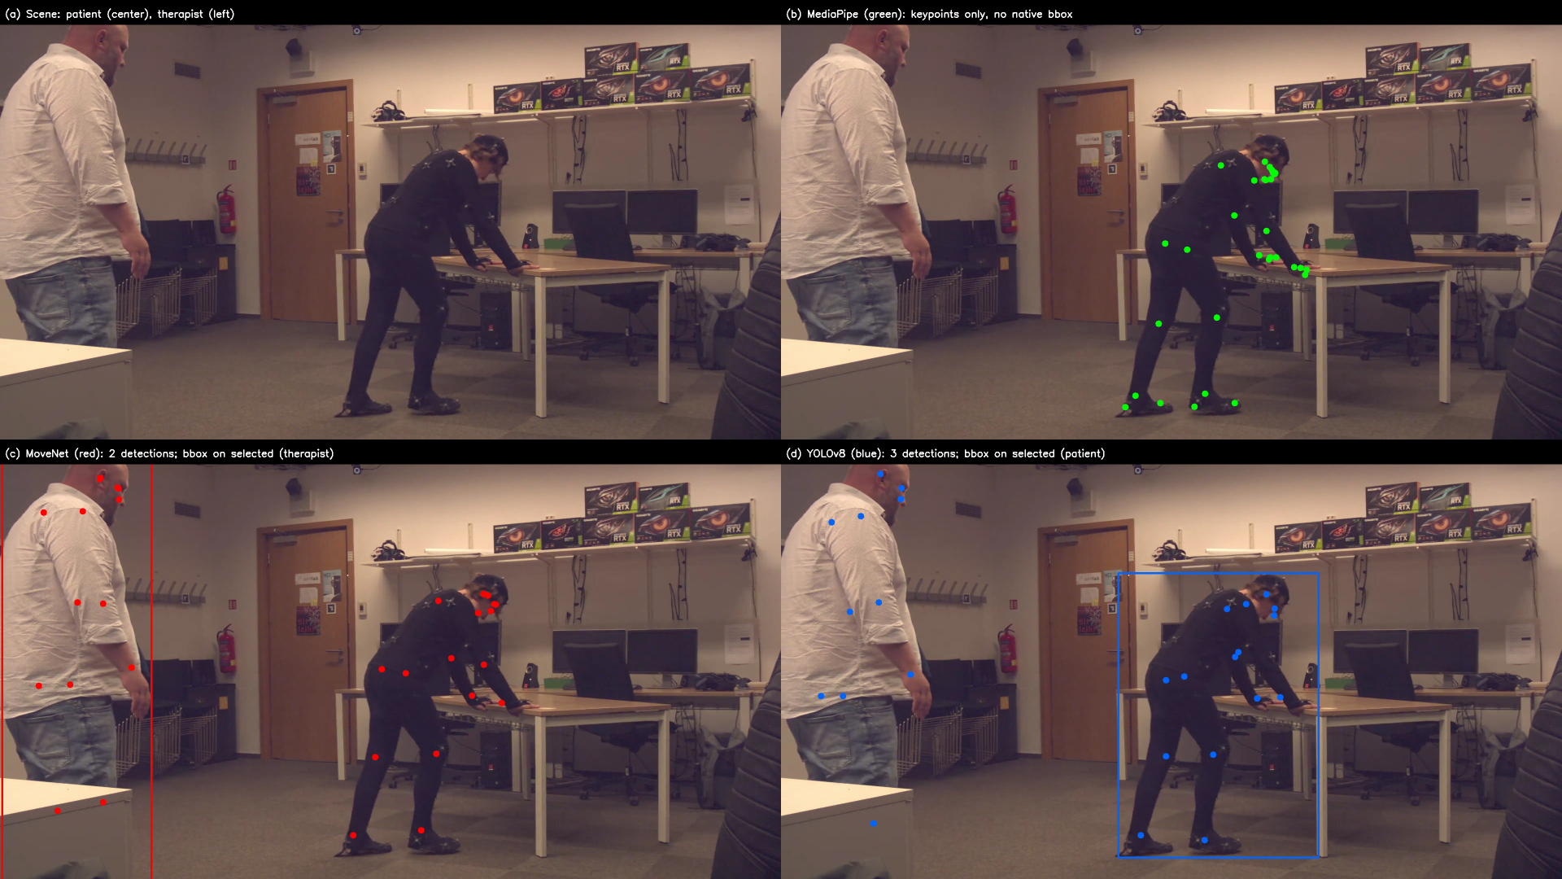
One frame, three behaviors
2+ persons detected: MediaPipe 23% · MoveNet 16% · YOLOv8 62% | coach outlier rate: 9.1% · 13.8% · 13.9%
17
Notes:
Let me show you one coach frame — the same moment, three models. [Panel b] MediaPipe
finds only the patient. The therapist does not even appear. [Panel c] MoveNet detects
both people — detection works — but its selection rule puts the box on the
therapist. That is a selection failure, not a detection failure — this
distinction matters. [Panel d] YOLOv8 detects three candidates — and still picks the
patient correctly.
One frame, three completely different behaviors. MediaPipe reports a second person in
23 percent of coach frames. MoveNet: 16. YOLOv8: 62. And the catastrophic failure
rates: 9, 14, and 14 percent.

Slide 18
The obvious explanation fails — in three steps
MediaPipe vs. YOLOv8
MediaPipe reports a 2nd person in 23% of frames, YOLOv8 in 62% — more detections, more failures
consistent with a detection-level explanation
MediaPipe vs. MoveNet
MoveNet detects the 2nd person LESS often (16% < 23%) yet fails MORE (13.8% > 9.1%)
breaks the explanation — mechanism beyond detection frequency
MoveNet vs. YOLOv8
4× difference in 2nd-person detections (16% vs. 62%)
nearly identical failure rates (13.8% vs. 13.9%)
Detection count alone does not explain coach robustness — the residual mechanism sits at the selection stage and is left open
18
Notes:
These numbers point to one central finding of this thesis. The intuitive explanation
would be: models that detect the second person more often also fail more often.
The three pairwise comparisons put this to the test.
[Zeile 1] MediaPipe versus YOLOv8: 62 percent versus 23 — more detections, more
failures. This pair is consistent with the explanation.
[Zeile 2] But MediaPipe versus MoveNet is not. MoveNet reports the second person in
only 16 percent of frames — less than MediaPipe — so it should be safer. Instead, it
fails more: 13.8 versus 9.1 percent. Here the explanation fails.
[Zeile 3] And MoveNet versus YOLOv8 confirms this: four times more detections, yet
nearly identical failure rates.
The conclusion: detection count alone does not explain coach robustness. The
mechanism must sit deeper — at the selection stage, in how candidates are kept and
chosen. Since the models do not expose those internals, the thesis names the
candidates and leaves the mechanism open.

Slide 19
One video breaks all three — no selection strategy is perfect
Coach sequence
MediaPipe
MoveNet
YOLOv8
Mean coach NMPJPE per video (before outlier cut)
PM_010-c17
81.9%
70.7%
69.9%
PM_011-c17
38.0%
59.7%
66.2%
PM_108-c17
17.2%
46.2%
51.1%
PM_119-c17
24.1%
74.0%
73.0%
PM_121-c17
30.9%
60.3%
75.3%
In four of five videos, MediaPipe stays below 40% — but PM_010 breaks all three models. MediaPipe is the most robust — not immune.
19
Notes:
One more honest look at those five coach videos — they are not all equal. [Tabelle]
In four of them, MediaPipe stays below 40 percent error, while the others fail. But
one video — PM 010 — breaks all three models, including MediaPipe: over 65
percent error everywhere.
So: no selection strategy is perfect. MediaPipe is the most robust of the three — but
not immune.

Slide 20
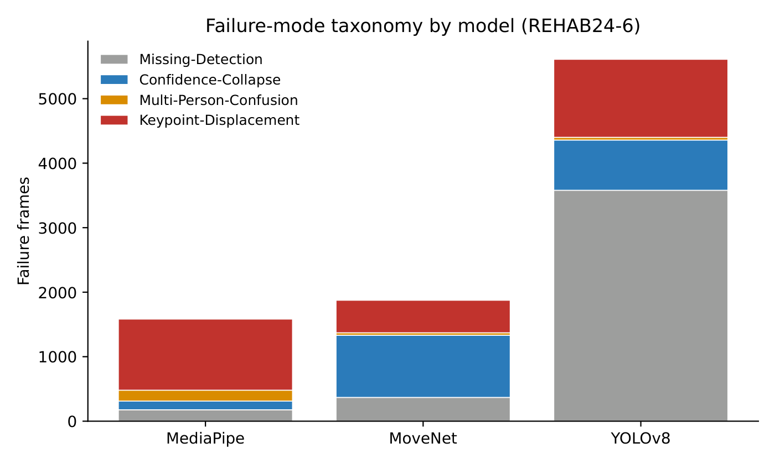
Each architecture fails in its own way
MediaPipe → Keypoint-Displacement
confident misprediction — 69.6% of 1,583 failures
MoveNet → Confidence-Collapse
graceful degradation — 51.4% of 1,875
YOLOv8 → Missing-Detection
no detection at all — 63.8% of 5,610 (≈20× MediaPipe's no-detection rate)
Consistent with each paradigm's design logic — observational, one family per paradigm
20
Notes:
The failure analysis completes the picture. I classified every failure frame into
four categories — and each model is dominated by a different one. MediaPipe's
dominant category is Keypoint-Displacement — confident misprediction: wrong
keypoints, high confidence. MoveNet's is Confidence-Collapse — graceful
degradation: it filters its own joints out instead of guessing. YOLOv8's is
Missing-Detection — no person, no pose — and it has the largest failure count
overall.
So the pattern is: commit-then-predict. Graceful degradation. All-or-nothing. Each
signature matches the design logic of its paradigm. I report this as an
observational correspondence — with one model family per paradigm, I cannot
separate architecture from training data. But as a hypothesis, it is consistent.

Slide 21
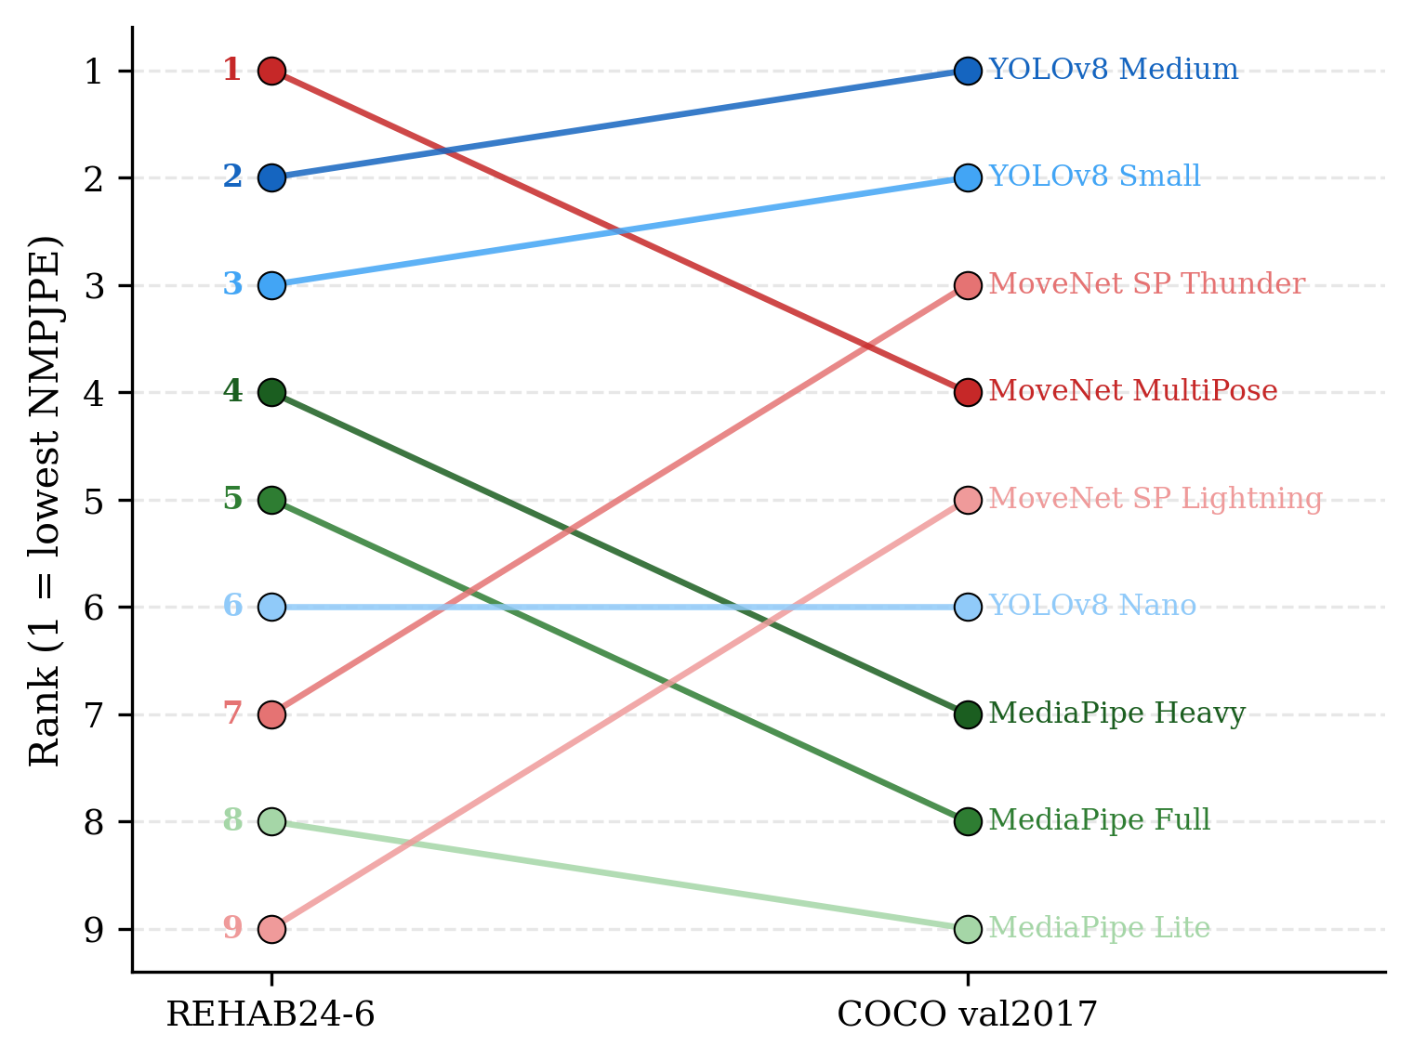
Rankings only partially transfer to COCO
REHAB #1 MoveNet → COCO #4
COCO #1: YOLOv8 Medium
MediaPipe drops sharply (5 → 8)
Main models: MoveNet first on both; MediaPipe & YOLOv8 swap
Different protocol → limited transferability, not benchmark invalidity
21
Notes:
One final check before the synthesis. REHAB24-6 was my main benchmark. But would a
standard benchmark give the same answer? To test that, all nine variants also ran on
COCO — as an auxiliary comparison, accuracy only.
And the answer is: only partially. [Slopegraph] Look at MoveNet MultiPose, the winner
on REHAB — on COCO it falls back to rank four. The new leader there is YOLOv8 Medium,
and MediaPipe falls even further. If we only look at the three main models, the
picture is calmer: MoveNet stays in front on both datasets, and MediaPipe and YOLOv8
simply swap places.
Now, why am I careful with this conclusion? Because the two evaluations don't just
use different data — they also follow different rules. On COCO there is no patient.
So I cannot let the pipeline pick the most prominent person — I have to match each
prediction to the person that was annotated. And that means: when the rankings shift,
I cannot say how much of that comes from the new domain, and how much from the
different rules. So I keep the claim modest: rankings transfer only partially. But
even that has a practical message — a COCO leaderboard alone would not tell you which
model to deploy for rehabilitation.

Slide 22
Three architectural profiles — not one ranking
MediaPipe — filtered top-down
MoveNet — low-exposure bottom-up
YOLOv8 — high-sensitivity one-stage
Lowest coach failure rate (9.1%)
33 native landmarks, simple API
— but slower (14.7 FPS) and weakest hips (16.7%)
Best accuracy (10.5%)
Lowest displacement (3.8%)
Highest main-model FPS (27.7)
— but lowest completeness (38%) and not the safest in coach scenes
Most complete detections (79%)
Most stable across datasets
— but detects other people most often (62%), weakest viewpoint robustness
Which model is right depends on which dimension your application cannot afford to lose
22
Notes:
So — back to the original question: which model for home rehabilitation?
The honest answer of six dimensions: there is no single winner. There are three
architectural profiles — one for each of the three paradigms from the beginning.
[Spalten] MediaPipe, the filtered top-down profile: safest
around the coach, richest landmarks — but slower, and weak hips. MoveNet, the
low-exposure bottom-up profile: best accuracy, stability, and speed — but the least
complete skeletons. YOLOv8, the high-sensitivity one-stage profile: the most complete
detections — but it sees other people most often, and it is the most
viewpoint-sensitive.
Which model is right depends on which dimension your application cannot afford to
lose.

Slide 23
Recommendations for CPU-based deployment
Default (body joints + CPU)
MoveNet MultiPose — accuracy + stability + throughput
Completeness is critical
YOLOv8 — full 12-joint skeleton most often
Coach robustness / richer landmarks
MediaPipe — lowest catastrophic coach rate, 33 landmarks
Maximum throughput
MoveNet SP Lightning — 100 FPS, if accuracy loss is acceptable
Deployment guidance matters as much as model choice: frontal camera positioning · interference monitoring · quality warnings
23
Notes:
As practical guidance: for body-joint analysis on CPU, MoveNet MultiPose is the
default choice. If you need the complete skeleton, take YOLOv8. If coach robustness
or the richer landmarks matter, take MediaPipe. If only speed counts, MoveNet
SinglePose Lightning runs at 100 FPS.
And one insight beyond the model choice: guide the patient to a frontal camera
position, watch for second persons, and warn when predictions get unstable. These
deployment decisions matter as much as the model itself. And with that, all five
questions from the beginning have an answer.

Slide 24
Limitations are scope decisions — each with a next step
Healthy volunteers, 10 subject clusters
→ validation on real patient cohorts (next step #1)
Frame-independent raw outputs (upper bound)
→ uniform temporal post-processing applied to all models
COCO comparison under a different protocol
→ standardized cross-dataset evaluation protocol
2D joint localization only
→ 3D joint angles and movement quality
24
Notes:
Of course, these results have clear boundaries. And each boundary points to a next
step.
The most important one: my subjects were ten healthy adults, in motion-capture suits.
Real patients look different and move differently. They are older. Different body
shapes. Everyday clothing. Sometimes a walking aid. And compensatory movements. All
of that can shift pose accuracy itself. So the first item of future work is
validation with real patients.
Second: I evaluated raw outputs, frame by frame. That is an upper bound on failures —
a real system with smoothing would only look better. The follow-up: apply the same
smoothing to all models. Third: the COCO comparison used a different protocol — a
standardized protocol would sharpen it. And fourth: this is 2D. Real assessment
ultimately needs 3D joint angles.
These are not oversights. They are scope decisions — and each one defines the next
experiment.

Slide 25
Conclusion
1 — MoveNet MultiPose is the strongest CPU default for body-joint rehabilitation analysis
lowest subject-cluster error, lowest displacement, highest main-model throughput
2 — The three models form three architectural profiles, not one ranking
detection count alone does not explain coach-scene robustness; each architecture carries a distinct failure signature
The most important next step toward clinical use: validation on real patient data
25
Notes:
Two findings to take home. First: on a rehabilitation benchmark with
motion-capture ground truth, MoveNet MultiPose is the strongest CPU default — most
accurate, most stable, fastest of the main models. Second: the three models do
not form a ranking. They form three architectural profiles — detection count does not
explain coach robustness, and each architecture fails in its own characteristic way.

Slide 26
Thank you — questions?
A Holistic Evaluation of 2D Mobile Pose Estimation Models for Home-Based Rehabilitation
Eren Demir · University of Bonn · July 2026
26
Notes:
So — can you trust a mobile pose estimator in a living room? Yes. But which one
depends on what your application cannot afford to lose. MoveNet MultiPose is the
default. The three architectures fail in three different ways — and knowing those
ways is as valuable as any ranking. The next step toward the clinic is validation on
real patients. Thank you.

Slide 27
Backup: statistical analysis in detail
Aggregation: median NMPJPE per camera-view sequence (robust to residual outliers) → mean of medians per subject cluster (person_id) → 10 values per model
Paired sign-flip permutation test: under H₀ each cluster difference's sign is a coin flip → enumerate all 2¹⁰ = 1024 sign assignments → exact two-sided p-value; minimum attainable p = 2/1024 ≈ 0.002
Holm correction: sort p-values ascending, test against α/k, α/(k−1), … — same family-wise error control as Bonferroni, uniformly more power
Percentile bootstrap: resample the 10 cluster differences with replacement, 20,000×, take the 2.5/97.5 percentiles → effect size + uncertainty
Results: MP−MoveNet +1.01pp [0.62, 1.42], p_Holm=.0059 · MoveNet−YOLO −1.50pp [−1.71, −1.27], p_Holm=.0059 · MP−YOLO −0.49pp [−0.85, −0.12], p_Holm=.0352
Video-level sensitivity analysis: same paired test, Monte-Carlo sign sampling (2¹²⁶ not enumerable) — agrees with cluster level
B1

Slide 28
Backup: NMPJPE definition and metric alternatives
NMPJPE = (1/N) Σ ‖pᵢ − gᵢ‖₂ / L_torso × 100%, N = 12 evaluated joints
L_torso = distance between GT shoulder midpoint and GT hip midpoint (per frame)
Joints below confidence 0.5 are excluded per joint; frames keep their remaining valid joints
Why not the alternatives:
PCK — collapses error size into hit/miss around a threshold
OKS — needs COCO per-keypoint sigmas and segmentation-area scale (undefined for MoCap GT)
Pixel MPJPE — not comparable across subjects, distances, resolutions
NMPJPE keeps the full error distribution, is scale-free, and reads as a fraction of body size
B2

Slide 29
Backup: viewpoint annotation and calibration
θ_raw = atan2(|Δz|, |Δx|) over the 3D ground-truth shoulder vector — folded to [0°, 90°]
From ground truth, not predictions → no circularity (model errors cannot distort the angle bins)
Camera-relative offset: θ_c17 = |θ_raw − 65°|, θ_c18 = 90° − θ_c17
65° calibrated empirically from 3 frontal reference recordings (PM_114, PM_122, PM_109); estimated uncertainty ±5° — REHAB24-6 publishes no full extrinsics
10° bins are wider than the ±5° uncertainty; the offset is global → any error shifts all models identically, the between-model comparison is invariant
Viewpoint distribution is strongly bimodal (40.8% frontal / 17.5% intermediate / 41.6% lateral) → interpreted as viewpoint sensitivity under fixed camera geometry, not a dense rotation study
B3

Slide 30
Backup: keypoint mapping (33 / 17 / 26 → 12)
Joint
GT joint
COCO idx
MediaPipe idx
Shoulders L/R
LeftArm / RightArm
5 / 6
11 / 12
Elbows L/R
LeftForeArm / RightForeArm
7 / 8
13 / 14
Wrists L/R
LeftHand / RightHand
9 / 10
15 / 16
Hips L/R
LeftUpLeg / RightUpLeg
11 / 12
23 / 24
Knees L/R
LeftLeg / RightLeg
13 / 14
25 / 26
Ankles L/R
LeftFoot / RightFoot
15 / 16
27 / 28
MoCap naming convention: a joint carries the name of the segment that STARTS at it — LeftArm = shoulder, LeftFoot = ankle
Facial landmarks excluded (no GT markers). Mapping validated visually by overlaying GT and predictions.
B4

Slide 31
Backup: all nine variants (accuracy + CPU speed)
Variant
Mean NMPJPE
FPS (CPU)
MoveNet MultiPose
10.52%
27.7
YOLOv8 Medium
10.86%
4.6
YOLOv8 Small
11.43%
10.3
MediaPipe Heavy
11.51%
6.0
MediaPipe Full
12.53%
14.7
YOLOv8 Nano
12.77%
18.9
MoveNet SP Thunder
13.33%
27.6
MediaPipe Lite
13.54%
21.9
MoveNet SP Lightning
14.97%
100.6
MultiPose > SP variants: SP models expect a centered, frame-filling person — without intelligent cropping the subject is small in the input
B5

Slide 32
Backup: COCO auxiliary protocol
1,519 val2017 images with ≥1 annotated person having ≥6 labeled keypoints
Predicted instance matched to the GT person with the nearest torso center (works for all models — MediaPipe has no boxes; OKS matching would be circular)
Same 12 evaluated joints; only visible GT joints included
On REHAB24-6, no GT matching is used — the pipeline selects the most prominent person, as a deployed app would (deployment realism)
Because matching and visibility handling differ, COCO results are descriptive: a transferability check under a different protocol — deliberately no inferential claims
B6

Slide 33
Backup: coach subset per video (mean NMPJPE)
Sequence
MediaPipe
MoveNet
YOLOv8
PM_010-c17
81.9%
70.7%
69.9%
PM_011-c17
38.0%
59.7%
66.2%
PM_108-c17
17.2%
46.2%
51.1%
PM_119-c17
24.1%
74.0%
73.0%
PM_121-c17
30.9%
60.3%
75.3%
PM_010 breaks all three models (>65%) — no selection strategy is perfect
MediaPipe stays below 40% in the other four sequences. NMPJPE before the outlier cut (failure regime). Named limitation: n=5, descriptive only.
B7

Slide 34
Backup: per-joint errors and the hip effect
Region
MediaPipe
MoveNet
YOLOv8
Shoulders
8.76%
10.29%
10.21%
Elbows
11.24%
10.00%
13.08%
Wrists
12.01%
11.84%
16.25%
Hips
16.72%
11.28%
14.59%
Knees
9.92%
7.76%
9.87%
Ankles
14.59%
11.41%
12.59%
Excluding hips: MediaPipe 12.53% → 11.66%; gap to MoveNet shrinks 2.01pp → 1.21pp
Error concentrated in one structurally specific region → consistent with a landmark-definition mismatch (BlazePose body model vs. MoCap skeleton) — indirect evidence; the index mapping itself is validated
B8

Slide 35
Backup: model internals
BlazePose (MediaPipe)
Two-stage detector–tracker; the paper describes the person detector as face-based (BlazeFace-derived) with alignment keypoints (mid-hip, scale, rotation). Training combines heatmap + regression supervision; inference is regression-only. 33 landmarks. IMAGE mode = detector runs every frame.
MoveNet
MobileNetV2 + FPN backbone, CenterNet-style: 4 heads — person-center heatmap, keypoint regression field, keypoint heatmaps, local offsets. Decoding weights heatmap maxima by inverse distance to the regressed position. Lightning 192², Thunder 256², MultiPose up to 6 persons + boxes. Trained on COCO + Google-internal 'Active' set (yoga/fitness/dance — per TF blog).
YOLOv8-Pose
Anchor-free one-stage detector (C2f blocks, decoupled head) extended with a pose head: per detection box + 17 keypoints (x, y, conf) in one pass; OKS-based keypoint loss. Ultralytics PyTorch runtime.
B9

Slide 36
Backup: accuracy and completeness are coupled
Accuracy is computed on the joints that survive the 0.5 confidence filter — per model
MoveNet: 10.52% NMPJPE · 38.2% full skeletons · 10.31 valid joints/frame
MediaPipe: 12.53% NMPJPE · 55.1% full skeletons · 10.72 valid joints/frame
YOLOv8: 12.77% NMPJPE · 79.1% full skeletons · 11.53 valid joints/frame
Same filter for all models — and deployment-realistic: an app consumes exactly the confident joints
Against a pure selection story: MoveNet leads in 5 of 6 body regions and on all 6 exercises
Clean check (extension): intersection analysis — score all models on jointly valid joints only; expected: same order, smaller gap
Completeness is therefore reported as its own dimension — RQ1 deliberately separates the two
B10
Notes:
Support fuer C1 (Valid-Joints-Selektionseffekt). Muster: zugeben -> Vergleich haelt -> Extension. Zeigen bei: Ist MoveNets Accuracy ein Filter-Artefakt? / Warum Completeness eigene Dimension?

