Slide 2
Robot therapy
Robot therapy is coming up in a big way, which entails different therapeutic elements to treat children and adults with autism.
Social robots provide therapy and potentially even help teach autistic children new skills.
When used in a clinical setting, these talking robots may help diagnose autism earlier.

Slide 3
What are Social Robots?
A social robot is an autonomous robot that interacts and communicates with humans or other autonomous physical agents by following social behaviors and rules attached to its role. This definition suggests that a social robot must have a physical embodiment.
A social robot should communicate and interact with humans and embodied agents. These are likely to be cooperative, but the definition is not limited to this situation.

Slide 4
Autism
Autism is a lifelong, developmental disability that affects how a person communicates with and relates to other people, and how they experience the world around them.
Autism is a spectrum condition. This means that, while all autistic people share certain difficulties, being autistic will affect them in different ways.
People with autism typically have trouble communicating, looking people in the eye, and can get upset by loud noises or bright lights.
They may also have a sensitivity to touch, tastes, smells and colours.
In particular, many autistic people like order and predictability.

Slide 5
Autism
The onset of autism is prior to age 3 years.
When autism was first characterized by Leo Kanner in 1943, the prevalence was estimated at 1 in every 2,000 children.
Today, one out of every 68 children is affected with autism or a related disorder.
It is more prevalent than breast cancer or childhood diabetes.
The recurrence rate for having a second child with autism if one already exists within a family is thought to be 15-20%.

Slide 6
Robots for Autism
„The robots have no emotion, so autistic children find them less threatening than their teachers and easier to engage with.“
~ Ian Lowe, headteacher of the Topcliffe Primary School in
Castle Vale, Birmingham

Slide 7
Goals
When a child interacts with the robot, it is almost the same as interacting with a normal person to develop social behavior.
Help teach children with autism appropriate social responses and create situations in which children can practice these skills.
Help the children apply the social responses learned from the robot to interactions with the therapist, and, ultimately, with family and peeers outside the clinic.

Slide 8
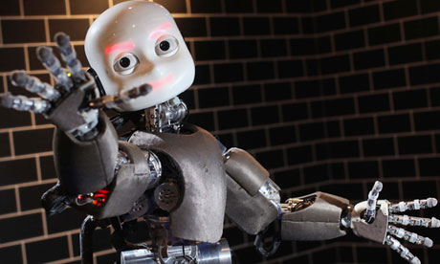
Robots4Autism

Slide 9
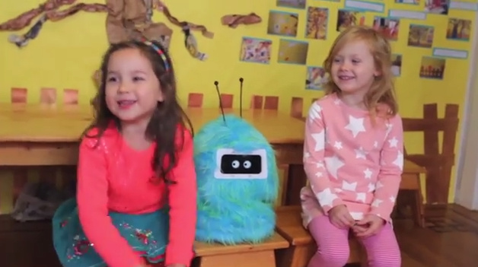
Romibo
Low-cost and affable robot (creator: Aubrey Shick)
“The robot is safe. The robot’s facial features don’t change,” says Laura McGuire, the mother of Liam, an autistic child.
“There’s not so much to figure out with talking to a robot, where there was a lot to figure out in talking to a human being.”

Slide 10
Kelly
In 2013 the University of Notre Dame published results from a study of 19 children with autism.
The researchers purchased a $14,000 talking robot, nicknamed Kelly, to coach autistic children to make eye contact or take turns talking. Kelly is a Nao “humanoid” robot, developed by French parent company Aldebaran in collaboration with eight universities and robotics companies in the U.K., France, Switzerland, Greece, and Denmark.

Slide 11
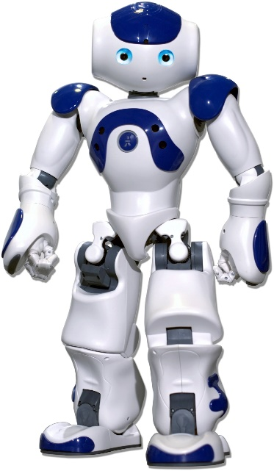
Nao
Today, NAO is the leading humanoid robot being used in research and education worldwide.
NAO was programmed with a series of verbal prompts and gestures that imitate those used by human therapists. The robot adapted its behavior to each child automatically depending on how he or she responded.

Slide 12

Bubblebot
Bubblebot is a peer.
In many cases the child has found resemblance in between the robot and his family or friends and has reacted to it.
The bubblebot was designed to help children social skills such:
Imitation
Taking turns
Maintaining joint attention with another person

Slide 13
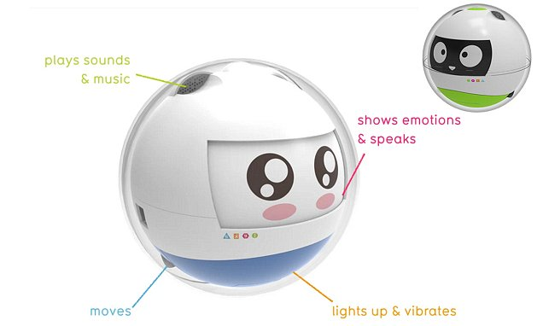
Leka
Motion-sensitive bot that lets children play learning games by providing sensory stimulation through movement, lights, vibration and sound.
Its makers have likened it to a 'guide dog' for children with the condition, helping them to navigate the challenges of learning and social interaction.
Could also help children with Down's syndrome, or multiple disabilities.
Typical elements of gaming, such as point scoring and competition, are applied to learning to make it more accessible.

Slide 14
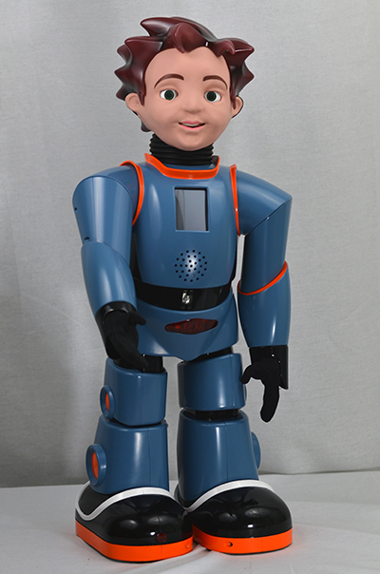
Milo
Milo can sense when a child begins to get frustrated or agitated and can react accordingly.
Milo is made partially of plastic and is 2 feet tall. He’s programmed to teach kids about a wide range of social interactions. Some experts say he’s proving more successful than humans in helping children with autism.
The robot speaks 20% slower than an average human and has a broadrange of facial expressions.
He is less likely to display emotions that get in the way of learning.

Slide 15
Can robots replace human therapists?
Robot-enhanced therapy ease the workload of human therapists.
They can lower the cost of treatment and help patients who have greater difficulty dealing with humans in social settings.
Robots can provide direct feedback to patients and interacting with them on a regular basis helps improve the overall therapy process.
Robot-enhanced therapy is already yielding results, especially with difficult populations such as dementia patients and individuals with autism.

Slide 16
Can robots replace human therapists?
Questions remain about the type of robot that will have long-term success with an autistic child. It’s still too early to know whether special needs children will respond better to simpler robots like Romibo or a more sophisticated device like the 23-inch-tall Nao.
It’s also not yet clear why some children respond to social robots and others do not and how well the learned skills translate to the real world.

