Slide 1
Often Overlooked Security Vectors:
DCOM, IOCTL, and File Mapping Objects
<footer>Colin Delaney Software Security Architect McAfee, Inc.
Stephen A. Ridley Senior Security Researcher Matasano Security

Slide 2
Introduction
Colin Delaney
  Software Security Engineer
  McAfee, Inc.
  Security testing, training (dev / qa), code audits, threat modeling
Stephen A. Ridley
  Senior Security Researcher
  Matasano Security
  Software Reverse Engineering, Vulnerability Research

Slide 3
Agenda
Overview
  A collection of three Win32 security-related topics
  Introduction of new custom tools
  Aimed at security minded software engineers (dev & qa)
DCOM Objects
  Overview, security considerations, enumeration tools
IOTCL Kernel Driver fuzzing
  Overview, reverse engineering control codes, fuzzing tools
File Mapping Objects
  Overview, permissions / security structures, auditing usage

Slide 4
DCOM Objects
Authentication Level (RPC_C_AUTHN_LEVEL_xxx)
Set through the dwAuthnLevel parameter in CoInitializeSecurity() and CoSetProxyBlanket() calls.
Client and server auth levels are compared during the handshake and the higher auth level is used.
  Default
  None
  Connect
  Call
  Packet
  Packet Integrity
  Packet Privacy

Slide 5
DCOM Objects
Launch and Activation Permissions
Controls which users have permission to launch the server both locally and remotely
  Local Launch
  Remote Launch
  Local Activation
  Remote Activation
Access Permission
Controls which users have permission to access the server both locally and remotely
  Local Access
  Remote Access

Slide 6
DCOM Objects
Configuration Permissions
Controls which users have permission to configure the server
  Full Control
  Read
  Special Permissions
Identity
The account that is used to run the application
  The interactive user
  The launching user
  This user (specify a user)
  The system account (services)

Slide 7
DCOM Objects
Tools Gap
Auditing COM and DCOM security attributes manually is a pain
Some tools do certain checks, but not all checks
New Tools: DEMO
COM Enumerator
  Parses a binary TypeLib info
  How to manually extract Typelib data from Portable Executables
  Identifying Portable Executables with embedded Typelib data
DCOM Enumerator
  Parses registry at HKEY_CLASSES_ROOT\AppID
  Extracts security attributes

Slide 8
Primer on TypeLib data
Typelib
IDL
The difference between the two?
TLB’s embedded in resource section of PE’s
LoadTypeLib() peeks into the TLB in the resource section under the hood, but how do we get at it?
OleView
PEView
DEMO:
  who_has_tlb.py (.exe)
  tlb_extract.py (.exe)

Slide 9
Primer on TypeLib data
[Screenshot of Resource Section containing TLB]

Slide 10
File Mapping Objects
CreateFileMapping()
Creates/opens a named or unnamed file mapping object for file
Takes a security descriptor (SD)
A NULL SD causes the object to get the default SD
Default SD ACLs are the creator’s primary or impersonation token
HANDLE CreateFileMapping(
HANDLE hFile,
LPSECURITY_ATTRIBUTES lpAttributes,
DWORD flProtect,
DWORD dwMaximumSizeHigh,
DWORD dwMaximumSizeLow,
LPCTSTR lpName );

Slide 11
File Mapping Objects
Need to check the lpSecurityDescriptor for the passed-in SECURITY_ATTRIBUTES structure
typedef struct _SECURITY_ATTRIBUTES {
DWORD nLength;
LPVOID lpSecurityDescriptor;
BOOL bInheritHandle;
} SECURITY_ATTRIBUTES, *PSECURITY_ATTRIBUTES;
Note: A NULL S_A structure is not the same as granting access to everyone by assigning a NULL discretionary access control list (DACL)

Slide 12
File Mapping Objects
Follow the SECURITY_ATTRIBUTES structure back to its discretionary access control list (DACL)
BOOL WINAPI SetSecurityDescriptorDacl(
__inout PSECURITY_DESCRIPTOR pSecurityDescriptor,
__in BOOL bDaclPresent,
__in_opt PACL pDacl,
__in BOOL bDaclDefaulted
);
pDacl
  A pointer to an ACL structure that specifies the DACL for the security descriptor
  If this parameter is NULL, a NULL DACL is assigned to the security descriptor, which allows all access to the object

Slide 13
File Mapping Objects
Auditing guidelines
Locate all instances of CreateFileMapping() usage
Check the LPSECURITY_ATTRIBUTES parameter
  If NULL, the default security descriptor is applied
    Check the ACLs of the creator’s primary or impersonation token
  If it points to a SECURITY_ATTRIBUTES structure…
    Check the lpSecurityDescriptor parameter of the SA
      If NULL, the default is used (check the caller)
      If not NULL, check for where the DACL is set
        Look for SetSecurityDescriptor*()
        If a NULL pDacl parameter is used this creates a NULL DACL will allows all access to the object

Slide 14
Userland → Kernelmode IO
“[The Agents] are the gatekeepers Neo, they are guarding all the doors, they are holding all the keys…”
–Morpheus “The Matrix”
The Kernel is where the buck stops. It has the ultimate “privilege”.
However it is often very possible for any process to communicate with the kernel through a number of the IO methodologies:
  RPC/LPC endpoints and Named Pipes
  Shared Memory
  IOCTL
This presentation focuses on IOCTL’s as this is the most popular method that userland components use to communicate with kernel-mode components
Notes:
Very few understand what IOCTLs are and how they relate to userland/kernel-mode code this slide should introduce the concepts a bit.

Slide 15
IOCTL Kernel Driver Fuzzing
Kernel drivers: often overlooked in security testing, but hugely important to the security of a system.
  Trust: code in the kernel space is trusted at the highest level possible.
  Scope: a vulnerability in a driver often means its exploitable by any system user.
Several hugely important components when understanding how drivers work on windows
  IOCTLs
  DRIVER_OBJECT
  IRP’s

Slide 16
IOCTLS
  The most popular mechanism for userland components to communicate with kernel drivers.
  IOCTLs are special functions called from userland processes that kernel drivers “listen” for.
  Each driver “listens” by registering a unique identifier called an IOControlCode (more on that later)
  Data is (basically) passed directly into the kernel driver from the userland call based on whichever driver has “registered” to listen for the IoControlCode first.
  The fundamental design flaw here….
Notes:
Elaborate more…

Slide 17
DRIVER_OBJECT structure
The DRIVER_OBJECT structure is how your driver “registers” a top-level dispatch function with the kernel:
DriverObject.MajorFunction[IRP_MJ_DEVICE_CONTROL] = mydispatchfunc;
Mydispatchfunc then gets called whenever anyone sends an IOCTL.
IOCTL data comes in as a special structure called _IRP structure
The actual IOCTL “opcode” can be reversed out of a binary .sys and used to target the driver when it is loaded.
Notes:
Elaborate more…

Slide 18
_IRP Structure
In windows all IO events are represented as _IRP structures
The associated IOControlCode is inside the _IRP structure that is parsed by the dispatch function within the driver.
Elaborate….
Notes:
Elaborate more…

Slide 19
How to validate/test driver security?
  ACL checks
  IOCTL buffer fuzzing
    Write your own custom fuzzers and test harnesses.
    Use packaged IOCTL fuzzers.
  Driver verifier checks
  Code signing (Vista provides this functionality out-of-box)
Notes:
Elaborate more on each of these bullet points….

Slide 20
So you wanna write your own driver fuzzer?
  Where to start?
  Test cases to consider...
  Why write your own when you could use a package?
Notes:
Elaborate more on each of these bullet points….

Slide 21
IOCTL Kernel Driver Fuzzing
Step 1: Compose the Driver List
Kartoffel: “a extensible command-line tool developed with the aim of helping developers to test the security and the reliability of a driver.”
http://kartoffel.reversemode.com/
kartoffel.exe -r > drivers-clean.txt
Install the software to be tested
kartoffel.exe –r > drivers-installed.txt
diff the two text files

Slide 22
IOCTL Kernel Driver Fuzzing
Step 2: ACL Check with WinObj
WinObj: “a 32-bit Windows NT program that uses the native Windows NT API to access and display information on the NT Object Manager's name space.”
http://technet.microsoft.com/en-us/sysinternals/bb896657.aspx
Launch WinObj
Open the \Device node
For each driver, right-click / Properties
Navigate to the Security tab
Select the Everyone group
Audit the allowed permissions

Slide 23
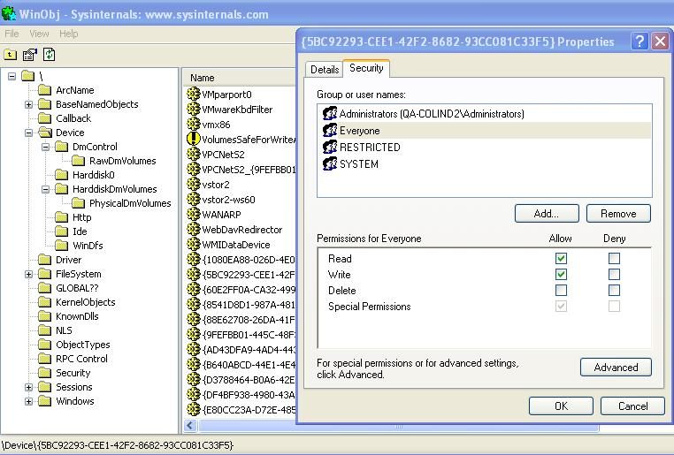
IOCTL Kernel Driver Fuzzing
In general, kernel drivers should not be Read/Write-Everyone

Slide 24
IOCTL Kernel Driver Fuzzing
Step 3a: Identify IOCTL Codes used by the Driver(s)
/* If source code is available */
Usually a switch (IoControlCode) is used
This maps IOCTL #define directives to handler functions
Search the driver source
Compose a list of codes handled by the driver
Might be listed in a header.h file

Slide 25
IOCTL Kernel Driver Fuzzing
Step 3b: Identify IOCTL Codes used by the Driver(s)
/* If source code is NOT available */
Need to reverse engineer the binary
DEMO: using IDA to reverse the IOControlCode and Dispatch functions from a .sys
Leverage DDK: Driver Object
DEMO

Slide 26
IOCTL Kernel Driver Fuzzing
Step 4: Get IOCTL Codes
Fuzzing tools are not going to recognize app macros
Need to translate application specific #define directives back to their values
Run each IOCTL code that the driver handles through this function and record the hex value that is outputted
printf(“output: %x”, IOCTL_CODE_MACRO);

Slide 27
IOCTL Kernel Driver Fuzzing
Step 5: Fuzz Each IOCTL Code Handler
Identify buffers the handler uses (input,output,both)
  Check the [in] and [out] parameters of each function
Determine the size (and ranges) of each buffer
  Might take some trial and error, stick to 4 byte boundaries
Run fuzzing tests
  Review the driver’s source to determine appropriate tests
Monitor for exceptions
  - Any crash/BSOD is a potentially exploitable security issue
Notes:
  Input fuzzing is only useful if an input buffer is used
  Try making a driver call from a Limited User account

Slide 28
IOCTL Kernel Driver Fuzzing
Step 6: Driver Verifier Checks
Driver Verifier: “A tool for detecting errors in kernel-mode drivers … such as memory corruption, mishandled IRPs, invalid DMA buffer usage, and possible deadlocks.”
http://www.microsoft.com/whdc/DevTools/tools/DrvVerifier.mspx
Note: Because of the relationship between kernel driver code and IRQLs, it is important to run these tests on both unicore and multicore systems. Running on a multi-processor system may help flush out synchronization issues.

Slide 29
IOCTL Kernel Driver Fuzzing
Step 6: Driver Verifier Checks
Start / Run / verifier.exe
Create custom settings (for code developers)
Select individual settings from a full list
Enable all options
Select driver names from a list
Reboot
Perform functional pass
Monitor for exceptions
/* Issues will likely result in a system crash */

Slide 30
IOCTL Kernel Driver Fuzzing
Tools Demo
/* Kernel-space "NT Object sniffer */

Slide 31
Contact Information
Colin Delaney
Colin_Delaney@mcafee.com
McAfee Inc.
Canada
Stephen A. Ridley
s7ephen@gmail.com
Matasano Security
USA

