Slide 1
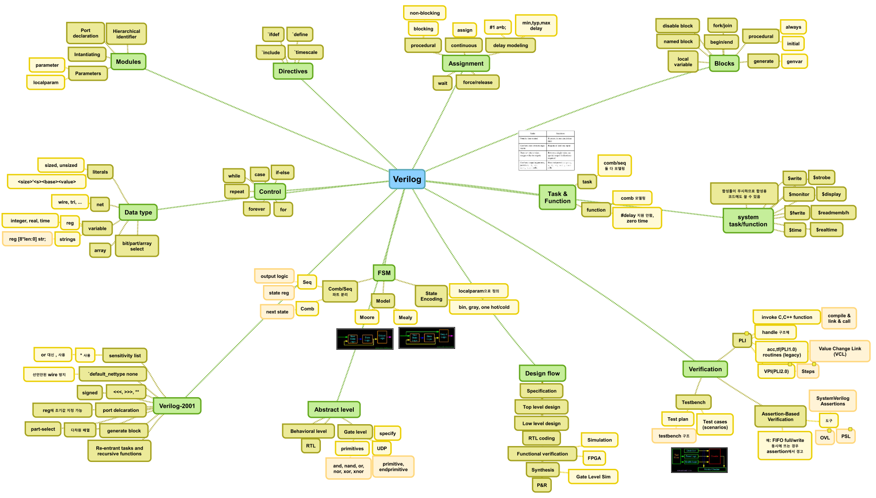
Notes:
C언어 같은 프로그래밍 언어를 배울 때
Data type
변수 선언, 변수 대입 (Assignment)
Control statement
Function & Class
같은걸 배움
HDL도 비슷하게
Data type : wire, reg
변수 선언, 변수 대입 (Assignment : Blocking, Non-blocking)
Control : if-else, case
물론, C언어같은 프로그래밍 언어와 HDL은 다름.
C언어로 SW를 짜고 컴파일을 돌린다.
C언어 코드를 컴파일러가 분석해서 어셈블리 코드를 생성하고 어셈블러가 기계어로 번역
기계어 코드 (instructions) 를 CPU가 한줄한줄 해석하면서 실행
HDL로 Hardware를 Description 한다음에 합성(Synthesis)를 한다. P&R을 한다.
내가 의도한 Hardware를 gate level로 변환한 다음에 배선을 해준다.
and/or/... gate, registers, 디지털 로직, ...
아날로그 IP는 Verilog로 설계하는 것 아님
합성이 되는 코드 (hardware로 만들어지는 - gate/register로 변환이 되는) 와 안되는 코드를 분리해서 생각할 수 있어야 함
Testbench (Stimulus) 코드는 합성이 안되도 상관없음

Slide 2
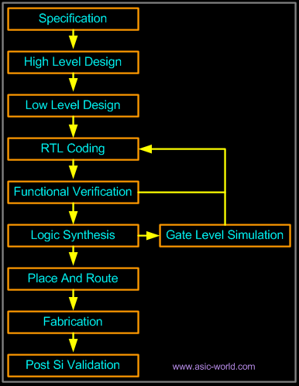
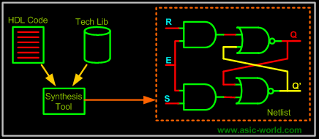
Thanasis Oikonomou
Verilog HDL Basics
Notes:
ASIC 설계 단계
RTL Coding : HW 로직을 설계하는 단계
Synthesis : 합성단계 => 공정에 맞는 셀로 치환
RTL Coding을 한다는 것 => .v 파일을 만드는 것

Slide 3
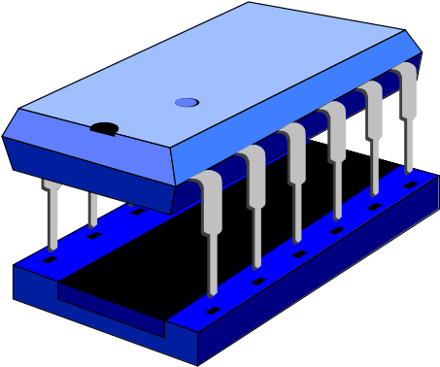
Verilog HDL Basics
Thanasis Oikonomou
Computer Science Dpt.
University of Crete, Greece
e-mail: poisson@csd.uch.gr
October 1998

Slide 4
What is Verilog
Hardware Description Language (HDL)
Developed in 1984
Standard: IEEE 1364, Dec 1995
Thanasis Oikonomou
Verilog HDL Basics
Notes:
Verilog-1995
Verilog-2001
강의자료는 Verilog-1995 기준으로 작성되어 있음

Slide 5
Application Areas of Verilog
System Specification
Suitable for all levels
Behavioral level
Not suitable
HW/SW
Partition
Hardware
Spec
Softwre
Spec
ASIC
FPGA
Boards
&
Systems
Software
PLD
Std Parts
Thanasis Oikonomou
Verilog HDL Basics

Slide 6

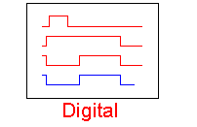
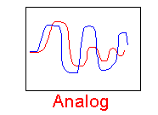
Basic Limitation of Verilog
Description of digital systems only
Thanasis Oikonomou
Verilog HDL Basics

Slide 7

Abstraction Levels in Verilog
Behavioral
RTL
Our focus
Gate
Layout (VLSI)
Thanasis Oikonomou
Verilog HDL Basics
Notes:
Verilog에서는 다양한 Abstract level로 HW를 description 할 수 있음
RTL : Register Transfer Level

Slide 8
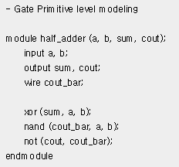
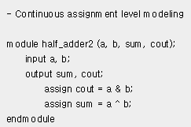
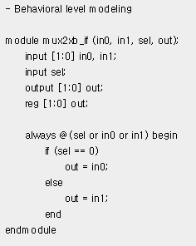
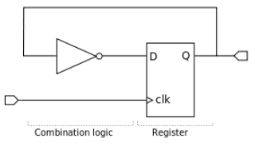
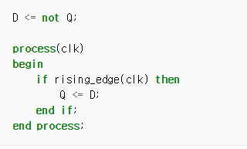
VHDL 코드
Thanasis Oikonomou
Verilog HDL Basics
Notes:
여러가지 추상 레벨로 HW를 기술할 수 있다. 라는게 포인트
엄격하게 구분짓는 것은 의미 없음

Slide 9
Hierarchical Design
Top Level
Module
E.g.
Full Adder
Sub-Module
1
Sub-Module
2
Half Adder
Half Adder
Basic Module
1
Basic Module
2
Basic Module
3
Thanasis Oikonomou
Verilog HDL Basics

Slide 10
Module
module my_module(out1, .., inN);
output out1, .., outM;
input in1, .., inN;
.. // declarations
.. // description of f (maybe
.. // sequential)
endmodule
in1
my_module
out1
in2
out2
f
inN
outM
Everything you write in Verilog must be inside a module
exception: compiler directives
Thanasis Oikonomou
Verilog HDL Basics
Notes:
모듈을 설계할 때
input, output 정의
클럭, 리셋 입력
다른 모듈과 interface

Slide 11
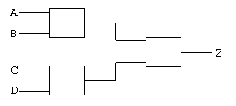
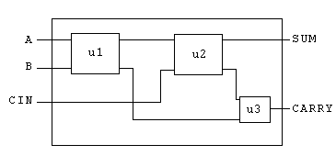
Main Language Concepts (i)
Concurrency
Structure
Thanasis Oikonomou
Verilog HDL Basics
Notes:
동시성 : HW는 모든 블록들이 동시에 동작함
구조화된 블록 : 모듈들이 구조화/계층화 되어 있음

Slide 12
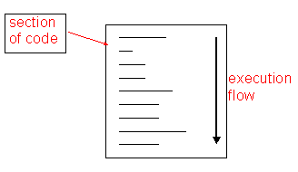
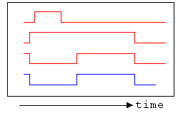
Main Language Concepts (ii)
Procedural Statements
Time
Thanasis Oikonomou
Verilog HDL Basics
Notes:
뭘 말하려는 건지 모르겠음 - pass

Slide 13
User Identifiers
Formed from {[A-Z], [a-z], [0-9], _, $}, but ..
.. can’t begin with $ or [0-9]
  myidentifier 
  m_y_identifier 
  3my_identifier 
  $my_identifier 
  _myidentifier$ 
Case sensitivity
  myid ≠ Myid
Thanasis Oikonomou
Verilog HDL Basics
Notes:
숫자, $로 시작하는 identifier는 사용할 수 없음

Slide 14
Comments
// The rest of the line is a comment
/* Multiple line
comment */
/* Nesting /* comments */ do NOT work */
Thanasis Oikonomou
Verilog HDL Basics

Slide 15
Verilog Value Set
0 represents low logic level or false condition
1 represents high logic level or true condition
x represents unknown logic level
z represents high impedance logic level
Thanasis Oikonomou
Verilog HDL Basics
Notes:
합성할 코드에서 x, z는 왠만하면 사용하지 마라
Simulation / Synthesis Mismatch가 발생할 수 있음
Simulation 상에서 Unknown value propagation이 생겨서 simulation이 불가할 수도 있음
x => don’t care와 관련있음

Slide 16
Numbers in Verilog (i)
<size>’<radix> <value>
  8’h ax = 1010xxxx
  12’o 3zx7 = 011zzzxxx111
No of
bits
Binary → b or B
Octal → o or O
Decimal → d or D
Hexadecimal → h or H
Consecutive chars
0-f, x, z
Thanasis Oikonomou
Verilog HDL Basics
Notes:
8’h ax = 1010xxxx 를 합성하면 HW가 어떻게 만들어 지느냐? 가 중요

Slide 17
Numbers in Verilog (ii)
You can insert “_” for readability
  12’b 000_111_010_100
  12’b 000111010100
  12’o 07_24
Bit extension
  MS bit = 0, x or z ⇒ extend this
    4’b x1 = 4’b xx_x1
  MS bit = 1 ⇒ zero extension
    4’b 1x = 4’b 00_1x
Represent the same number
Thanasis Oikonomou
Verilog HDL Basics
Notes:
size prefix보다 value의 bit수가 적으면 bit extension이 일어남
size prefix보다 value의 bit수가 크면 truncation이 일어남

Slide 18
Numbers in Verilog (iii)
If size is ommitted it
  is inferred from the value or
  takes the simulation specific number of bits or
  takes the machine specific number of bits
If radix is ommitted too .. decimal is assumed
  15 = <size>’d 15
Thanasis Oikonomou
Verilog HDL Basics
Notes:
size 값이 생략되어 있으면 기본적으로 RHS value는 32비트로 만들어지는 것으로 알고있음

Slide 19
Nets (i)
Can be thought as hardware wires driven by logic
Equal z when unconnected
Various types of nets
  wire
  wand (wired-AND)
  wor (wired-OR)
  tri (tri-state)
In following examples: Y is evaluated, automatically, every time A or B changes
Thanasis Oikonomou
Verilog HDL Basics

Slide 20


Nets (ii)
A
wire Y; // declaration
assign Y = A & B;
Y
B
wand Y; // declaration
assign Y = A;
assign Y = B;
A
Y
B
wor Y; // declaration
assign Y = A;
assign Y = B;
dr
A
Y
tri Y; // declaration
assign Y = (dr) ? A : z;
Thanasis Oikonomou
Verilog HDL Basics
Notes:
wire Y = A & B; 로 wire 선언하면서 assig도 동시에 할 수 있음
1비트 wire는 선언을 하지 않고 가져다 쓰면 암시적으로 생성을 하고 에러를 안띄움 => 버그의 원인이 될 수 있음

Slide 21
Registers
Variables that store values
Do not represent real hardware but ..
.. real hardware can be implemented with registers
Only one type: reg
  reg A, C; // declaration
  // assignments are always done inside a procedure
  A = 1;
  C = A; // C gets the logical value 1
  A = 0; // C is still 1
  C = 0; // C is now 0
Register values are updated explicitly!!
Thanasis Oikonomou
Verilog HDL Basics
Notes:
값을 기억하는 HW => 레지스터와 래치
래치는 왠만하면 만들지 말기
reg 로 선언한 변수는 실제 registe로 만들어 질수도 있고, latch로 만들어질수도 있고, wire로 만들어질수도 있음

Slide 22
Vectors
Represent buses
  wire [3:0] busA;
  reg [1:4] busB;
  reg [1:0] busC;
Left number is MS bit
Slice management
  busC[1] = busA[2];
  busC[0] = busA[1];
Vector assignment (by position!!)
busB[1] = busA[3];
  busB[2] = busA[2];
  busB[3] = busA[1];
  busB[4] = busA[0];
busC = busA[2:1]; ⇔
busB = busA; ⇔
Thanasis Oikonomou
Verilog HDL Basics
Notes:
Vector는 multi-bit wire/register 를 의미함

Slide 23
Integer & Real Data Types
Declaration
  integer i, k;
  real r;
Use as registers (inside procedures)
  i = 1; // assignments occur inside procedure
  r = 2.9;
  k = r; // k is rounded to 3
Integers are not initialized!!
Reals are initialized to 0.0
Thanasis Oikonomou
Verilog HDL Basics
Notes:
real => HW로 만들어짐???? , 안만들어짐
integer는 32비트 reg로 만들어짐?

Slide 24
Time Data Type
Special data type for simulation time measuring
Declaration
  time my_time;
Use inside procedure
  my_time = $time; // get current sim time
Simulation runs at simulation time, not real time
Thanasis Oikonomou
Verilog HDL Basics
Notes:
time 은 시뮬레이션용 type

Slide 25
Arrays (i)
Syntax
  integer count[1:5]; // 5 integers
  reg var[-15:16]; // 32 1-bit regs
  reg [7:0] mem[0:1023]; // 1024 8-bit regs
Accessing array elements
  Entire element: mem[10] = 8’b 10101010;
  Element subfield (needs temp storage):
    reg [7:0] temp;
    ..
    temp = mem[10];
    var[6] = temp[2];
Thanasis Oikonomou
Verilog HDL Basics

Slide 26
Arrays (ii)
Limitation: Cannot access array subfield or entire array at once
  var[2:9] = ???; // WRONG!!
  var = ???; // WRONG!!
No multi-dimentional arrays
  reg var[1:10] [1:100]; // WRONG!!
Arrays don’t work for the Real data type
  real r[1:10]; // WRONG !!
Thanasis Oikonomou
Verilog HDL Basics

Slide 27
Strings
Implemented with regs:
  reg [8*13:1] string_val; // can hold up to 13 chars
  ..
  string_val = “Hello Verilog”;
  string_val = “hello”; // MS Bytes are filled with 0
  string_val = “I am overflowed”; // “I ” is truncated
Escaped chars:
  \n newline
  \t tab
  %% %
  \\ \
  \“ “
Thanasis Oikonomou
Verilog HDL Basics
Notes:
string은 합성시에 어떻게??

Slide 28
Logical Operators
&& → logical AND
|| → logical OR
! → logical NOT
Operands evaluated to ONE bit value: 0, 1 or x
Result is ONE bit value: 0, 1 or x
  A = 6; A && B → 1 && 0 → 0
  B = 0; A || !B → 1 || 1 → 1
  C = x; C || B → x || 0 → x
but C&&B=0
Thanasis Oikonomou
Verilog HDL Basics

Slide 29
Bitwise Operators (i)
& → bitwise AND
| → bitwise OR
~ → bitwise NOT
^ → bitwise XOR
~^ or ^~ → bitwise XNOR
Operation on bit by bit basis
Thanasis Oikonomou
Verilog HDL Basics
Notes:
&, |, ^ 등을 단항 연산자로 쓸 수도 있음

Slide 30
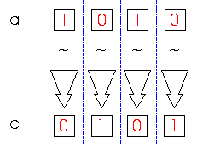
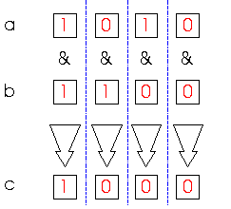
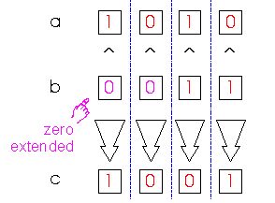
Bitwise Operators (ii)
c = ~a;
c = a & b;
a = 4’b1010;
b = 4’b1100;
a = 4’b1010;
b = 2’b11;
c = a ^ b;
Thanasis Oikonomou
Verilog HDL Basics

Slide 31
Reduction Operators
& → AND
| → OR
^ → XOR
~& → NAND
~| → NOR
~^ or ^~ → XNOR
One multi-bit operand → One single-bit result
  a = 4’b1001;
  ..
  c = |a; // c = 1|0|0|1 = 1
Thanasis Oikonomou
Verilog HDL Basics

Slide 32
Shift Operators
>> → shift right
<< → shift left
Result is same size as first operand, always zero filled
a = 4’b1010;
...
d = a >> 2; // d = 0010
c = a << 1; // c = 0100
Thanasis Oikonomou
Verilog HDL Basics
Notes:
- Shift는 HW로 어떻게 만들어질까?

Slide 33
Concatenation Operator
{op1, op2, ..} → concatenates op1, op2, .. to single number
Operands must be sized !!
  reg a;
  reg [2:0] b, c;
  ..
  a = 1’b 1;
  b = 3’b 010;
  c = 3’b 101;
  catx = {a, b, c}; // catx = 1_010_101
  caty = {b, 2’b11, a}; // caty = 010_11_1
  catz = {b, 1}; // WRONG !!
Replication ..
  catr = {4{a}, b, 2{c}}; // catr = 1111_010_101101
Thanasis Oikonomou
Verilog HDL Basics

Slide 34
Relational Operators
> → greater than
< → less than
>= → greater or equal than
<= → less or equal than
Result is one bit value: 0, 1 or x
  1 > 0 → 1
  ’b1x1 <= 0 → x
  10 < z → x
Thanasis Oikonomou
Verilog HDL Basics

Slide 35
Equality Operators
== → logical equality
!= → logical inequality
=== → case equality
!== → case inequality
  4’b 1z0x == 4’b 1z0x → x
  4’b 1z0x != 4’b 1z0x → x
  4’b 1z0x === 4’b 1z0x → 1
  4’b 1z0x !== 4’b 1z0x → 0
Return 0, 1 or x
Return 0 or 1
Thanasis Oikonomou
Verilog HDL Basics
Notes:
===, !== 잘 안씀

Slide 36
Conditional Operator
cond_expr ? true_expr : false_expr
Like a 2-to-1 mux ..
A
1
Y
B
Y = (sel)? A : B;
0
sel
Thanasis Oikonomou
Verilog HDL Basics
Notes:
- conditional operator는 주로 mux 로직에서 사용됨

Slide 37
Arithmetic Operators (i)
+, -, *, /, %
If any operand is x the result is x
Negative registers:
  regs can be assigned negative but are treated as unsigned
    reg [15:0] regA;
    ..
    regA = -4’d12; // stored as 2¹⁶-12 = 65524
    regA/3 evaluates to 21861
Thanasis Oikonomou
Verilog HDL Basics
Notes:
+, - 은 쉽게 HW로 inference 됨
multiplication (*)는?
division (/)는?
modulo (%)는?

Slide 38
Arithmetic Operators (ii)
Negative integers:
  can be assigned negative values
  different treatment depending on base specification or not
    reg [15:0] regA;
    integer intA;
    ..
    intA = -12/3; // evaluates to -4 (no base spec)
    intA = -’d12/3; // evaluates to 1431655761 (base spec)
Thanasis Oikonomou
Verilog HDL Basics

Slide 39
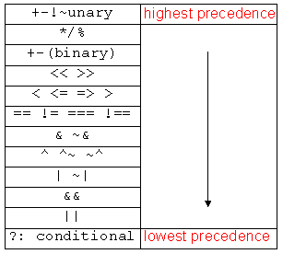
Operator Precedence
Use parentheses to
enforce your
priority
Thanasis Oikonomou
Verilog HDL Basics

Slide 40
Hierarchical Design
Top Level
Module
E.g.
Full Adder
Sub-Module
1
Sub-Module
2
Half Adder
Half Adder
Basic Module
1
Basic Module
2
Basic Module
3
Thanasis Oikonomou
Verilog HDL Basics

Slide 41
Module
module my_module(out1, .., inN);
output out1, .., outM;
input in1, .., inN;
.. // declarations
.. // description of f (maybe
.. // sequential)
endmodule
in1
my_module
out1
in2
out2
f
inN
outM
Everything you write in Verilog must be inside a module
exception: compiler directives
Thanasis Oikonomou
Verilog HDL Basics
Notes:
모듈을 설계할 때
input, output 정의
클럭, 리셋 입력
다른 모듈과 interface

Slide 42
Example: Half Adder
A
module half_adder(S, C, A, B);
output S, C;
input A, B;
wire S, C, A, B;
assign S = A ^ B;
assign C = A & B;
endmodule
S
B
C
A
S
Half
Adder
B
C
Thanasis Oikonomou
Verilog HDL Basics

Slide 43
Example: Full Adder
in1
A
S
I1
A
S
sum
Half
Adder 1
ha1
Half
Adder
ha2
in2
B
C
I2
B
C
I3
cout
cin
module full_adder(sum, cout, in1, in2, cin);
output sum, cout;
input in1, in2, cin;
wire sum, cout, in1, in2, cin;
wire I1, I2, I3;
half_adder ha1(I1, I2, in1, in2);
half_adder ha2(sum, I3, I1, cin);
assign cout = I2 || I3;
endmodule
Module
name
Instance
name
Thanasis Oikonomou
Verilog HDL Basics

Slide 44
Hierarchical Names
ha2.A
in1
A
S
I1
A
S
sum
Half
Adder 1
ha1
Half
Adder
ha2
in2
B
C
I2
B
C
I3
cout
cin
Remember to use instance names,
not module names
Thanasis Oikonomou
Verilog HDL Basics

Slide 45
Port Assignments
module
Inputs
Outputs
Inouts
reg or net
net
module
reg or net
net
module
net
net
Thanasis Oikonomou
Verilog HDL Basics

Slide 46
Continuous Assignements a closer look
Syntax:
  assign #del <id> = <expr>;
Where to write them:
  inside a module
  outside procedures
Properties:
  they all execute in parallel
  are order independent
  are continuously active
optional
net type !!
Thanasis Oikonomou
Verilog HDL Basics
Notes:
Delay modeling을 위한 #del 은 합성되지 않음

Slide 47
Structural Model (Gate Level)
Built-in gate primitives:
  and, nand, nor, or, xor, xnor, buf, not, bufif0, bufif1, notif0, notif1
Usage:
  nand (out, in1, in2); 2-input NAND without delay
  and #2 (out, in1, in2, in3); 3-input AND with 2 t.u. delay
  not #1 N1(out, in); NOT with 1 t.u. delay and instance name
  xor X1(out, in1, in2); 2-input XOR with instance name
Write them inside module, outside procedures
Thanasis Oikonomou
Verilog HDL Basics

Slide 48
Example: Half Adder,
2nd Implementation
A
module half_adder(S, C, A, B);
output S, C;
input A, B;
wire S, C, A, B;
xor #2 (S, A, B);
and #1 (C, A, B);
endmodule
S
B
C
Assuming:
XOR: 2 t.u. delay
AND: 1 t.u. delay
Thanasis Oikonomou
Verilog HDL Basics

Slide 49
Behavioral Model - Procedures (i)
Procedures = sections of code that we know they execute sequentially
Procedural statements = statements inside a procedure (they execute sequentially)
e.g. another 2-to-1 mux implem:
  begin
  if (sel == 0)
  Y = B;
  else
  Y = A;
  end
Execution
Flow
Procedural assignments:
Y must be reg !!
Thanasis Oikonomou
Verilog HDL Basics

Slide 50
Behavioral Model - Procedures (ii)
Modules can contain any number of procedures
Procedures execute in parallel (in respect to each other) and ..
.. can be expressed in two types of blocks:
  initial → they execute only once
  always → they execute for ever (until simulation finishes)
Thanasis Oikonomou
Verilog HDL Basics

Slide 51
“Initial” Blocks
Start execution at sim time zero and finish when their last statement executes
  module nothing;
  initial
  $display(“I’m first”);
  initial begin
  #50;
  $display(“Really?”);
  end
  endmodule
Will be displayed
at sim time 0
Will be displayed
at sim time 50
Thanasis Oikonomou
Verilog HDL Basics
Notes:
Simulation 용 코드

Slide 52
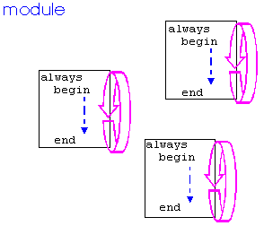
“Always” Blocks
Start execution at sim time zero and continue until sim finishes
Thanasis Oikonomou
Verilog HDL Basics
Notes:
실제 합성용 RTL 설계시에 가장 많이 사용하는 block이라고 볼 수 있음

Slide 53
Events (i)
@
  always @(signal1 or signal2 or ..) begin
  ..
  end
  always @(posedge clk) begin
  ..
  end
  always @(negedge clk) begin
  ..
  end
execution triggers every
time any signal changes
execution triggers every
time clk changes
from 0 to 1
execution triggers every
time clk changes
from 1 to 0
Thanasis Oikonomou
Verilog HDL Basics

Slide 54
Examples
3rd half adder implem
  module half_adder(S, C, A, B);
  output S, C;
  input A, B;
  reg S,C;
  wire A, B;
  always @(A or B) begin
  S = A ^ B;
  C = A && B;
  end
  endmodule
Behavioral edge-triggered DFF implem
  module dff(Q, D, Clk);
  output Q;
  input D, Clk;
  reg Q;
  wire D, Clk;
  always @(posedge Clk)
  Q = D;
  endmodule
Thanasis Oikonomou
Verilog HDL Basics

Slide 55
Events (ii)
wait (expr)
always begin
  wait (ctrl)
  #10 cnt = cnt + 1;
  #10 cnt2 = cnt2 + 2;
  end
e.g. Level triggered DFF ?
execution loops every
time ctrl = 1 (level
sensitive timing control)
Thanasis Oikonomou
Verilog HDL Basics

Slide 56
Example
always @(res or posedge clk) begin
if (res) begin
Y = 0;
W = 0;
end
else begin
Y = a & b;
W = ~c;
end
end
res
a
b
Y
c
W
clk
Thanasis Oikonomou
Verilog HDL Basics

Slide 57
Timing (i)
d
initial begin
#5 c = 1;
#5 b = 0;
#5 d = c;
end
c
b
0
5
10
15
Time
Each assignment is
blocked by its previous one
Thanasis Oikonomou
Verilog HDL Basics

Slide 58
Timing (ii)
d
initial begin
fork
#5 c = 1;
#5 b = 0;
#5 d = c;
join
end
c
b
0
5
10
15
Time
Assignments are
not blocked here
Thanasis Oikonomou
Verilog HDL Basics

Slide 59
Procedural Statements: if
E.g. 4-to-1 mux:
module mux4_1(out, in, sel);
output out;
input [3:0] in;
input [1:0] sel;
reg out;
wire [3:0] in;
wire [1:0] sel;
always @(in or sel)
if (sel == 0)
out = in[0];
else if (sel == 1)
out = in[1];
else if (sel == 2)
out = in[2];
else
out = in[3];
endmodule
if (expr1)
true_stmt1;
else if (expr2)
true_stmt2;
..
else
def_stmt;
Thanasis Oikonomou
Verilog HDL Basics

Slide 60
Procedural Statements: case
E.g. 4-to-1 mux:
module mux4_1(out, in, sel);
output out;
input [3:0] in;
input [1:0] sel;
reg out;
wire [3:0] in;
wire [1:0] sel;
always @(in or sel)
case (sel)
0: out = in[0];
1: out = in[1];
2: out = in[2];
3: out = in[3];
endcase
endmodule
case (expr)
item_1, .., item_n: stmt1;
item_n+1, .., item_m: stmt2;
..
default: def_stmt;
endcase
Thanasis Oikonomou
Verilog HDL Basics

Slide 61
Procedural Statements: for
for (init_assignment; cond; step_assignment)
stmt;
E.g.
module count(Y, start);
output [3:0] Y;
input start;
reg [3:0] Y;
wire start;
integer i;
initial
Y = 0;
always @(posedge start)
for (i = 0; i < 3; i = i + 1)
#10 Y = Y + 1;
endmodule
Thanasis Oikonomou
Verilog HDL Basics

Slide 62
Procedural Statements: while
E.g.
module count(Y, start);
output [3:0] Y;
input start;
reg [3:0] Y;
wire start;
integer i;
initial
Y = 0;
always @(posedge start) begin
i = 0;
while (i < 3) begin
#10 Y = Y + 1;
i = i + 1;
end
end
endmodule
while (expr) stmt;
Thanasis Oikonomou
Verilog HDL Basics

Slide 63
Procedural Statements: repeat
E.g.
module count(Y, start);
output [3:0] Y;
input start;
reg [3:0] Y;
wire start;
initial
Y = 0;
always @(posedge start)
repeat (4) #10 Y = Y + 1;
endmodule
repeat (times) stmt;
Can be either an
integer or a variable
Thanasis Oikonomou
Verilog HDL Basics

Slide 64
Procedural Statements: forever
Typical example:
clock generation in test modules
module test;
reg clk;
initial begin
clk = 0;
forever #10 clk = ~clk;
end
other_module1 o1(clk, ..);
other_module2 o2(.., clk, ..);
endmodule
T_{clk} = 20 time units
forever stmt;
Executes until sim
finishes
Thanasis Oikonomou
Verilog HDL Basics

Slide 65
Mixed Model
Code that contains various both structure and behavioral styles
module simple(Y, c, clk, res);
output Y;
input c, clk, res;
reg Y;
wire c, clk, res;
wire n;
not(n, c); // gate-level
always @(res or posedge clk)
if (res)
Y = 0;
else
Y = n;
endmodule
res
c
n
Y
clk
Thanasis Oikonomou
Verilog HDL Basics

Slide 66
System Tasks
Always written inside procedures
$display(“..”, arg2, arg3, ..); → much like printf(), displays formatted string in std output when encountered
$monitor(“..”, arg2, arg3, ..); → like $display(), but .. displays string each time any of arg2, arg3, .. Changes
$stop; → suspends sim when encountered
$finish; → finishes sim when encountered
$fopen(“filename”); → returns file descriptor (integer); then, you can use $fdisplay(fd, “..”, arg2, arg3, ..); or $fmonitor(fd, “..”, arg2, arg3, ..); to write to file
$fclose(fd); → closes file
$random(seed); → returns random integer; give her an integer as a seed
Thanasis Oikonomou
Verilog HDL Basics

Slide 67
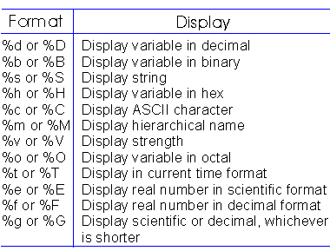
$display & $monitor string format
Thanasis Oikonomou
Verilog HDL Basics

Slide 68
Compiler Directives
`include “filename” → inserts contents of file into current file; write it anywhere in code ..
`define <text1> <text2> → text1 substitutes text2;
  e.g. `define BUS reg [31:0] in declaration part: `BUS data;
`timescale <time unit>/<precision>
  e.g. `timescale 10ns/1ns later: #5 a = b;
50ns
Thanasis Oikonomou
Verilog HDL Basics

Slide 69
Parameters
in[3:0]
p_in[3:0]
out[2:0]
wu
A. Implelementation
without parameters
wd
clk
module dff4bit(Q, D, clk);
output [3:0] Q;
input [3:0] D;
input clk;
reg [3:0] Q;
wire [3:0] D;
wire clk;
always @(posedge clk)
Q = D;
endmodule
module dff2bit(Q, D, clk);
output [1:0] Q;
input [1:0] D;
input clk;
reg [1:0] Q;
wire [1:0] D;
wire clk;
always @(posedge clk)
Q = D;
endmodule
Thanasis Oikonomou
Verilog HDL Basics

Slide 70
Parameters (ii)
module top(out, in, clk);
output [1:0] out;
input [3:0] in;
input clk;
wire [1:0] out;
wire [3:0] in;
wire clk;
wire [3:0] p_in; // internal nets
wire wu, wd;
assign wu = p_in[3] & p_in[2];
assign wd = p_in[1] & p_in[0];
dff4bit instA(p_in, in, clk);
dff2bit instB(out, {wu, wd}, clk);
// notice the concatenation!!
endmodule
A. Implelementation
without parameters (cont.)
Thanasis Oikonomou
Verilog HDL Basics

Slide 71
Parameters (iii)
B. Implelementation
with parameters
module top(out, in, clk);
output [1:0] out;
input [3:0] in;
input clk;
wire [1:0] out;
wire [3:0] in;
wire clk;
wire [3:0] p_in;
wire wu, wd;
assign wu = p_in[3] & p_in[2];
assign wd = p_in[1] & p_in[0];
dff instA(p_in, in, clk);
// WIDTH = 4, from declaration
dff instB(out, {wu, wd}, clk);
defparam instB.WIDTH = 2;
// We changed WIDTH for instB only
endmodule
module dff(Q, D, clk);
parameter WIDTH = 4;
output [WIDTH-1:0] Q;
input [WIDTH-1:0] D;
input clk;
reg [WIDTH-1:0] Q;
wire [WIDTH-1:0] D;
wire clk;
always @(posedge clk)
Q = D;
endmodule
Thanasis Oikonomou
Verilog HDL Basics

Slide 72
Testing Your Modules
module top_test;
wire [1:0] t_out; // Top’s signals
reg [3:0] t_in;
reg clk;
top inst(t_out, t_in, clk); // Top’s instance
initial begin // Generate clock
clk = 0;
forever #10 clk = ~clk;
end
initial begin // Generate remaining inputs
$monitor($time, " %b -> %b", t_in, t_out);
#5 t_in = 4'b0101;
#20 t_in = 4'b1110;
#20 t_in[0] = 1;
#300 $finish;
end
endmodule
Thanasis Oikonomou
Verilog HDL Basics

Slide 73
The Veriwell Simulator
Assuming that modules dff, top and top_test reside in files dff.v, top.v and top_test.v respectively, run:
~hy225/veriwell/sparc_bin/veriwell dff.v top.v top_test.v
result:
.. (initial messages)
0 xxxx -> xx
5 0101 -> xx
25 1110 -> xx
30 1110 -> 00
45 1111 -> 00
50 1111 -> 10
70 1111 -> 11
.. (final messages)
Thanasis Oikonomou
Verilog HDL Basics

Slide 74
숙제
선배사원이 APB를 이용하여 레지스터를 제어할 수 있는 CPU Peripheral로 붙일 타이머/PWM 로직을 짜오라고 시켰다.
어떻게 디자인/코딩할 것인가? 생각해보기
어떻게 Verification (시뮬레이션 / FPGA 합성) 할 것인가? 생각해보기
Thanasis Oikonomou
Verilog HDL Basics

