Slide 1
DSA using Java - Queue

Slide 2
DSA using Java - Queue
Queue is kind of data structure similar to stack with primary difference that the first item inserted is the first item to be removed (FIFO - First In First Out) where stack is based on LIFO, Last In First Out principal.
A Queue is a linear structure that follows a particular order in which the operations are performed. The order is First In First Out (FIFO). A good example of a queue is any queue of consumers for a resource where the consumer that came first is served first.

Slide 3
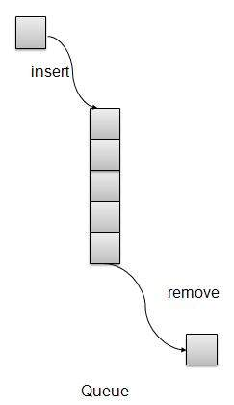
Queue Representation

Slide 4
Basic Operations
insert / enqueue − add an item to the rear of the queue.
remove / dequeue − remove an item from the front of the queue.
We're going to implement Queue using array in this article. There is few more operations supported by queue which are following.
Peek − get the element at front of the queue.
isFull − check if queue is full.
isEmpty − check if queue is empty.

Slide 5
Insert / Enqueue Operation
Whenever an element is inserted into queue, queue increments the rear index for later use and stores that element at the rear end of the storage. If rear end reaches to the last index and it is wrapped to the bottom location. Such an arrangement is called wrap around and such queue is circular queue. This method is also termed as enqueue operation.

Slide 6
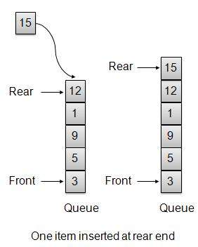

Slide 7
public void insert(int data){
if(!isFull()){
if(rear == MAX-1){
rear = -1;
}
intArray[++rear] = data;
itemCount++;
}
}

Slide 8
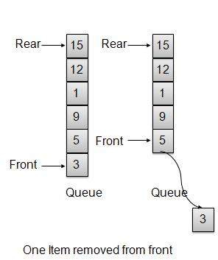
Remove / Dequeue Operation
Whenever an element is to be removed from queue, queue get the element using front index and increments the front index. As a wrap around arrangement, if front index is more than array's max index, it is set to 0.

Slide 9
public int remove(){
int data = intArray[front++];
if(front == MAX){
front = 0;
}
itemCount--;
return data;
}
Queue implementation in eclipse in word file.

Slide 10
Types of Queues:
Simple Queue
Circular Queue
Double Ended Queue (Deque)
Priority Queue
Ascending Priority Queue
Descending Priority Queue

Slide 11
Circular Queue: Circular Queue is a linear data structure in which the operations are performed based on FIFO (First In First Out) principle and the last position is connected back to the first position to make a circle. It is also called ‘Ring Buffer’.

Slide 12
Double ended Queue: Double Ended Queue is also a Queue data structure in which the insertion and deletion operations are performed at both the ends (front and rear).
That means, we can insert at both front and rear positions and can delete from both front and rear positions.
Since Deque supports both stack and queue operations, it can be used as both.
The problems where elements need to be removed and or added both ends can be efficiently solved using Deque.

Slide 13
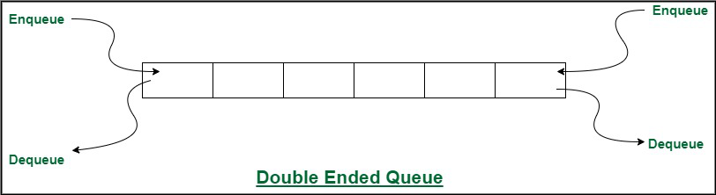

Slide 14
Priority Queue: A priority queue is a special type of queue in which each element is associated with a priority and is served according to its priority.
There are two types of Priority Queues. They are:
Ascending Priority Queue: Element can be inserted arbitrarily but only smallest element can be removed. For example, suppose there is an array having elements 4, 2, 8 in the same order. So, while inserting the elements, the insertion will be in the same sequence but while deleting, the order will be 2, 4, 8.

Slide 15
Descending priority Queue: Element can be inserted arbitrarily but only the largest element can be removed first from the given Queue. For example, suppose there is an array having elements 4, 2, 8 in the same order. So, while inserting the elements, the insertion will be in the same sequence but while deleting, the order will be 8, 4, 2.

Slide 16
Applications of a Queue:
The queue is used when things don’t have to be processed immediately, but have to be processed in First In First Out order like Breadth First Search.
This property of Queue makes it also useful in the following kind of scenarios.
Queues can be used to schedule jobs and ensure that they are executed in the correct order.
Queues can be used to manage the order in which print jobs are sent to the printer.
Queues are used to implement the breadth-first search algorithm.
Queues can be used to manage incoming calls and ensure that they are handled in the correct order.

Slide 17
5. Queues can be used to manage the order in which processes are executed on the CPU.
6. Queues can be used for buffering data while it is being transferred between two systems. When data is received, it is added to the back of the queue, and when data is sent, it is removed from the front of the queue.

