Slide 1
Data Structures and Algorithms(CSE2001)
MODULE 1
Stack Linear Data Structure
1-<number>

Slide 2
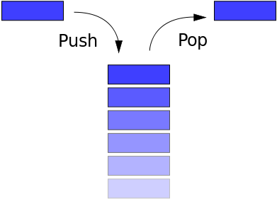
Stack
What is a Stack ?
A stack is a particular kind of abstract data type or collection in which the fundamental (or only) operations on the collection are the addition of an entity to the collection, known as push and removal of an entity, known as pop.
1-<number>

Slide 3
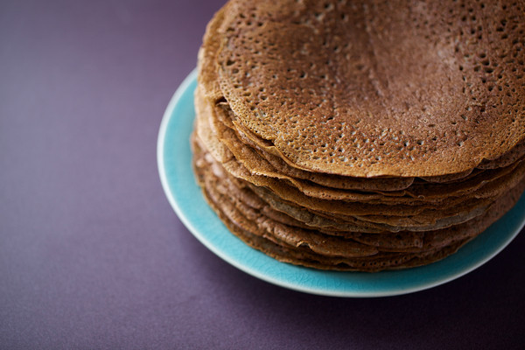

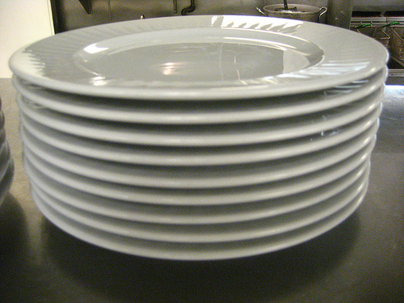

Examples
1-<number>

Slide 4
In Simple Words
A stack
  Last-in, first-out (LIFO) property
    The last item placed on the stack will be the first item removed
  Analogy
    A stack of dishes in a cafeteria
    A stack of Books
    A stack of Dosa
    A stack of Money

Slide 5
Basic Principle or representation
The relation between the push and pop operations is such that the stack is a Last-In-First-Out (LIFO) data structure.
In a LIFO data structure, the last element added to the structure must be the first one to be removed.

Slide 6
Stack ADT
Stack ADT operations
  Create an empty stack
  Destroy a stack
  Determine whether a stack is empty
  Add a new item
  Remove the item that was added most recently
  Retrieve the item that was added most recently

Slide 7
Operations on Stack
bool isEmpty() const;
// Determines whether a stack is empty.
// Precondition: None.
// Postcondition: Returns true if the
// stack is empty; otherwise returns
// false.

Slide 8
Operations on Stack
bool push(StackItemType newItem);
// Adds an item to the top of a stack.
// Precondition: newItem is the item to
// be added.
// Postcondition: If the insertion is
// successful, newItem is on the top of
// the stack.

Slide 9
Operations on Stack
bool pop(StackItemType& stackTop);
// Retrieves and removes the top of a stack
// Precondition: None.
// Postcondition: If the stack is not empty,
// stackTop contains the item that was added
// most recently and the item is removed.
// However, if the stack is empty, deletion
// is impossible and stackTop is unchanged.

Slide 10
Operations on Stack
bool getTop(StackItemType& stackTop) const;
// Retrieves the top of a stack.
// Precondition: None.
// Postcondition: If the stack is not empty,
// stackTop contains the item that was added
// most recently. However, if the stack is
// empty, the operation fails and stackTop
// is unchanged. The stack is unchanged.

Slide 11
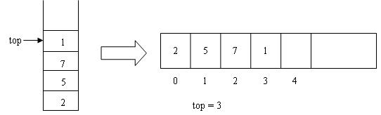
Implementation Using Arrays

Slide 12
The Stack Class - Public Contents
class Stack
{
public:
Stack() { size = 10; current = -1;}
int pop(){ return A[current--];}
void push(int x){A[++current] = x;}
int top(){ return A[current];}
int isEmpty(){return ( current == -1 );}
int isFull(){ return ( current == size-1);}

Slide 13
The Stack Class - Private Contents
private:
int object; // The data element
int current; // Index of the array
int size; // max size of the array
int A[10]; // Array of 10 elements
};

Slide 14
Stack - a Very Simple Application
The simplest application of a stack is to reverse a word.
You push a given word to stack - letter by letter - and then pop letters from the stack.

Slide 15
Applications of Stack
Recursion
Decimal to Binary Conversion
Infix to Postfix Conversion and Evaluation of Postfix Expressions
Rearranging Railroad Cars
Quick Sort
Function Calls
Undo button in various software.

Slide 16
outputInBinary - Algorithm
function outputInBinary(Integer n)
Stack s = new Stack
while n > 0 do
Integer bit = n modulo 2
s.push(bit)
if s is full then
return error
end if
n = floor(n / 2)
end while
while s is not empty do
output(s.pop())
end while
end function

Slide 17
Algebraic Expressions
Infix expressions
  An operator appears between its operands
    Example: a + b
Prefix expressions
  An operator appears before its operands
    Example: + a b
Postfix expressions
  An operator appears after its operands
    Example: a b +

Slide 18
A complicated example
Infix expressions:
  a + b * c + ( d * e + f ) * g
Postfix expressions:
  a b c * + d e * f + g * +
Prefix expressions:
  + + a * b c * + * d e f g

Slide 19
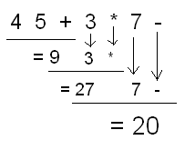
Evaluation of Postfix Expression

Slide 20
Evaluation of Postfix Expression
The calculation: 1 + 2 * 4 + 3 can be written down like this in postfix notation with the advantage of no precedence rules and parentheses needed
1 2 4 * + 3 +
The expression is evaluated from the left to right using a stack:
  when encountering an operand: push it
  when encountering an operator: pop two operands, evaluate the result and push it.

Slide 21
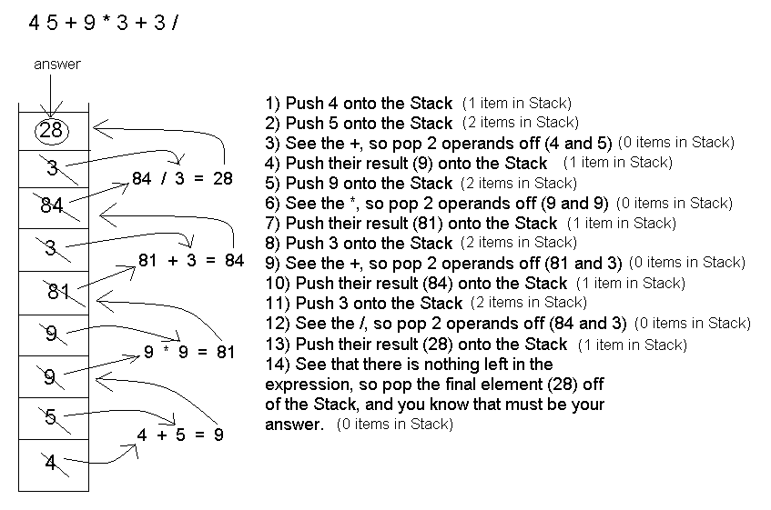
Evaluation of Postfix Expression

Slide 22
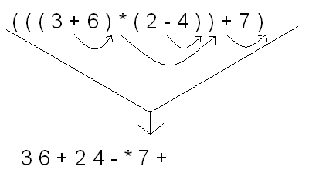
Infix to Postfix Conversion

Slide 23

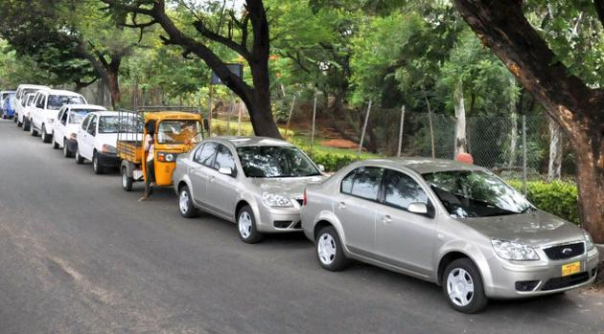
What’s this ?

Slide 24
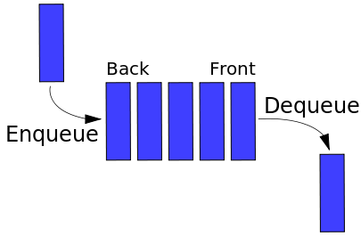
Queue

Slide 25
Queue
A stack is LIFO (Last-In First Out) structure. In contrast, a queue is a FIFO (First-In First-Out ) structure.
In a FIFO data structure, the first element added to the queue will be the first one to be removed.
A queue is a linear structure for which items can be only inserted at one end and removed at another end.

Slide 26
Operations on Queue
We will dedicate once again six operations on the Queue.
  You can add a person to the queue (enque),
  Look who is the first person to be serviced (front)
  Rremove the first person (dequeue) and
  Check whether the queue is empty (isEmpty).
  Also there are two more operations to create and to destroy the queue.

Slide 27
Operations
Queue create()
  Creates an empty queue
boolean isEmpty(Queue q)
  Tells whether the queue q is empty
enqueue(Queue q, Item e)
  Place e at the rear of the queue q
destroy(Queue q)
  destroys queue q

Slide 28
Operations
Item front(Queue q)
  returns the front element in Queue q without removing it
  Precondition: q is not empty
dequeue(Queue q)
  removes front element from the queue q
  Precondition: q is not empty

Slide 29
Implementation Using Arrays
If we use an array to hold queue elements, dequeue operation at the front (start) of the array is expensive.
This is because we may have to shift up to “n” elements.
For the stack, we needed only one end; for queue we need both.
To get around this, we will not shift upon removal of an element.

Slide 30
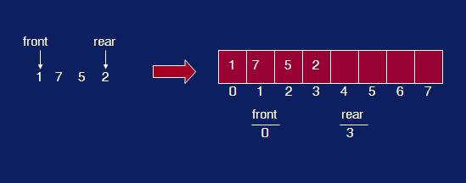
Snapshot of a Queue

Slide 31
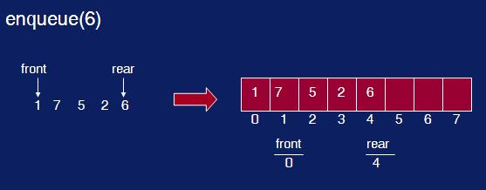
enqueue()

Slide 32
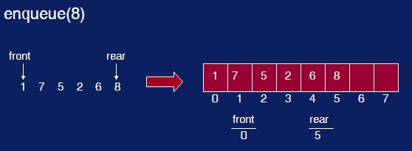
enqueue() again

Slide 33
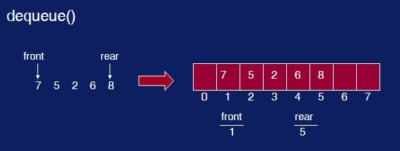
dequeue()

Slide 34
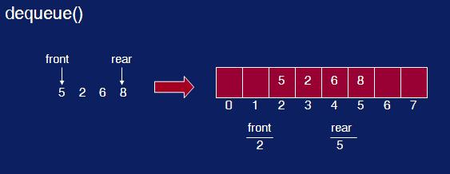
dequeue() again

Slide 35
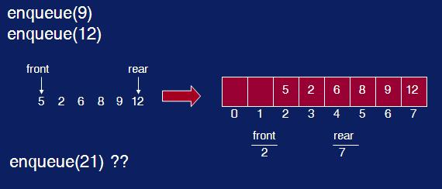
Two more enqueue()

Slide 36
What’s Wrong ?
We have inserts and removal running in constant time but we created a new problem.
We cannot insert new elements even though there are two places available at the start of the array.
Solution: allow the queue to “wrap around”. Basic idea is to picture the array as a circular array.

Slide 37
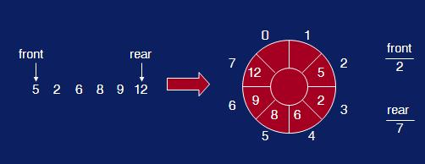
Queue array wrap-around

Slide 38
enqueue(element)
void enqueue(int x)
{
rear = (rear+1)%size;
array[rear] = x;
noElements = noElements+1;
}

Slide 39
dequeue()
int dequeue()
{
int x = array[front];
front = (front+1)%size;
noElements = noElements-1;
return x;
}

Slide 40
isEmpty() and isFull()
int isFull()
{
return noElements == size;
}
int isEmpty()
{
return noElements == 0;
}

Slide 41
isEmpty() and isFull()
int isFull()
{
return noElements == size;
}
int isEmpty()
{
return noElements == 0;
}

Slide 42
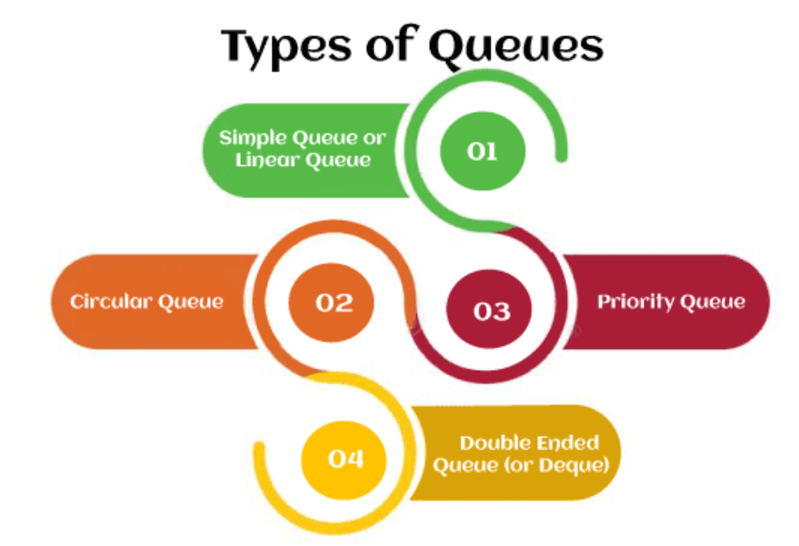

Slide 43
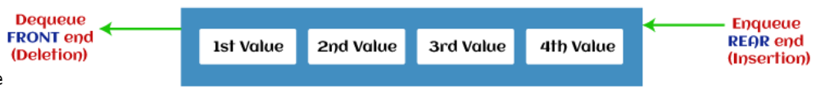
Simple Queue or Linear Queue
In Linear Queue, an insertion takes place from one end while the deletion occurs from another end. The end at which the insertion takes place is known as the rear end, and the end at which the deletion takes place is known as front end.

Slide 44
Circular Queue
In Circular Queue, all the nodes are represented as circular. It is similar to the linear Queue except that the last element of the queue is connected to the first element. It is also known as Ring Buffer, as all the ends are connected to another end.

Slide 45
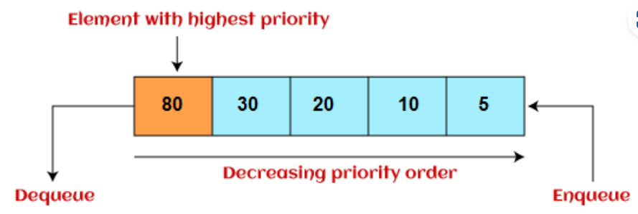
Priority Queue
It is a special type of queue in which the elements are arranged based on the priority. It is a special type of queue data structure in which every element has a priority associated with it. Insertion in priority queue takes place based on the arrival, while deletion in the priority queue occurs based on the priority. Priority queue is mainly used to implement the CPU scheduling algorithms.

Slide 46
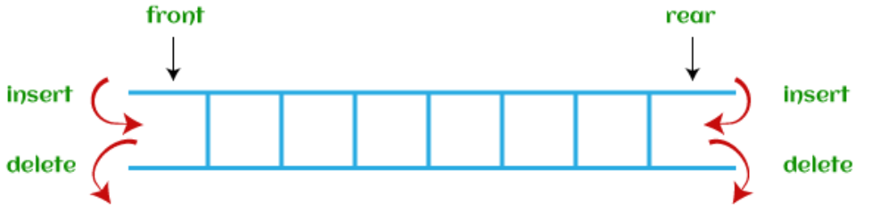
Deque (or, Double Ended Queue)
In Deque or Double Ended Queue, insertion and deletion can be done from both ends of the queue either from the front or rear. It means that we can insert and delete elements from both front and rear ends of the queue.

Slide 47
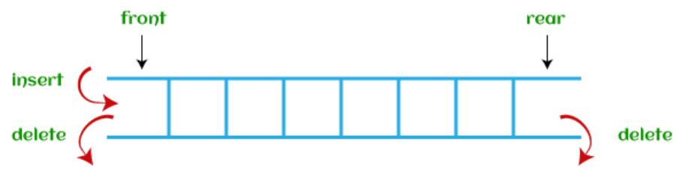
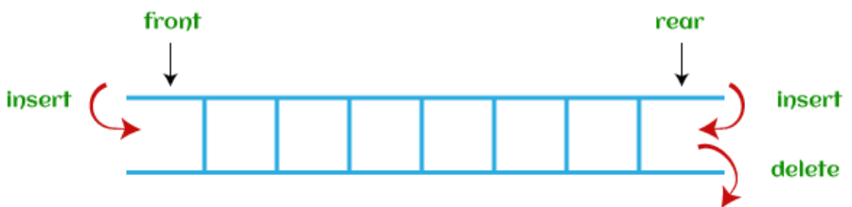
Deque (or, Double Ended Queue)
There are two types of deque:
  Input restricted deque
  Output restricted deque

Slide 48
Applications of Queues
Queue is used when things don’t have to be processed immediatly, but have to be processed in First In First Out order like Breadth First Search.
This property of Queue makes it also useful in following kind of scenarios.
When a resource is shared among multiple consumers. Examples include CPU scheduling, Disk Scheduling.
When data is transferred asynchronously (data not necessarily received at same rate as sent) between two processes. Examples include IO Buffers, pipes, file IO, etc.

Slide 49
Applications of Queues
Operating systems often maintain a queue of processes that are ready to execute or that are waiting for a particular event to occur.
Computer systems must often provide a “holding area” for messages between two processes, two programs, or even two systems. This holding area is usually called a “buffer” and is often implemented as a queue.
Call center phone systems will use a queue to hold people in line until a service representative is free.

Slide 50
Applications of Queues
Buffers on MP3 players and portable CD players, iPod playlist. Playlist for jukebox - add songs to the end, play from the front of the list.
Round Robin (RR) algorithm is an important scheduling algorithm. It is used especially for the time-sharing system. The circular queue is used to implement such algorithms.

