Slide 1
Circular Linked Lists

Slide 2
The circular linked list is a linked list where all nodes are connected to form a circle. In a circular linked list, the first node and the last node are connected to each other which forms a circle. There is no NULL at the end.

Slide 3
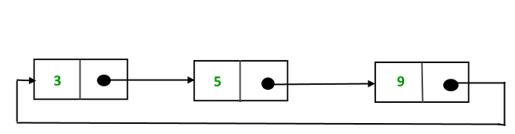
Two types of circular linked lists:
Circular singly linked list: In a circular Singly linked list, the last node of the list contains a pointer to the first node of the list. We traverse the circular singly linked list until we reach the same node where we started. The circular singly linked list has no beginning or end. No null value is present in the next part of any of the nodes.

Slide 4
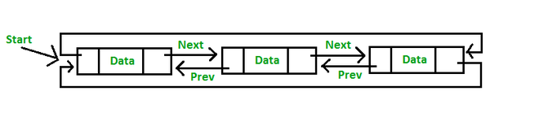
Circular Doubly linked list: Circular Doubly Linked List has properties of both doubly linked list and circular linked list in which two consecutive elements are linked or connected by the previous and next pointer and the last node points to the first node by the next pointer and also the first node points to the last node by the previous pointer.

Slide 5
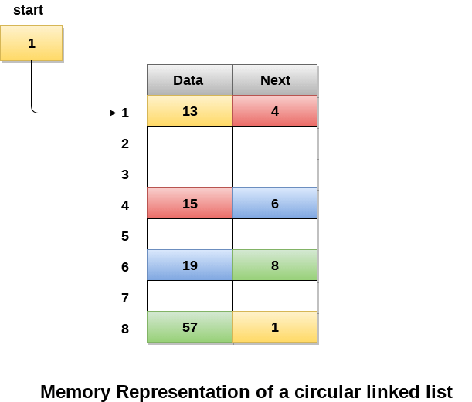
Memory Representation of circular linked list:

Slide 6
Memory Representation of circular linked list:
In the following image, memory representation of a circular linked list containing marks of a student in 4 subjects.
However, the image shows a glimpse of how the circular list is being stored in the memory.
The start or head of the list is pointing to the element with the index 1 and containing 13 marks in the data part and 4 in the next part. Which means that it is linked with the node that is being stored at 4th index of the list.
However, due to the fact that we are considering circular linked list in the memory therefore the last node of the list contains the address of the first node of the list.

Slide 7
Representation of circular linked list in data structure
Node representation of a Circular Linked List:
public class Node {
int data;
Node next;
public Node(int data) {
this.data = data;
this.next = null;
}
}

Slide 8
Operations on the circular linked list:
In a circular linked list, we perform the following operations...
Insertion
Deletion
Display

Slide 9
Insertion
In a circular linked list, the insertion operation can be performed in three ways. They are as follows...
Inserting At Beginning of the list
Inserting At End of the list
Inserting At Specific location in the list

Slide 10
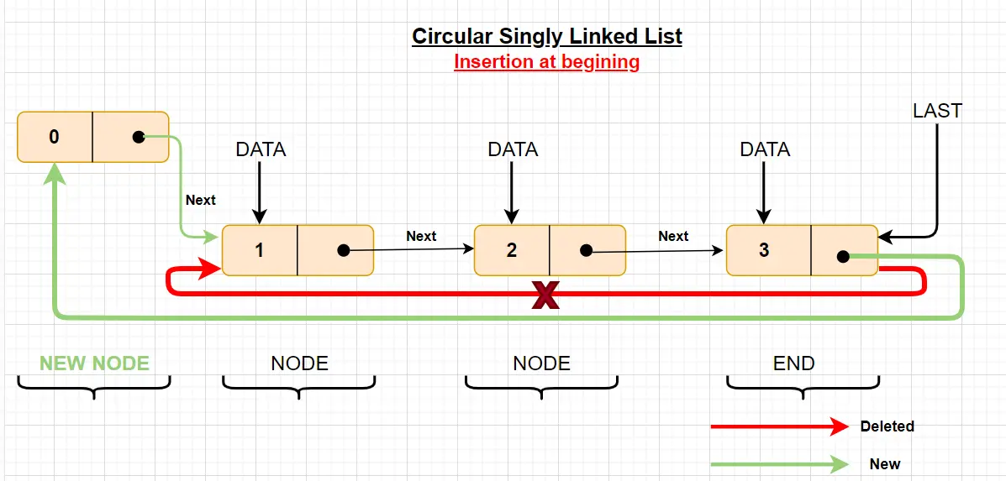
Insert the new node as the first node:

Slide 11
Inserting At Beginning of the list
We can use the following steps to insert a new node at beginning of the circular linked list...
Step 1 - Create a newNode with given value.
Step 2 - Check whether list is Empty (head == NULL)
Step 3 - If it is Empty then, set head = newNode and newNode→next = head .
Step 4 - If it is Not Empty then, define a Node pointer 'temp' and initialize with 'head'.
Step 5 - Keep moving the 'temp' to its next node until it reaches to the last node (until 'temp → next == head').
Step 6 - Set 'newNode → next =head', 'head = newNode' and 'temp → next = head'.

Slide 12
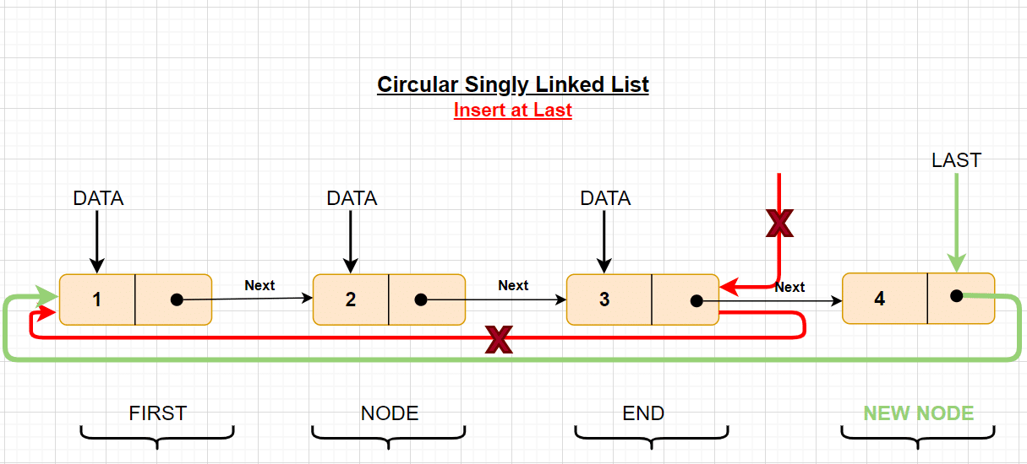
Inserting At End of the list

Slide 13
Inserting At End of the list
Step 1 - Create a newNode with given value.
Step 2 - Check whether list is Empty (head == NULL).
Step 3 - If it is Empty then, set head = newNode and newNode → next = head.
Step 4 - If it is Not Empty then, define a node pointer temp and initialize with head.
Step 5 - Keep moving the temp to its next node until it reaches to the last node in the list (until temp → next == head).
Step 6 - Set temp → next = newNode and newNode → next = head.

Slide 14
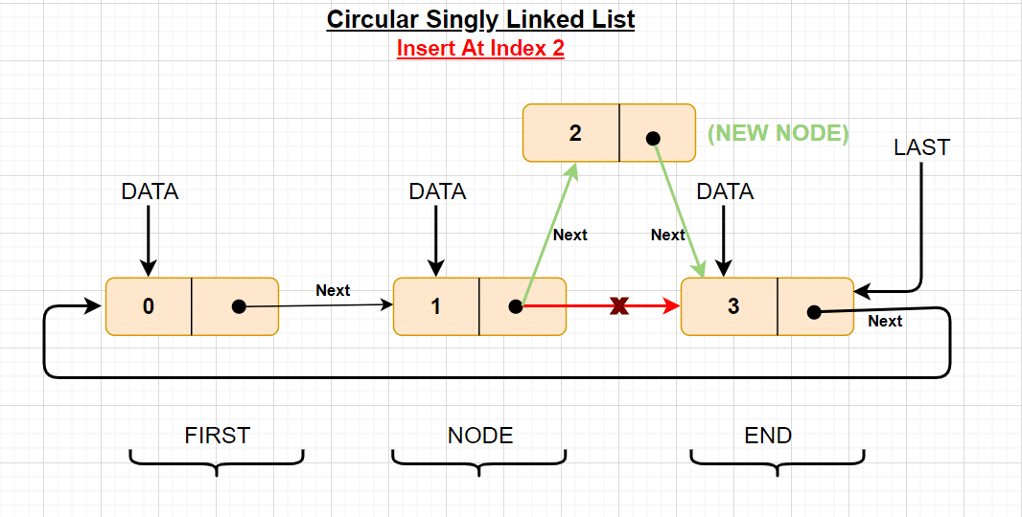
Inserting At Specific location in the list (After a Node)

Slide 15
Step 1 - Create a newNode with given value.
Step 2 - Check whether list is Empty (head == NULL)
Step 3 - If it is Empty then, set head = newNode and newNode → next = head.
Step 4 - If it is Not Empty then, define a node pointer temp and initialize with head.
Step 5 - Keep moving the temp to its next node until it reaches to the node after which we want to insert the newNode (until temp1 → data is equal to location, here location is the node value after which we want to insert the newNode).
Step 6 - Every time check whether temp is reached to the last node or not. If it is reached to last node then display 'Given node is not found in the list!!! Insertion not possible!!!' and terminate the function. Otherwise move the temp to next node.
Step 7 - If temp is reached to the exact node after which we want to insert the newNode then check whether it is last node (temp → next == head).
Step 8 - If temp is last node then set temp → next = newNode and newNode → next = head.
Step 8 - If temp is not last node then set newNode → next = temp → next and temp → next = newNode.

Slide 16
Deletion
In a circular linked list, the deletion operation can be performed in three ways those are as follows...
Deleting from Beginning of the list
Deleting from End of the list
Deleting a Specific Node

Slide 17
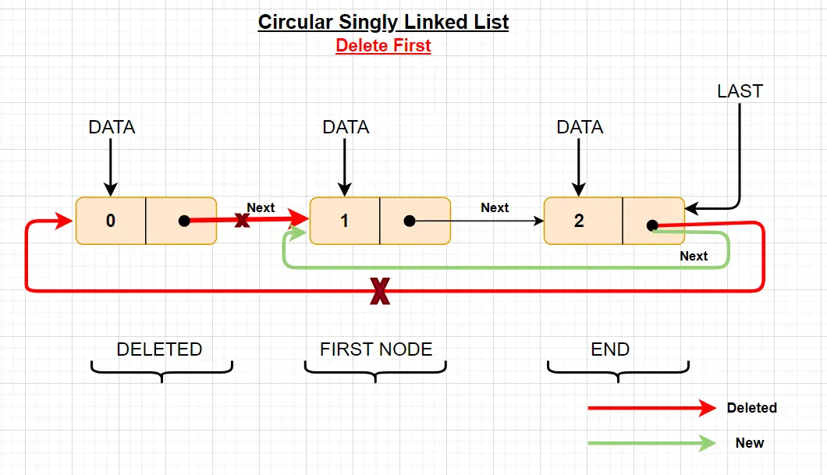
Deleting from Beginning of the list

Slide 18
Deleting from Beginning of the list
Step 1 - Check whether list is Empty (head == NULL)
Step 2 - If it is Empty then, display 'List is Empty!!! Deletion is not possible' and terminate the function.
Step 3 - If it is Not Empty then, define two Node pointers 'temp1' and 'temp2' and initialize both 'temp1' and 'temp2' with head.
Step 4 - Check whether list is having only one node (temp1 → next == head)
Step 5 - If it is TRUE then set head = NULL and delete temp1 (Setting Empty list conditions)
Step 6 - If it is FALSE move the temp1 until it reaches to the last node. (until temp1 → next == head )
Step 7 - Then set head = temp2 → next, temp1 → next = head and delete temp2.

Slide 19
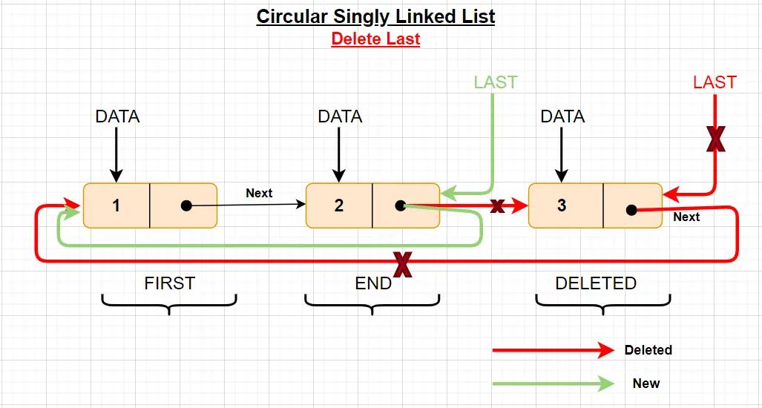
Deleting from End of the list

Slide 20
Deleting from End of the list
Step 1 - Check whether list is Empty (head == NULL)
Step 2 - If it is Empty then, display 'List is Empty!!! Deletion is not possible' and terminate the function.
Step 3 - If it is Not Empty then, define two Node pointers 'temp1' and 'temp2' and initialize 'temp1' with head.
Step 4 - Check whether list has only one Node (temp1 → next == head)
Step 5 - If it is TRUE. Then, set head = NULL and delete temp1. And terminate from the function. (Setting Empty list condition)
Step 6 - If it is FALSE. Then, set 'temp2 = temp1 ' and move temp1 to its next node. Repeat the same until temp1 reaches to the last node in the list. (until temp1 → next == head)
Step 7 - Set temp2 → next = head and delete temp1.

Slide 21
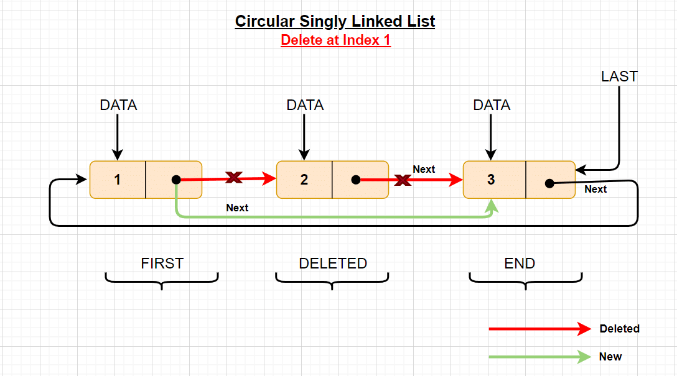
Deleting a Specific Node from the list

Slide 22
Deleting a Specific Node from the list
Step 1 - Check whether list is Empty (head == NULL)
Step 2 - If it is Empty then, display 'List is Empty!!! Deletion is not possible' and terminate the function.
Step 3 - If it is Not Empty then, define two Node pointers 'temp1' and 'temp2' and initialize 'temp1' with head.
Step 4 - Keep moving the temp1 until it reaches to the exact node to be deleted or to the last node. And every time set 'temp2 = temp1' before moving the 'temp1' to its next node.
Step 5 - If it is reached to the last node then display 'Given node not found in the list! Deletion not possible!!!'. And terminate the function.
Step 6 - If it is reached to the exact node which we want to delete, then check whether list is having only one node (temp1 → next == head)
Step 7 - If list has only one node and that is the node to be deleted then set head = NULL and delete temp1 (free(temp1)).
Step 8 - If list contains multiple nodes then check whether temp1 is the first node in the list (temp1 == head).
Step 9 - If temp1 is the first node then set temp2 = head and keep moving temp2 to its next node until temp2 reaches to the last node. Then set head = head → next, temp2 → next = head and delete temp1.
Step 10 - If temp1 is not first node then check whether it is last node in the list (temp1 → next == head).
Step 1 1- If temp1 is last node then set temp2 → next = head and delete temp1 (free(temp1)).
Step 12 - If temp1 is not first node and not last node then set temp2 → next = temp1 → next and delete temp1 (free(temp1)).

Slide 23
Displaying a circular Linked List
Step 1 - Check whether list is Empty (head == NULL)
Step 2 - If it is Empty, then display 'List is Empty!!!' and terminate the function.
Step 3 - If it is Not Empty then, define a Node pointer 'temp' and initialize with head.
Step 4 - Keep displaying temp → data with an arrow (--->) until temp reaches to the last node
Step 5 - Finally display temp → data with arrow pointing to head → data.

