Slide 1

ONLINE BANKING SYSTEM
Team Members
Sayantan Samanta
Swarvanu Sengupta
SK.Asfaque Ahamed
Swarnali Banerjee
Sudipta Mondal

Slide 2
Problem Definition
Online banking (or Internet banking) allows customers to conduct financial transactions on a secure website operated by their retail or virtual bank, credit union or building society.

Slide 3
Advantage
Convenience
Transaction speed
Efficiency
Effectiveness
Inexpensive

Slide 4
Roles Of Actors & Functionality
Module 1:Administrator:
Register an account
Close account
View details of an account
Search

Slide 5
Module 2:Customers:
User id & password
Account details
Fund transfer

Slide 6
Hardware/Software Requirements
Hardware requirements:
client side:
server side:
Software requirements:
Web server-JBOSS4.2
Front end-JEE,JSP
Back end-Oracle 10g
Processor | RAM | Disc space
Pentium II at 500Mhz | 64MB | 500MB
Processor | RAM | Disc space
Pentium III at 1Ghz | 512MB | 1 GB
Pentium III at 1Ghz | 512MB | 512MB

Slide 7
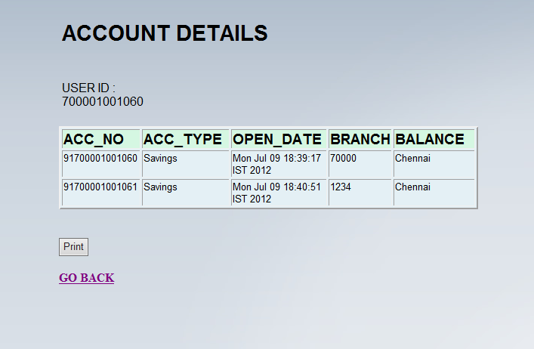
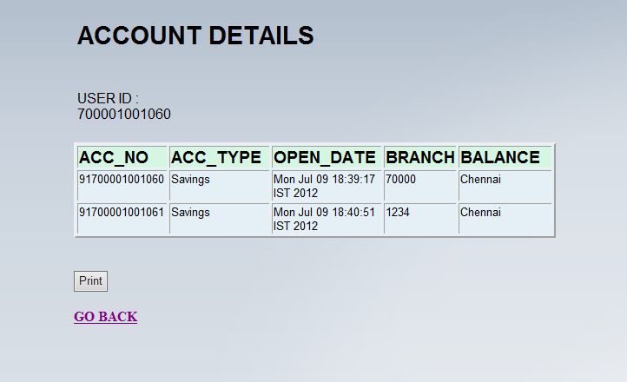
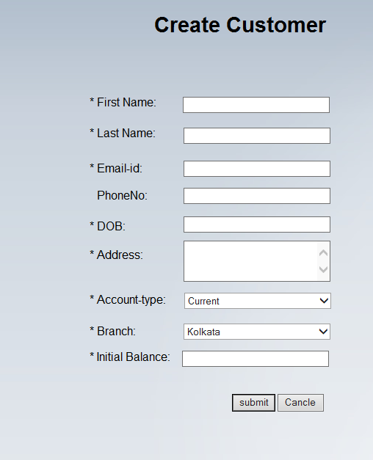
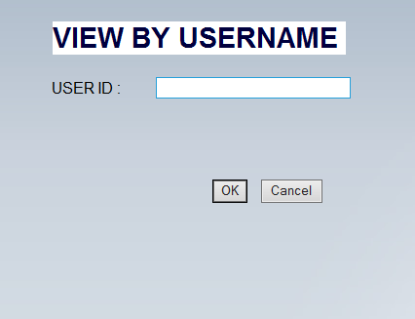
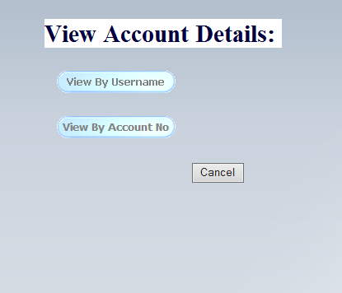
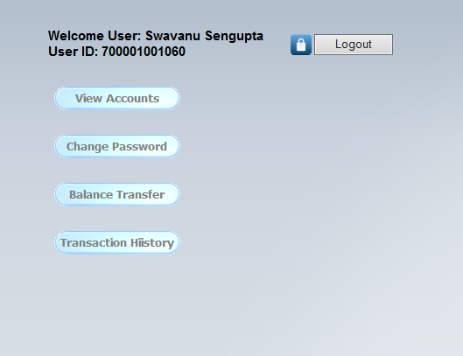
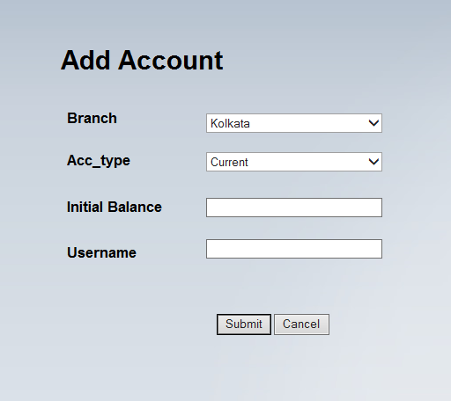
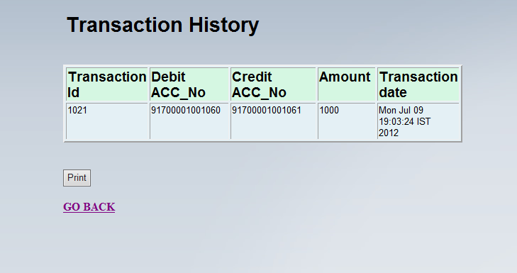
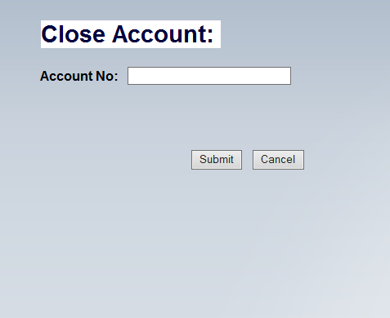
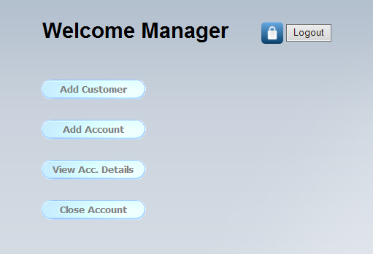
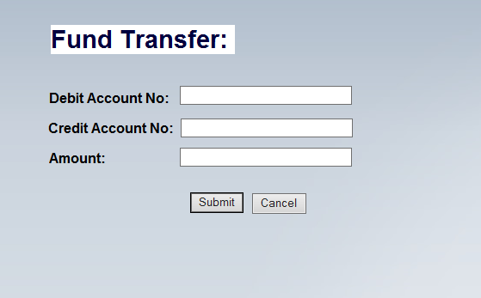
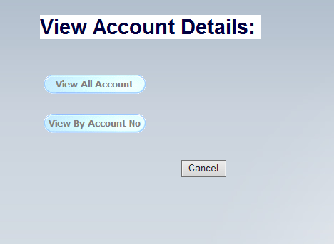
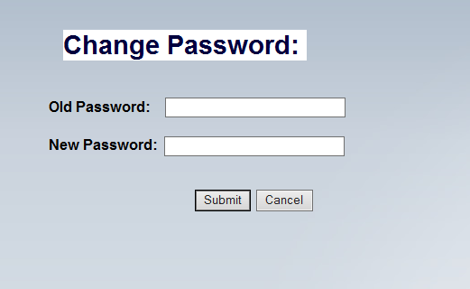
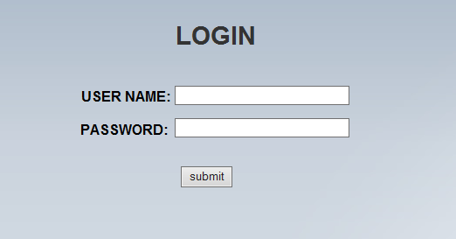
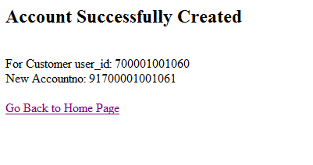
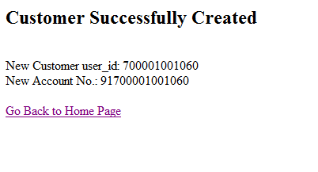
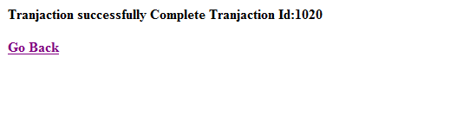
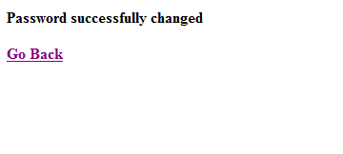
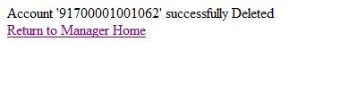
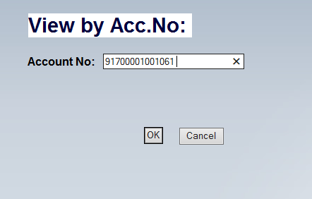
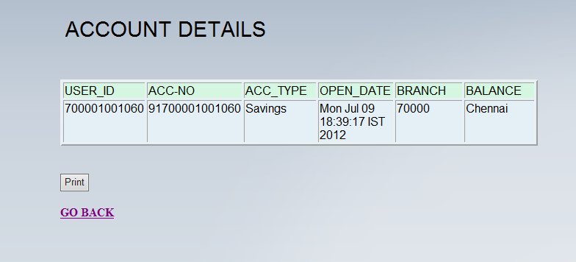
Screen Shots/Features:

Slide 8
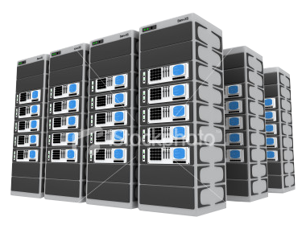
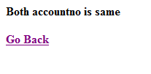
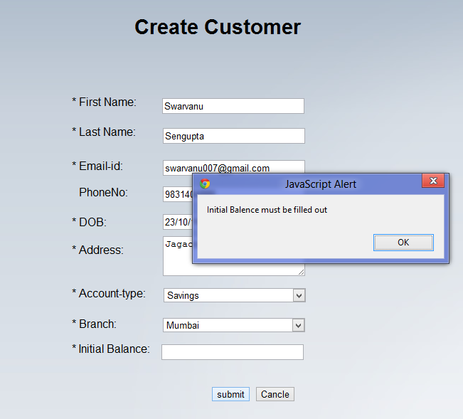

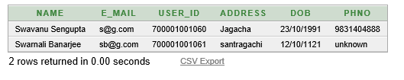



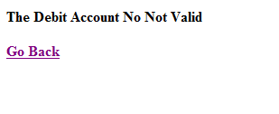
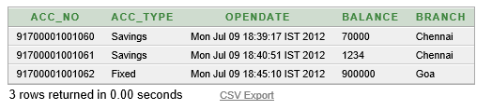
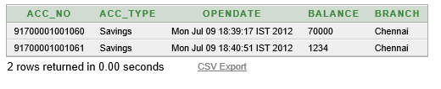
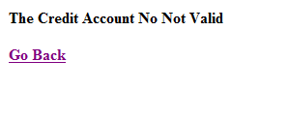




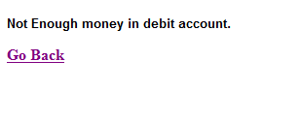
Extra but Important Features:
AB17XY 700001001004
Encryption / Decryption Logic
AB17XYHFKKKRH1221 700001001004
AB17XY 700001001004

Slide 9
Future Enhancement
In future it will be multiuser
Cash withdrawal record can be maintained.
Record of loans can also be kept.
Use of sql keys
Ultimately the software may lead to a complete automation system.
Online bill payment
Forgot password features

