Slide 1
Deep ANC

Slide 2
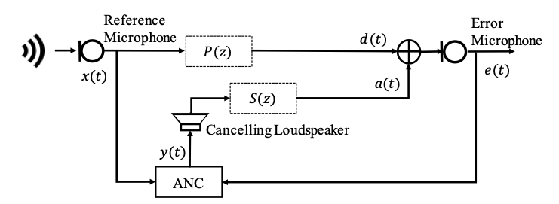
Traditional active noise control
Based on adaptive signal processing with the least mean square algorithm
Not perform satisfactorily in nonlinear distortion

Slide 3
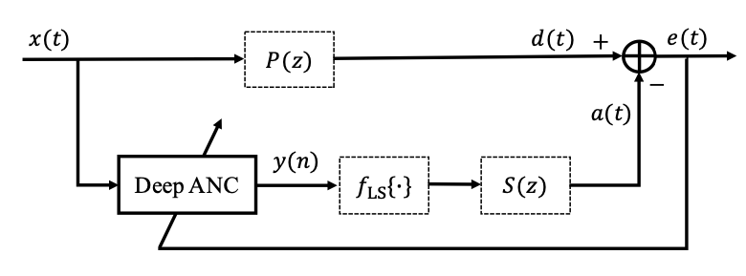
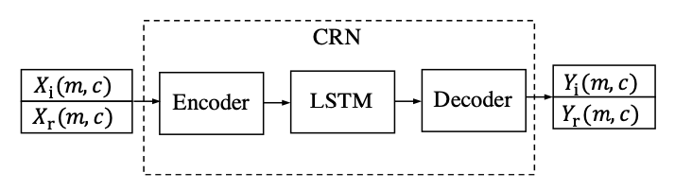
Active noise control based on CRN
Propose Deep ANC
Perform satisfactorily in nonlinear distortion
Formulate ANC as a supervised learning problem
Use Deep ANC to evaluate the real and imaginary spectrograms of canceling signal

Slide 4

Training method1
Deep ANC trained with only noise
Loss function
L: the length of the noise signal, e(t): error signal

Slide 5
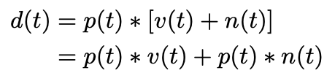

Training method2
Deep ANC trained with noisy speech
Loss function
p(t): impulse response of primary path
v(t): speech signal
n(t): noise signal

Slide 6
Learning machine
Why CRN?
1. suitable for real-time processing
2. used for complex spectral mapping and speech enhancement

Slide 7
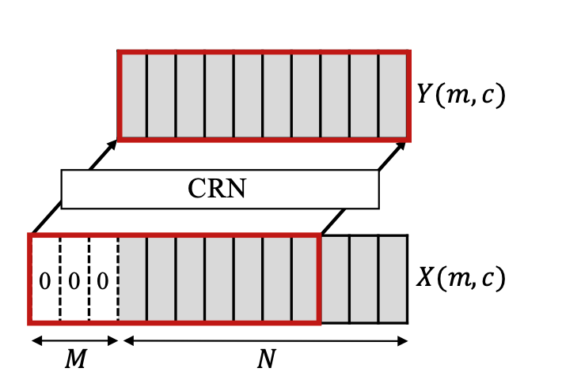
Delay-compensated training
X(t) -> X(m,c) (by Fourier transform)
Get the real and imaginary spectrograms
Input: X(m,c)
Output: Y(m,c)
m: time unit, c: frequency
Use previous M frames and N – m original frames to be input frame
Predict M frames of the target

Slide 8
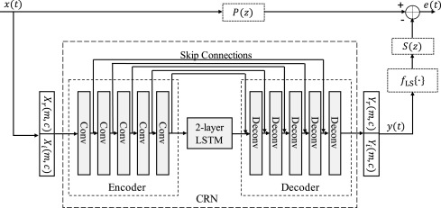
Flow

Slide 9
Dataset
Sound-effect library
Non-speech environmental sound
Price: depends on each library
Link: https://www.sound-ideas.com/search.aspx?qstr=noise&Type=Product&Filter=%%
NOISEX-92
Engine noise, factory noise, babble noise, speech-shaped noise
Price: Free
Link: http://spib.linse.ufsc.br/noise.html

