Slide 1
AXTRACT Test Deck
Subtitle: PPTX extraction

Slide 2
Agenda
Revenue review
Regional table
Chart image

Slide 3
Regional Revenue
Region | FY2024 | FY2023 | Change
North America | $1,200 | $1,100 | 9%
Europe | (450) | 480 | -6%
Asia Pacific | 980 | 900 | 8.9%
LATAM | 1,234.56 | (1,234) | 50%

Slide 4
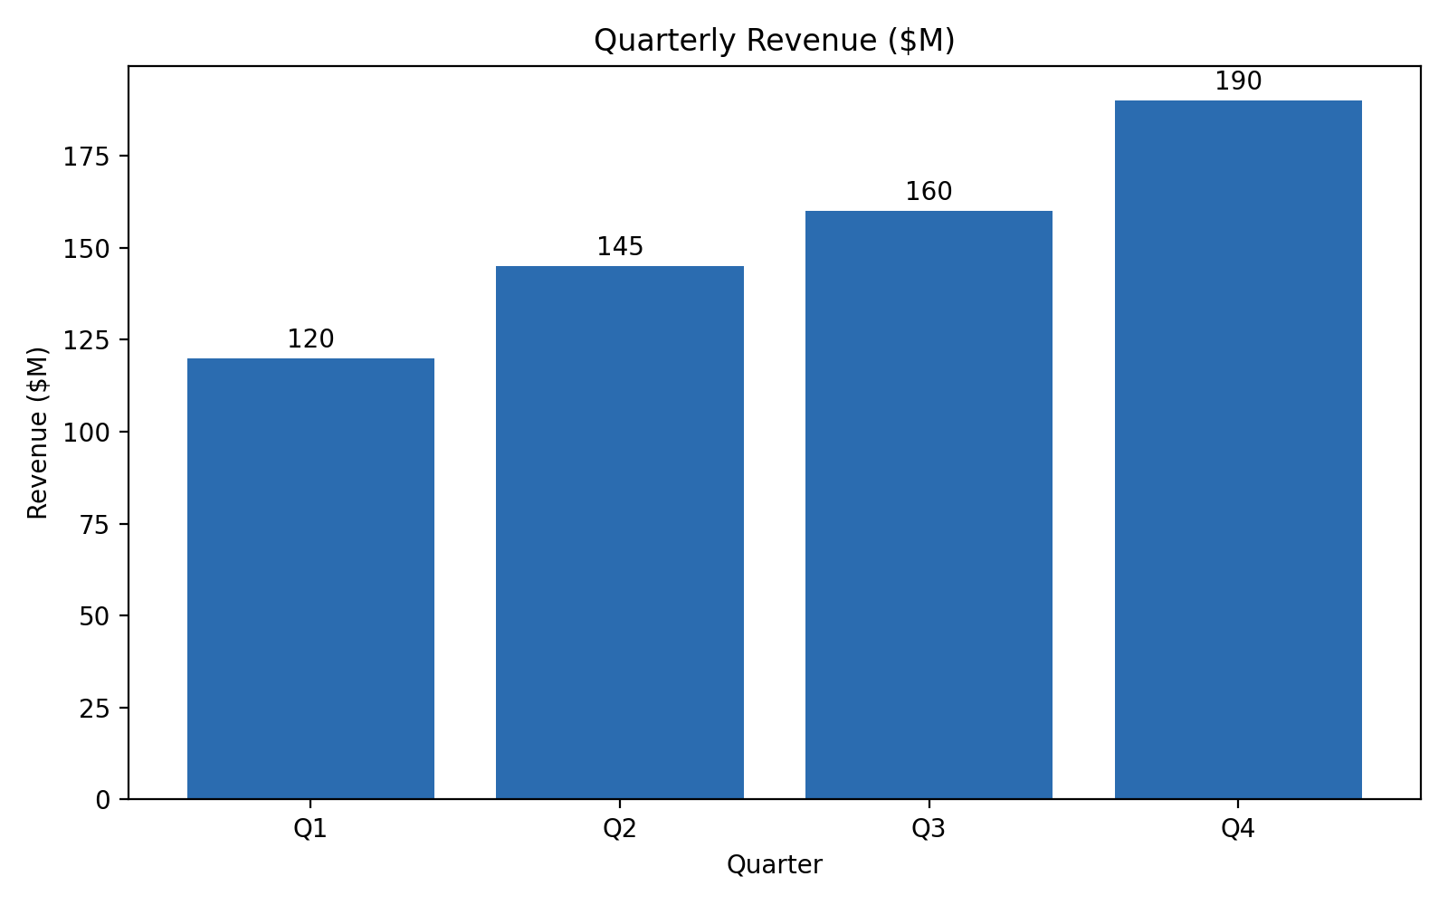
Quarterly Revenue Bar Chart

