Slide 1
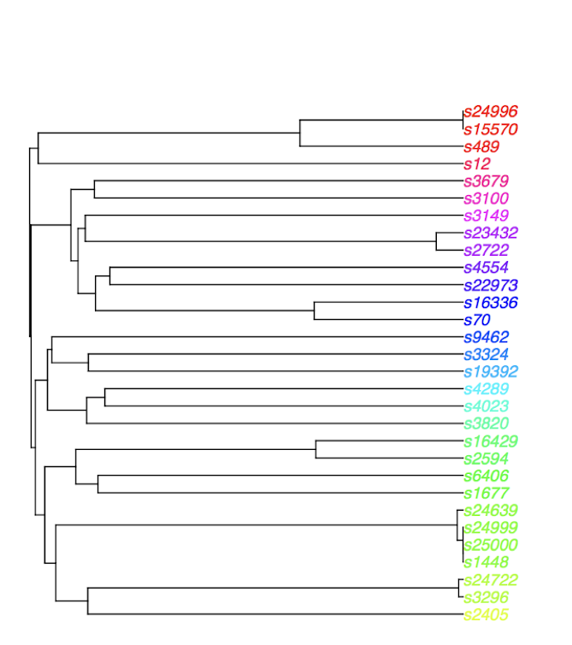
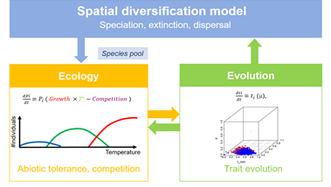

Linking pattern and process:
insights from comparing 12
eco-evolutionary simulation models
ALLEN HURLBERT
University of North Carolina

Slide 2
Motivation
Simulation models produce patterns expected under a given set of rules, processes, and constraints
Models vary in complexity (designed for different purposes):
Statistical vs Conceptual vs Realistical
The same process could be implemented in many different ways

Slide 3
Motivation
Simulation models produce patterns expected under a given set of rules, processes, and constraints
Models vary in complexity (designed for different purposes):
Statistical vs Conceptual vs Realistical
The same process could be implemented in many different ways
GENERAL QUESTION
How dependent is the perceived link between pattern and process on the model implementation choices for a given process?

Slide 4
Research Questions
PATTERNS
Phylogenetic trees, metrics of tree shape (Louca & Pennell 2020 highlight challenge)
QUESTION
Are there any process-pattern linkages that are robust to details of model implementation?
Which process-pattern linkages are most sensitive to implementation?
can we infer the strength of a process from tree shape
discriminant / classification analysis

Slide 5
Research Questions
Are there any process-pattern linkages that are robust to details of model implementation?
Experimental design
For each simulation model, sample uniformly across (“relevant”) parameter space.

Slide 6
Research Questions
Are there any process-pattern linkages that are robust to details of model implementation?
Experimental design
For each simulation model, sample uniformly across (“relevant”) parameter space.
Identify parameters most associated with key processes of interest:
Environmental filtering
Dispersal
Niche conservatism
Mutation/speciation rates
Competition
Time

Slide 7
Research Questions
Are there any process-pattern linkages that are robust to details of model implementation?
Experimental design
For each simulation model, sample uniformly across (“relevant”) parameter space.
Identify parameters most associated with key processes of interest:
Environmental filtering
Dispersal
Niche conservatism
Mutation/speciation rates
Competition
Time
3) Confirm sign of parameter

Slide 8
Research Questions
Are there any process-pattern linkages that are robust to details of model implementation?
Experimental design
For each simulation model, sample uniformly across (“relevant”) parameter space.
Identify parameters most associated with key processes of interest:
Environmental filtering
Dispersal
Niche conservatism
Mutation/speciation rates
Competition
Time
3) Confirm sign of parameter
4) Calculate metrics of tree shape

Slide 9
Research Questions
Are there any process-pattern linkages that are robust to details of model implementation?
Experimental design
For each simulation model, sample uniformly across (“relevant”) parameter space.
Identify parameters most associated with key processes of interest:
Environmental filtering
Dispersal
Niche conservatism
Mutation/speciation rates
Competition
Time
3) Confirm sign of parameter
4) Calculate metrics of tree shape
5) Correlation coefficient summarizes association between model parameters and tree metrics

Slide 10
Models participating in relevant experiments
Model | env | nic | dis | mut | com | tim
Yule (yu)
PDA (pda)
TreeSim (oh)
DAISIE (ve) |  |  | X | X |  | X
Hurlbert-Stegen (hs) | X | X | X | X |  | (X)
Pontarp (pontarp) | X | X | X |  | X
Hartig (fh)
Coelho et al. (mt)
Leprieur et al. (split)
Rangel (ra)
gen3sis (ga) |  |  | X | X |  | X
Xu-Etienne (xe) |  |  | X |  | X
Cabral (ca) | X | X | X | X | X | X

Slide 11
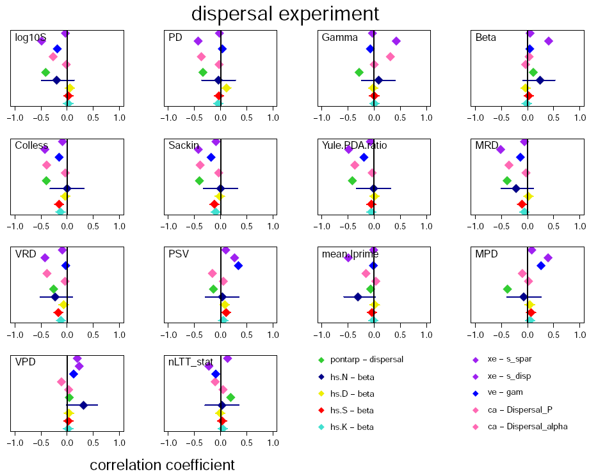

Slide 12
Several tree metrics show a consistent association with dispersal.

Slide 13
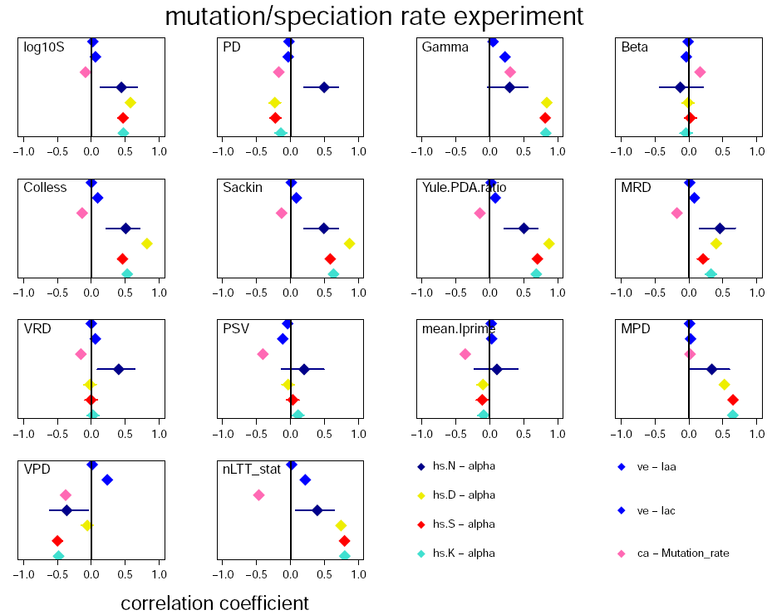
Several tree metrics show a consistent association with mutation/speciation,
but certain models are sometimes outliers
(e.g. Cabral or hs.N here)

Slide 14
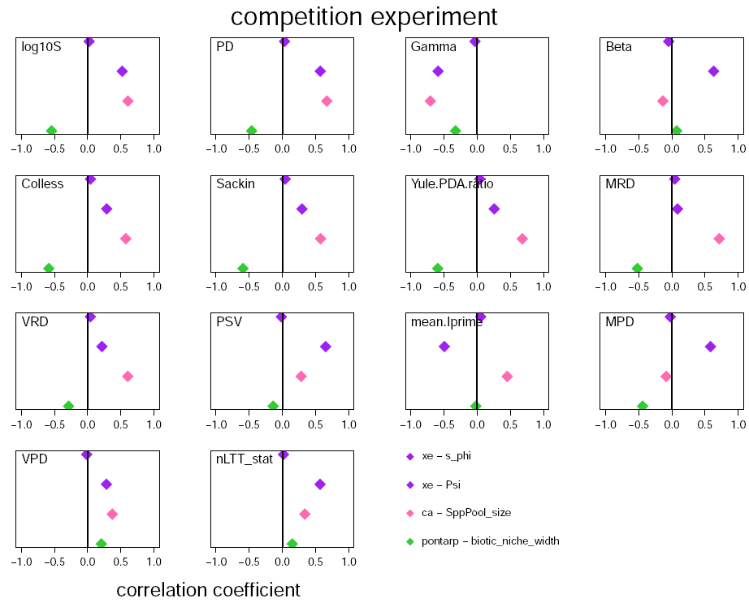
Some processes seem to result in larger absolute correlations than others
(but small sample size)

Slide 15
Some processes seem to result in larger absolute correlations than others
(but small sample size)
Also, note clearly different implementations of the “process”

Slide 16
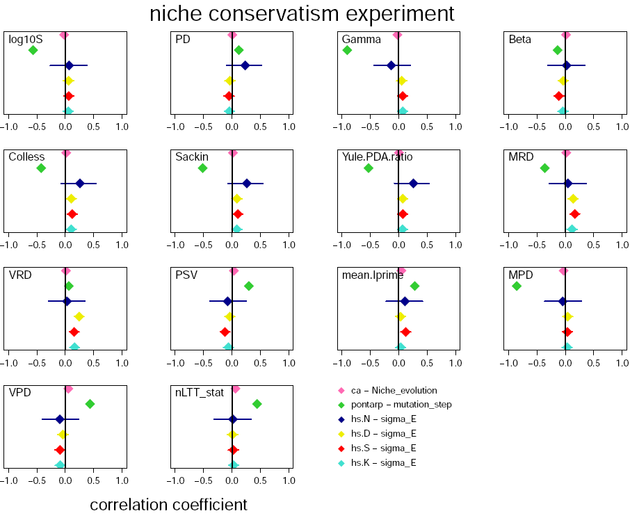
Some processes seem to result in weak correlations
Pontarp stands out here, and often has relatively strong correlations

Slide 17
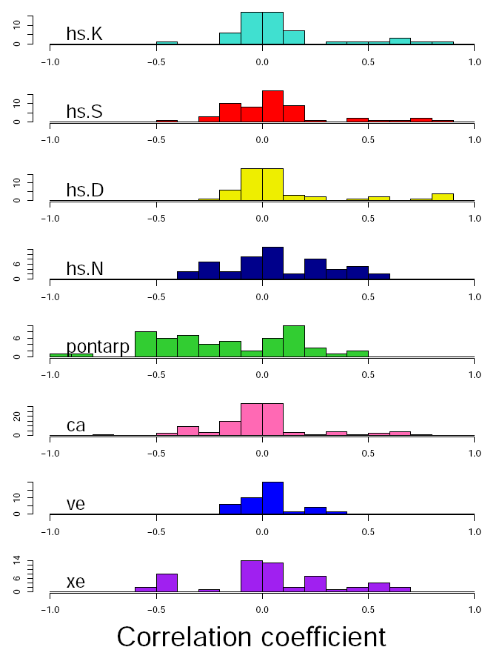
By Model
Some processes seem to result in weak correlations
Pontarp stands out here, and often has relatively strong correlations

Slide 18
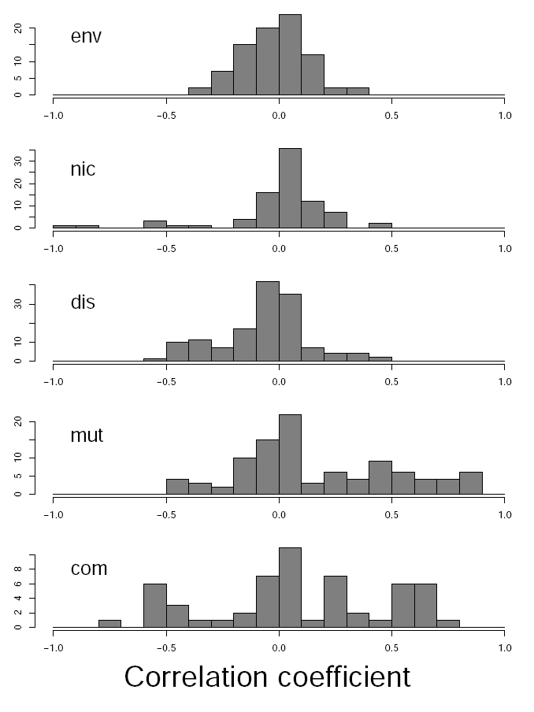
By Model
By Experiment
Some processes seem to result in weak correlations
Pontarp stands out here, and often has relatively strong correlations
Mutation/speciation and competition result in stronger corrs

Slide 19
Moving forward
A general search for consistency across all pattern-process linkages
What can models tell / not tell us about these processes?
Adding models to the experiment (e.g. gen3sis, rangel, coelho, …)
Clarifying / classifying interpretation of parameters relative to the experiment
“time” – so far only Cabral has run, but this should be possible for all

Slide 20
Moving forward
A general search for consistency across all pattern-process linkages
What can models tell / not tell us about these processes?
Adding models to the experiment (e.g. gen3sis, rangel, coelho, …)
Clarifying / classifying interpretation of parameters relative to the experiment
“time” – so far only Cabral has run, but this should be possible for all
Can we infer the strength of a process from tree shape
discriminant / classification analysis
within and across models
(despite incomplete model-experiment combinations)

Slide 22
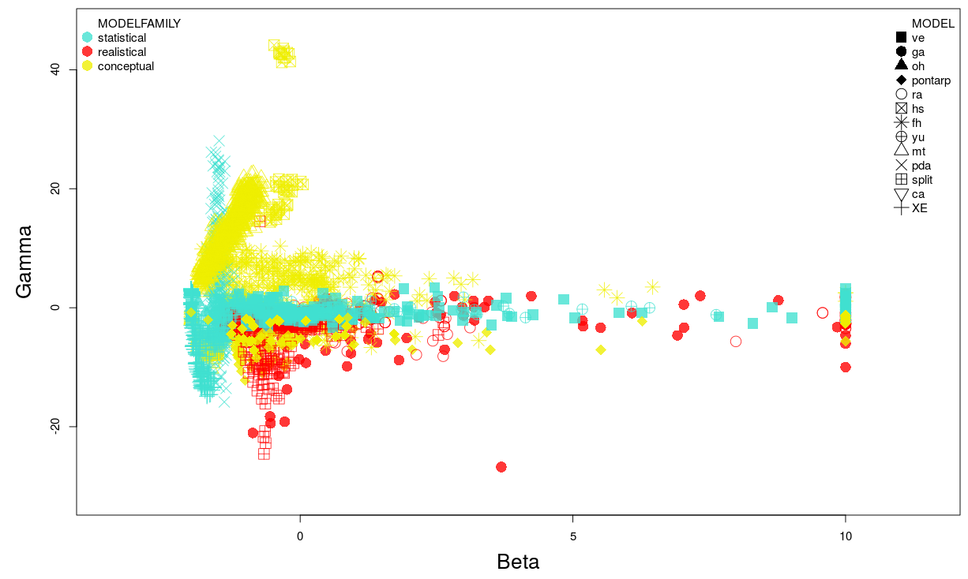
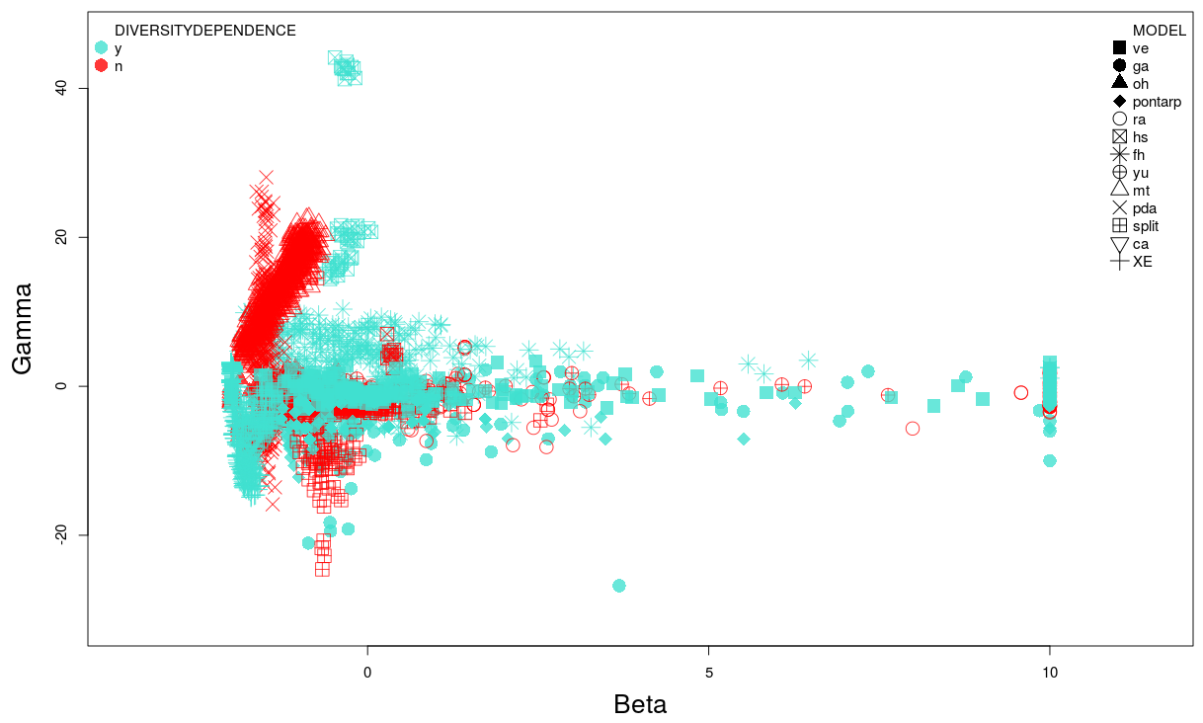
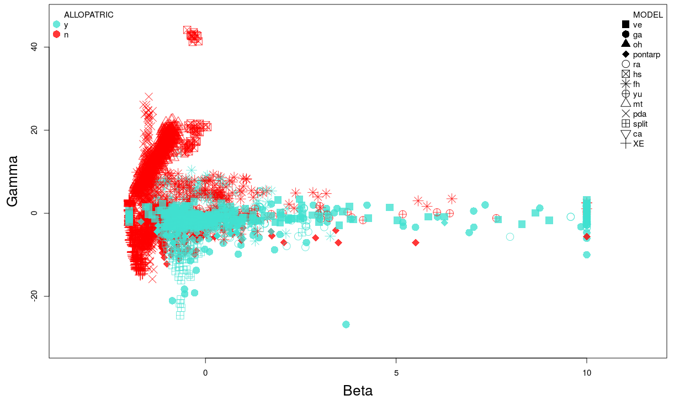
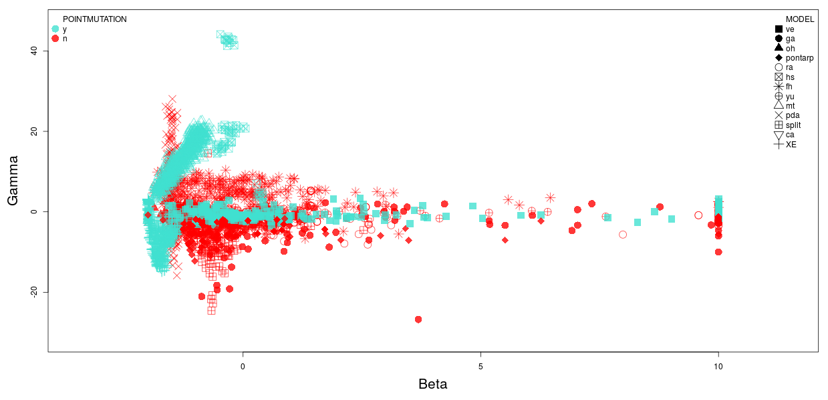
Model class
Diversity dependence
Allopatric speciation
Point mutation speciation

