Slide 1
Ecomerce APP
An Ecommerce app. Aliexpress clone

Slide 2
Description
This app helps inhabitants to shop online and make purchases without any physical fatigue. This application will become the best seller among companies. So, the buyer can add the product of his choice to the basket and buy it later.

Slide 3
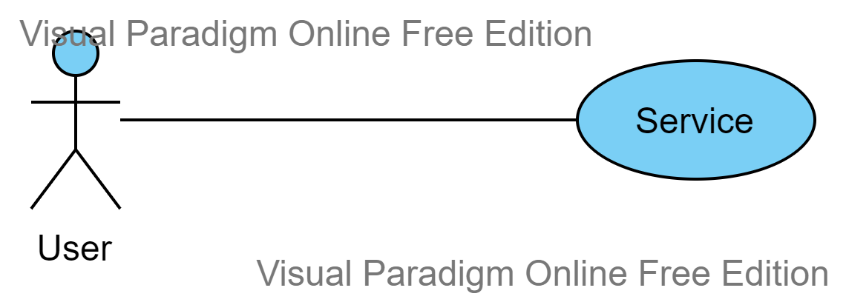
Context Diagram

Slide 4
Requirement ID | Description
F1 | Search product
F1.1 | Search by name
F1.2 | Search by category
F2 | Show popular products
F3 | Show list of products
F3.1 | Show price
F3.2 | Show description of product
F4 | Show product page
F4.1 | Choose size
F4.2 | Choose color
F4.3 | Add to basket
F5 | Manage basket
F5.1 | Show list of products
F5.2 | Delete some products from the basket
F5.3 | Show total price
Functional Requirment

Slide 5
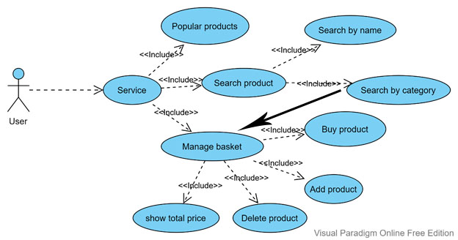
Use Case Diagram

Slide 6
Scenarios
Step | Description
1 | Open home page
2 | Browse popular products
3 | Choose one
4 | Open product page
5 | Choose attributes
6 | Add to basket
7 | Go to basket
8 | Delete some products
9 | Buy

Slide 7
Glossary
API
Basket
Brand
Customer
Application programming interface for app.
Virtual basket to gather items before buying
Name of popular product
User

Slide 8
Glossary
Discounts
Scene
JavaFX
FXML
That product which in the sale
The screen which appears on user`s device
Deploy rich client applications that operate consistently across diverse platforms.
The structure for building a user interface separate from the application logic

Slide 9
Glossary
Shipping
U I
Manufacture and packing of goods and will controlled by shipping or logistic company
User may interact with to use a digital product or service. Like screens, touchscreens, keyboards, sounds and even light.

Slide 10
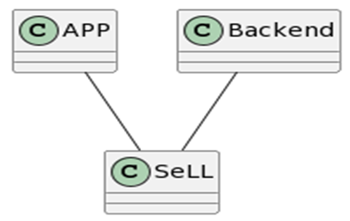
System Design

