Slide 1
Changing Case

Slide 2
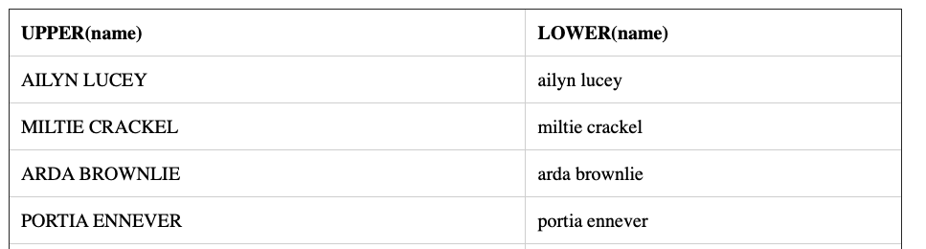
Changing Case
Use the function UPPER() to return a string converted to uppercase
Use the function LOWER() to return a string converted to lowercase
Case changes affect only letters. Digits, punctuation and whitespace are left unchanged
If argument is NULL, it returns NULL
Use an alias for a better output column name
SELECT UPPER(name), LOWER(name)
FROM members;

Slide 3
Concatenating Strings

Slide 4
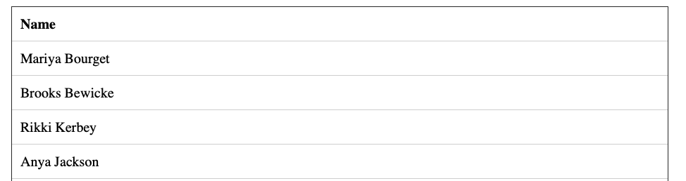
Concatenating Strings with Concat()
Use Concat() to concatenate stings
The following applies:
Concatenation does NOT add space between strings
Concatenating a null involves a null
Concatenating a string and a nonstring, you must convert the nonstring to a string
SELECT CONCAT(first_name, ' ', last_name) AS Name
FROM customer_data;

Slide 5
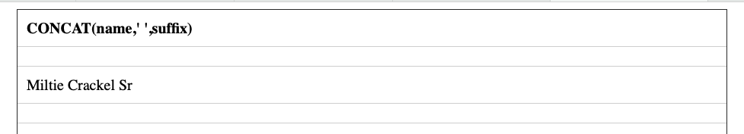
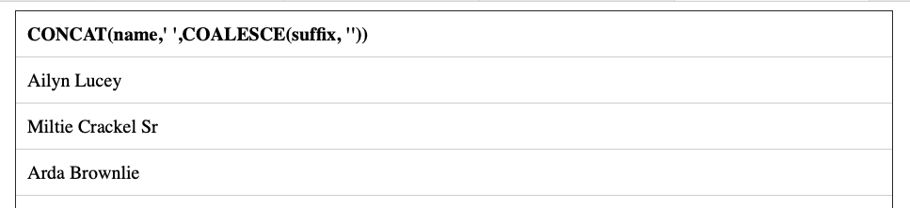
Concatenating Strings with Concat()
If your column contains nulls – you may get unexpected results
Use the COALESCE function to handle any potential issues
SELECT CONCAT(name,' ',suffix)
FROM members;
SELECT CONCAT(name,' ',COALESCE(suffix, ''))
FROM members;

Slide 6
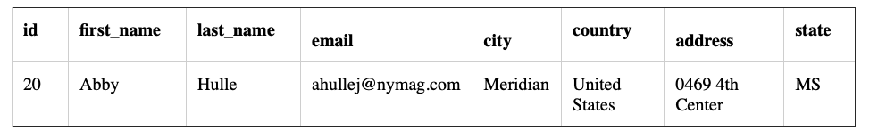
Concatenating Strings with Concat()
You can use Concat() in SELECT, WHERE and ORDER BY clauses
SELECT *
FROM customer_data
WHERE CONCAT(first_name, ' ', last_name) = 'Abby Hulle';

Slide 7
Using Mathematical Operations

Slide 8
Operators and Functions
Allow you to calculate results derived from column values and other data
You can perform the following:
Arithmetic operations – cut everyone’s salary by a set %
String operations – concatenate first and last name
Datetime operations – compute the interval between two dates
System operations – find out what time the DBMS thinks it is
Operator is a symbol or keyword indicating the operation that acts on one or more elements
Operands are the SQL expressions
Function is a built-in, named routine that performs a specialized task
Functions can take parenthesized arguments

Slide 9
Arithmetic Operation
Mathematical operations can be applied to results
Arithmetic operators perform mathematical operation on two operands
These include:
+ for addition
- for subtraction
* for multiplication
/ for division
-expr will reverse the sign of expr

Slide 10
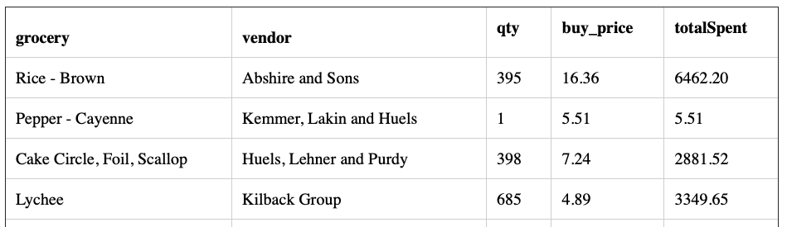
Arithmetic Operation
The result of any arithmetic operation that involves a null is null
Use parenthesis to control the calculation order
When calculating multiple data types, the system will convert to the most complex type
(integer X decimal value will convert to a decimal value)
SELECT grocery, vendor, qty, buy_price, qty * buy_price AS totalSpent
FROM groceries;

Slide 11
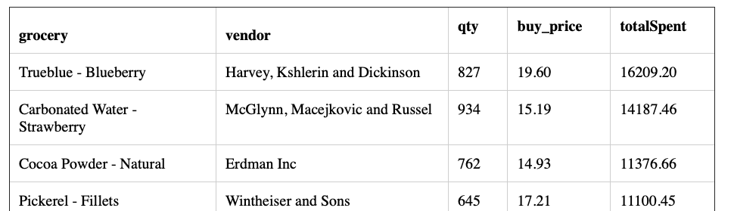
Arithmetic Operations
SELECT grocery, vendor, qty, buy_price, qty * buy_price AS totalSpent
FROM groceries
ORDER BY totalSpent DESC;

Slide 12
Working with Substrings

Slide 13
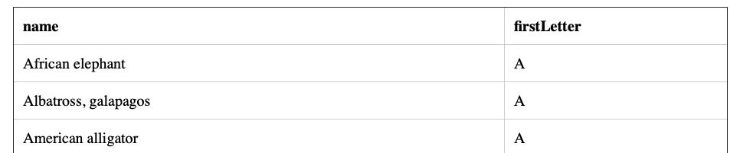
Extracting a SUBSTRING()
Use the function SUBSTRING() to extract a part of a string
A substring is any sequence of contiguous characters
Extracts part of a string starting at a specified position and continuing for a specified number of characters
SUBSTRING(string FROM start FOR LENGTH)
You can use SUBSTRING() in SELECT, WHERE and ORDER BY
SELECT name, SUBSTRING(name FROM 1 FOR 1) AS firstLetter
FROM animalNames
ORDER BY firstLetter;

Slide 14
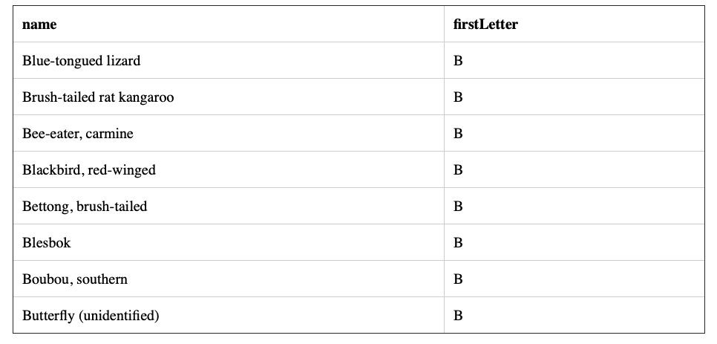
Extracting a SUBSTRING()
SELECT name, SUBSTRING(name FROM 1 FOR 1) AS firstLetter
FROM animalNames
WHERE SUBSTRING(name FROM 1 FOR 1) = 'B';

Slide 15
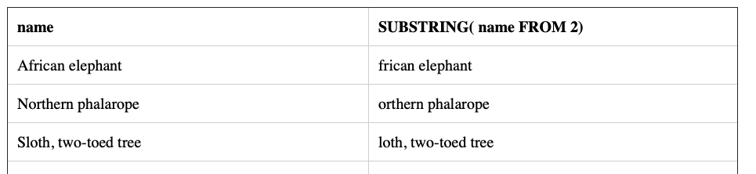
Extracting a SUBSTRING()
SELECT name, SUBSTRING(name FROM 2)
FROM animalNames;

Slide 16
Word Length

Slide 17
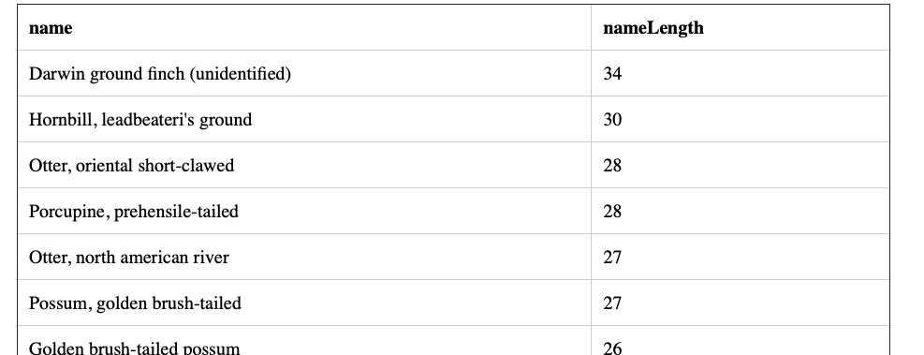
String Length
CHARACTER_LENGTH() is used to return the number of characters in a string
Returns an integer greater than or equal to 0
Length of an empty string is zero
SELECT name, CHARACTER_LENGTH(name) AS nameLength
FROM animalNames
ORDER BY nameLength DESC;

Slide 18
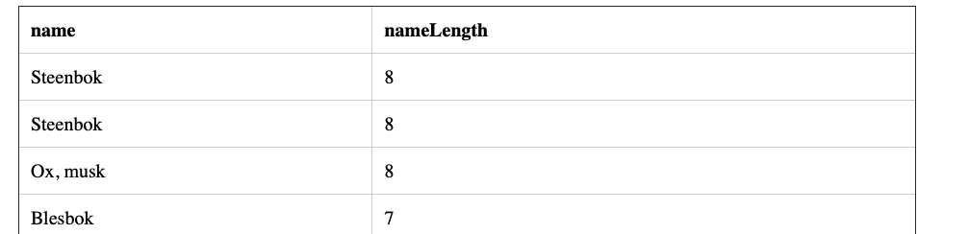
String Length
SELECT name, CHARACTER_LENGTH(name) AS nameLength
FROM animalNames
WHERE CHARACTER_LENGTH(name) < 10
ORDER BY nameLength DESC;

Slide 19
Removing Extra Characters

Slide 20
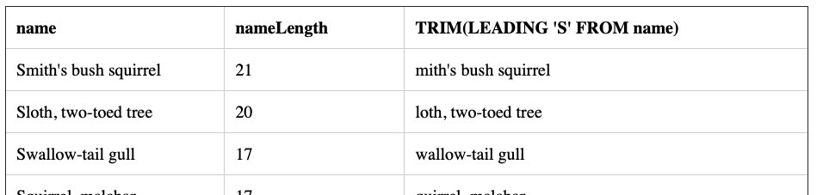
Trimming with TRIM()
Use the TRIM() function to remove unwanted characters from the ends of strings
It removes leading characters, trailing characters, or both
Trims spaces by default, but you can use to strip out any unwanted characters
Used for trimming trailing spaces from CHAR values
Trimming has no effect on empty strings
SELECT name, CHARACTER_LENGTH(name) AS nameLength, TRIM(LEADING 'S' FROM name)
FROM animalNames
WHERE SUBSTRING(name FROM 1 FOR 1) = 'S'
ORDER BY nameLength DESC;

Slide 21
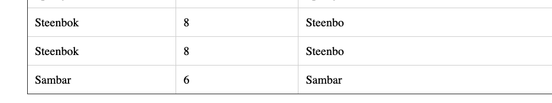
Trimming with TRIM()
SELECT name, CHARACTER_LENGTH(name) AS nameLength, TRIM(TRAILING 'k' FROM name)
FROM animalNames
WHERE SUBSTRING(name FROM 1 FOR 1) = 'S'
ORDER BY nameLength DESC;

Slide 22
Getting Position of Information

Slide 23
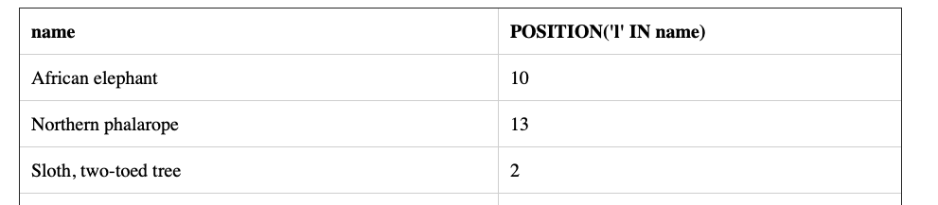
POSITION()
POSITION() returns an integer value
Returns 0 for no substring match
POSITION(substring IN string)
Where substring is the string to search for and string is the string to search.
Each argument is a string expressions such as a column that contains character strings
SELECT name, POSITION('l' IN name)
FROM animalNames

Slide 24
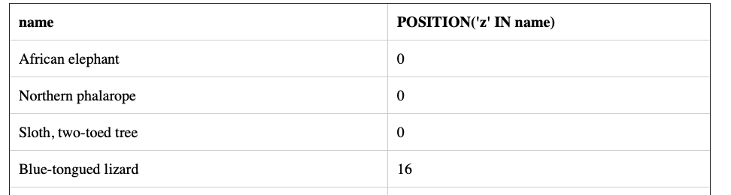
POSITION
SELECT name, POSITION('z' IN name)
FROM animalNames;

Slide 25
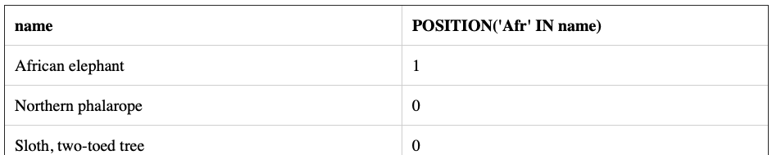
POSITION()
SELECT name, POSITION('Afr' IN name)
FROM animalNames;

Slide 26
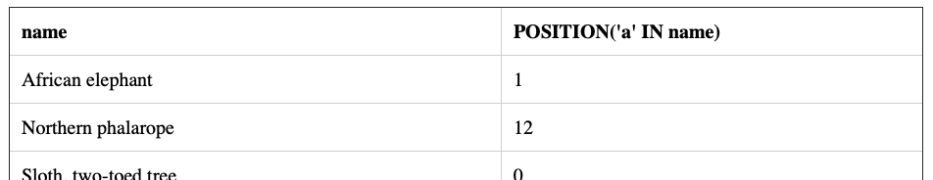
POSITION()
SELECT name, POSITION('a' IN name)
FROM animalNames;

Slide 27
DATES

Slide 28
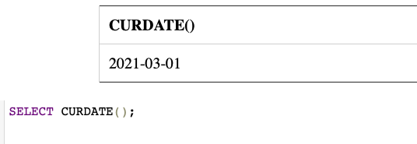
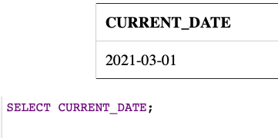
CURRENT DATE
You can access the current date by using the CURDATE() function
CURRENT_DATE is a synonym that can be used in place of the function

Slide 29
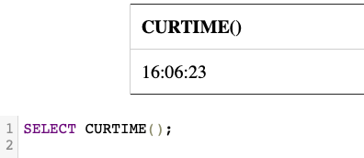
CURRENT_TIME
Can select the current time using the CURTIME() function.
You can also use the synonym CURRENT_TIME
NOTE: Time is on 24 hour clock

Slide 30
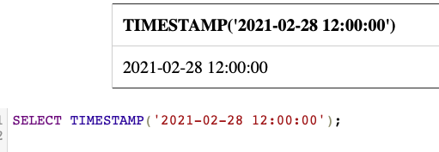
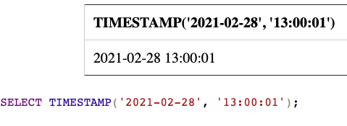
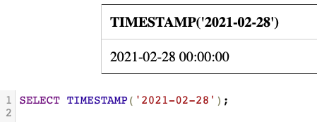
TIMESTAMP
The time stamp function take two expressions
First is the datetime value and the second is a time value
This will return date or time as datetime value

Slide 31
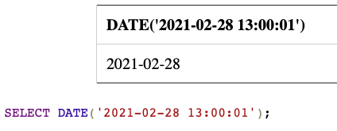
DATE Function
The Date function will extract the date part of a date or datetime expression

Slide 32
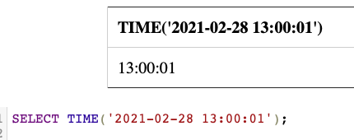
TIME Function
This will extract the time from a time or timestamp

Slide 33
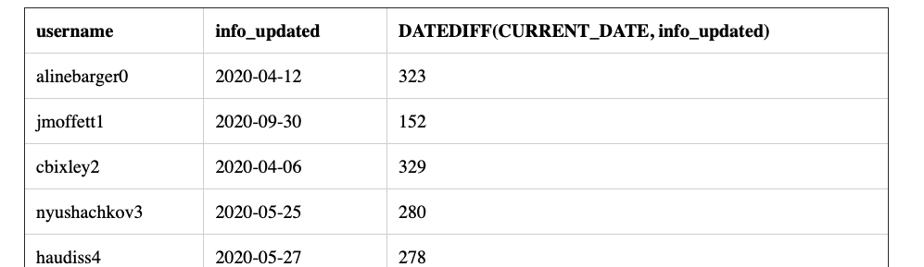
DATEDIFF function
The DATEDIFF function takes two values – and determines the number of days between the two.
SELECT username, info_updated, DATEDIFF(CURRENT_DATE, info_updated)
FROM test

Slide 34
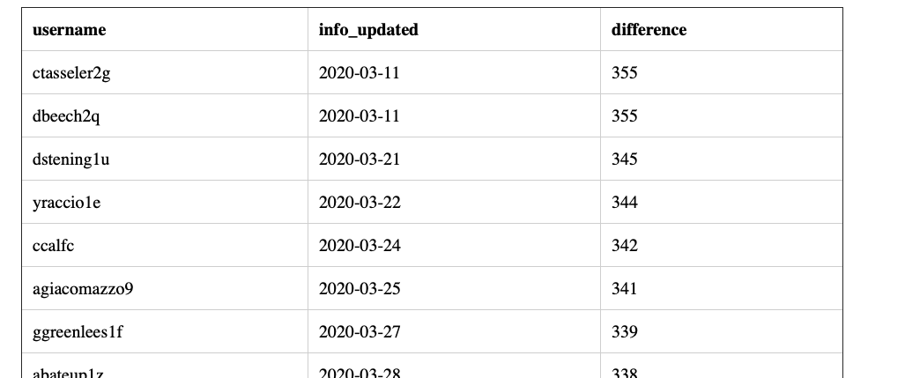
DATEDIFF
SELECT username, info_updated, DATEDIFF(CURRENT_DATE, info_updated) AS difference
FROM test
WHERE DATEDIFF(CURRENT_DATE, info_updated) > 200
ORDER BY difference DESC;

Slide 35
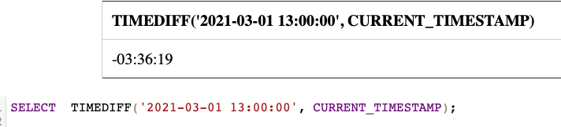
TIME DIFF
The TIMEDIFF() function returns the time between two values

Slide 36
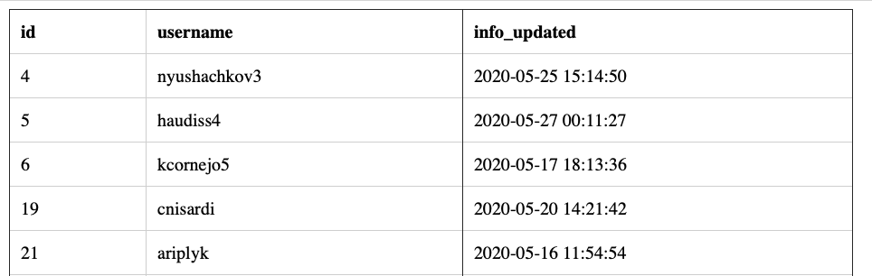
EXTRACT
The EXTRACT function allow you to extract a portion from the date/time
That portion could be the:
YEAR – gets the year
MONTH – gets the month
DAY – gets the day
HOUR – gets the hour
MINUTE – gets the minute
SECOND – gets the seconds
SELECT * FROM test
WHERE EXTRACT(MONTH FROM info_updated) = 5;

Slide 37
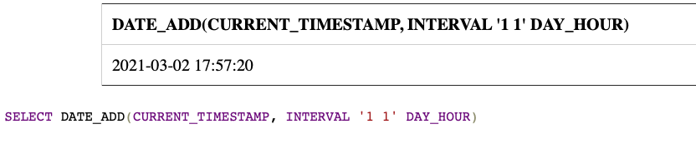
Adding to date and time
You can use DATE_ADD function to add a specific interval to a date
The function takes two arguments
First argument is the date
Second is made up of the interval and the unit
For example – today’s date + 2 days would be
DATE_ADD(CURRENT_DATE, INTERVAL 2 DAY)
Or today’s date in one year
DATE_ADD(CURRENT_DATE, INTERVAL 1 YEAR)

Slide 38
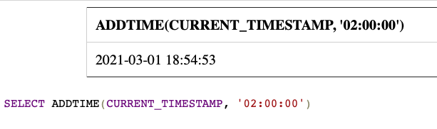
Adding to date and time

