Slide 1
Subqueries
MAD 202

Slide 2
Relational Databases
The key component of databases is being able to optimize the data and reduce errors and redundancy
We create tables that hold information that is related
The relationship between one table and another is represented by a foreign key
A foreign key is another table’s primary key
It allows one columns value to provide a lookup in another table to retrieve additional information.

Slide 3
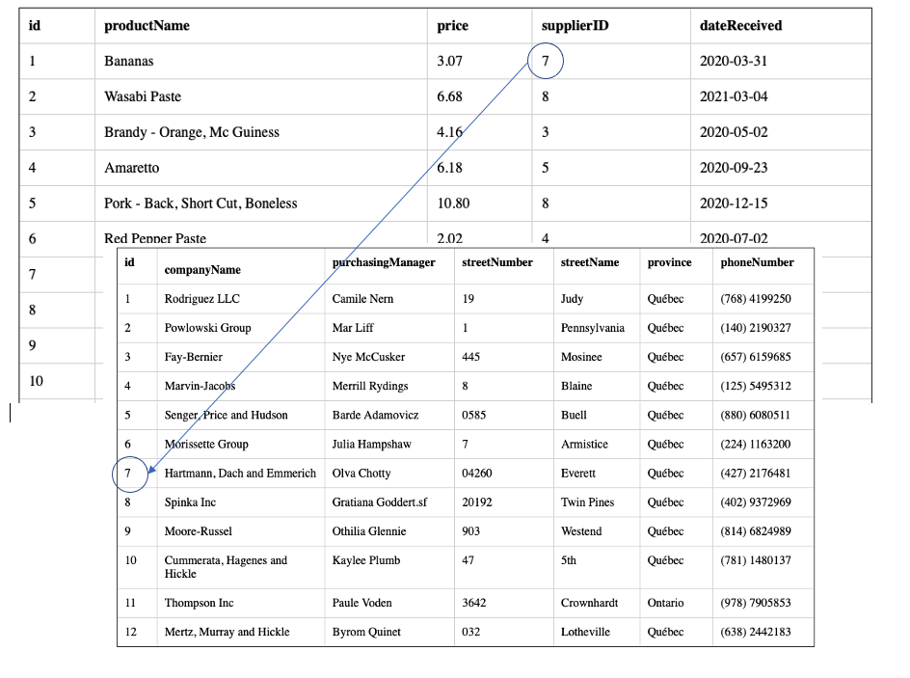
Relationships
Foreign Key
Product Table
Primary Key
Supplier Table

Slide 4
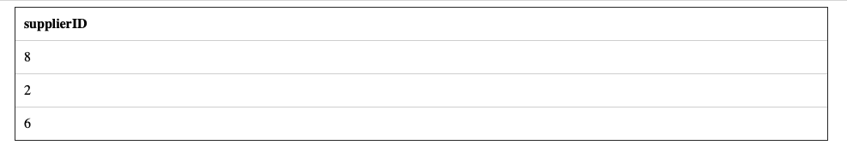
Subqueries
With subqueries, we use the results of one query – to filter another table’s results.
What if we wanted to know what supplier supplied us with Bread?
We query one table (products) to get all of the suppliers that provide us with bread
SELECT supplierID
FROM products
WHERE productName LIKE '%bread%';

Slide 5

Subqueries
Important things to note – we asked for a single column of values. Just the supplierID
Do not create a query that returns multiple columns of values
SELECT supplierID, productName
FROM products
WHERE productName LIKE '%bread%';

Slide 6
Subqueries
To ensure that you do not have duplicates – use DISTINCT
SELECT DISTINCT supplierID
FROM products
WHERE productName LIKE '%bread%';

Slide 7
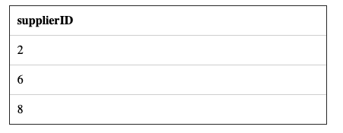
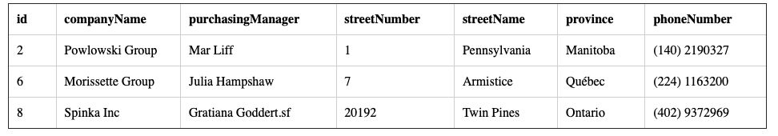
Subqueries
We could now use those ID’s to look up the list of suppliers that have those specific companies
SELECT *
FROM suppliers
WHERE id IN (8,2,6);

Slide 8
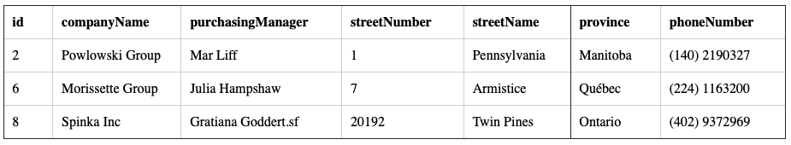
Subqueries
Subqueries simplify the process of creating two statements.
SELECT *
FROM suppliers
WHERE id IN ( SELECT DISTINCT supplierID
FROM products
WHERE productName LIKE '%bread%' );

Slide 9
Testing Membership
The IN keyword tests to see if the value is comparable to a series of values
Can also use the keyword NOT to reverse the results of the query
SELECT *
FROM suppliers
WHERE id IN ( SELECT DISTINCT supplierID
FROM products
WHERE productName LIKE '%bread%' );
This query returns more than a single value

Slide 10
Nesting subqueries
A subquery can include a series of subqueries.
The nested subqueries follow the same rules as a single sub query

Slide 11
Subquery Syntax
Follows the same syntax as a normal SELECT statement with the following differences:
You can nest a subquery in a SELECT, FROM, WHERE, or HAVING clause
ALWAYS enclose a subquery in parentheses ( )
Do NOT terminate a subquery with a ;

Slide 12
Subquery Syntax
Do NOT put an ORDER BY clause in a subquery (this has no value since you are returning intermediate information, so order is unimportant)
Tables must be included in both the queries in order to have its columns appear in the final result
The subquery may return an empty table

Slide 13

Subqueries and Aggregate Functions
Subqueries are excellent for use with aggregate functions
What is the cheapest product we have?
SELECT *
FROM products
WHERE price IN (SELECT MIN(price) FROM products);

Slide 14

Simple subqueries
Inner subquery – the nested query
Outer subquery – the statement containing the subquery
A simple subquery evaluates the inner subquery once and provides its result into the outer query
Process this first – returns result and passes to the outer query
SELECT *
FROM products
WHERE price in (SELECT MAX(price) FROM products)

Slide 15
Can also check for values that are NOT IN….
Select the products that do not come from Ontario.
SELECT *
FROM products
WHERE supplierID NOT IN (
SELECT id
FROM suppliers
WHERE province = 'Ontario');

Slide 16
Qualifying column names
Can explicitly declare column names in a subquery:
SELECT pub_name
FROM publishers
WHERE publishers.pub_id IN
(SELECT titles.pub_id
FROM titles WHERE type=‘biography)
Implicit assumptions are being made in the above case so explicitly declaring column names is not required – column names are qualified implicitly by the table referenced in the FROM clause at the same nesting level.
The reason for qualifying is that the column name exists in both tables

Slide 17
Subqueries as Column Expressions
Subqueries that are used as column expressions MUST return a single value - (scalar subquery)
This is accomplished through aggregate functions (these return a sum, an average, etc) or very restrictive WHERE conditions
The subquery is placed in the position of a column expression in the SELECT clause
LIST each product, the price and the average price
SELECT productName, price, (SELECT AVG(price) FROM products)
FROM products;

Slide 18
Comparing a Subquery
Subqueries can be used as filters in a WHERE or HAVING clause using any of the comparison operators (=,<>,<, etc)
Rules:
The SELECT clause can only include a single expression or column name:
SELECT title FROM…
SELECT title, pages FROM….
The compared values must have the same data type or be implicitly convertible (string value to string value)
The subquery MUST only return a single value
Use an aggregate
Using a join with the outer query based on a key always returns a single value

Slide 19
Comparing a subquery
Show the customers that live in the same province as Thompson Inc is located in
SELECT * FROM customers
WHERE province =
(SELECT province
FROM suppliers WHERE companyName = 'Thompson Inc');
Make note of the equal
This only returns a SINGLE value

